Slide 1
AZIMUTHAL POD PROPULSION
BY:
ADITHYA MANDA
BHAVESH HASWANI
2ND YEAR B.Tech
IMU CHENNAI

Slide 2
INTRODUCTION
An azimuthal pod is a configuration of ship’s propeller placed in pods that can be rotated in any horizontal direction making the rudder unnecessary.
The pods propeller usually faces forward because in this configuration the propeller is more efficient. Since it can rotate about its mount axis the pod can apply its thrust in any direction.
Azimuth thrusters allow ships to be more maneuverable and enable them to move astern nearly as efficiently as they move ahead.

Slide 3

The pod incorporates an electric single or double wound A.C motor mounted directly on an extremely short propeller shaft. The electric motor drives a fixed pitch propeller. The motor is controlled by a frequency converter which produces full nominal torque over the entire speed range.
This concept has a great potential for passenger carrying vessels, Ro-Ro vessels, tankers, chemical tankers and LNG/LPG carriers.

Slide 4
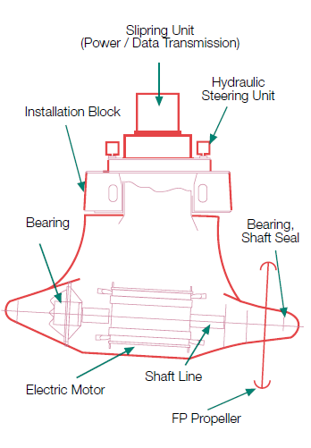
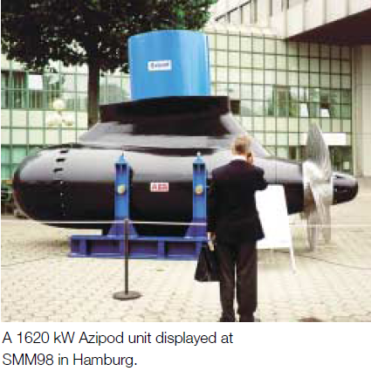
Most of the pods produced today generally have the same design. However there are two major variants, based on the location of the motor:
Mechanical transmission, where a motor inside the ship is connected to the pod by gearing. The motor may be diesel or diesel-electric.
Electrical transmission, where an electric motor is in the pod itself, connected directly to the propeller without gears. The electricity is produced by an onboard engine, usually diesel or gas turbine.

Slide 5
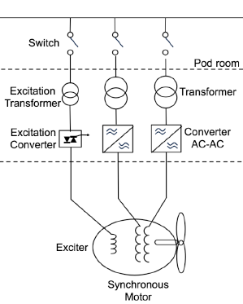
Electrical systems in pod propulsion usually consist of Transformers, Frequency converters and Propulsion motors.
Transformer
The transformer is used to divide the system into several parts in order to obtain different voltage levels but also for phase shifting. The transformer isolates the two sides electrically. In pod propulsion two types are most common, wet and dry type.
The output of a transformer, supplying a pod system, is adjusted to the input rectifier stage of the converter.

Slide 6
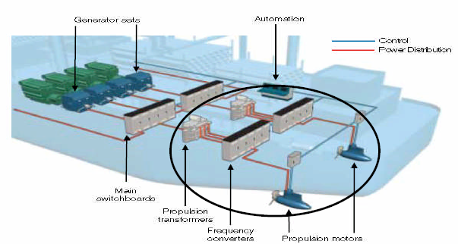
Frequency converter
The purpose of the frequency converter is to control the speed and torque of the motor by changing constant frequency of the main generator into variable frequency for the motor.

Slide 7
Electric motor
The electric motor is used for conversion from electrical to mechanical power. In pod propulsion three motors are used: synchronous-, permanent magnet- and induction motors.
The by far most common motor is the synchronous motor (SM), because of the high efficiency in high power range.
The permanent magnet synchronous motor (PMSM) has a magnet instead of windings in the rotor which gives no losses in the rotor and fewer components. But still the magnets are a limitation in higher power applications.

Slide 8
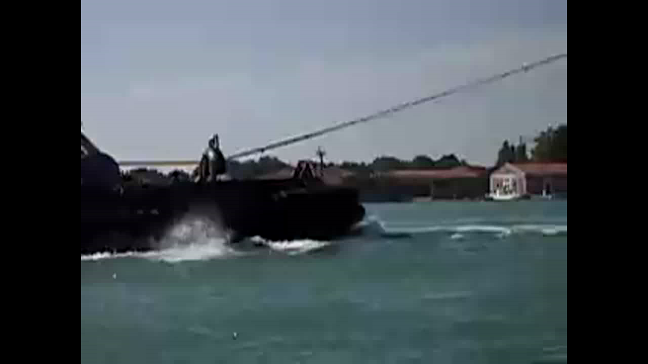
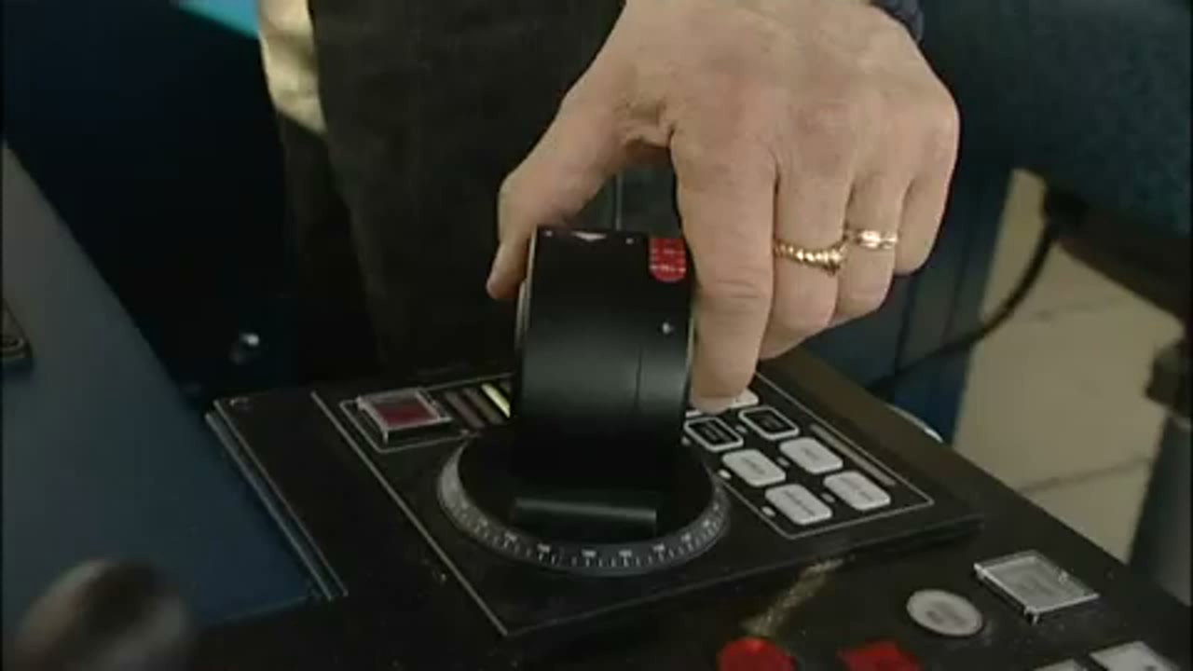
Comparisons:
The purpose of this thesis is to compare the Azimuthal pods to
the conventional propeller and rudder system .
CONVENTIONAL PROPELLER :
AZIMUTHAL PROPULSION POD :

Slide 9
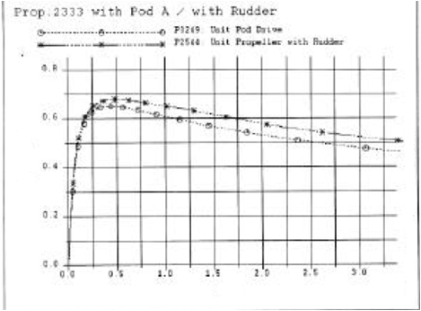
EFFICIENCY OF PROPULSION UNIT
When compared with the efficiency of a propeller alone, the propulsion efficiency of a single pod unit is lower.
A realistic conclusion can only be drawn if the unit efficiency of the pod is compared with the unit efficiency of the conventional propeller with rudder.
A gain in propeller efficiency can be expected for twin pod arrangements because the inflow to the propeller is more uniform (absence of shafts and shaft brackets).
This leads to better design conditions for the propeller and therefore to higher propeller efficiencies.

Slide 10
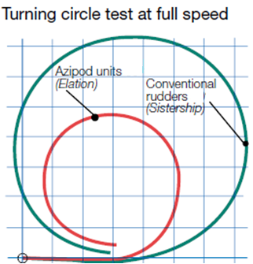
MANEUVERABLITY
Since it can rotate around its mount axis, the pod can apply its thrust in any direction. Azimuth thrusters allow ships to be more maneuverable and enable them to travel backward nearly as efficiently as they can travel forward.
The M/S Elation which uses Azimuthal pods can travel
17 knots astern
25 knots ahead
5 knots sideways.
Also ships working on azimuthal pods do not require tug boats to dock thus proving to be economical to use.
Full scale comparison of turning circles of M/S Elation and Paradise with conventional propulsion with rudder is shown.

Slide 11
BENEFITS:
The benefits of the pod drives are (in order of their significance):
Easy to handle.
More cargo space because the engine can be located more freely.
Excellent harbor maneuverability.
Greater fuel efficiency.
Lower emissions.
Lower noise level.
Lower vibrations hence better passenger comforts.
Suited as booster drive in order to increase the speed.

Slide 12
Demerits:
The demerits of the pod drives are (in order of their significance):
Higher installation costs.
Diesel electric system required (power loss).
Lesser efficiency in case of single screw arrangement.

Slide 13
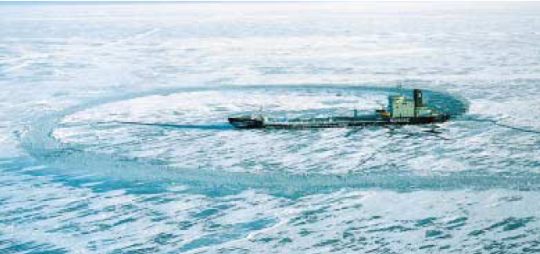
CONCLUSION:
Azimuthal propulsion units have extremely good fuel efficiency saving up to 10-15% when compared to conventional propellers. They also enable ships to be free of vibration and to be handled easily even in poor weather conditions and difficult passages. They are very well suited for Cruise liners, Icebreakers, Ro-Ro passenger ferry, Bulk carriers and Tankers.
We strongly affirm the technical superiority and reliability of AZIMUTHAL PODS and it would be very surprising if future merchant vessels were fitted with any other propulsion system other than AZIMUTHAL PROPULSION UNITS.

Slide 14
ANY QUERIES???

Slide 15


