Slide 1
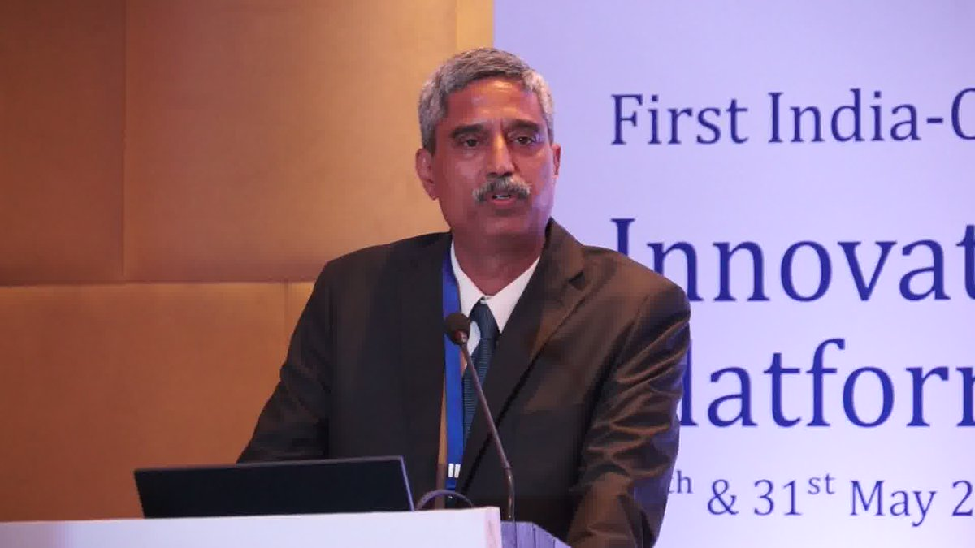
Promoter Director DC Sekhar
Background
Ex Merchant Navy Captain of large Oil Tankers ,
Finance Management with U21Global Singapore,
Executive General Management at IIM Bangalore
Fellow of Company of Master Mariners of India
Executive Committee and India Member - International Spill Control Organisation – a not-for-profit think tank of oil spill response industry
Carried out for Engineers India Ltd –
Marine EIA of
Nuclear power plant and Offshore Desalination plants
Carried out for Ministry of Shipping -
Techno Commercial feasibility of
Ro-Ro Operations, Cruise Tourism, Yacht Marina, Inland waterways, Hydrofoil, Seaplane landing, Offshore Logistics, Bunkering.

Slide 2
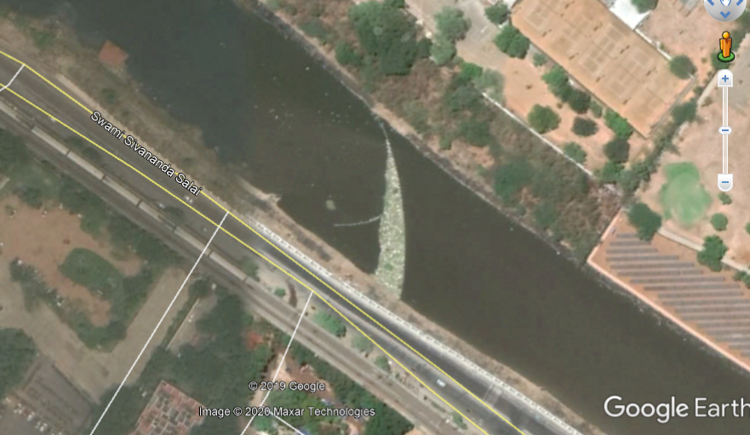
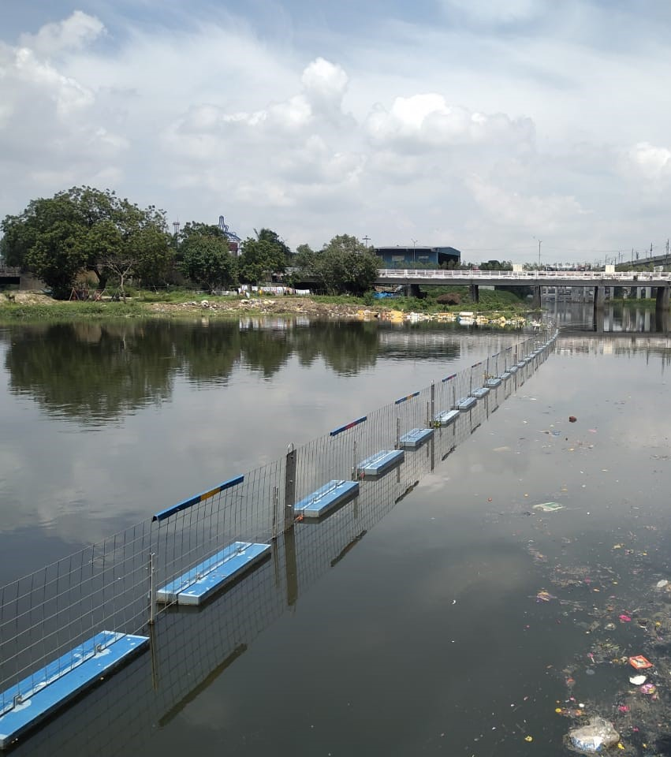
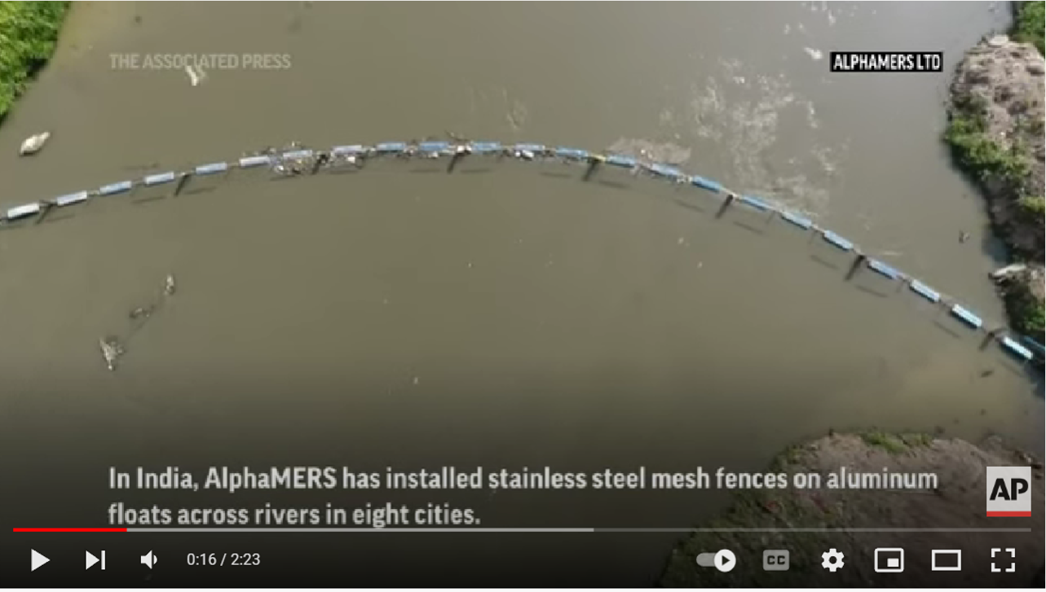
Using natural flow of river water, this technology stopped floating trash and plastics, brought to the riverbank and is the most successful technology in the world.

Slide 3
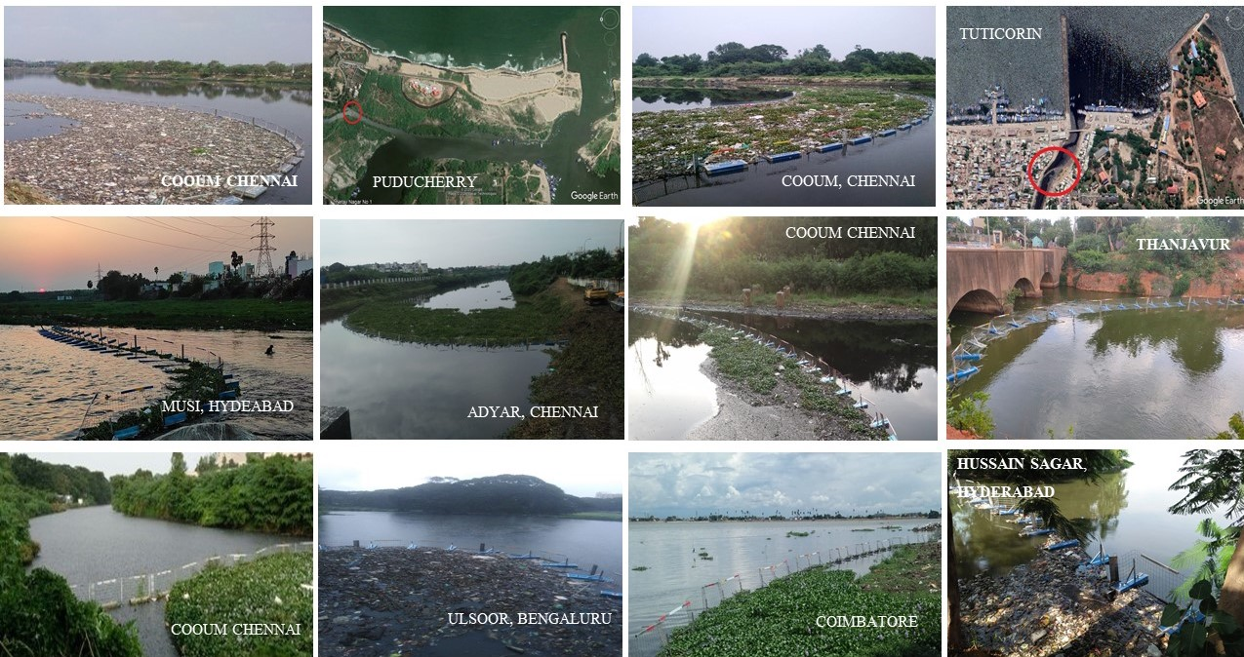
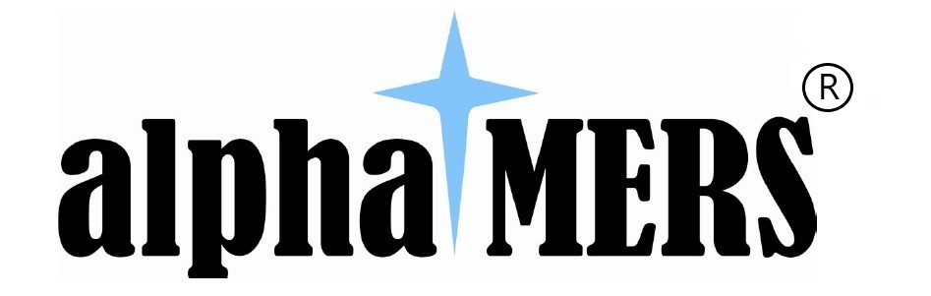
Proprietary river clean-up technology of AlphaMERS – Floating Trash Barrier

Slide 4
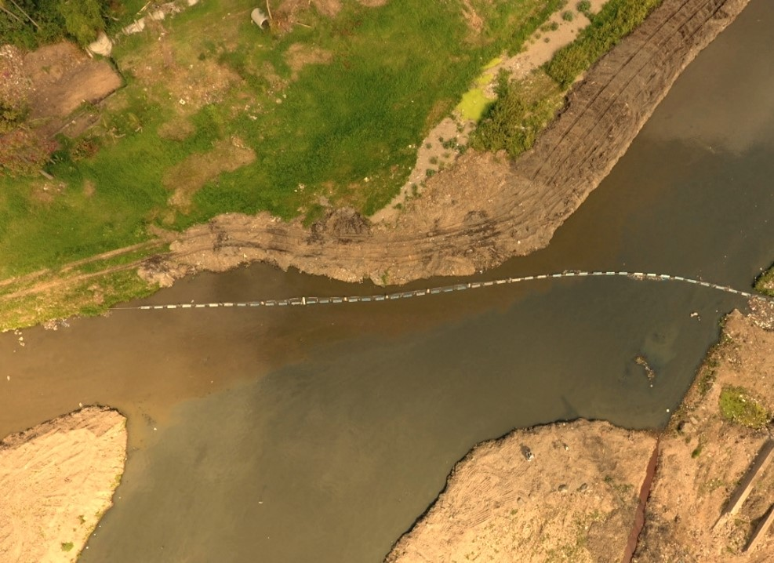
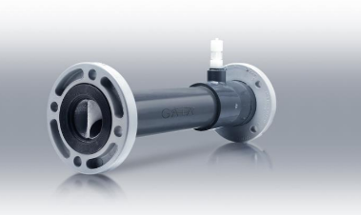
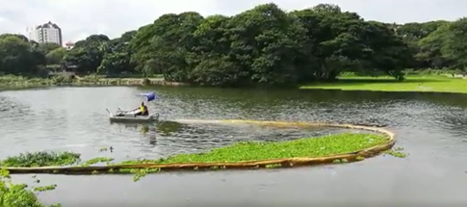
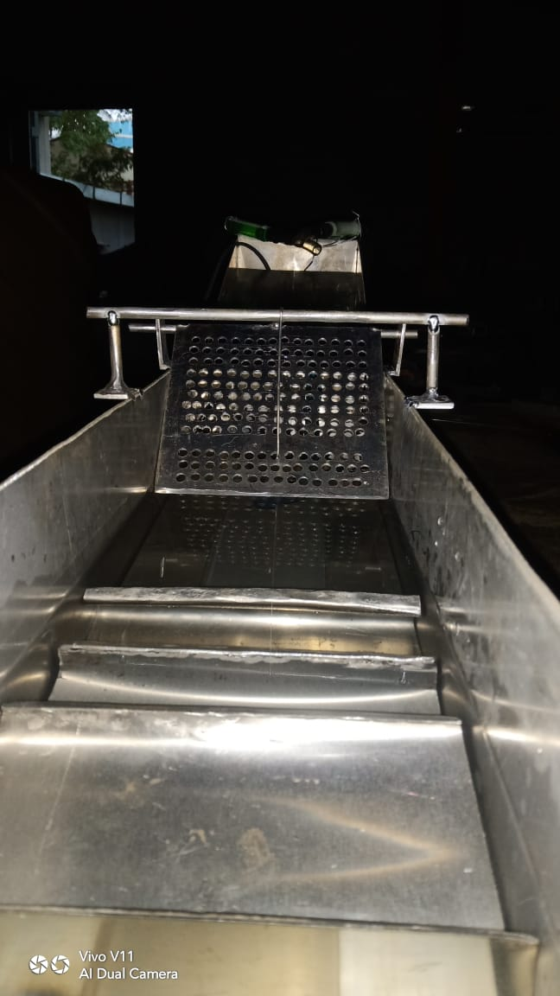
Aquatic environment

Slide 5
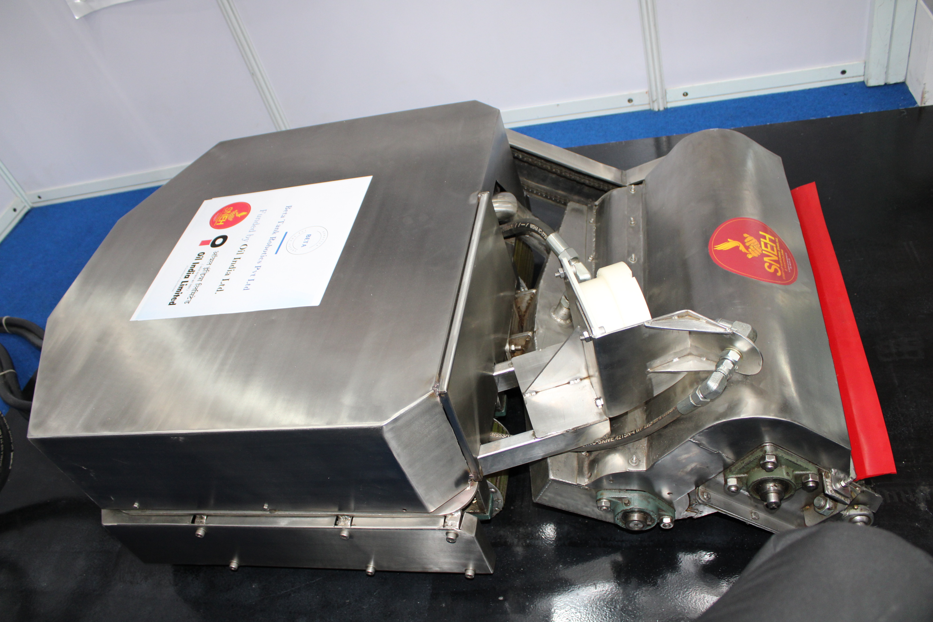
Robotic cleaning of Petroleum tanks
This remote controlled robot is extremely compact, passes under heating coils, controlled and powered by hydraulics, sweeps and pumps out sludge from crude oil tanks.

Slide 6
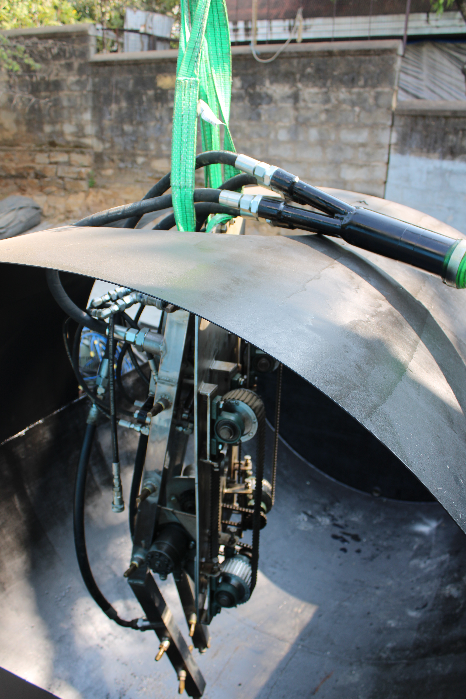
Robotic cleaning of Petroleum tanks
This remote controlled robot, enters the retail tank through normal tank opening, opens its arms, washes the tank with high pressure water.

Slide 7
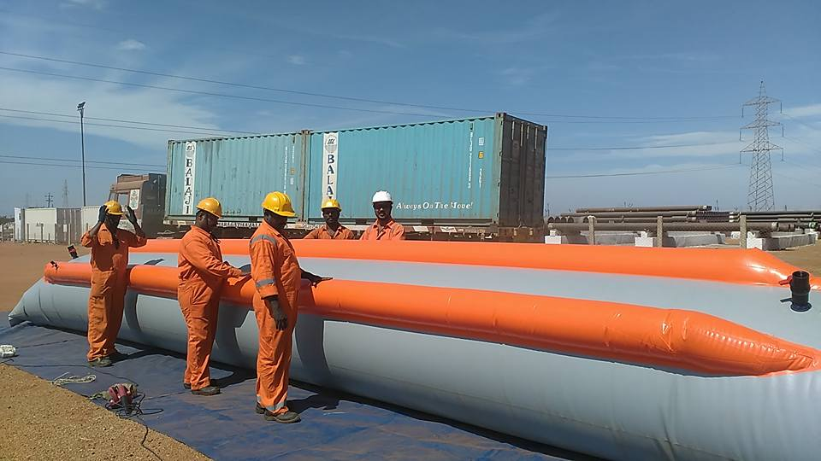
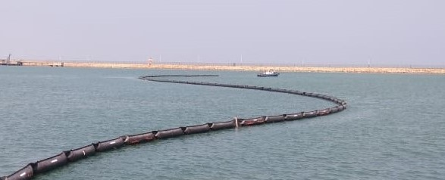
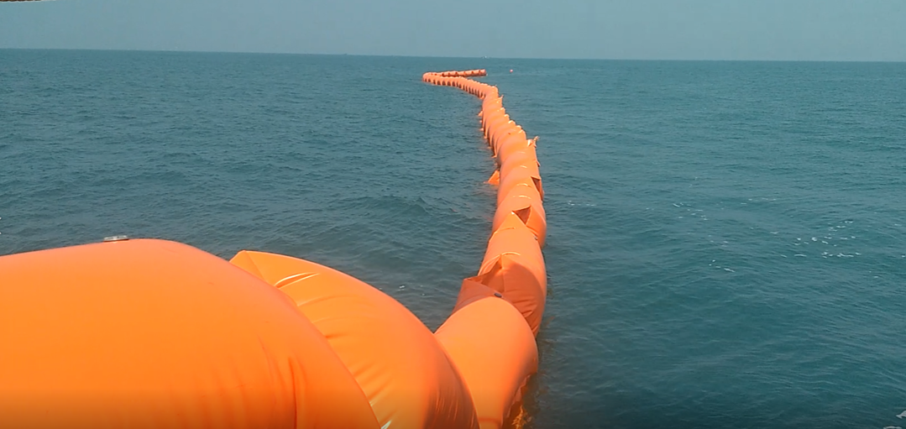
Oil Spill Response Equipment
The images are of various specialised oil spill response equipment designed, developed and supplied by AlphaMERS Ltd to meet the regulatory needs for such equipment by Oil and Port Industry.

Slide 8
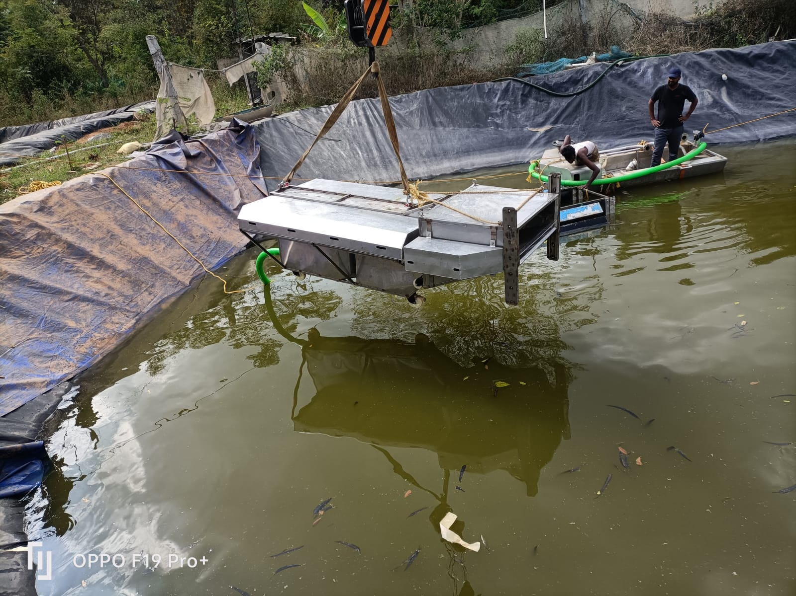
Integrated skimming system
This is a high value skimming system with all auxiliaries to skim oil while moving through the water and towed by a boat.

Slide 9
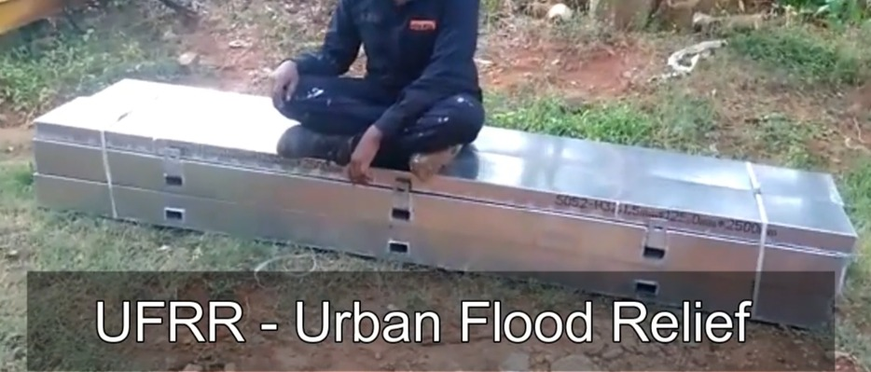
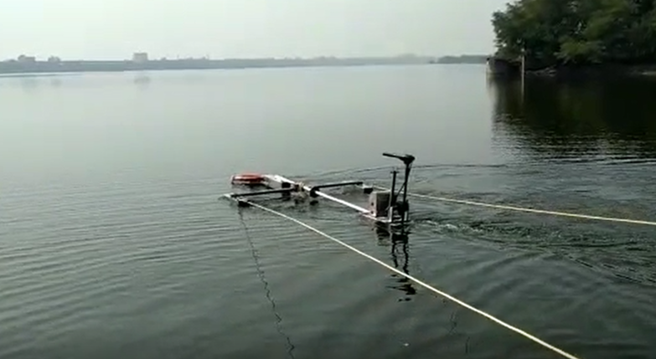
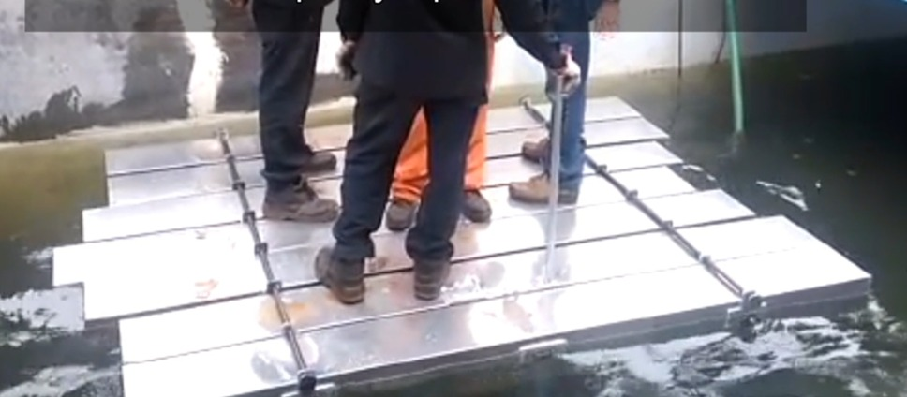
Disaster Management

Slide 10
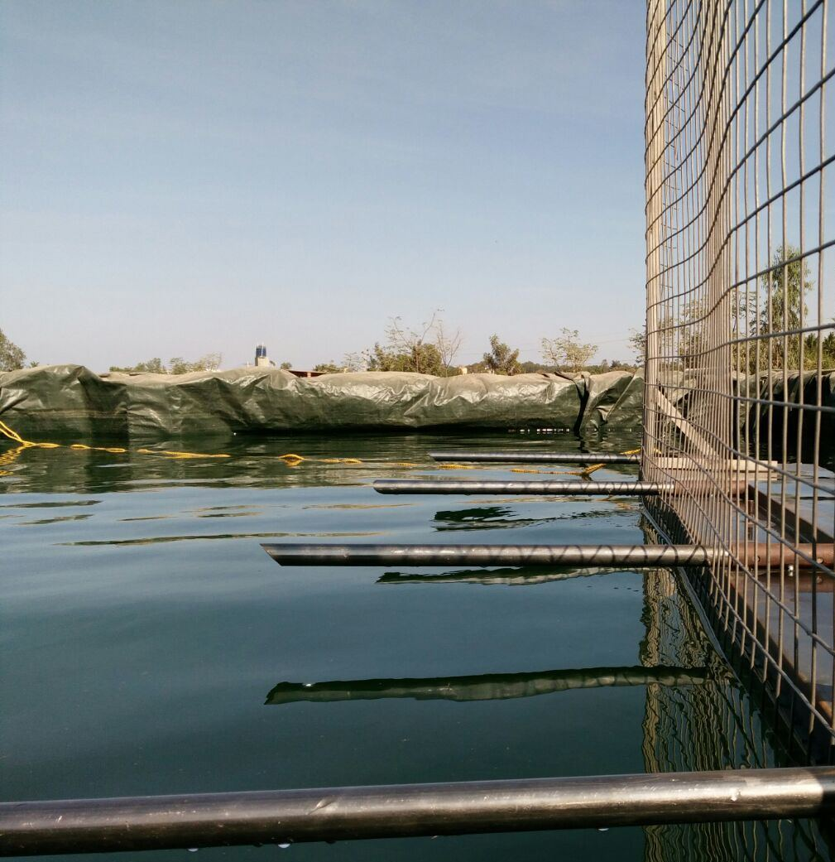
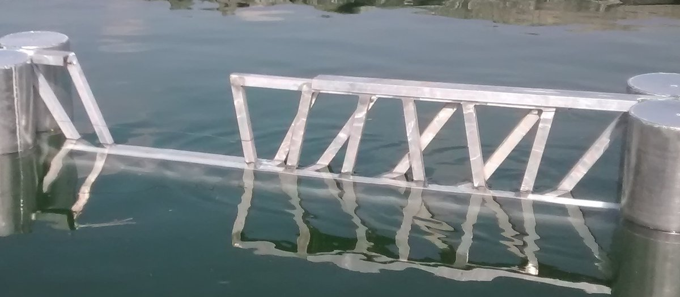
Maritime perimeter security

Slide 11
