Slide 1
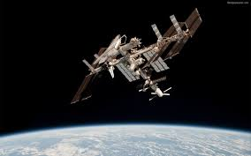
C.V RAMAN COLLEGE OF ENGINEERING
Presentation
Impact of satellite on communication
PRESENTED BY:
SAURABHA KUMAR PANDEY
SUSHOBHAN SHIT
BHAJAN LAL JENA
AKASH VERMA
Saurabhaecc@gmail.com

Slide 2
CONTENT
INTRODUCTION
MODULATION AND DEMODULATION
UTILITY IN SHIPS
A.I.S (AUTOMATIC IDENTIFICATION SYSTEM)
RECENT DEVELOPMENTS
FUTURE EXPECTATION

Slide 3
INTRODUCTION
Revolving body around the earth is satellite.
The first communication system was launched on
18 DECEMBER 1958.
“EXTRA TERRESTRIAL RELAY” by author
C CLARK in 1945.

Slide 4
TYPES OF SATELLITES
ACTIVE
PASSIVE

Slide 5
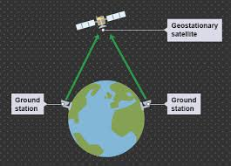
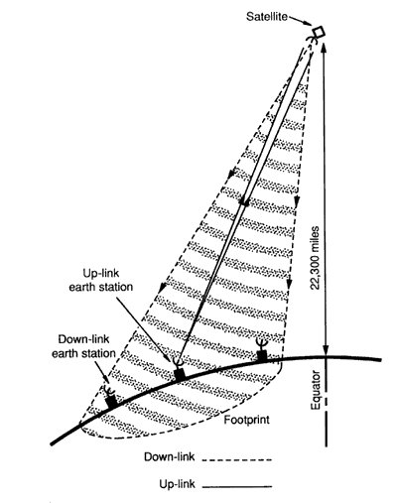
GEOSTATIONARY SATELLITE

Slide 6
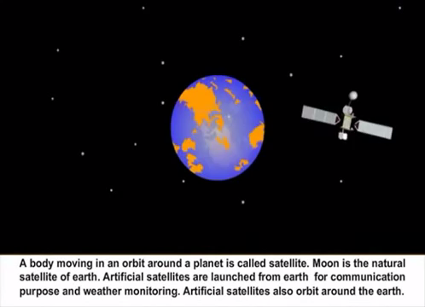

Slide 7
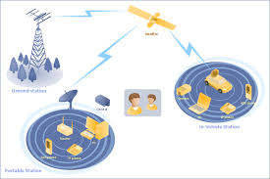
MODULATION
NEED OF MODULATION
TRANSPONDER
DEMODULATION
OUTPUT SIGNAL

Slide 8
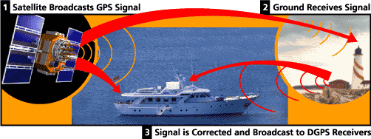
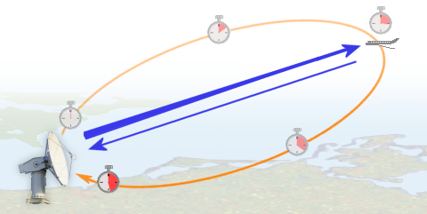
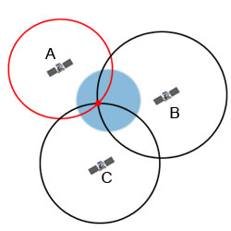
UTILITY IN SHIPS
SSAS
G.P.S.
RADAR

Slide 9

EPIRB

Slide 10
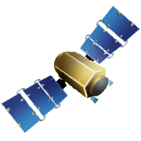
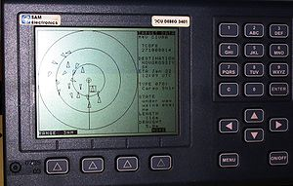
AUTOMATIC
IDENTIFICATION SYSTEM
TRACKING SYSTEM

Slide 11
APPLICATION OF AIS
Maritime Security
Vessel traffic Services
Collision Avoidance
Aids to Navigation
Search and Rescue

Slide 12

RECENT DEVELOPMENT
MANUFACTURER | ISRO
Launch mass | 2,650 kilograms (5,840 lb
Power | 3 kilowatts
Launch date | 29 August 2013, 20:30 UTC
Period | 23.93 hours
Band | UHF,C-BAND,KU-BAND
GSAT-7
GSAT-14
MANUFACTURER | ISRO
Launch mass | 1,982 kilograms (4,370 lb
Power | 2,600 watts
Launch date | 5 January 2014, 10:48 UTC
Period | 23.93 hours
Band | 6KU-BAND,6 EXT C-BAND ,2 KA-BAND

Slide 13
ISRO TO LAUNCH ASTROSAT
IN 2015
ORGANIZATION | ISRO
Launch date | 2015 (planned)
Launch site | Satish Dhawan Space Centre
Mass | 1,650 kg (3,640 lb)
Orbit height | 650 km (400 mi)
Orbit period | 5 years
Wavelength | Multi-wavelength

Slide 14
REFRENCES
WEBSITES: www.electronicsforu.com , www.amazon.com
ARTICLES : Communication satellites , Wireless communications , Artificial satellites , Space exploration.
BOOKS: Satellite Communications by Timothy Pratt and Dennis Roddy , Satellite Communication Systems by M. Richharia

Slide 15

THANK YOU
ANY QUERRY???

