Slide 1
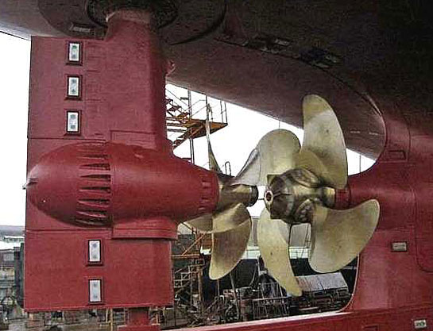
CONTRA ROTATING AZIPOD PROPELLERS

Slide 2
Introduction
Originally Finnish- jointly by Kvaerner Masa-Yards dockyards and ABB
Puller configuration
Based on electric propulsion concept where motor sets can be freely located to the vessel
Optimum water flow to the propellers
improvement in hydrodynamic propulsion efficiency

Slide 3
Azipod concept
In the Azipod system the electric motor is installed inside the pod
Azipod provides greater hydrodynamic efficiency.
Azipod system is always fed through a variable-frequency drive or cycloconverter that allows speed and direction control of the propulsion motors.

Slide 4
Technical Features
Load ratio for the main and Azipod propeller can be flexibly adjusted.
The Azipod propeller diameter is smaller than that of the main propeller
Propeller blade numbers are different
The Azipod propeller speed is higher than that of the main propeller
The Azipod have 360 degree rotation.

Slide 5
The C.R.A.P control system

Slide 6
Control system features
maximum flexibility
Mutual independence provides maximum redundancy

Slide 7
The Model Test

Slide 8
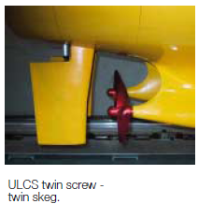
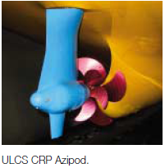
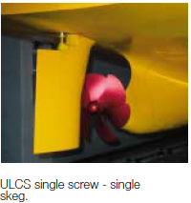

Slide 9
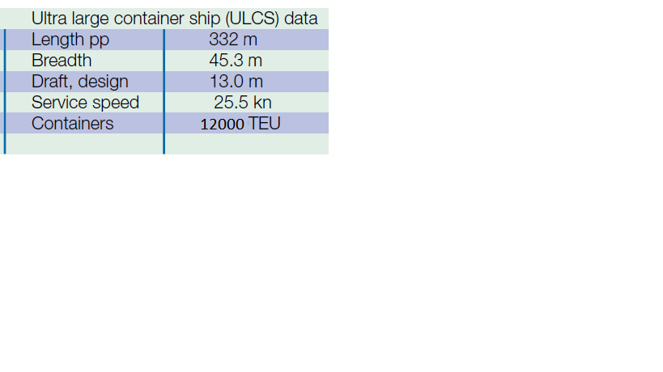

Slide 10
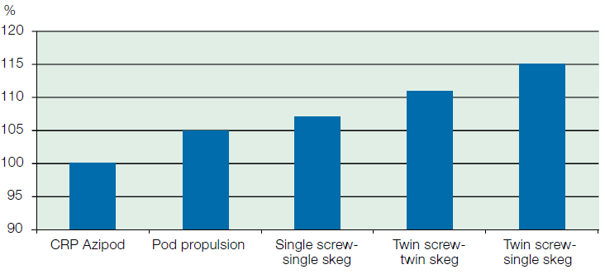
Required propulsion power

Slide 11
Transmission losses

Slide 13
THE EFFECT OF VESSEL SPEED ON TOTAL PROPULSION EFFICIENCY

Slide 14
The power plant principle
the vessel's electrical and propulsion power networks are combined

Slide 15
C.R.A.P blade cavitation observations during ship maneuvering
CRAP configuration provides unprecedented uniformity of ship wake velocities, thus achieving good cavitations characteristics

Slide 16
TEST CONDITIONS AND EQUIPMENT
A pulse generator to synchronize the strobes with the AZIPOD propeller speed (one flash per propeller revolution).
Acceleration;
Crash-stop;
Full-speed maneuvering

Slide 17
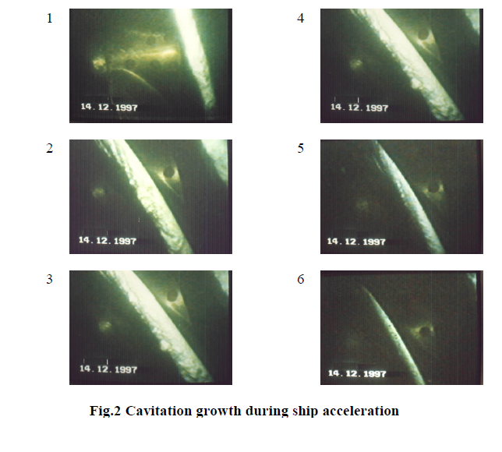
Acceleration:

Slide 18
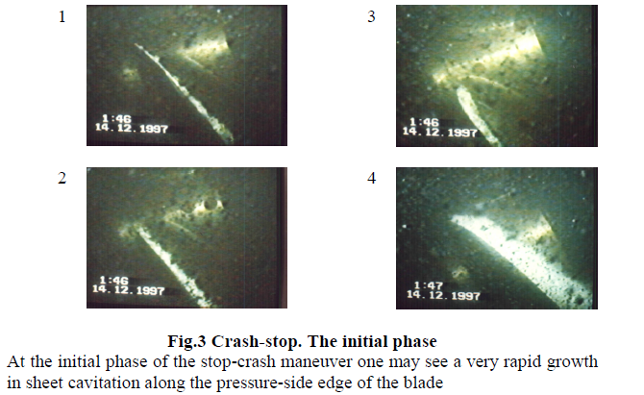
Crash –stop:

Slide 19
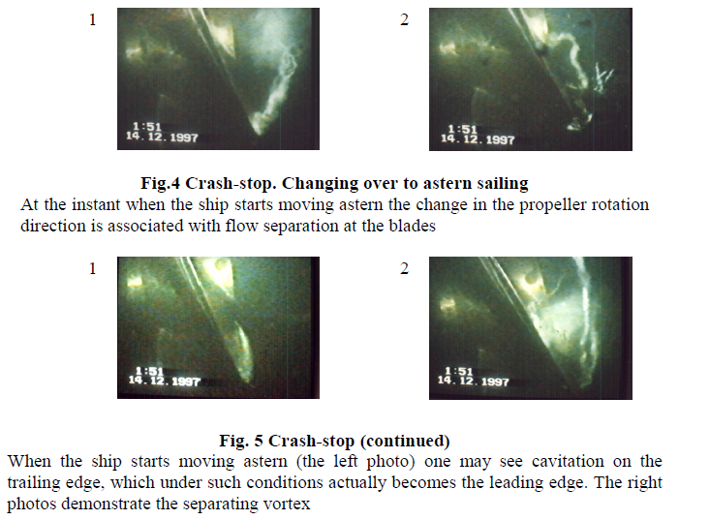

Slide 20
Turning circle with C.R azipod

Slide 21
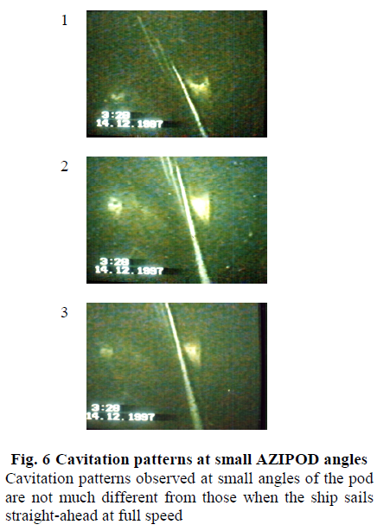
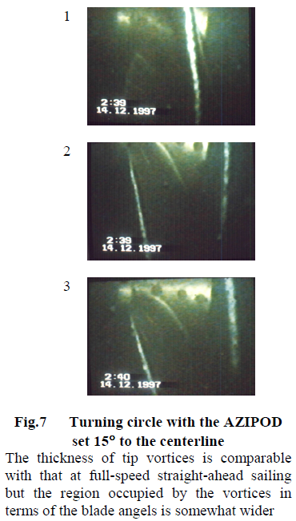

Slide 22
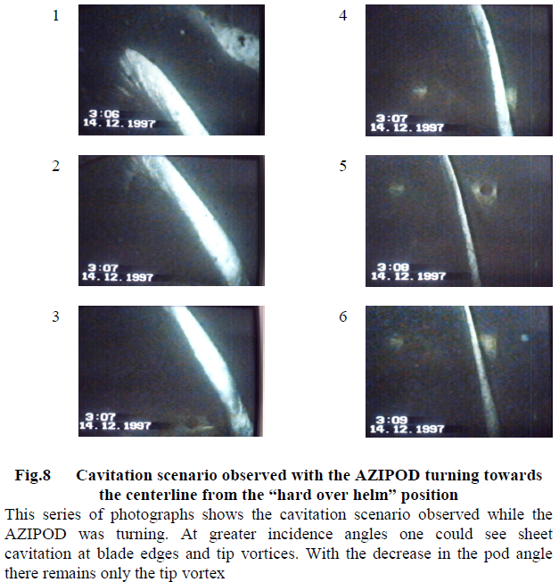

Slide 23
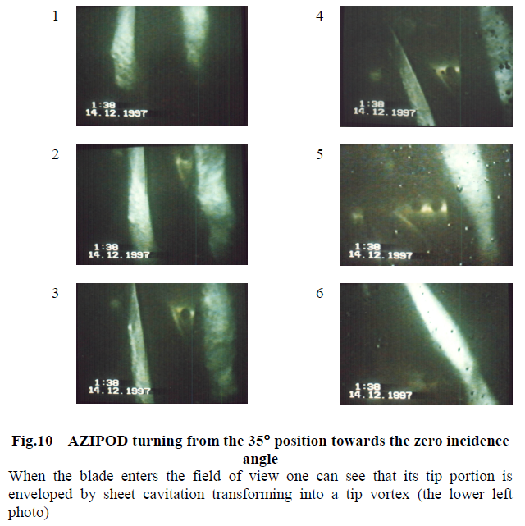

Slide 25
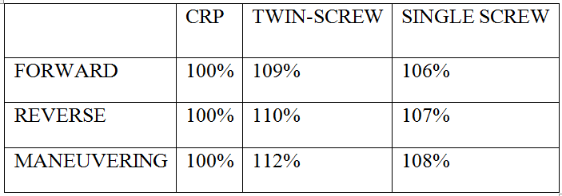
Calculated relative fuel and lubrication oil consumption in three different operation modes during one voyage are (ABB research manual):

Slide 26
Machinery Comparison
Savings in operational costs

Slide 29
The CRAP Benefits

Slide 30
Operational:
Improved manoeuvring in ports and channels
Vessel operation at lower speeds
Environmentally-friendly propulsion, less emissions
Superior safety in extraordinary situations such as crash stop, emergency manoeuvring and heavy weather
Technical:
High propulsion efficiency
Low total installed engine power
Two independent propulsion systems provide a high degree of redundancy
No need for stern thrusters or rudders
Flexible general arrangement possible
Economical:
Better fuel economy
Shipbuilding costs are reasonable as there is less installed engine power
Better slot time keeping in harbours, as the manoeuvring is easier and less tug assistance is needed
Increased container capacity (both space and weight)

Slide 31
CONCLUSION
  Model test results clearly indicate that CRP Azipod propulsion is the most economic propulsion system.
  In large power applications it is a serious alternative in RoPax, ULCS, LNG carriers and tankers.
  Its high total propulsion efficiency makes the initial cost of the system attractive and because its operating costs are much lower than conventional Propulsion systems, its selection are fully justified.
  It is clear that CRP Azipod is a propulsion system that is going to change the marine world.
Conventional ‘passive’ rudders will be replaced by ‘active’ rudders on several vessel types, for more economic and safe ship operation

Slide 32
BIBLIOGRAPHY
ABB.COM
KVAERNER-MASA RESEACH MANUAL
WIKIPEDIA.COM

Slide 33
QUESTIONS???

