Slide 1
Smart Ideation and Innovation
… Adesh Gokhale…
Tolani Maritime Institute – March 18 th 2023

Slide 2
Understand the difference…..
Yesterday ……Today…..Tomorrow
Information….Experience…..Knowledge

Slide 3

Smart Ideation and Innovation

Slide 4

- Lighting of the bulb is only the beginning – then the hard work starts
- The best entrepreneurs don’t come up with great ideas, they solve market needs
Smart Ideation and Innovation
4

Slide 5
The best entrepreneurs don’t come up with great ideas “ they solve market needs “
Examples…..
Larry Page and Sergey Brin
First Drop
Tile Vendor
Gaumutra bank
Amazon

Slide 6
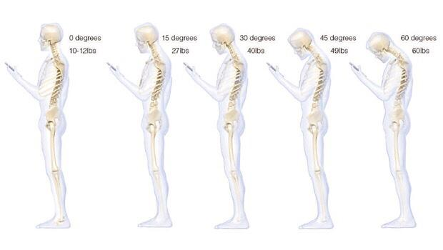
Look around and you will be flooded with smart opportunities
Drinking bottle
High Rise building – Drones application for cleaning and fire fighting, Energy generation
EV – Hybrid scooters, 15 yrs old scooters
Old Smart phones – Education / CCTV Camera
Agriculture – Animal repellent , Two metal difference
Cell phone charger using land line phones
Blue tooth communication – Mesh network
Navy Signals
DTH for communication
Hospital / Doctor co-ordination
Smart solar wearables – Posture , Safety device
Medical non invasive devices is a big opportunity
Rural medical opportunities ( medicine ATM’s )
Fintech – end to end online and OMS ( order management system )
Waste Management
Car Double battery

Slide 7
Smart Ideation and Innovation
Tip # 1 | Recognize ripples as they are forming | if trends, patterns, and changes are detected before other’s have noticed them
Tip # 2 | Adapt and Integrate | Look at the small things. Many of the best opportunities lie in what has been overlooked
Tip # 3 | The Obvious | Don't overlook the obvious
Tip # 4 | Update | Look for new, generally unknown information. The best information… what is new and/or generally unknown
Tip # 5 | Communicate | Talk with people. Find out the “NEED “
Tip # 6 | Innovate | Look for ways to overcome barriers that blocked a good idea in the past.

Slide 8
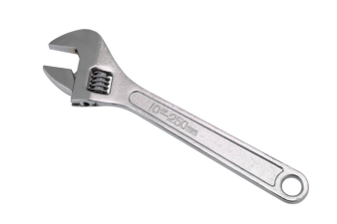
Tool
Smart Ideation and Innovation
 |  |  | G - Model
 | Does fit | Resources | Market | Technology | Sales | Funding | Stake | Score
 | into Goals | Available | Knowledge |  | Marketing |  | Holders
Idea 1 | 1 | 0 | 1 | 0 | 1 | 0 | 1 | 4
Idea 2 | 0 | 1 | 0 | 1 | 0 | 1 | 0 | 3
Idea 3 | 1 | 1 | 1 | 0 | 0 | 0 | 1 | 4
Idea 4 | 0 | 0 | 0 | 0 | 1 | 1 | 1 | 3
Idea 5 | 1 | 1 | 1 | 1 | 1 | 0 | 0 | 5
Idea 6 | 1 | 1 | 0 | 0 | 1 | 1 | 1 | 5
Score | 4 | 4 | 3 | 2 | 4 | 3 | 4
Innovation , Incubation and Startup Ecosystem For Nation Building

Slide 9



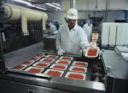
Market Size
Today : 117.7 $B
Future : 418.9 $B by 2022
Today : 75.8 $B
Future : 84-87 $B
Estimated : 5.8 $B
Future : 7.8 $B
Estimated : 191 $B
Future : 8-10 % growth
Source : India Brand Equity Foundation ( IBEF ) / NASSCOM

Slide 10
Do I have “ Tomorrow “ ?
Q & A

