Slide 1

REDUCTION OF SHIP WEIGHT
USING ALUMINIUM FOAM
EUGENE FONSECA
SATEJ JOSHI
AMEY PESHWE

Slide 2
AIM
Reduction in Ship Structural Weight.
Improving Cargo Carrying Capacity.
Adhering to Environmental Standards.

Slide 3
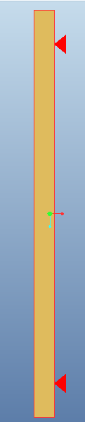
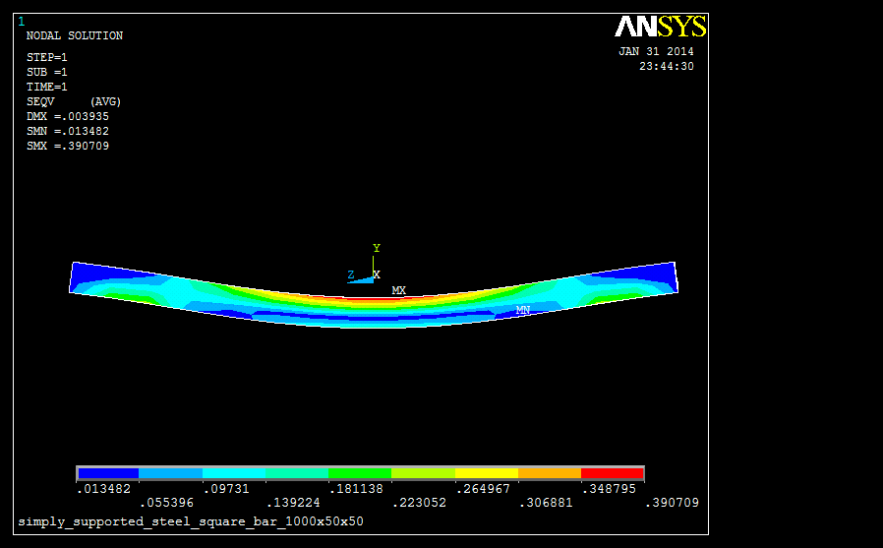

SIMPLY SUPPORTED BEAM
19.65 Kg

Slide 4
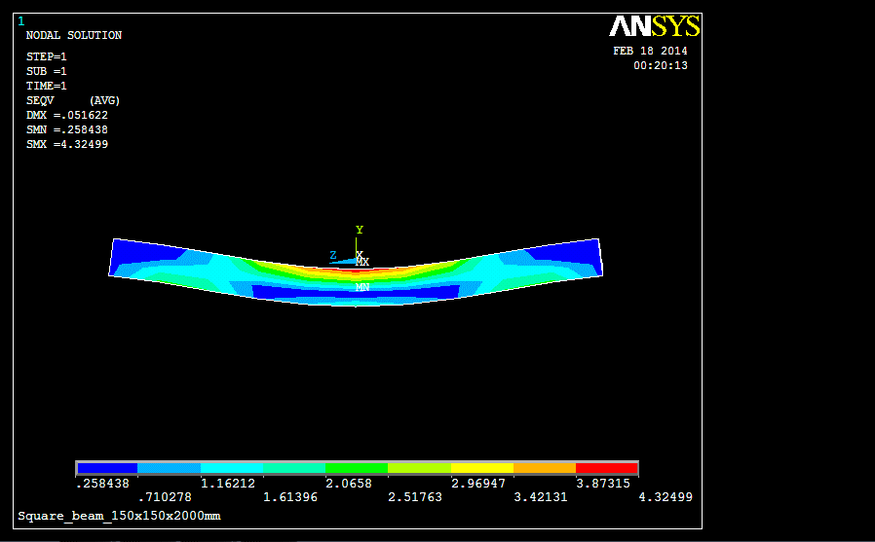


Slide 5
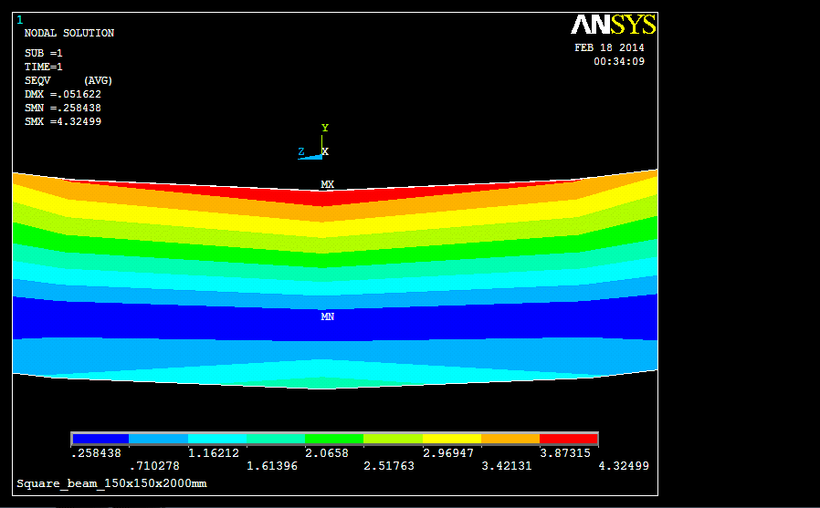
STEEL
LIGHT WEIGHT
MATERIAL
UNDER UTILIZED
STEEL

Slide 6
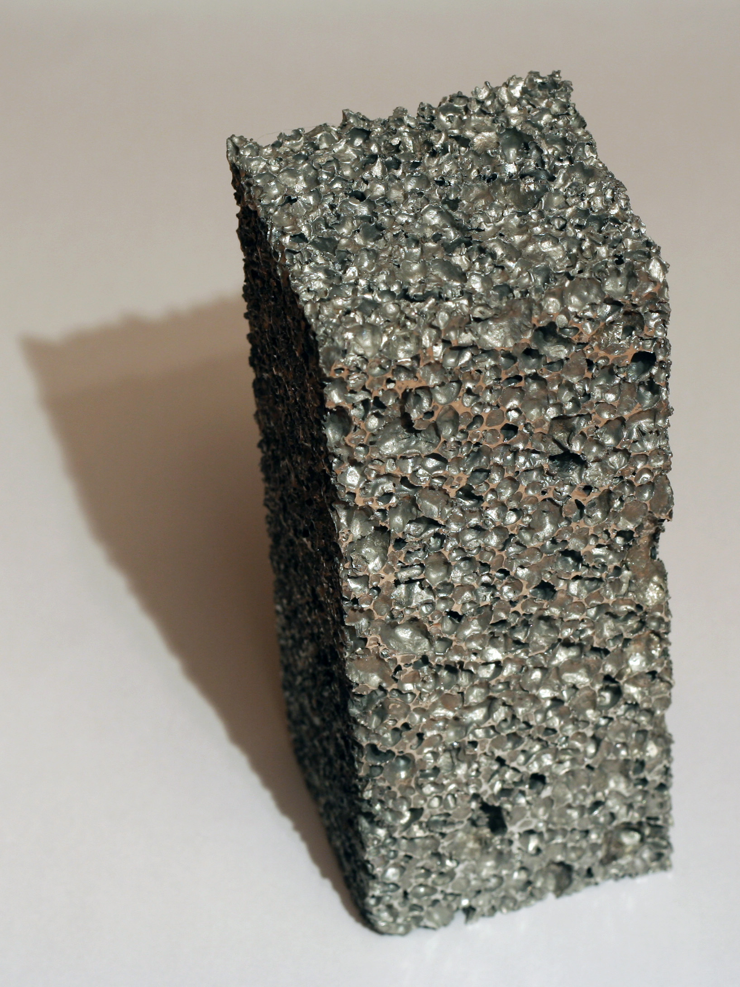
ALUMINIUM FOAM
ALUMINIUM
METAL FOAM
Excellent Energy Absorption
Low Thermal Conductivity
Sound and Vibration Damping and Absorption
Tailorable Density
Recyclable
VOID SPACES

Slide 7
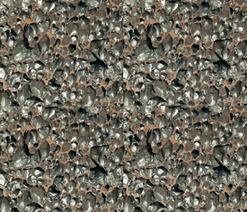
STEEL
ALUMINIUM
FOAM
STEEL

Slide 8
STEEL VS SAS SANDWICH

Slide 9
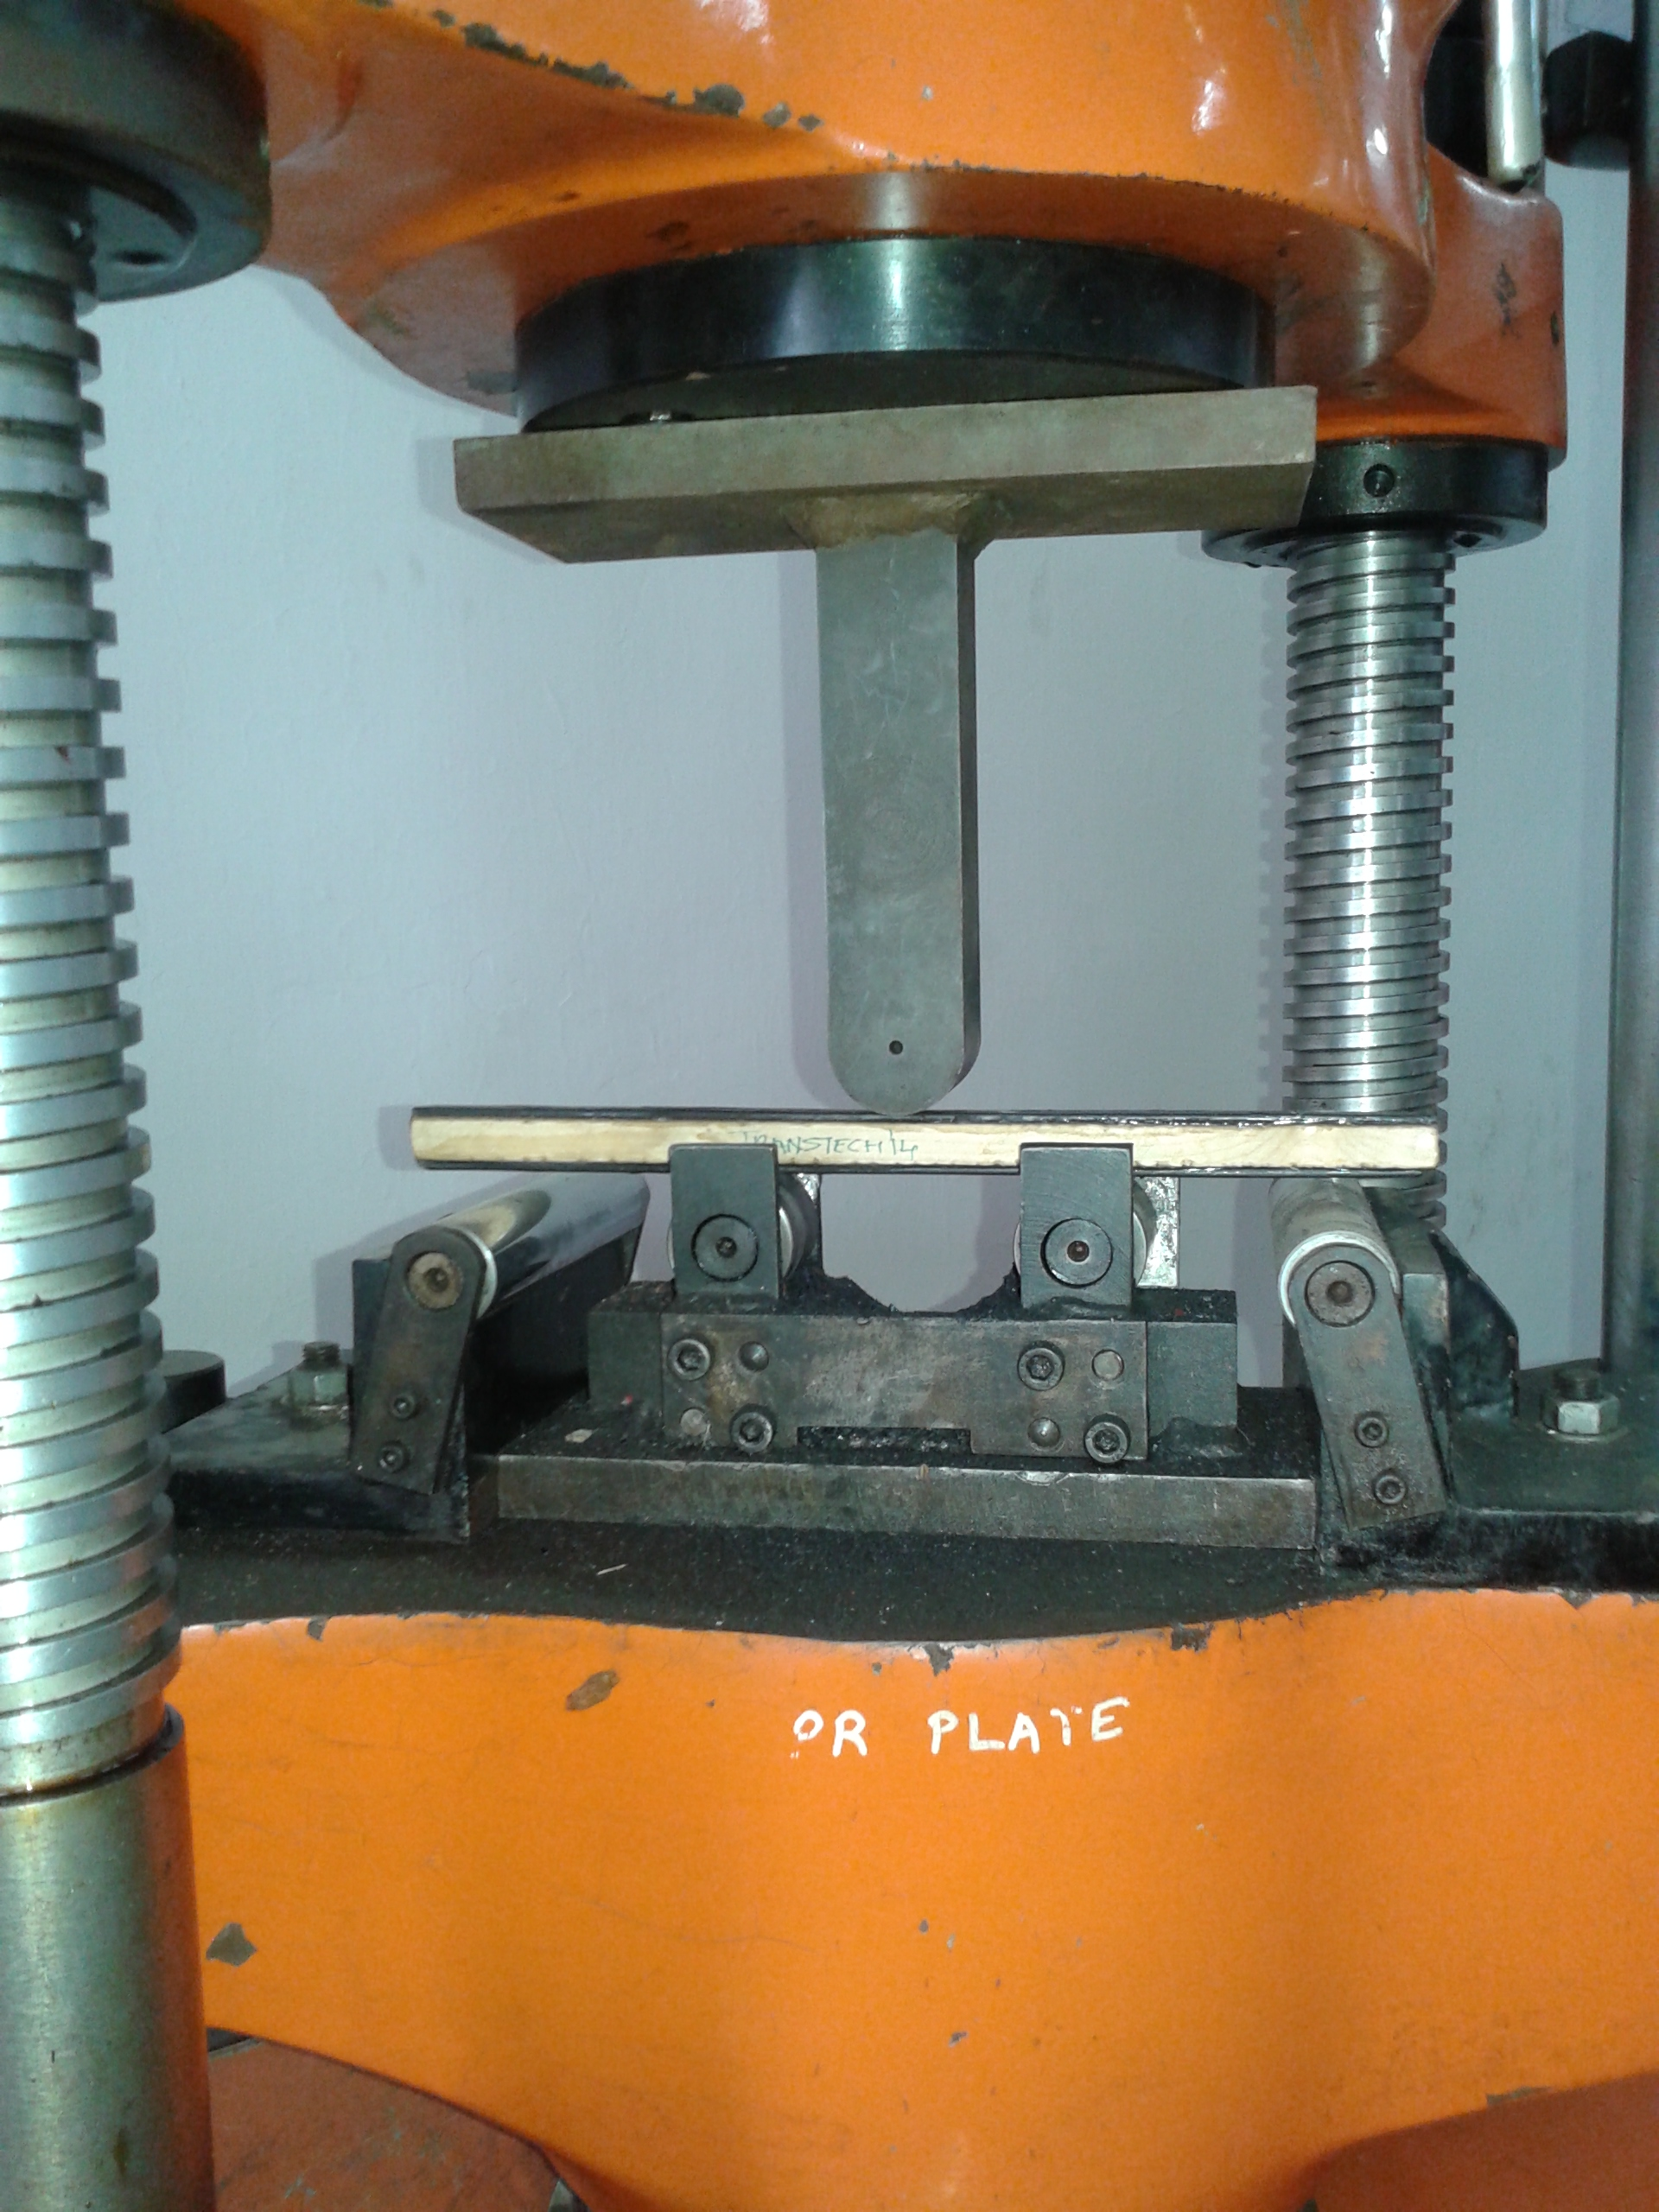
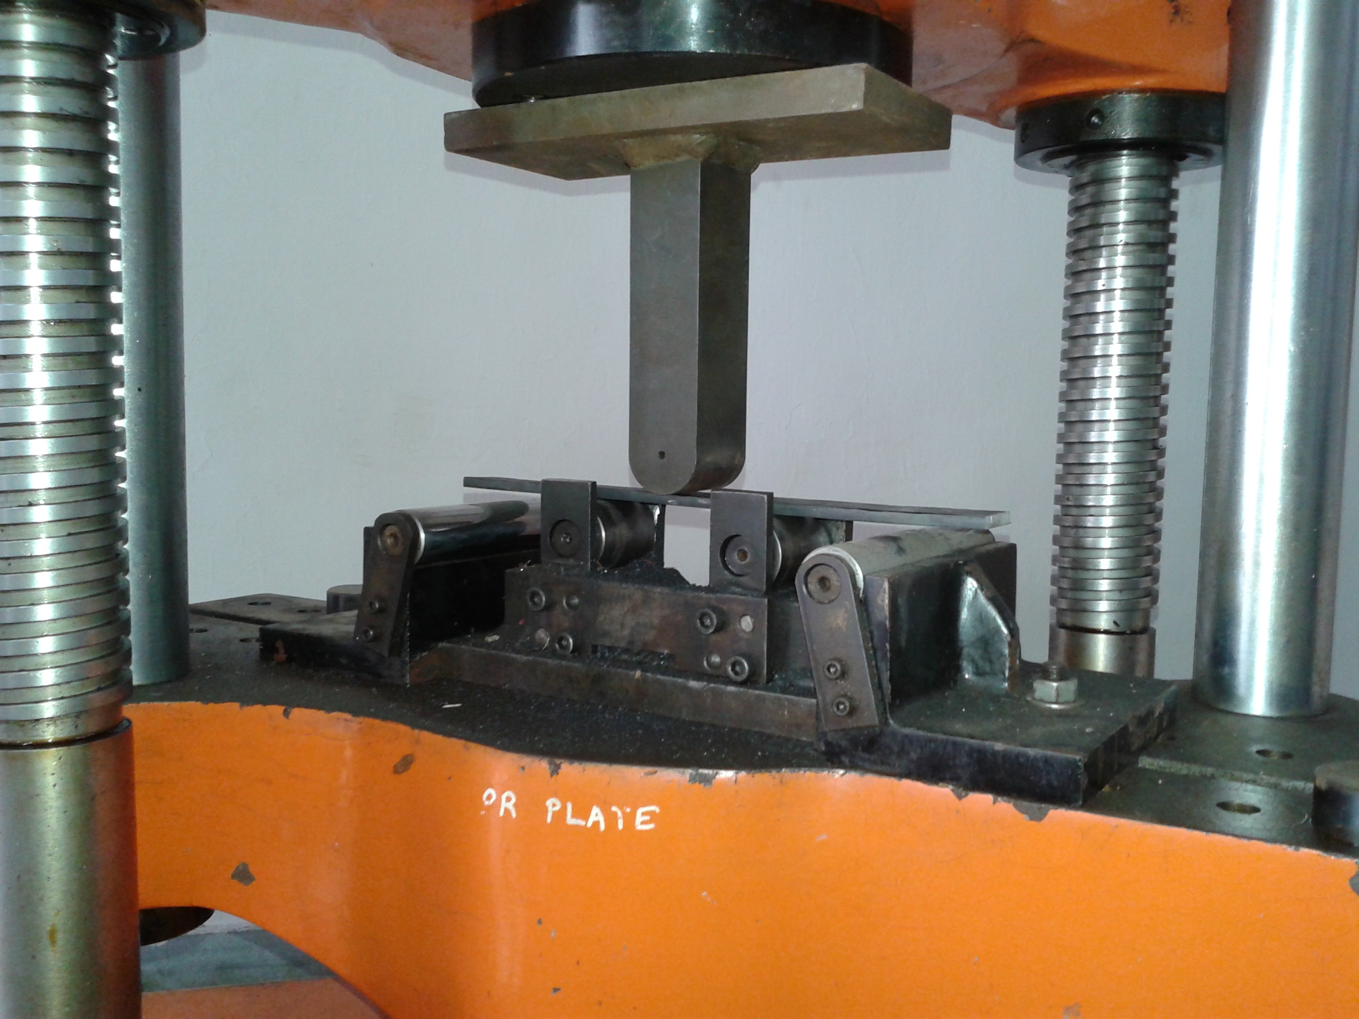
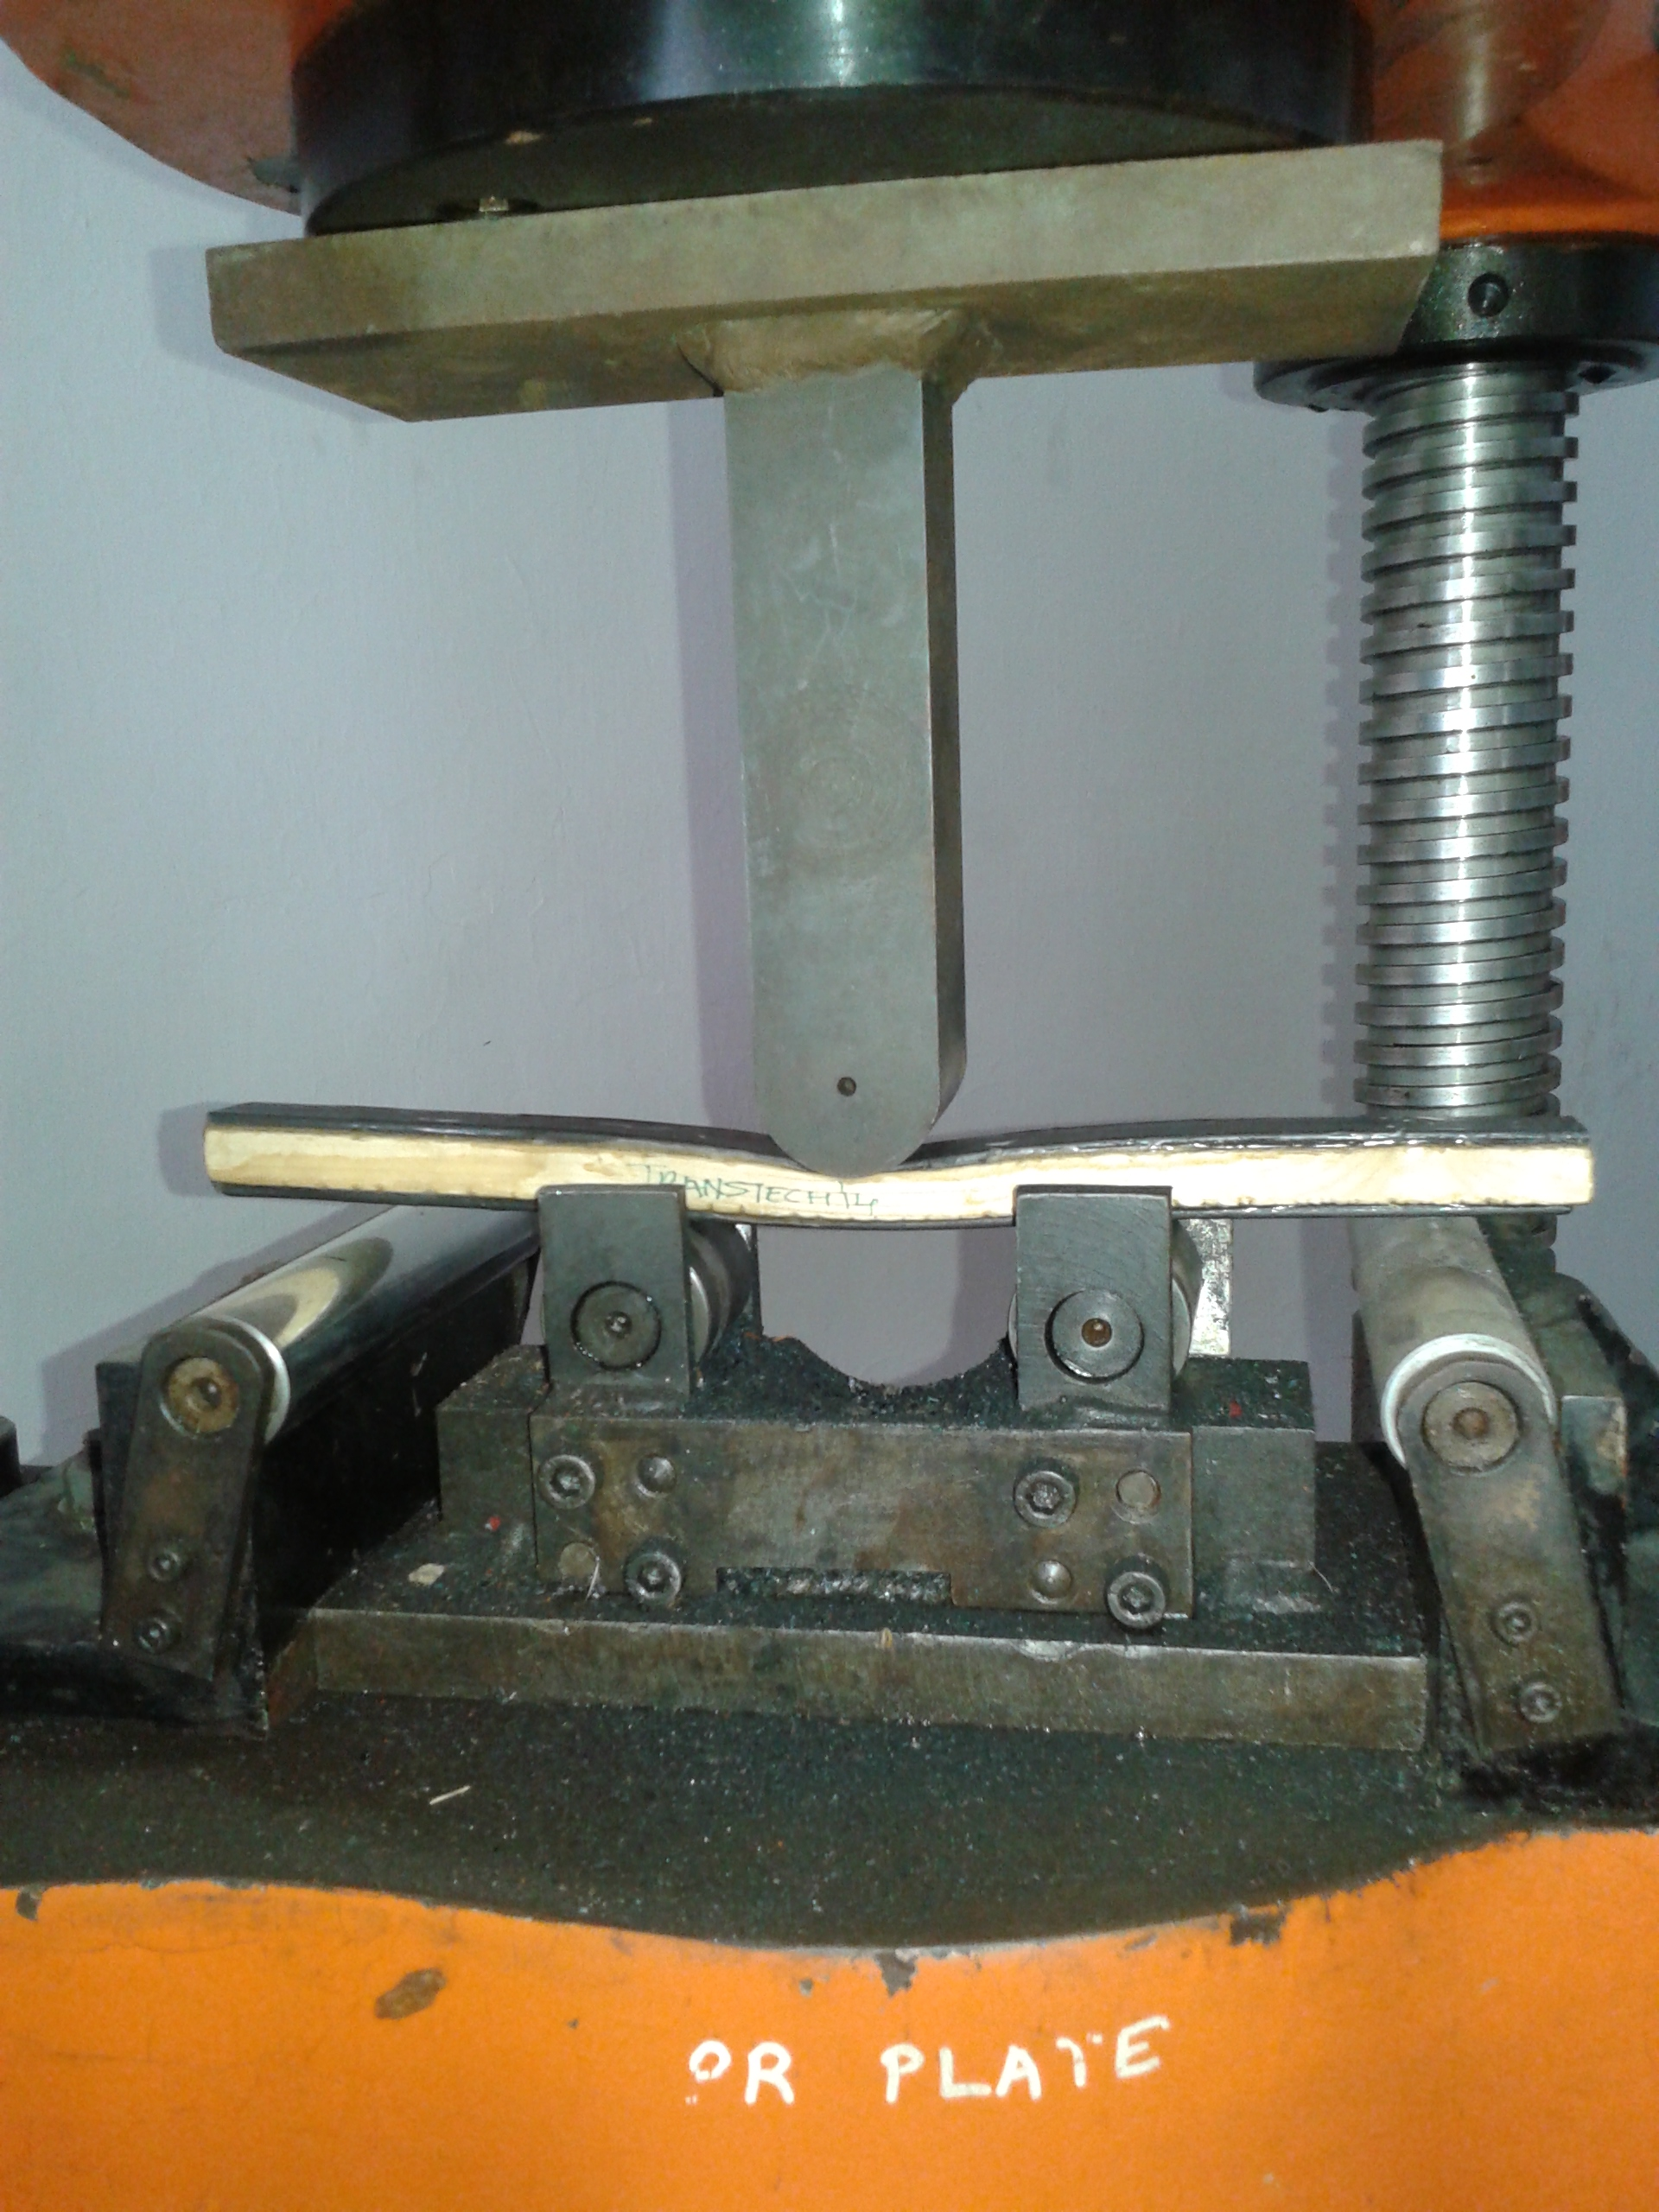
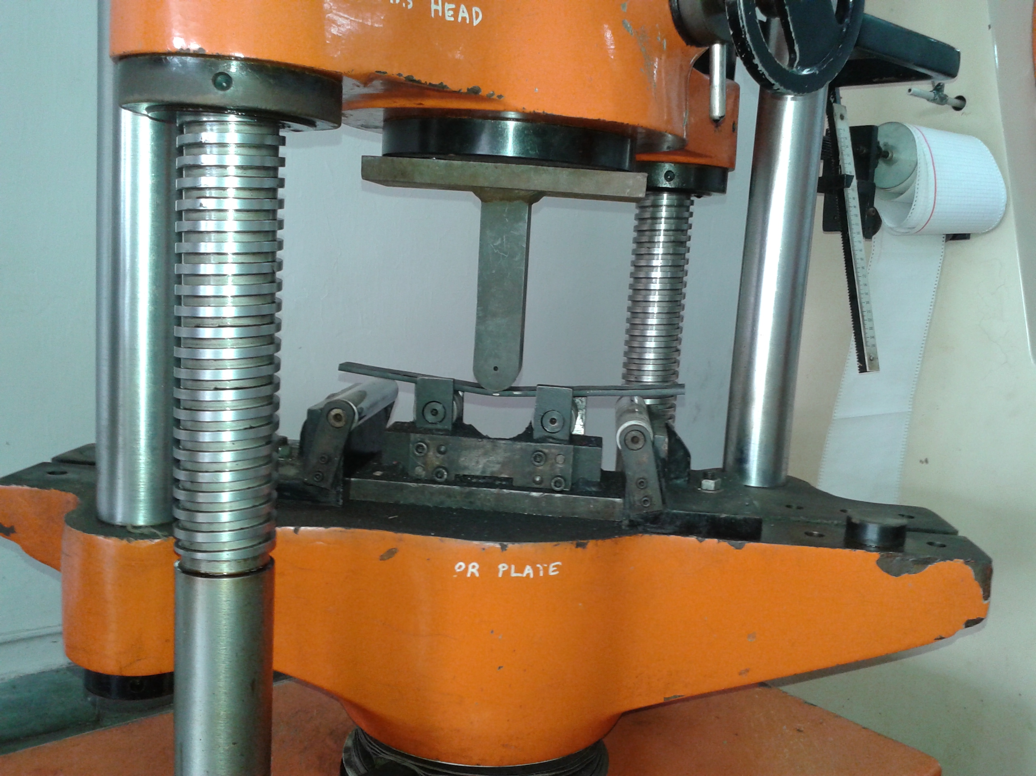
Sandwich
Steel

Slide 10
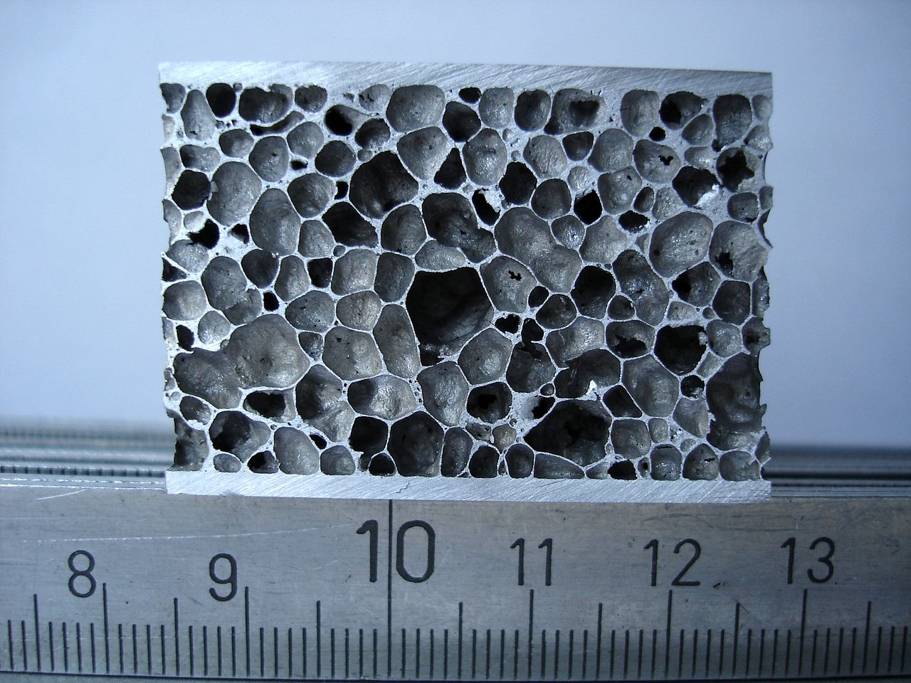

Slide 11
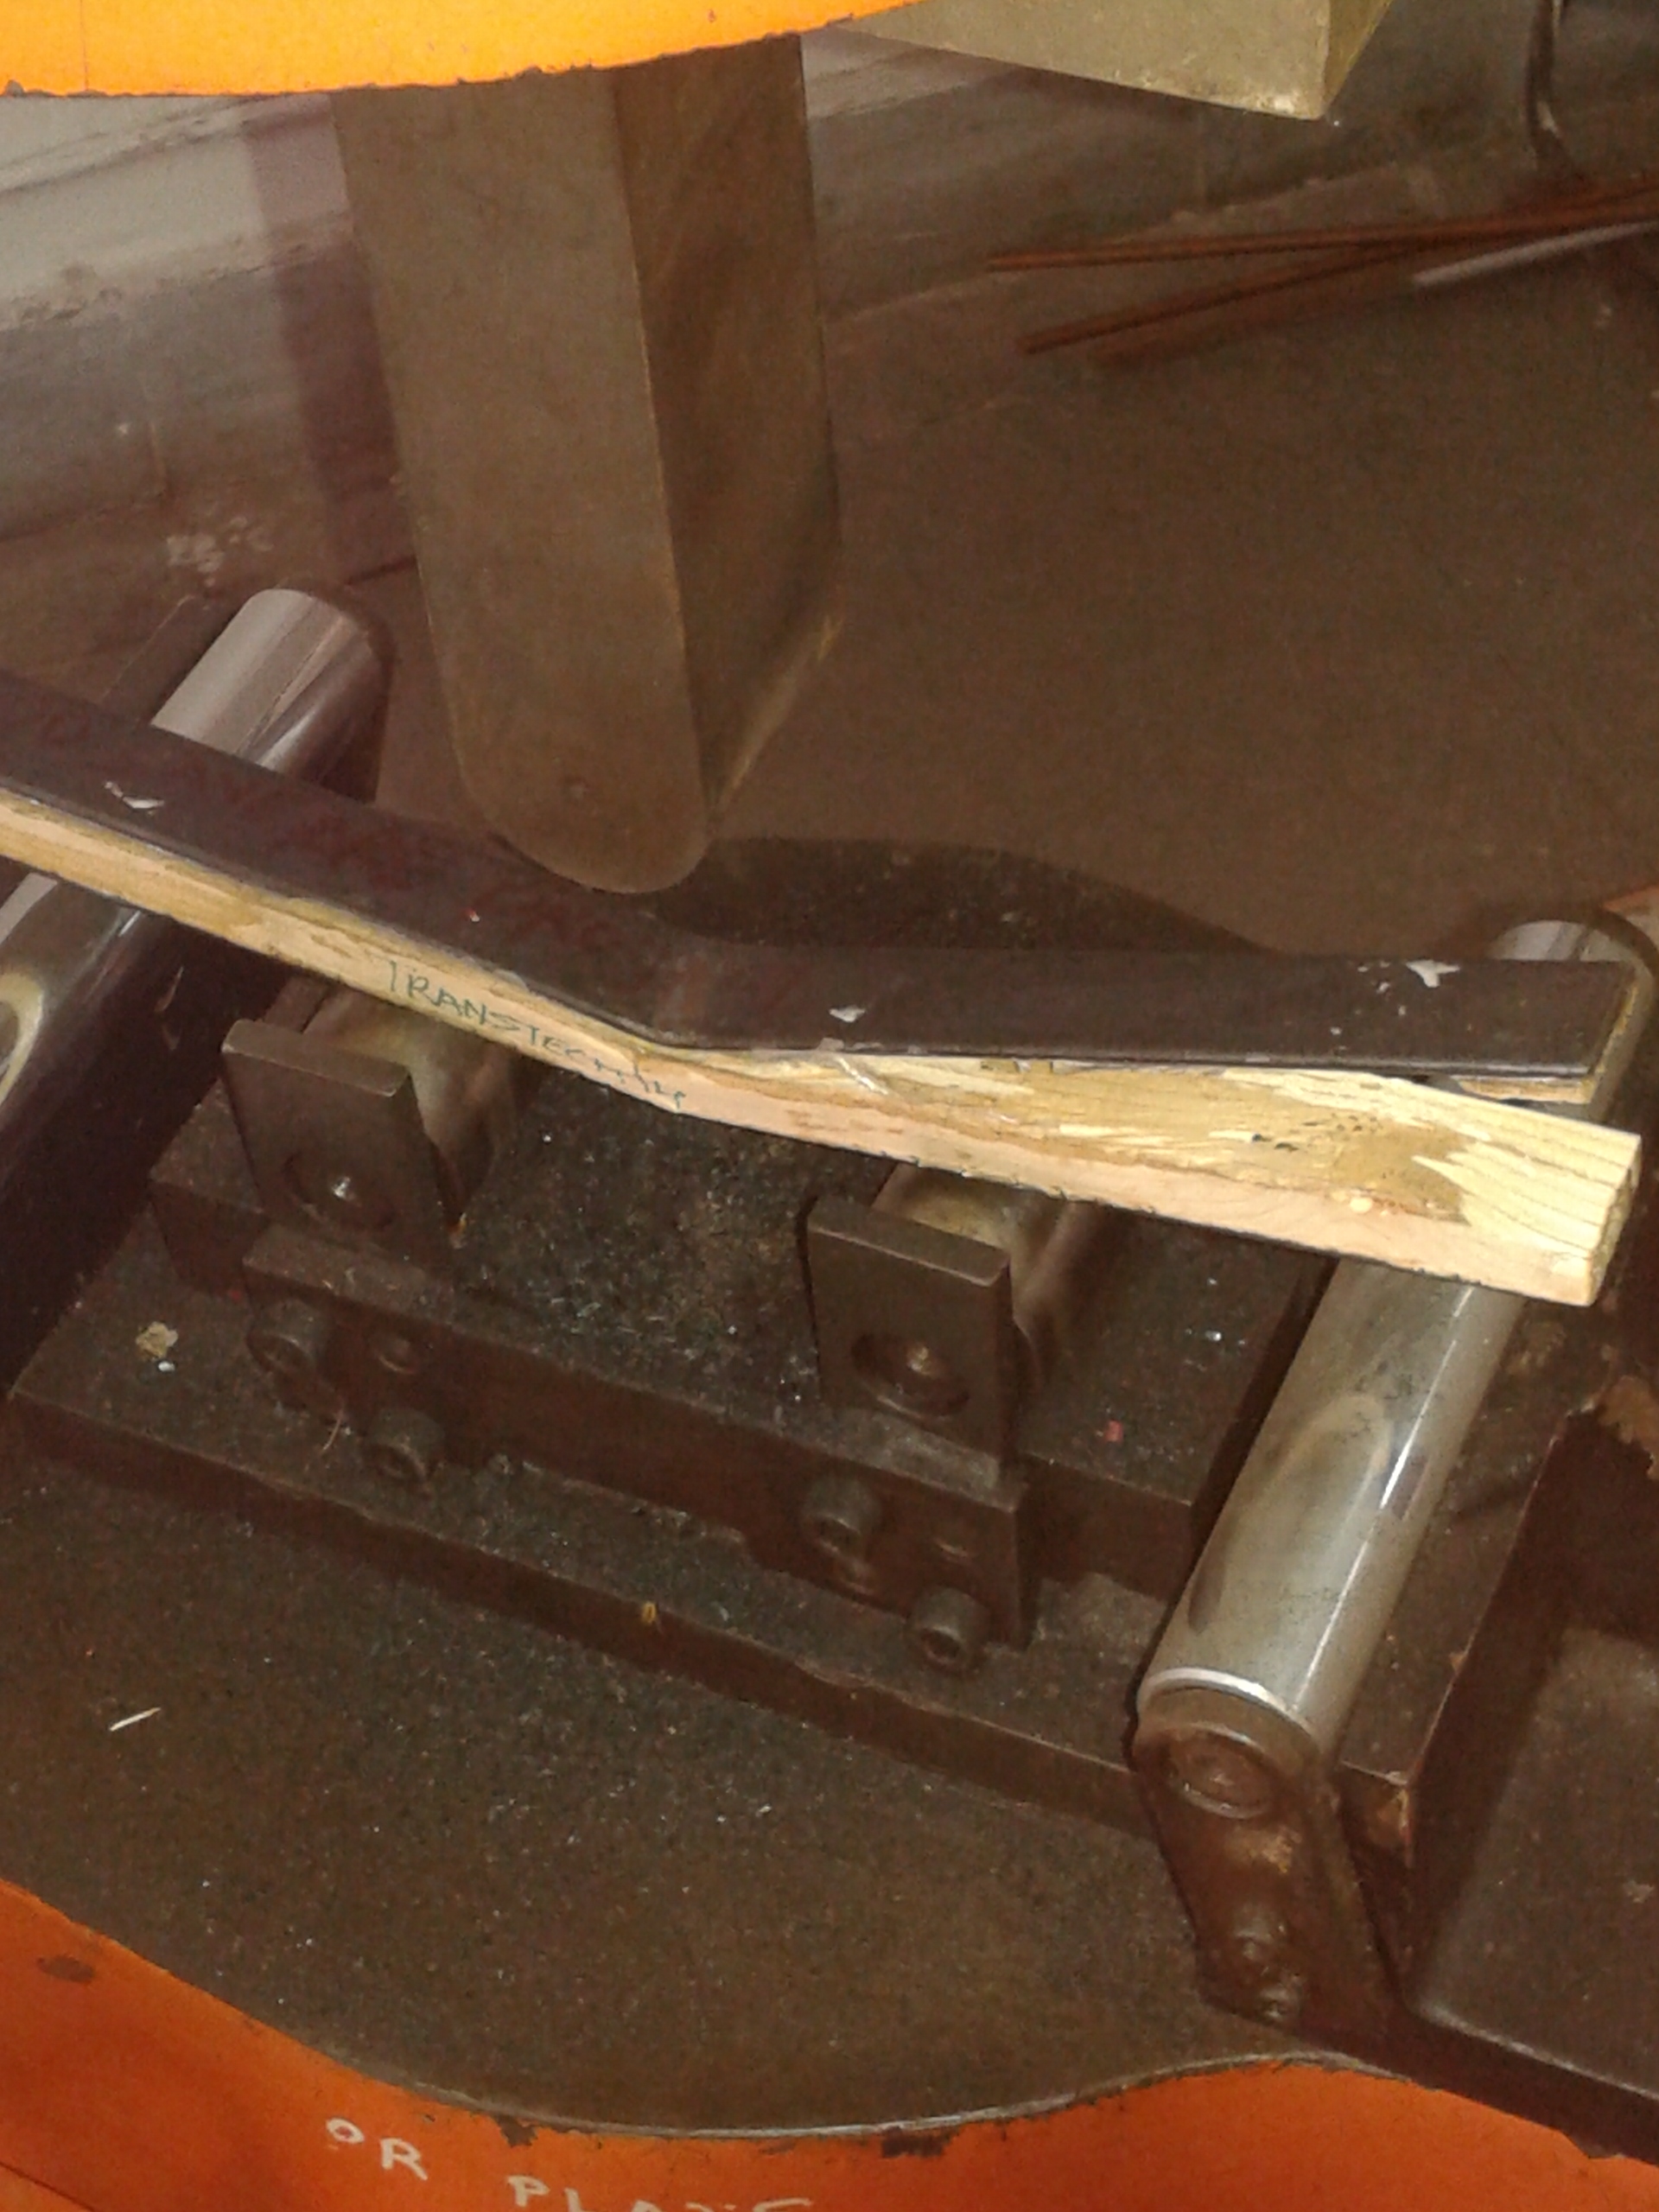
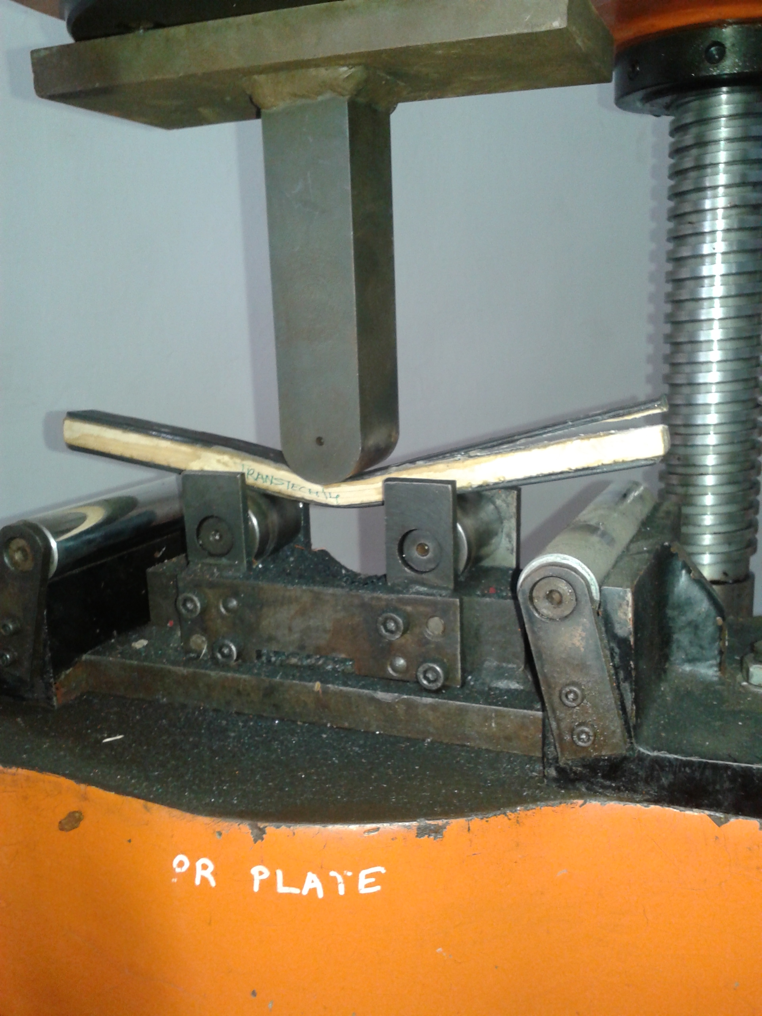

Slide 12
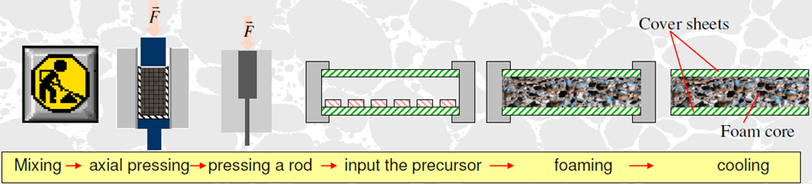
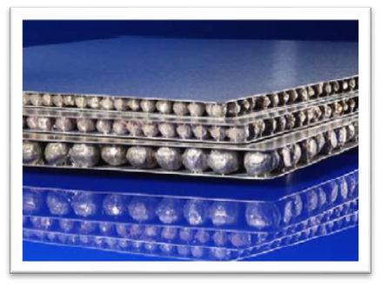
AlSi₁₂
TiH₂
Precursor
MANUFACTURING

Slide 13
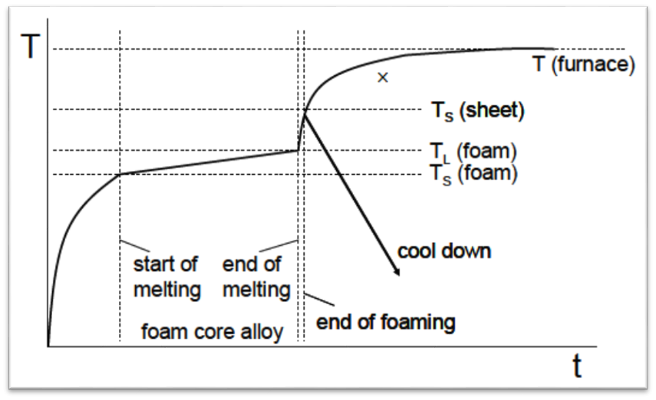
BONDING

Slide 14
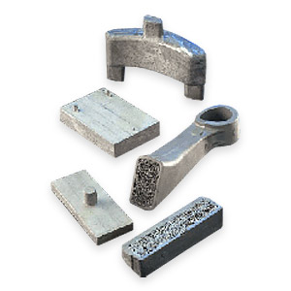
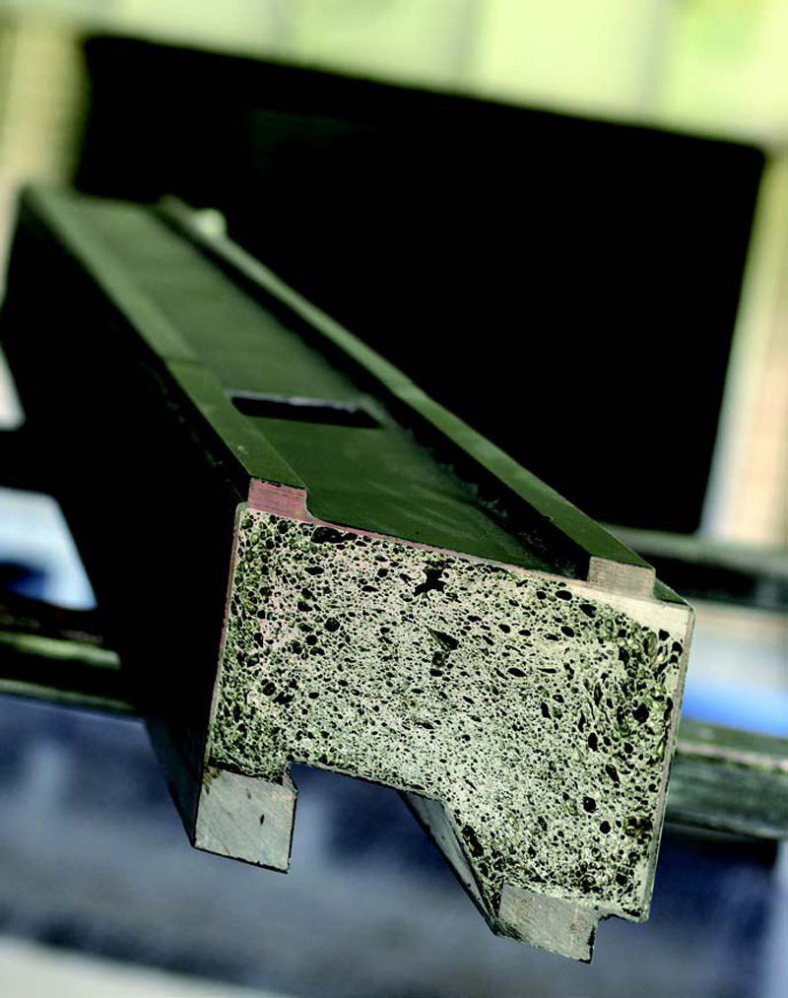
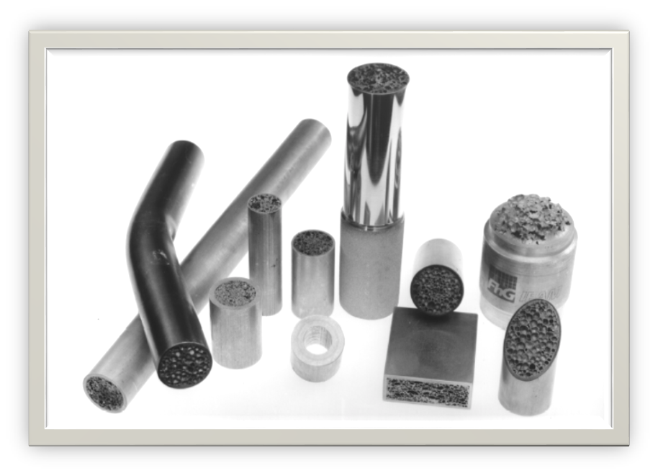
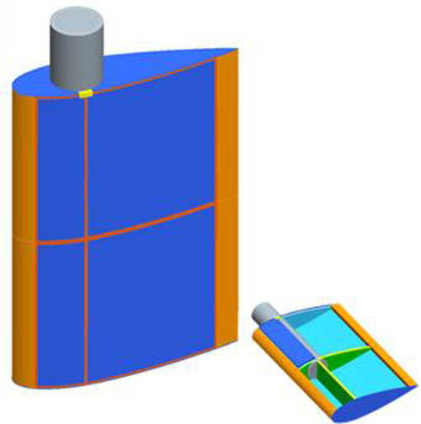
COMPLEX STRUCTURES

Slide 15
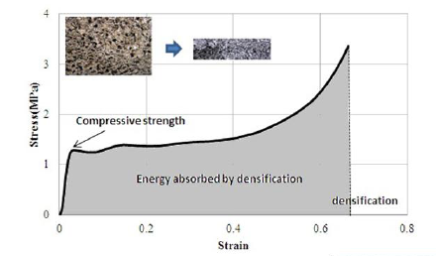
FORGING
Complex Structures from SAS sandwiches, forged
in a die.
Forging reforms the foam structure resulting in
densification of the foam core.
Densification improves impact absorption

Slide 16
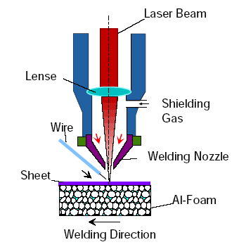
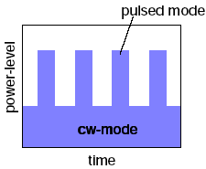
WELDING
The method of welding used is pulse beam welding.
Pulse beam welding employs mili-second long pulses to join two SAS panels.

Slide 17
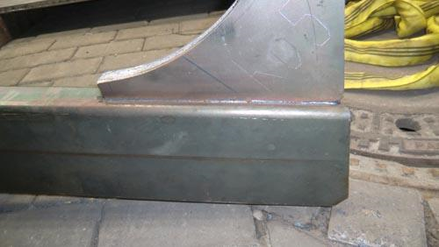
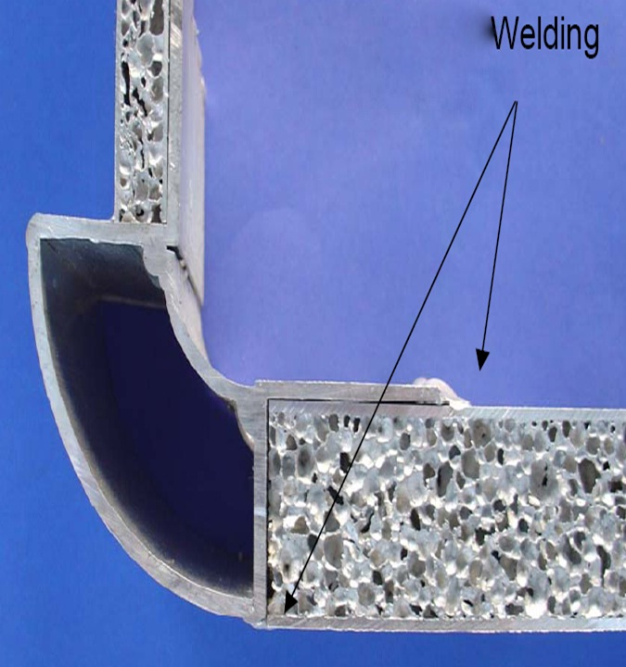

Slide 18
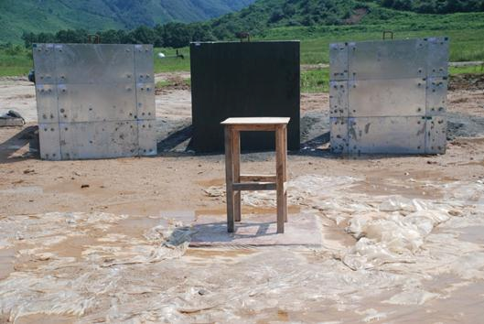
CORROSION TEST
Aluminium Foam Exposed to NaCl
spray for 1000 hours.
:Results:
Aluminium Foam is unaffected by the corrosive medium (sea water) and no structural defects were detected. Steel face sheets are protected by usual anti corrosive methods. Al Foam Sandwich is suitable for marine use.

Slide 19
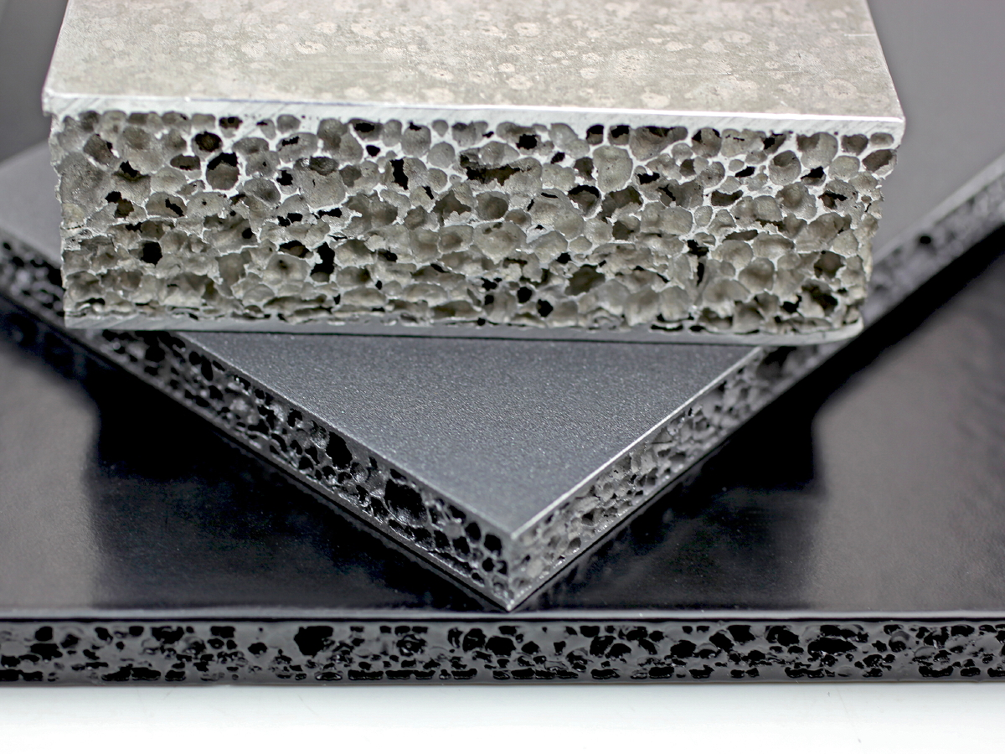

Slide 20
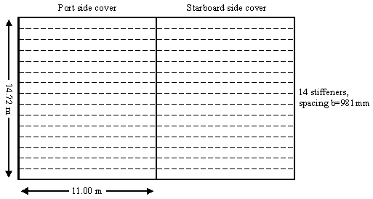
APPLICATION
Vessel : MV Derbyshire
Biggest British Ship lost in Typhoon on 10.09.1980 at 4 years age.
Hatch Cover
Faulkner’s improved design single skin, transversely stiffened type.
:Vessel Particulars:
Length: 281.94 Meters.
Beam: 44.20 Meters.
Depth: 24.90 Meters.
Construction Date: 1976
Vessel Type: (OBO) Carrier
Number of Cargo Holds: 9
Class: DNV

Slide 21

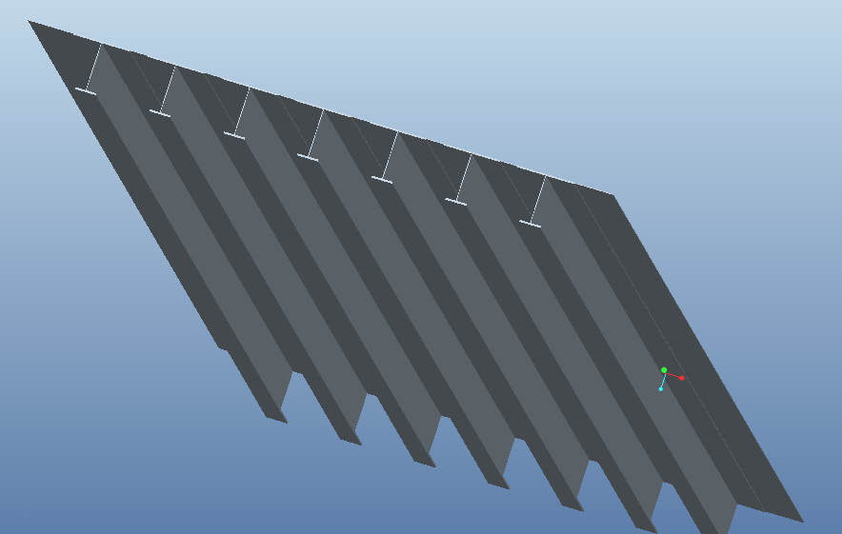
FAULKNER’S DESIGN
Transverse Stiffener | Input
Top flange breadth (b) | 63 cm
Top flange thickness (t) | 1.05 cm
Web height (h) | 63.5 cm
Web thickness (t) | 1.5 cm
Bottom flange breadth (b) | 28 cm
Bottom flange thickness (t) | 2.5 cm
Neutral Axis (z) | 33.4 cm
Design Load | 17.5 kN

Slide 22
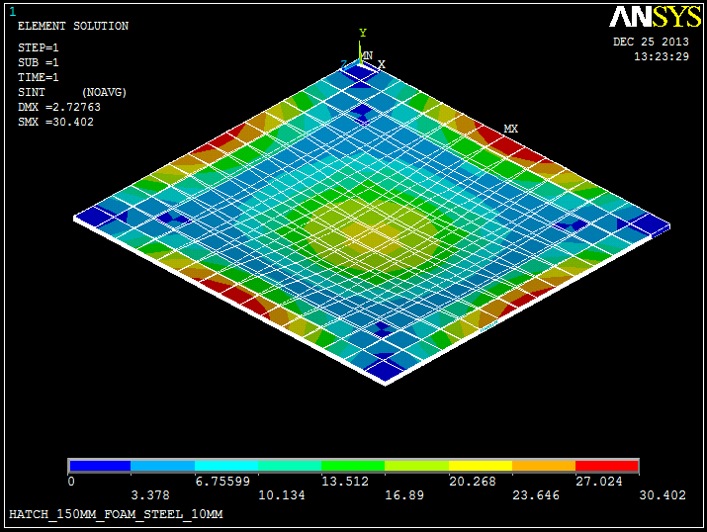
SAS DESIGN
Proposed Design

Slide 23
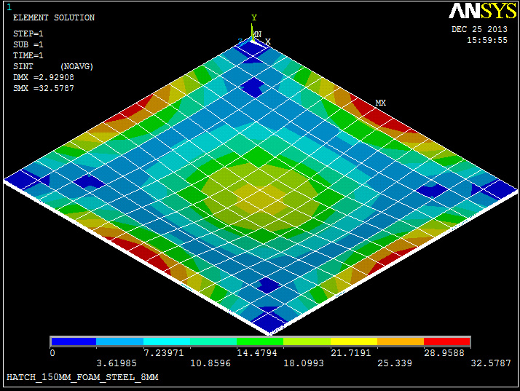
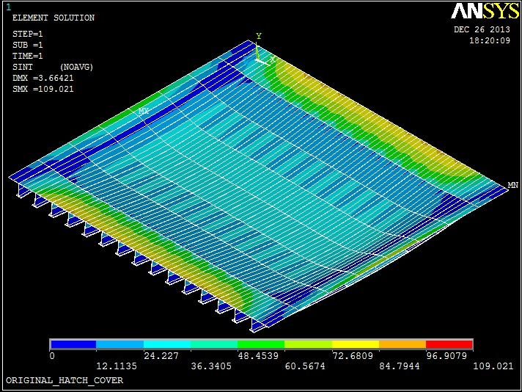
FEM ANALYSIS
Faulkner’s Hatch Cover:
Max Stress : 109 MPa
SAS Panel Hatch Cover:
Max Stress : 32 MPa

Slide 24
75.2%
20%
70.1%

Slide 25
FEM - RESULTS
Parameter | Steel Hatch Cover | (SAS) Hatch Cover
Thickness | 670 mm with 14 stiffeners | 150 mm Al Foam with 8 mm Face Steel Sheet
Weight | 76.887 MT | 41.958 MT
Deflection | 3.664 mm | 2.929 mm
Max Stress | 109.36 Mpa | 32.58 MPa

Slide 27
Saving of 315 Ton for 9 hatch covers together.
The freight charges for shipping iron ore : 23 USD/tonnes.
Thus the total profit achieved in every voyage is:
315 x 23 = 7245 USD
The additional cost for using SAS design amounts to 72,331 USD
Voyages to break even : 87

Slide 28
CONCLUSION
The FEM results along with our experiments conclusively satisfy our aim and prove that SAS is a smart material and a viable alternative to steel in the future.

Slide 29
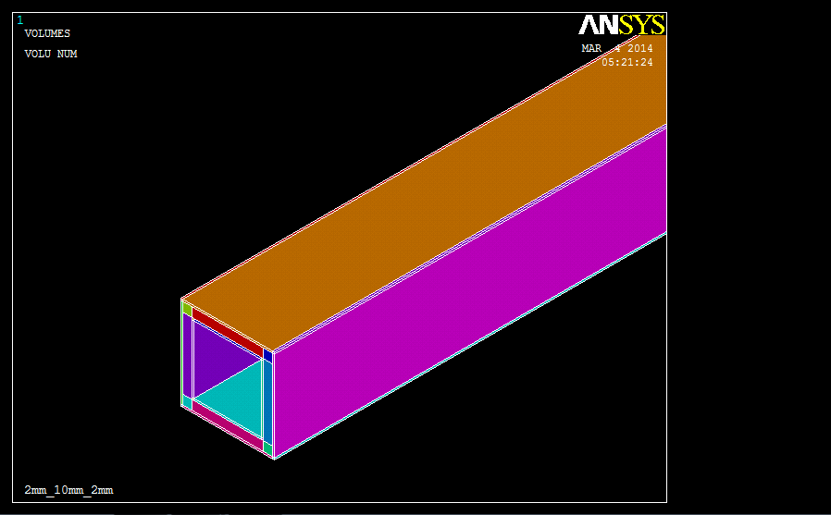
FUTURE WORK

Slide 30
Acknowledgements
Any project idea requires authenticated inputs based on well-rounded research. A lot of data and research work was provided to us by Fraunhofer Institute for Machine tools and Forming Technology, based in Chemnitz, Germany through their Head of the Department, Dr. THOMAS HIPKE. This invaluable support is greatly acknowledged.
We sincerely thank the following for their key inputs and guidance:
Mr. AYAZ KHAN, Cdr. BHASKAR WALIMBE
Dr. SANJAY POHEKAR Dr. SANJEET KANUNGO
Mr. INDRA BASU Mr. SHISHIR DUTT
Mr. ARUN MAHAJAN Mr. AMOL TATKE
All the instructors in TMI workshop for helping prepare the model.

Slide 31
THANK YOU!
ANY QUESTIONS?

