Slide 1
SMART MATERIALS FOR SMART FUTURE
Nachiket Deshmukh
P.R.M.I.T&R Badnera.

Slide 2
Contents
Acronym of the word ‘SMART’
Definition
Shape memory alloys
Chromic materials Introduction & application
Electric materials
Possible applications of few smart materials in daily life
References

Slide 3
Acronym of SMART
Specific
Measurable
Achievable/ affordable
Realistic
Time bound

Slide 4
Definition
A material which has built-in or intrinsic:
Sensor- to sense a change in environment (either physical or chemical),
Actuator- to respond to change in a predetermined manner & extent in a short or appropriate time and
Control mechanism- to revert the changed state to its original one;
is called smart material.
-(Definition adopted in the workshop organized by US Army Research Office in 1998)

Slide 5
Materials to be focused
Shape memory alloys
Photo chromic materials
Thermo chromic materials
Electro chromic materials
Photo electric materials
Thermo electric materials
Piezo electric materials

Slide 6
Shape memory alloys
A group of metallic materials that demonstrate the ability to return to some previously defined shape or size when subjected to appropriate thermal procedure are known as shape memory alloys (SMA).
The alloys like Ag-Cd, Au-Cd, Cu-Al-Ni, Cu-Zn, Ni-Ti, Cu-Sn, Ni-Al, Cu-Zn-X (where X= Si, Sn, Al) exhibit shape memory effects. Out of above listed alloys Ni-Ti i.e. Nitinol is most common alloy.

Slide 7
Applications of SMAs
Aircraft: Variable Geometry Chevron
Piping: Shape memory coupling
Automotive

Slide 8
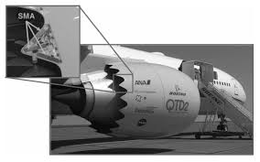
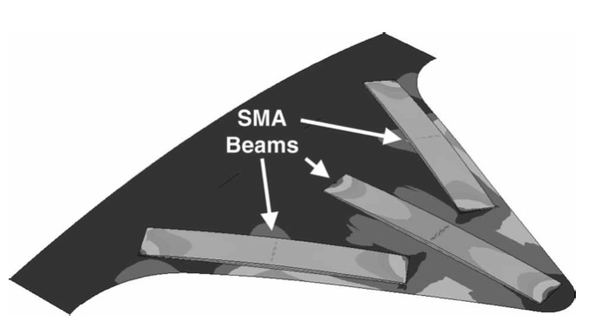
Variable geometry chevron
1. Take off/ Landing:
Curved
2. Horizontal at higher altitude:
Straight

Slide 9
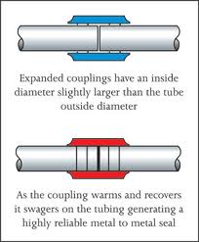
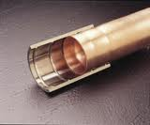
Shape memory coupling

Slide 10
Chromic Materials
Materials that change their surface color according to the change in surrounding atmosphere are known as chromic materials.
Material | Factor causing color change
Photo chromic | Light falling on object
Thermo chromic | Change in temperature
Electro chromic | Electric current

Slide 11
Photo chromic materials
They change material state from transparence to color when they are exposed to light, and revert to transparency when the light is dimmed or blocked
It is one of the oldest phenomena which dates back to 1880s.
E.g. TiO₂ films loaded with silver nano particles

Slide 12
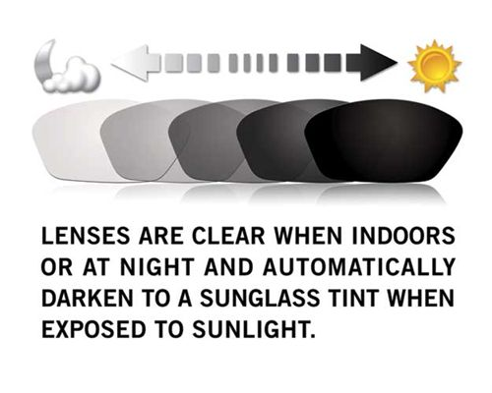
Applications of Photo chromic materials

Slide 13
Thermo chromic materials
Materials that possesses thermochromism are thermo chromic materials.
Thermo chromism is the property of substances to change color due to a change in temperature.
E.g. V₂O₅ (Vanadium pent oxide)

Slide 14
Applications/ products of Thermo chromic materials
Smart vouchers- help shopkeepers to identify fake customers
Novelty items- for fun or in case of milk bottles meant for baby, it gives warning if milk is too hot.
Thermometers

Slide 15
Electro chromic materials
An electro chromic material is one that changes color reversibly when a burst of charge is applied to it.
The color change is commonly between a transparent state and a colored state, or between two colored states.
E.g. CuO (black) changes to Cu₂O (red brown) (copper from oxidized form to reduced form)

Slide 16
Applications of Electro chromic materials
Smart windows
In rear view mirror of the car

Slide 17
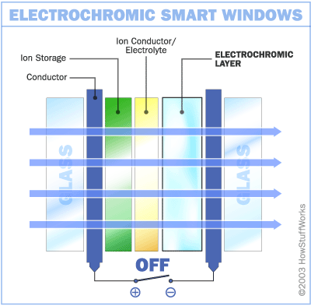
Smart window
Direction of ion flow w.r.t electro chromic layer | Condition of window
Entering | Opaque
Leaving | Transparent

Slide 18
“Electric” materials
These materials produce electric current by the application of light, heat, pressure etc.
Material | Input
Photo electric | Falling light
Thermo electric | Change in surface temperature
Piezo electric | Applied pressure

Slide 19
Photo electric materials
Materials that produces electricity when light falls on them, are called as photo electric materials.
This conversion of light energy into electricity is known as photo electricity.

Slide 20
Applications of photo electric materials
Photo multipliers
Image sensors
Night vision devices

Slide 21
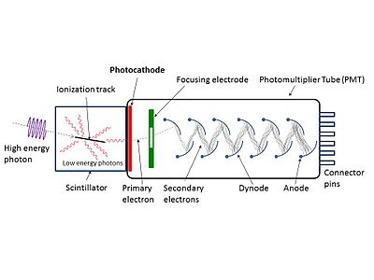
Photo multiplier
Schematic of a photomultiplier tube coupled to a scintillator. This arrangement is for detection of gamma rays.

Slide 22
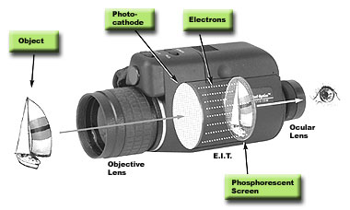
Night vision device

Slide 23
Thermo electric materials
These materials show the thermoelectric effect in a strong or convenient form.
The thermoelectric effect:
Seebeck effect | Temperature current
Peltier effect | Current temperature
Thomson effect | Conductor heating/cooling

Slide 24
Applications
Power generation
Refrigeration

Slide 25
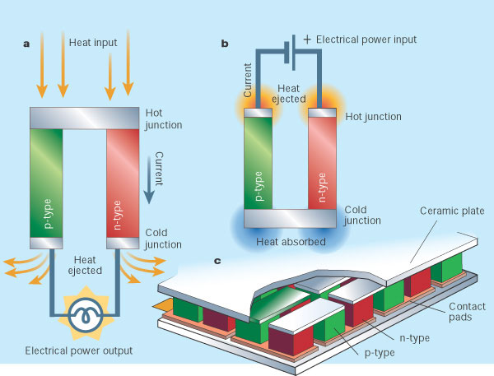
Thermo electric refrigerator

Slide 26
Piezo electric materials
Piezoelectric materials have the ability to produce a voltage when subjected to mechanical stress.
The effect is reversible when these materials are subjected to an externally applied voltage, can change shape by a small amount.
Examples: quartz, naturally occurring crystals, bone, synthetic crystals, synthetic ceramics.

Slide 27
Applications
High voltage sources
Reduction of vibrations

Slide 28
Possible applications of few smart materials in daily life
Thermo electric | Indication of amount of heat available at a particular space
Photo chromic | In the front panel of 4 wheeler to reduce effort on driver’s eye in brightness of sunlight
Thermo chromic | Indication of overheating of cutting tool
Piezo electric | Mobile charging by placing suitable piezo electric smart material under the sole of shoe

Slide 29
References
1.Addington, M., & Schodek, D. (2005). Smart Materials and Technologies. Boston: Elsevier.
2. Hochbaum, Allon I.; Chen, Renkun; Delgado, Raul Diaz; Liang, Wenjie; Garnett, Erik C
3. Najarian, Mark; Majumdar, Arun; Yang, Peidong (2008). "Enhanced thermoelectric performance of rough silicon nanowires". Nature 451 (7175): 163–7.
4. Wikipedia- the free encyclopedia.
Tutorials from IIT’s.

