Slide 1
Technologies in Diesel Engines
Ajay Yadav
MTU India Pvt Ltd

Slide 2
Diesel Engines Need Continous Upgrade
To meet compliance requirement
Bring down Life Cycle Costing
Improve performance
Improve Time Between Overhaul
Mitigate various risks
Meet customers expectations

Slide 3
Diesel Engines Need Continous Upgrade
Today in Diesel Engines Industry most of the Technological Evolution is taking place to meet the Enviornmental requirement.
In Marine Application Diesel Engines are required to meet emission standards set by IMO

Slide 4
Emission Challenges

Slide 5
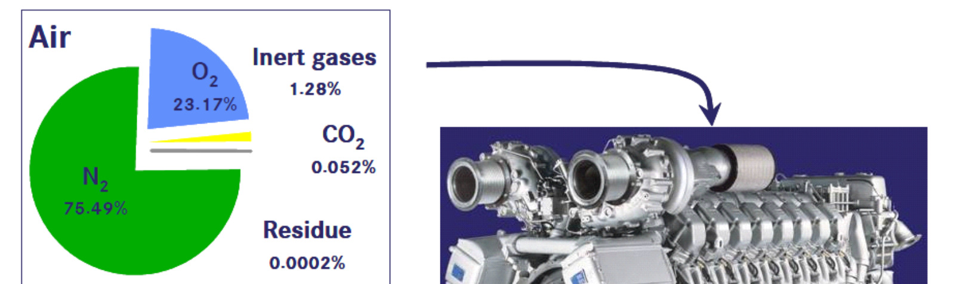
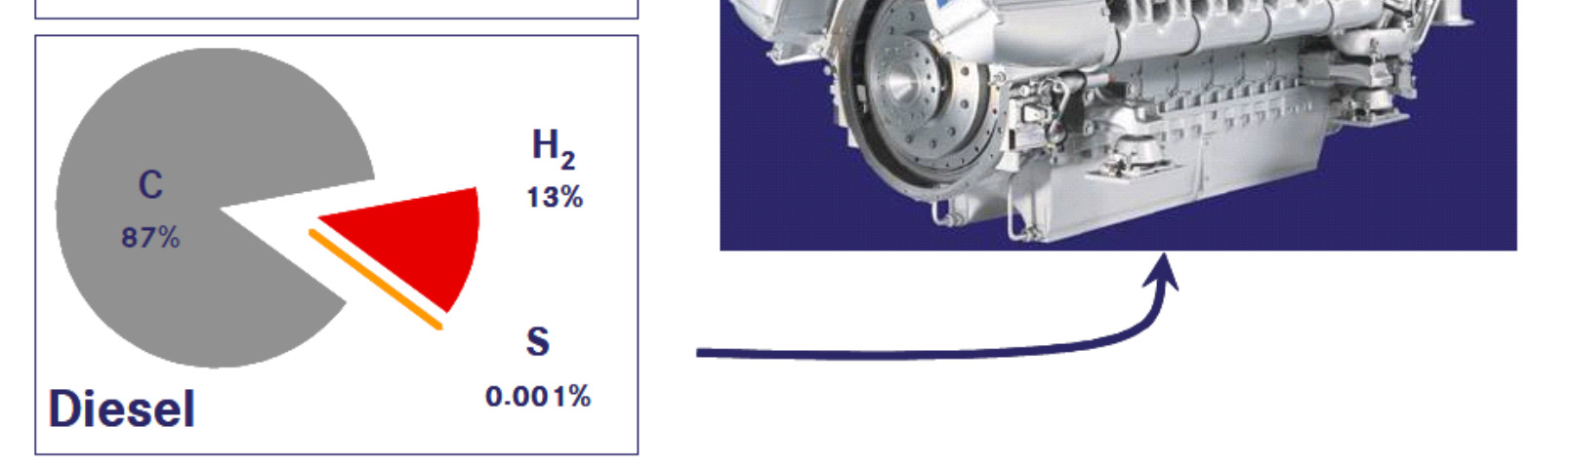
Emission Challenges

Slide 6
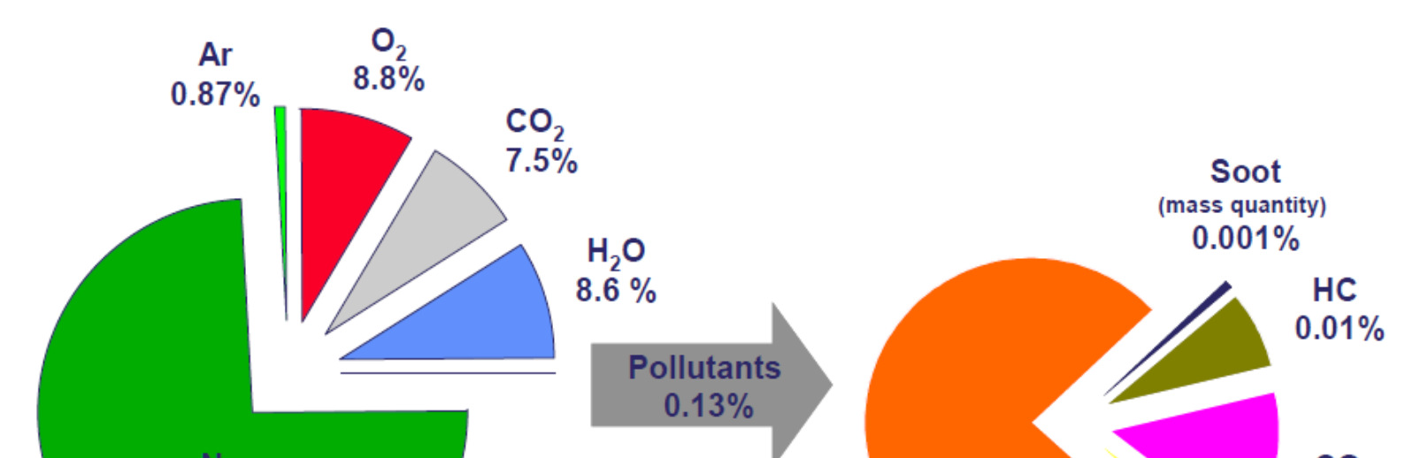
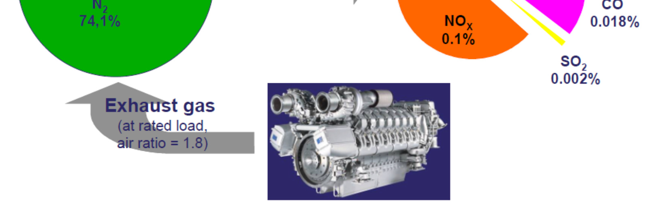
Emission Challenges

Slide 7
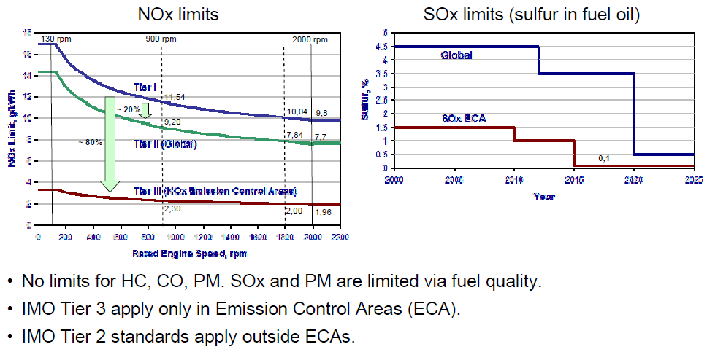
Emission Challenges

Slide 8
Emission Legislation
 | Year | NO_{x} + HC | PM
Tier 2 | 2006 | 6.40 | 0.20
Tier 4i | 2011 | 3.5+0.4 | 0.10
Tier 4 | 2015 | 3.5+0.19 | 0.04
Off-Highway Diesel Engines
> 560 in Asia and Europa are
today not emission regulated.

Slide 9
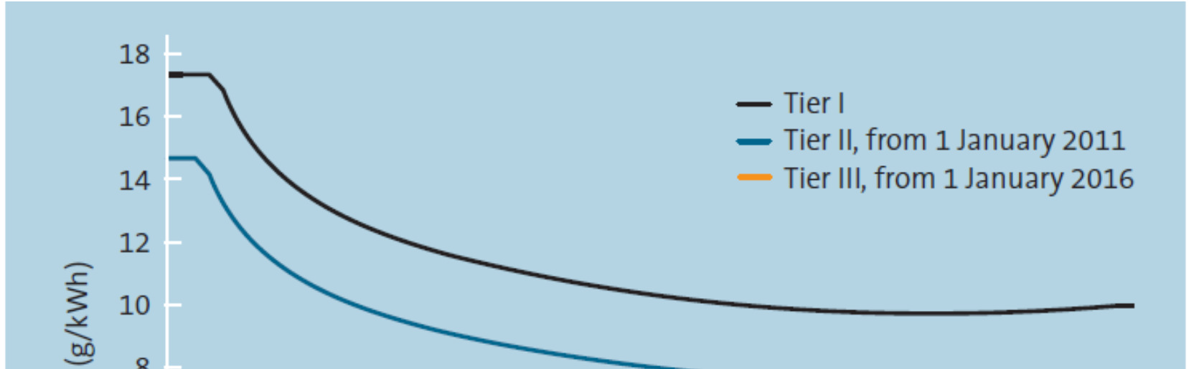
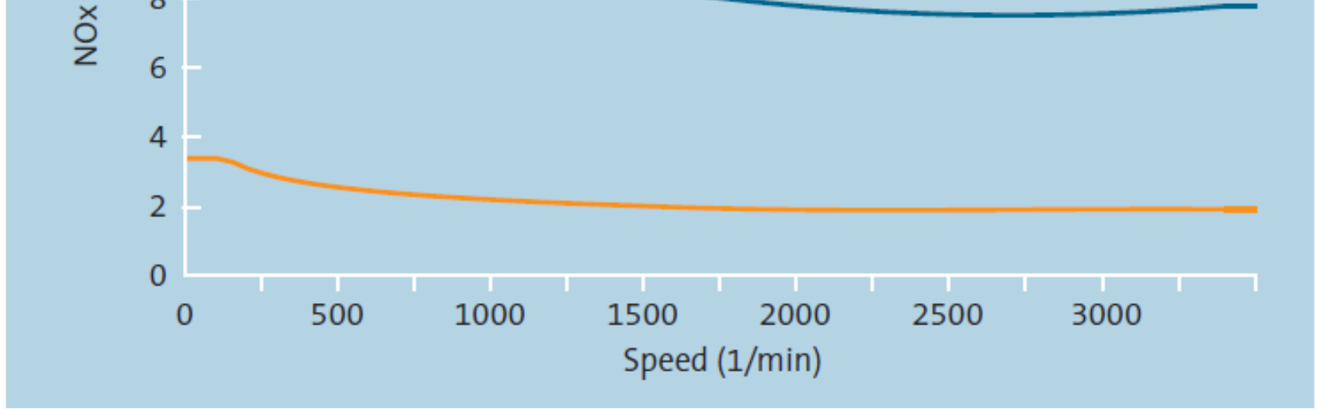
Emission Challenges

Slide 10
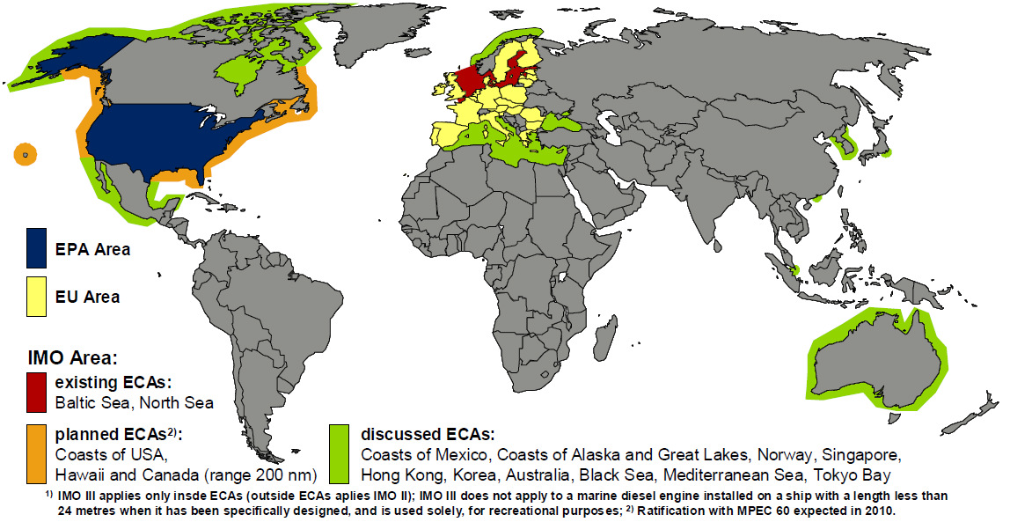
Emission Challenges

Slide 11
Emission Challenges
Soot Nox Trade-Off

Slide 12
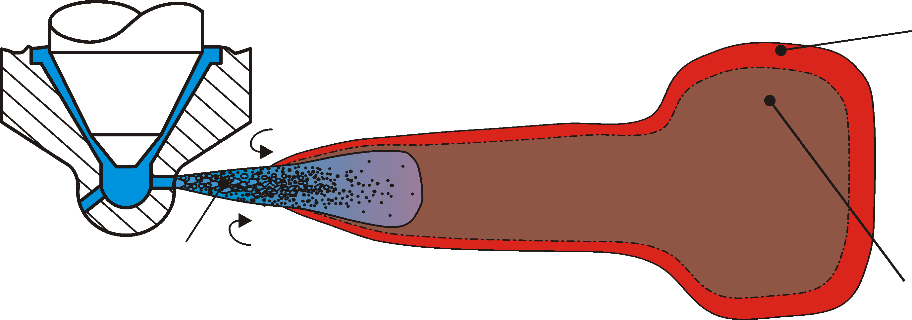
Diesel Engine: Formation of Pollutants
oxygen-rich combustion
~2400 °C →NO_{x}
Air, 650 °C
fuel 70 °C
partial combustion, lack of oxygen, ~1300 °C → soot
Diesel engine: simultaneous formation of soot and NOx

Slide 13
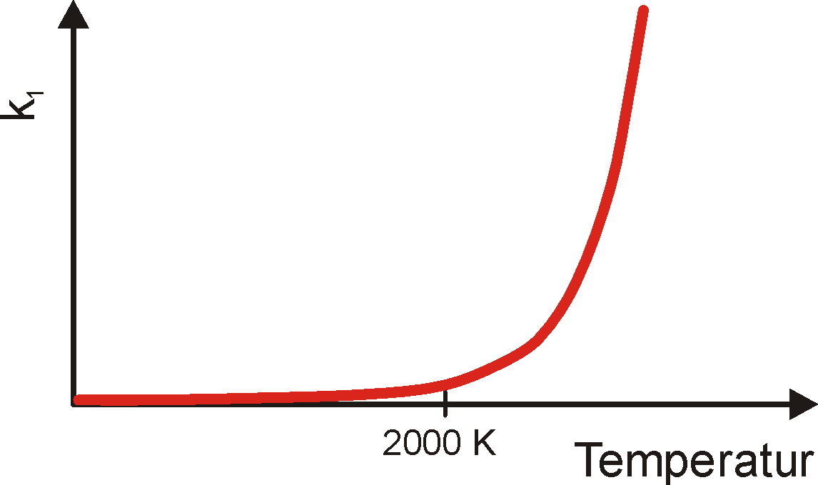
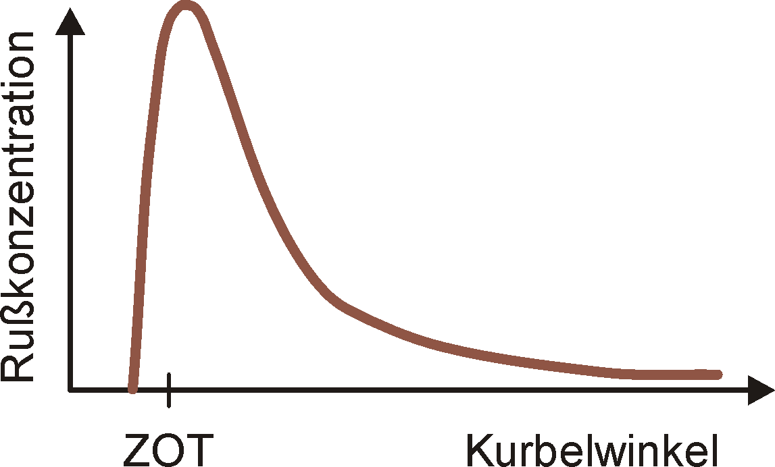
Formation of Pollutants
Formation of nitrogen oxides (NO_{x}): Zeldovich-Mechanism:
(1)
(2)
(3)
N N
Extent/height and duration of local peak temperature important
temperature
Soot Formation
soot concentration
Production: lack of O₂
Reduction: up to 99% (T>1100 °C)
deg. crank angle

Slide 14
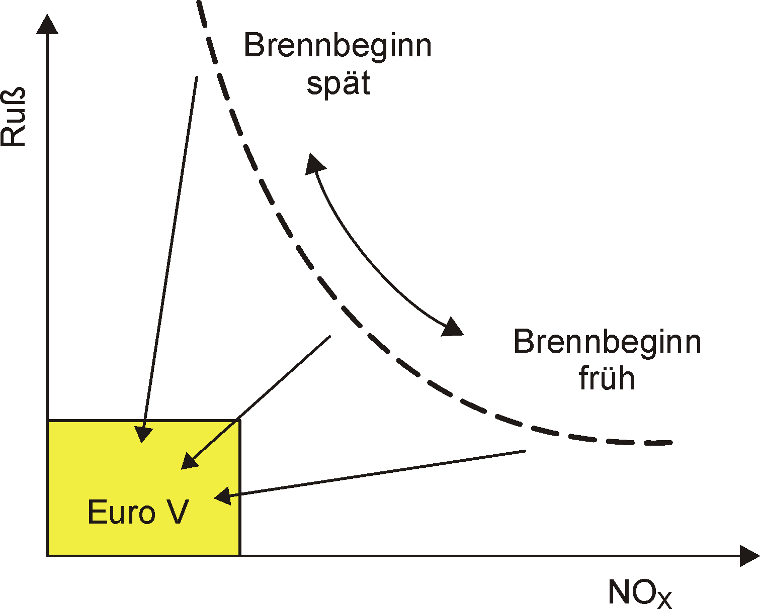
Diesel Engine: Soot-NOx Trade-Off
late begin of ignition
soot
?
?
early begin of ignition
?
target
NOx

Slide 15
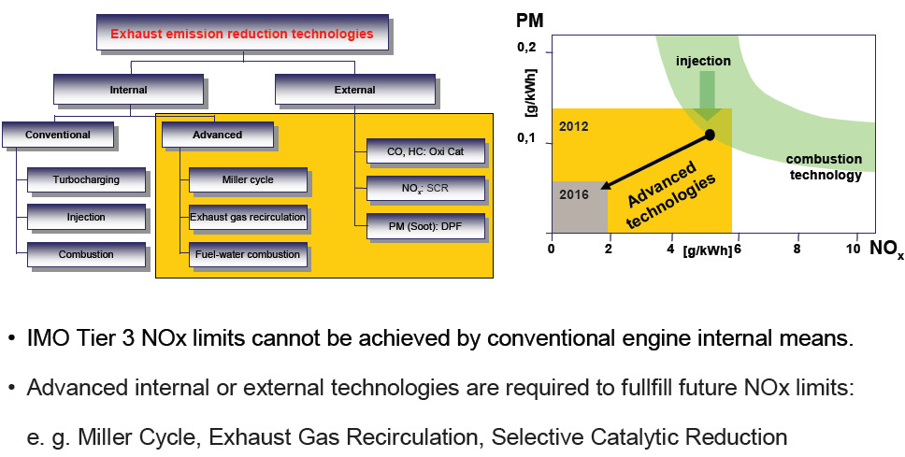
Emission Reduction Technologies

Slide 16
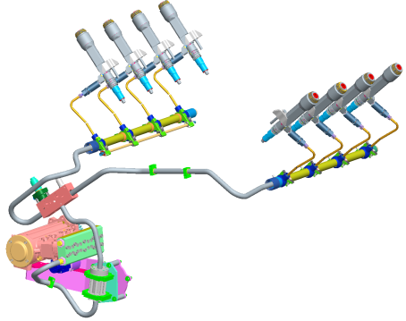
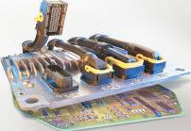
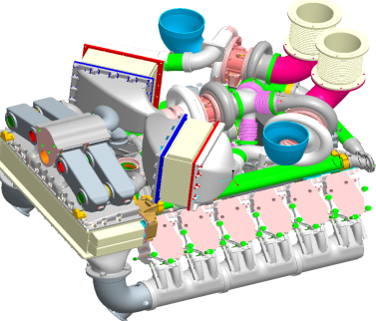

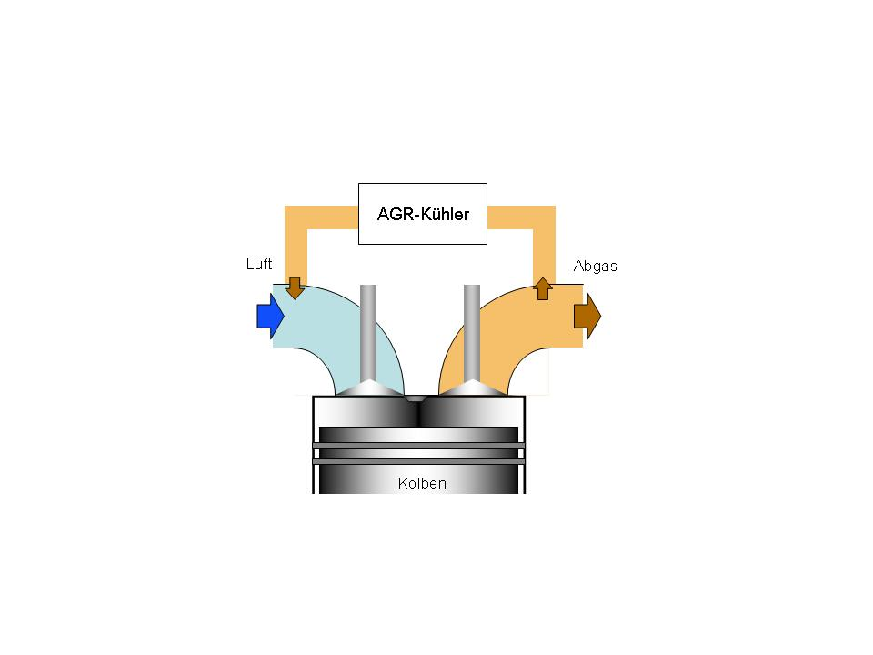
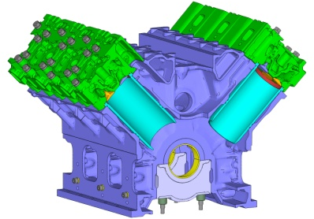
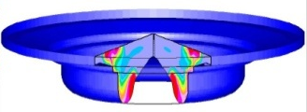
New In-Engine Technologies
New engine
controller
ECU-9
2-stage turbocharging
Advanced
Injection system
Electronics
Injection
Turbo-
charging
Technology
concept
„Mobile“
EGR cooler
Peak
pressure
EGR
Air
Exhaust Gas
Combustion
Increased peak pressure
piston
Cooled exhaust gas recirculation
New Combustion

Slide 17
Common Rail Fuel Injection

Slide 18
Common Rail Fuel Injection
Common Rail Injection for clean & Economical combustion
Combustion process optimised to achieve low pollutant levels and lower fuel consumption
Main Components
A) High pressure fuel pump
B) Common Rail
C) Electronic injectors
D) Engine Controller (MTU Proprietry Product)

Slide 19
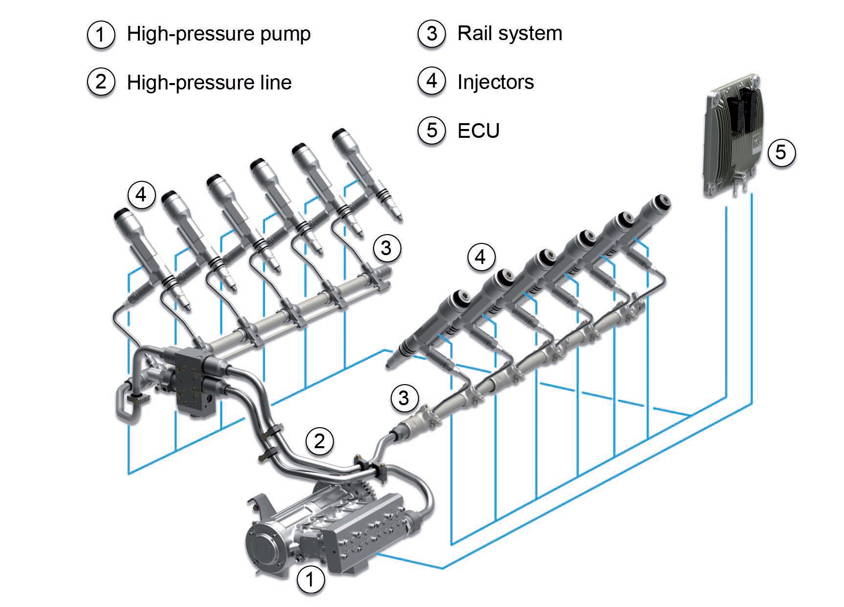
Common Rail Fuel Injection

Slide 20
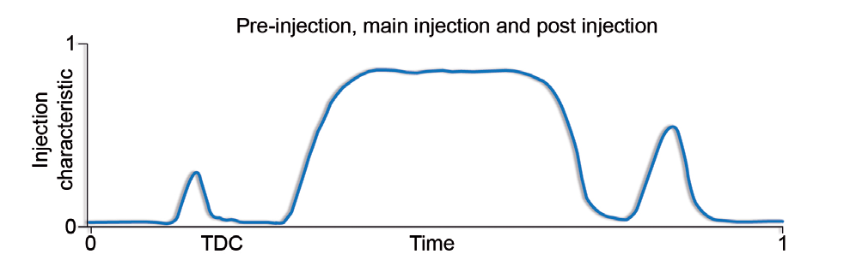
Common Rail Fuel Injection

Slide 21
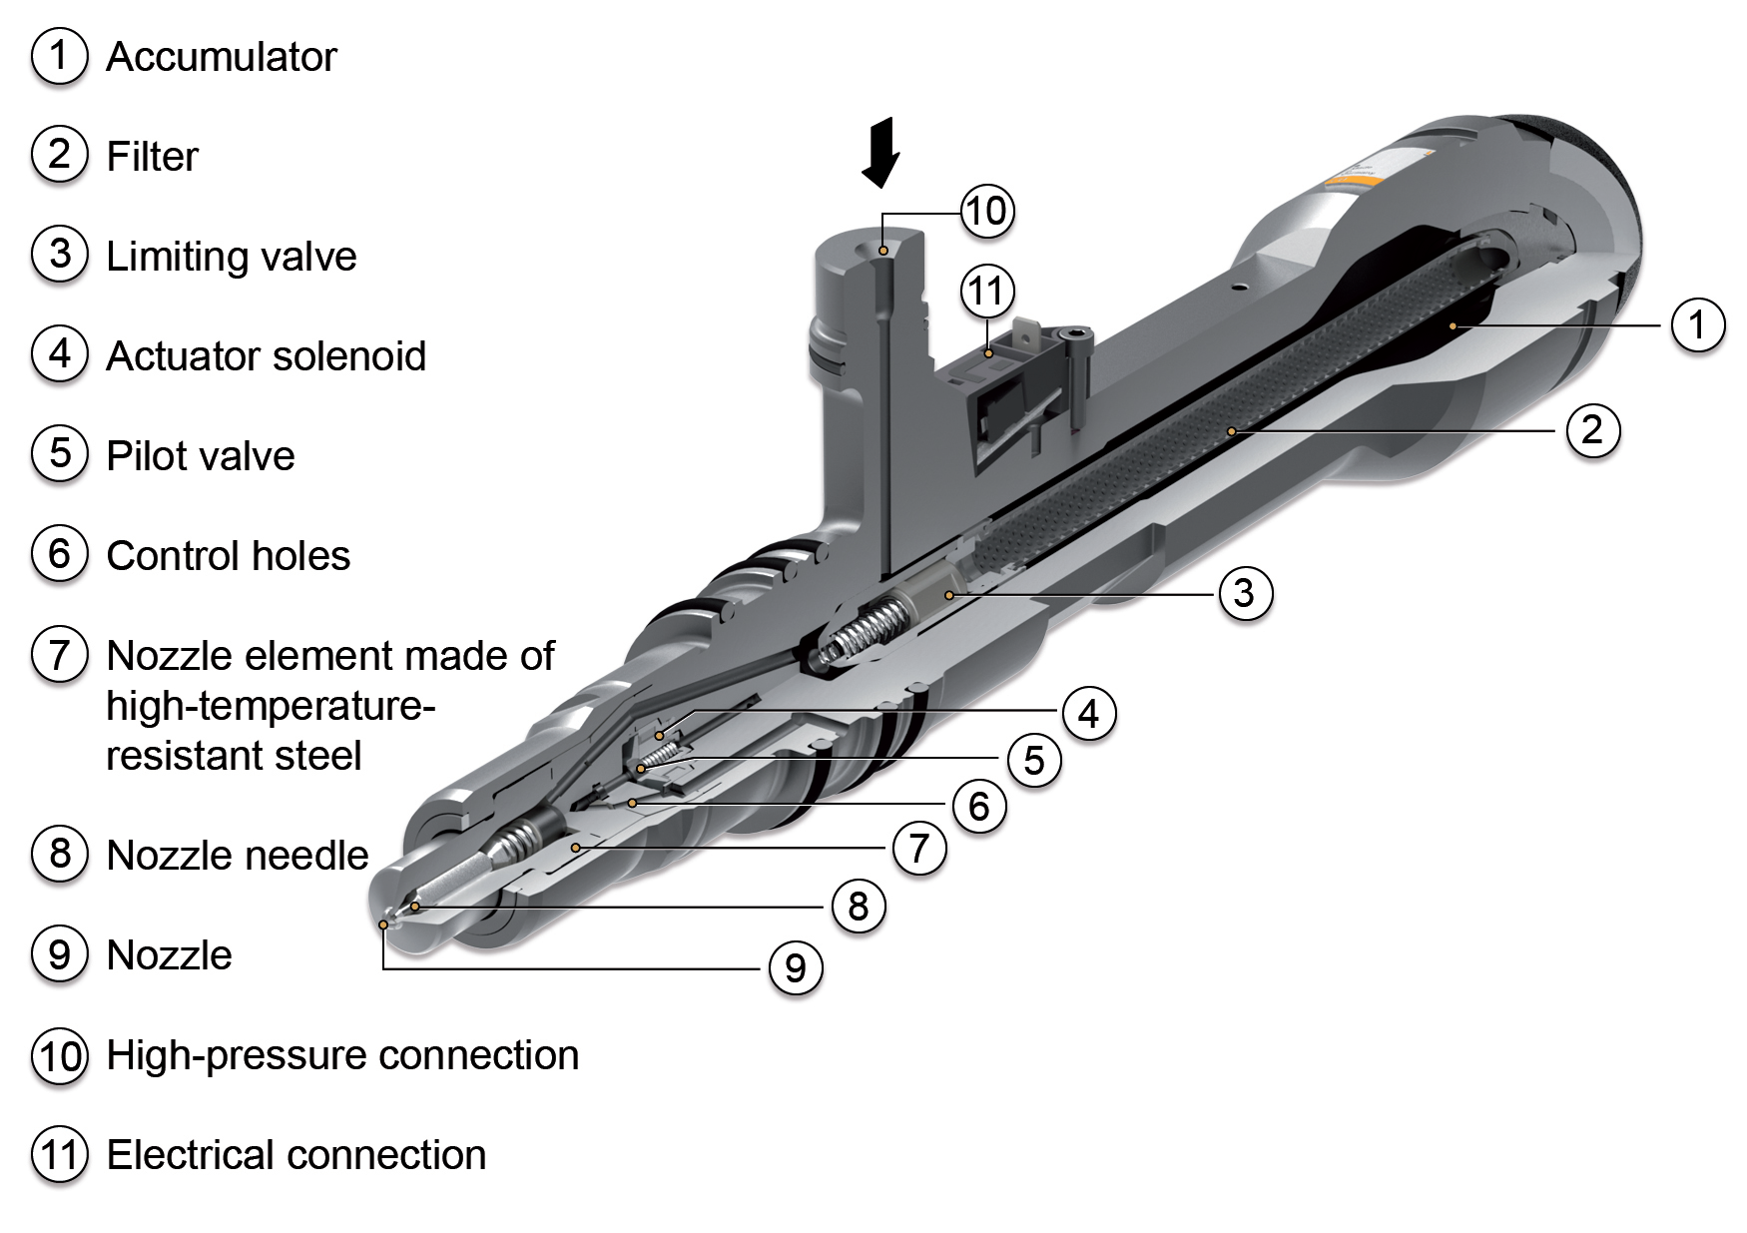
Common Rail Fuel Injection

Slide 22
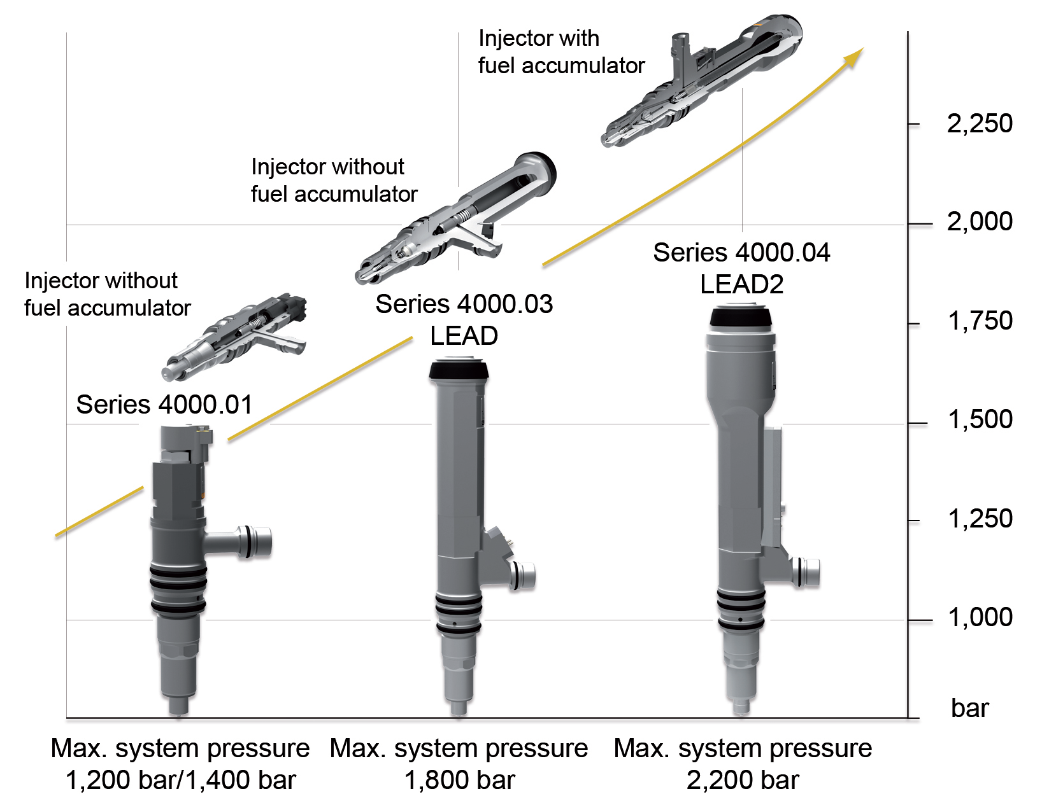
Common Rail Fuel Injection

Slide 23
Miller Cycle

Slide 24
Emission Reduction Technologies
Miller Cycle
without Miller
fuel consumption
with
Miller
70%
100%
NOx
Inlet valve closes earlier
Up to 30% NOx reduction at constant fuel consumption
Improved charge air pressure and intercooling necessary

Slide 25

image
Turbocharging Key Technology in High Performance Engine

Slide 26
Importance of Turbocharging
Single Most critical equipment which has direct effect on
A) Economy
B) Dynamics
C ) Emission Cheracterstics
D) Nullifies the negative effects of external emision measures on engine performance
MTU develops and Produces Turbochargers itself

Slide 27
Turbocharging
Key Technology for high performance engine
More Oxygen
leads to better Combustion
Provides higher power output
Assits
Economy
Dynamic Loading
Emission
Reliable Power Delivery
Functioning at High and Low Altitude
Makes Engine Compact

Slide 28
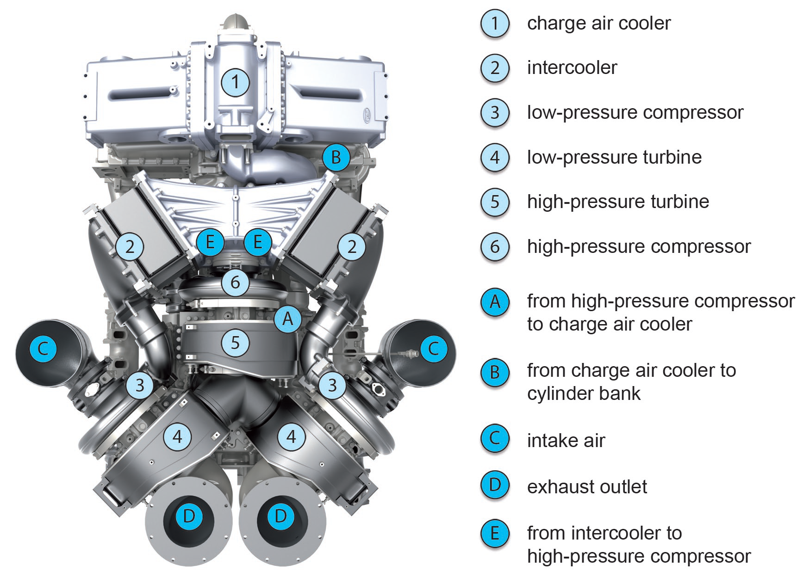
Turbocharging

Slide 29
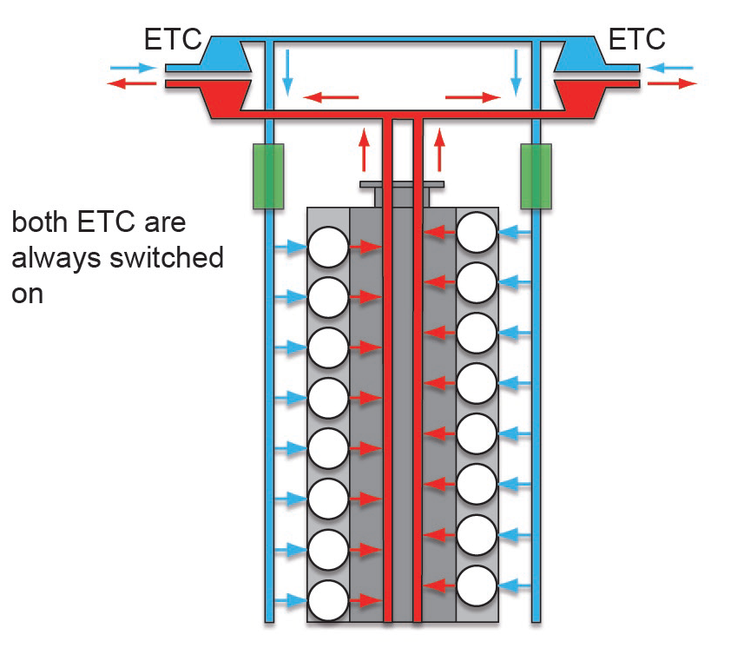
Single Stage Supercharging

Slide 30
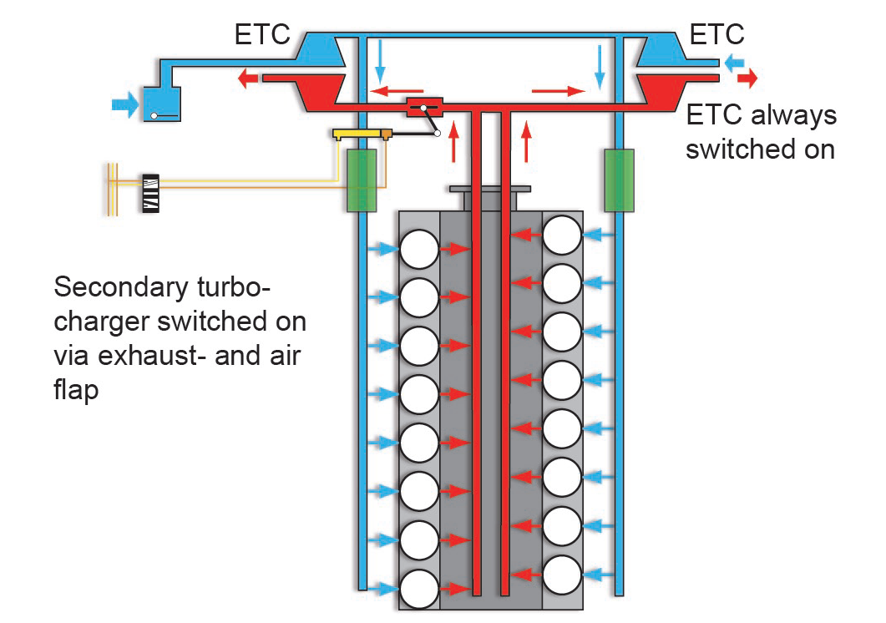
Sequential Single Stage Turbocharging

Slide 31
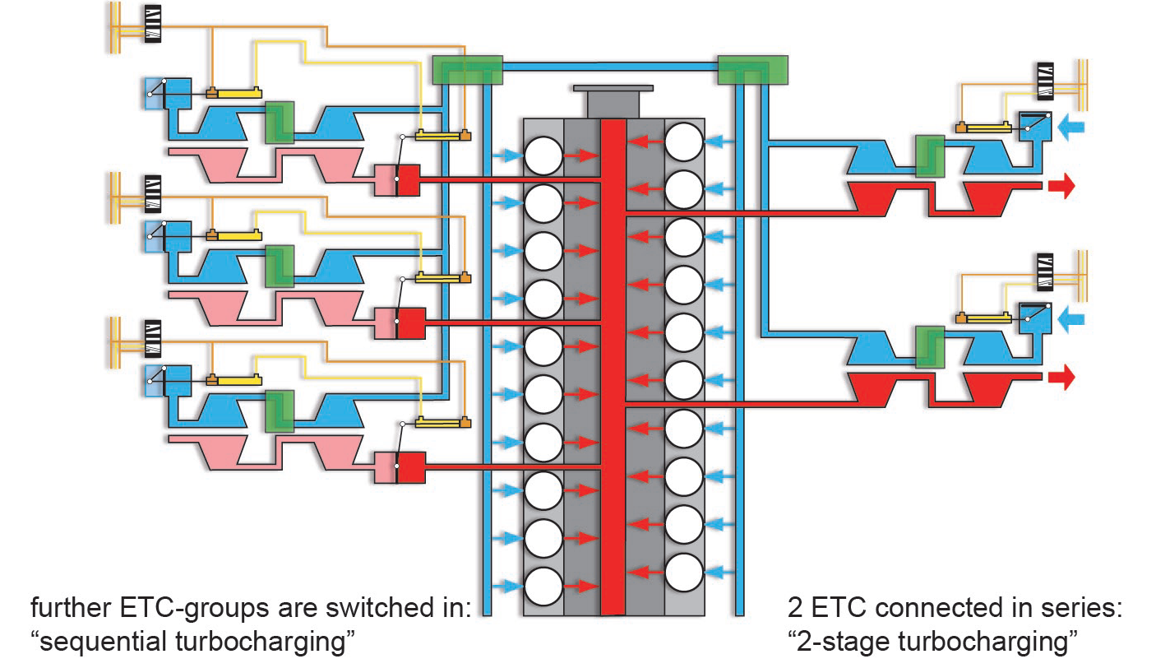
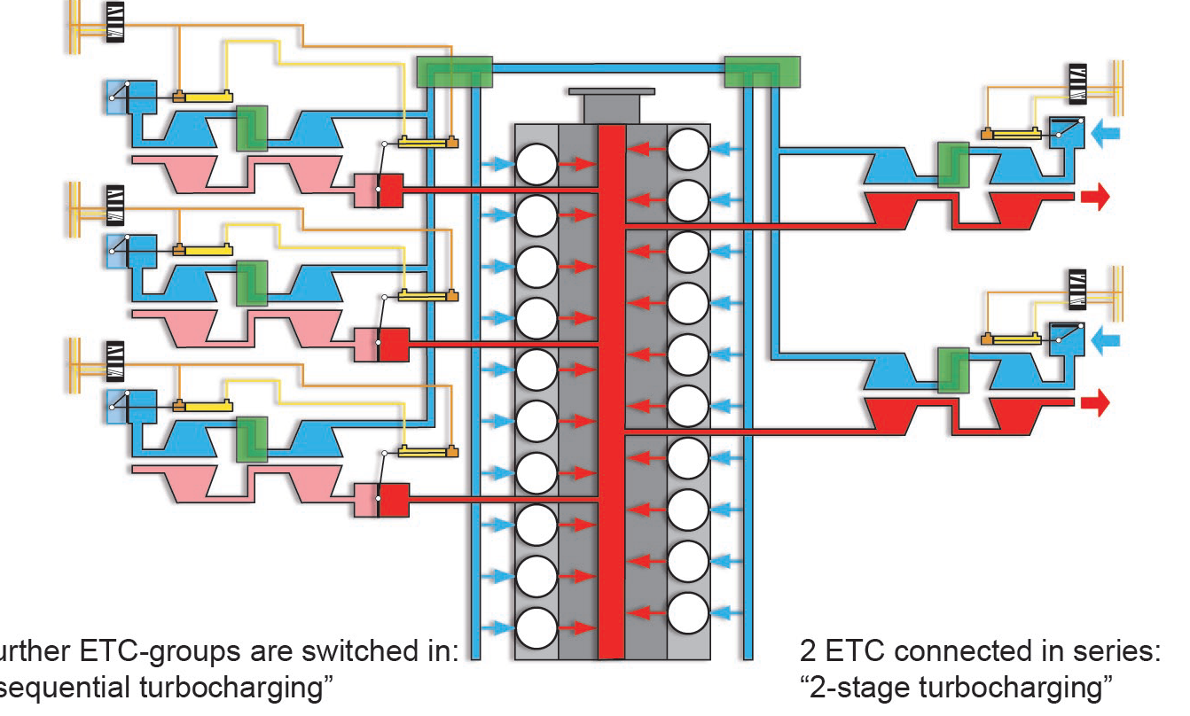
Sequential Two Stage Turbocharging

Slide 32
Regulated Two Stage Turbocharging

Slide 33
Emission Reduction Technologies
Miller Cycle

Slide 34
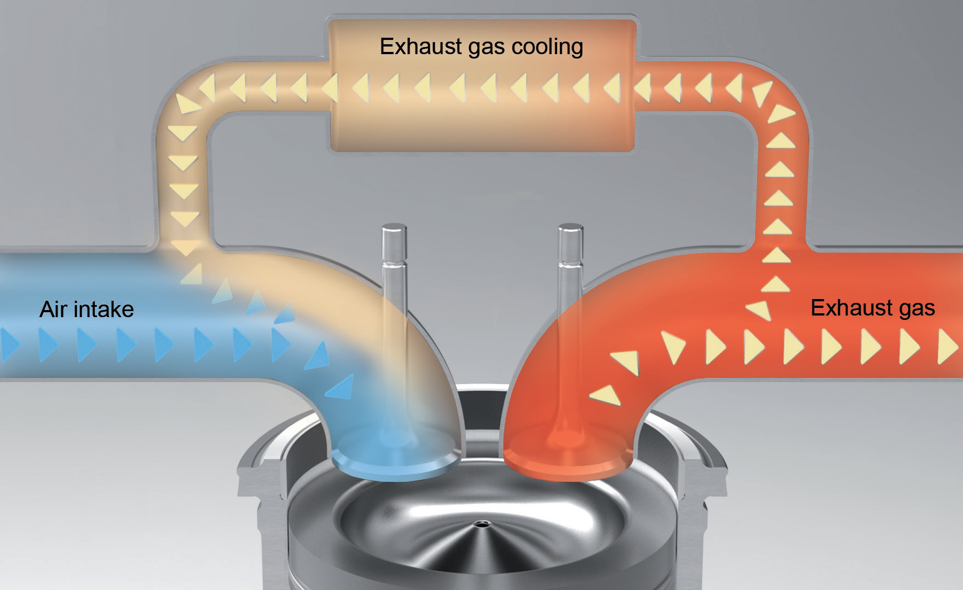
Exhaust Gas Regeneration
EGR

Slide 35
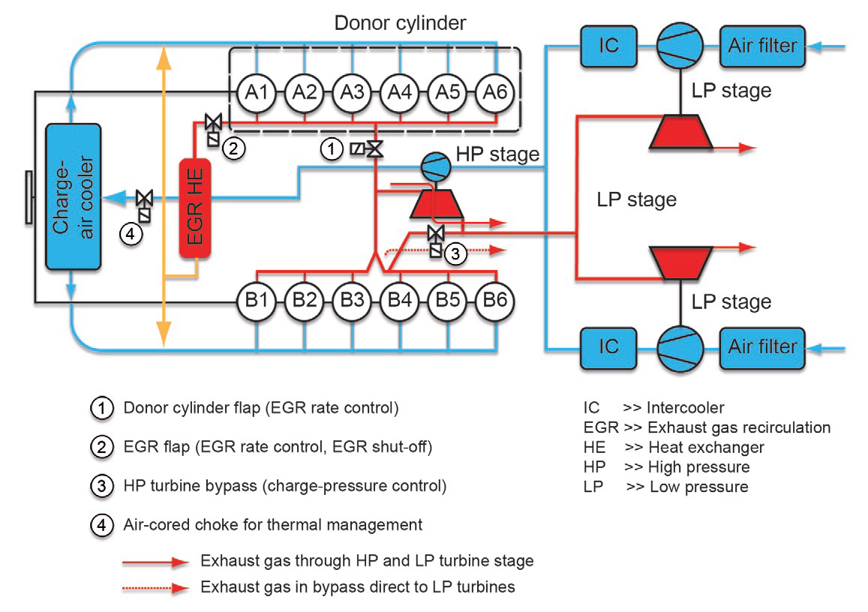
Exhaust Gas Regeneration
EGR

Slide 36
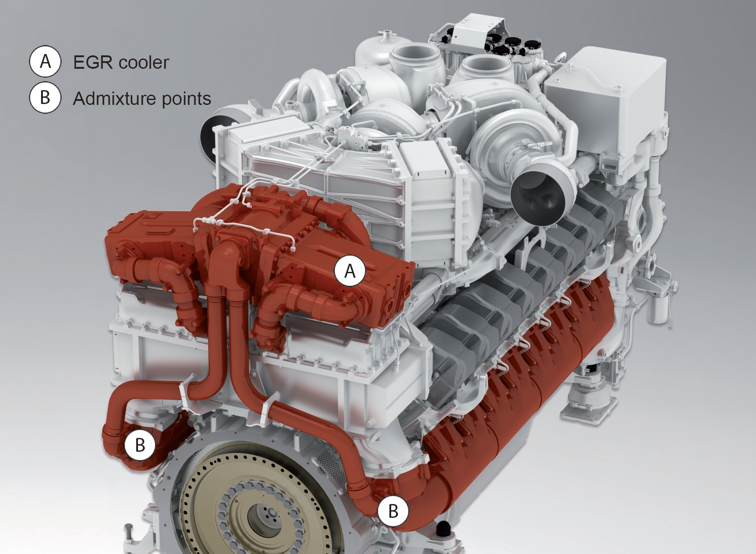
Exhaust Gas Regeneration
EGR

Slide 37
Selective Catalytic Reduction
(SCR)
Miller Cycle

Slide 38
Selective Catalytic Reduction
(SCR)
A chemical reaction converts harmful Nitrogen oxides (NOx) in exhaust gas water (H2O) and Nitrogen (N2)
Combined with internal engine technologies, extremely low nitrogen oxide (upto 90%) emissions can be achieved with lowfuel consumption.
Added benefit is a reductionin particulate emissions of up to 60 percent.Depending on the emission standard applicable — the need for an additional diesel particulate filter (DPF) in the exhaust system can be eliminated
Consists of a 32.5 percent solution of extra pure grade of urea in de-ionized water. A Amount of reducing agent added is between five and seven percent of the fuel consumption.
.

Slide 39
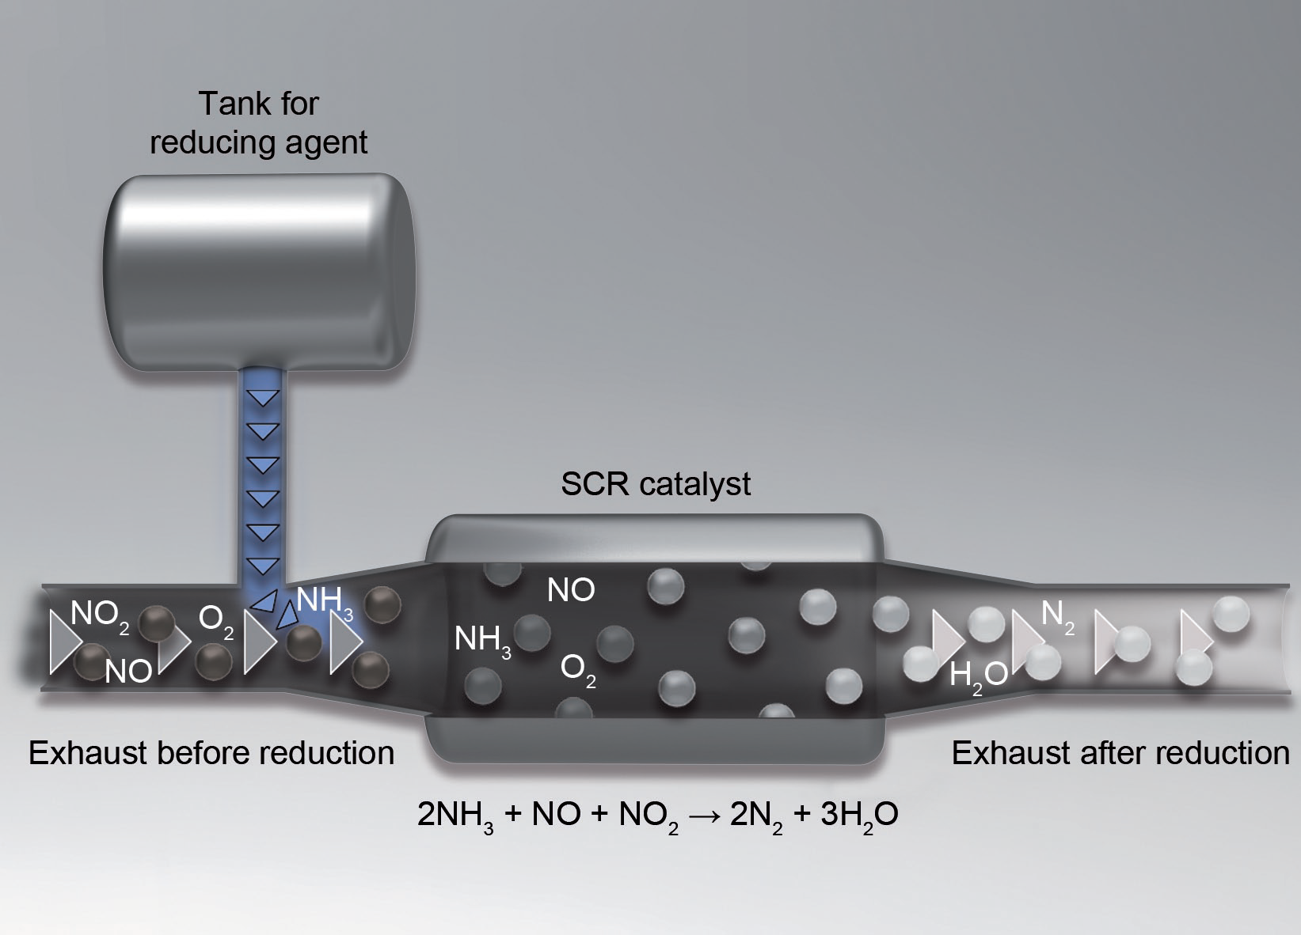
Selective Catalytic Reduction
(SCR)

Slide 40
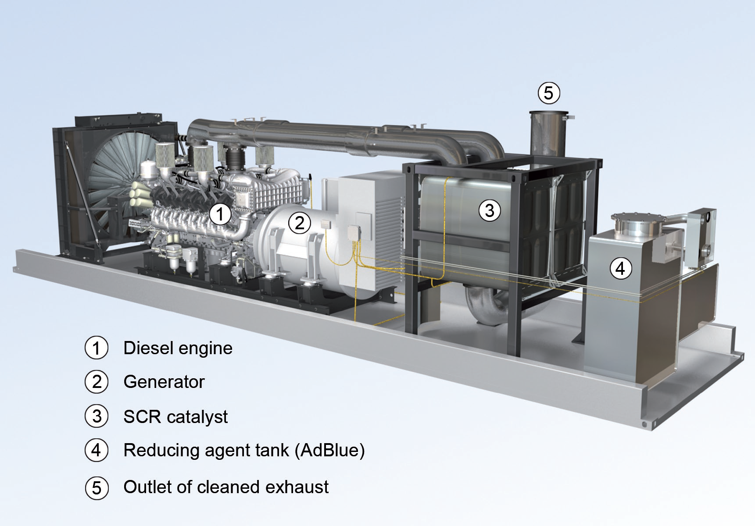
Selective Catalytic Reduction
(SCR)

Slide 41
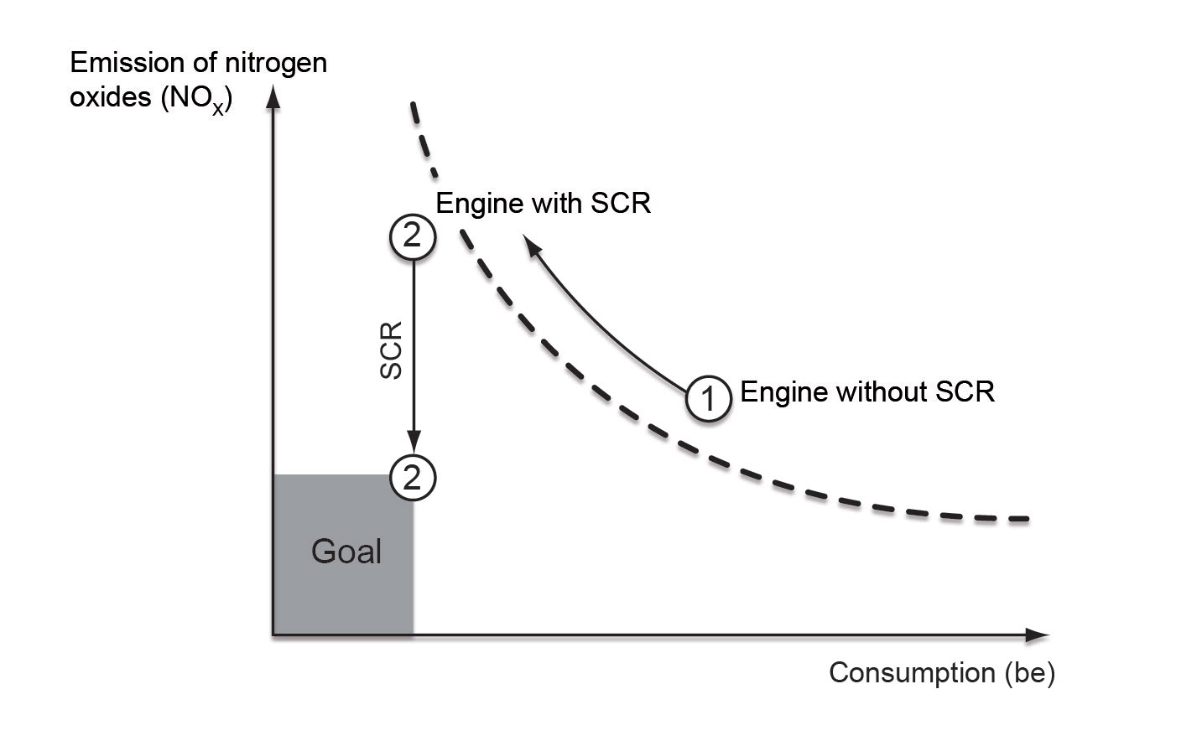
Selective Catalytic Reduction
(SCR)

Slide 42
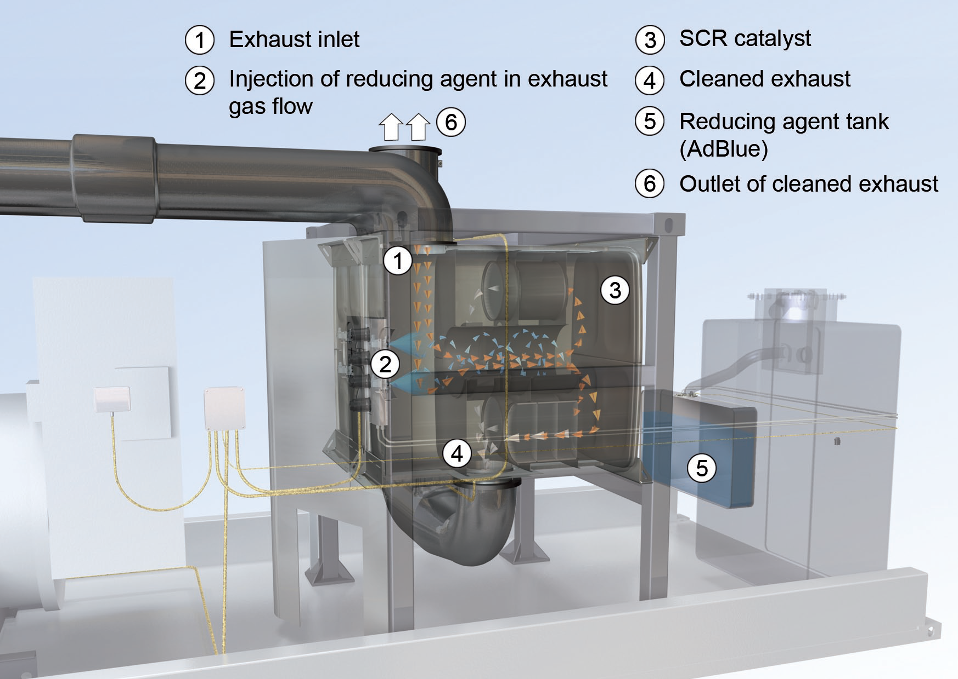
Selective Catalytic Reduction
(SCR)

Slide 43
Emission Reduction Technologies
Miller Cycle

Slide 44
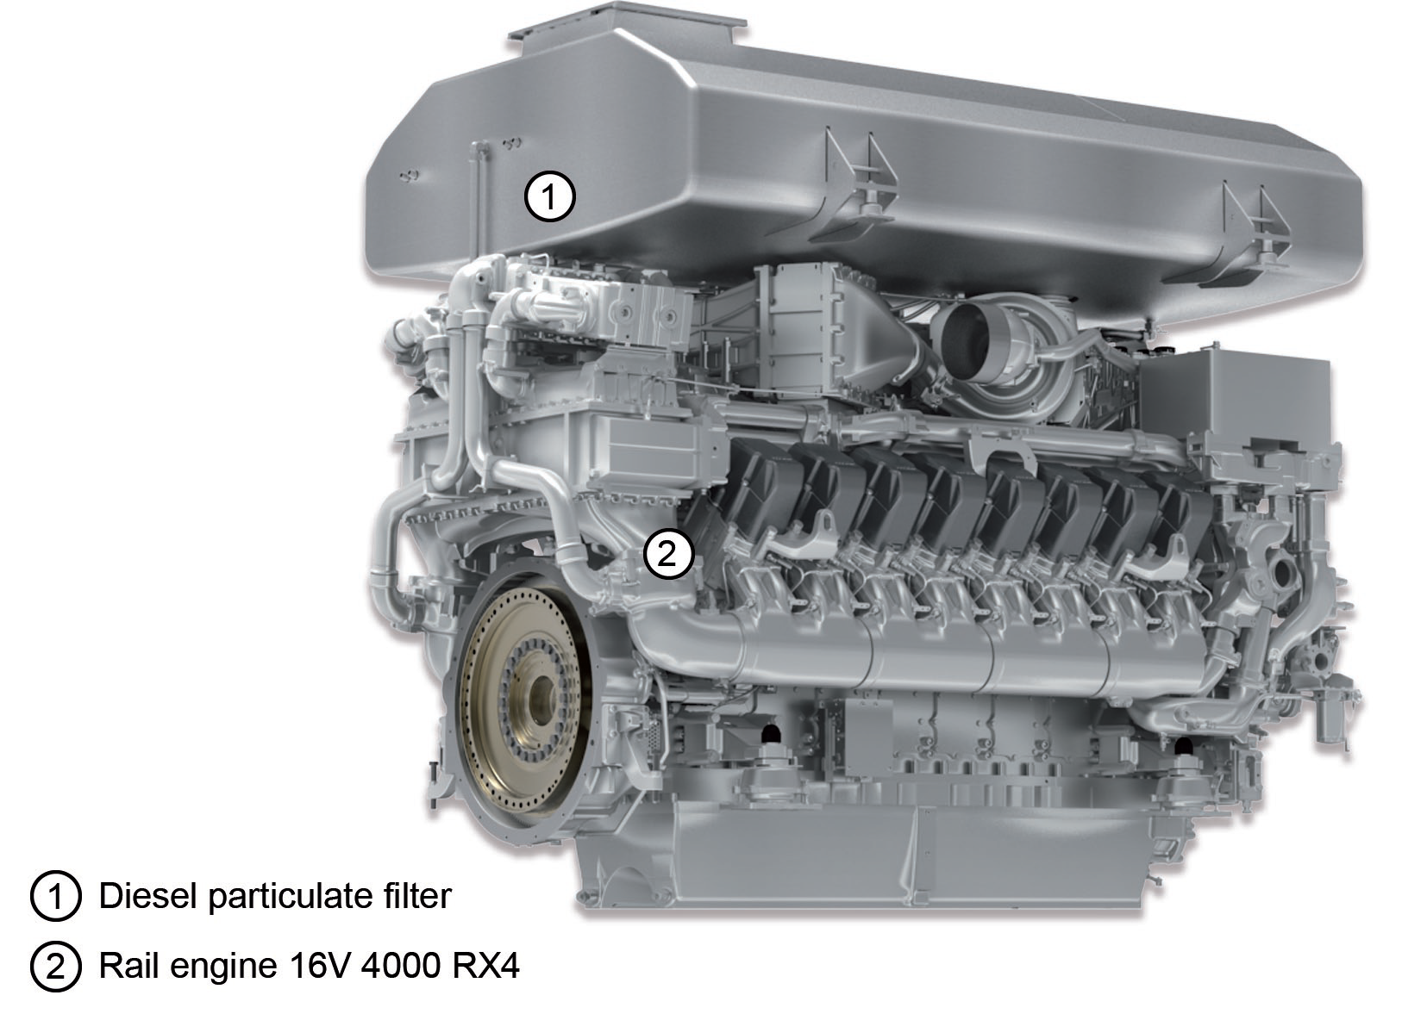
Diesel Particulate Filter

Slide 45
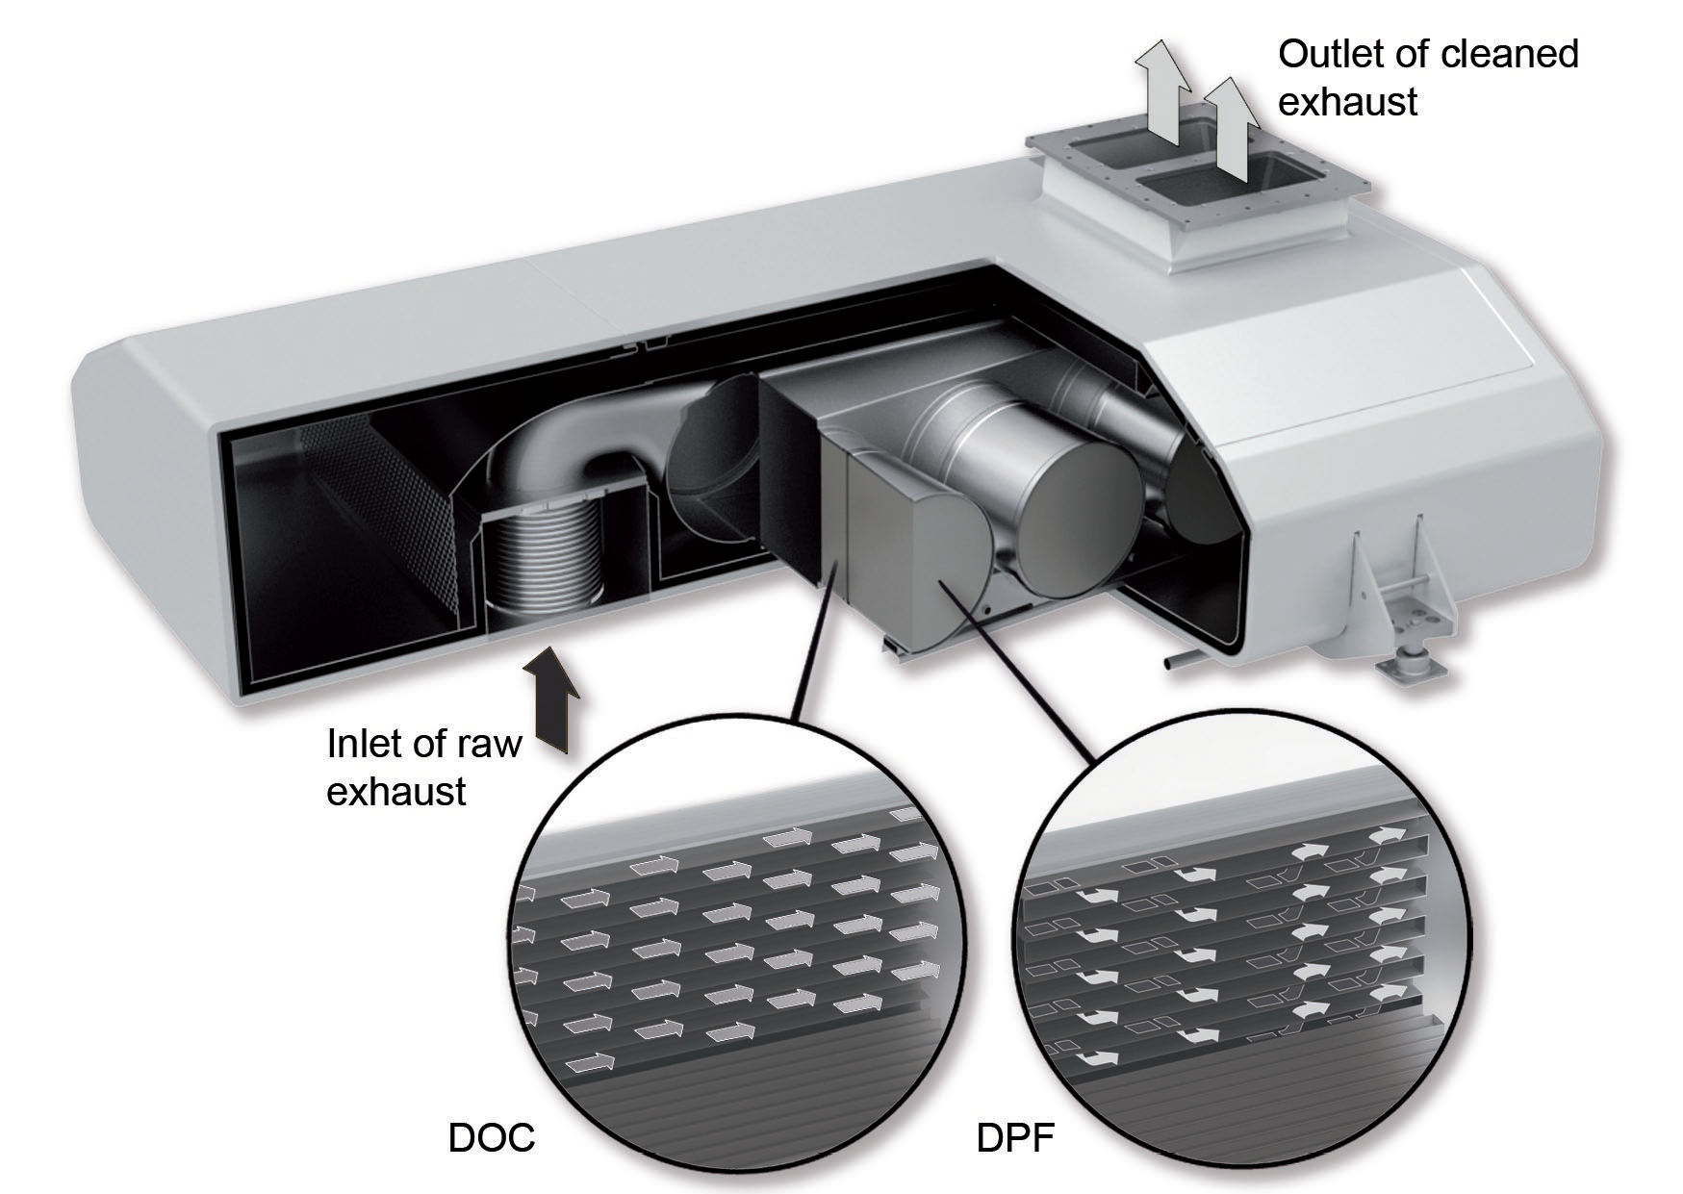
Diesel Particulate Filter

Slide 46
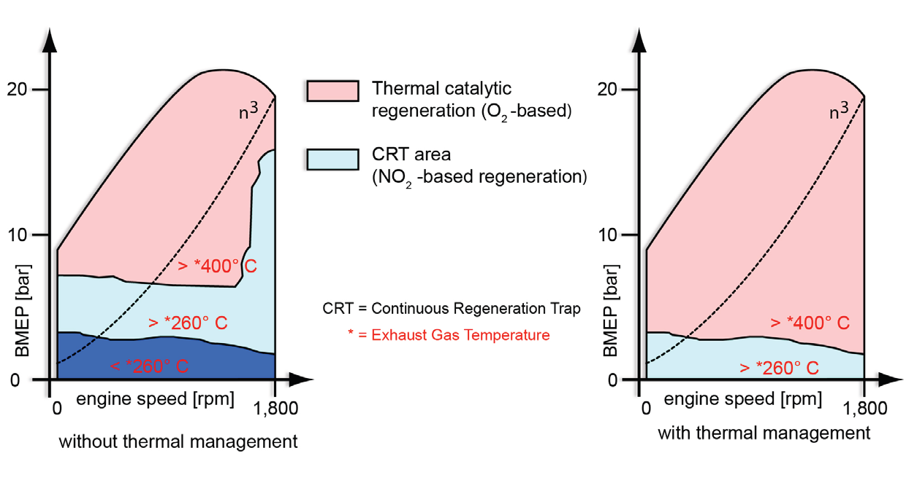
Diesel Particulate Filter

Slide 47
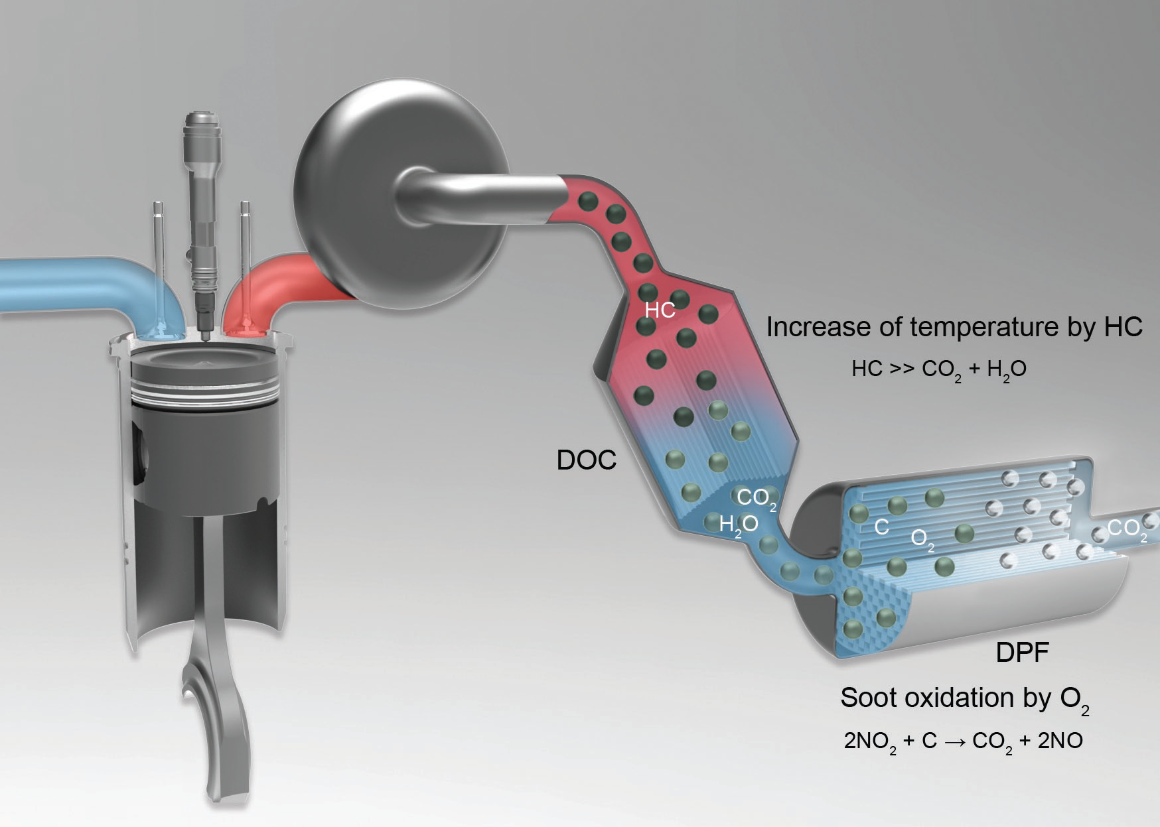
Diesel Particulate Filter

Slide 48
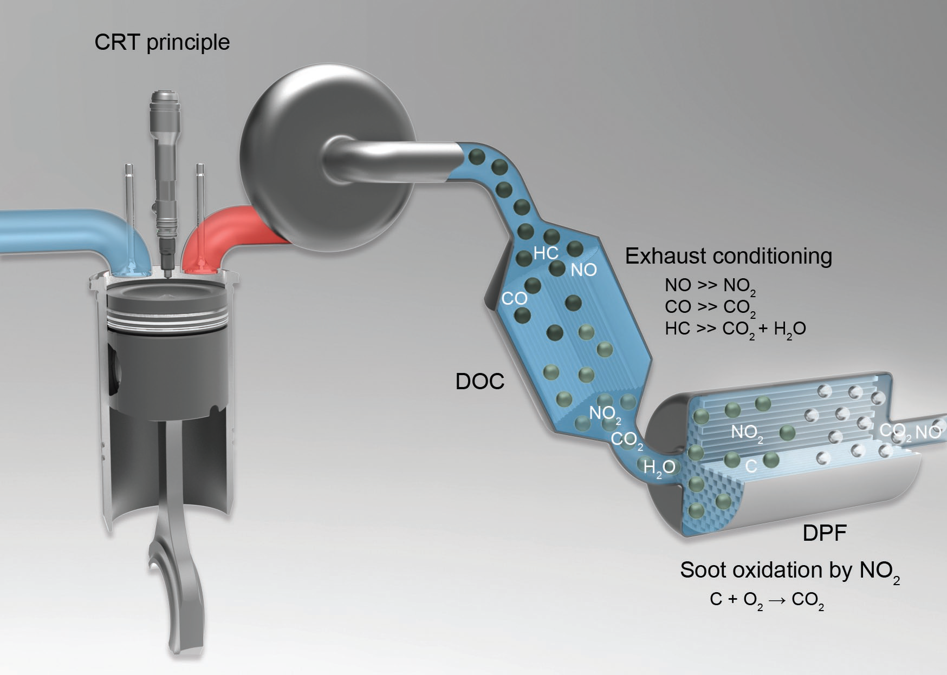
Diesel Particulate Filter

Slide 49
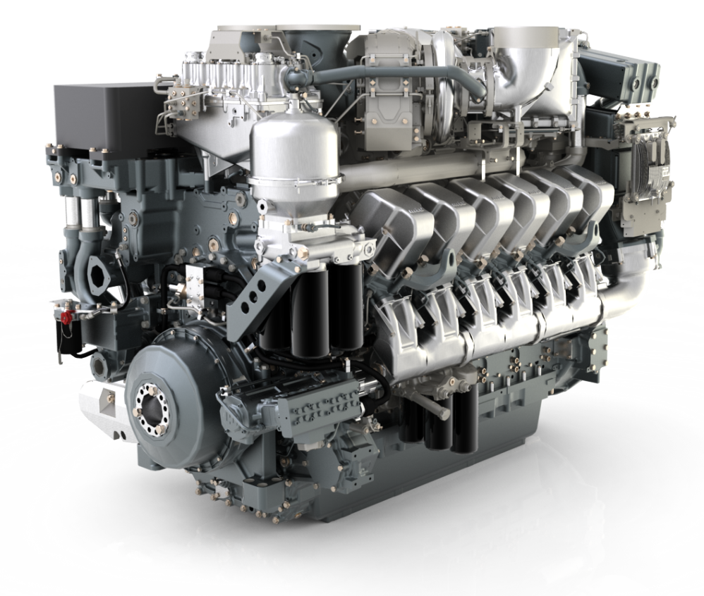
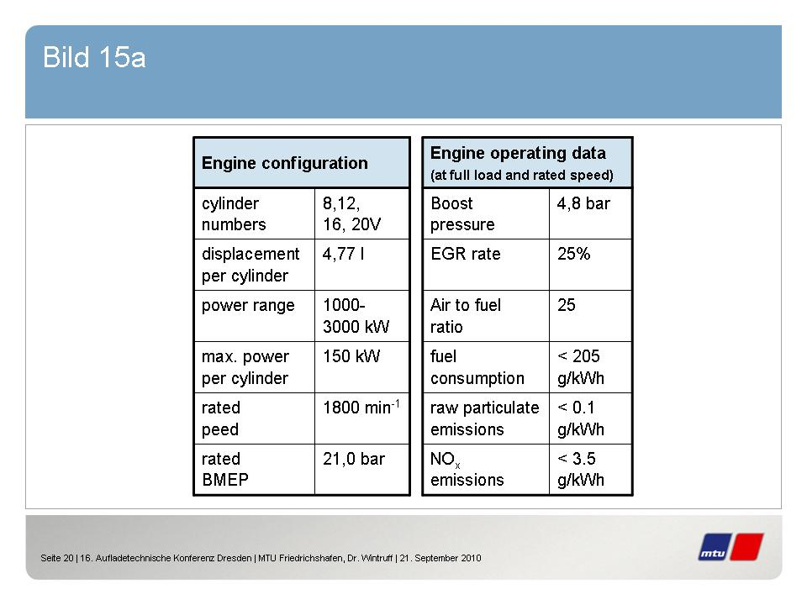
New Series 4000
2-stage Turbocharging
with intercoolers
EGR-Cooler
rated
speed
CR Injection pump
Miller Valve Timing,
New Combustion System

Slide 50
Emission Reduction Technologies
Miller Cycle

Slide 51
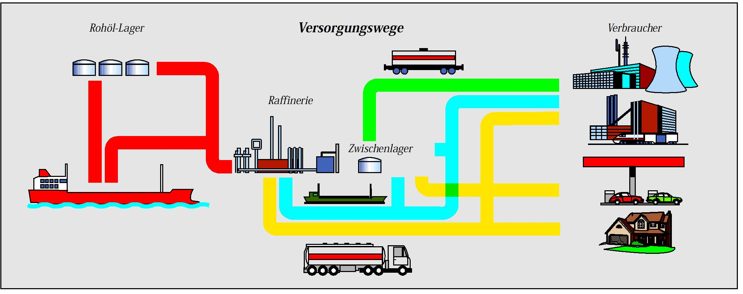

F Diesel Fuel Oils
Dieseloils, e.g. medium distillates like HEL, MDO, MGO, F75 / F76, F54 etc., are industrial manufactured products with specific defaults but enormous differences.
Especially the way from the refinery to the road tanker, bulkcarrier or pipelines in the tank reservoirs and from there through further carriers to the end-user is causing unintended and not calculable changement of the fluids.
Crude-oil
storage
Way of supply
Consumer
Refinery
Temporary storage

Slide 52
Contaminations
The contaminants are:
• solids: particles of rust in different sizes
- dust and sand
- sediments of the products
• water, leading to micro organisms
An effective fuel-treatment means
- suitable filtration with
- simultaneous water-separation!
Notes:
Auf die einzelnen Verschmutzungen, die durch geeignete Filtersysteme entfernt werden können, wollen wir nicht tiefer eingehen.
Wasser und Mikroorganismen sind der Schwerpunkt dieser Information.

Slide 53
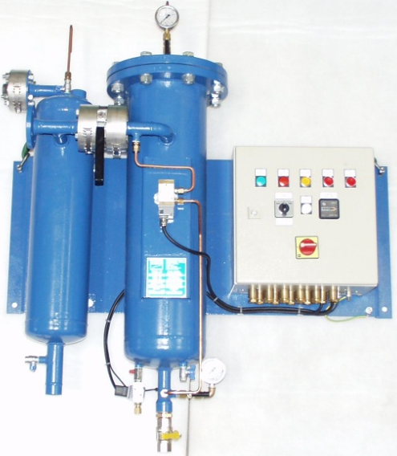
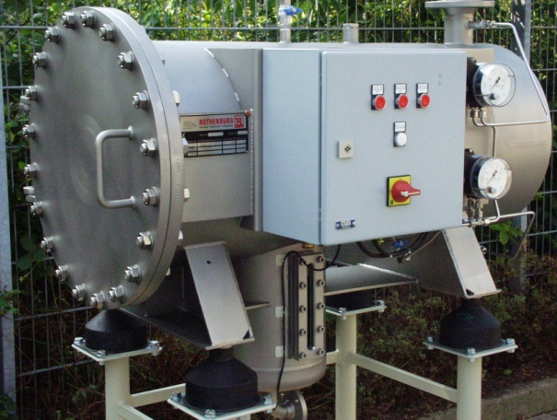
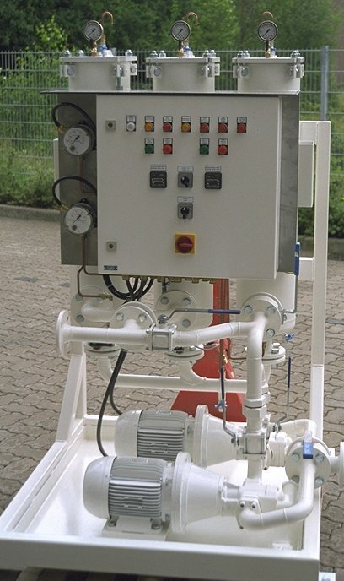
NFV-Filter-Waterseparator
Type FTS
3-stage: • Filter
• Coalescerelement
• Separatormembrane
Type KFWA
1-stage: Filter-Coalescerelement
For main and by-pass flow
Type PTS
2-stage: • Filter-Coalescerelement
• Separatormembrane

Slide 54
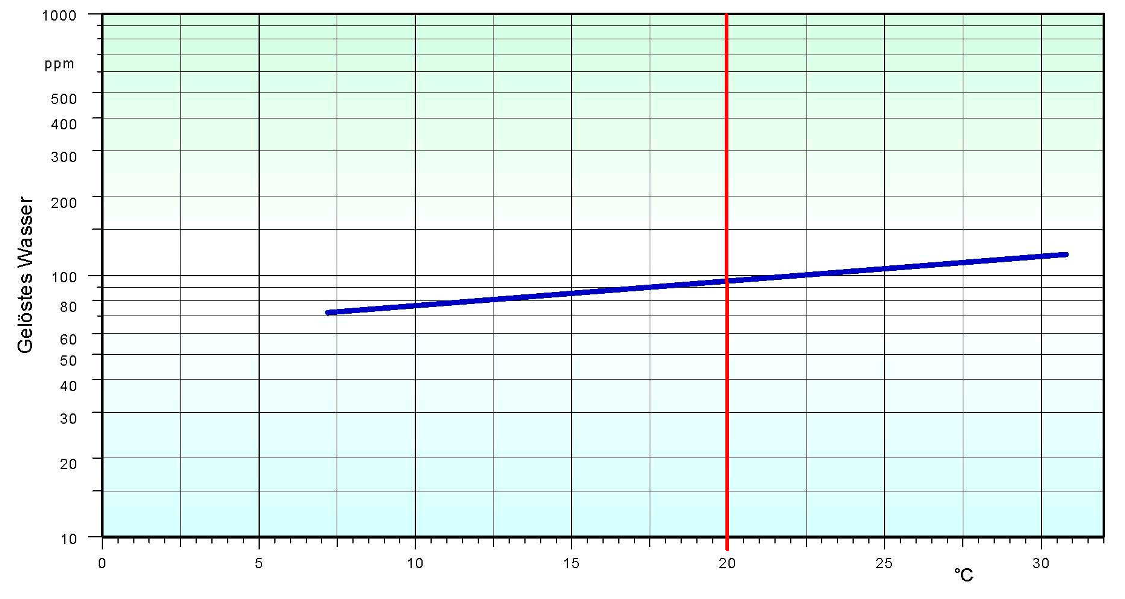
Water/ micro organisms
A temperature-fall from 35°C down to 7,5°C already produces 55 ppm water !!!
Average dilute
Water in NATO diesel fuel oil F-75
55 ppm
Temperatur

Slide 55
Water/ micro organisms
The solution is fuel-treatment with a
NFV-dewatering system
Filling
Fuel
10.000 germs/ml
Water
10.000.000 germs/ml
Discharge
Dewatering by a
NFV-dewatering sytem
like FTS/PTS

Slide 56
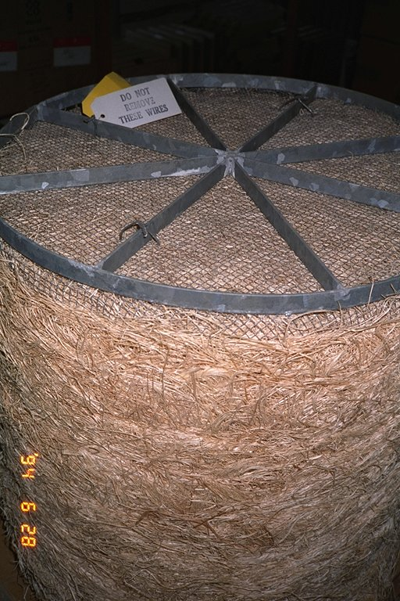
Filter- coalescer- elements
The classic Coalescer initially had been developed for the whole aviation-range, i.e. normally for a clean and low-viscosity product of low density .
The 1st coalescer
1934 the founders of Company FRAM launched the first Coalescer for water-separation out from aviation-fuel.
It was fitted into pipelines and consisted of a mixture of wooden wool and hay.
1960 the last types of this coalescer were sold
Notes:
In den weiteren Ausführungen wird nicht auf Zentrifugen und Systeme eingegangen, die nicht in der Lage sind Restwassergehalte von < 20 ppm freien Wassers zu erreichen.

Slide 57
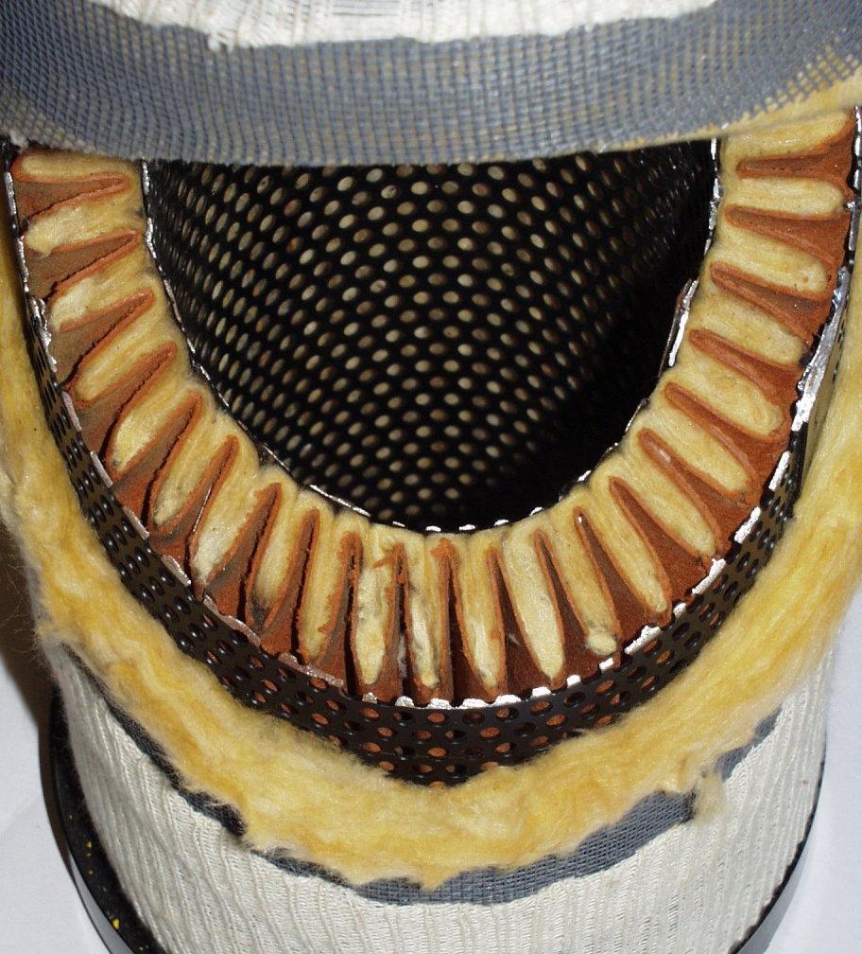
Filter- coalescer- elements
Typical Coalescer
FRAM / Warner Lewis etc.
Inner dome
Fibrebed/fibre glass
Filament
Support dome
Fibrebed / fibre glass
Supporting fabric
Droplet-tube
End cap

Slide 58
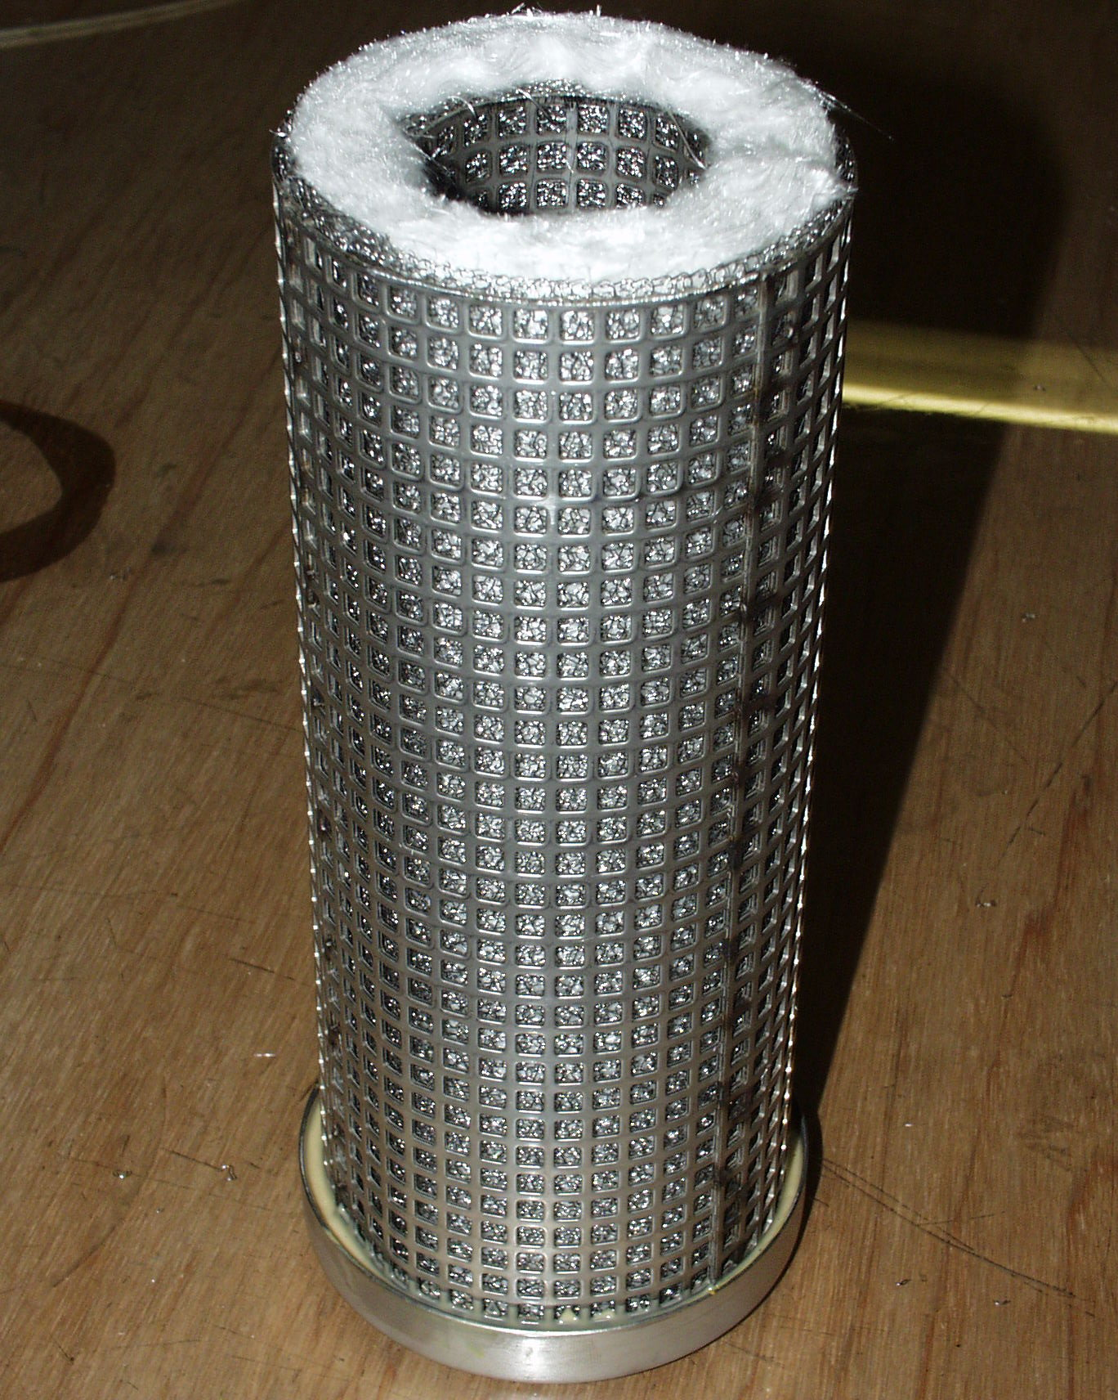
Filter- coalescer- elements
Inner dome
Filament
Fibrebed out from
hydrophile materials
Droplet-pipe,partially above
outer-dome
Outer and support-dome
End cap

Slide 59

Principle of procedure
Typical waterdrop creation in fibrebed of a filter- coalescer- element for water separation

Slide 60

Principle of procedure
Schematic diagram of separation

Slide 61

MTU - Engines and System Engineering

Slide 62



















Rolls-Royce Power Systems
Our Products
Rolls-Royce Power Systems
High-speed engines
Decentralized Energy
Systems
Medium-speed engines
Components
Bergen Engines AS
Complete Drive and Propulsion Systems
up to10,000 kW
Gas Systems
up to 2,530 KW
Diesel Systems
up to 3,400 kW
Diesel and Gas Engines
up to 9,500 kW
Injection
Systems
Gas Turbines up to 50,000 kW

Slide 63


























Diverse Product Portfolio
Complete Drive and Propulsion Systems
Decentralized Energy Systems
Components
Marine
Industrial
Governmental
Oel & Gas
Diesel Systems
Gas Systems
Injection Systems
Yachts
Commercial
vessels
Rail
Agric. equipment
Constr. Equipment
industrial Applic.
Mining
Military vehicles
Vessels for public
authorities
Submarine
Onshore
Offshore
Mechanical drives
Emergency standby
systems
Base load plants
Peak load plants
Base load plants
Peak load plants
High-speed engines
Medium-speed
engines
Bergen Engines AS
Bergen Engines AS

Slide 64



MTU ValueCare
A full line of Products and Services to help you keep going.
ValueService
Extensive global service and support
to help you maximize performance
and uptime.
• Customized Care
• Extended Coverage
• Extended Propulsion Coverage
• Annual Check
• Maintenance, Repair and Overhaul
• Remote Services
• Technical Documentation
• Training
• Service Units
• Workshop and Test Bench Solutions
ValueSpares
Genuine spare parts and top-quality consumables designed specifically
for MTU engines and systems.
• Genuine Parts
• Consumables (Filters, Oil, Coolant)
• Detroit Diesel 2-Cycle Parts
ValueExchange
Remanufactured engines, systems and service parts, engineered with the same high-quality standards as new products.
• Remanufactured Parts
• Remanufactured Engines, Systems
and PowerPacks®
Notes:
MTU ValueCare includes three product lines. The first one is ValueService: extensive global service and support to help you maximize performance and uptime.
The second is ValueSpares: genuine spare parts and top quality consumables designed specifically for MTU engines and systems. And the third product line is ValueExchange: Genuine remanufactured engines, systems and service parts, engineered with the same high standards as new products.
Customized Care: Maintenance and repair contracts

Slide 65
Our Vision
We are the preferred partner
for sustainable solutions
in power, propulsion and services.
“Your Powerful Partner”

Slide 66
Our Roots
A Firm Foundation for the Future
Foundation of
Luftfahrzeug-Motorenbau GmbH
Renamed as
Maybach-Motorenbau GmbH
Renamed as
Motoren- und Turbinen-Union
Friedrichshafen GmbH
Renamed as
Motorenbau GmbH
Relocation to Friedrichshafen
Merger to form
Maybach Mercedes-Benz
Motorenbau GmbH
Renamed as
MTU Friedrichshafen GmbH
1909
1912
1918
1933
1966
1969
2001
2005
2006
2011
2013
2014
Foundation of L´Orange
Sale by DaimlerChrysler to EQT
Foundation of Tognum
Rolls-Royce
and Daimler
acquire majority shareholding
in Tognum
Bergen Engines becomes
a Tognum subsidiary
Tognum renamed as
Rolls-Royce Power Systems

Slide 67











Important Pioneers in MTU´s History
1909
Gottlieb Daimler
Wilhelm Maybach
Karl Maybach
Graf Ferdinand von Zeppelin
1918
On-Highway-
Motoren
Off-Highway-
Motoren
1966
Rudolf Diesel
1966
1969
1969
2006
today
67
Notes:
67
Founded by German engineering pioneers
MTU’s technology has same roots as Daimler-Benz
MTU today still in tradition of innovation and technological leadership

Slide 68


MTU stands for
Power. Passion. Partnership.
Power: at the forefront of technological progress
With its top-of-the-range, high-performance drive and propulsion solutions, MTU stands for technological leadership.
MTU supplies cutting-edge technologies such as fuel injection, exhaust turbocharging, automation and exhaust aftertreatment from a single source and conducts analytics in-house to guarantee the highest level
of expertise for customer-specific systems solutions.
Notes:
68
Creation of MTU through merger of Daimler and MAN business
Split of MTU-F and MTU-M in 1969 (IPO of MTU-M in 2005)
Formation of DC Off-Highway in 2002
DaimlerChrysler: 100% ownership of MTU in 2005

Slide 69


MTU stands for
Power. Passion. Partnership.
562 MTU patents/patents pending (of which 214 are inventions)
Milestone developments:
- "Fliegender Hamburger" high-speed rail car
- MTU-built turbocharging systems for large diesel engines
- MTU-built automation systems
- First large diesel engine with Common Rail injection
"Fliegender Hamburger" rail car 1933
Notes:
1039 Tognum AG Patent-/Patentanmeldungen (davon 369 Erfindungen/Familien)

Slide 70





MTU
Key Technologies for Diesel Engines
Fuel injection
Electronics
Analytics
Exhaust Turbocharging
Exhaust Emission Minimizing
Injection pressure
Injection process
Combustion process
Efficiency
Pressure ratio
Turbocharger map
Engine management
Map control
System Control
Exhaust gas re-circulation
Miller Cycle
Aftertreatment
Strength
Bearing Load
LCF-behavior
Fuel consumption
Exhaust emission
Noise Emission
Fuel consumption
Exhaust emission
Power-to-weight-to
size ratio
Fuel Consumption
Exhaust Emission
Transient behavior
Lowest Emission with optimized LCC
Fuel consumption
Durability
Weight
Acoustics
Notes:
MTU’s areas of major strengths are in key areas for diesel engine technology:
Fuel injection (eg. 4000 series as first common rail engine of its class), turbocharging, electronics and exhaust aftertreatment key technologies for combustion process in diesel engines
Exhaust aftertreatment with increasing importance in light of new emission requirements
Analytics is fundamental for engine properties and durability
MTU is a technology and innovation leader commanding the key technologies of diesel engines

Slide 71


MTU
Product Program
LM 2500/LM 6000
Gasturbine
GE
8000
956/1163
4000
396
2000
S60
PP1800
1600
1500
1300
Lower Power Range
1100
1000
900/460/500
PDU
900/460/500/S60
106/199/
870/880/890
Power [kW]
0
1.000
2.000
3.000
4.000
5.000
6.000
7.000
8.000
9.000
10.000
22.500
45.000

Slide 72
Customized Solutions
Approach
Conception
Understand and analyze customers objectives and requirements
Develop, compare and offer several suitable solutions
Select approach together with customer
Define scope of supply and services, derive technical & contract spec
System
Engineering
Establish project team and project management
Develop integrated solution based on proven components and software
Verification of system via analysis, simulation and testing
Realization
Realization and construction of the system
Interface testing to OEM equipment e.g. by simulation
Factory acceptance testing
Coordination of delivery, documentation, training
Setting to work and prototype testing
Usage
Release for operation
Global Service & Expert Support for system scope true life-cycle
Remote Services

Slide 73






Customized Solutions
Examples
PowerPack
for Rail Cars
Propulsion Systems
for Ships
Power Modules
for Excavators & Trucks

Slide 74
Customized Solutions
Benefits for our Customers
Tailor made for the specific task of the customer
Optimized system performance, reliability and life-cycle cost
One partner for a system – responsible for performance, time and cost
Limited no. of interfaces, minimized risk
Worldwide service for full system, thru the life cycle

Slide 75













MTU
Marine Applications
Commercial Vessels
Military & Governmental Vessels
und Behördenschiffe
Merchant
Offshore
Yachts
Tug- and Pushboats
Passenger Ships,
Ferries,
Inland Cargo Vessels
Offshore Supply Vessels,
Crew Boats, Platforms
Series Yachts,
Mega Yachts,
Displacement Yachts
Patrol Crafts, Frigates,
Submarines,
Special-Purpose Vessels
Notes:
Marine is the most important Sales Center in terms of revenues
Main applications for diesel engines are commercial ships, yachts and naval/governmental ships
DC OH has a leading position in fast ships market
Highly recognized products for premium applications like luxury yachts and naval ships

Slide 76








MTU
Marine Components and Systems
Components
Standardized Systems
Project Systems
Diesel propulsion engines
Diesel engines including
engine monitoring and
control systems
Gearbox
Standard accessories
Entire propulsion system
including engines, gas
turbines, gearboxes,
shafts and propellers as
well as monitoring and
automation systems.

Slide 77









MTU
Industrial Applications - Rail
Components and Systems
for Diesel Railcars
Components and Systems
for Locomotives
PowerPacks® for diesel railcars and multipurpose
vehicles
Complete drive plants from a single source
Diesel electric, diesel hydraulic or diesel mechanical
Diesel engines with EU Stage IIIa or Stage 3b certification.
Diesel engines for mainline, multipurpose,
marshalling and working locomotives
Diesel engines for diesel hydraulic and power
modules for diesel electric locomotives
Diesel engines, generators and other accessories
for locomotives scheduled for refurbishment
(diesel electric and diesel hydraulic)
Diesel engines with EU Stage IIIA certification.
Notes:
Main applications within Sales Center Industrial are:
Rail
C&I, Agriculture
Mining
Selected examples (eg. Liebherr truck in Chilean copper mine)

Slide 78








MTU
Industrial Applications - Agriculture
Agriculture
Notes:
Marine is the most important Sales Center in terms of revenues
Main applications for diesel engines are commercial ships, yachts and naval/governmental ships
DC OH has a leading position in fast ships market
Highly recognized products for premium applications like luxury yachts and naval ships

Slide 79








MTU
Industrial Applications – C&I
C&I
Notes:
Marine is the most important Sales Center in terms of revenues
Main applications for diesel engines are commercial ships, yachts and naval/governmental ships
DC OH has a leading position in fast ships market
Highly recognized products for premium applications like luxury yachts and naval ships

Slide 80







MTU
C&I and Agriculture: Components and Systems
Components
Standardized Systems
Diesel drive engines
For future exhaust stages Tier4i/EU3b:
Engines and appropriate exhaust
aftertreatment systems
Notes:
Main applications within Sales Center Industrial are:
Rail
C&I, Agriculture
Mining
Selected examples (eg. Liebherr truck in Chilean copper mine)

Slide 81







MTU successful in a wide range of Applications
Mining
Surface Mining
Underground Mining
Diesel Engines & Systems

Slide 82








MTU
Defense Applications
Light Armor
Medium Armor
Heavy Armor
Military Trucks
Notes:
Well positioned in defense niche markets with market leadership in heavy armor [more #1 positions?]
Reputation of technological lead within defense
Key applications and examples: Heavy armor vehicles (eg. Leopard tank), Light armor vehicles (eg. Puma personnel carrier)

Slide 83




MTU
Defense Components and Systems
Components
Standardized Systems
Project Systems
Diesel engines, adapted for
defense applications
Complete drive systems
including engines, gearbox,
cooling and air filtration
system, monitoring and
control system.
Special development of
engines and power
transmission components
for customer-specific drive
units.

Slide 84





MTU
Oil & Gas Applications
Off-Shore
On-Shore
Drilling Platforms, FPSO
(Floating Production, Storage and Offloading)
Drilling/Production
Well Servicing
Units for:
Emergency power generation
Fire extinguisher pumps
Engines and units for developing oil and gas deposits
Engines and units for well stimulation.

Slide 85




MTU
Oil & Gas Applications
Components
Standardized Systems
Project Systems
Diesel engines for emergency
gensets and fire extinguishers
Diesel engines for mechanical
drives
Diesel engines with ATEX
certification.
Frac packs
El. drilling packages
Aux. gensets for drill rigs.
Complex systems for the
Oil & Gas industry.
Notes:
Single diesel engines, gensets and complete systems for power generation
Continuous and emergency power supply
[Explain: What is a genset?]

Slide 86
MTU stands for
Power. Passion. Partnership.
Passion: a pioneering spirit
MTU focuses on the customer's wishes and requirements. Precision and professionalism mark its goal-oriented approach
to work.
MTU has key engine components developed by its own engineers and manufactured in-house to safeguard the high quality standard it has pledged.
Notes:
86
Creation of MTU through merger of Daimler and MAN business
Split of MTU-F and MTU-M in 1969 (IPO of MTU-M in 2005)
Formation of DC Off-Highway in 2002
DaimlerChrysler: 100% ownership of MTU in 2005

Slide 87









Production Sites
Production sites
Country
Employees
Manufacturing and assembly of diesel
and gas engines and complete drive
and propulsion systems
Friedrichshafen
2 Plants
5,672
Assembly of diesel engines
Überlingen
77
Magdeburg
246
REMAN-Components
Assembly of motors and -systems
Augsburg
390
Assembly of gas generator sets
Ruhstorf
175
Assembly of diesel generator sets
Status: 2013/12/31
Notes:
87
Aktuelle MA-Zahlen noch in Abfrage bei PPGB, Frau Volkert

Slide 88







Production Sites
Production sites
Country
Employees
Aiken
245
Assembly of diesel engines
Mankato
347
Assembly of diesel engines
Suzhou
145
Assembly of series 2000 diesel engines
of generator sets
155
Manufacturing of Series 4000 cylinder
liners, remanufactured cylinder heads,
Major engine overhauls
Türkei
Notes:
88
Aktuelle MA-Zahlen noch in Abfrage bei PPGB, Frau Volkert

Slide 89
MTU stands for
Power. Passion. Partnership.
Partnership: a spirit of cooperation
With its foresight and cooperativeness, MTU is a leader that can be counted upon in the partnerships it forges.
With over 1,200 sales und service centers worldwide, MTU guarantees expert product support throughout the entire life cycle – anytime and anywhere.
As a partner in the MTU_ValueCare program, MTU provides its customers with all-round support and promotes the long service life of its high-grade products.
Notes:
89
Creation of MTU through merger of Daimler and MAN business
Split of MTU-F and MTU-M in 1969 (IPO of MTU-M in 2005)
Formation of DC Off-Highway in 2002
DaimlerChrysler: 100% ownership of MTU in 2005

Slide 90

Global Presence

Slide 91
Power. Passion. Partnership.
With its top-of-the-range, high-performance drive and propulsion solutions, MTU stands for technological leadership.
With its foresight and cooperativeness, MTU is a leader that can
be counted upon in the partnerships it forges.
MTU focuses on the customer's wishes and requirements.
Precision and professionalism mark its goal-oriented approach
to work.
Notes:
91
Creation of MTU through merger of Daimler and MAN business
Split of MTU-F and MTU-M in 1969 (IPO of MTU-M in 2005)
Formation of DC Off-Highway in 2002
DaimlerChrysler: 100% ownership of MTU in 2005

Slide 92
Thank you for your attention

