Slide 1
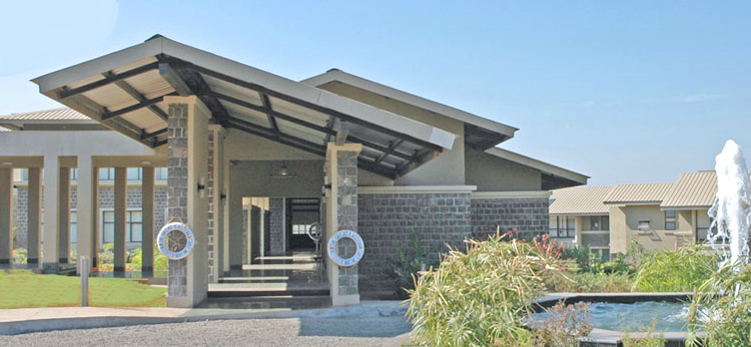

WORLD TECHNICAL VISION 2040
THE GREAT EASTERN INSTITUTE OF MARITIME STUDIES
THINK WILD
BY:-
Cdt. SUDHAKAR NAGENDRA SINGH
Cdt. VIPUL SHARMA
Cdt. VIVEK SRIRAJ TADALA 07.03.2014

Slide 2

INTRODUCTION
VISION 2040
1. FUTURE ENERGY
2. IMPROVED HULL
DESIGN
3. ENVIRONMENT
4. HUMAN FACTORS
5. FINANCIAL
SOLUTIONS

Slide 3

FUTURE ENERGY RESOURCES
1. Electric Propulsion.
2. Gas-Fuelled Ships.
3. Fuels Based On Renewable Energy.

Slide 4
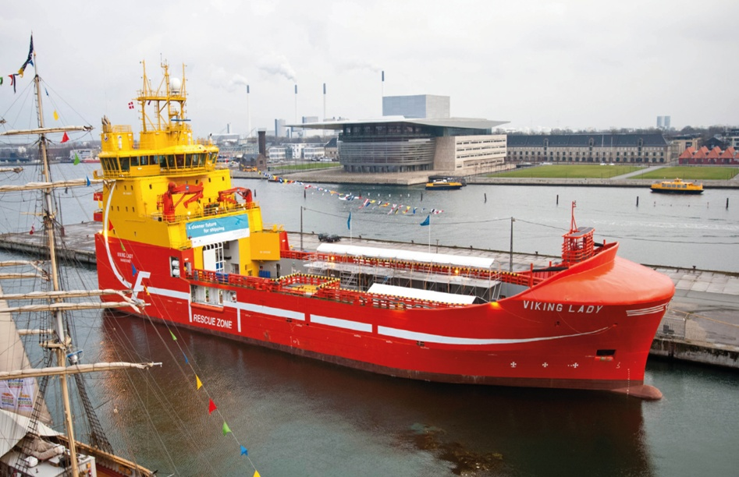
ELECTRIC PROPULSION
Hydrogen Fuel Cells
The MCFC power unit cell was the first fuel cell to be installed on a merchant ship named Viking Lady.

Slide 5
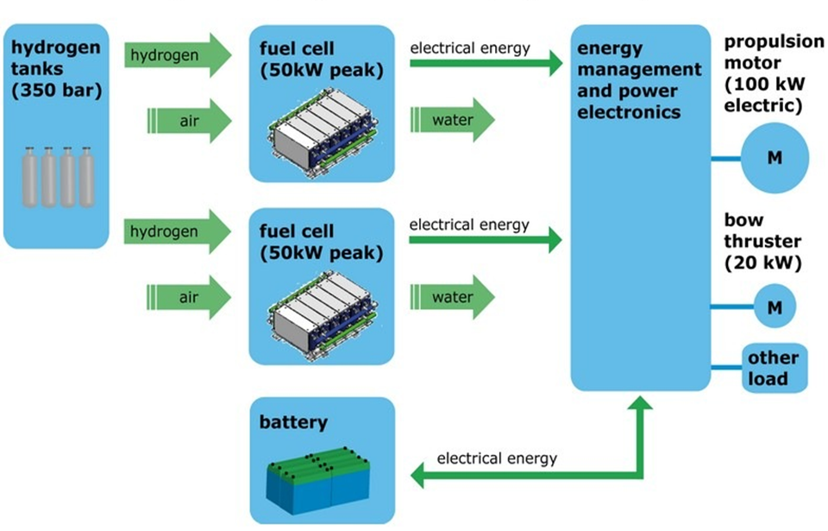
PRINCIPLE OF HYBRID FUEL CELL PROPULSION

Slide 6
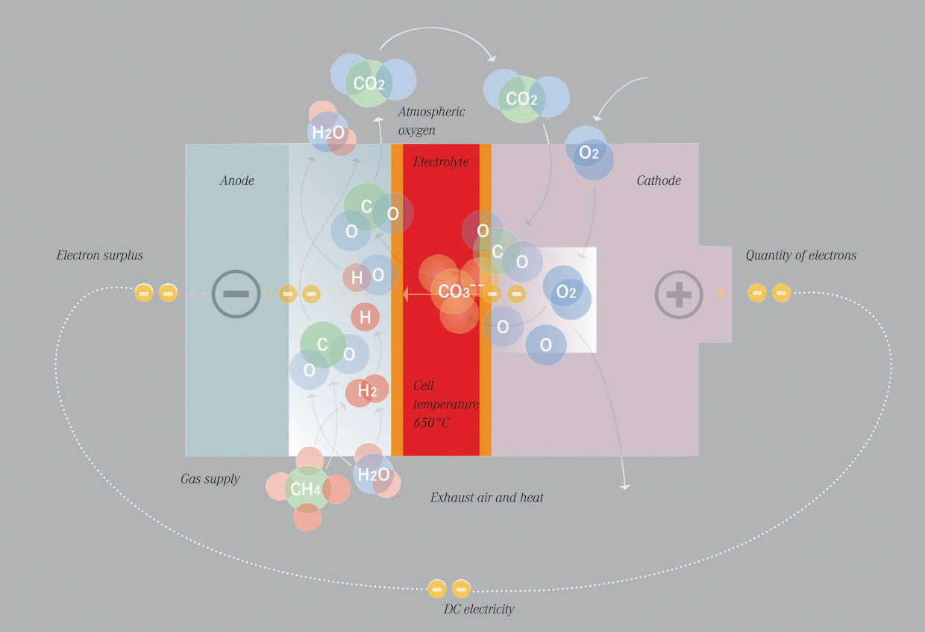
CHEMICAL PROCESSES INSIDE AN MCFC

Slide 7
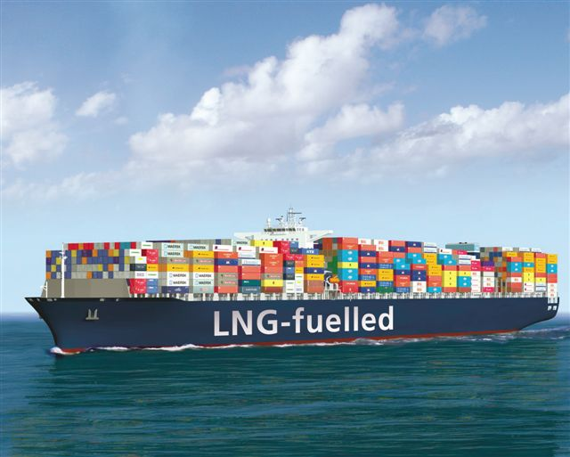
GAS-FUELED SHIPS – LNG
ADVANTAGES:-
LNG is a potential solution.
Reduction in Sox and Nox.
Reduction in CO2 upto 20%.
Present Sulphur content in marine fuel 1%.
By 2015, marine fuels should contain at most 0.1 percent Sulphur.

Slide 8
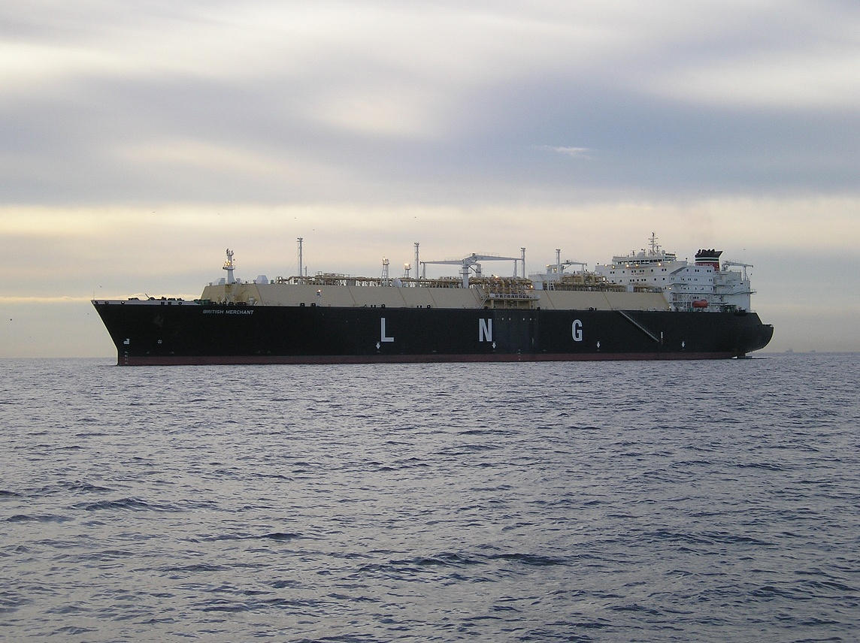
CONCERNS ABOUT LNG
Vessels using LNG as a fuel is low, but increasing.
It require significant investments to increase the percentage of ports.
It costs a lot of money to convert motor systems to use LNG.
At present LNG is a cheaper fuel but what about future.

Slide 9
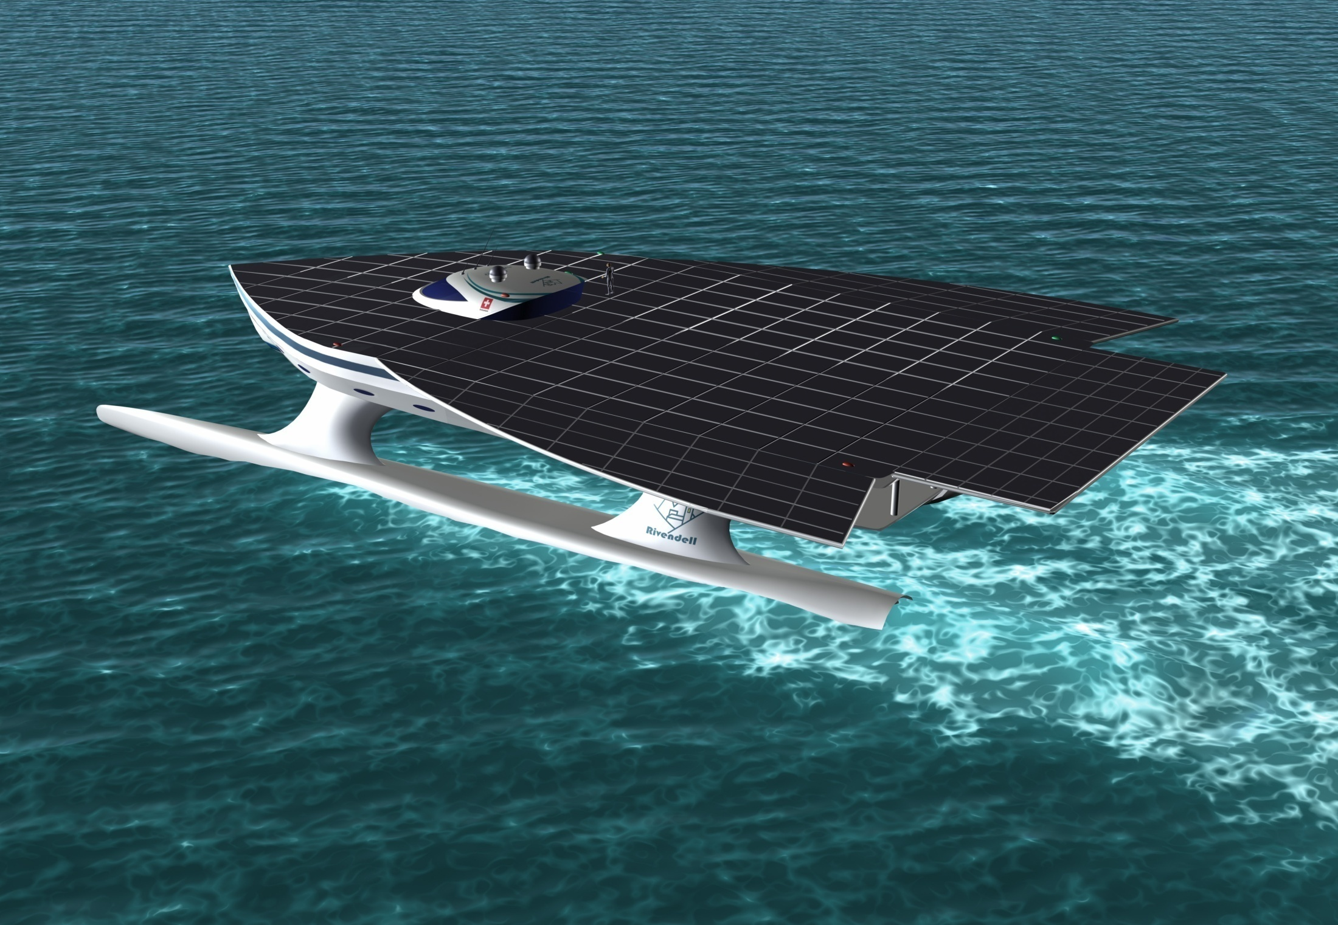
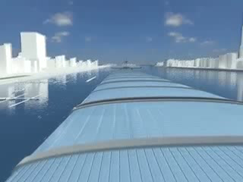
AUXILIARY PROPULSION
TYPES
WIND ENERGY
WAVE ENERGY
SOLAR ENERGY

Slide 10
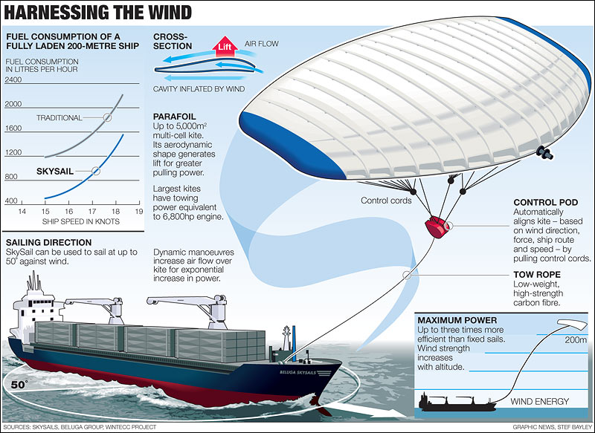
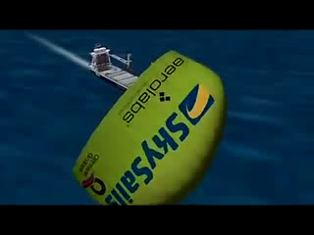
SAILS

Slide 11
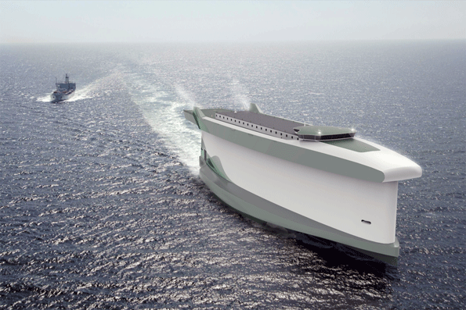
2. IMPROVED HULL DESIGN

Slide 12
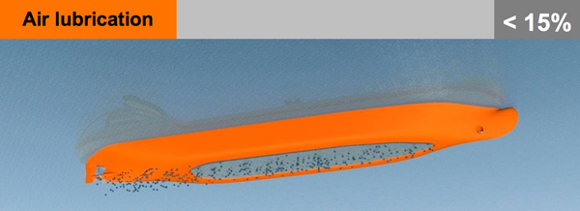
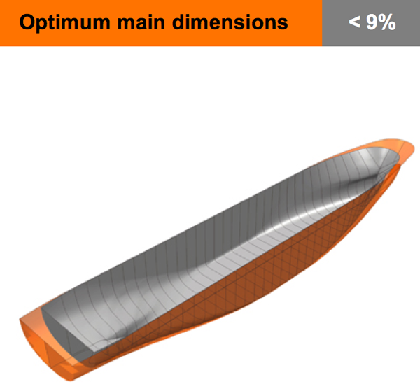
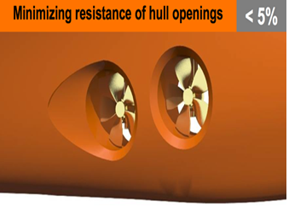
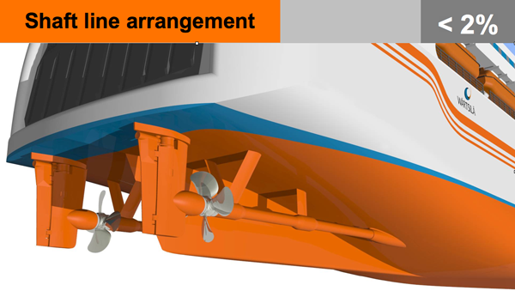
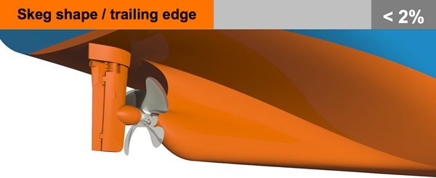
SUPERIOR DESIGNS TO REDUCE HULL RESISTANCE

Slide 13
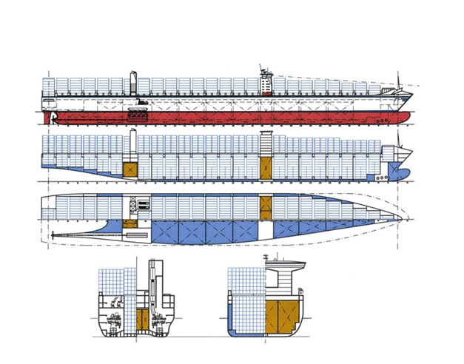
FUTURE CONTAINER SHIP

Slide 14

3. ENVIRONMENT
Ballast Water Treatment
Reduction Of Gas Emissions

Slide 15
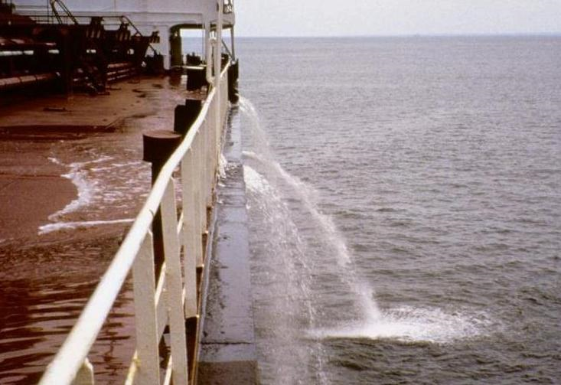
BALLAST WATER
Important for stability
Transfer of alien invasive organisms
Methods of treatment:-
1.Chemical treatment,
2.Heating,
3.Filtration,
4.Ultraviolet light etc.

Slide 16
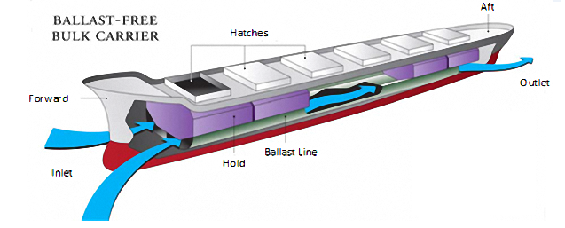
BALLAST FREE BULK CARRIER

Slide 17
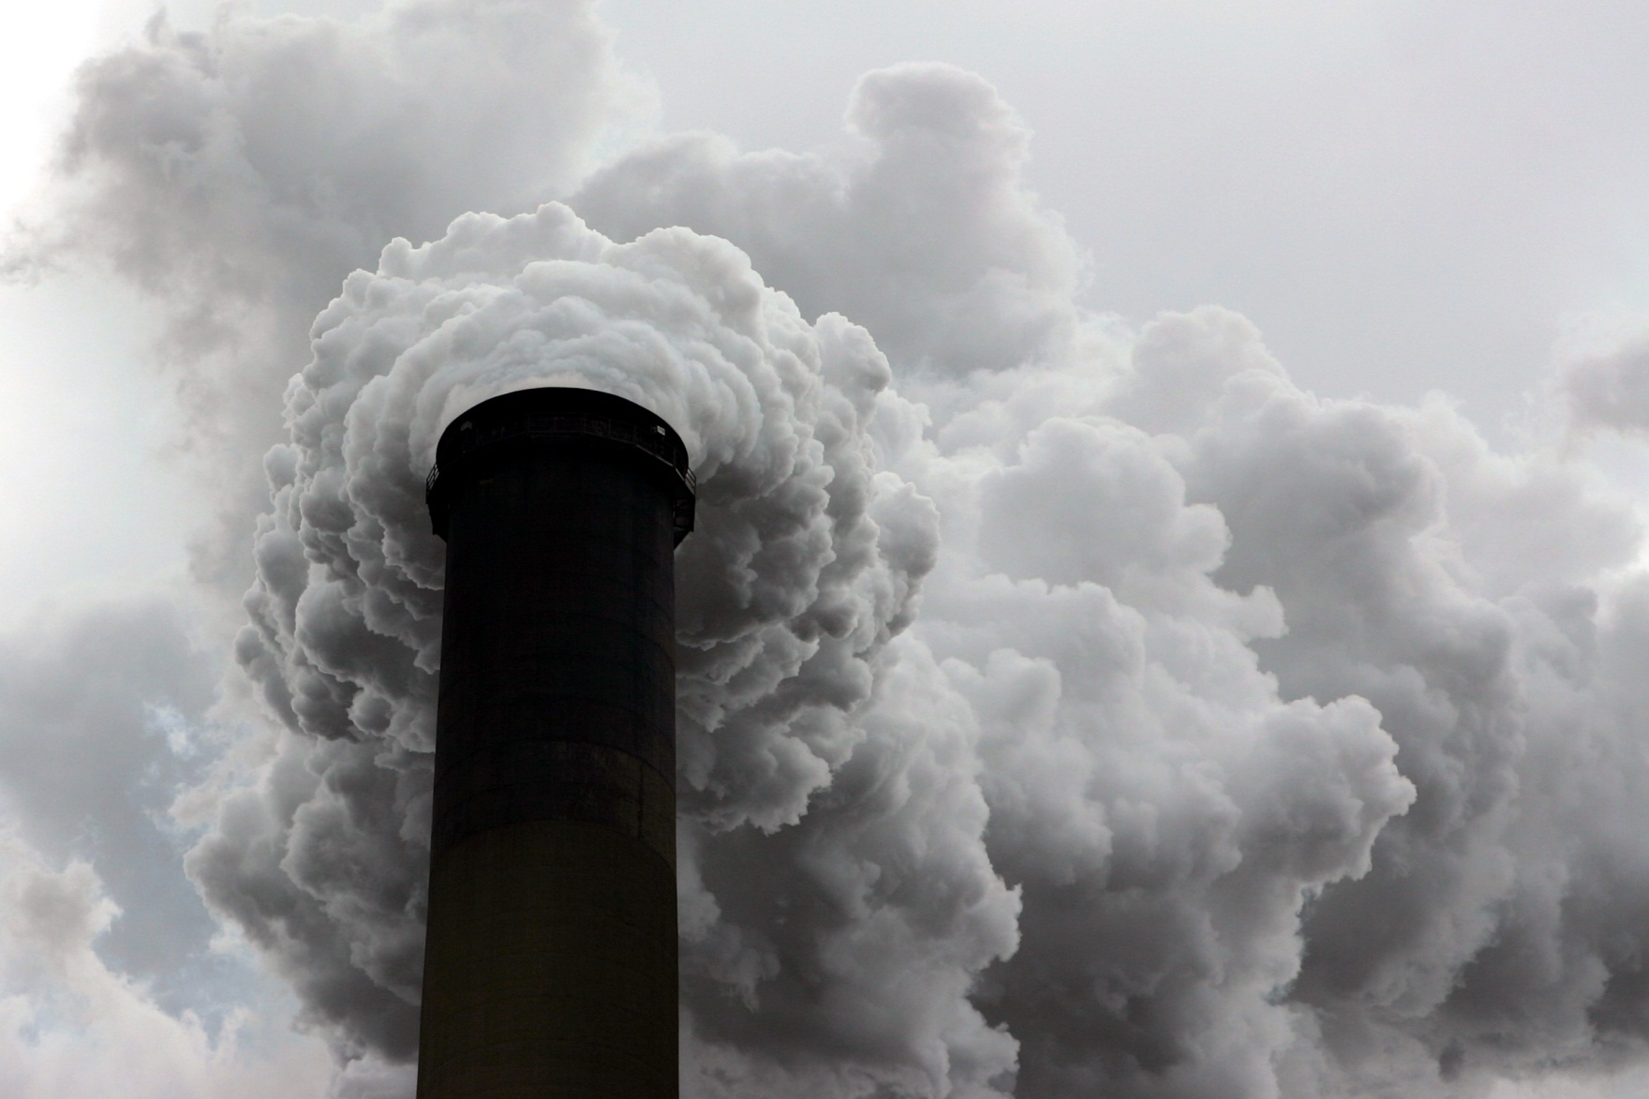
REDUCTION OF GAS EMISSIONS
Notes:
Air emissions from ships have not been adequately evaluated for. IMO’s policies are the first efforts to address this issue.

Slide 18
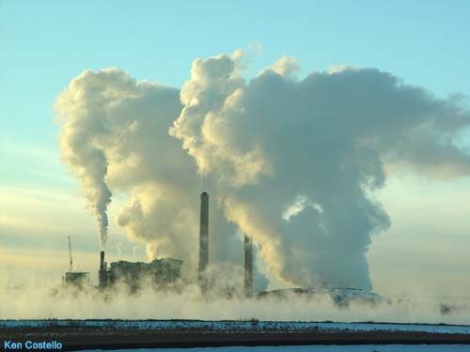
POLLUTANTS
1.CO2
2.SOx
3.NOx
Notes:
Sulphur oxide is one of the elements of the emissions from the ships. This has a huge negative impact on the environment

Slide 19

EFFECTS
Acid Rains in coastal areas
Notes:
NOx emissions also contribute to acid rain. A reduction of NOx emissions will contribute to better local air quality in coastal areas.

Slide 20
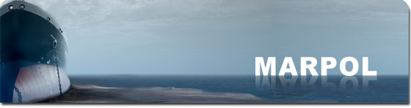
MARPOL 73/78 Annex VI
Notes:
MARPOL 73/78 Annex VI –Directive 2005/33/EC has been issued to address the policies and regulation with respect to the reduction of Sox emission from Ships.

Slide 21

WHAT DO WE DO NOW?
LNG
BIO FUELS
3. FUEL WATER EMULSIFICATION
4. EXHAUST GAS RECIRCULATION
5. SELECTIVE CATALYTIC REDUCTION
6. HYBRID AUXILIARY POWER
GENERATION
Notes:
The major area of sulphur existence in ships is the fuel. Sulphur oxide is formed by oxidation of sulphur in the fuel. SOx as a product of combusting fuel oil can be reduced by decreasing the sulphur content in the fuel supplied to the vessel

Slide 22
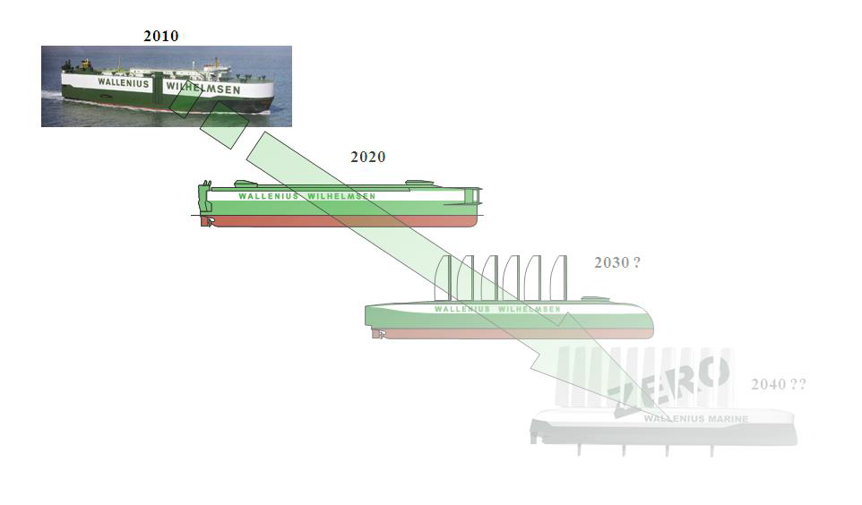
ROAD TO ZERO EMISSION

Slide 23
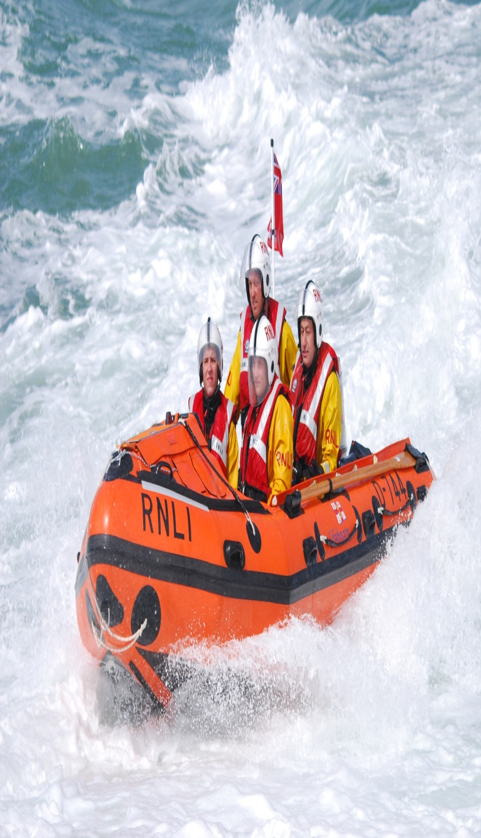
4.HUMAN FACTORS
Five Key Things :-
1. Creation of safe environment.
2. Improve hazard management.
3. Simplify procedures.
4. Modernization
5. Leadership

Slide 24
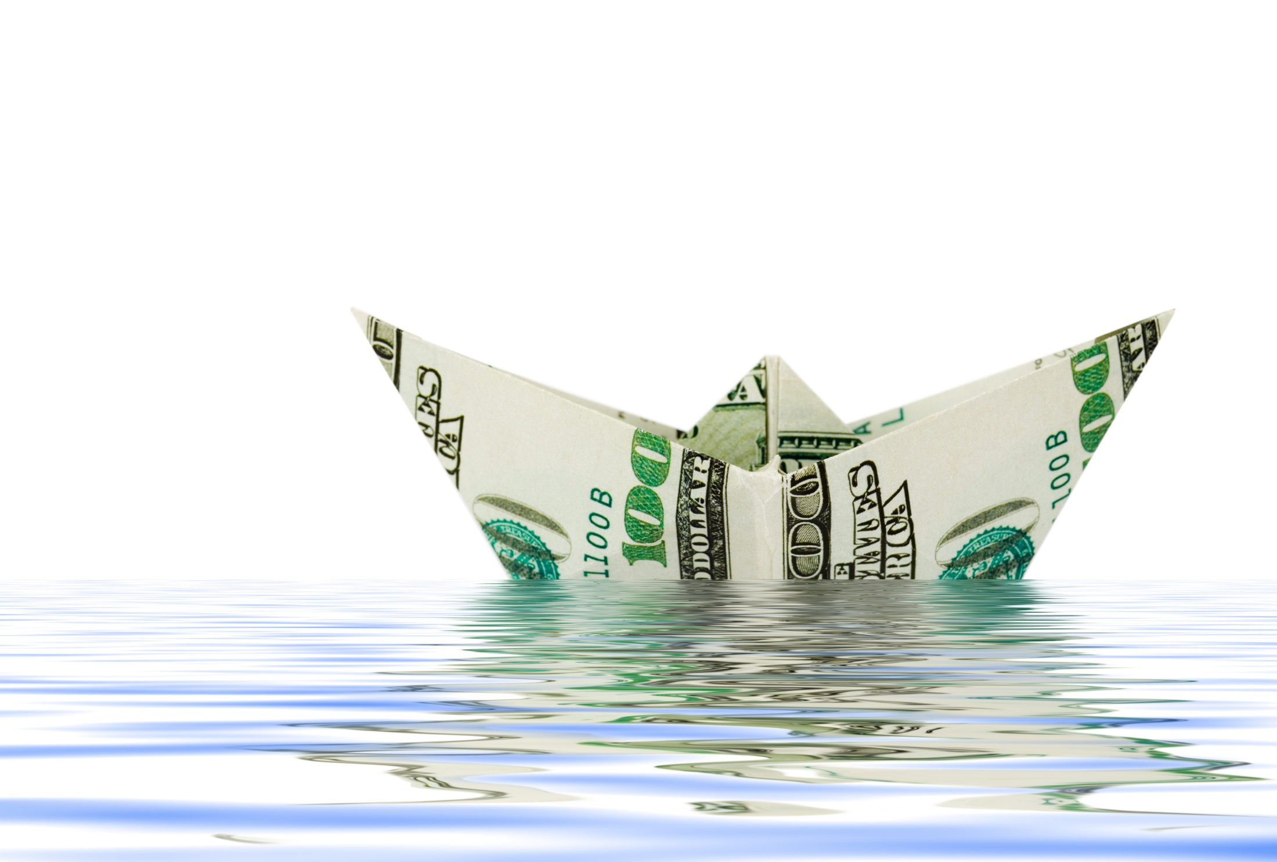
5.FINANCIAL SOLUTIONS
The Challenge
Key area of action
3. Initial plan
4. Ultimate objective

Slide 25


Slide 26
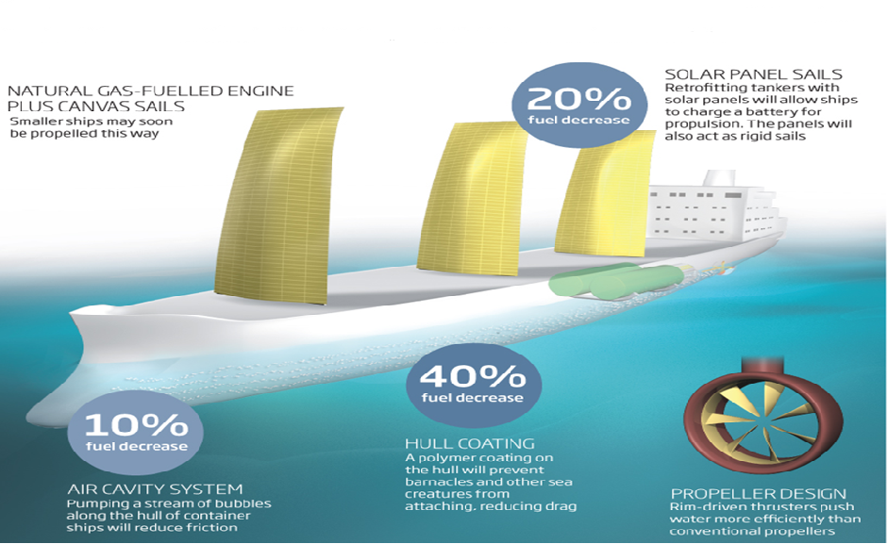
CONCLUSION

Slide 27

REFERENCE:
Marinediesel.uk
Motorship.com
Wikipedia.org
Marpol 73/78
WALLENIUS MARINE
Gcaptain.com
www.dnv.com

Slide 28

ACKNOWLEGEMENT
Principal & Head, Mr.Ajoy Chatterjee
Vice Principal, Capt.Phillip John
Course Incharge, Mr. R K Joshi
Soft Skill Trainer, Mrs.Meena Ravi Shankar
All other faculty members.

Slide 29

HOPE OUR PRESENTATION WAS QUITE EDUCATIONAL
THANK YOU FOR YOUR PATIENT LISTENING
DO YOU HAVE ANY QUESTIONS?

