Slide 1


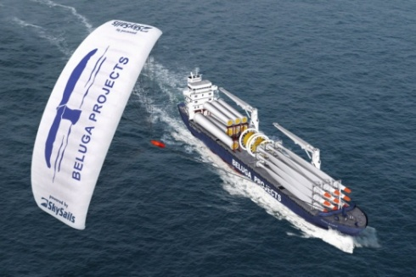
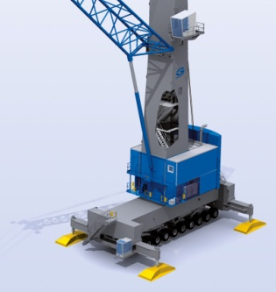

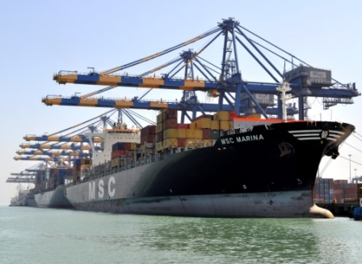
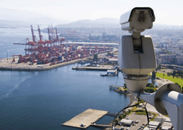
Advancement in technologies for sustainable development

Slide 2

Maritime Transport
For the last 100 years, International maritime transport is the backbone of the world globalized economy.
Maritime transport is far more ancient in terms of time as compared to other modes of transport
Over 90 percent of the world’s goods are transported by sea
Shipping is a highly efficient means of transporting cargo with lower CO2 emissions per ton-kilometer than trucking and far lower emissions than air transport.
Industry is estimated to account for around 4 percent of all CO2 emissions globally
Shipping also accounts for 10 to 15 percent of all emissions of nitrogen oxides (NOx) and 4 to 6 percent of sulphur oxides (SOx)
Increase in these emissions are expected to create wide-ranging and potentially devastating climate change
While international organisations like IMO, IPCC etc are grappling with these issues, it is equally important that at the local level, we deal with the sources of pollution and reduce it, if not eliminate it
Shipping and ports are interdependent and hence, it is natural that they work together in the spirit of mutual cooperation and understanding

Slide 3


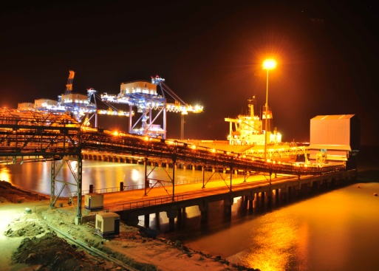
Agenda
1
Adani Group
2
Adani Ports & Special Economic Zone Limited
3
Technologies for Sustainable Development

Slide 4



The Adani Group
Leading Business Conglomerate with interest in diversified sectors...
Resources
Logistics
Energy
Sourcing hydrocarbons from around the world to fuel India’s growth
Owning a large network of ports,
railways, ships and operate various facilities around our ports
Leading player in
private sector power generation
Resources
Logistics
Energy
Coal Mining
Oil & Gas Exploration
Coal Trading
Multi Modal Logistics
Ports
Special Economic Zones
Gas Distribution
Power
Bunkering
Grain Silos & Fruits
Edible Oil

Slide 5
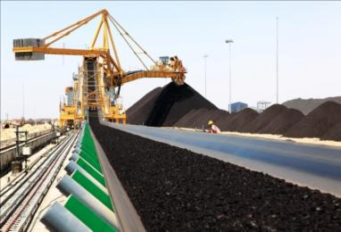
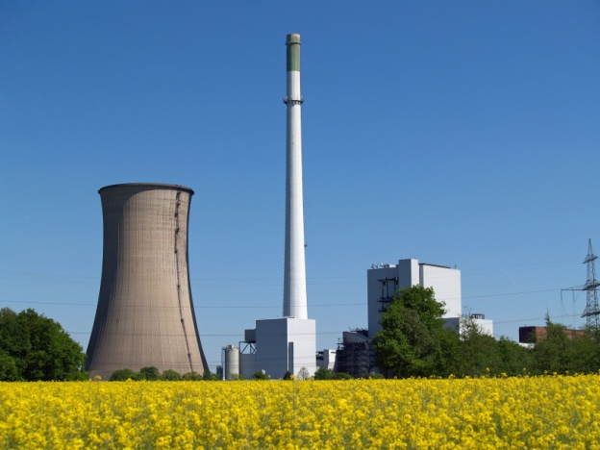
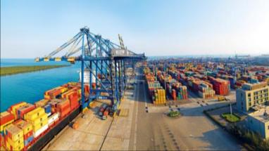
Adani Group – Listed Companies
Adani Group has 3 listed companies...
Adani Enterprises Limited
(AEL)
Adani Power Limited
(APL)
Adani Ports & SEZ Limited
(APSEZ)

Slide 6
Agenda
1
Adani Group
2
Adani Ports & Special Economic Zone Limited
3
Technologies for Sustainable Development

Slide 7
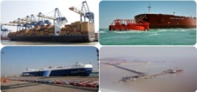
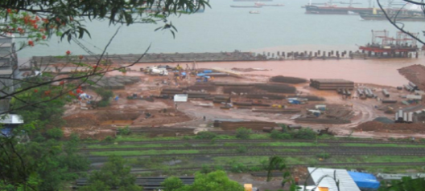


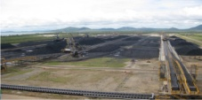
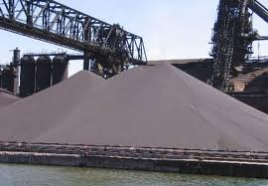
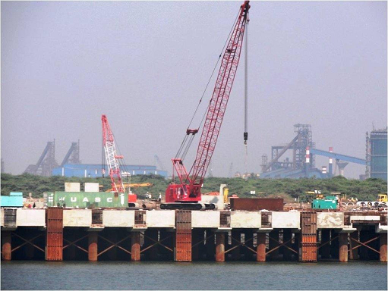
APSEZ – Market Leader in India, Expanding Globally
Operational
Under Construction
  Mundra: Multi Cargo Port, Multi Product SEZ
  Mormugao: Coal Berth
  Dahej: Dry Bulk
Kandla
Mundra
  Vizag: Coal Berth
Hazira
Dahej
Mormugao
Vizag
  Abbot Point: Coal Terminal
  Kandla: Dry Bulk Terminal
  Hazira: Multi Cargo Port
Abbot Point *

Slide 8
APSEZ – 245 MMTPA capacity created..
With 195 MTPA capacity created in India, APSEZ is largest port developer in India
Capacity Creation: Assets Created and Under Implementation
Ports | Current Capacity | Proposed Capacity
Indian Ports (MMTPA)
Mundra | 165 | 240
Dahej | 20 | 20
Goa | - | 8
Hazira | 10 | 75
Vizag | - | 7
Kandla (Tuna) | - | 20
Global Ports
Abbot Point | 50 | 100
Dudgeon Point | - | 90
Total Capacity | 245 | 560

Slide 9
APSEZ Mundra : Cargo handled in 2012-13
Mundra Port is ranked second amongst all the Indian Ports in terms of cargo throughput and container handling.

Slide 10
APSEZ Mundra : Port Performance
Cargo handled by Mundra Port
CAGR 27%
Vessels handled at Mundra Port
CAGR 15%

Slide 11
APSEZ Mundra : Financial Performance
Standalone Revenues
CAGR 33%
Standalone Net Profit
CAGR 44%

Slide 12
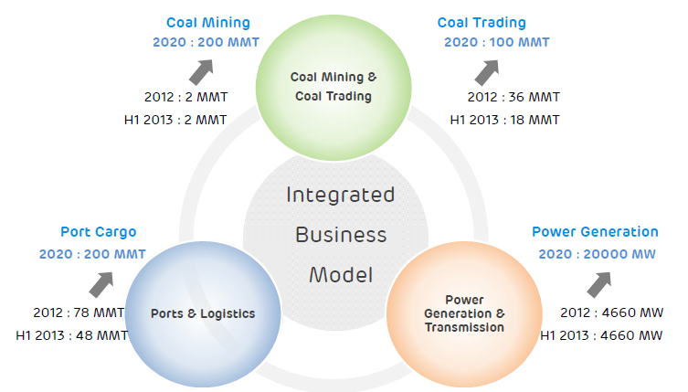
Adani : Today and 2020
200 MMT of coal mining, 100 MMT of coal trading,
200 MMT of Port Handling and 20000 MW of Power Generation
by 2020
2012 : 82 MMT

Slide 13
Agenda
1
Adani Group
2
Adani Ports & Special Economic Zone Limited
3
Technologies for Sustainable Development

Slide 14
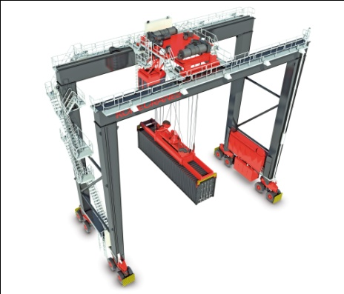
e-Power
E- RTG
E-MHC
Shore Power
Pioneers in Asia to convert the Rubber Tyred Gantry (RTGs) running on diesel to electricity.
Reduced CO2 emissions by 70%,
Reduced the engine maintenance waste by 80%
Conserved the diesel fossil fuel by 80%.
Savings of Rs. 55.9 per move which will result in a savings of approx. Rs. 22 crores per year.
Successfully electrified almost the entire fleet of Lieberr mobile harbour cranes
Substantially reduced the CO2 emissions
Saving of around Rs. 2500 per operating hour per crane as compared to Diesel.
Tugs use high powered engine that guzzle diesel
Once tugs are not in operation their engine is shut down and they are plugged to shore based power which eliminates carbon emission.
comfort to the crew since the engines are put off

Slide 15
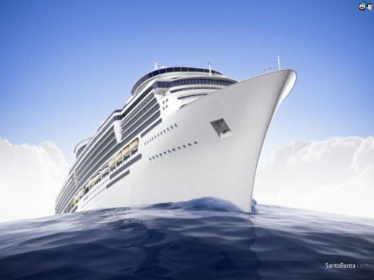
Green technologies in Shipping
Slow Steaming
Low Carbon Fuels
Sky Sails
Most important trend in shipping today,
Slow steaming simply means running at a slower speed.
Currently the hottest trend in shipping as it can not only significantly cut carbon emissions but it also reduces consumption and fuel costs.
Research is currently being done into the improved refinement of bunker fuel.
Reduction in the quantity of ash, sulphur and other by-products in fuel is growing and efforts are being made to reduce the cost of these new low carbon fuels.
Liquefied natural gas is also being considered as an alternative fuel for ships.
Sky Sails - are basically massive kites attached to the bow of a vessel which pulls the ship through the water. The usage of sky sails is increasing day by day and this technology can reduce daily fuel consumption by 10-30%.

Slide 16
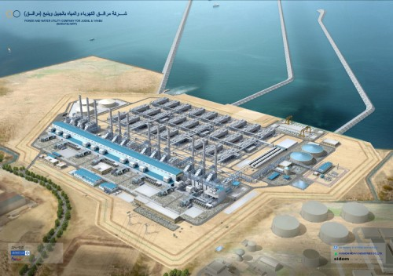
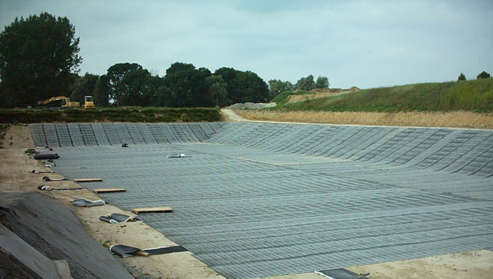
Conserving the Ground water & Rain water
Desalination Plants
Storm Water Retention Dam
Ground water availability low due to scanty rainfall in Kutch district of Gujarat.
APSEZL has decided that it will not use any ground water for the port and power operations
APSEZL has already set up desalination plants with a capacity of over 27 Million Litres per Day (MLD) and also is will be commissioning another plant with a capacity of over 20 MLD.
The establishment of a storm water retention dam (SRD) provides with extra capacity for onsite flood water retention.
The water reticulation system would consist of a network of yard drains, connected to a series of settling ponds where the coal can settle and clear water is pumped to SRD.
At all times the settling ponds are required to be kept empty so that it is available to receive water during heavy rainfall events and not letting the water go waste.

Slide 17
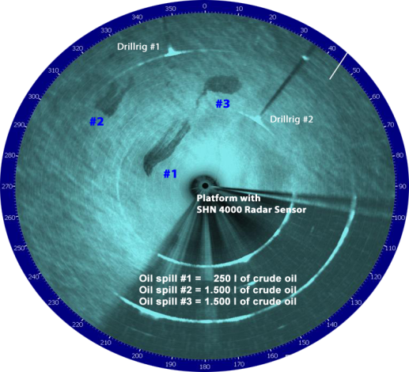
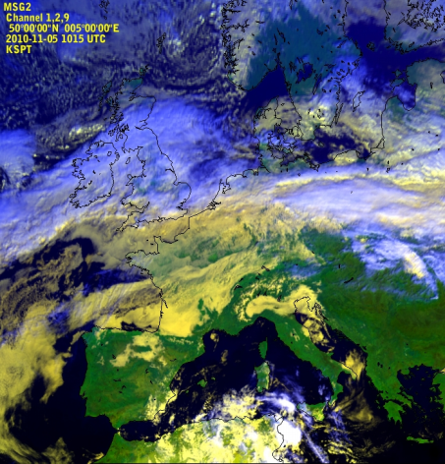
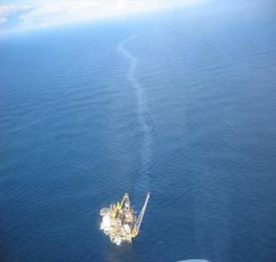
Oil Spill Detection System
Oil Spill Detection
Advantages
The detection of oil spills by radar systems is based on the dampening effect oil has on surface waves. An oil slick at sea “smoothes” the water surface and thus reduces the radar backscatter to the sensor. This creates a darker signature in the image which, after automatic processing, experienced analysts can then interpret as a possible oil slick.
Algorithms have been developed to minimize the risk of false classification, which are based on various parameters including wind currents, bathymetry, area and perimeter of patch, and historical statistics, to mention a few.
Early detection of oil spills using radars
Detect the drift pattern of the oil sleek
Assist in containing and planning contingency measures

Slide 18
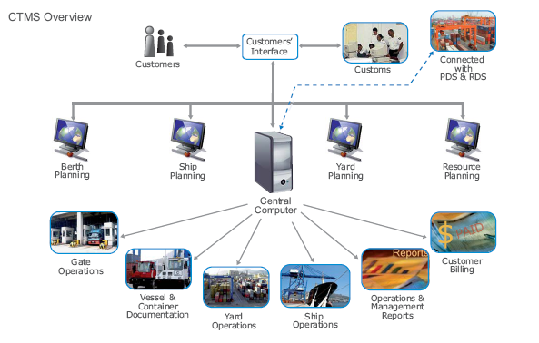
Information Technology a big boon for Ports & Shipping
SAP ERP systems
TOS
Surveillance Systems
By using SAP ERP system at Mundra, there is an annual savings of nearly 500 Tonnes of paper which is equivalent to 10,000 trees or 33 acres of green land per year.
Automation of the port utilities has also supported this cause
Terminal Operating System software has revolutionized container terminal operations.
TOS has made transactions fast and simple, allows excellent planning, and ensures better monitoring and control which allows high levels of terminal productivity, efficiency and cost savings.
Reduction in paper work
The usage of advanced security and surveillance systems has resulted in low investment in creating physical infrastructure in the port premises for protecting it against security breaches.
This has resulted in substantial saving of natural resources and thereby leading to the preservation of the environment.

Slide 19

Thank You

