Slide 1



Tolani Maritime Institute
8-9 March 2019
Pune
TransTech 2019
International Technical Seminar on Transportation Technology
Theme
“Advancement in Technologies for Sustainable Transportation”

Slide 2

MarEngr Atiqur Rahman Chy
Engineer Instructor
Cadet Md. Salman Shah
Cadet Ezaz Ahmed
Bangladesh
Marine Academy
---
Overview of MET

Slide 3
Glimpse of Human Maritime History
Recorded maritime history says that…
During 50,000 BC people of South Asian region went down to the Pacific Islands with wooden sailing ships.
And the human civilization spread over the other parts of the world through similar sea-expeditions.

Slide 4
Bangladesh – truly a Maritime Country!
1/2
Around 200 inland shipbuilding yards,
Recent modern ocean-going shipbuilding impulse,
Centuries-old bay fishing heritage,
IMO Member-State & IMO Council Member,
BMA is a branch of WMU Sweden,
A new Maritime University (BSMRMU),
18 Private MET Institutions.
Besides, we are keeping the world shipping GREEN through
safe recycling of scrapped ships!

Slide 5
Bangladesh – truly a Maritime Country!
2/2
One of the largest river networks (3,500 rivers having 24,000 Km),
One of the largest bays,
Largest delta,
Longest unbroken sea-beach,
One of the oldest sea-ports,
Over 60,000 Seafarers in early 20th century,
Ancient wooden shipbuilding heritage (imported by Turkey, China,
Portugal and Germany during 13th-18th centuries),
Unsinkable ‘Sampan (like Gondola of Venice)’ heritage.

Slide 6
Journey begins…
1952: Decision for establishing ‘Mercantile Marine Academy’.
  Juldia Point (valleys of Juldia-Rangadia) at the Karnaphuly river-mouth at Bay of Bengal was chosen for the planned academy.
  Reason was to create a ‘ship-like environment’; Juldia Point was considered as it was almost like a ship but not floating!
1962: New Academy went into functioning from 3rd Sept.
1960s: Experienced Merchant Mariners, trained in British-run institutes like “Conway” & “Worcester” in UK & “Dufferine” in Bombay (India) and Naval Officers were deployed as faculty members during the initial years.
1972: However, after liberation in 1971, the Academy was re-established as Bangladesh Marine Academy (BMA) with Merchant Mariners as the Faculty Members.

Slide 7

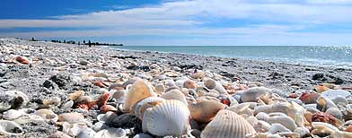
Bangladesh Government - Ministry of Shipping
Bangladesh Marine Academy
A branch of World Maritime University, Sweden

Slide 8
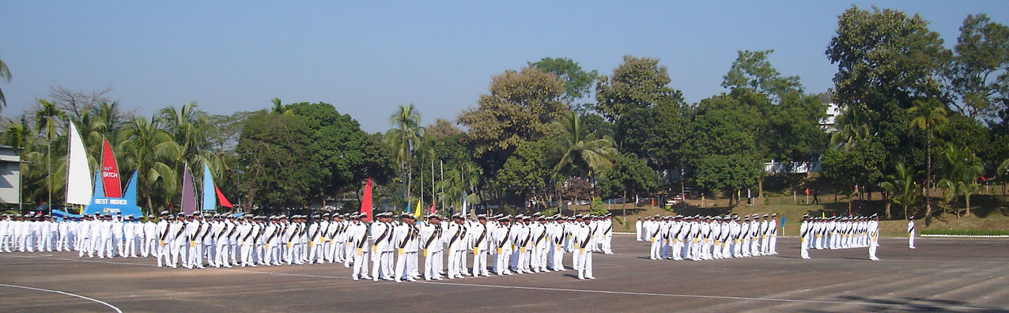
Mission
Developing world-class Maritime Leaders!
Vision
Emerging as a leading maritime education, training and research facilities provider in the shipping world through continuous innovation and endeavours.
Inspiration
It is Allah Who has subjected Sea to you.

Slide 9
Professional Profile of BMA
Current Name : Bangladesh Marine Academy (BMA)
Previous name : Mercantile Marine Academy (1962-1971)
Inspiration : It is Allah who has subjected sea to you.
Excellence : Where the Maritime Leaders are born!
Mission : Developing World-Class Maritime Leaders!
Vision : Emerging as a leading MET & Research facilities provider in the shipping world through
continuous innovation and endeavors.
Type : Full Government Institution
Administrative Organization : Ministry of shipping
Monitoring (Academic) Organization : Department of Shipping
Bachelor Degree from : BSMR Maritime University, Bangladesh

Slide 10
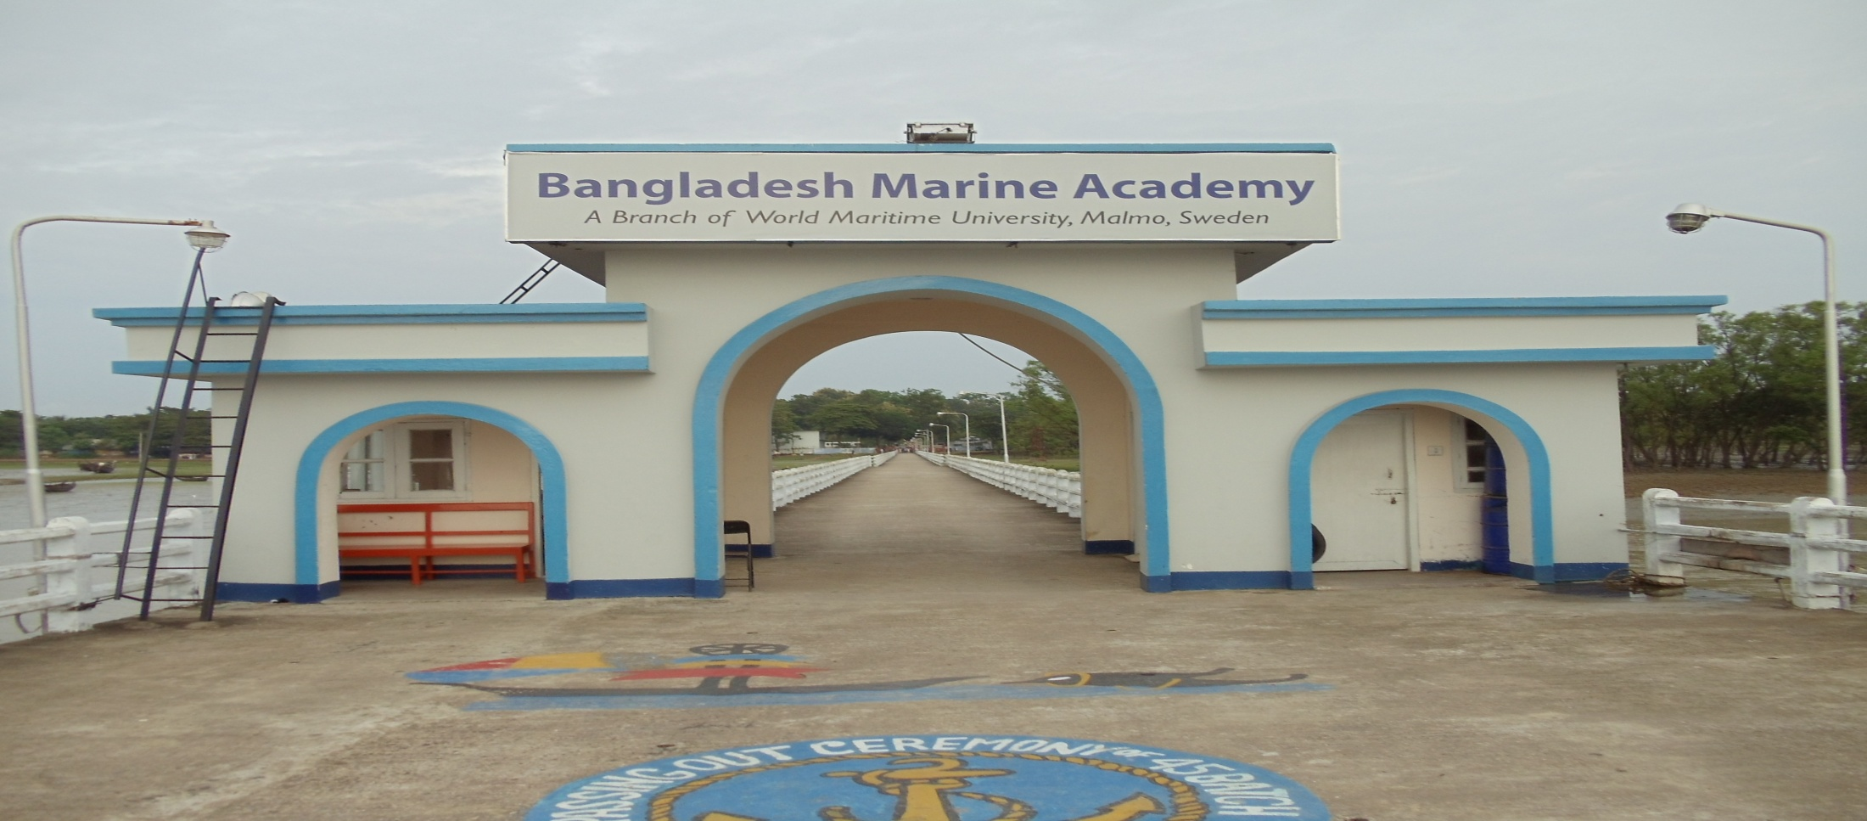
Welcome aboard – Academy Campus www.macademy.gov.bd
10

Slide 11
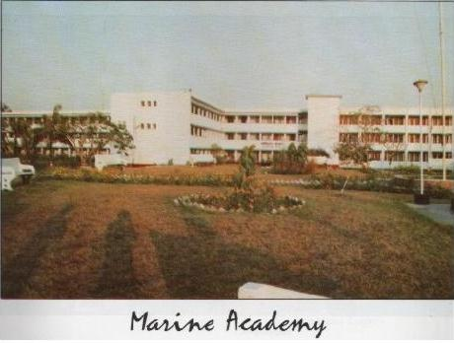
Admin & Academic Block

Slide 12
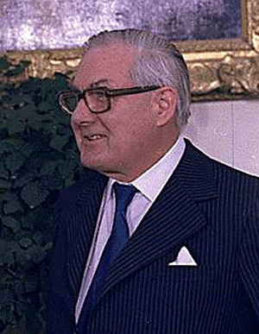
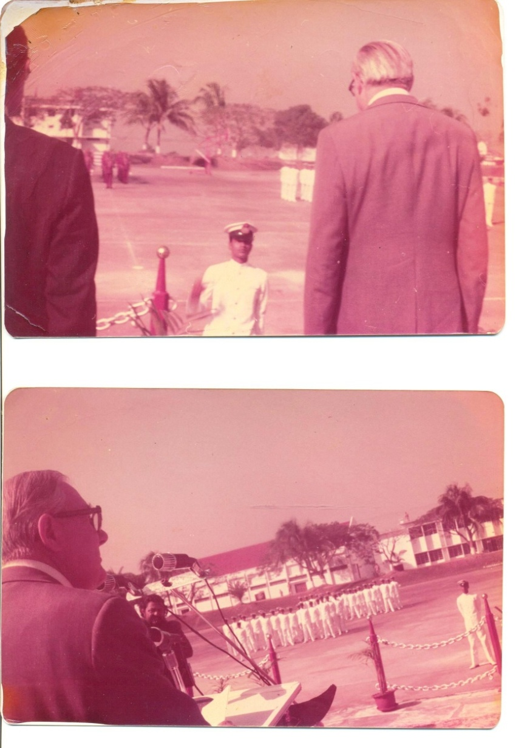
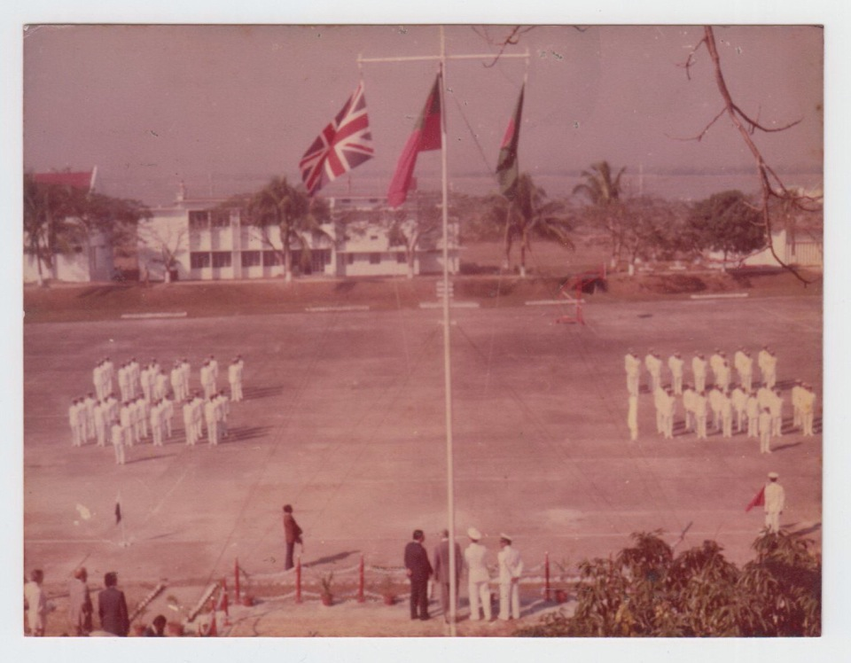
British Prime Minister
Mr. James Callaghan
visited Academy in 1977

Slide 13
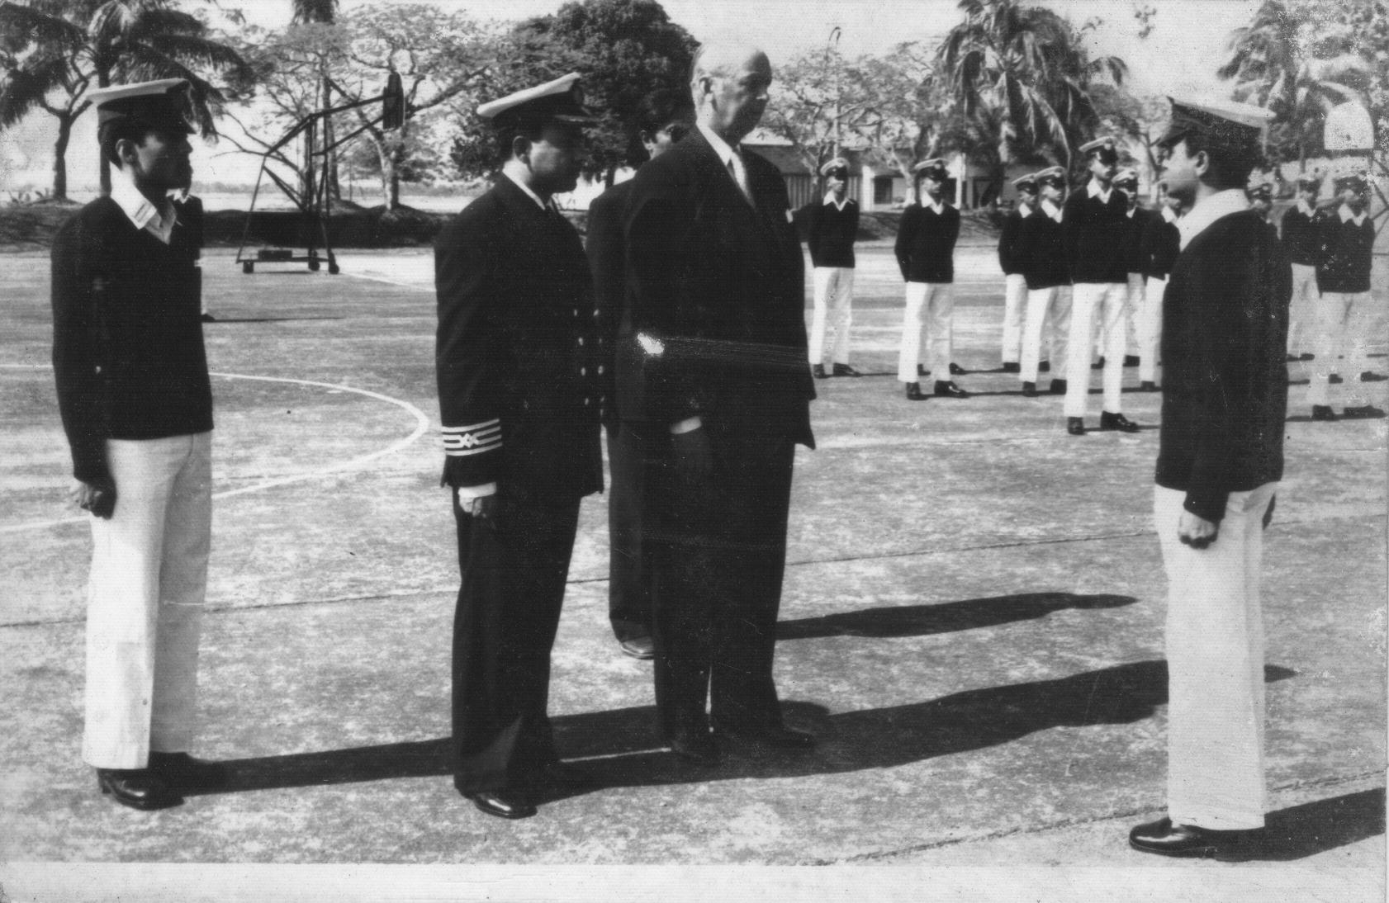
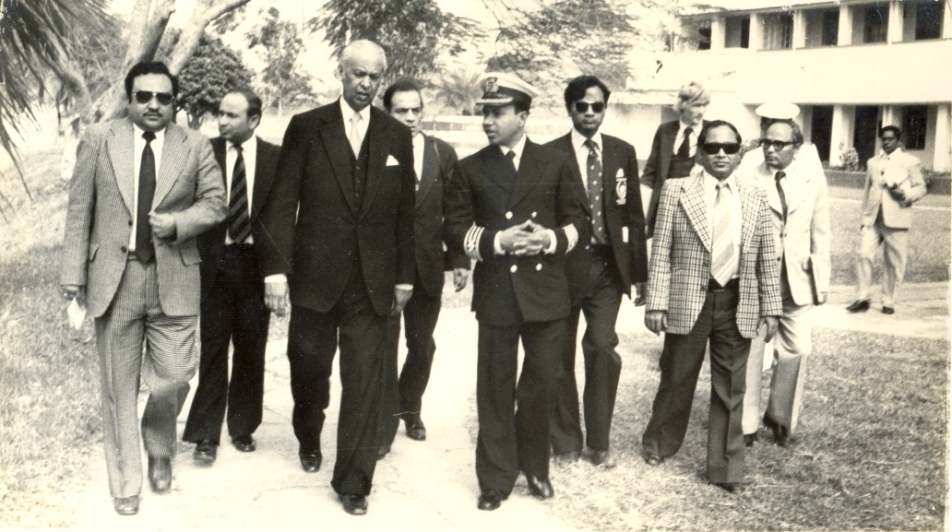
IMO Sec-Gen Mr. C P Srivastabha visited Academy on 3 Jan 1980

Slide 14
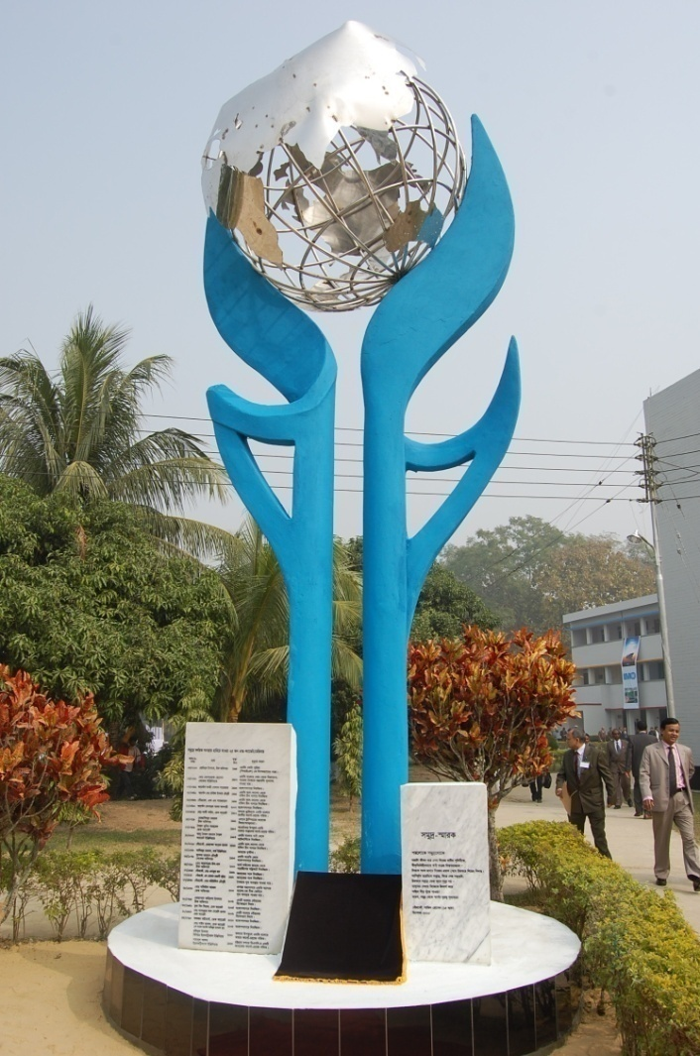
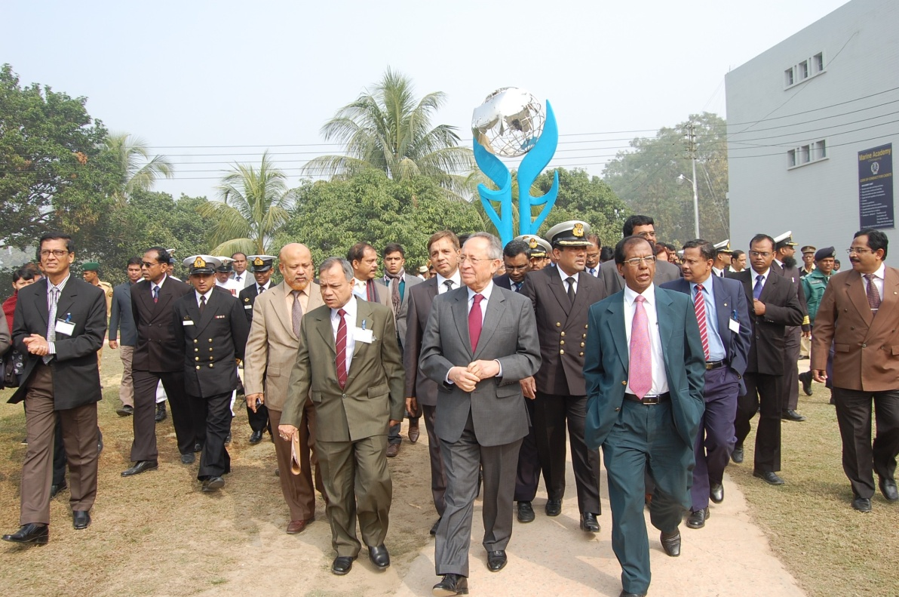
Mr. Efthimios E Mitropoulos, IMO Sec-Gen visited Academy on 13 Jan 2011

Slide 15
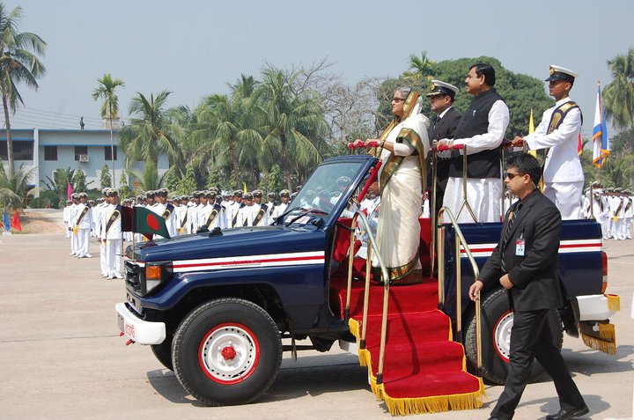
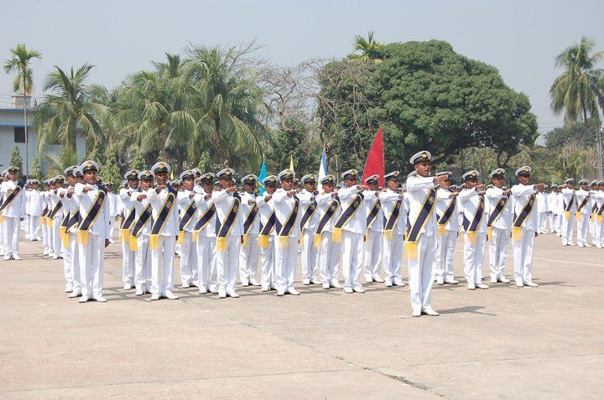
Hon’ble Bangladesh Prime Minister Sheikh Hasina at Graduation Parade on 26 Feb 2011

Slide 16
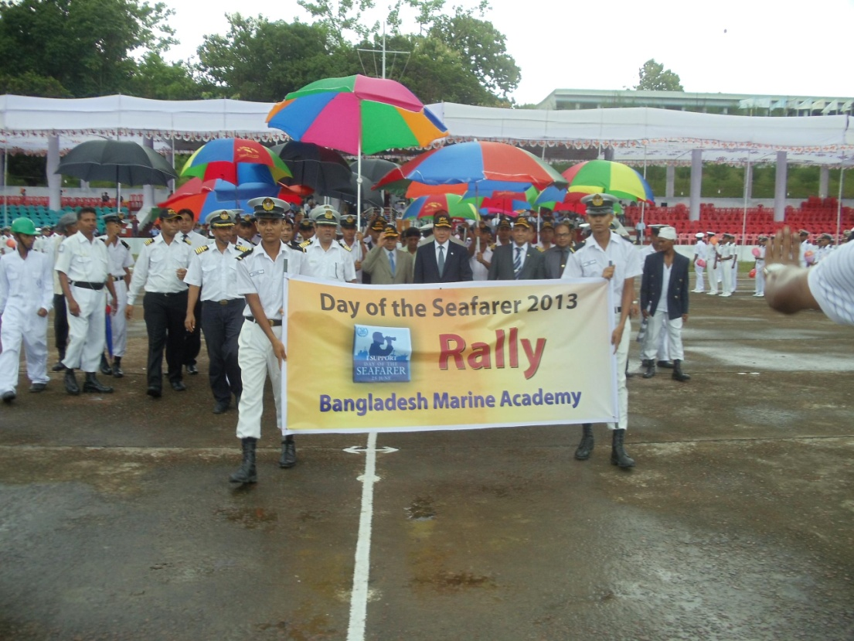
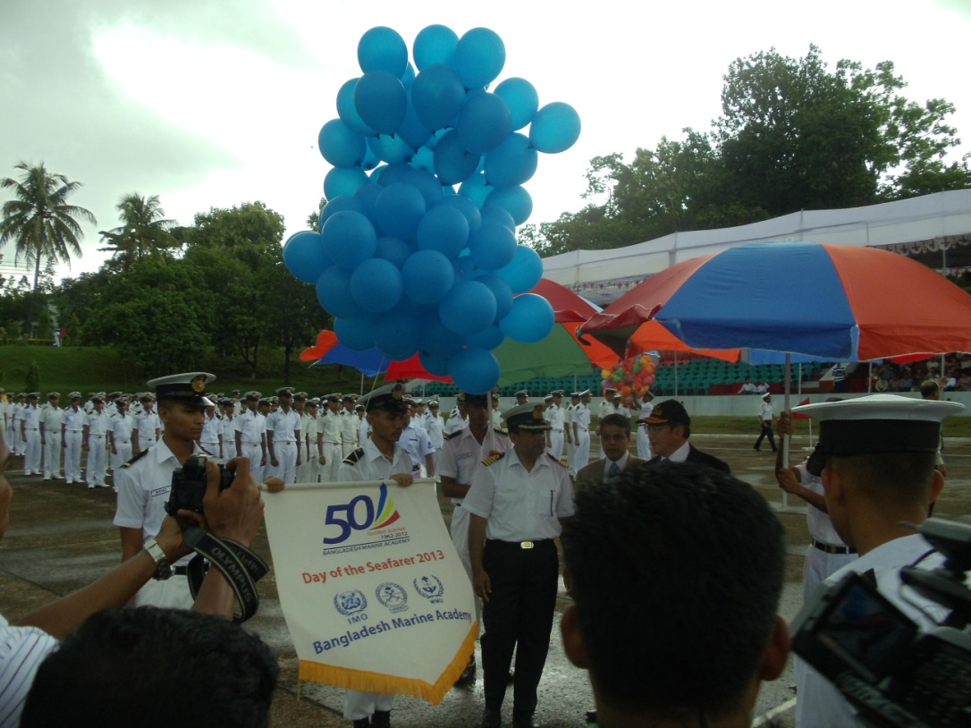
IMO SecGen Mr. Koji Sekimizu on
Day of the Seafarer - 25 June 2013 at Academy

Slide 17
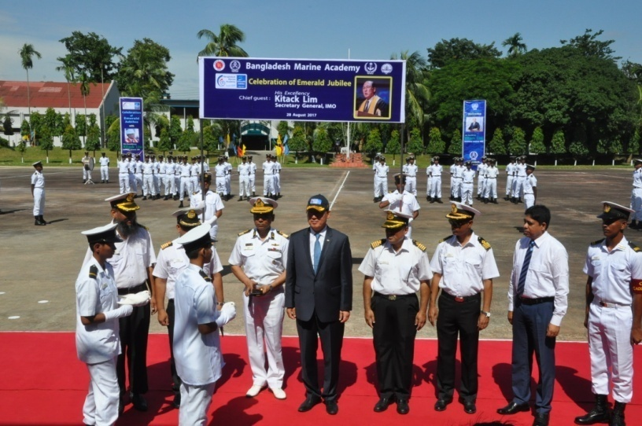
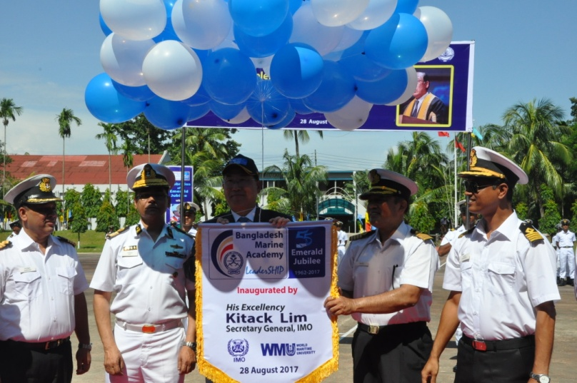
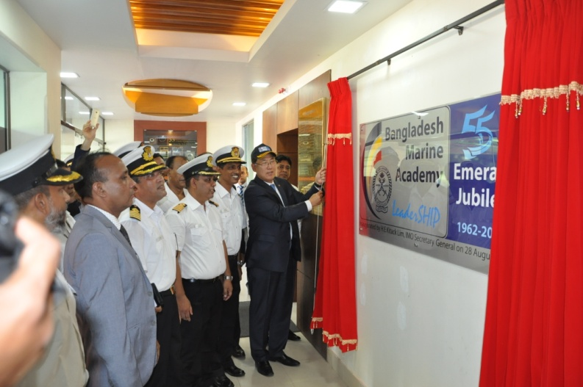
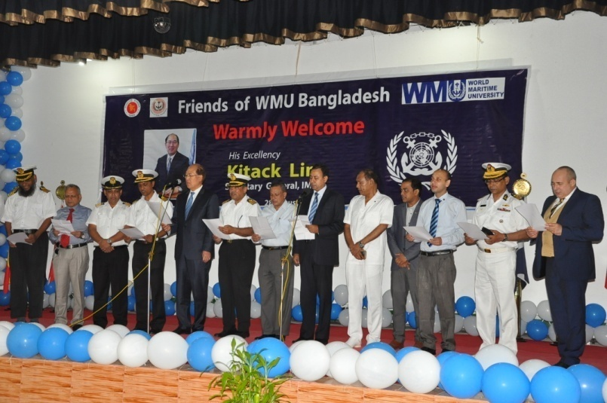
Dr. Kitack Lim, IMO SecGen
Chief Guest in
‘BMA Emerald Jubilee (55 years)’
28 Aug 2017

Slide 18
International Standing of BMA
          1990: A branch of Word Maritime University (WMU)
          2000: Enlisted country (Bangladesh) in IMO White List
          2010: Member of GlobalMET (Australia), InterManager & Marine Biz-TV
          2010: Professional link/attachment/relation with IMEC, ISF, ITF, IMarEST & NI
          2010: Research-attachment with Australian Maritime College (University of Tasmania, Australia)
          2011: Recognized by European Commission (EMSA)
          2011: Linked with Dalian Maritime University (China), Vietnam Maritime University &
          Singapore Maritime Academy
          2012: Academic collaboration with Shell Marine Singapore
          2013: Member of International Maritime Rescue Federation (IMRF)
          2013: Sajid Hussain (Commandant) is a Member to WMU Board of Governors
          2014: MOU with WMU for conducting WMU short/long courses at BMA campus
          2014: Recognized by MPA Singapore
          2014: Member of Global On-Board Training Centre (GOBTC)
          2016: BMA has been awarded with ISO 9001 Certificate by DNV-GL
          2017: BMA has been awarded “South Asian Business Excellence Award 2017” as the
          Best Institution in South Asia in Maritime Education by SAPS
          2018: MOU with Tolani Maritime Institute, Pune, India
          2019: In way to earn ‘WMU Partner’ status enhancing from ‘WMU Branch’

Slide 19
BMA: Pre-Sea Training
BMA bears over 5-decades’ long reputation of producing professionally skilled, environmentally aware, prudent and polite Marine Cadets.
It grooms the young Cadets (after schooling of 12 years with HSC [A-Level]), currently 150 per year, through a regimental & residential MET programme with English as the working language, in accordance with the IMO STCW.
Upon completion of 4 years' MET the Cadets are awarded with Pre-Sea Nautical Science or Pre-Sea Marine Engineering Certificate from BMA and Bachelor of Maritime Science (Nautical/Marine Engineering) Honours Degree from BSMRMU.

Slide 20
BMA: Post-Sea Training
Since 2010, the Academy has expanded its course areas for all higher levels of Maritime Education.
Today it offers all preparatory & ancillary courses up to CoC
Class I (Master Mariner & Marine Chief Engineers) level.
Today it also offers rescue, anti-piracy and industrial safety courses.

Slide 21
BMA: Post-Sea Courses
Preparatory Courses: IMO Model Courses 7.01, 7.02, 7.03, 7.04
Ancillary Corses:
1.01: Tanker Familiarization
1.02: Specialized Training for Oil Tanker
1.07: ROC & ARPA - Operational Level
1.08: ROC & ARPA - Management Level
1.13: Elementary First Aid
1.14: Medical First Aid
1.15: Medical Care
1.19: Personal Survival Techniques
1.20: Fire Prevention and Fire Fighting
1.21: Personal Safety and Social Responsibilities
1.23: Proficiency in Survival Craft & Rescue Boats
1.25: GMDSS
2.03: Advanced Fiar Fighting
3.26: Security Training for Seafarers with Designated Security Duties 3.24: Security Awareness Training for Port Facility Personnel with Designated Security Duties

Slide 22
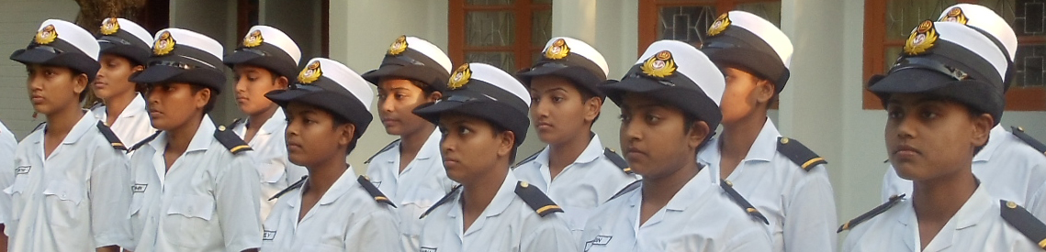
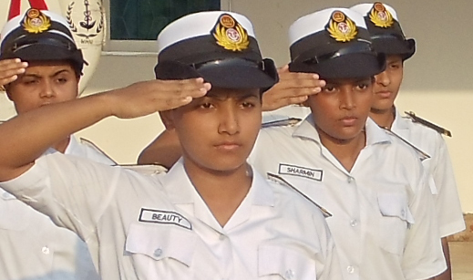
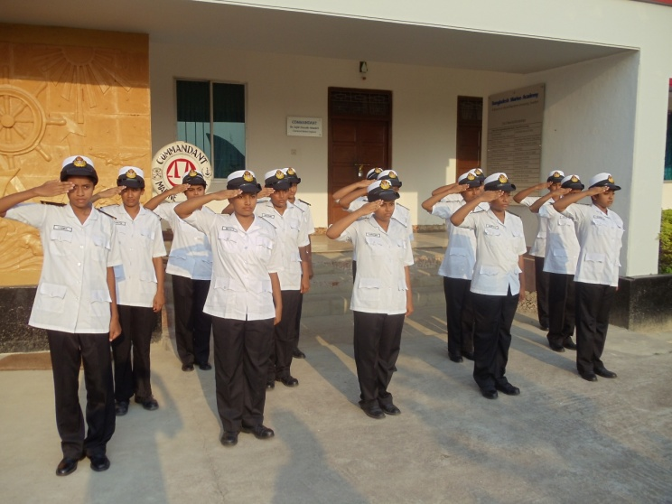
Developing world-class Female Maritime Leaders!
...since 2012
IMO Res. 14:
Promotion of the participation
of women in all levels in the maritime industry; STCW CONF.2/32; 1 July 2010.

Slide 23
BMA MET: Keeping pace with STCW
MET courses revised for implementation of STCW ‘78 from 1984.
Again revised from 1998 for implementation of STCW ‘95.
Bangladesh was included in the first IMO White List of 72 countries published in 2000.
Again revised in 2012 for implementation of STCW 2010 in collaboration with AMC Australia.

Slide 24
Cadet Training: Keeping pace with time
1962-1971: Effort made to follow UK MET under Colombo Plan.
1972-1974: Followed UK MNTB
1975-1980: Followed UK MNTB and METC of City & Guilds of London Institute
1981-1983: UK TEC Diploma
1984-1990: STCW 78 & UK TEC Diploma
1991-1992: STCW 78 & 2-years’ BSc Pass Degree (CU)
1993-2002: STCW 78/95 & 2-years’ BMS Degree (NU)
2003-2013: STCW 95/2010 & 3-years’ BMS Degree (NU)
2014-2014: STCW 2010 & 3-years’ BMS Degree (BSMRMU)
2015-onwards: STCW 2010 & 4-years’ BMS (Honours) Degree (BSMRMU)

Slide 25
BMA: Consultancy Services
It also commenced research & maritime consultancy for national & international organizations:
2012-13: Ministry of Labour, Govt. of Bangladesh (MLC for Bangladesh)
2012-13: ILO Dhaka, Bangladesh (MLC for Bangladesh)
2015-16: IMO-NORAD Project (Safe Ship-Recycling - Safe and Environmentally Sound Ship Recycling in Bangladesh - SENSREC) by WMU-led Consortium.
Consortium Partners:
World Maritime University (Sweden), University of Strathclyde (UK), Dokuz Eylül University (Turkey), Green Ship Recycling Services (Germany), Bangladesh Marine Academy (Bangladesh), BUET (Bangladesh) & University of Chittagong (Bangladesh).

Slide 26
Strategic Vision Plan: 2014-2020
The Strategic Vision Plan 2014 – 2020 (short, medium and long term) has been formulated to enhance & keep the Academy at the fore-front of MET.
The strategic priorities are:
1. Expanding Core Competencies of Faculty and Professional Staff
2. Strengthening Education & Research Capabilities
3. Securing Institutional Financial Sustainability
4. Planning for Future Growth

Slide 27
Professional Profile of a BMA Cadet
Basic General Qualification (12 years schooling):
(i) Secondary School Certificate (SSC - equivalent to O-Levels) and
(ii) Higher Secondary School Certificate (HSC - equivalent to A-Levels) with Physics, Chemistry & Math;
(iii) Proficiency in English & Computer operation.
Professional Marine Qualification (IMO Model Course 7.03 & 7.04):
(i) Pre-Sea Nautical Science or Pre-Sea Marine Engineering* by BMA
(ii) Bachelor of Maritime Science (N/E) Degree* by BSMR Maritime University.
* 2 years in Academy & 1 year at sea

Slide 28
Evaluation of a BMA Cadet
Smart & useful citizens of Bangladesh
Qualitative Evaluation
Equipped with Maritime Leadership & Professional qualities
Quantitative Evaluation
Input : Cost for training for a Cadet to Captain/ChEngr => US$ 32,000
Output: Earning in average 20 years sea-service => US$ 1.3 Million
Yearly earning (2018) by 4,500 BMA Graduates=> US$ 220 Million
Where in the world such business may be found!

Slide 29
BMA Cadets
At 4 corners of the Globe!
Our alumni are truly international by profession & competence!
Our alumni are everywhere on earth!
Our alumni are keeping remarkable role in Bangladesh Shipping: At Maritime Administration, Shipping Trade, Maritime Academies & Universities & Industries.
Our alumni are keeping remarkable role in International shipping: At International Organisations (IMO, NI, IMarEST etc) and in Maritime sectors of various countries.

Slide 30
New Endeavours
FOUR New Marine Academies by 2020
Four new Marine Academies (each for 50 Cadets) as branches of BMA are expected to go into functioning in 2020.
Maritime University
Bangabandhu Sheikh Mujibur Rahman Maritime University has commenced functioning in 2015 at capital city Dhaka.

Slide 31
New Endeavours
MSc in Maritime Science by Oct 2018 (commenced)
This course of BSMR Maritime University particularly aims the BMA Graduates
Training Ship for BMA by 2022
6,000 DWT ship for 150 Trainee Cadets expected to be received by 2022.
Full-mission Simulator (Deck & Engine) for BMA by 2022
Simulation Center will be established by 2022
Infrastructure Reformation by 2019
Majority of the old infrastructure will be remodeled/renovated by 2019

Slide 32
Our Academy – Our Pride!
BMA is a national point for smart young generation!
BMA is a Maritime Motherland!
BMA is a place where the Maritime Leaders are born!
BMA is developing world-class Maritime Leaders!
BMA ensures Quality Cadets’ entry into seafaring!
BMA is a place where the morale is sky-high!
BMA Graduates are
smart & skilled Maritime Leaders for World Shipping!
BMA Graduates are
economically useful elements for the family-society-country-world!

Slide 33
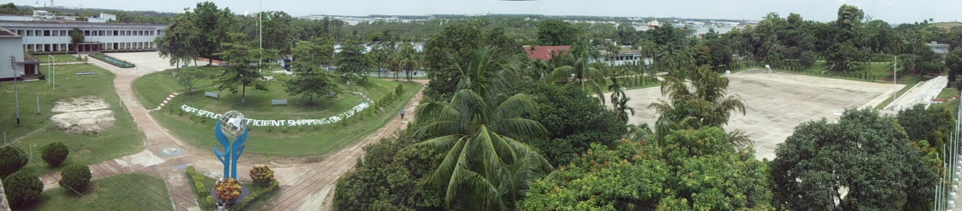
Aap sabko bahut bahut dhanyavaad!
Bon Voyage!

