Slide 2

Alfa Laval is a leading global provider of specialized products and engineered solutions.
The company

Slide 3

Processes
We help customers to
heat, cool, separate
and transport products
such as oil, water,
chemicals, beverages,
foodstuff, starch and
pharmaceuticals.

Slide 4



Solutions
Alfa Laval aims at creating better everyday conditions for people by providing highly efficient and environmentally responsible solutions for water supply, energy production and food.

Slide 5
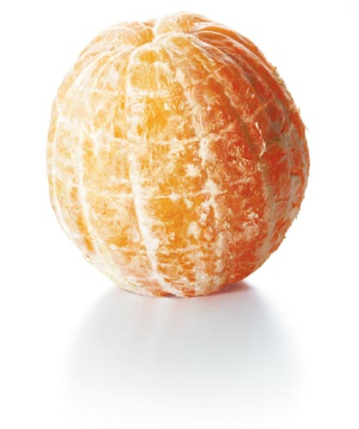
Our corporate mission
To optimize the performance
of our customers’ processes.
Time and time again.

Slide 6

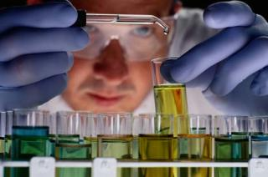

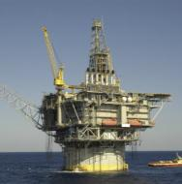

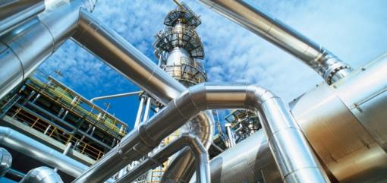
We serve most industries
Biofuels
Biotech and pharmaceutical
Chemicals
Crude oil refinery
Engine and transport
Fluid power
Food and beverages
HVAC
Industrial fermentation
Latex
Machinery
Marine and diesel
Metal working
Mining and mineral processing
Oil and gas
Power
Pulp and paper
Refrigeration and air-conditioning
Semiconductor systems
Steel and coke oven gas
Sugar
Wastewater treatment

Slide 7
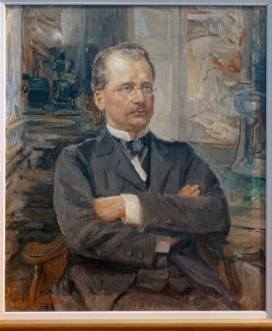
Gustaf de Laval (1845-1913)
“The Man of High Speeds”
200 projects and inventions
92 patents, including the milk separator (1878) and the steam turbine (1883)
Started 37 companies
Notes:
1

Slide 8

A global company
34 manufacturing units*
106 service centres
Sales companies in
55 countries
Other sales representation in 45 countries
* Plus a number of minor production and assembling units

Slide 9
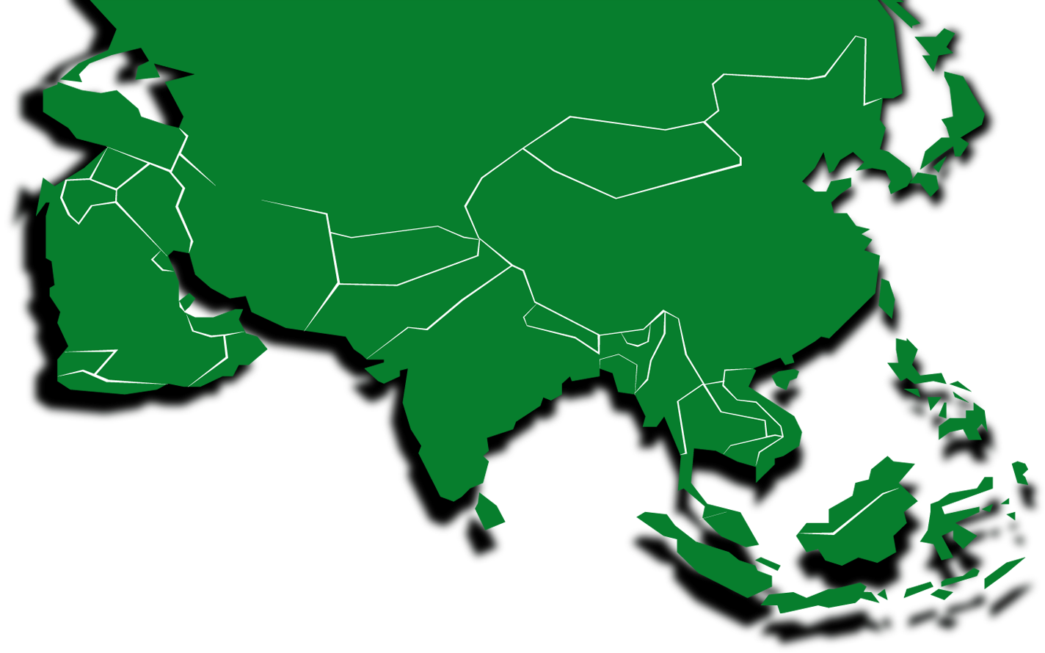

`
Presence in Asia
Japan
1930
South Korea
1979
Dubai
1994
China
1984
Saudi Arabia
1995
Pakistan
1987
Taiwan
1986
India
1937
Thailand
1983
Philippines
1986
Malaysia
1969
Singapore
1978
Indonesia
1993
Note: The map shown above has no country specific boundaries and is for illustrative purposes only

Slide 10
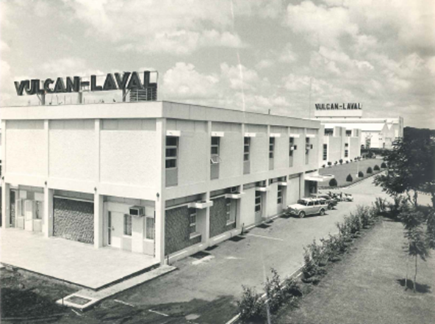
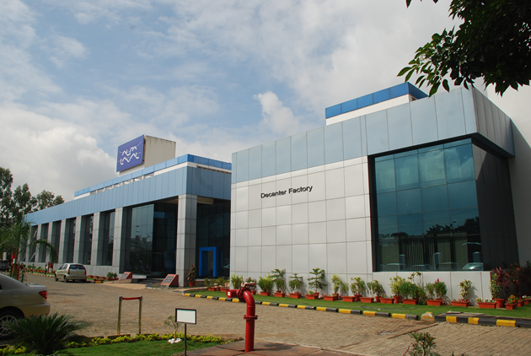
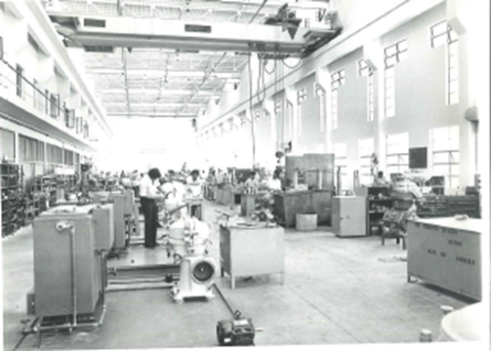
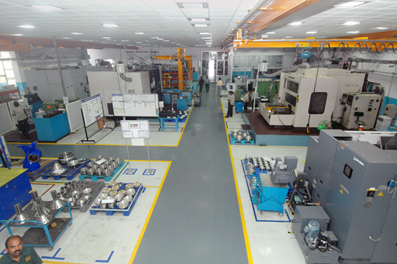
Alfa Laval India
A journey of 77 years and counting

Slide 11
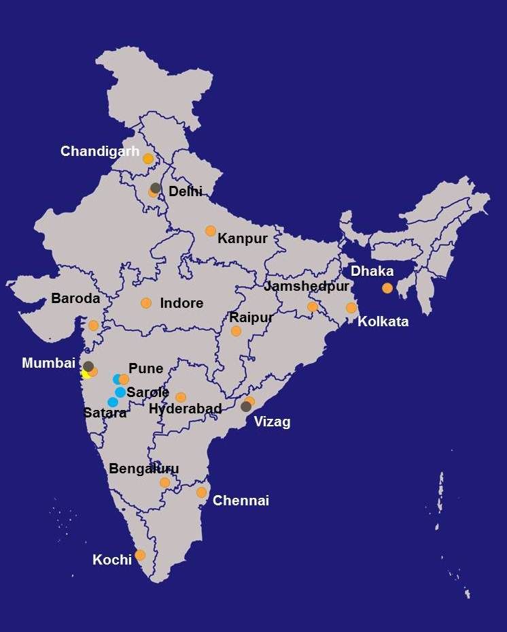
India corporate snapshot
Sales and Service Office
Manufacturing Unit
Service Centre
Distribution Centre
1,200 Employees
40 Field Service Engineers

Slide 12
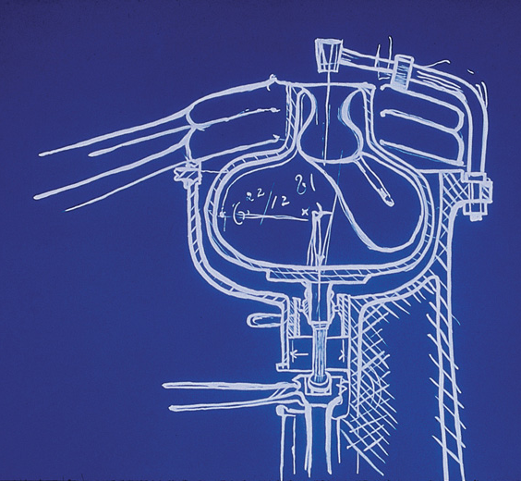
Competitive strengths
A global company, founded in 1883
Highly engineered products
Global market leadership
Large customer and geographical diversification
Large base of installed products
Strong brand recognition

Slide 13
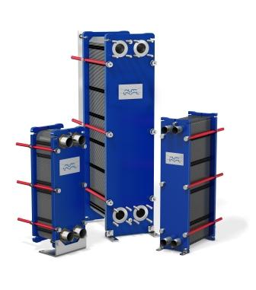
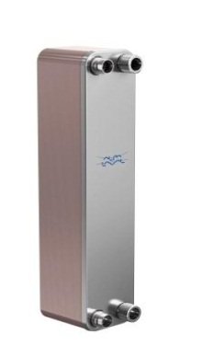
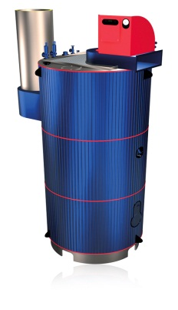
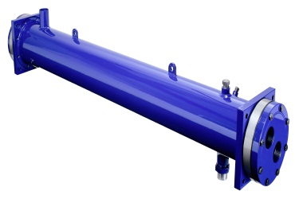
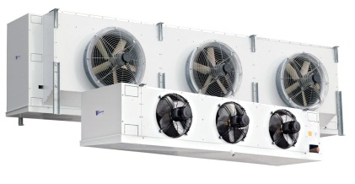
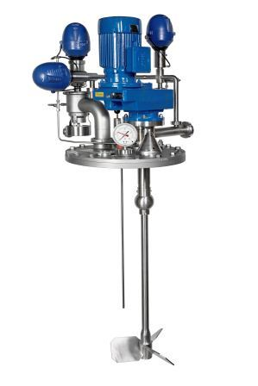
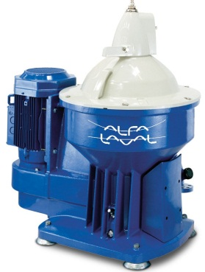
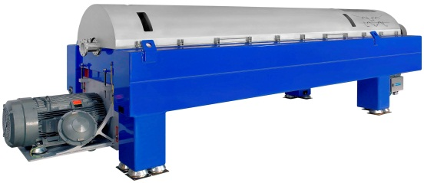
Key technologies

Slide 14
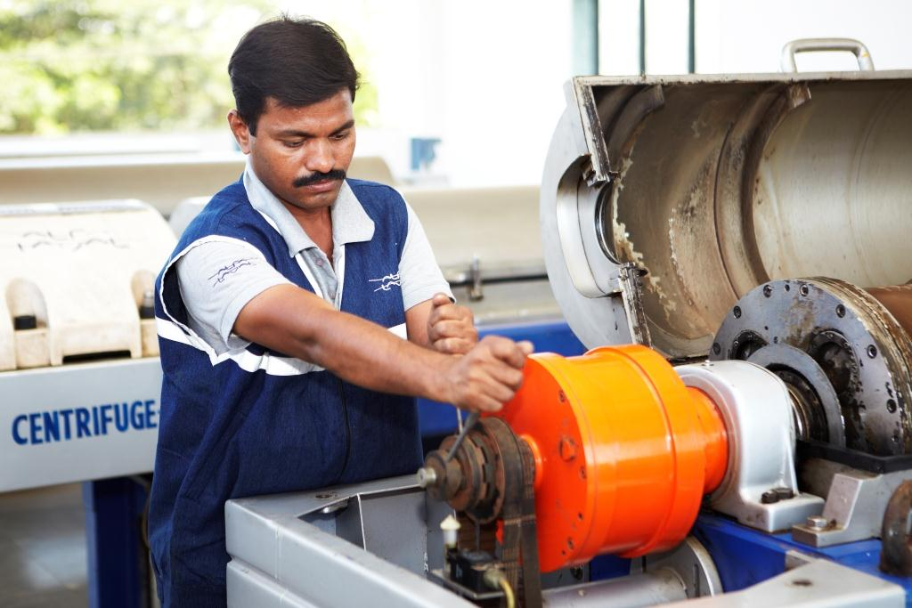
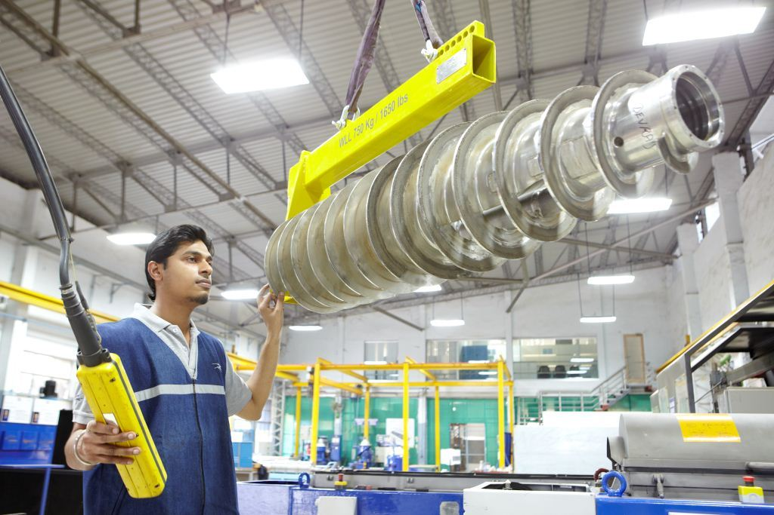
Extending performance
Alfa Laval Service:
Ensures optimal performance of your equipment throughout its entire lifecycle
Provides expert know-how through local staff in more than 100 countries
Maximizes uptime and safety
Offers the services you need to continuously improve operations

Slide 15
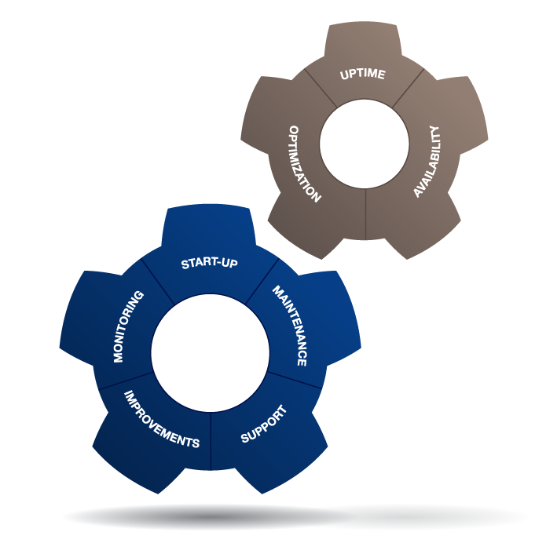
360° Service Portfolio
Alfa Laval’s 360° Service Portfolio includes all the services you need throughout the entire lifecycle of your Alfa Laval equipment.
All services can be included in a Performance Agreement – an individual, fully flexible, tailored service solution.

Slide 16
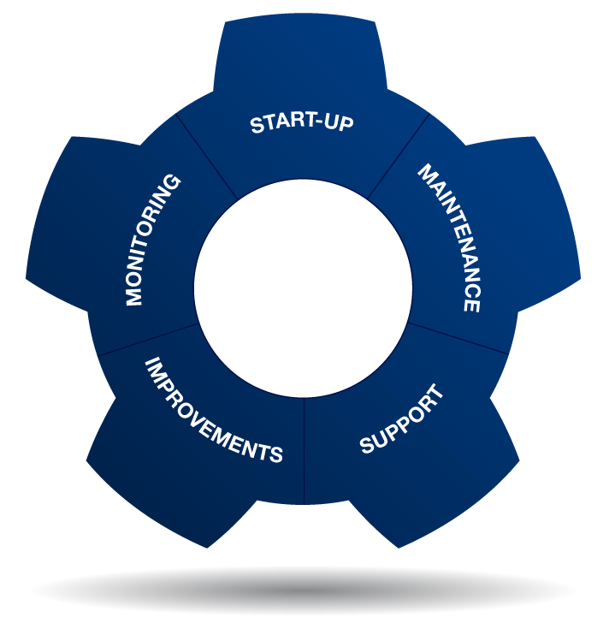
Service Products
Installation Supervision
Commissioning
Commissioning Supervision
Preventive Maintenance
Reconditioning
Cleaning Services
Repair
Service Kits
Service Tools
Spare Parts
Condition Audit
Performance Audit
Telephone Support
Training
Troubleshooting
Technical Documentation
Equipment Upgrades
Redesign
Replacement & Retrofit

Slide 17
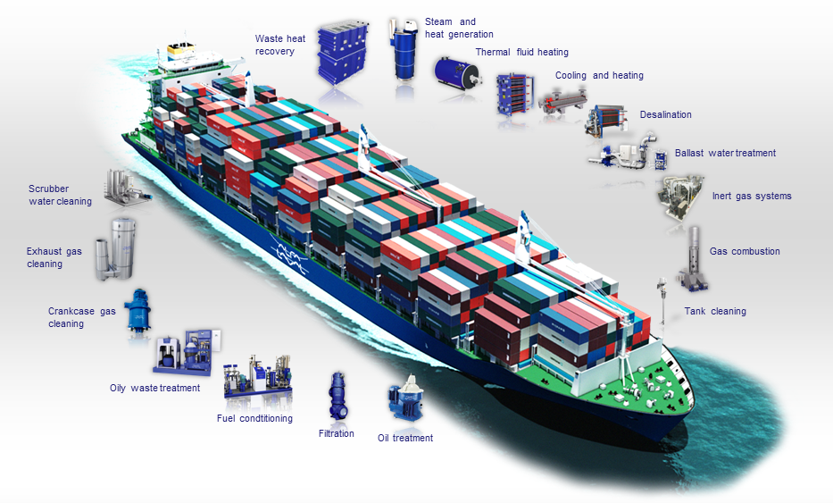
Alfa Laval on board

Slide 18
PureDry – A completely new concept

Slide 19
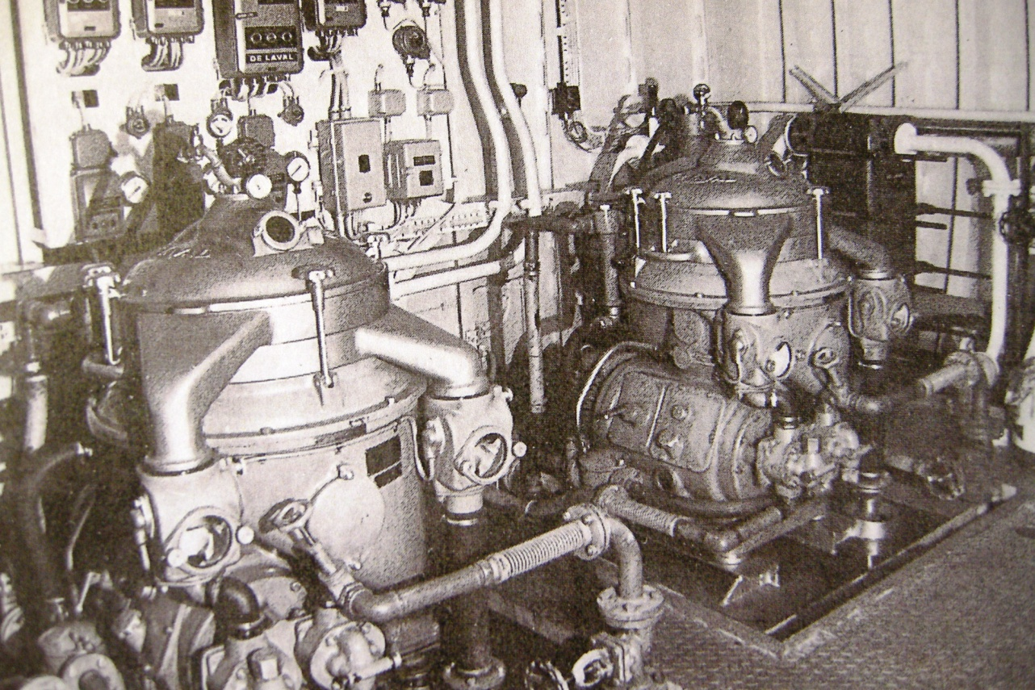
PureDry-historical background

Slide 20

1887

Slide 21
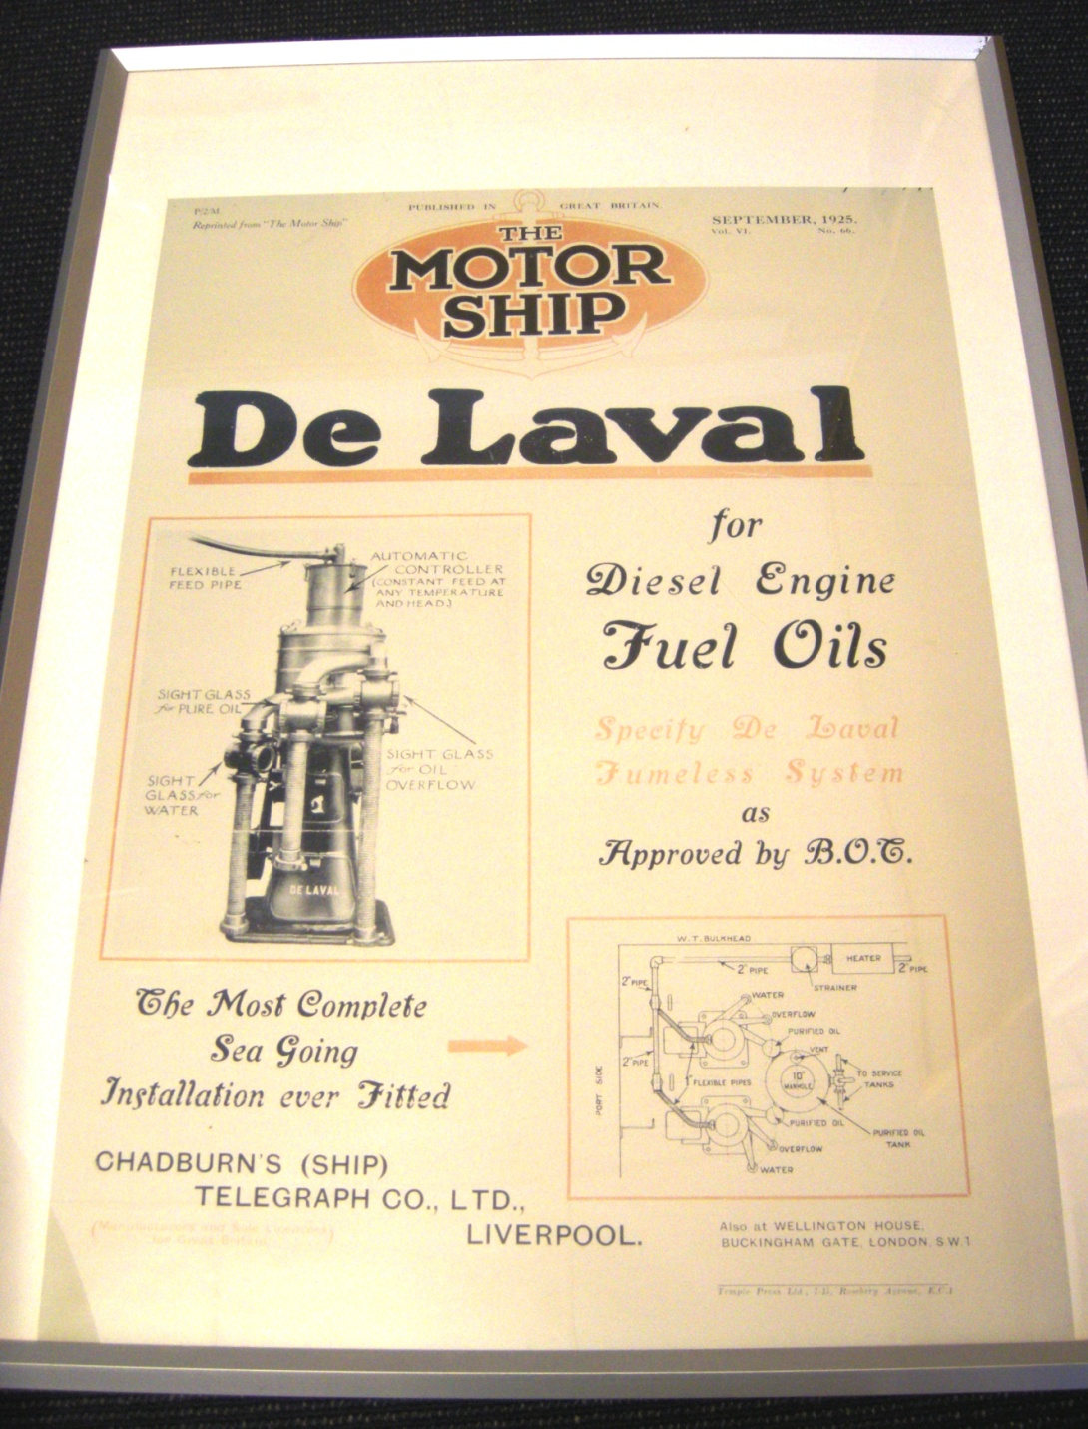
1925
The first FO centrifugal high speed disc type separator

Slide 22
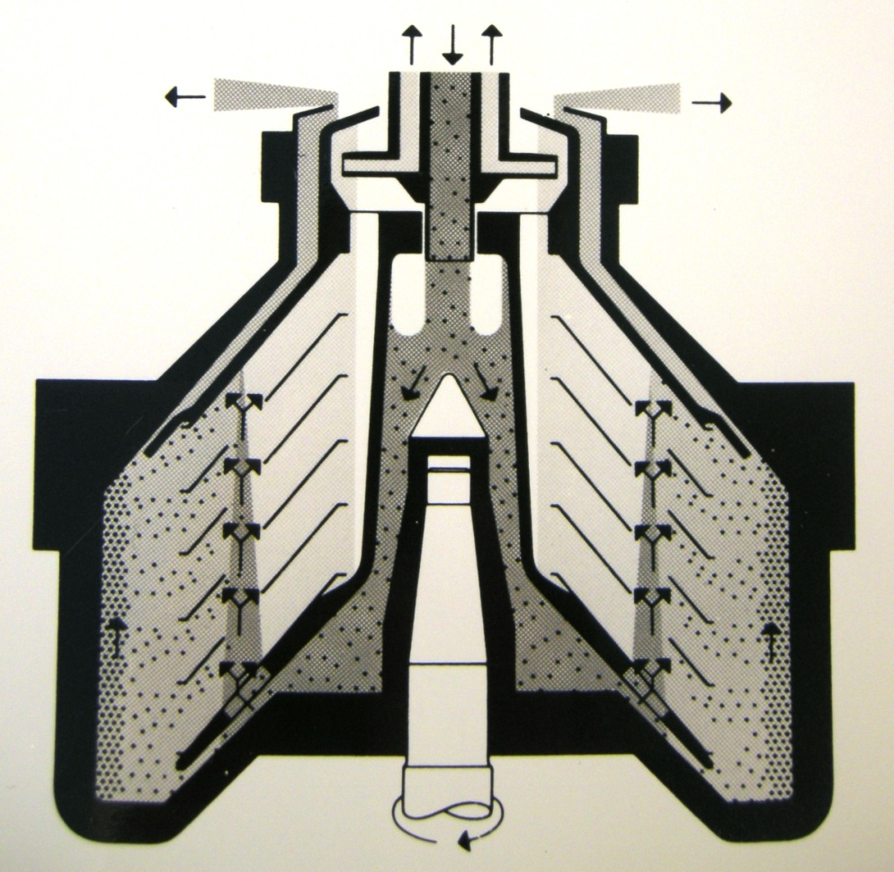
Solid Bowl – Manual cleaning

Slide 23
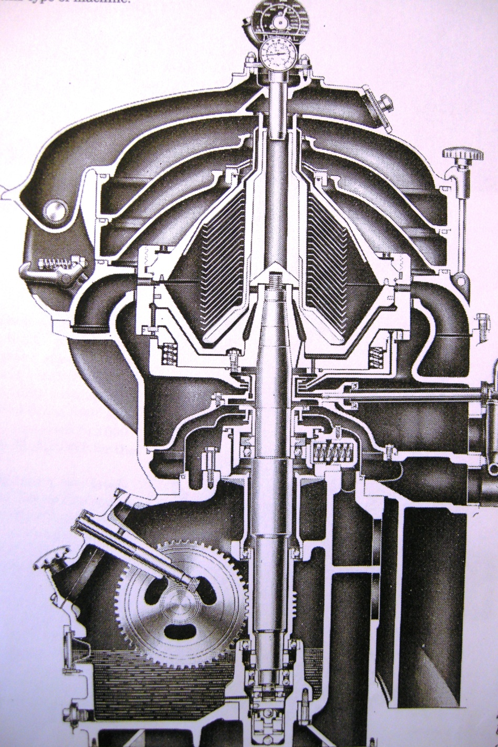
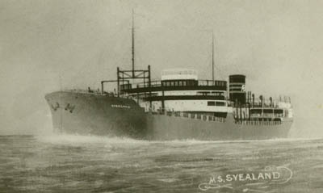
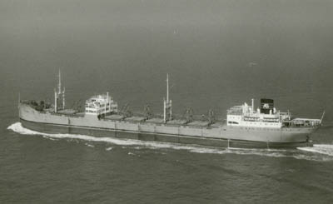
1953
PX 2920 onboard M/S Svealand (Brostrom) – 1 st vsl with
selfcleaning separator

Slide 24
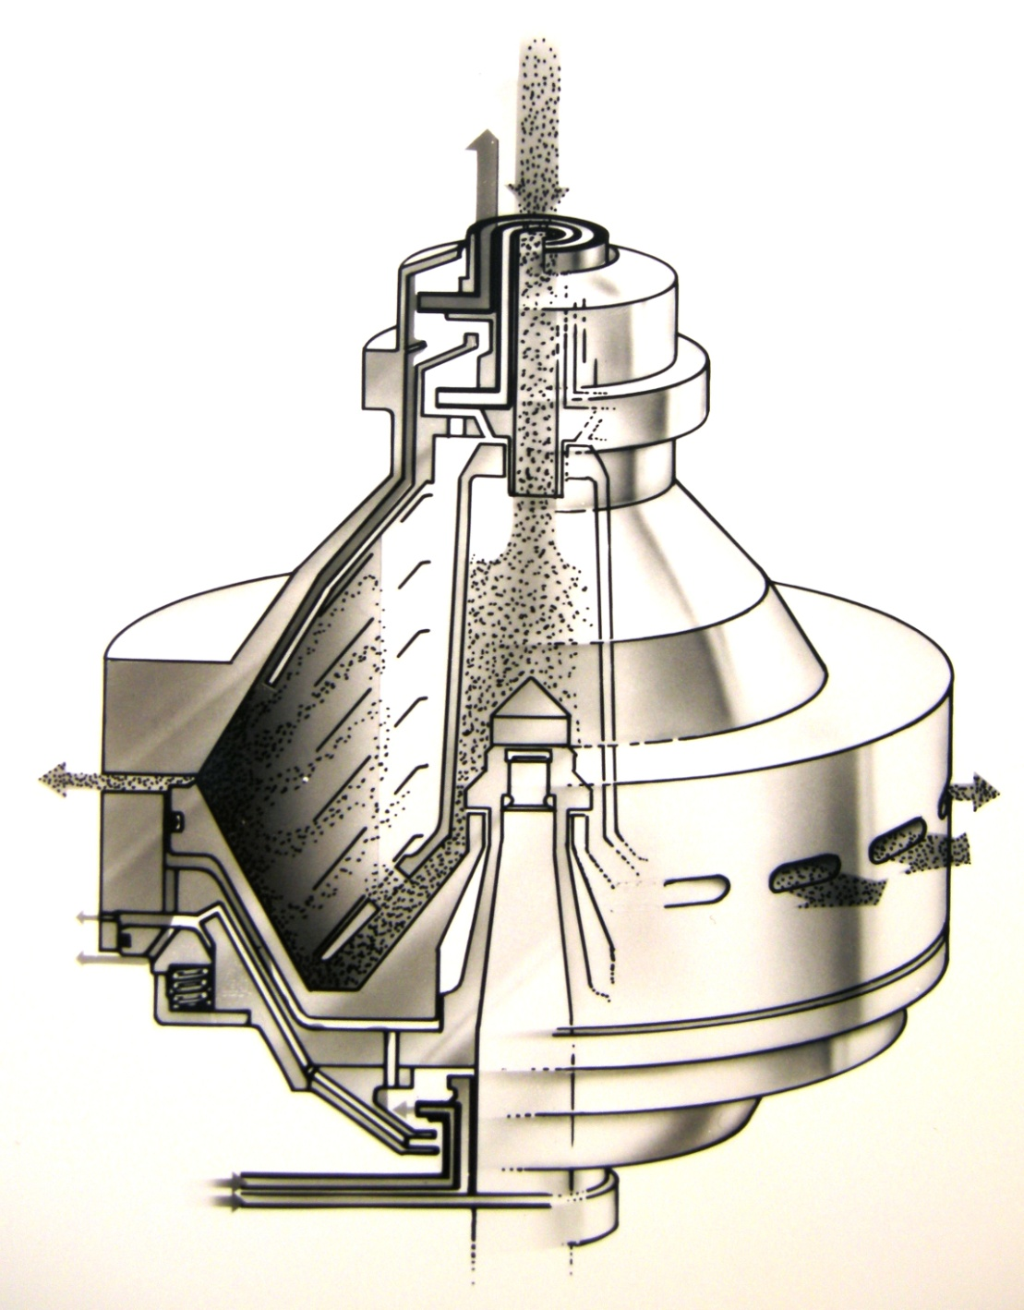
Solid Bowl Self-cleaning (PX)

Slide 25

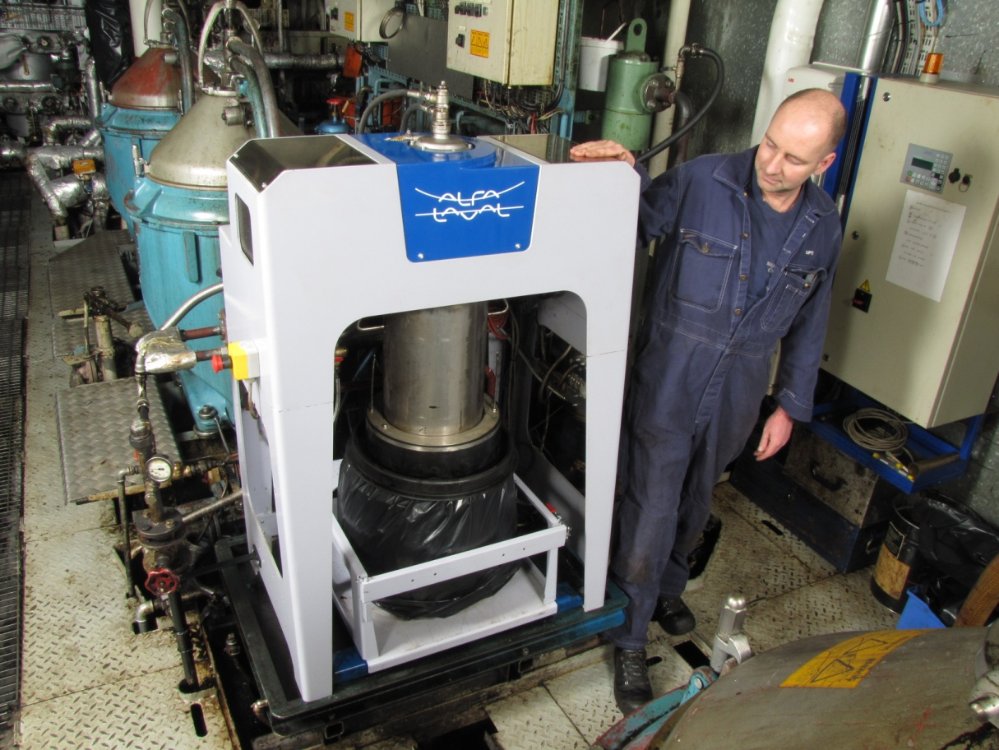
2012
2012
M/S Silja Symphony

Slide 26
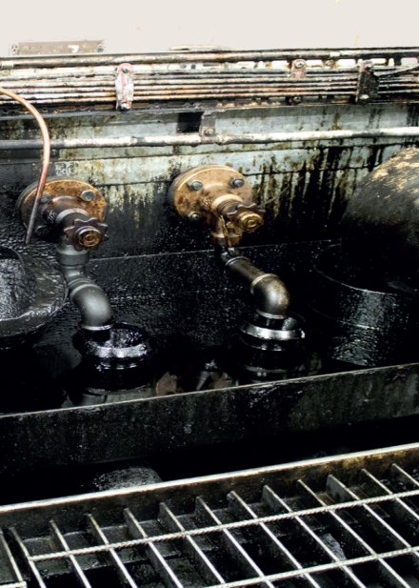
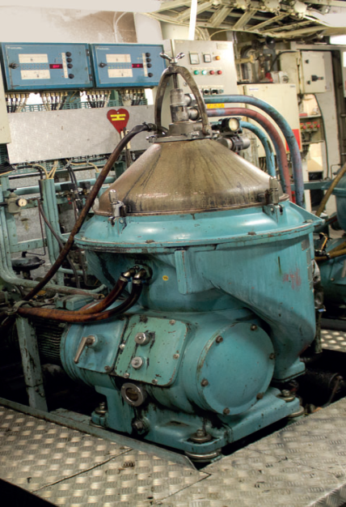
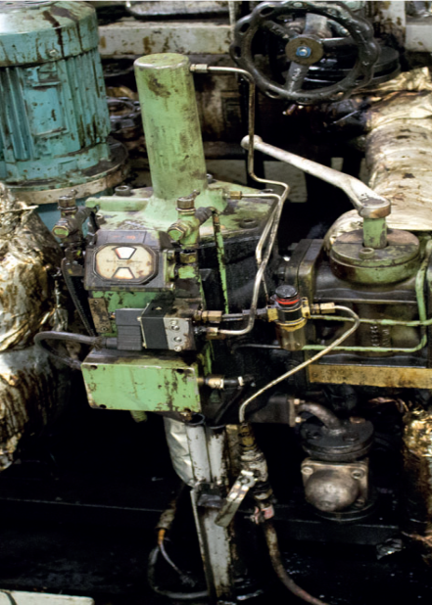
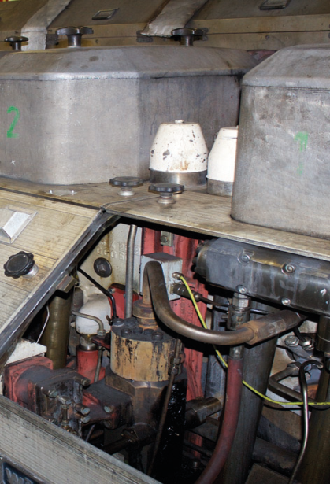
Up to 2 % of HFO is lost – The Sources
Automatic back flushing fuel oil filters.
Fuel settling and service tank drains, tank coamings and cofferdams.
Fuel injection pumps.
Boiler burner leakages.
Drip trays under fuel transfer umps, etc.
Pipe leakages.
Fuel spill incidents.
Fuel oil purifiers.

Slide 27
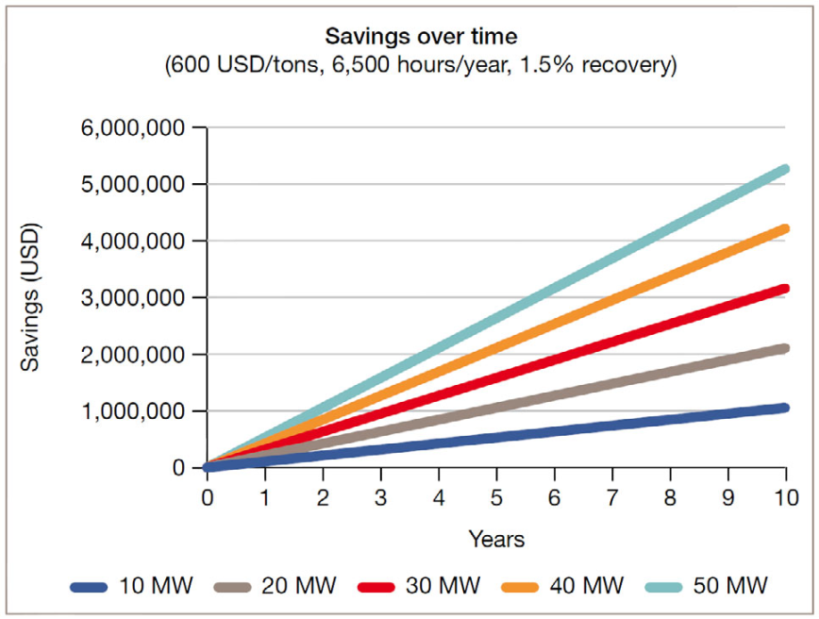
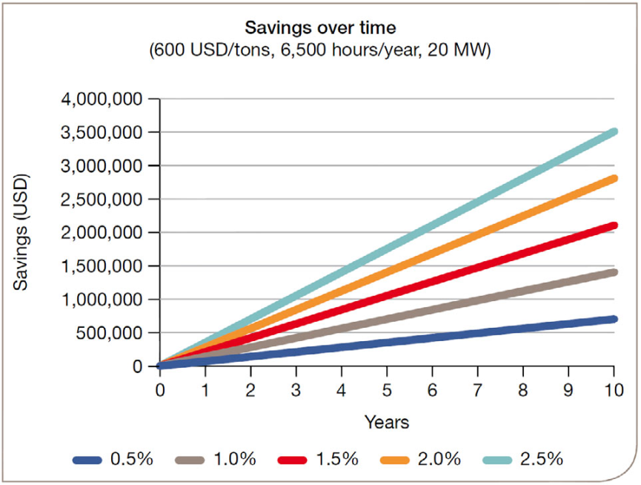
Why install a PureDry
Economic Benefits :
Recover on average up to 2% of the bunkered fuel.
Factors determining the profitability of a PureDry installation :
Fuel consumption of the engines
The vessel’s sailing time per year
Percentage of fuel that can be recovered
Price of bunker fuel.
Recovery
Ship

Slide 28
Why install a PureDry
Environmental benefits :
No incineration of waste fuel needed.
Waste oils collected in the waste oil tank.
When the tank is full, sustainable combustion of the oil may be the only solution to get tank capacity again.
To maintain the incineration process, diesel oil is required to be added in order to support the combustion if the water content is higher than 50%.
Oily waste contains typically 66 – 80% water. A diesel fired support flame supports the incineration.
0.1 kg of diesel oil is required to make 1 kg of water disappear up the stack.
This results in emissions and thereby a larger carbon footprint.
Marpol Annex VI regulation will lead to fewer ship owners will be installing incinerators.
Water separated has an oil content of less than 1,000 ppm and is pumped to the ship’s bilge tank, which can be further reduced to below 5 ppm.
Minimal amount of solids for disposal ashore.

Slide 29
Rules & Regulations
MEPC.1/Circ.642
Recover and reuse the HFO part of the waste oils as fuel to the diesel engines.
Re-generation of fuel oil from oil residue (sludge) should be an approved means of disposal of oil residue (sludge)”.
Oily drains should be recorded in the oil record book as any other oil residue (sludge) collection.

Slide 31
4.6 Re-generating fuel oil from sludge
4.6.1 Oil residue (sludge) may be used onboard as re-generated fuel. Oil residue (sludge) is collected in an oil residue (sludge) tank prior to processing (disposal) back into the fuel oil system as re-generated fuel oil.
4.6.2 Oily drains should be recorded in the oil record book as any other oil residue (sludge) collection.
4.6.3 Re-generation of fuel oil from oil residue (sludge) should be an approved means of disposal of oil residue (sludge) according to the Supplement to the IOPP Certificate.
4.6.4 The re-generating process may include filtration, decanting or purification to remove unwanted heavy parts from the oil residue (sludge).

Slide 32
Benefits for shipyards and power plants
• Compact, modular, easy-to-install system.
• Smaller holding tank volumes for waste oil and waste water, increasing payload capacity.
• Easy to integrate with existing onboard systems.
Benefits for owners and operators
• Substantial savings from recovery of fuel oil.
• Reduction in carbon dioxide footprint.
• Effective pretreatment of water prior to discharge to the bilge water tank.
• Minimal amount of solids for disposal ashore.

Slide 33
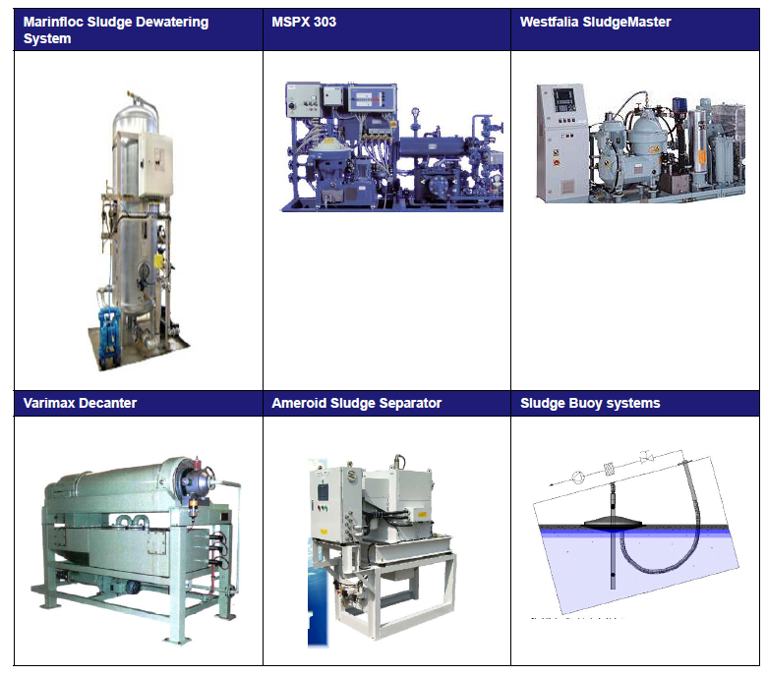
Sludge treatment products on the market:

Slide 34
The waste fuel oil tank
Condition for recovery of fuel oil :
Waste fuel oil collected from the sources listed is segregated in a separate tank from other drains and leakages, such as lube oil, hydraulic oils, etc.
Gravitational settling :
Top Layer : Oil, contaminated with water
Middle layer : Water polluted by oil, chemicals, particles in emulsion form.
Bottom layer : Heavy sludge and solids
Oil 20 – 30 %
Oil polluted water, 70 - 80 %
Waste oil tank
  Suspended solids, ~1 %

Slide 35
PureDry system – BX50 separator with heating module

Slide 36
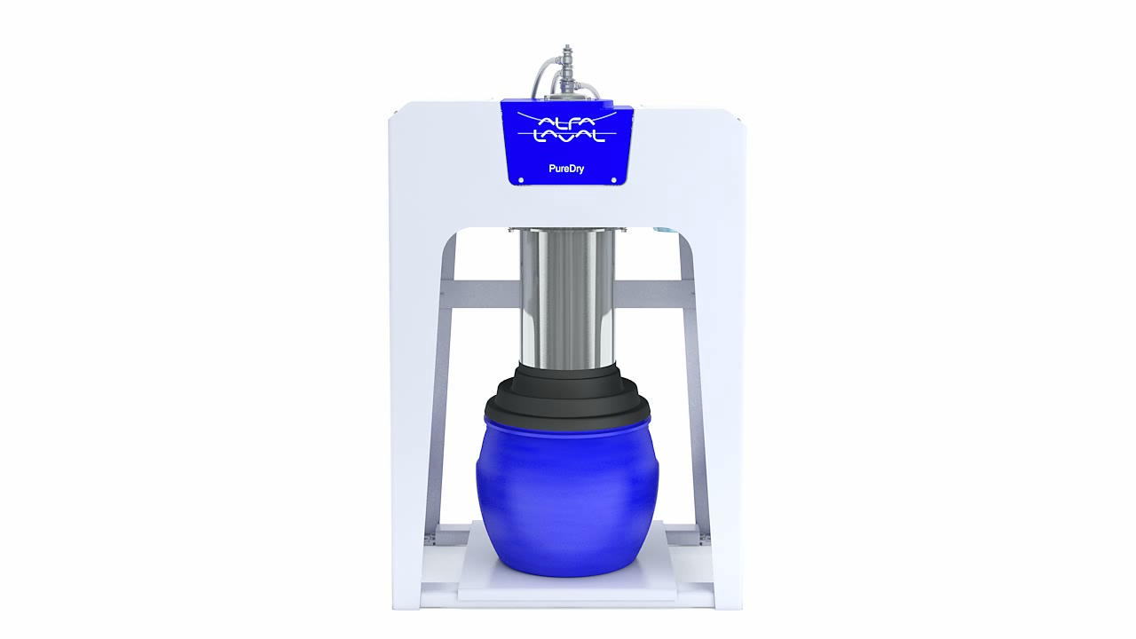

Slide 37
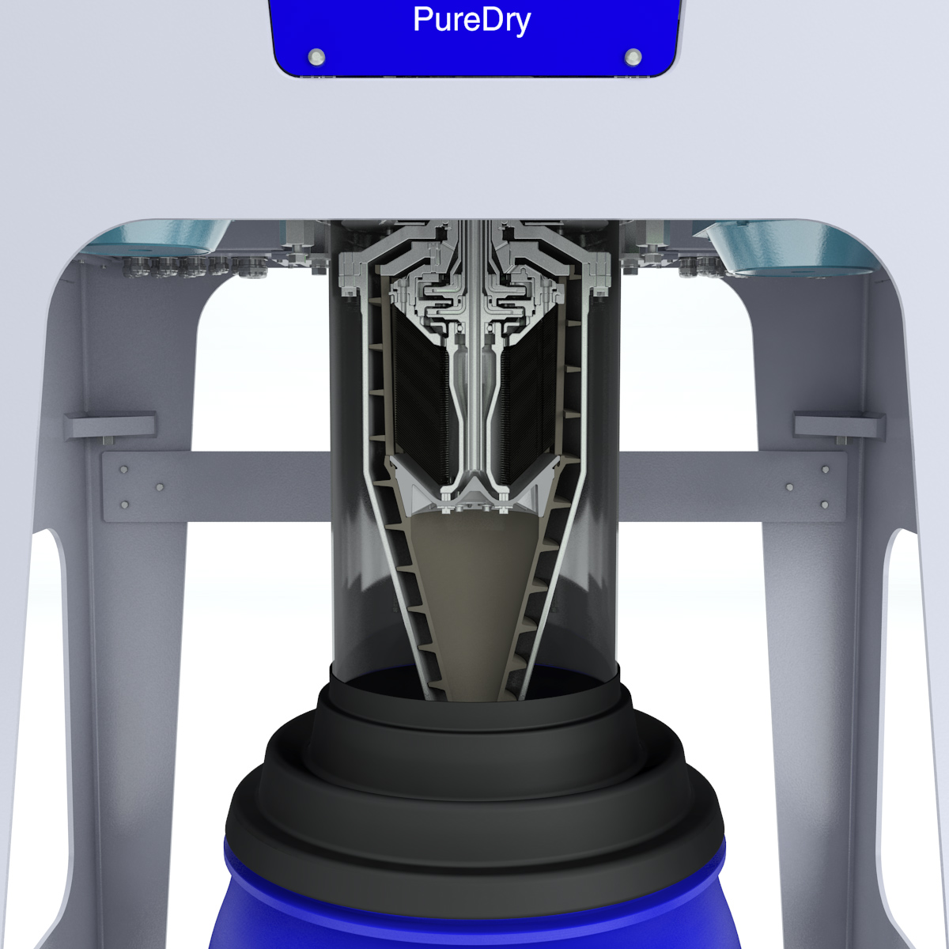
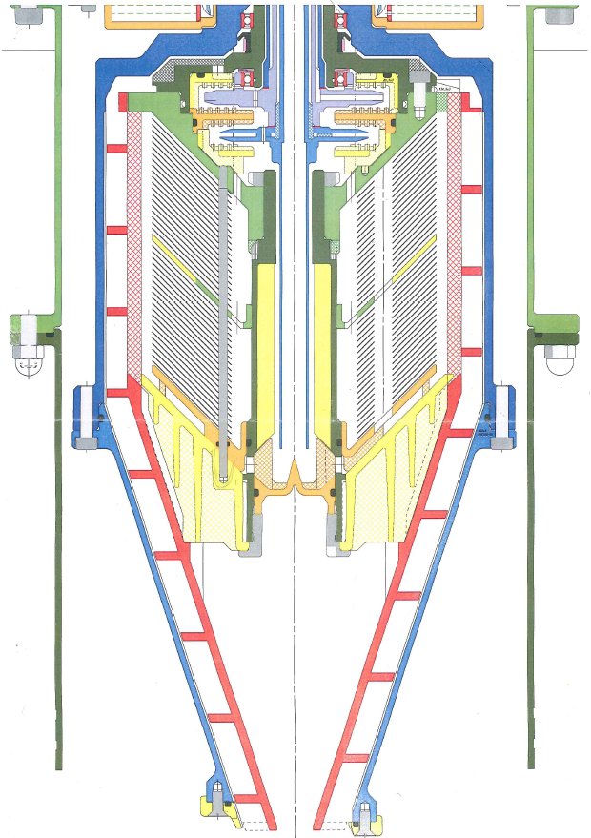

Slide 38
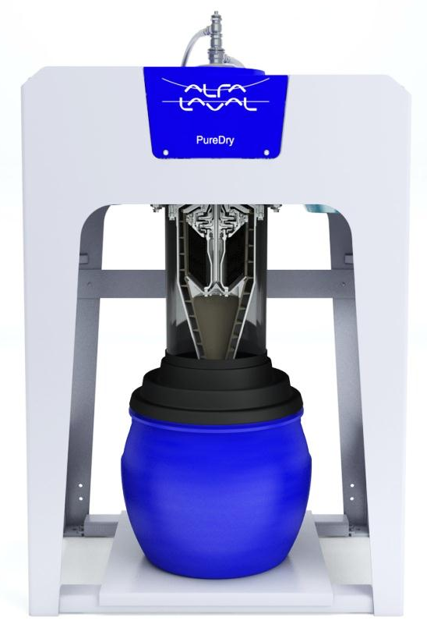
XCavator
Separator
insert

Slide 39
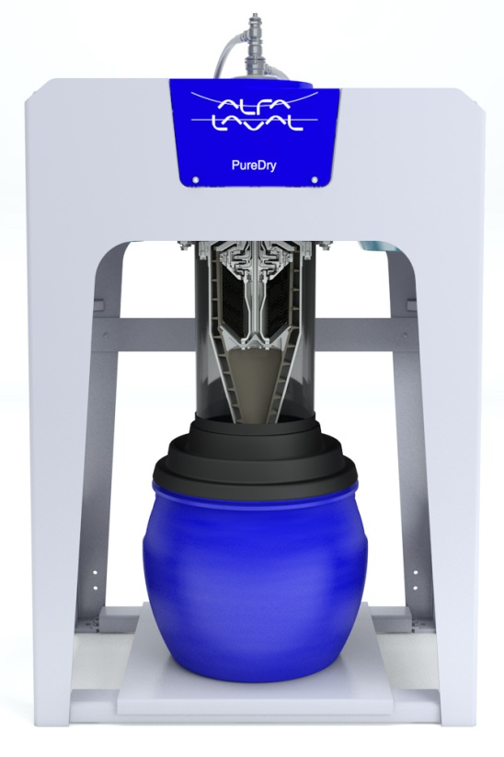
BX 50
Rotor complete

Slide 43
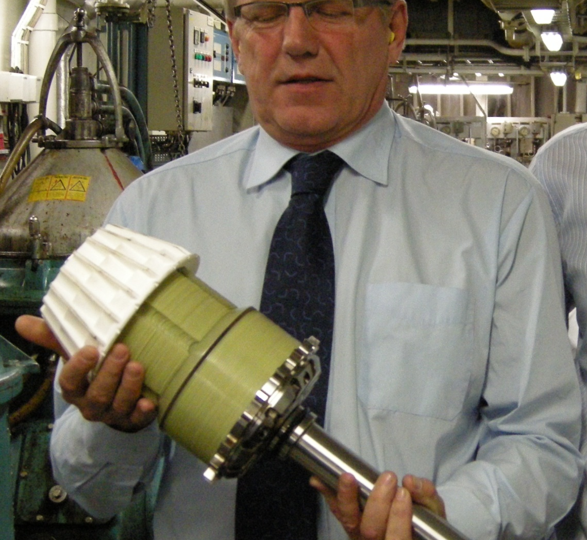

Slide 44

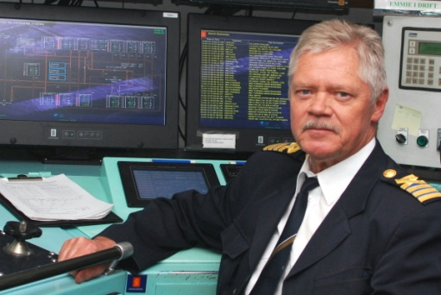
PureDry
M/S Silja Symphony
C/E Mats Göras

Slide 45
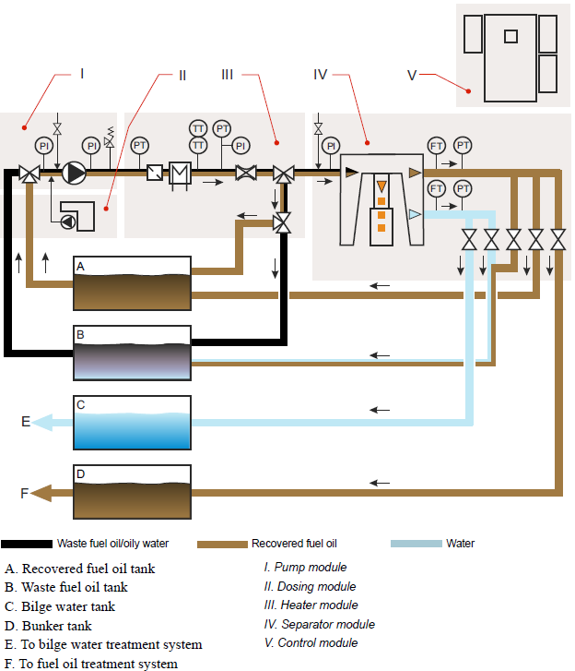
PureDry Process

Slide 46
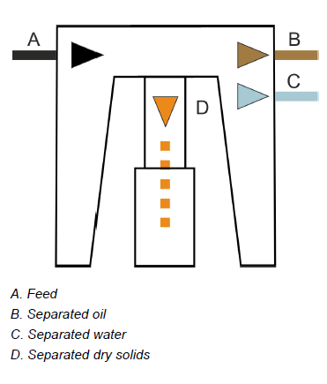
Separation of oil and water
Ratio between oil and water = Quality of oil
Compare the feed flow rate with flow rate of the outputs
Eg : the oil flow (B) is 85% of the feed (A) water flow (C) is 15% of the feed, we can conclude that the feed is taken from the upper part of the tank where it is mostly oil. The separated oil is rather clean from water.
On the other hand if the water flow (C) is 85% of the feed (A) we can conclude that the feed is taken from the middle of the tank where it is mostly water. The separated water is polluted with oil.

Slide 47
Separation of oil and water
Oil Purity
If the oil outlet flow is above certain percentage of the feed flow rate the oil is clean enough to be further treated and recovered.
If the water flow is above a certain percentage of the feed flow rate the water is clean enough to be treated in a bilge water treatment system.

Slide 48
Separation of oil and water
Flow interpretation
•oil flow breakpoint, Bo
•water flow breakpoint, Bw
By measuring the oil and water flow after separation and compare the values with corresponding set point values (Bo and Bw) the EPC 60 control unit can determine from what layer in the tank the feed is taken from. The result of the separation is dependent upon which layer the feed is taken from and will be handled differently in the process.

Slide 49
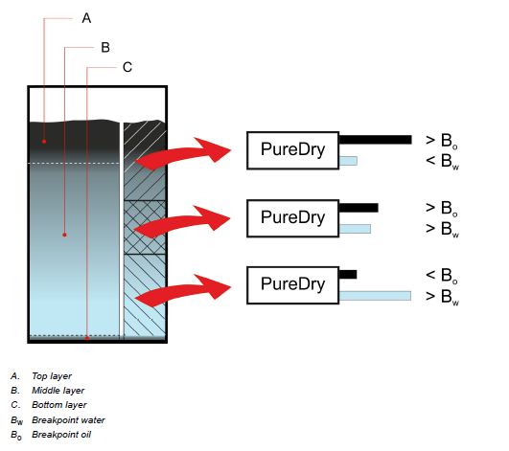

Separation of oil and water
The relationship between breakpoint value, measured value and expected purity of oil and water
Oil flow breakpoint, Bo
Water flow breakpoint, Bw

Slide 50
Process – Essential components
Recovered FO Tank :
Located between the waste fuel oil tank and the bunker tank.
Recovered fuel oil is temporarily stored before it is finally treated and pumped to the bunker tank.
Flowmeters :
The flow meters continuously measure the oil and water flow and give signals to EPC 60 control unit.
The signal from the oil flow meter controls the feed flow, temperature, discharge interval and the three shut-off valves at the oil outlet.
The signal from the water flow meter controls the two shut-off valves at the water outlet. However, when feed is taken from the oil recovered fuel oil tank, the signal from the water flow meter also controls the three oil shut off valves

Slide 51
PureDry System : Separation in 3 Phases
Water containing less than 1,000 ppm oil
Fuel oil containing less than 5% water
Super-dry solids for disposal
3 Modules :
Pumping Module
Heating Module
Separation Module

Slide 52

System overview
Four main functions
Notes:
1. Pumping stage
Function.
Feeds waste fuel oil to the system.
Main components
A positive displacement pump with variable frequency converter.
Demulsifier dosing unit.
Valves and transmitters.
2. Pre-treatment stage
Function
Prepares waste fuel oil for efficient separation.
Main components
Heat exchanger.
Steam regulating valve.
Strainer.
Valves and transmitters.
Separation stage
Heavy phase
Light phase
Solid content
3. Separation stage
Function
Separates water and sludge from waste fuel oil.
Main components
Separator.
Valves and transmitters.
4. Process control&Monitoring
Function
Controls and monitors the process.
Main components
Control & monitoring unit.
Variable frequency drives (VFDs) for pump and separator.

Slide 53


Pumping stage
Function.
Feeds waste fuel oil to the system.
Main components
•A positive displacement pump with variable frequency converter.
•Dosing module.
•Valves and transmitters.
Pretreatment stage
Function
Prepares waste fuel oil for efficient separation.
Main components :
•Heat exchanger.
•Steam regulating valve.
•Strainer.
•Valves and transmitters.

Slide 54


Separation stage
Function :
Separates water and dry solids from waste fuel oil.
Main components :
•Separator.
•Valves and transmitters.
Process control & monitoring
Function :
Controls and monitors the process.
Main components :
•Control & monitoring unit.
•Variable frequency drives (VFDs) for pump and separator.

Slide 55
System Layout

Slide 56
Operating Principle :
A positive displacement feed pump directs the waste oil to the system.
Process liquid passes through a duplex strainer, which traps large particles
Pre-heater : For optimum separation efficiency, feed temperature of 95°C.
A three-way changeover valve : directs the oily waste to the separation stage. (all conditions met).
Water : Transferred either to the ship’s bilge water treatment system.
Chemical Dosing Unit - To enhance performance in the presence of stable emulsions (Alpacon205)
EPC60 : Continuous Monitoring

Slide 57

EPC 60 panel
The HMI consists of a control panel with
•an alphanumeric backlit display,
•a numeric keypad with enter key,
•four special keys (arrow up/down, escape and info),
•14 LEDs,
•10 push buttons.

Slide 58

Process Modes :
During separation the PureDry process works in different process modes depending on how the EPC 60 control unit reads the signals from the flow meters. The modes are grouped as follows:

Slide 59



Start mode

Slide 60




Waste fuel oil treatment 1

Slide 61




Waste fuel oil treatment 2

Slide 62




Waste fuel oil treatment 3

Slide 63



Multi pass mode (Batch mode)

Slide 64




Fuel transfer mode 1 (Recovered fuel oil treatment mode 1)

Slide 65




Fuel transfer mode 2 (Recovered fuel oil treatment mode 2)

Slide 66

Installation

Slide 67

Installation Preferences
Separated waste handling, FO waste only
LO to be handled separate
Tank Set-up Waste fuel oil tank > 8 m3, low level switch, heat tracing, suction point min 300 mm from bottom
Recovered fuel oil tank >2-4 m3 H, L level switch, heat tracing, ( insulated)
Heat tracing on oil pipes
Clean tanks before startup
Notes:
Separat waste fuel oil tank
All drains routed to correct tank
Tanks needed
Tank spec

Slide 68
Pump installation :
As close to tanks as possible
Lifetime reduced by increasing suction height
10 meters suction lenght and 40kPa suction height max. ( as low as possible)
Shutoff valve before pump if installed below tank
A non return valve if pump is installed above tank
2 Pumps ?
Heater Module :
Close to separator
Access to service (strainer)

Slide 69





What do we want from a fuel oil sludge treatment system?
Recovered fuel oil
Water to bilge water treatment system
Super concentrated sludge for disposal
Fuel oil waste

Slide 70
The PureDry System removes Catalytic fines from the recovered fuel oil and concentrate them in the dry solids

Slide 71
Maintenance and Service by Exchange- MSE

Slide 72
MSE concept
Maintenance and Service by exchange
The modular design of PureDry allows us to use a totally new concept to handle service and repair.
All parts that need regular maintenance can be dismantled in complete blocks and sent to an Alfa Laval service center. PureDry can be delivered with one extra separator insert and bearing housing to enable the exchange concept without downtime.

Slide 73


Parts to be overhauled or exchanged
Gearbox to be exchanged every third year with a reconditioned unit
Separator insert to be overhauled at service center
Main bearing housing, 12 months
XCavator to be replaced when worn down

Slide 74

PureDry – SuperDry Solids

Slide 75

SuperDry Solids

Slide 76
What to do with the super-dry solids ?
This can be landed as dry waste and disposed of in the same way as oily rags and used filter cartridges.
How much?
Example: On a ship burning heavy fuel oil, with an engine rated at 20 MW, the amount of super-dry solids collected is typically less than 10 kg per 24 hours.

Slide 77



Slide 78
PureDry / PureBilge Integrated System

Slide 79
PureDry – Waste Fuel Recovery (WFR)

