Slide 1




Towards Clean Transportation Through Materials Innovation
Satish Ogale
Department of Physics and Centre for Energy Science
IISER Pune
satishogale@iiserpune.ac.in, satishogale@gmail.com in
Funding : CSIR, MNRE, DST (Nanomission), DIT, BRNS (DAE), Govt of India

Slide 2
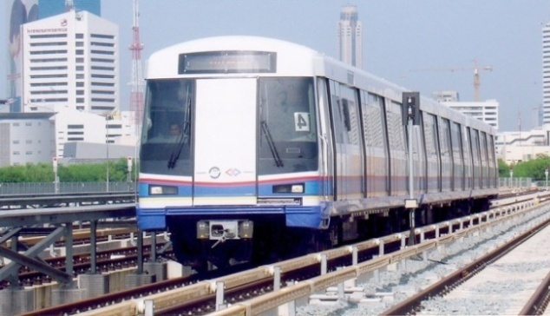

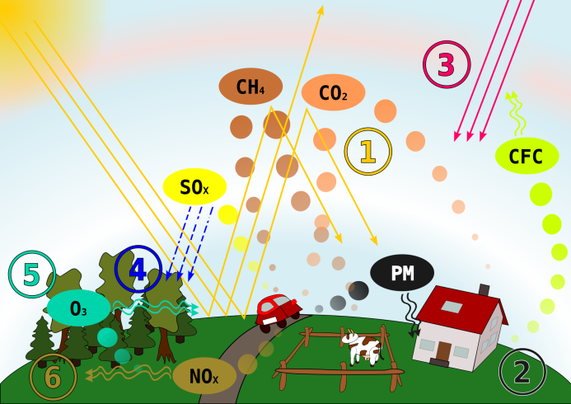
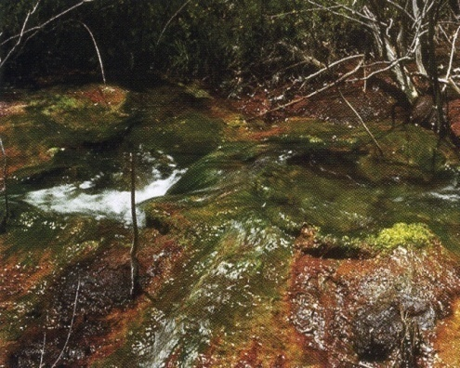
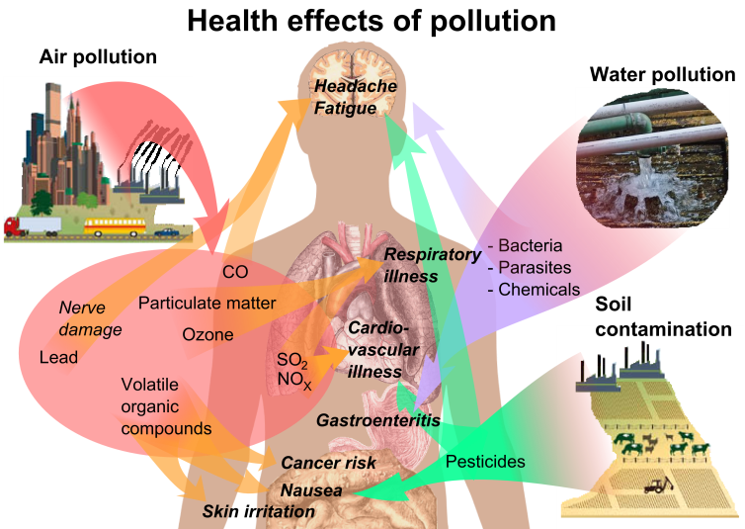

Development
Industrialization
(Energy)
Excessive use of Polluting Fuels
Air and Water Pollution
(Environment)
Ursachen&Auswirkungen.svg
Health Hazards
https://en.wikipedia.org/wiki/Pollution (references therein)

Slide 3
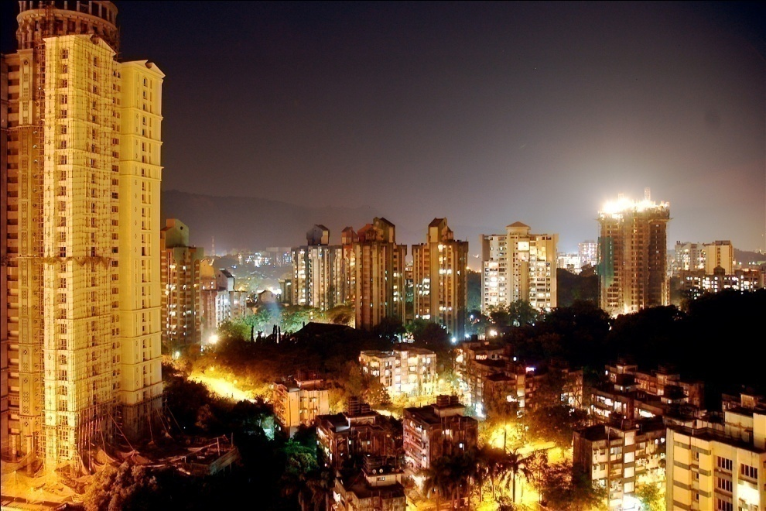
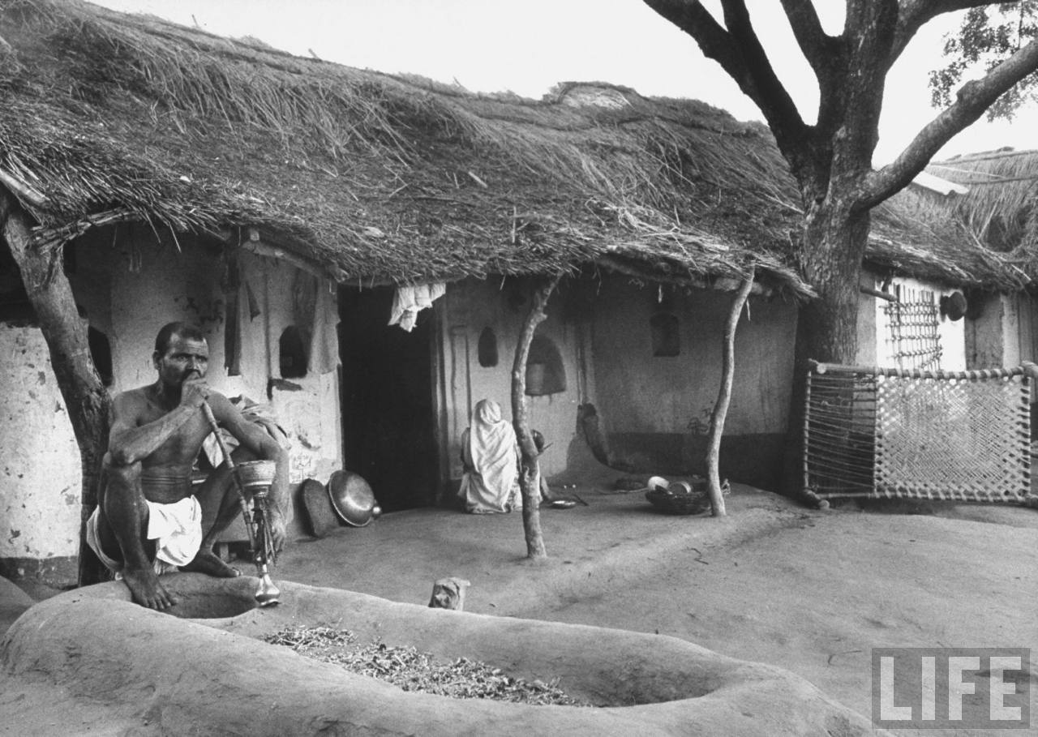
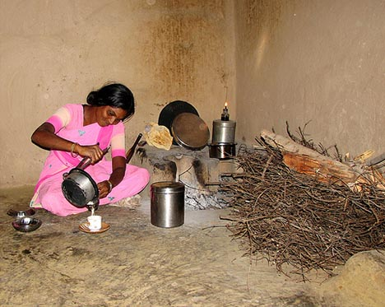
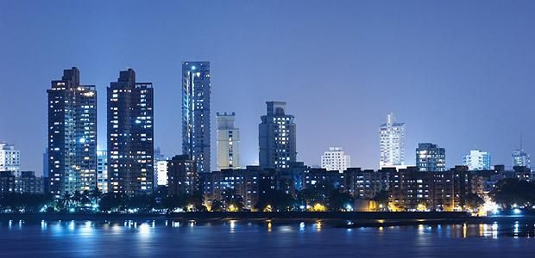

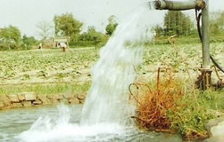
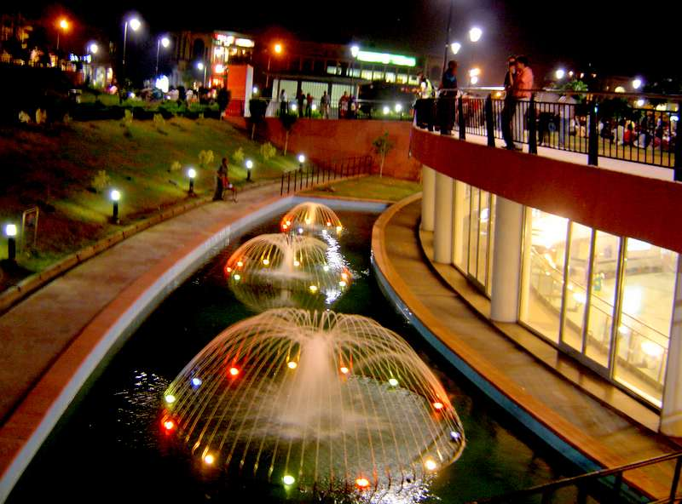

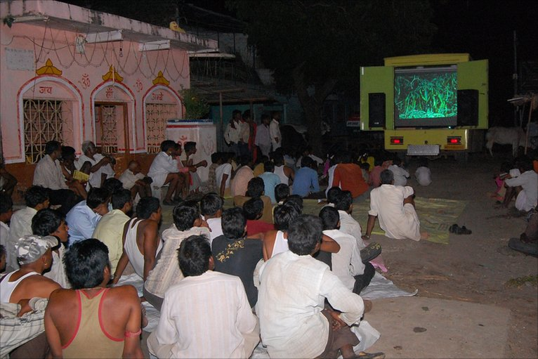

Grid Power
Distributed
Power

Slide 4

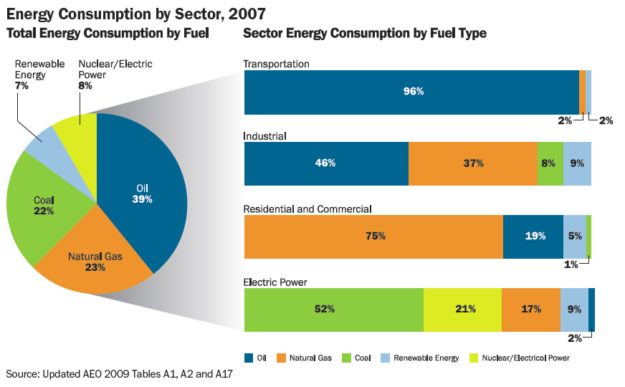
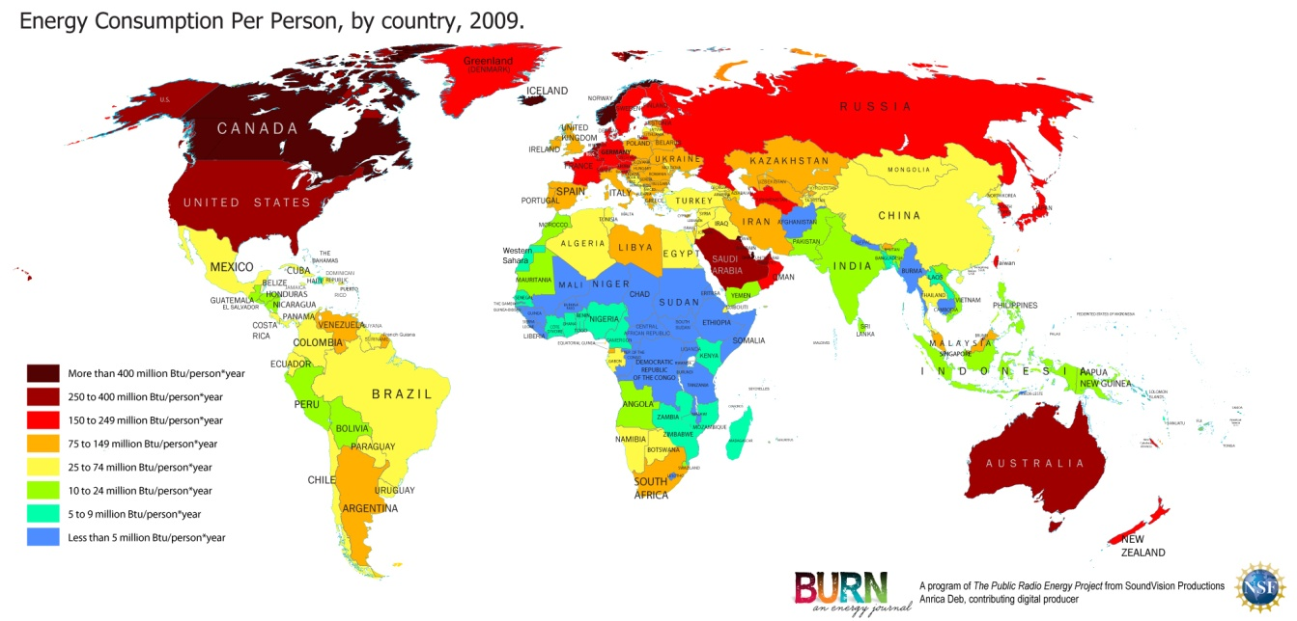
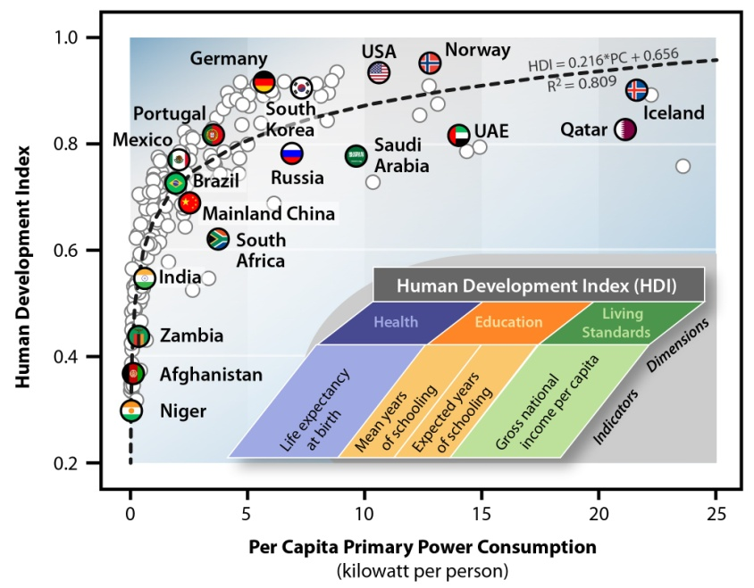

Slide 5
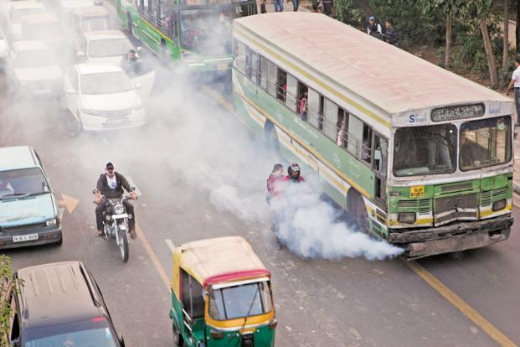
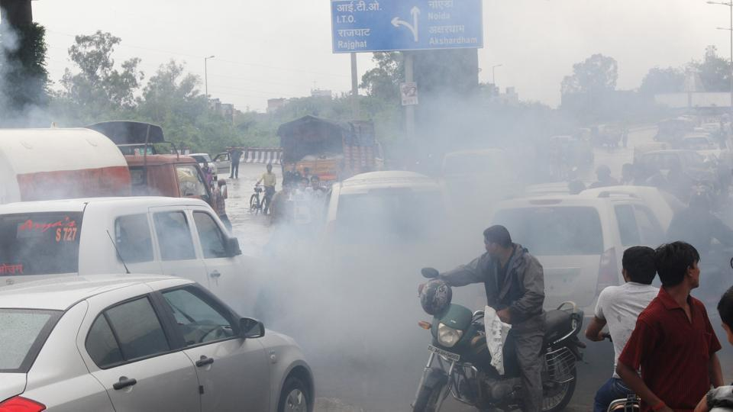
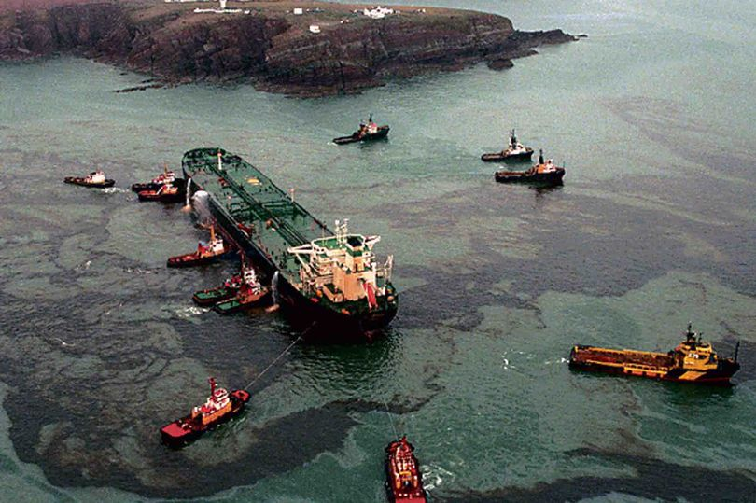


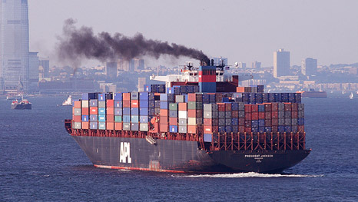
TRANSPORTATION
&
POLLUTION

Slide 6
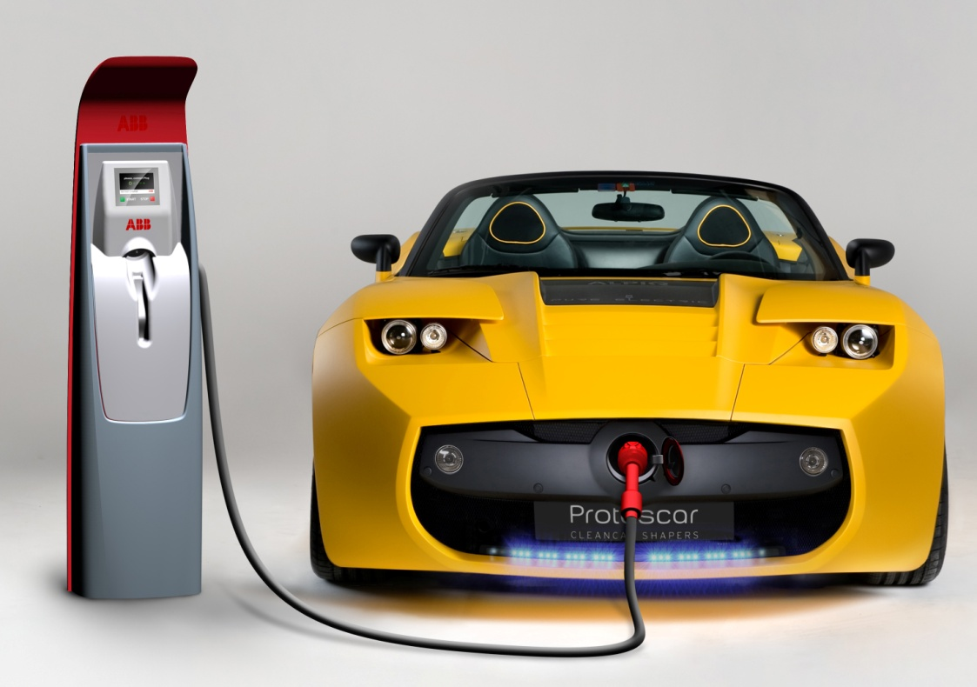
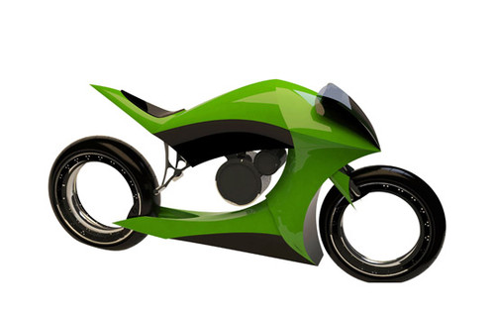
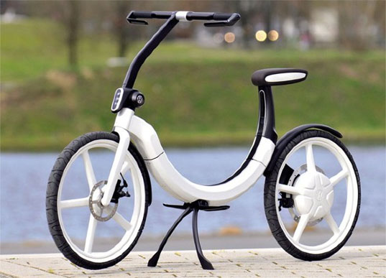
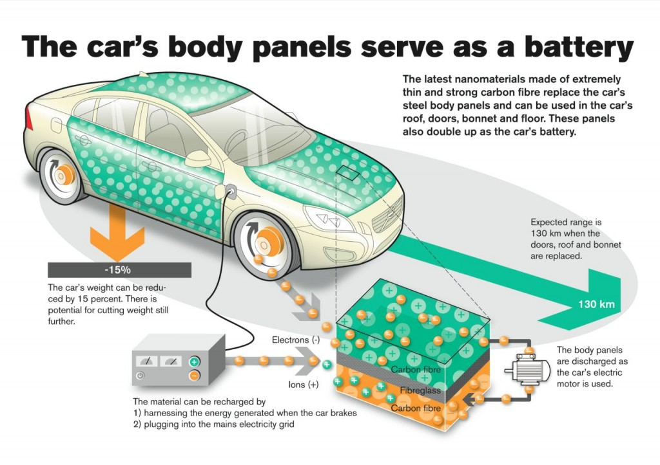
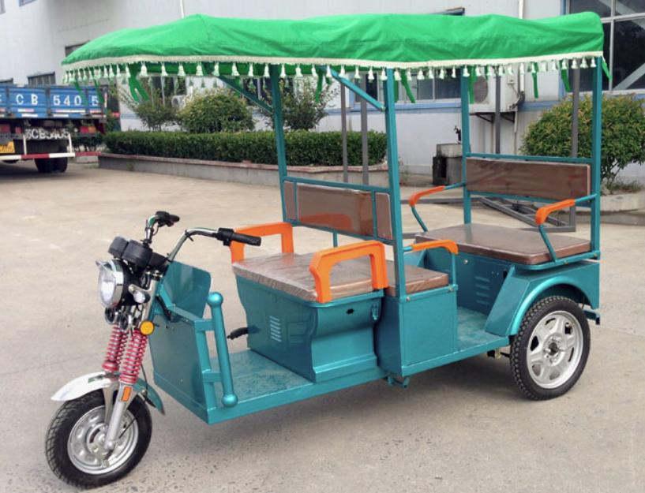

Slide 7
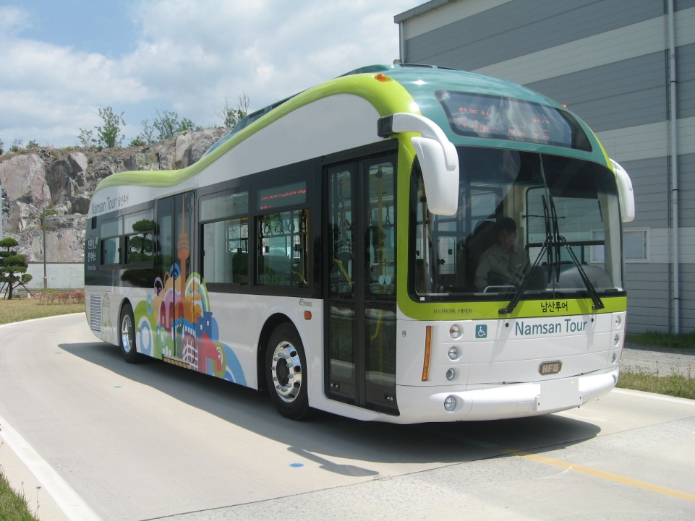
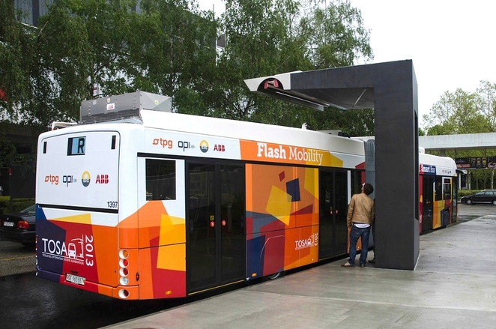
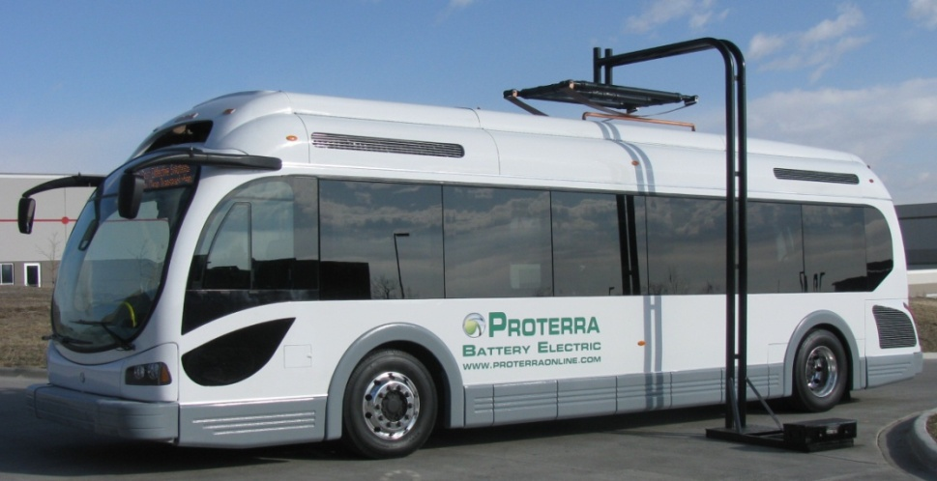
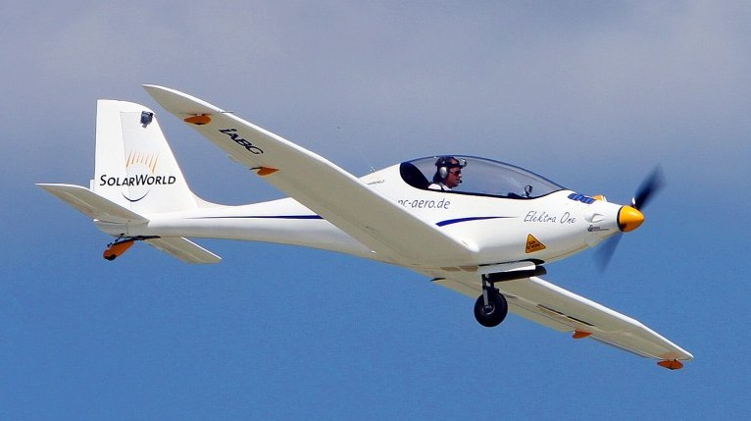
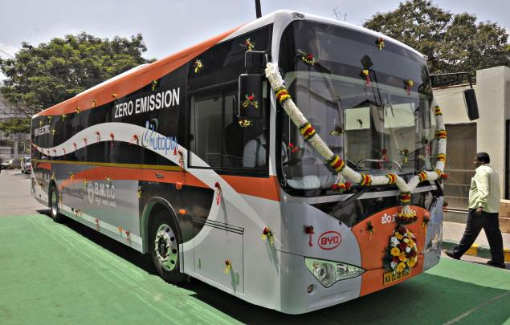
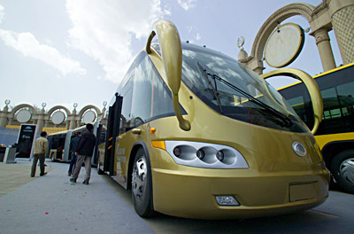

Slide 8
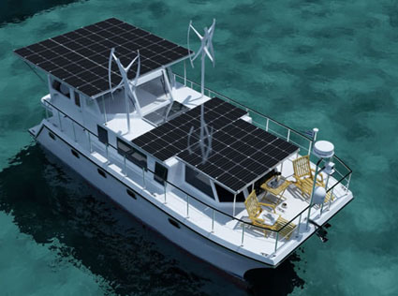
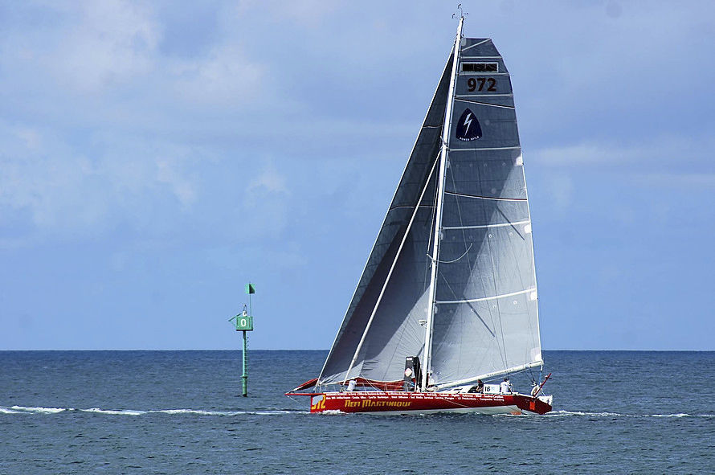
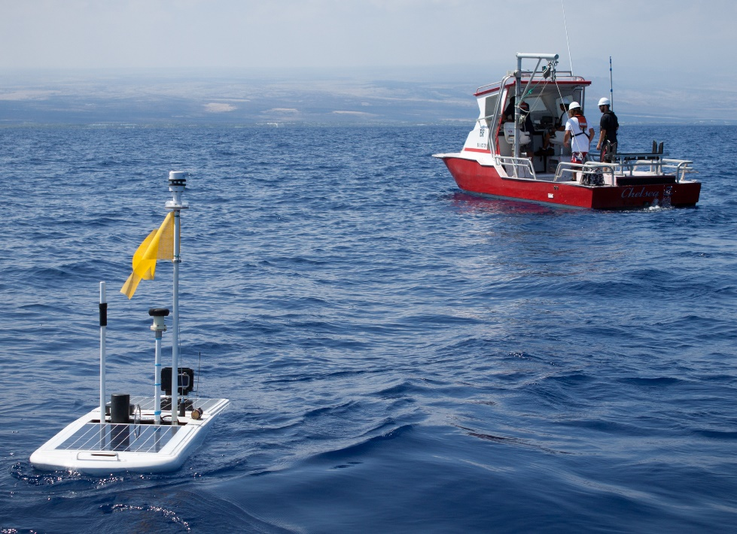
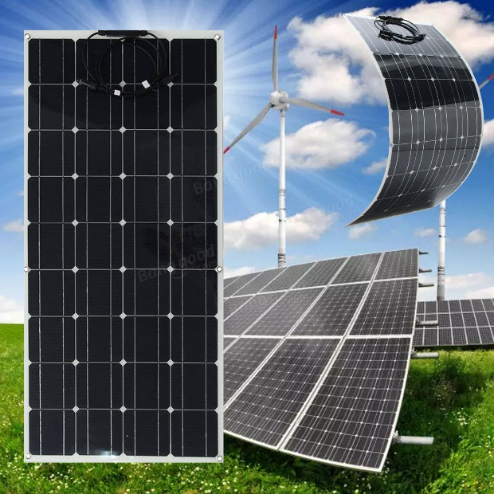
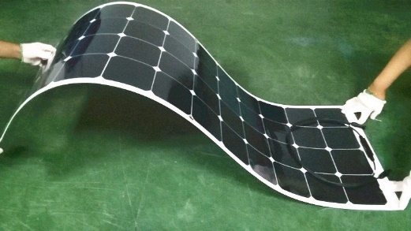

Slide 9
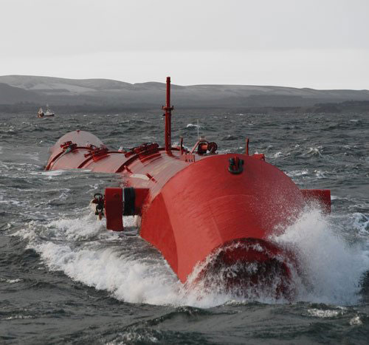
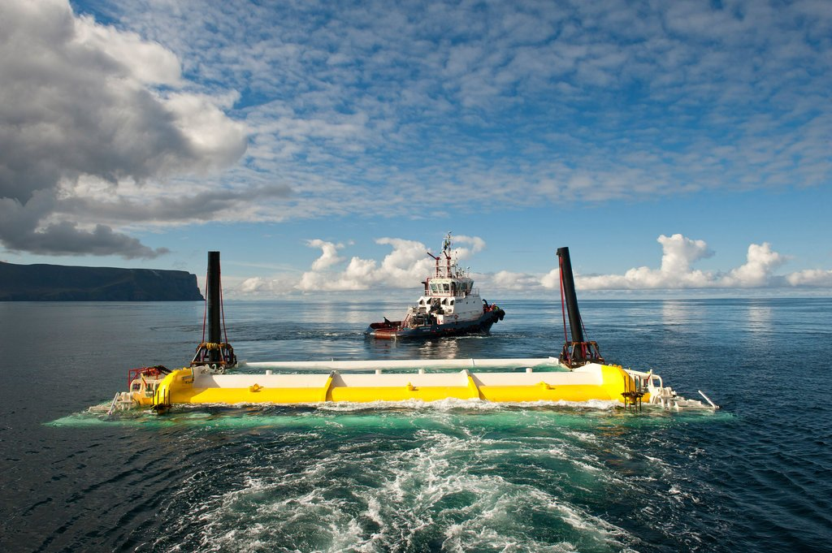
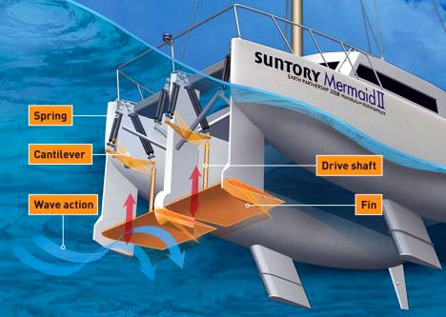
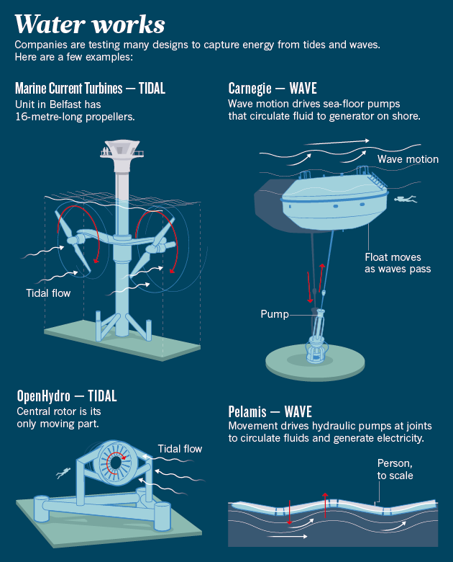
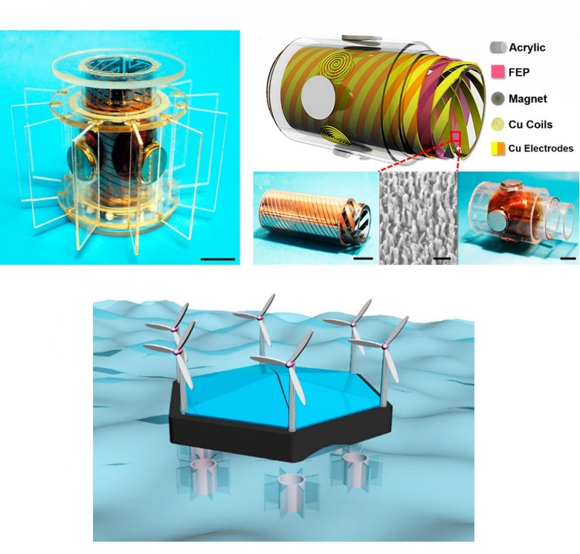
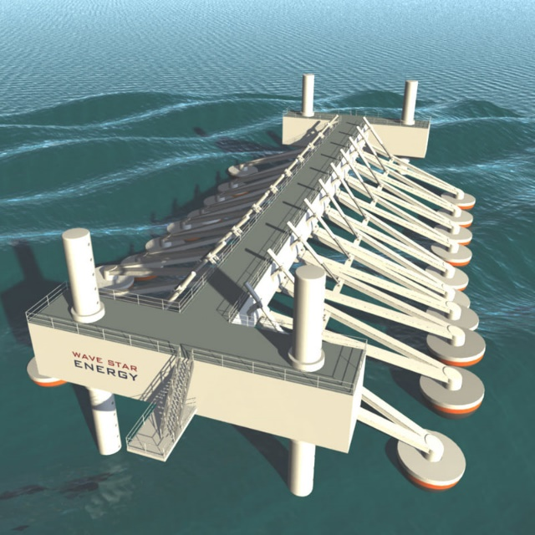

Slide 10
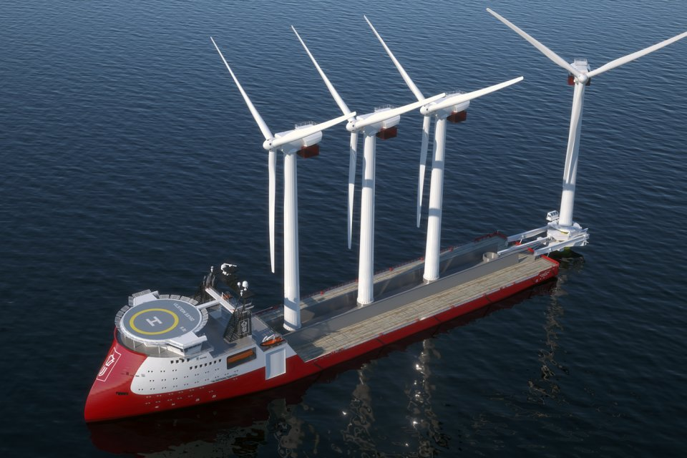

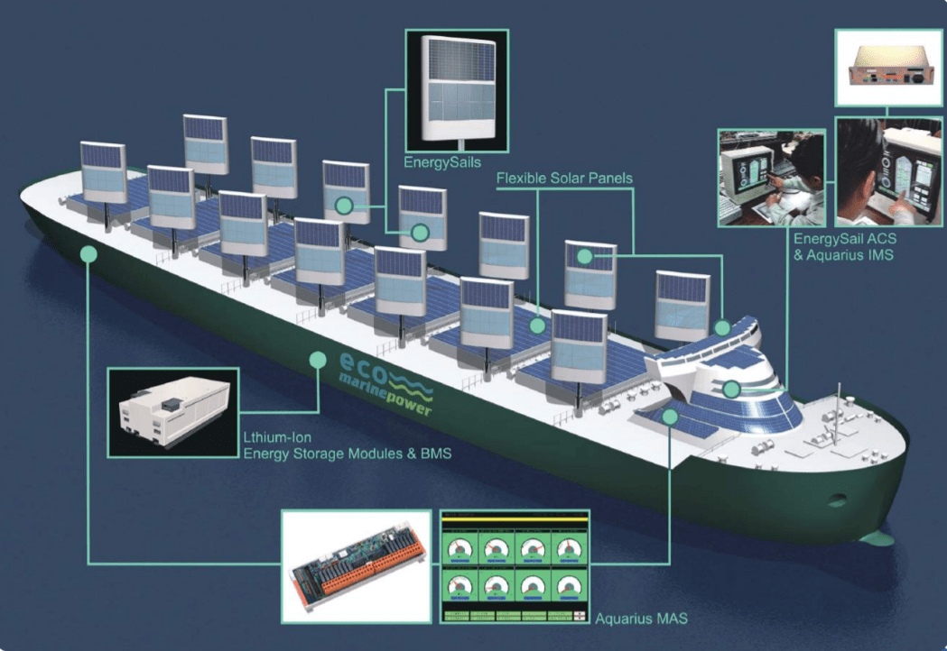
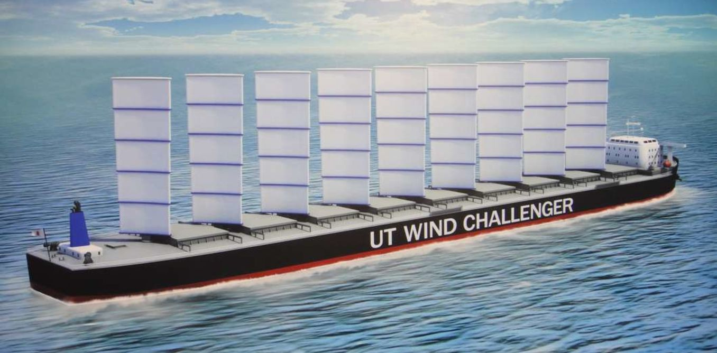

Slide 11

Conversion
Solar Cells, Solar Water Splitting for Hydrogen
Metal Oxides, Sulfides, Semiconductor QDs
Hybrid Perovskites
Dyes, Functional Polymers,
Ionic liquids, gels, organo-metallics
Storage
Super-capacitor, Li- Battery
Hybrid Devices
Conservation
Solid State Lighting (LED)
Functional High Surface Area Carbon, Metal Oxides/sulfides, Conducting Polymers, Engineered Hetero-junction systems and Interfaces

Slide 12
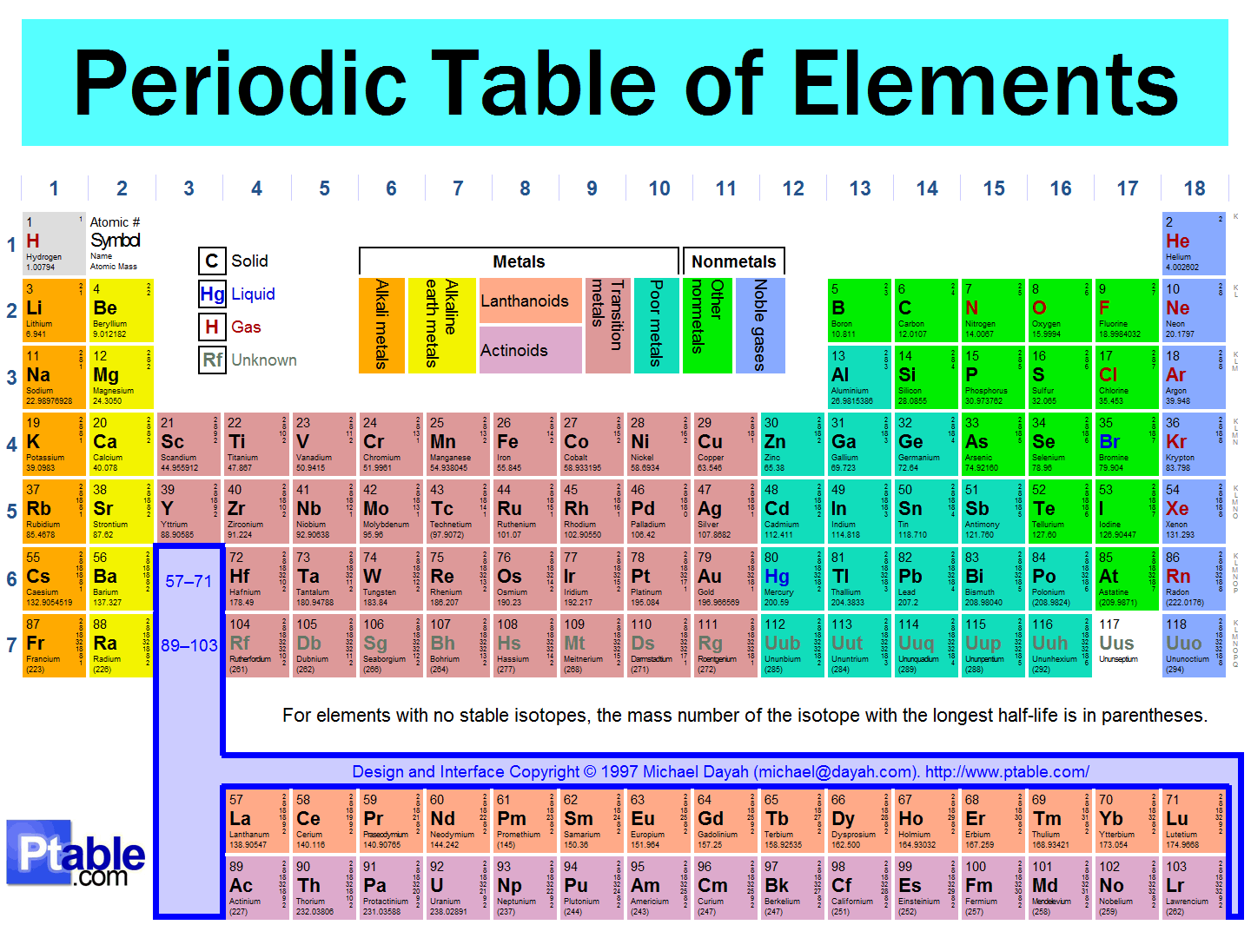
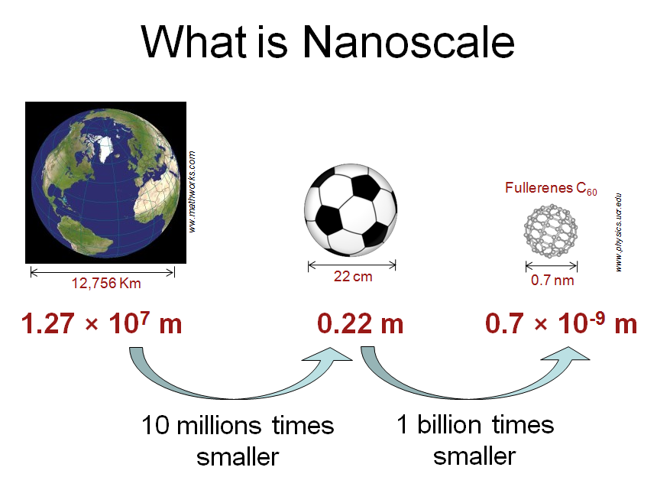
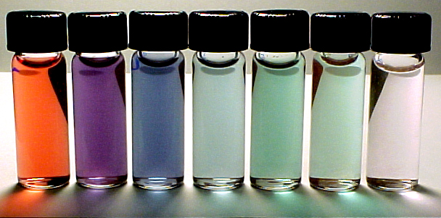
Quantum Phenomena
Large Surface to Volume Ratio
Nanoscience
Gold nanoparticles of different sizes
Passivated Carbon Nanodots
Sun et al. JACS 128, 7756 (2006)

Slide 13
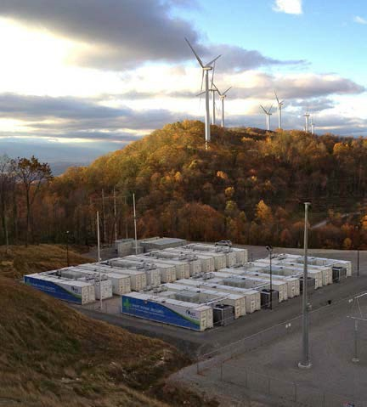
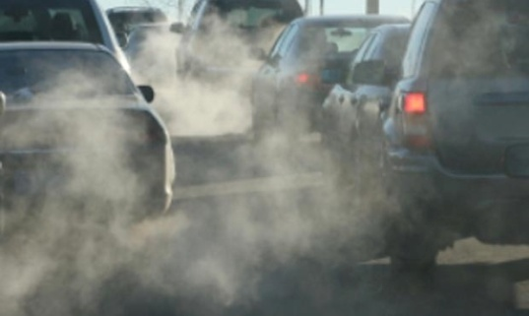
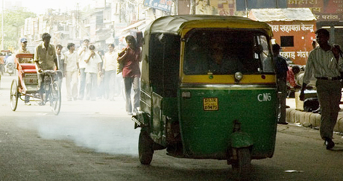
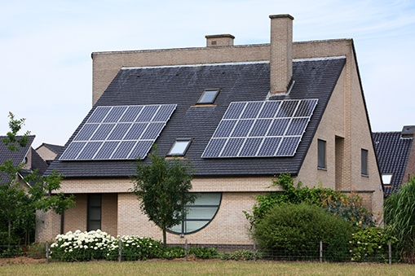


Electrical Energy Storage
Stationary Storage For
Renewable Sources
Mobile Storage Storage For
Clean Transportation

Slide 14


1859: The Lead battery is invented
1887: The first full-scale electric car

Slide 15




Slide 16
High Energy Density, Moderate Power Density
High Power Density, Moderate Energy Density

Slide 17



Natural Abundance
Diversity of Forms and Functions
Biocompatibility
Molecular
Polymeric
Liquids
Solid
SP²
SP³
Functional Carbon
Dimensionality
Doping and Defects
Conductivity
Functionalization
Surface Area
Light weight
Porosity
Inertness / Reactivity
Flexibility

Slide 18


Introduction to different varieties of Carbon
Bulk forms of Carbon;
Nano Engineered Bulk Carbons
Hard Carbons
Activated Hard Carbons
Soft Carbons
Berchell T.D
Reprinted and modified with permission of
Elsevier@ Fuels publication
Nano Carbons Forms
Theranostics 2012; 2(3):235-237

Slide 19






ChemSusChem 5, 2159, 2012
Surface area
1730m²/g
Raman

Slide 20




Slide 21








6, 1249, 2013
Neem dead leaves
Crushed powder
Neem Tree
Carbon after high
temperature pyrolysis
Supercapacitor from dead leaves carbon

Slide 23







Slide 24



Slide 25
Schematic illustration of the synthesis of hard carbon from Walnut shell

Slide 27




In the News

Slide 28





In the News

Slide 29




Slide 30



US Patents Granted from NCL

Slide 31





Making a large area supercapacitor electrode
High surface area conducting carbon from
Sugarcane Bagasse
Putting scotch tapes on both
sides of Al foil to manage the thickness
Blade coated carbon film
on Al foil
Spreading the slurry and
blade coating

Slide 32




Contacts made using Al strips
After Rolling with Separator
Final sealed supercapacitor
Electrolyte addition in the glove box

Slide 33
Electrode Dimensions : Length = 46 cm ,Width= 5cm Total area of the electrode = 230cm^{2,}
Total carbon loading on single electrode ~ 2.5g
Expected Capacitance for the device ~ 100 ± 10 F
Capacitance at 0.1 A ~ 98 F

Slide 34



KPIT– IISER-P Joint Project
Sodium-ion Battery Development
Team IISERP
Anil Suryawanshi
Dhanya Puthussery
Abhik Banerjee
Yogesh Gawli
Vinita Ahuja
Varun Natu
Team KPIT
Tejas Kashtriya
Sarika Phadke
Anil Suryawanshi
Kauthubh Phathak
Abhay Patwardhan
Nagaraj
KPIT Retrofitted Electric Bus

Slide 35


Use Case: Inter-city public transportation bus, 9 meter-11 Ton
Daily running ~200 km, average route distance < 25 km
Fast-charging batteries solutions → 20 min top-up charging at the end of every trip → 1/3rd capacity pack on-board (600 kgs)
Half cell testing done up to 6000+ cycles at 2C/8C
Full cell testing done up to 6000+ cycles at 2C/8C
Current → Pouch cell fabrication and optimization

Slide 36


Sun, Water and Hydrogen

Slide 37






Slide 38


Slide 39




Slide 42







Dye Sensitized Solar Cells & Perovskite Solar Cells
Champion Conversion Efficiency > 22%
Devices are certified at IIT Bombay

Slide 43








Dye sensitized solar cell (DSSC) by a novel fully room temperature process: a solar paint for smart windows and flexible substrates
RSC Advances, 2012, 2, 11645–11649

Slide 44


Small Scale Applications

Slide 45
Functional Nanomaterials and Interface systems for
Sensor Applications
Sensors
Functional Soft Materials
Photo-sensors, Touch/Pressure Sensors
Nanogenerators

Slide 46









Advanced Sensors (IOT-Internet of things)
Driverless Car

Slide 47


Slide 48









New Generation Devices
Wearable
Self-powered
or
Low Power
Light weight
Robust
Water /Dust Resistant
Heat resistant

Slide 49




Slide 50







Slide 51


FE SEM
TEM

Slide 52




Fe₃O₄ – Carbon magnetically recoverable high surface area
Super-absorbant nanocomposites

Slide 53



Slide 54


Using Gels as Nanocatalyst Support

Slide 55



Sl.No | Metals(5ppm) | % Removal
 |  | Sabja | Fe₃O₄ -Sabja
1 | As⁺³ | 53.32 | 98
2 | Cr⁺³ | 69.40 | 96
3 | Cr⁺⁶ | 55.32 | 86
4 | Pb⁺² | 44.11 | 92
5 | Cd⁺² | 32.35 | 84
6 | Hg⁺² | 40.16 | 90

Slide 56




Device fabrication facilities @ NCL
TiO₂ blocking layer deposition
TiO₂ mesoporous layer deposition
Hot Roll Press
Dip Coating
Spray Pyrolysis
Spray pyrolysis system useful for uniform blocking layer on large area (10cm X 10cm)
Screen Printing
Multi-Coating system
Laser scriber
Programmable hot plate
Mesoporous TiO₂ films

Slide 57






Large area DSSC fabrication
Silver fingers for efficient charge collection
Silver line/UV sealant width in micron scale
Silver and UV sealant dispensing robotic arm
UV irradiation chamber
Electrode pile up machine
DSSC device (7 cm X 7 cm)

Slide 58


Solar Cell characterization facilities @ NCL
Solar Simulator
Sideways Solar Simulator
Impedance measurement
Transient Absorption set up
(Developed in-House)
IPCE measurement set up

Slide 59



Material synthesis and device fabrication for charge storage systems
Electrospinning System
Tube furnace maximum temperature 1300⁰C
High speed centrifuge

Slide 60





Material synthesis and device fabrication for charge storage systems
Mixing machine
Hot Roll Press
Hydraulic press
Multi-Coating system
Punching & crimping machines

Slide 61



Device characterization of charge storage systems
Autolab Potentiostat
Battery testing systems with 8 channels
Electrochemical work-station

Slide 62






Other device fabrication facilities & Characterization facilities @ NCL
Glove box
Sputtering/ Evaporator
Gas chromatography machine
Pulsed laser deposition system
Excimer laser λ=248nm
Deposition chamber
Thickness Profilometer
FE-SEM

Slide 63








The Team
Satish Ogale
Shouvik Datta
Mukul Kabir
R. Vaidhyanathan
Musthafa Muhammed
Next Generation Solar Cells, Solar Fuels, Charge Storage
Photovoltaics and Advanced Semiconductor Characterization
Theory
And Predictive Modeling
Molecular & Mesoporous Materials, MOFs, COFs
Electrochemistry, Charge storage Devices, Fuel Cells
Angshuman Nag
Pavan Kumar
Surjeet Singh
Quantum Dots
and
Photophysics
Plasmonics and Photonics
Growth and Properties of Novel Materials

Slide 64



Background
Solar Water Splitting
Dye Cell
2D Perovskite Nanostructures
Dye Cell 9%
Perovskite Cell 16.8%
Plasmonics
Supercapacitor
COF electrocatalyst Water Splitting
LED/QLED/OLED

Slide 65


Slide 66







Slide 67


It is all in our hands
Thank You

