Slide 1
A STUDY OF BRUSHLESS DC MOTOR
PRESENTED BY:
ABINASH DASH
AUTHORS:
ABINASH DASH
SHIV PRATAP MAURYA
SUMANTRA CHAKRABORTY
COIMBATORE MARINE COLLEGE

Slide 2
CONTRIBUTION OF SHIPPING INDUSTRY IN WORLD TRADE
Around 90% of world trade is carried by the international shipping industry.
Seaborne trade continues to expand, bringing benefits for consumers across the world through competitive freight costs..
There are over 50,000 merchant ships trading internationally, transporting every kind of cargo. The world fleet is registered in over 150 nations, and manned by over a million seafarers of virtually every nationality.
Over the last four decades total seaborne trade estimates have quadrupled, from just over 8 thousand billion tonne-miles in 1968 to over 32 thousand billion tonne-miles in 2008.

Slide 3
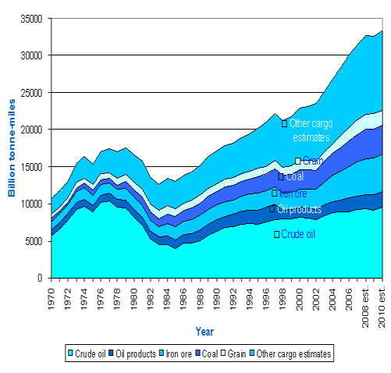

Slide 4
INTRO TO THE INTRODUCTION
There has been a fuss over what really transportation is……for every one else it might be a car…by road or by plane..that is by air….but for me and everyone of you as u all may agree is shipping.
There always has been a improvement in this sector…..to be precise starting from alternate fuels to reliable..cost friendly..and more or less smaller device with large power……so this is it our thought and stress ends here with the introduction of BLDC……(Brushless DC motors)

Slide 5
INTRODUCTION
You have some choices when it comes to determining which motor you will need for whatever application or project you are implementing, and your choice will depend on a variety of factors
If you have a project or application where you will only need a motor for short term use, you may prefer a cheaper motor that may wear out more quickly. If your job requires a motor that will last as long as possible, you will probably want to consider a BLDC motor, for reasons which will become apparent.
There are four basic type of electrically adjustable peed drives being installed in today’s modern industrial machines-
-DC brush type motors and controllers.
-DC brushless motors and controllers.
-AC variable frequency controller and induction motors.
-AC vector controller and induction motor s.

Slide 6
Background
Before going into detail of BLDC lets have a look on the history and characteristics of DC motors-
History of DC motors-
DC motor was invented in1856 Werner Son Siemens in Germany.
Variable speed by armature voltage control was first used in early 1930s using a system involving a constant speed AC motor driving a DC generator.
In 1960s a electrical Regulator company brought to market a general purpose, static, solid state controller that converted the AC directly to rectified DC using SCR (thyristor) devices. That technology was adopted and is still in use.

Slide 7
HISTORY OF BLDC
The earliest evidence of brushless D.C. motors was when T. G. Wilson and P.H.Trickey made a D.C. Machine with a solid state Commutation.
It is subsequently developed as high torque, high response drive for specialty application such as tape and disk drive for computers, robotics and positioning system and in air craft where brush wear is intolerable due to low humidity.
First large brushless DC motor (50hp) were designed by Robert E.

Slide 8
CHARACTERISTICS OF DC
The DC motor worked on the principle that speed of the shaft is direct function of applied armature voltage.
At zero applied to the armature, the motor will run at zero speed, while at rated voltage(500vdc for most industrial motor over a few hp), the motor will run at rated speed (1750 rpm has developed as a “standard”).
The motor produce torque based on similar relationship with current.
Dc motors are very efficient in converting electrical energy in mechanical energy.
Controller efficiency is very high.

Slide 9
CHARACTERISTICS
The stator is the induced part of the machine.
The rotor is the inductor of the machine.
In brushless DC motors, the internal armature, the rotor, is a permanent magnet. This armature is supplied by a constant current (DC).
The external armature (stator) is polyphased (3 phases in our case) and is covered by polyphased currents. The pulsation of these currents is ώ.

Slide 10
WHY BLDC…..Advantages…..
Advantages over BRUSHED DC motors:
Better speed versus torque characteristics
High dynamic response
High efficiency
Long operating life
Noiseless operation
Higher speed ranges

Slide 11
ADVANTAGES (contd………)
Advantages over AC induction motors:
Operations at all speed
Better dynamic characteristics
No special starter circuit required
No slip is experienced between stator and rotor frequencies

Slide 12
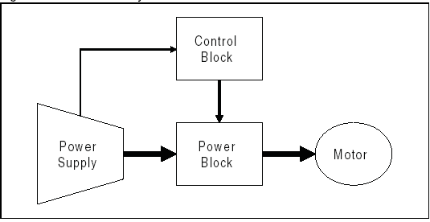
THE ONLY DISADVANTAGE AND ITS SOLUTION……
A controller is always required to keep the motor running.
SOLUTION: with the advent of computers ..this problem is solved..we have computers and microcontrollers to control this motor every time..for speed variations, tuning, adaptation etc., . If in case anything goes wrong with the motors or drives we are alerted by the alarm systems fitted to it through a embedded software sys.

Slide 13
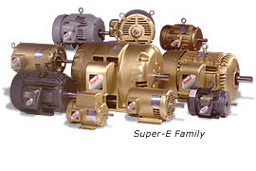

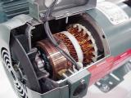
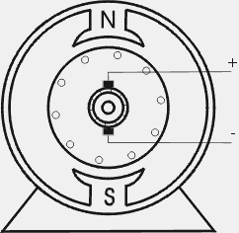

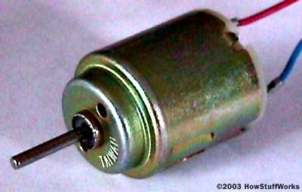
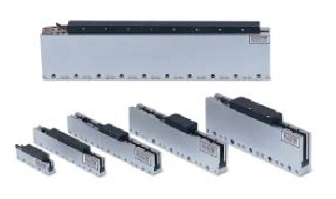
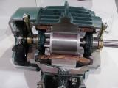
MORE ABOUT BLDC

Slide 14
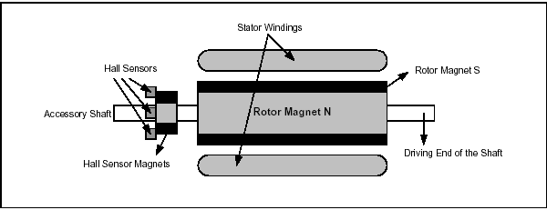
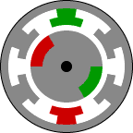
CONSTRUCTION

Slide 15
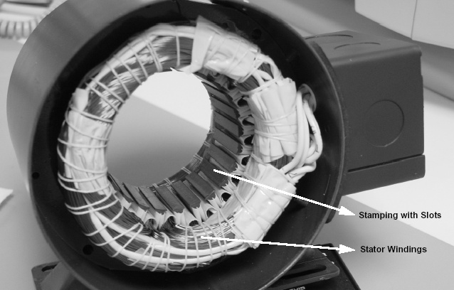
construction
Brushless DC motors consist of two coaxial magnetic armatures separated by an air gap. In this type of motor,
– The external armature, the stator, is fixed.
– The internal armature, the rotor, is mobile (the rotor can also be external in certain cases).
The stator is the induced part of the machine.
Followed by the hall sensors the most important part of the machine.

Slide 16
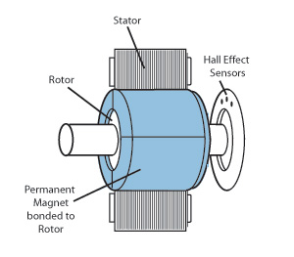
Working of the motor
The rotor is the inductor of the machine.
In brushless DC motors, the internal armature, the rotor, is a permanent magnet. This armature is supplied by a constant current (DC).
The external armature (stator) is polyphased (3 phases in our case) and is covered by polyphased currents. The pulsation of these currents is ώ.

Slide 17
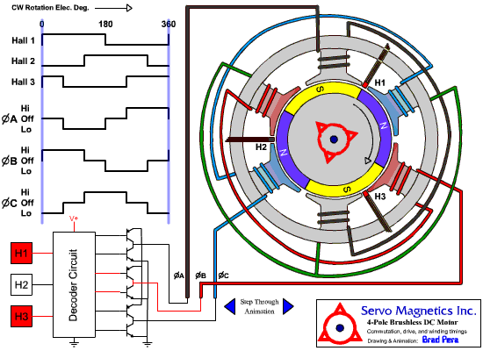
How it works
Halls Sensors sense the position of the coils
The Decoder Circuit turns appropriate switches on and off
The voltage through the specific coils turns the motor

Slide 18
Operation and WORKING PRINCIPLE
BLDC motors are a type of synchronous motor. This means the magnetic field generated by the stator and the magnetic field is generated by the rotor which rotates at the same frequency.
The stator of a BLDC motor consists of stacked steel laminations with windings placed in the slots that are axially cut along the inner periphery.
Most BLDC motors have three stator windings connected in star fashion. Each of these windings are constructed with numerous coils interconnected to form a winding.
One or more coils are placed in the slots and they are interconnected to make a winding.
The rotor is made of permanent magnet and can vary from two to eight pole pairs with alternate North (N) and South (S) poles.

Slide 19
Operation and WORKING PRINCIPLE cont….
Based on the required magnetic field density in the rotor, the proper magnetic material is chosen to make the rotor. Unlike a brushed DC motor, the commutation of a BLDC motor is controlled electronically
To rotate the BLDC motor, the stator windings should be energized in a sequence.
Rotor position is sensed using Hall effect sensors embedded into the stator. Most BLDC motors have three Hall sensors embedded into the stator on the non-driving end of the motor.
Whenever the rotor magnetic poles pass near the Hall sensors, they give a high or low signal, indicating the N or S pole is passing near the sensors. Based on the combination of these three Hall sensor signals, the exact sequence of commutation can be determined.

Slide 20
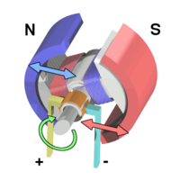
ITS POWER AND TORQUE
When electric current passes through a coil in a magnetic field, the magnetic force produces a torque which turns the motor.
Force in Motor:
F=ILB
F = Force
B = Magnetic Field
L = Length of Conductor
I = Current in Conductor
Torque in Motor:
T = IBA sin θ
A = LW
L = Length of Winding
W = Width of Windin

Slide 21
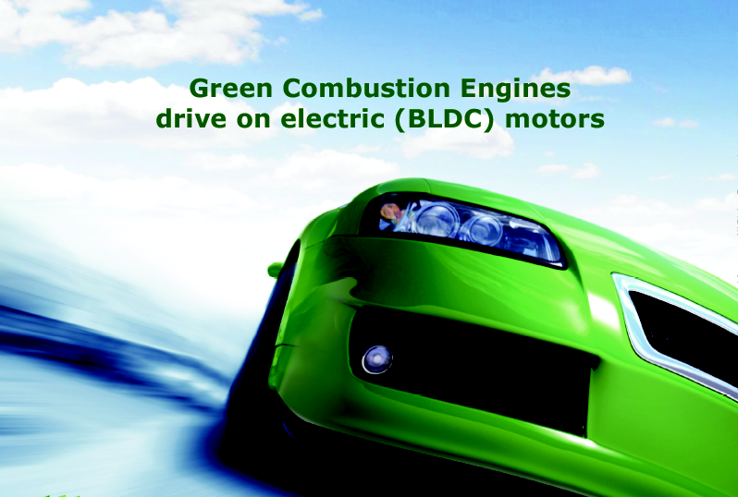
application

Slide 22
AREA OF APPLICATIONS……IN VARIOUS SECTORS
BLDC motors can be used in various fields such as:-
Automotive…to be precise……TRANSPORTATION
Aerospace
Medical
Industrial Automation Equipment and Instrumentation
LETS ONLY CONCENTRATE ON SHIPPING…..AS MENTIONED IT IS TRANSPORTATION….

Slide 23
APPLICATION
BLDC is used in the following:-
Fuel Pumps
EPS(Electronic Power Steering)
Fan controllers for air conditioning systems
Tachometer controls
Vehicle interiors
Air conditioning flap controllers

Slide 24
APPLICATIONS IN SHIPPING….
Starter motors,
Bilge pumps,
Winches,
Hoists,
Bow Thrusters,
Trolling Motors,
Auxiliary Power units,
Gas Compressors

Slide 25
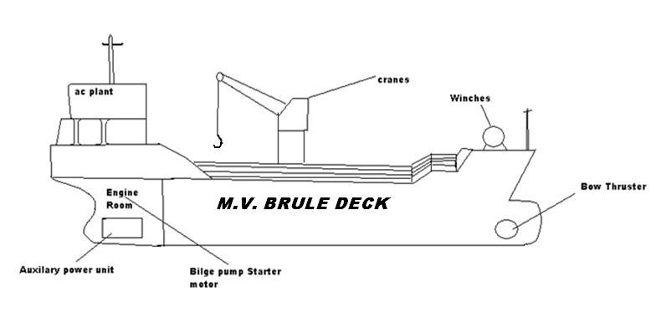
Our CONCEPT ship

Slide 26
M. V. BRULE DECK
THE name comes from brushless DC motors.
THIS vessel of ours would be using its HVAC systems for AC plants
THIS is used as aux. power units and propulsion units as trolling motors and the concept is same as in azipod
THIS is used as winches in cranes and davits
THIS is also being used as the most important part of the ship that is bow thruster.

Slide 27
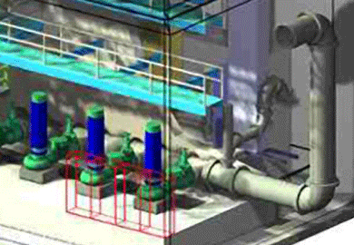
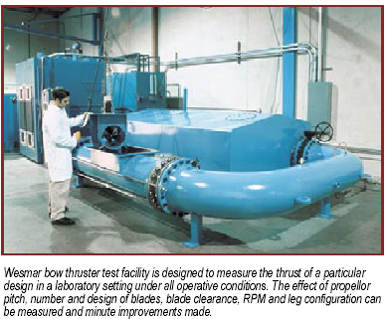
HVAC and BOW THRUSTERS

Slide 28
GAS COMPRESSORS
Presently used onboard are star delta type AC induction type motors.
These take a large startup current…And now with use of BLDC this requirement for large initial current is eliminated.
Cause these motors do not require large starting current. As much you require the data is fed to the system and it functions.

Slide 29
DC PRECONCEPTIONS……..
There always has been a concept that..Larger the DC larger the device…..QUESTIONS???
How we use these BLDC as BOW THRUSTERS, as GAS COMPRESSORS, or as ANY OTHER HUGE CURRENT DRAWING LOADS….AND THE SIZE OF PERMANENT MAGNET WE MIGHT REQUIRE?
NO….everybody is wrong as we will use ELECTROMAGNETIC BLDC….
THEN THE OTHER QUESTION……………………………………………………………MAINTAINANCE?

Slide 30
SOLUTIONS TO YOUR QUESTION…..Maintenance?
Nothing has ever gone wrong in its operation….need to know why?
This Electromagnetic BLDC is being used by MARS probe since last 7 years and still running successfully…..Tell you where it is on its THRUSTERS.
QUESTION TO YOU…..AND YOU HAVE YOUR SOLUTION…..
WHOSE ENVIORNMENT IS WORSE SPACE OR SEA?
THUS looking to maintenance side its reliable, safer, cost friendly …..

Slide 31
THANKING YOU
...QUESTIONS…
?

