Slide 1

Environmental impacts and remedies of Marine Pollution
Presented by
Nudratulla Khan & Kevin Karan
Academy of Maritime Education and Training University
Chennai, Tamil Nadu, INDIA

Slide 2
Our Environment

Slide 3
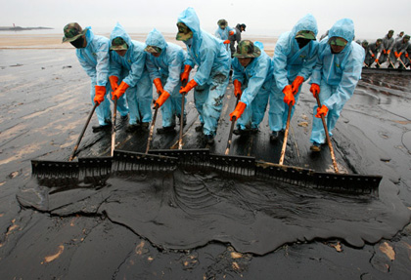
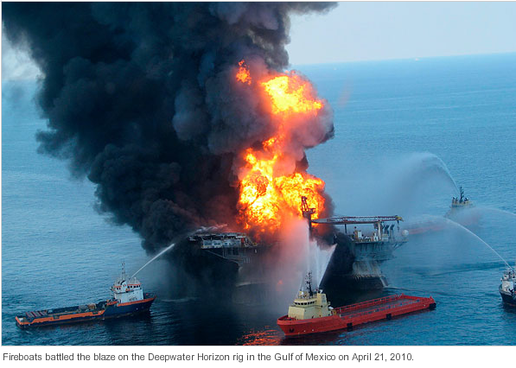

Slide 4
The following can be distinguished as main sources of marine pollution:
Oil Spills
Ballast water pollution
Release of toxic chemicals used in antifouling paints
Dumping of wastes such as garbage, sewage and plastic
heavy metals from mining activities
Air pollution through emission
Waste from cruise ships
Improper handling of Hazardous Cargoes

Slide 5
The following can be distinguished as main sources of marine pollution:
Oil Spills
Ballast water pollution
Release of toxic chemicals used in antifouling paints
Dumping of wastes such as garbage, sewage and plastic
heavy metals from mining activities
Air pollution through emission
Waste from cruise ships
Improper handling of Hazardous Cargoes

Slide 6
CAUSE 1: Oil pollution from operational oil spills
Collisions, grounding, fires, etc
Failure of equipment.
Incorrect operating procedures.
Hull fracture.

Slide 7
CAUSE 1: Oil pollution from operational oil spills
IMPACTS
Chemical ingredients of oil cause physical changes in the organisms
Thick oil sticks to the body of marine organisms making them incapable of performing their normal metabolism.
The density of oil is less that water thus, it floats on top, forming a thick impermissible membrane.
As the layer is black and opaque, the sunlight hinders its passage through the surface preventing the marine plants for their growth through photosynthesis.

Slide 8
CAUSE 1: Oil pollution from operational oil spills
REMEDIES
Quickly moving to double-hull ships
Shipboard Oil Pollution Emergency Plan
Tankers should be allowed only when the guidelines of International and National laws in discharge of oil is met

Slide 9
CAUSE 2: Atmospheric air pollution is caused from the exhaust emissions from a ship’s engine. The most harmful emissions are nitrogen and sulphur resulting from burning ship’s bunker oil.
IMPACTS
The changes in climate are a result of increased ocean temperatures and rising levels of CO_{2,} NOx and SO₂ in the atmosphere resulting in acidification, acid rain and eutrophication.
Altering livelihoods of the communities.
There is a worldwide sulphur and nitrogen chemicals in the air that have a harmful effect on plants and marine animals causing respiratory problems in people.
SOx emission interacts with the moisture in the atmosphere forming sulphuric acid, which in turn condenses in the clouds causing acid rain.

Slide 10
CAUSE 2: Atmospheric air pollution is caused from the exhaust emissions from a ship’s engine. The most harmful emissions are nitrogen and sulphur resulting from burning ship’s bunker oil.
REMEDIES
Low-sulphur fuel
Scrubbers.
water injection and Humid Air Motor
Gas engines
Shore-side electricity

Slide 11
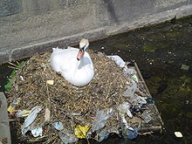
CAUSE 3 : Pollution due to waste water and Garbage disposal into the sea
IMPACTS
Debris into the sea is mainly discarded
with human rubbish which either floats
or suspended in the ocean.
Around 70-80% of marine debris is plastic;
the mass of it in the oceans is increasing and
tons of waste gets accumulated since years.
The plastics can also suffocate the living organisms. Many marine animals consume flotsam by mistake, as it often looks similar to their natural prey.
The sewage when disposed contains organic matter which gets absorbed with available dissolved oxygen reducing the level of oxygen in the ocean that marine organisms require.
The matter also feeds on algae blooms that are present in the water, stimulating their growth. This decomposing algae releases toxic substances harmful to marine organisms that can enter through fish or other organisms.
Sea food when consumed has a tendency of concentrating pathogens in their gut, consuming of which increases the possibility of food poisoning.

Slide 12
REMEDIES
International Rules and Regulations are needed to strictly to avoid garbage and sewage entering into the oceans.
Plastic usage should be banned or at least use of it should be minimized in the ship.
Reestablish the "polluter pays" principle.
Regular maintenance and monitoring of septic system
Sewage must be treated in specially provided sewage treatment tanks.
Pumping untreated sewage overboard in some areas is prohibited by law.
The waste water treatment equipment can be used as given below:
Oily Water Separator equipment consists of an Oily Water Separator, Oily Water Separator Pump, Strainer, Discharge Water Collecting Device
Discharge Water Oil Content Monitor
Sludge Storage Equipment consisting of Sludge Tank and Sludge Piping
Automatic discharge stop device

Slide 13
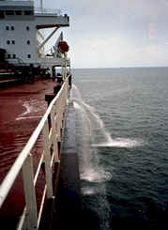
CAUSE 4: Disturbance caused from Ballast water tanks carried by ships
IMPACTS
The discharge of ballast water from the ship is unloaded after travelling from one place to another, the marine organisms are carried away from it which changes their ecosystem and hindering normal survival.
The flora and fauna are prone to become vulnerable as a result of introduction of alien species.
Figure 1: A cargo ship pumps ballast water over the side

Slide 14
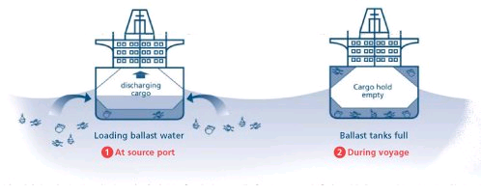
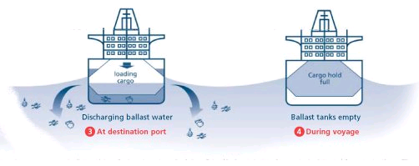

Slide 15
REMEDIES
Ballast water management plan should be prepared.
The guidelines of the ballast operations should be followed and any disfunctioning of vessel/tanks should be reported quickly
Exchange of ballast should take place under low depth waters
Eco-friendly ballast water treatment plants to be adopted
Disposal of sediment by cleaning the tanks should be done on regular basis.

Slide 16
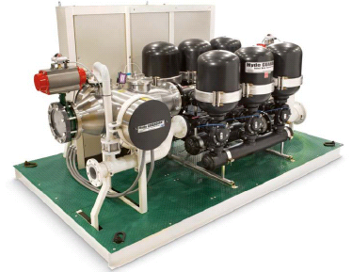
Hyde Ballast Water Treatment Systems
The Hyde GUARDIAN™ Ballast
Water Treatment System is a fully
automated two stage treatment
process:
1st Stage - Disc filtration
2nd Stage - UV disinfection
The Hyde GUARDIAN™ uses
no chemicals or active
substances!

Slide 17
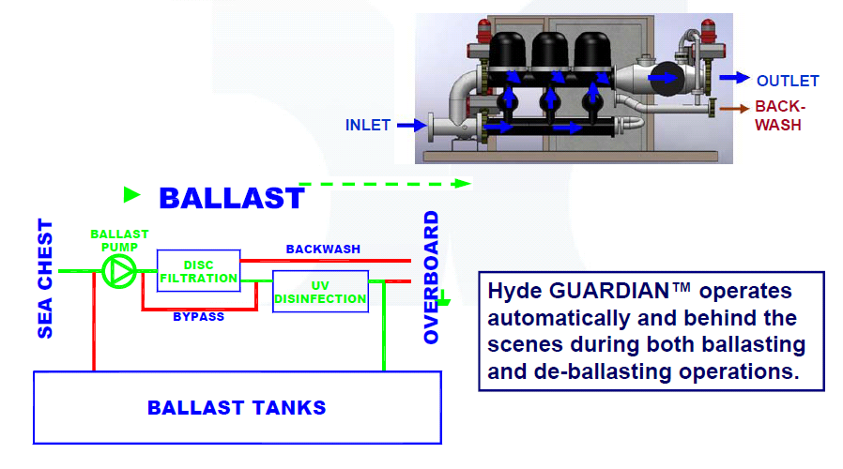

Slide 18
Conclusion
The oceans are a vast resource whose usefulness to the global society is continuing to be realized.
The guidelines set needs to be followed in order to minimize the probability of future introductions of harmful substances into the marine ecosystem while protecting the safety of ships and benefit of natural resources.
Marine ecosystems will become more fragmented and less equipped to adapt to changing conditions, such as the effects of climate change.
Thus, it is in the best interest of humanity that the natural resources are exploited and preserved in a sustainable manner.

Slide 19
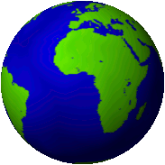
Together we can live a better today and plan for much better tomorrow!
Thank you…

