Slide 1
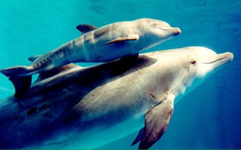
UNDERWATER NOISE POLLUTION DUE TO MERCHANT VESSELS
-CAUSES, IMPACT AND ITS MITIGATION
By- Cdt. Saumya Singh
ID NO. 201137TP285
Tolani Maritime Institute

Slide 2
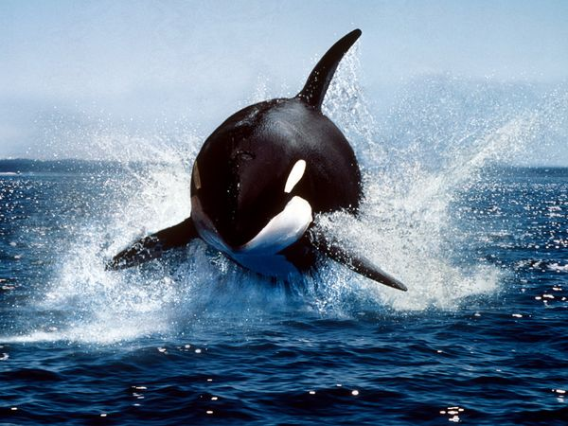
INDEX
Introduction
Causes of Noise
Cavitation
Impact of Noise
Qualitative Impact
Mitigation Strategies
Conclusion

Slide 3
INTRODUCTION
Worldwide commercial fleet has increased from 30000(1950) to 85000(1998) vessels.
Today world seaborne trade includes 90% of the total world trade.
Large commercial vessels produce relatively loud and predominantly low frequency sound.
Acts as source of obstruction to useful biological acoustic signals the aquatic organisms use to interact with their environment.
Major contributors to underwater noise – ship propeller and ship machinery; former being the dominant factor.

Slide 4
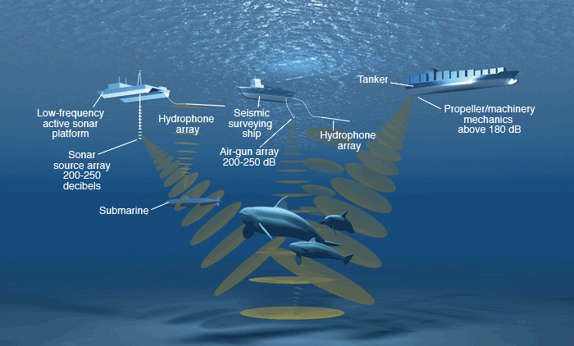

Slide 5
NOISE
Prime source of noise- propeller (100-110db at low frequency bands).
λ α (1/frequency)
Generation of noise by-
Displacement of water by blade profile
Differential pressure across propeller faces
Variable pressure field
Collapse of Cavitation bubble (most potent source)

Slide 6
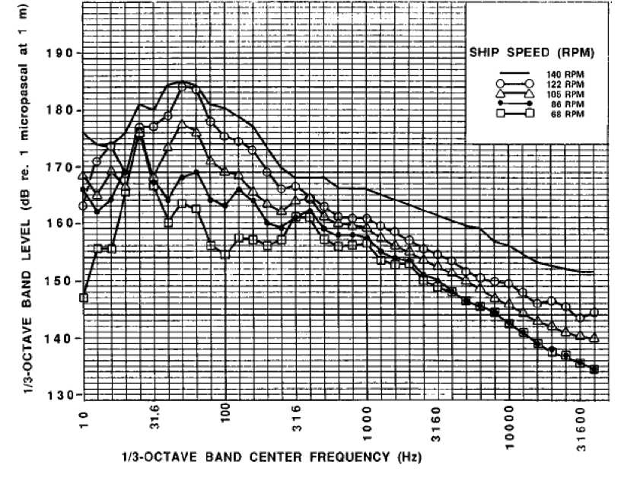

Slide 7
CAVITATION
Above or below the vapor pressure, temperature constant
Cavitation Inception Speed.
Collapse of Cavitation bubble – creates shock waves and erosion of blades.
Bursting of bubbles covers the frequency band upto 1mhz.
Pressure difference – approx. 4000 atm
Temperature rise range – 500-800°C

Slide 8
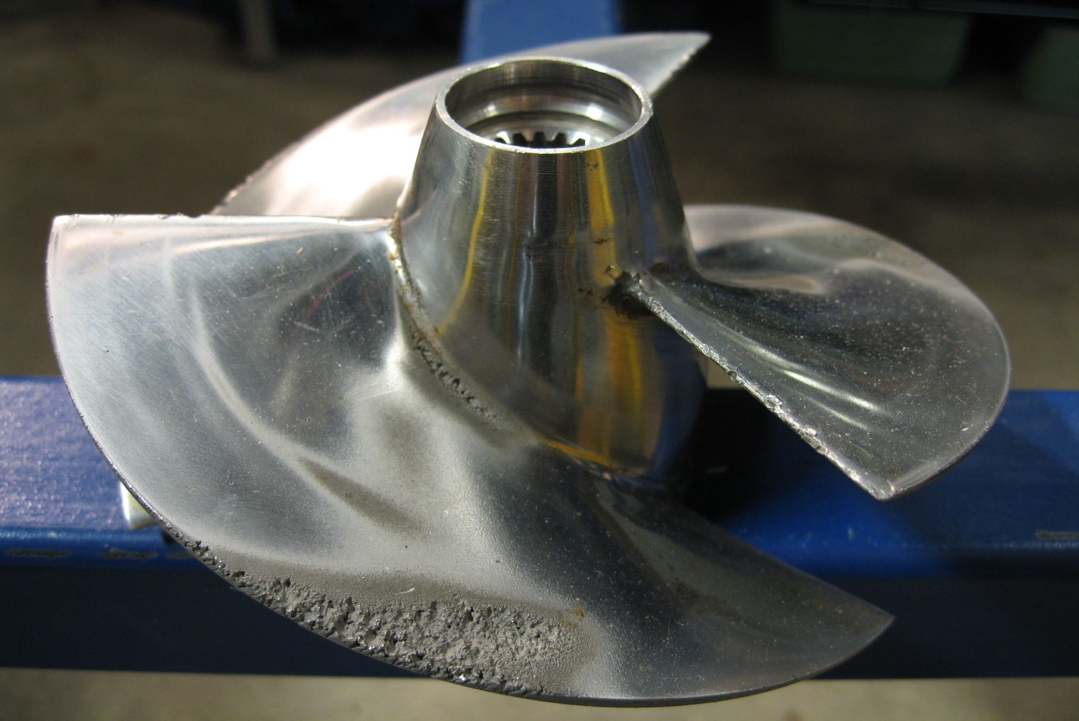

Slide 9
IMPACT OF NOISE
50 Hz-300 Hz – from propeller Cavitation
Maximum levels - 40 TO 60 Hz
Broadband range used by baleen whales- 10 hz-300hz .
Increased speed, increased noise levels.
Suspect stranding off the coast of Bahamas, North Carolina, the Canary Island, U.S Virgin Island, Italy, Japan.

Slide 10
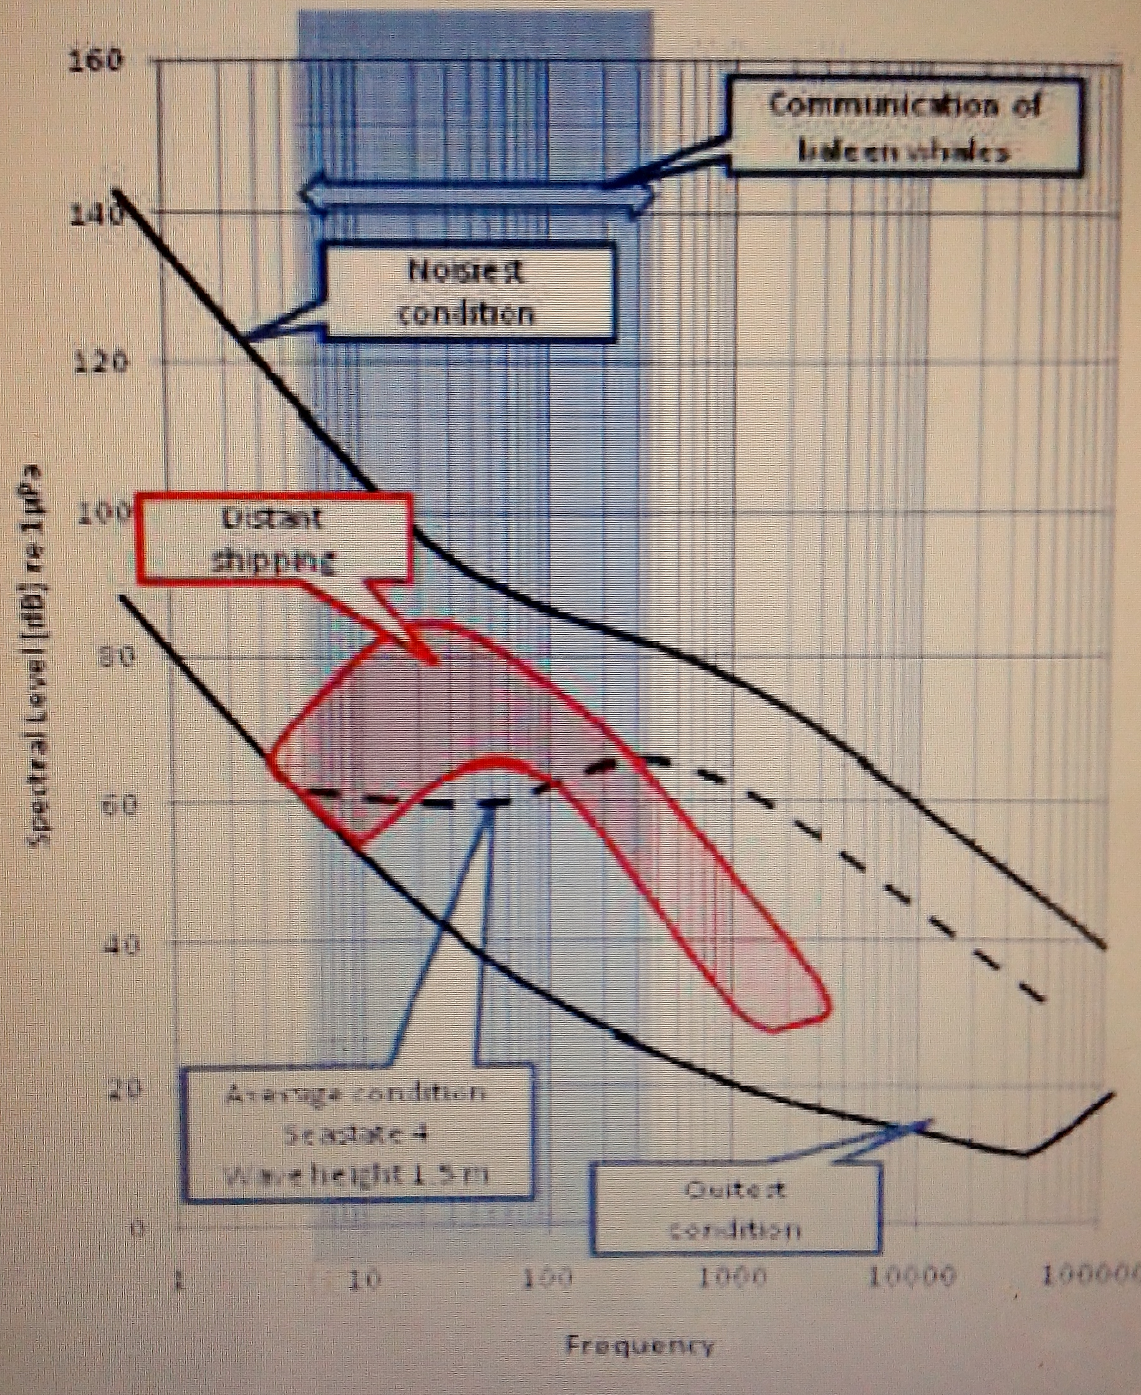

Slide 11
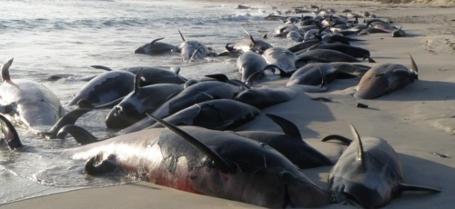
QUALITATIVE IMPACT
Physiological impact
Non-auditory
Auditory
Stress related
Behavioral impact
Perceptual impact
Indirect effects

Slide 12
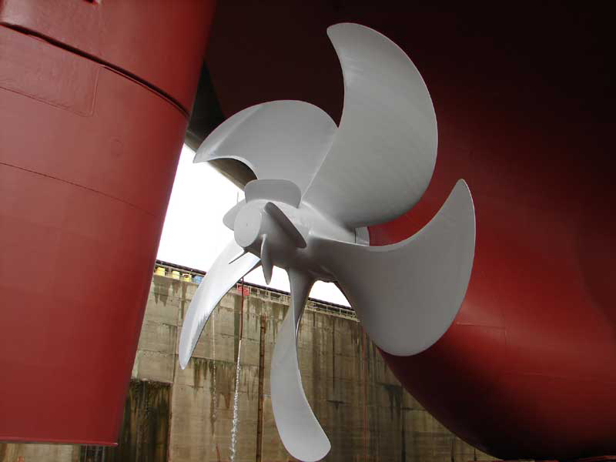
NOISE MITIGATION
Various noise mitigation techniques -
Propeller blade surface
Propeller design
Propeller hub caps
Propeller/Rudder interaction
Wake improving devices

Slide 13
CONCLUSION
Immediate measures to be taken .
Meetings ,forums and surveys should be conducted in this arena of grave concern .
Planned vessel routing and changes in ship construction methods.
Methods should be environment friendly as well economically viable.
Raising awareness and encouraging , sharing of ideas and research to alleviate the problem.

Slide 14
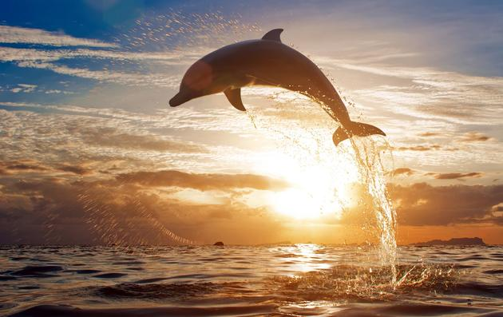
THANK YOU

Slide 15
WORKING OF PROPELLER
SCREW PROPELLER- MOST COMMON AND EFFICIENT PROPULSIVE DEVICE FOR SHIPS.
SLIP FACTOR- PROPELLER ADVANCE LESS THAN PITCH.
BLADE PROFILE–AEROFOIL SHAPE ( FOLLOWS BERNOULLI’S PRINCIPLE).
DIFFERENTIAL PRESSURE ACROSS LEADIND EDGE AND TRAILING EDGE PRODUCING RESULTANT FORCE.
LIFT AND DRAG – COMPONENTS OF RESULTANT FORCE.
LIFT TO DRAG RATIO DETERMINES EFFECTIVENESS OF FOIL AS LIFTING SURFACE.
PITCH ANGLE- TILTING OF BLADES TO INCREASE THE THRUST.

