Slide 1


Slide 2


Slide 3
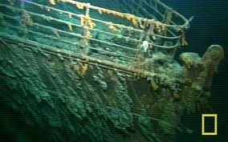
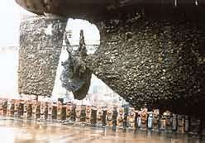
FOULING

Slide 4

Fouling results from the growth of aquatic plants on the surface of submerged objects. Its most widely known effect is on the efficiency of propulsion of ships.
Estimated that costs of $3billion were incurred by the global shipping fleet each year in dealing with fouling.
Including $720million in increased fuel consumption & $409milion due to shipping delays .

Slide 5
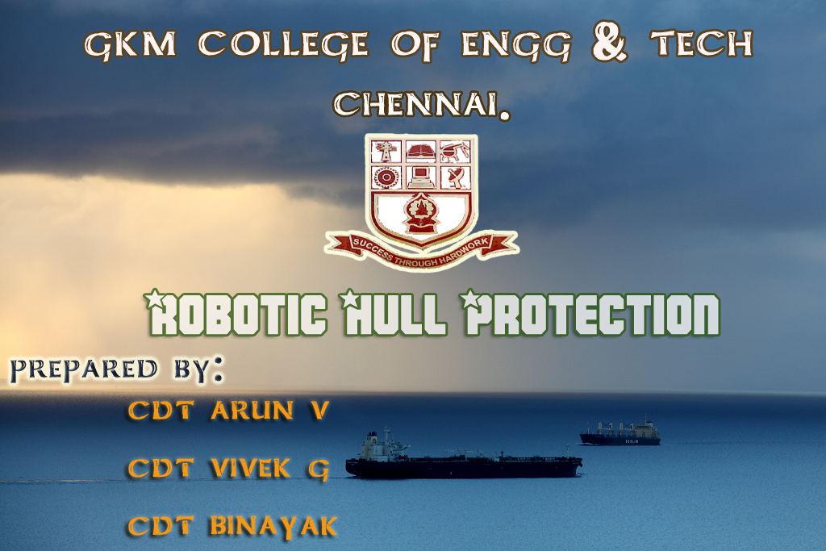


Slide 6

OBJECTIVE
To study the Robotic hull protection application in marine industry.
Introduction
Construction
Working
Advantage
conclusion

Slide 7
INTRODUCTION
For over 130 years people have thought about machines or robots for cleaning ship hulls.
Only few developments have
found wider application, an example could be hydraulic brush system operated by diver.
Diver(s) presence enhances the risk of diving accidents at work.

Slide 8

The number of accidents in offshore and inshore diving is in a range 120-140 for 100000 dives.
While fatal accidents occur in number of 6-7 for 100000 dives.
Diver has limited time to be able to work underwater so a team of divers is required to perform cleaning task.
An open issue is the cost of diver safety measures and environment protection requirements that must be taken into consideration discussing the cost benefits.

Slide 9

Some of the technologies we use are
Brush technology
Grit blasting
&
Sand blasting

Slide 10

BRUSH TECHNOLOGY
Most systems consist of one or more rotating brushes pneumatically, or hydraulically driven.
The major problems in cleaning using heavy duty brushes could have damage hull paints.
It can be used by manual operation.

Slide 11
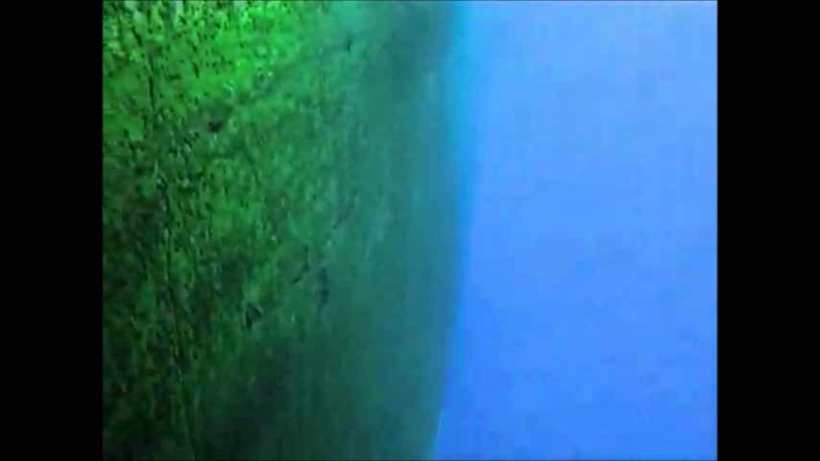

Slide 12

GRIT BLASTING & SAND BLASTING
The grit blasting is used to remove the fouling only in ship at dry dock condition.
It can also damage the hull paint and the hull structure.
It can operate only in manual.

Slide 13
Remotely controlled machines are not able to clean the whole wetted ship surface due to some hull features that restrict the robot operation.
Ship bow and stern, due to hull shape are very difficult for automatic cleaning and that area will probably be cleaned by divers.

Slide 14
MULTIFUNCTIONAL ROBOTIC PLATFORM
This robots are independently worked in hull cleaning.
It can be used for cleaning & inspection of the hull.
It can be fixed in ship hull with magnetic wheel.

Slide 15
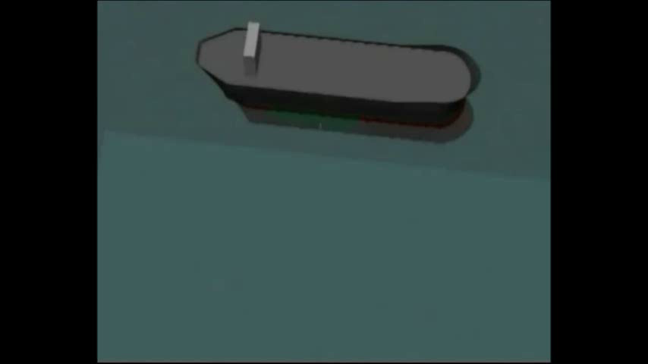

Slide 16


construction
This robot have magnetic wheels for climbing the vertical walls.
which consists of three pieces of magnet and two pieces of pure steel plates.
The robot is powered by DC servo motor.
multifunctional robotic platform having ultrasonic sensory system that is placed on plate’s surface .

Slide 19

WORKING
Robot needs some preparation before the vehicle is placed on the surface of the ship hull.
When digital data of the ship hull construction are provided to the robot control computer.
Map of the hull is automatically charted, recording the location of every weld, thickness change, rivet and indentation on the ship’s surface.

Slide 20
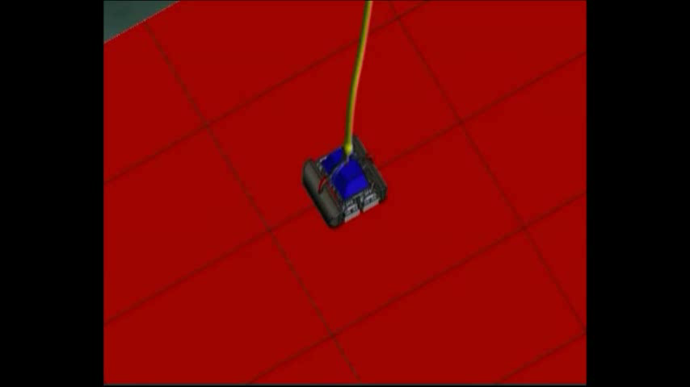

Slide 21

WATER JETTING TECHNOLOGY
The use of high pressure water jets has become an accepted alternative to brush cleaning systems.
Water jets can be easily controlled by reducing or increasing the pressure from the pump.

Slide 22
Adjustable jets of pressurized sea water blast the marine growth off the surface of the ship.
Then removed bio-fouled are sucked by the vacuum pump.
Here, 150 liters/m² of water a minute is filtered and the bio-fouling removed and rendered harmless to the local environment.
Robot is that it is an autonomous system so it can continue cleaning with the ship remaining in service.

Slide 23

HULL SURVEYING
Hull surveying is an important part of any vessel's life span.
These are performed by using an ultrasonic sensory system that is placed on the plate's surface.
When every manual hull inspection taken once with in five years.
But 20% of hull may not be inspected by visual. Due to the vessel’s dock support.

Slide 24

In our robot ultrasonic plate thickness measurement is used measure the thickness of the hull plate.
This waves are emitted by piezoelectric cell (or) EMAT sensors.

Slide 26
NAVIGATION

Slide 27
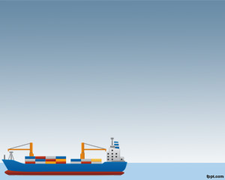

ADVANTAGES
It prevents the damage of the hull coating.
This system improve the efficiency of the ship.
This system works totally independent.
It not only keeps the ship clean but also feeds back vital information about the hull’s condition.

Slide 28
All other developed cleaning or inspection systems currently available are remotely controlled.
No requirement of highly skilled and experienced operators.
The platform can be launched whenever the vessel is in port or at anchor.

Slide 29

CONCLUSION
Towards the starting of the new era in shipping industries
And its everyday growth in effective running and efficient
Output, this project delivers a complete outcome to the ships hull protection in the future with an green alternative.

Slide 30
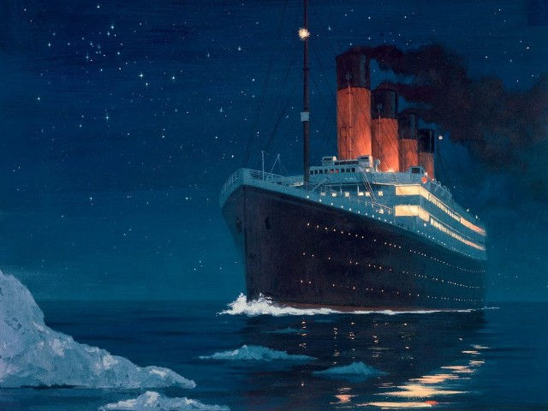



Slide 31


ANY QUERIES

