Slide 1


A
presentation
on
HEAT PIPES AND ITS APPLICATIONS IN MARINE
PRESENTED BY
Mr. Nikhil Ashok Ingle
Design Engineer (M.Tech Thermal)
Urja Disha Boiler Technologies
Nigdi, Pune-411044.

Slide 2
CONTENTS
Introduction to Heat Pipe
Working principle
Thermodynamic cycle
Types
Working Fluids and temperature ranges
Heat Pipe characteristics
Heat transfer limitations
Applications in Marine
Other applications of Heat Pipe

Slide 3
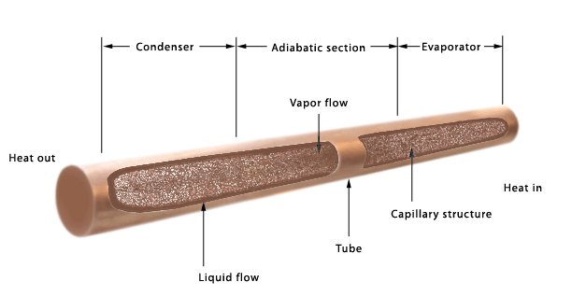
INTRODUCTION TO HEAT PIPE
A heat pipe is a metal tube sealed at both ends with a vacuum inside, filled with a small quantity of fluid.
In short, it’s a device used for transporting heat from one place to another.
The heat input region of the heat pipe is called evaporator, the cooling region is called condenser.
In between evaporator and condenser sections, there is an adiabatic section.

Slide 4
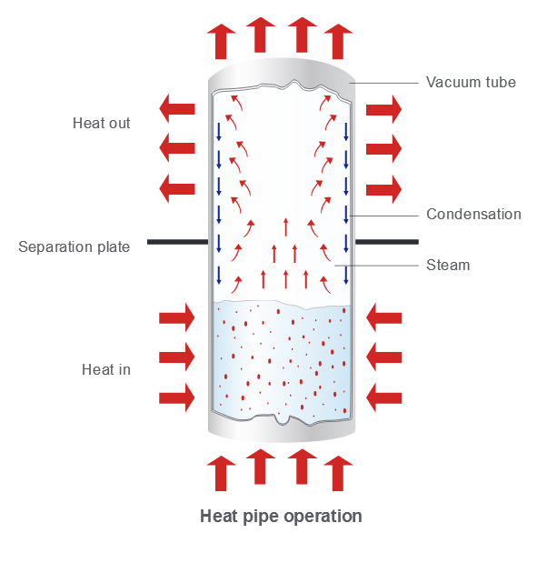
WORKING PRINCIPLE
At evaporator:
Fluid inside the heat pipe picks heat from the source and evaporates.
The vapors travel from evaporator to adiabatic section and to condenser.
At condenser:
Vapor releases latent heat to heat sink and condenses.
The condensate returns to evaporator and the cycle continues.

Slide 5
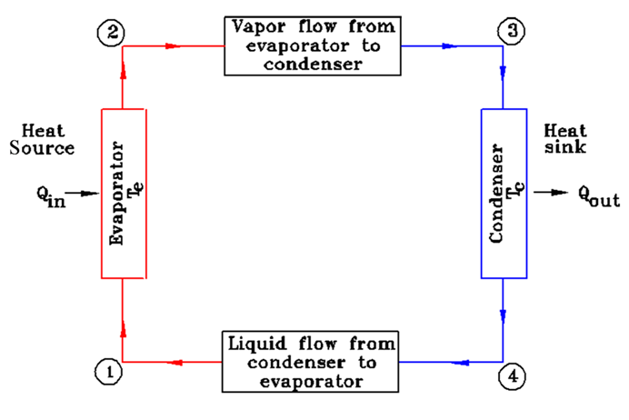
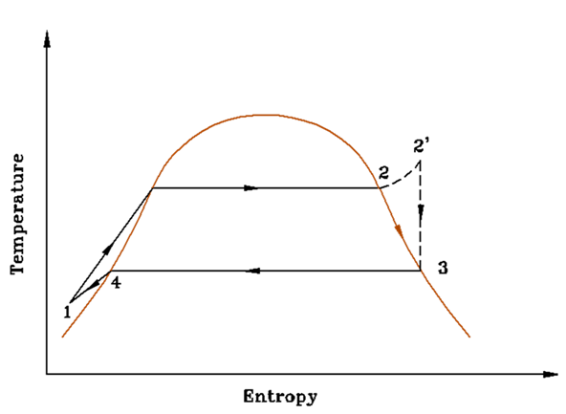
THERMODYNAMIC CYCLE

Slide 6
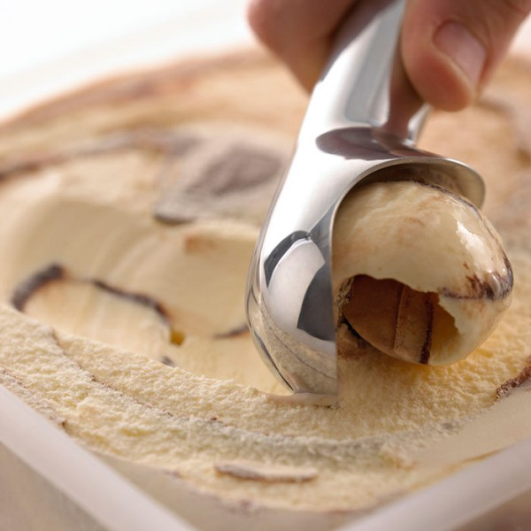
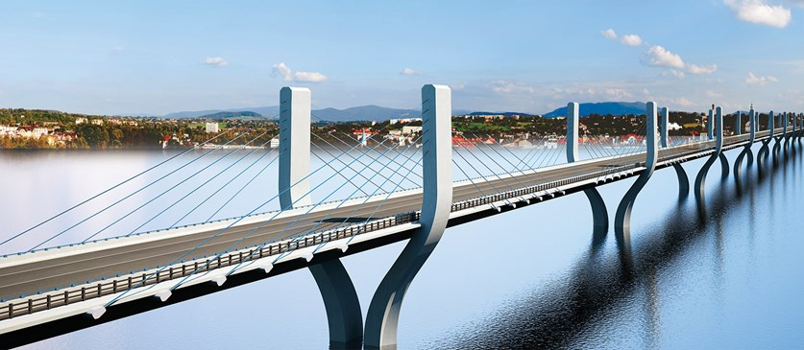
EXAMPLE OF HEAT PIPE

Slide 7
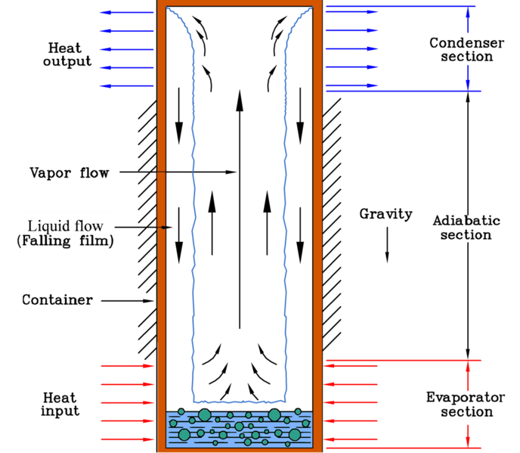
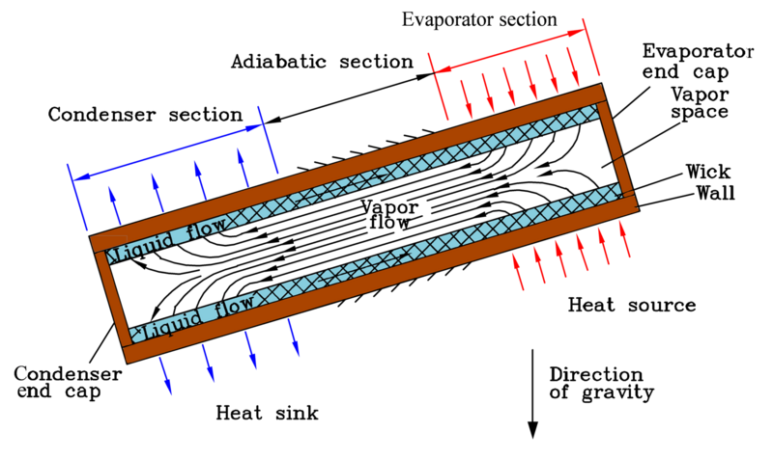
TYPES OF HEAT PIPE
Thermosyphon Heat Pipe
Capillary Wick heat pipe

Slide 8
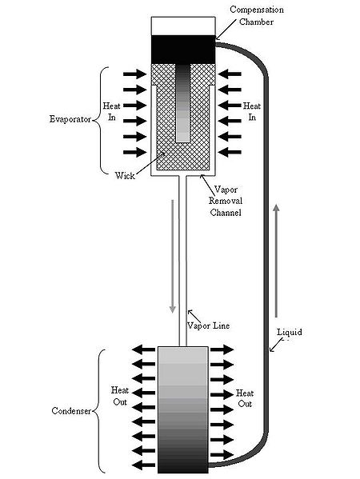
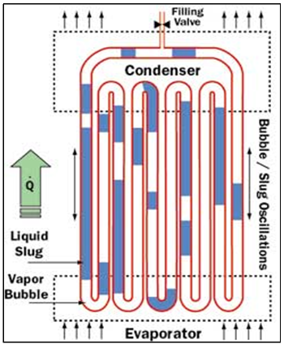
TYPES OF HEAT PIPE
Water: d < 5.34 mm (JAY M. OCHTERBECK)
Loop Heat Pipe
Pulsating heat pipe

Slide 9
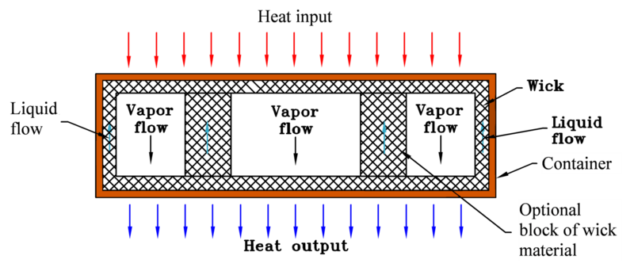
TYPES OF HEAT PIPE
Flat Plate
Rectangular, used to cool semiconductor or transistor packages assembled in arrays on the top of the heat pipe.
Flat plate heat pipe

Slide 10
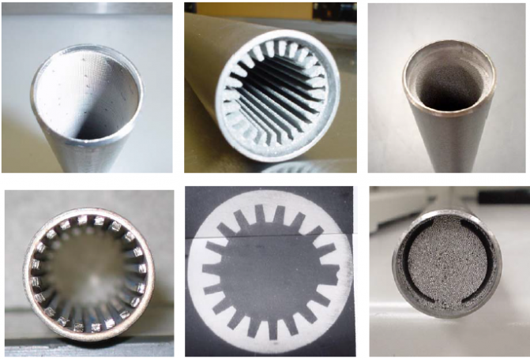
WICK STRUCTURE
It is a porous structure made of materials like steel, copper, aluminum or nickel in various ranges of pore sizes.
The prime purpose of wick is to generate capillary pressure to transport the working fluid from condenser to evaporator.

Slide 11
WORKING FLUIDS AND TEMPERATURE RANGES
Temperature Range | Value | Working Fluid
Cryogenic temperature range | -272°C to -73°C | Helium, Hydrogen, Neon, Methane
Low temperature range | -72°C to 227°C | Water, Ammonia, Freon 11, Flutec PP2, Flutec PP9
Medium temperature range | 227°C to 427°C | Dowtherm, Mercury, Sulphur
High temperature range | 427°C to 2727°C | Potassium, Sodium, Lead, Silver

Slide 12
HEAT PIPE CHARACTERISTICS
High effective thermal conductivity: Less temperature difference needed to transport heat than traditional materials resulting in low thermal resistance.
(A ΔT of 900°C is needed to transfer 1 kW heat across 30 mm diameter, 1 m long copper rod. A Heat Pipe of same size can transfer same amount of heat with a ΔT of 10°C ) (Faghiri 2012),
Efficient transport of concentrated heat
Temperature control: The evaporator and condenser temperature can remain nearly constant (at Tsat) (Faghiri 1995)
Freedom of design.
Maintenance free.

Slide 13
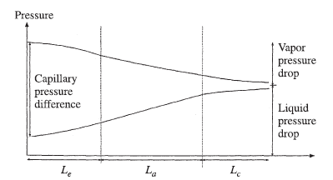
HEAT TRANSFER LIMITATIONS
Limitations | Explanation
Capillary limit | Occurs when driving pressure in capillary structure is insufficient to provide adequate liquid flow from condenser to evaporator. At capillary limit, dryout of evaporator wick will occur.

Slide 14
HEAT TRANSFER LIMITATIONS
Limitations | Explanation
Boiling limit | Occurs when the applied evaporator heat flux causes nucleate boiling in evaporator weak. This creates vapor bubbles that partially block the liquid return and can lead to evaporator wick dryout.

Slide 15
HEAT TRANSFER LIMITATIONS
Limitations | Explanation
Entrainment limit | Occurs due to the high shear forces between vapor flow and liquid flow. The liquid droplets in the wick may be entrained by the vapor and returned to the condenser resulting in insufficient liquid flow to the wick structure.

Slide 16
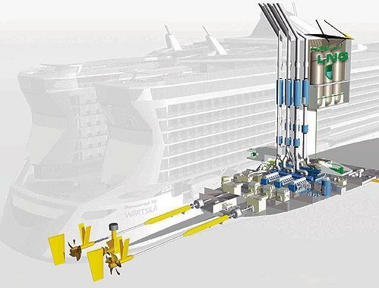
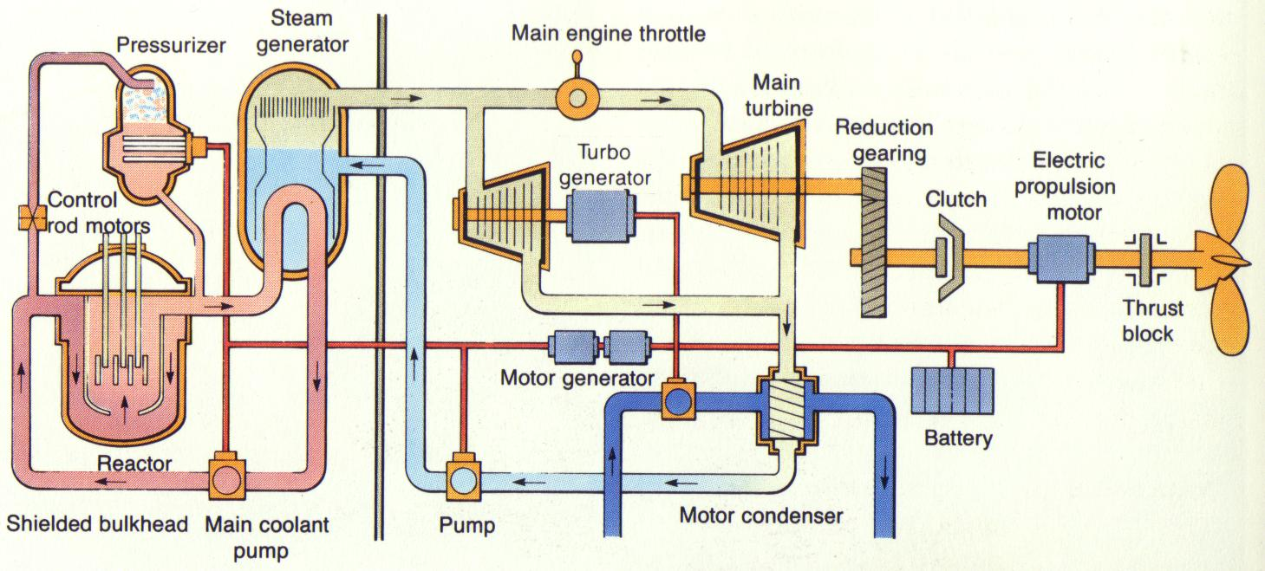
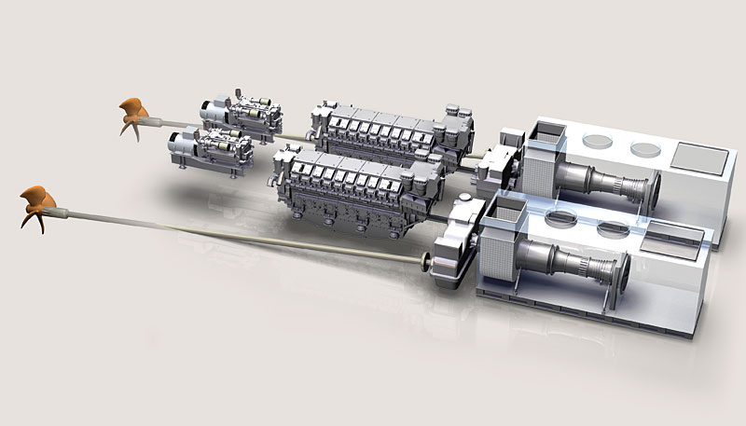
APPLICATIONS IN MARINE
Types of engines used for propulsion
Steam engine
Diesel engine
Gas turbine engines
Nuclear reactor engines
LNG engine propulsion
Nuclear engine propulsion
Diesel engine propulsion

Slide 17
APPLICATIONS IN MARINE
What are the processes which require HOT WATER or STEAM on ship?
Desalination
Hotel/Catering
Laundry
Day to day human activities( bathing, ironing, etc.)
Food processing
Oil heater
Air conditioning
This requirement can be fulfilled by making use of heat pipes to generate hot water or steam utilizing the exhaust gas from engines

Slide 18
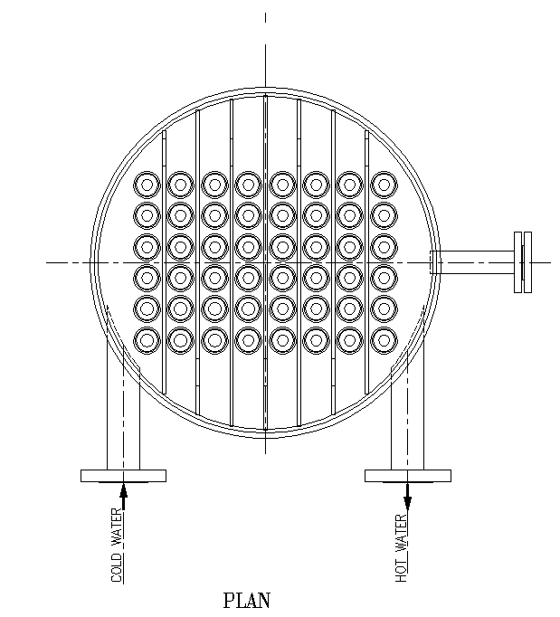
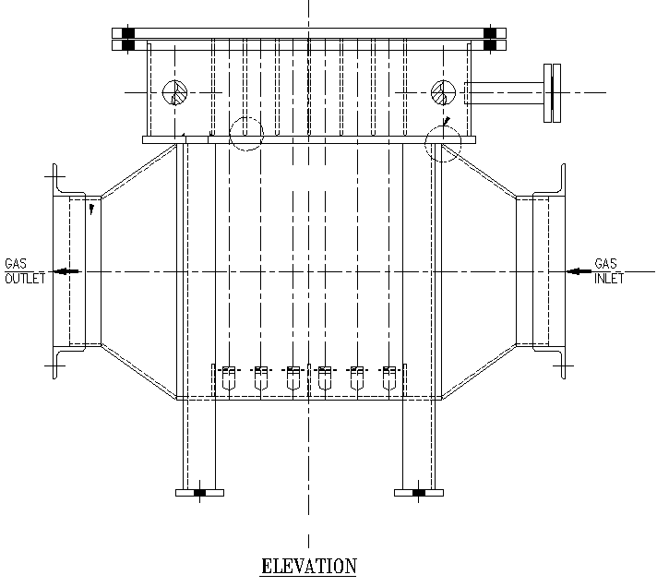
APPLICATIONS IN MARINE
Heat pipe hot water generator

Slide 19
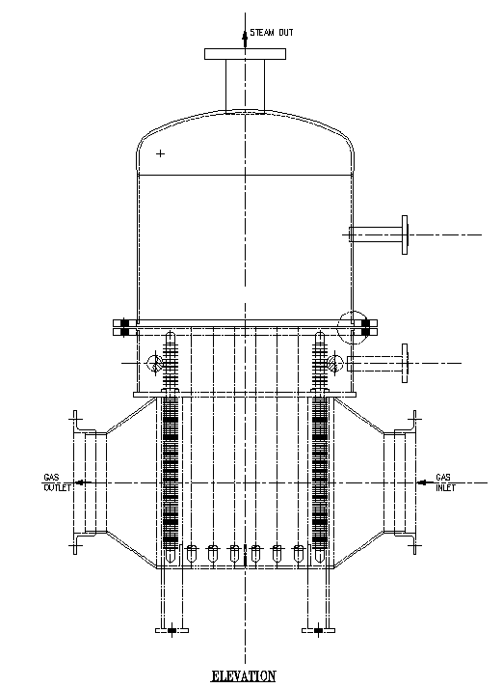
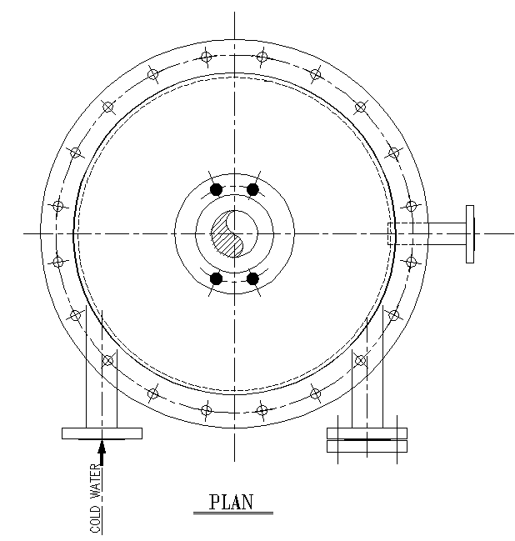
APPLICATIONS IN
MARINE
Heat pipe steam generator

Slide 20
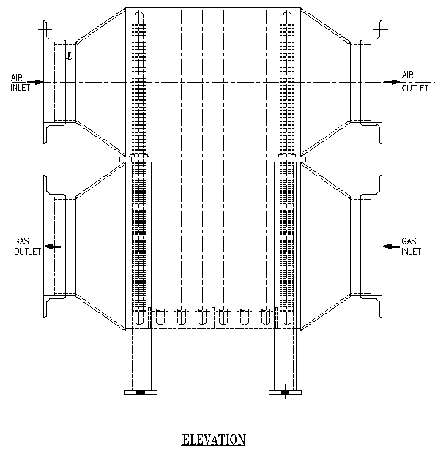
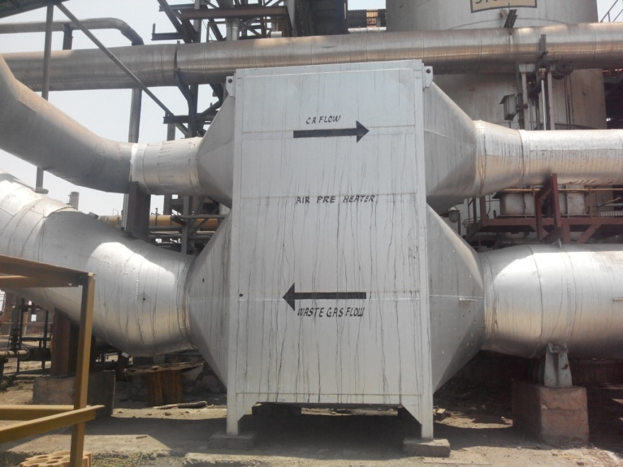
APPLICATIONS IN MARINE
Heat pipe air pre heater

Slide 21
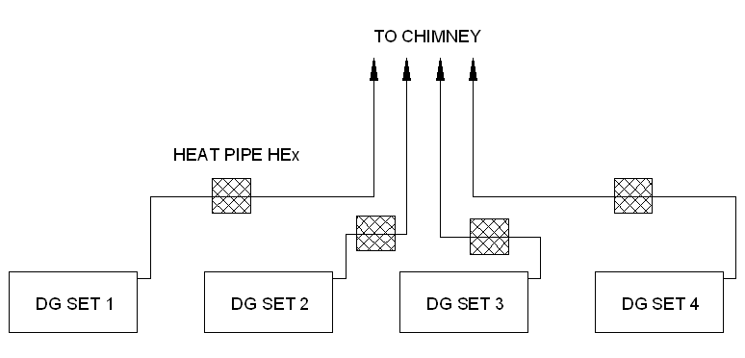
APPLICATIONS IN MARINE
Possible layout of heat pipe heat exchanger on ship

Slide 22
ADVANTAGES OF HEAT PIPE OVER CONVENTIONAL HEAT EXCHANGER
Parameter | Conventional HEx | Heat Pipe HEx | Remarks
Space | Large | Compact/ Less | 35-40%
Weight | It is Heavy | It is light weighted | 30-35 %
Corrosion Potential | Get corroded quickly | Low intensity of corrosion | No condensation of gases
Site Activity | High | Less | Whole equipment is built in shop
Maintenance | High | Less
Life of equipment | Less | More

Slide 23

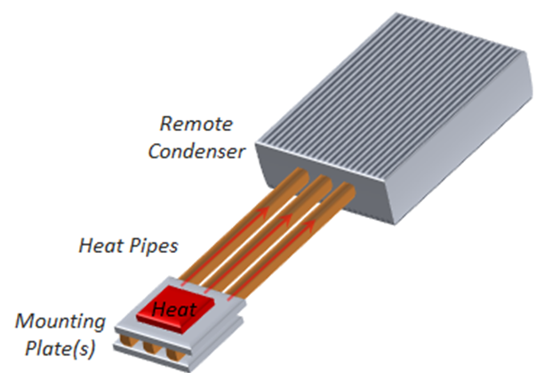
OTHER HEAT PIPE APPLICATIONS
Electronic and electrical equipment cooling: Used to cool transistors and high density semiconductors
Aerospace and Avionics: Cool satellite solar array during reentry (ISRO uses ammonia heat pipe)
Heat exchangers and Heat pumps
Gas Turbine Engines and the Automotive Industry
Medical: Medicine and Human body temperature control
Ovens and Furnaces

Slide 24


