Slide 1

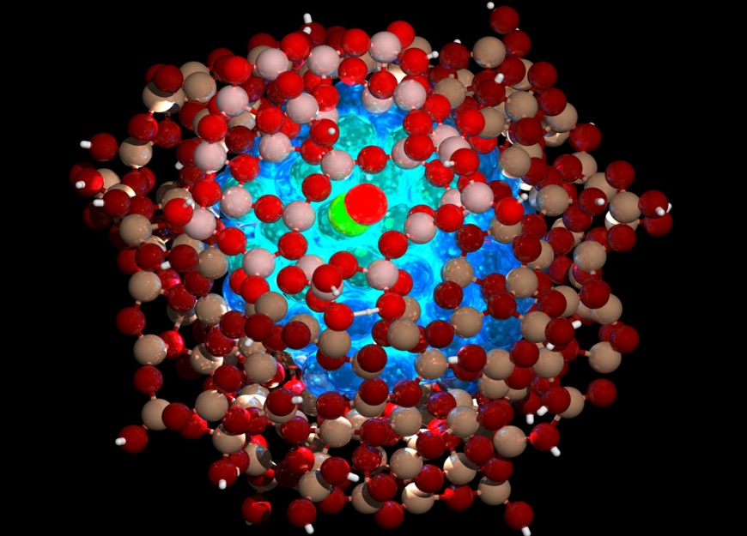
TOLANI MARITIME INSTITUTE
PROTECTION OF BOOT TOPPING OF SHIP
USING NANOCAPSULES
BY
RAJEEV METTA
S.M. ALI ABBAS RIZVI

Slide 2
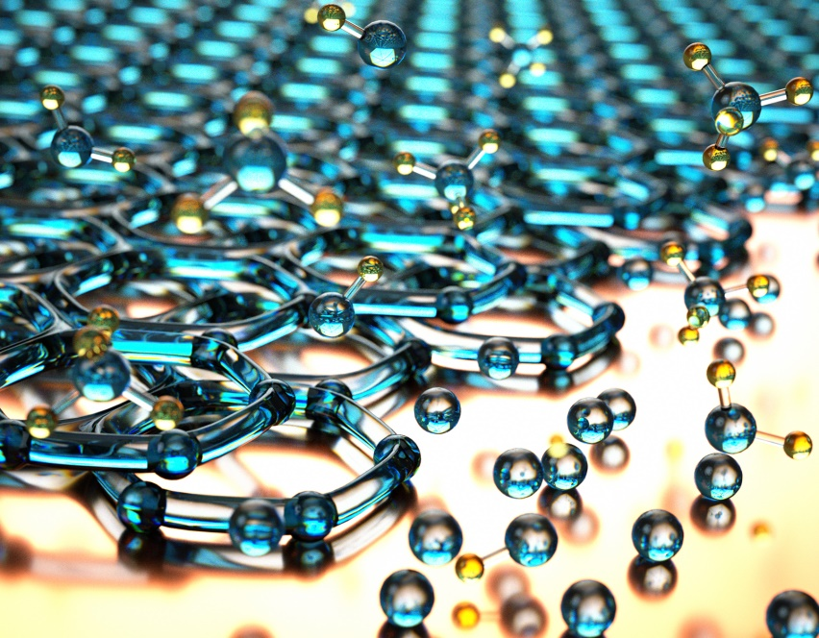
NANOPARTICALS
Materials that are composed of particles whose size in the order of nanometers . These nanoparticles can be tailor-made for specific functions.
The areas where nanoparticles are gaining acceptance are
Medical industry
Food industry
Paints
Clothing

Slide 3
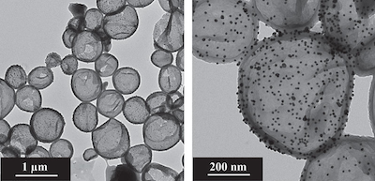
NANOCAPSULES
Nano capsules is a class of nanoparticles whose structure is in the form of a double layered sphere.
This material was developed by scientists from Max Planck Institute for Polymer Research in Mainz and the Max-Planck-Institut für Eisenforschung GmbH in Düsseldorf.
Notes:
Introduction to Nano capsules and research that happened in Germany

Slide 4
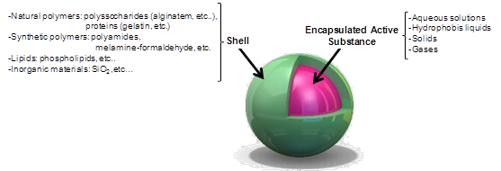
Structure of Nanocapsules
The Nanocapsule is made of polyaniline , a conductive polymer to contain anti-corrosive substance.
The outer layer is porous in nature and in corrosive environment and this lets the anti-corrosive payload to work against corrosion.
Notes:
Describe the sturcure.

Slide 5

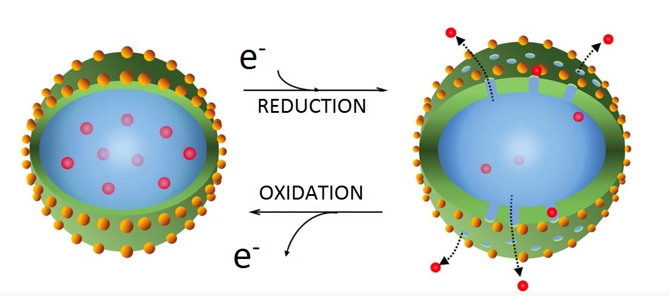
Nanocapsules as paints
Nanocapsules are mixed with epoxy based paints to form sol-gel matrix to effectively reduce corrosion of the metal surface to practically negligible levels.
Notes:
The nanocapsules detects corrosion by sensing a drop in electrical potential levels.
As the potential drops, the outer surface reduces itself and becomes porous allowing the anti-corrosive payload to release and oxidizes itself over the metal surface rendering it inert.
Once the corrosive agent stops acting, the inner layer reduces and the outer layer oxidizes to restore the anticorrosive properties. The working of nanocapsules can be equated to skin.

Slide 6
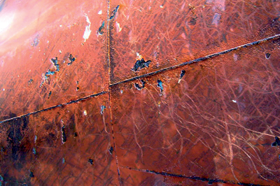
Corrosion in boot topping area
Maximum corrosion occurs in the boot topping area since this region is an interface between sea water and moist air – both of which are very effective corrosion agents.
The convention method of protecting this area is by applying epoxy based paints.
But epoxies tend to be brittle and also do not give any indication of corrosion of metal underneath it.
Notes:
The boot topping is the area immediately above and below the mean water level of the ship.

Slide 7
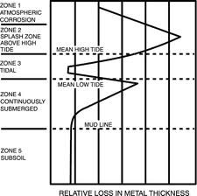

Slide 8
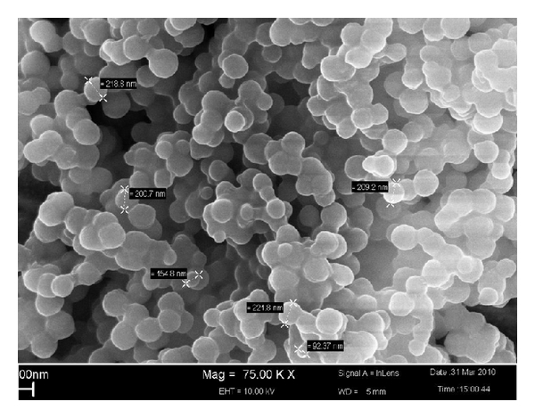
Advantages of nanocapsules
Though nanocapsules cannot replace epoxy paints as of now, the major advantages of using them are :
Nanocapsules can be used to fight marine fouling as it gives a polishing effect.
Application of nanocapsules reduce the paint thickness by 15%
Nanocapsules are highly reactive and it is able to fight off corrosion actively.
In an event where the nanocapsules’ surface is scratched , the nanocapsules can rebind with each other to restore the surface.
Notes:
In a condition where the nanocapsules cannot guarantee effective resistance against bio-fouling, it is possible to overcoat the existing antifouling paints.

Slide 9
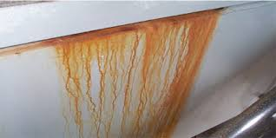
As the application of nanocapsules will reduce the thickness of the paint film leaching of toxic compounds into the sea water will be reduced

Slide 10
Economic advantages
of using nanocapsules
The reason for adopting nanocapsules is that it offers greater protection of the side shell of the ship for a lesser cost in the long run.
To explain the above statement, we take an average sized bulk carrier. Let the wetted surface area for the ship be about 8000m²
For epoxy paints to retain their effectiveness, four coats of it are applied.
The average cost of epoxy paint is about $6.50 per sq. meter.
The density of epoxy paint is about 1200 kg/m³

Slide 11
The thickness of every coat of epoxy paint = 0.000125m
Hence, the weight of the total epoxy coating would be = 8000*.000125*1200*4 =4800kg
The total cost of the paint would be = 8000*4*6.50 = $208000
The service time of epoxy paint is 5 years
Therefore, cost of epoxy paints per year = $52000 (including maintenance)

Slide 12
If nanocapsules are applied,
Reduction of thickness in the epoxy coat = 15%
Estimated cost of nanocapsules = $15 per square meter
The total weight of the paint coating would be = 8000*.000125*1250*4*.75 = 3600Kg
The cost of paint would be = .75*208000 + 15*8000 = $276000
The service time of epoxy paint with nanocapsule coating will be about 8 years

Slide 13
Hence, the cost per year of this coating would be = $34500
The estimated cost saved per year = $17500
Additionally, weight reduced is 1200Kg
This weight can either be utilized to increase fuel efficiency, or to increase the dead weight of the ship.
If this weight is used as additional deadweight,
Assumed freight rate of a region $150 per tonne and the ship makes
30 trips a year, the increase in income would be = 1.2*150*30 = $5400

Slide 14
Hence, the total saving is
$22000 per year per
ship

Slide 15
Conclusion
The development of nanocapsules is in its nascent stage but its application is wide range. In years to come, it is expected that nanocapsules will eliminate paints completely. Further research can be done in colour changing nanocoatings to indicate the precise location of corrosion and combined with nanocapsules; it just might be possible to eliminate corrosion of structures completely.

Slide 16
A peak into the future
Nanocapsules as self-healing materials.
Colour changing Nano coating to detect localized corrosion.
Programmable materials.

Slide 17
References
Corrosion Resistance Of Nanoparticle -Incorporated Nano Coatings by R. Joseph Rathish, R. Dorothy, R. M. Joany, M. Pandiarajan and Susai Rajendra, 2013.
Development and Performance Evaluation of Corrosion Resistance Self-Healing Coating Akshya Kumar Guin, Suryakanta Nayak, Manish Kumar Bhadu, Veena Singh, and Tapan Kumar Rout, 2014.
www.ecsdl.org
www.paintsquare.com

Slide 18


