Slide 1
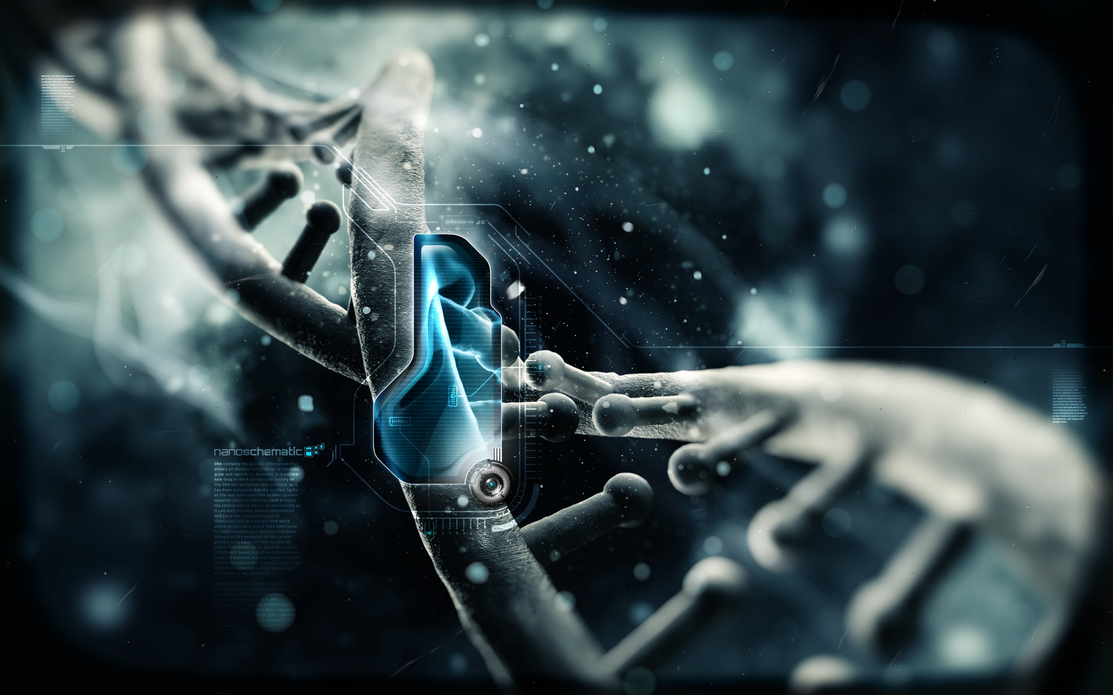

SMART MATERIALS FOR SMART FUTURE
TANVEER SINGH BHULLAR
SHIVENDRA PANDEY
SURENDAR SINGH RATHOR

Slide 2
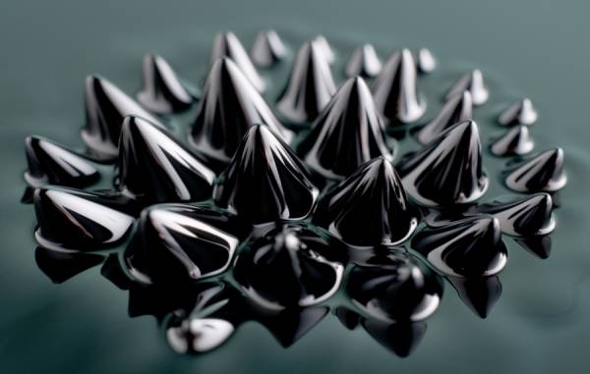
WHAT ARE SMART MATERIALS & HOW THEY WORK
Sense and respond to environment
Stimuli acting upon these materials are :
Stress & Strain
Temperature
Chemicals (including pH stimuli)
Electric field & Magnetic field
Hydrostatic pressure

Slide 3

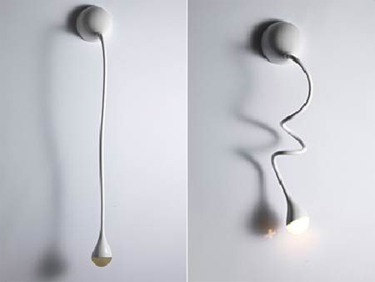
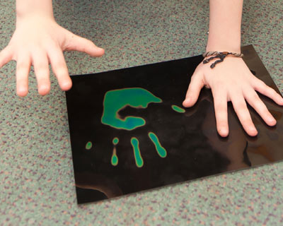
SMART I.Q.
A color change
Photo chromic paints, glasses
A volume change
pH sensitive polymers
Acoustic emission
Sound emitted under high stress
Capable of reversing mechanical properties (viscosity, stiffness, shape)

Slide 4
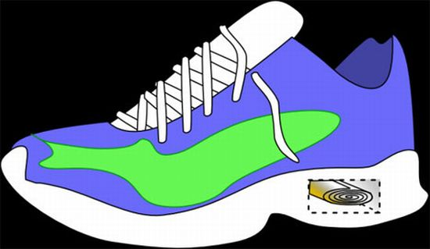
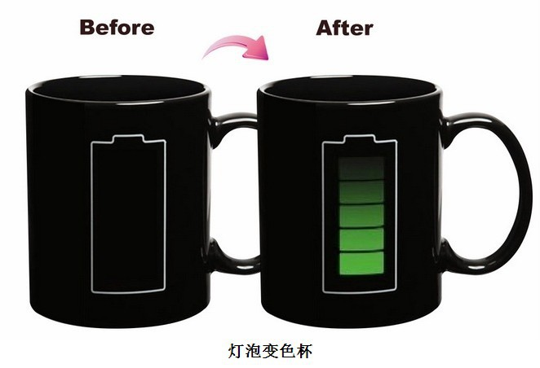
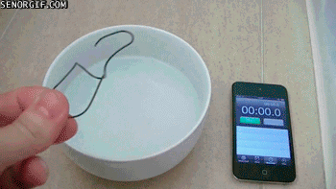
TYPES OF SMART MATERIAL
Piezoelectric
Shape memory alloys
Thermo chromic

Slide 5
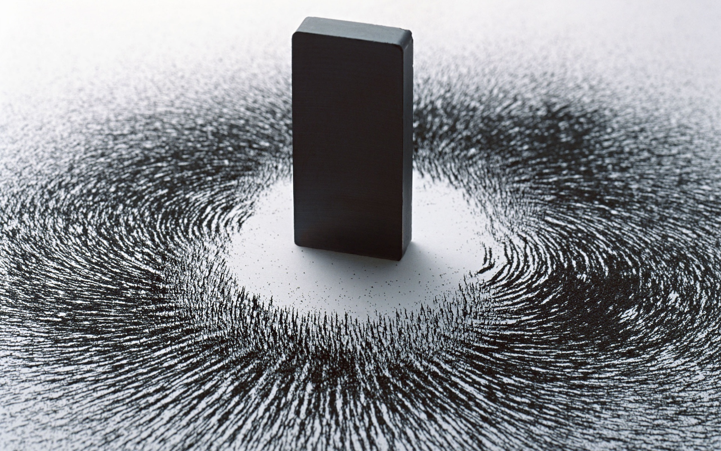
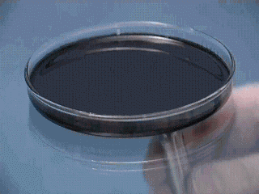
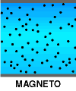
Magneto
Electro
Rheological

Slide 6
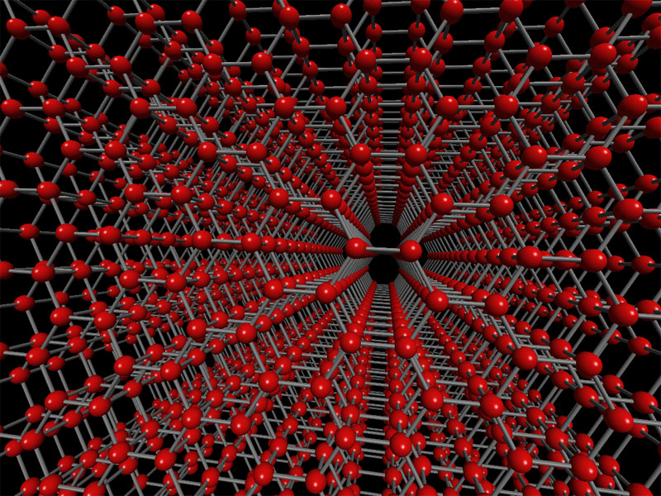
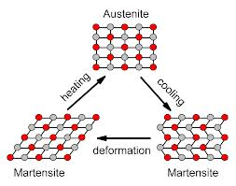
SHAPE MEMORY ALLOYS
SMA’S can exhibit large recoverable strains. Ex- Nitinol
Martensite
Low temperature phase
Monoclinic crystal structure
Austenite
High temperature phase
Cubic crystal structure

Slide 7
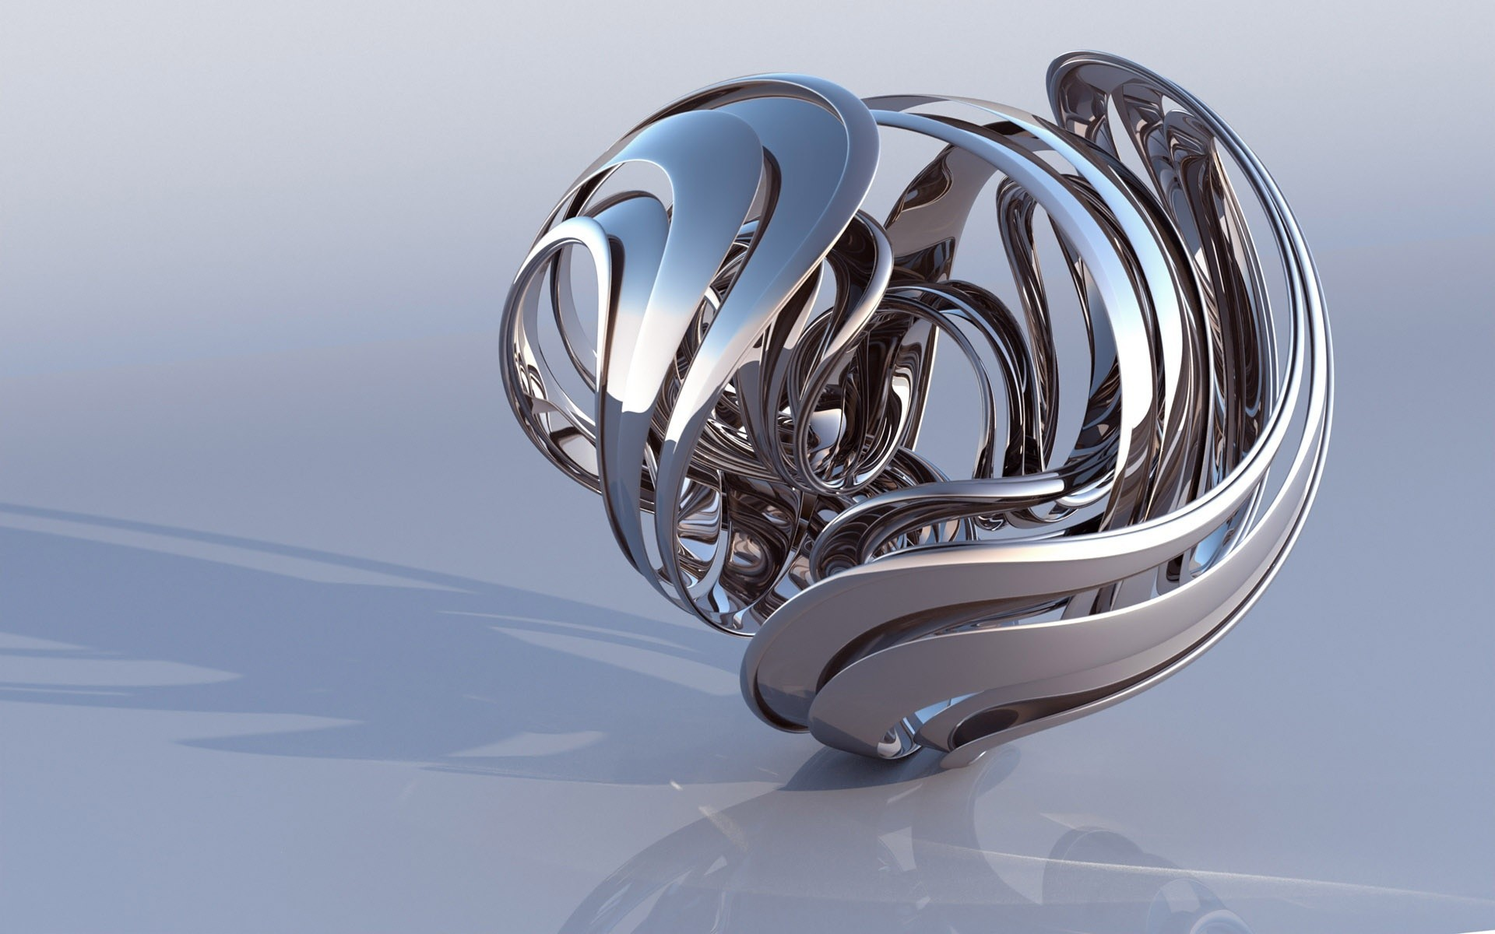
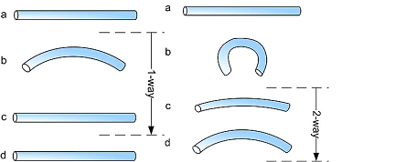
SHAPE MEMORY EFFECTS
Two common effects are :
One-way
Two-way

Slide 8
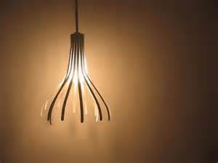
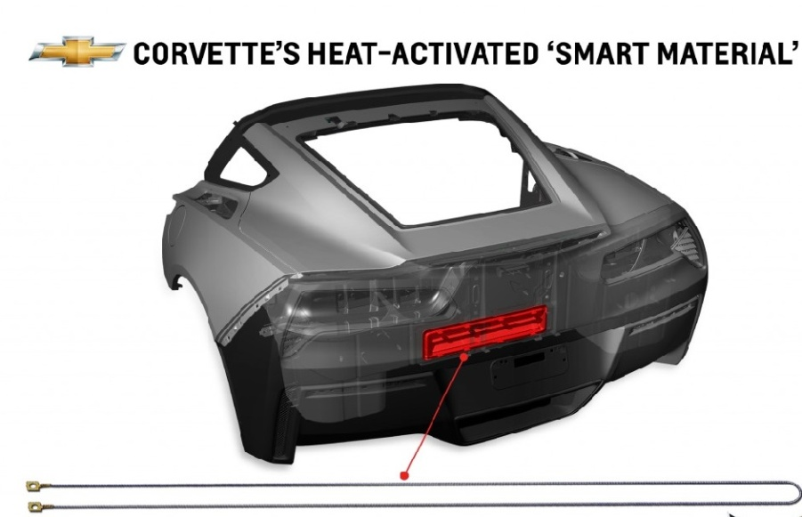
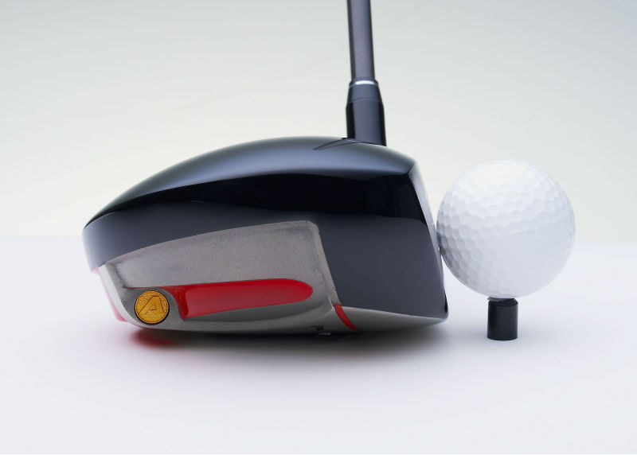
SHAPE MEMORY ALLOYS USES

Slide 9
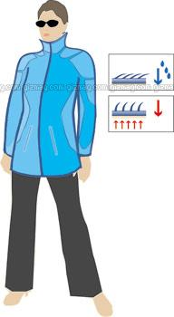
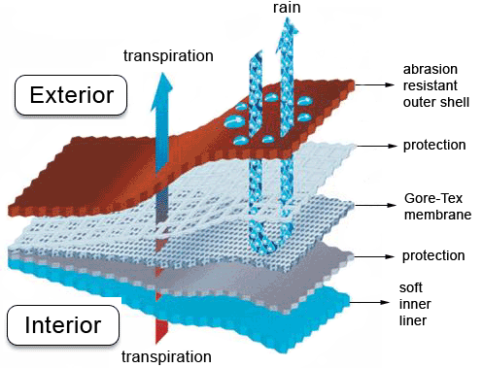
SMART FABRIC
Pine cone model
Adapts to changing temperature by opening when warm or shutting tight if cold.
Gore-tex

Slide 10
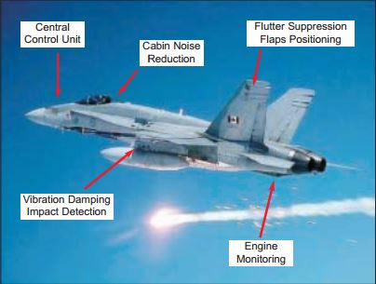
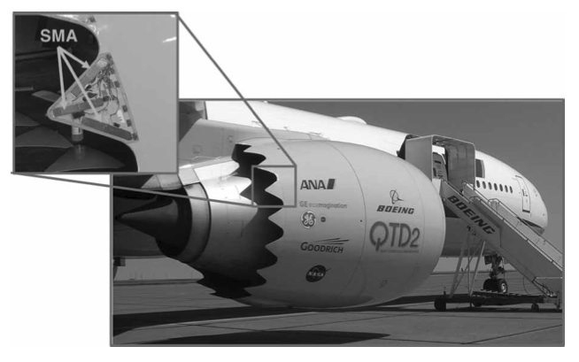
AEROELASTIC TAILORING
SMA wire actuators can be attached to points on the inside of an airfoil, and can be activated to alter shape of airfoil. This shape change can effectively increase efficiency of a wing in flight at several different flows.

Slide 11

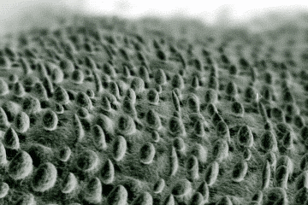
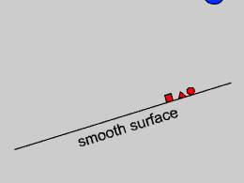
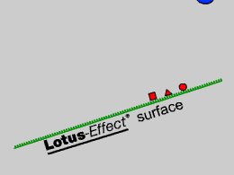
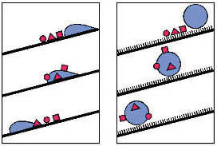
Biomimetics: Lotus effect
Most efficient self-cleaning plant
= great sacred lotus
(Nelumbo nucifera)
Mimicked in paints and
other surface coatings
Pipe cleaning in oil refineries (Norway)

Slide 12
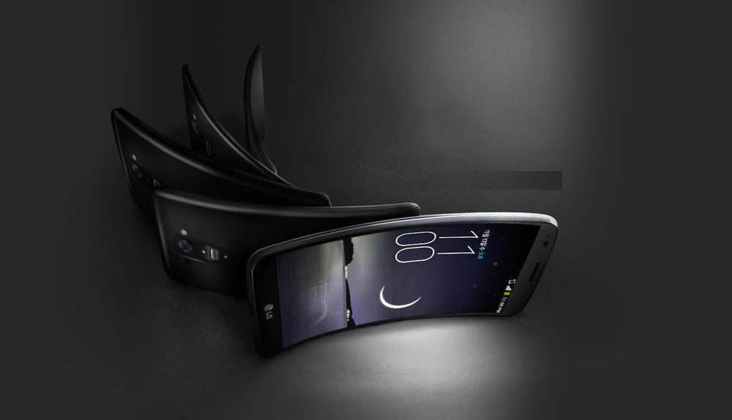
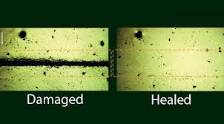

ADVANTAGES
Vibration absorber, shape controller
Sensors as well as actuators
Self healing and repairing ability
High energy density
High elasticity

Slide 13

LIMITATIONS
Non biodegradable
Environmental Pollution
Expensive to produce
Long term effects unknown

Slide 14
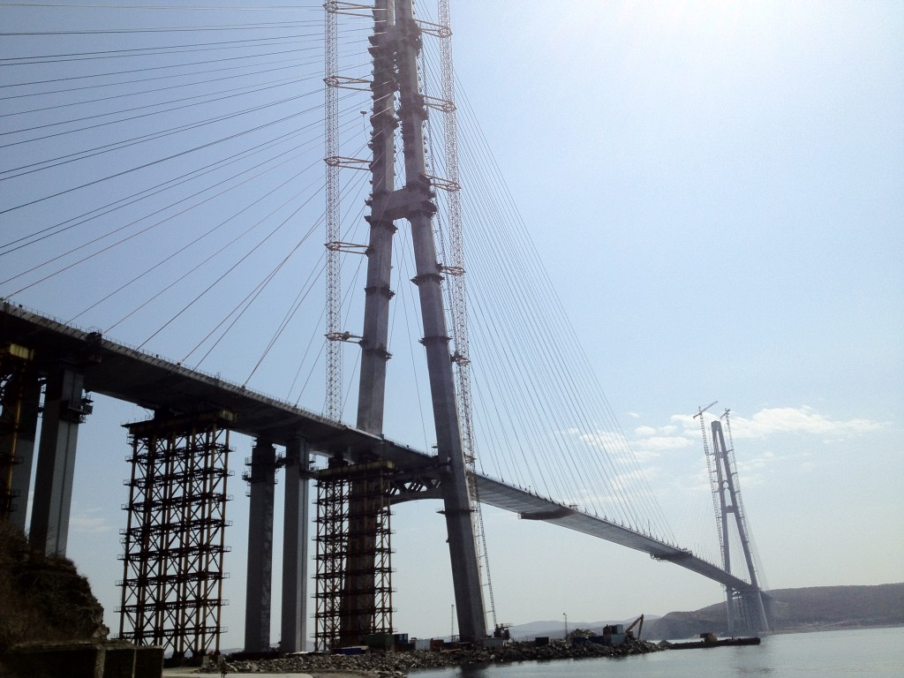
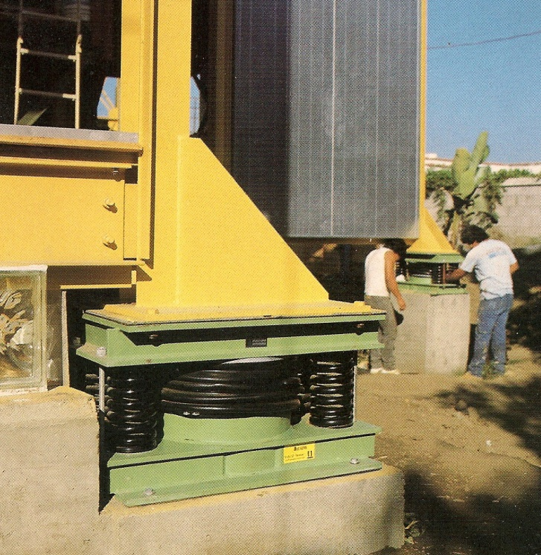
APPLICATIONS
Noise, vibration dampers
Systems monitoring using fiber optic cabling
Shape control of structures using self morphing
“Self healing” surface coatings to reduce corrosion
Piezoelectric coatings, de-icing solution

Slide 15

SMART SYSTEMS
Integrate the properties of embedded sensors, actuators and control mechanism in order to response to given stimulus in a useful manner. Usually this involves implementing hardware and software control mechanism.
Notes:
Defined as miniaturized devices that incorporate functions of sensing, actuation and control.
The “smartness” of the system can be attributed to autonomous operation based on closed loop control, energy efficiency and networking capabilities

Slide 16
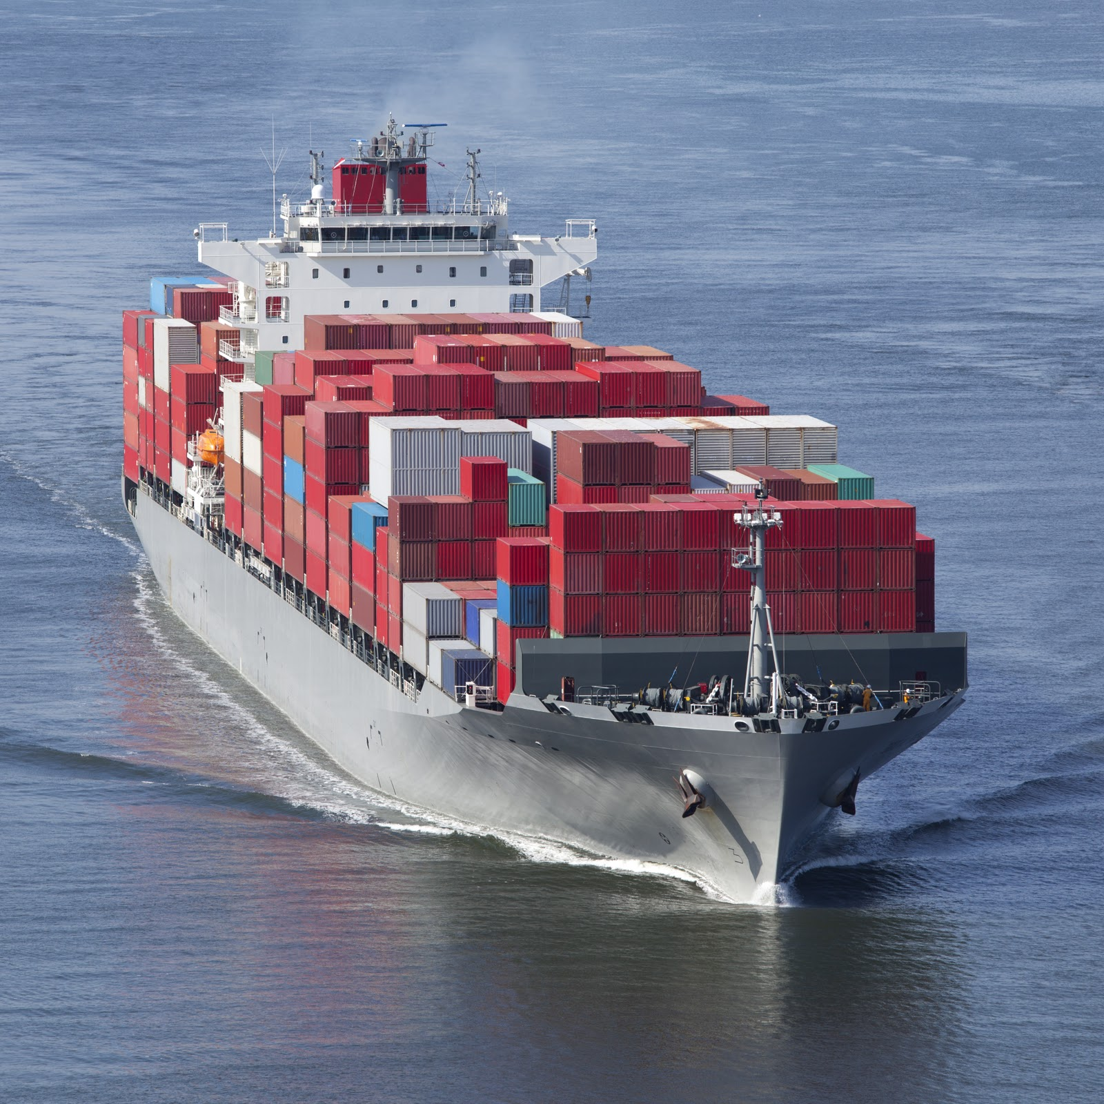
Smart Ship Technologies
Ship hull structure monitoring using fiber optic sensors.
Ex:-Fiber Bragg Grating sensors.
Self healing coatings (e.g. surface coatings and paints) to protect metal from corrosion.

Slide 17
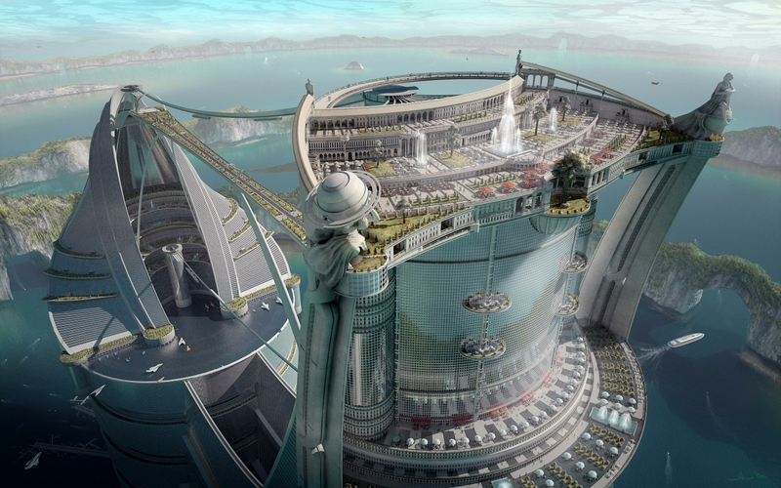
FUTURE APPLICATIONS
Future applications are envisioned to include engines in cars and airplanes and electrical generators
Possible automotive applications using SMA springs include engine cooling, carburetor and engine lubrication controls
Control of a radiator blind.

Slide 18
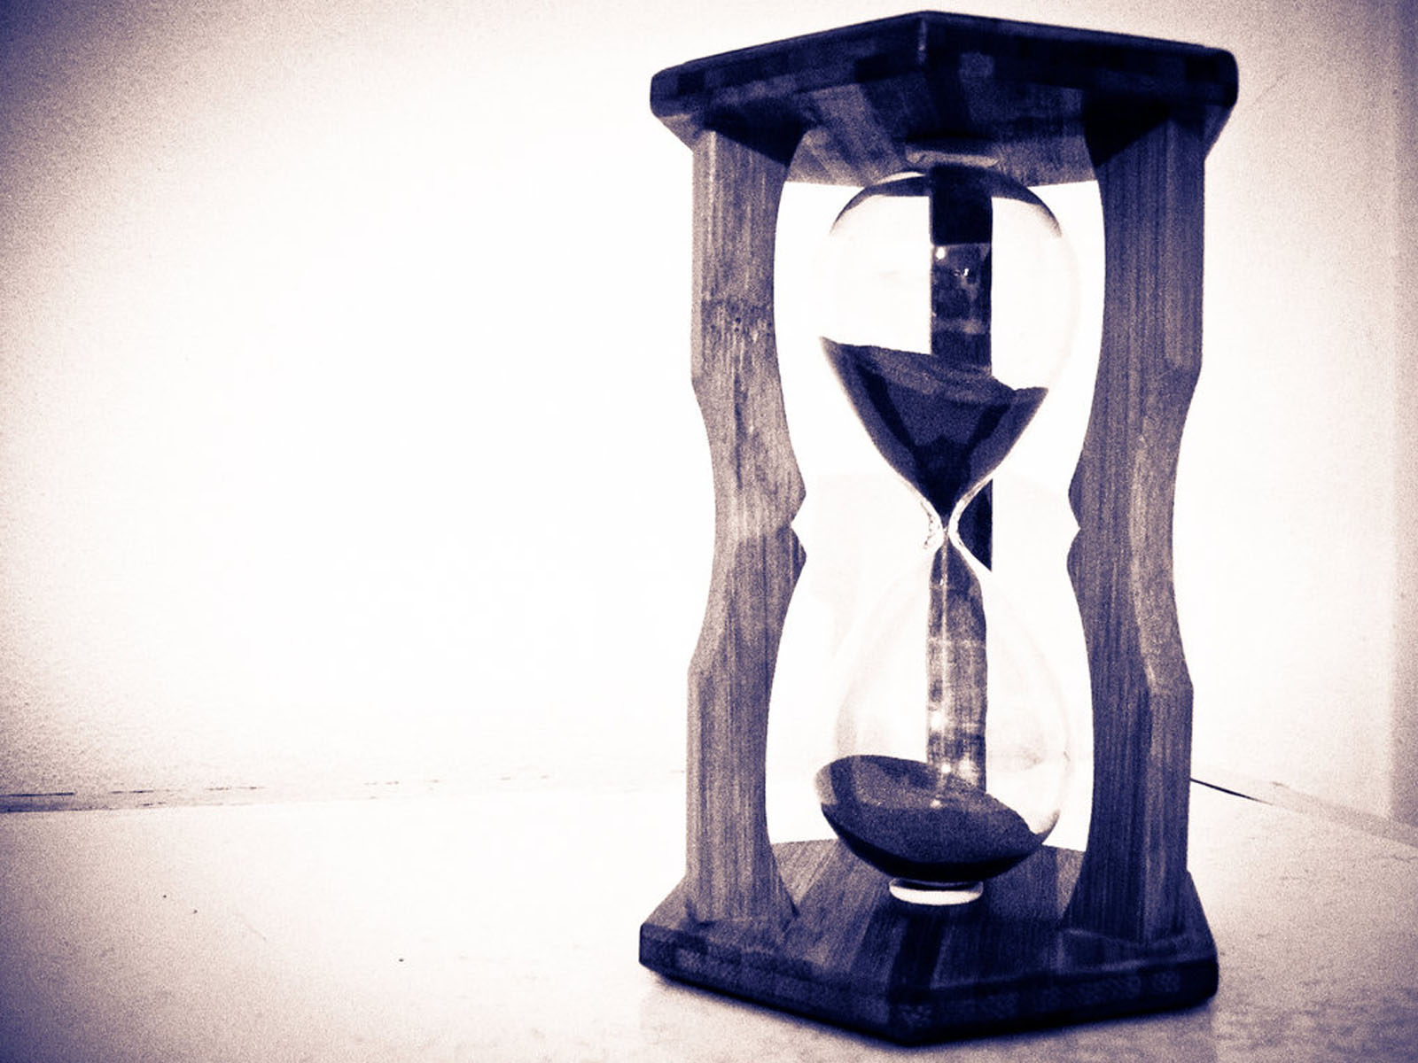
CONCLUSION
The future of smart materials and systems is wide open.
The use of smart materials in a product is only limited to one’s talent, capability and ability to "think out of the box.”
Smart materials are going to be the creative agents of our world in years to come”

Slide 19

REFERENCES
Akhras, Smart Materials and Smart Systems for the future, Canadian Military Journal, 08/2000
European Commission ICT Work Programme 2007-08
European Commission ICT Work Programme 2009-10
Gessner, T. : Smart Systems Integration 2008, VDE Verlag, Berlin 2008
SMART MATERIALS by James A. Harvey : chapter 13;401-402
Shape memory alloys and their applications by Richard Lin
Smart materials for active noise and vibration reduction by H. P. Monner, German Aerospace Center (DLR), Institute of Composite Structures and Adaptive Systems Lilienthalplatz 7, D-38108 Brunswick, Germany. :1-3
Postnote January 2008 Number 299 ,Smart Materials and Systems :1-2

Slide 20

ACKNOWLEDGEMENT
Principal & Head, Mr. Ajoy Chatterjee
Vice Principal Capt Phillip John
Course In charge, Mr. Melville Patrao
Soft Skill Trainer, Mrs.Meena Ravi Shankar
All other faculty members.

Slide 21

HOPE OUR PRESENTATION WAS QUITE INFORMATIVE
THANK YOU FOR YOUR PATIENT LISTENING
DO YOU HAVE ANY QUESTIONS?

