Slide 1


THE GREAT EASTERN INSTITUTE OF MARITIME STUDIES
26-Feb-15
A Presentation On
“Hybrid Renewable Power Generation & its Applications”
Presented By-
Cdt. Ben Joy Chethiyil
Cdt. Rohit Verma
Cdt. Taraka Prabhu Teja
(Graduate Marine Engineer -XXIX BATCH)
1
HAF

Slide 2
What’s Hybrid ?
A HYBRID is anything that uses two distinct power sources to move or propell.
The hybrid technology is not only a current issue in the field of electric vehicles.
Also in the area of ships there are some projects to replace the proven diesel mechanical drives by innovative drive concepts.
Keywords: Hybrid, power transmission, transmission line, power quality, Voltage Source
Converter (VSC), ship, battery, harbor tug, motor ferry

Slide 3


Why Hybrid ?…
Study By IMO
With no change in international regulations, IMO predicted in 2007
Annual fuel consumption of 389 million Tonnes would rise to 426 million Tonnes by 2020.
Annual SO₂ emissions to rise from 16.2 million Tonnes to 22.7 million Tonnes
Annual CO₂ emissions to rise from 1120 million Tonnes to 1475 million Tonnes

Slide 4
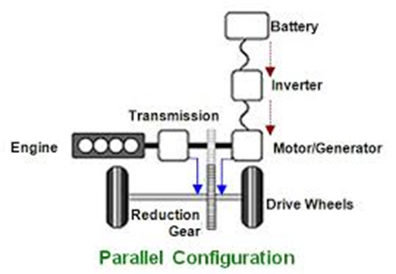
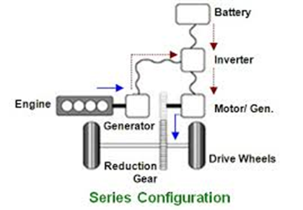
Hybrid Types :
Series & Parallel

Slide 5
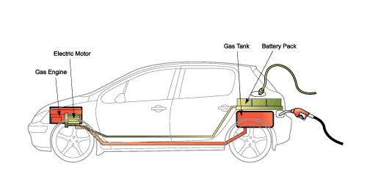
Plug-in hybrid electric vehicle (PHEV)
Another subtype of hybrid vehicles is the plug-in hybrid electric vehicle (PHEV).

Slide 6
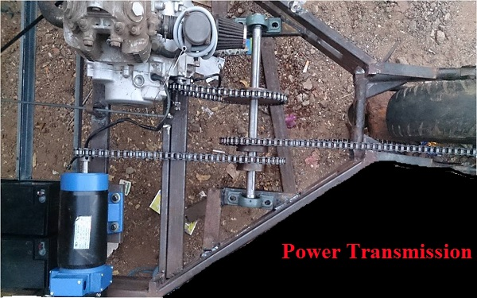

Slide 7
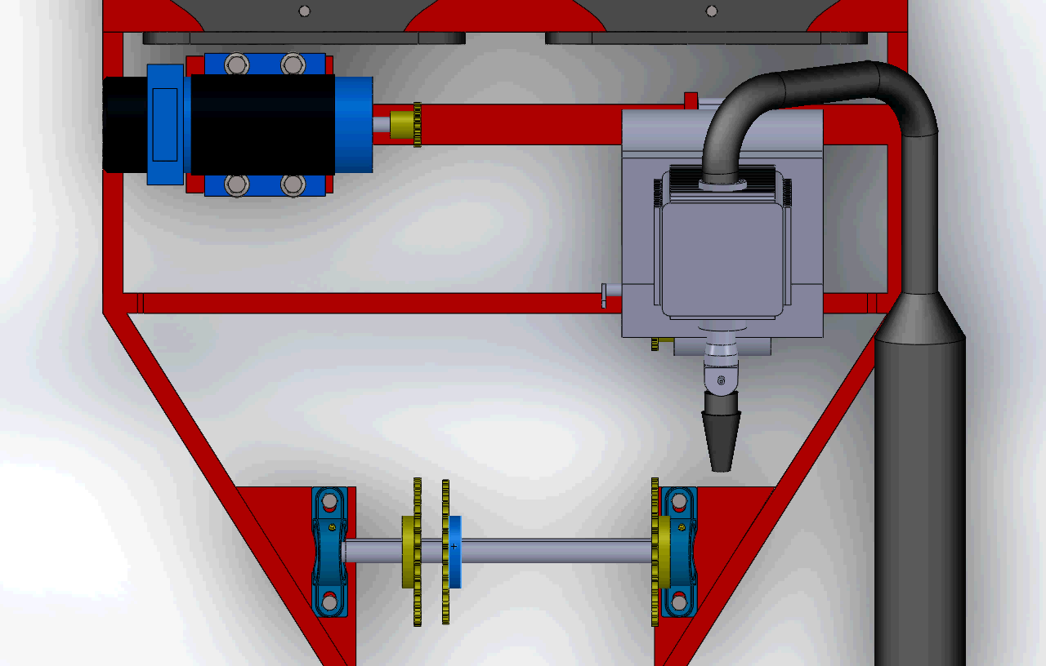
Power Transmission

Slide 8
Analysis for
Combined Running
For 1 litre of petrol:
On engine
45 Km
Battery charges at 45 km/hr
20 Amp for 1hr
Battery discharge
20 Amp
Motor range at 45 km/hr
45 Km
Total Distance
90 km
Petrol Cost
70 Rs/ltr
Cost / km
Rs 0.84

Slide 9
Hybrid Marine Applications
Fuel Cells
Solar Energy
Nuclear Power
Wind Energy

Slide 10
Fuel Cells
Fuel cell is an electrochemical device or a cell that converts chemical energy from a fuel into electrical energy
COMPONENTS OF THE FUEL CELL
Anode
Cathode
Anode catalyst –usually made of platinum powder
Cathode catalyst- usually made of nickel
Electrolyte & basic circuit connectors

Slide 11
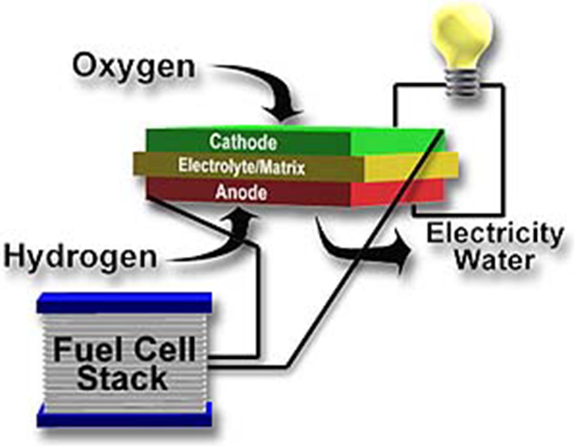
BLOCK DIAGRAM
OF UNIT FUEL CELL

Slide 12

Working of the Hydrogen Fuel Cells

Slide 13
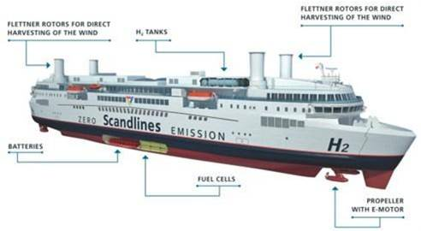
Ship Moving on Fuel Cells

Slide 14
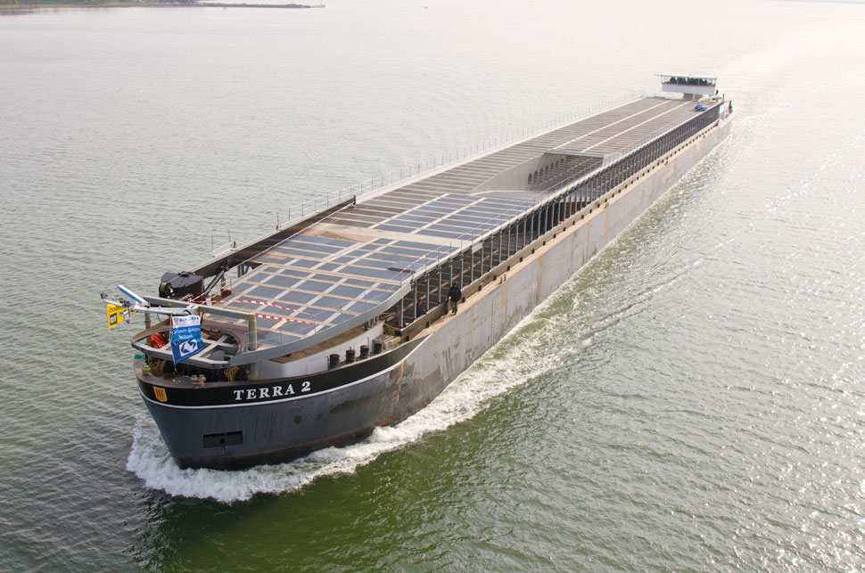
Ship On Solar Energy

Slide 15
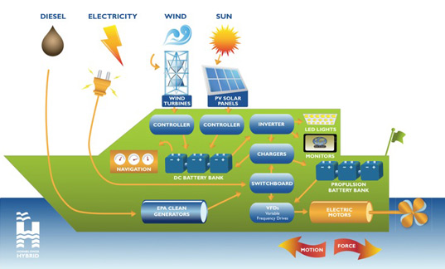
Block Diagram of a Solar Ship

Slide 16

Nuclear Ice-Breaker

Slide 17
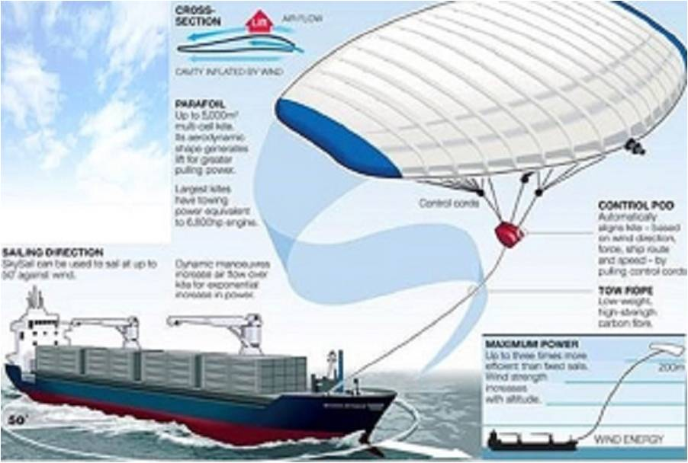
Wind for Future Sailing
SKYSAIL
SKYSAIL
SKY SAIL

Slide 18
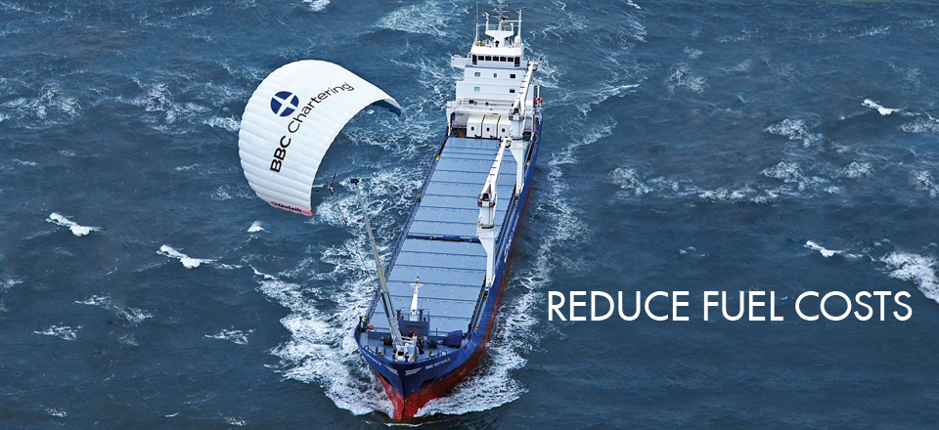
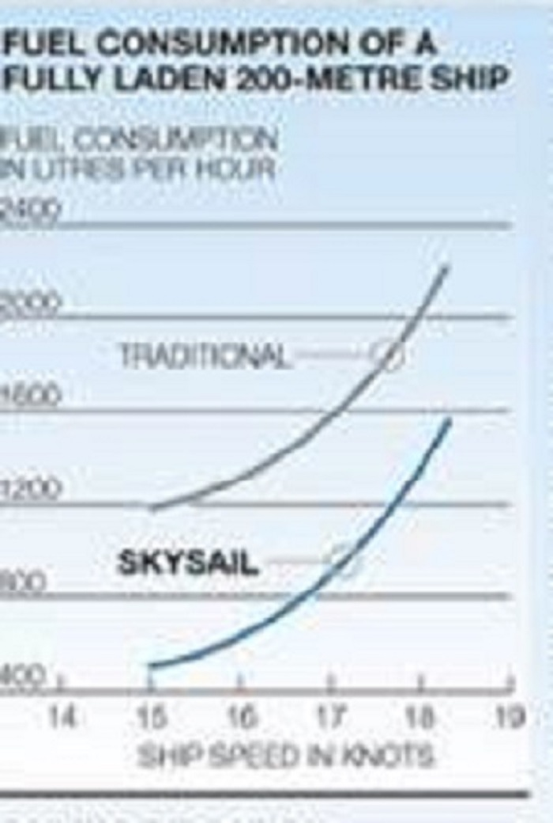

Slide 19
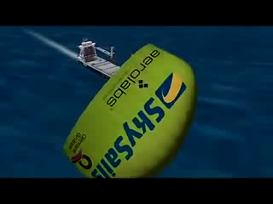
Sky Sail

Slide 20
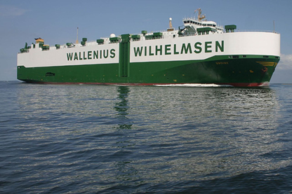

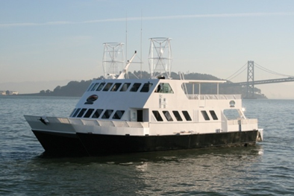

Some Of The Ships That Are Already Running Such Technology With Slight Variation In The Propulsion Plant Are:
MY DIVINE
VIKING LADY
HORNBLOWER HYBRID
SCANDLINES

Slide 21
Merits
Good For Environment
Reduce Toxic Emissions
Fuel Efficient
Consumes less fuel
Financial Benefits
Less money spent on fuels
Less energy is required to run
Aerodynamic design
      Demerits :
Less Power
Primary source of power is less
Poor Handling
Addition of more weight due to Batteries, motors etc..
Can Be Expensive
Expensive than ordinary engines
.

Slide 22
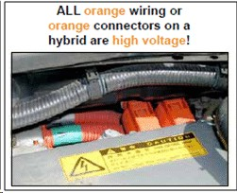

Electric and Hybrid Vehicle Safety
Most hybrid marine vessels contain a high voltage electrical system.
High voltage issues arise in tedious situations when the integrity of the cables may become compromised.
Electrically powered vessels are equipped with circuit breaker.

Slide 23
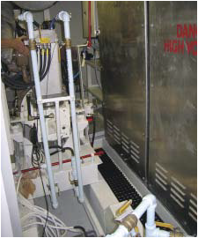
Safe casings for batteries
The stainless steel cases on the right-hand side
house large battery banks on a hybrid vessel.

Slide 24
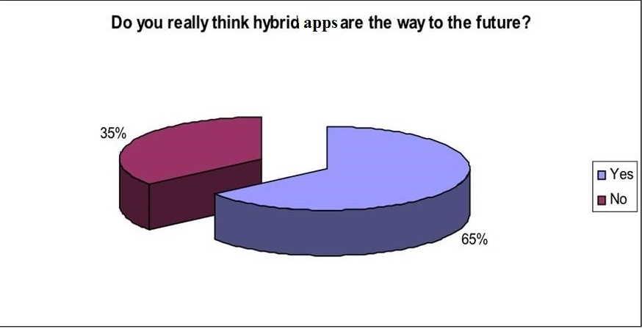
Conclusion

Slide 25


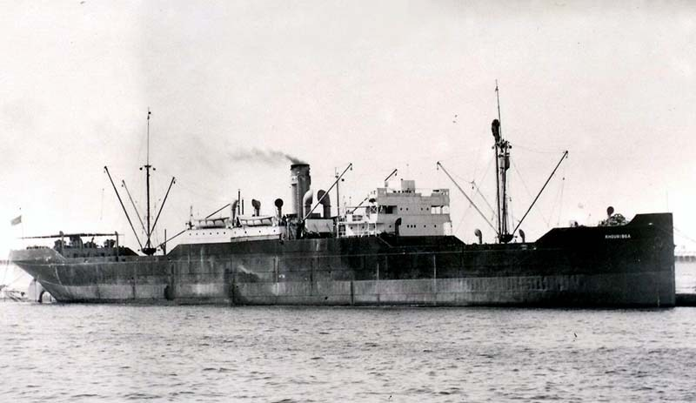
The Past was BLACK,
but…
The Future is GREEN…

Slide 26


ACKNOWLEDGEMENT

Slide 27

References :
“How Electric and Hybrid Cars Work” –Nick Hunter (2013).Gareth Stevens Publishing.
The Electric Car :Development and Future Of Battery, Hybrid & Fuel Cell Cars (IEE POWER & ENERGY Series,38) illustrated edition by Michael Westbook.
Future Cars :Green Designed :Bio-Fuel, Hybrid, Electrical,Hydrogen,Fuel Economy in all Sizes and Shapes by Ulrich Bethscheider-kieser (2008)
Electric and Hybrid vehicles – Engines and power trains by Ronald K. Jurgen
E- books.org

Slide 28


Slide 29


