Slide 1
ENERGY HARVESTING
PIEZO ELECTRIC CELLS
PRAVIN MISHRA
RAHUL SHARMA
ASHISH KUMAR
ANURAG CHAKRAVARTY
C.V. RAMAN COLLEGE OF ENGINEERING

Slide 2
INTRODUCTION
Diesel engines are used presently for electricity generation onboard
Shortage of fuel oil will lead to shifting from diesel engines to other sources
Other sources for electricity onboard are shaft driven generators , turboalternaters and storage batteries

Slide 3
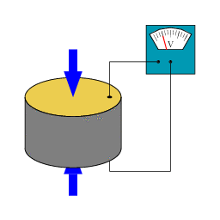
PIEZOELECTRICITY
Electricity is produced in some special types of crystal in response to applied mechanical stress
Leadzinconate titatanate is a piezoelectric material which generates measurable amount of electricity when its structure is deformed by 0.1% of its original dimension

Slide 4


Slide 5

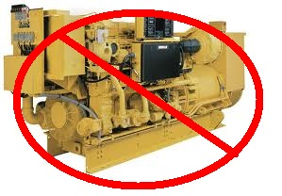

BENEFITS
NO FUEL
NO CONV.ENGINES
NO POLLUTION

Slide 6
Onboard Aspects
The piezoelectric cells can be placed on
Ship sides & bulbous bow
Machinery spaces
In conjunction with photovoltaic cells on open spaces on deck
Floating buoys

Slide 7
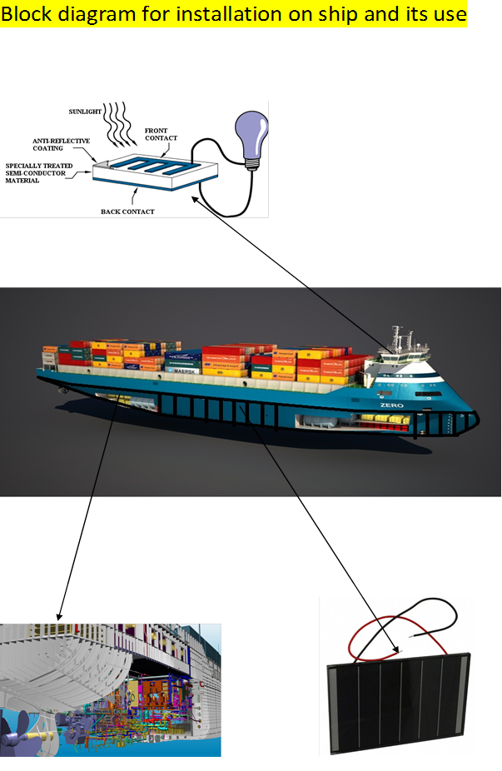

Slide 8
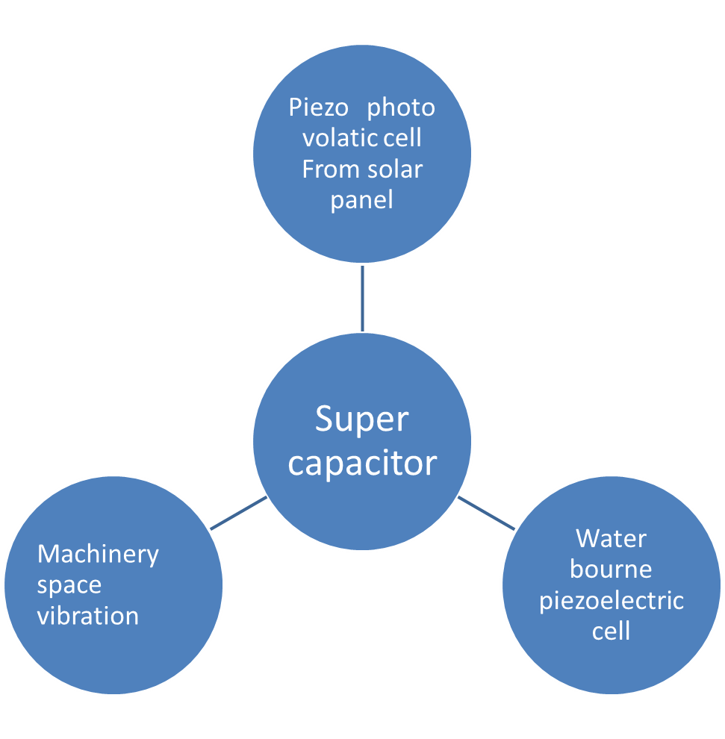

Slide 9
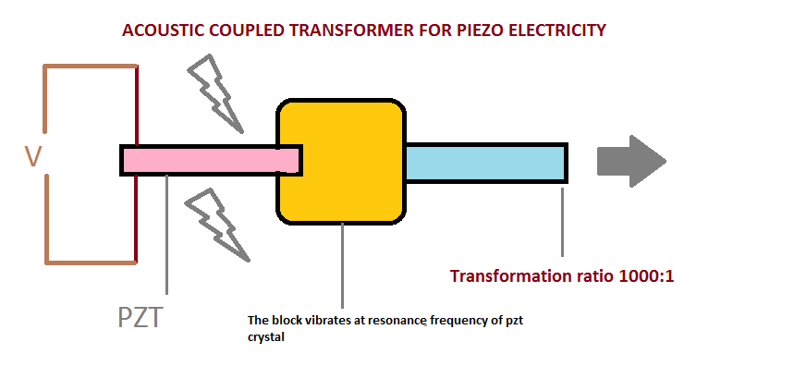
High voltage usage

Slide 10
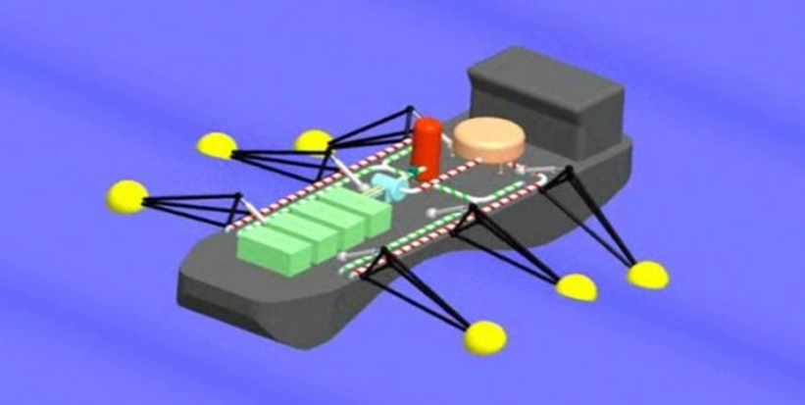
Shore based application
Piezoelectric buoys can be used at port
It is expected that ship could store 20 mega watt per hour

Slide 11
ANY QUERIES?
THANK YOU

