Slide 1

THE GREAT EASTERN INSTITUTE OF MARITIME STUDIES
(LONAVALA)
Small Signal Stability Analysis using Fuzzy PSS
BY
Vrushank.C.S
Shriyanchalmani Tripathi
Vishwas Setiya

Slide 2
overview
Introduction
Power System Stability background
Small Signal Stability Analysis
Small signal stability
Fuzzy Power System Stabilizers.
Simulation Tools
Mat Lab
Simulink
Conclusion.
Conventional Power system Stabilizer.
Fault stabilizers
System Analysis Using Heffron – Phillips Model

Slide 3
INTRODUCTION
Power system is becoming more complex now a days; large synchronous machines are employed to generate the power. But the stable operation of power system is very important .Thus, power system stability study, plays a vital role in the power generation. In any power system, synchronous machine is one of the major components which contribute to stability analysis. Thus proper modelling of synchronous machine is important to analyze the power system for its stability.
Low frequency oscillations are common in interconnected power system. These oscillations are created when a disturbance (such as fault, change in Pm, and change in Vref) occurs in power system. Low frequency oscillations can be effectively damped using PSS (power system stabilizer). Heffron-Phillips model provides reliable results for small signal stability studies.

Slide 4
Power system stability
Modern power systems are operating increasingly closer to their control and operational limits, such as those imposed by generator Automatic Voltage Regulators (AVR) or other devices.
This scenario has originated on the increase in demand for electric energy coupled with economic and environmental restrictions on power system expansion.
It is recognized that gradual system parameter variations such as load increase, combined with contingencies, lead to system instabilities.
These stressed conditions can lead a system to unstable conditions, it has become necessary to properly model the effect of such limits on the system.

Slide 5
Power system stability
Power System
Stability
Frequency
Stability
Rotor Angle
Stability
Voltage
Stability
Small Signal
Stability
Transient
Stability
Oscillatory mode
Non-oscillatory mode

Slide 6
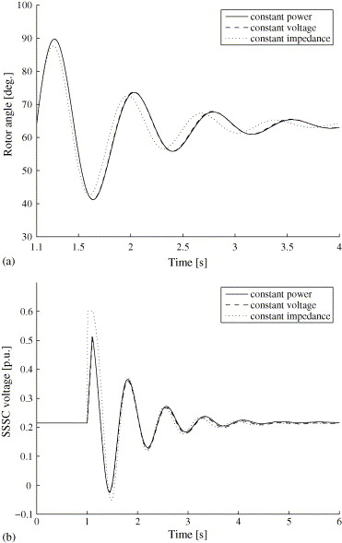
Small Signal Stability
Low frequency oscillations have been observed when large power systems are inter-connected by relatively weak tie lines. These oscillations may sustain and grow to cause system separation if no adequate damping is available.
The small signal stability margins are highly dependent upon such system factors as load flow feasibility boundaries, minimum and maximum damping conditions.
It is very difficult to say in advance which of these factors will make a decisive contribution to instability.
The small-signal stability problem is usually one of insufficient damping of system oscillations.

Slide 7
Characteristics Of Small Signal Stability Problems
( Local Problems )
Associated with rotor angle oscillations of a single generator or a single plant against the rest of the power system. Such oscillations are called local plant mode oscillations. Most commonly encountered small-signal stability problems are of this category.
Local problems may also be associated with oscillations between the rotors of a few generators close to each other. Such oscillations are called inter-machine or inter-plant mode oscillations.
The local plant mode and interplant mode oscillations have frequencies in the range of 0.7 to 2.0 Hz.
Analysis of local small-signal stability problems requires a detailed representation of a small portion of the complete interconnected power system. The rest of the system representation may be appropriately simplified by use of simple models and system equivalents.

Slide 8
Characteristics Of Small Signal Stability Problems
(Global Problems)
Global small-signal stability problems are caused by interactions among large groups of generators and have widespread effects.
They involve oscillations of a group of generators in one area swinging against a group of generators in another area. Such oscillations are called inter-area mode oscillations. Large interconnected systems usually have two distinct forms of inter-area oscillations:
(a)A very low frequency mode involving all the generators in the system. The frequency of this mode of oscillation is on the order of 0.1 to 0.3 Hz.
(b)Higher frequency modes involving subgroups of generators swinging against each other. The frequency of these oscillations is typically in the range of 0.4 to 0.7 Hz.

Slide 9
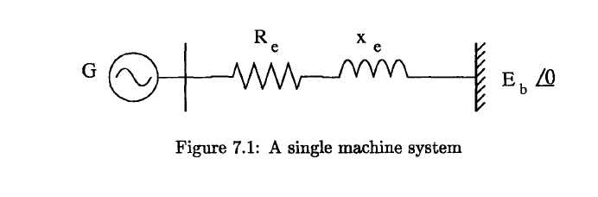
System Representation Using Heffron – Phillips Model
Consider a single machine system .For simplicity, we will assume a synchronous machine represented by model 1.0 neglecting damper windings both in the d and q axes. Also, the armature resistance of the machine is neglected.
The system block diagram, consisting of the representation of the rotor swing equations, flux decay and excitation system.

Slide 10
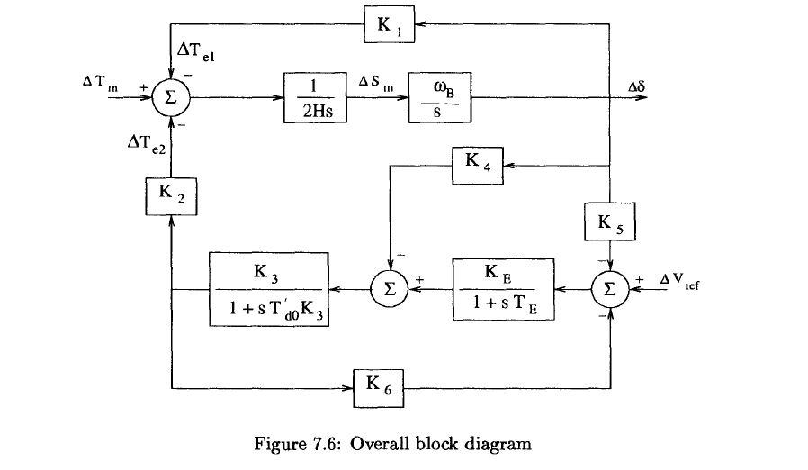
System Representation Using Heffron – Phillips Model

Slide 11
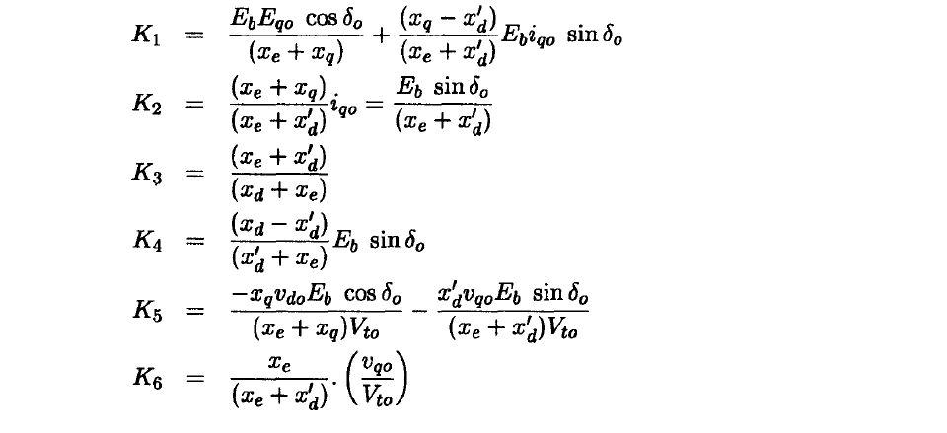
System Representation Using Heffron – Phillips Model
For Re=O, the expressions for the constants K1 to K6 are simplified. As the armature resistance is already neglected, this refers to a lossless network on the stator side. The expressions are given below.

Slide 12
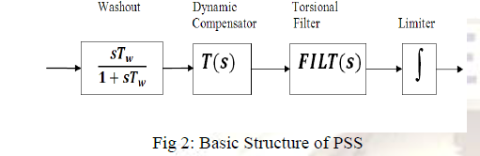

Conventional Power System Stabilizer
A cost efficient and satisfactory solution of the problem of oscillatory instability is to provide damping for generator rotor oscillation. This is conveniently done by providing Power System Stabilizers (PSS) which are supplementary controllers in the excitation systems.
Washout Circuit: The washout circuit is used to eliminate steady state bias in the output of PSS which will modify the generator terminal voltage
Dynamic Compensator: The dynamic compensator used in industry is made up of lead-lag stages and has the following transfer function,
Where K is the gain of PSS and the time constants, T1 to T4 are chosen to provide a phase lead for the input signal in the range of frequencies that are of interest (0.1 to 3.0Hz)

Slide 13
Conventional Power System Stabilizer
Torsional Filter: The Torsional filter in the PSS is a band reject or a low pass filter to attenuate the first torsional mode frequency. It is used to avoid the adverse interaction of PSS with the torsional oscillations. This can lead to shaft damage, particularly at light generator loads when the inherent mechanical damping is small .
Limiter: The output of the PSS must be limited to prevent the PSS acting to counter the action of AVR. At load rejections it is desired to trip the PSS, since AVR acts to reduce the terminal voltage to nominal value .
One of the main drawback of this method is that it requires Mathematical model ,which gets complicated for a large bus system.
.

Slide 14
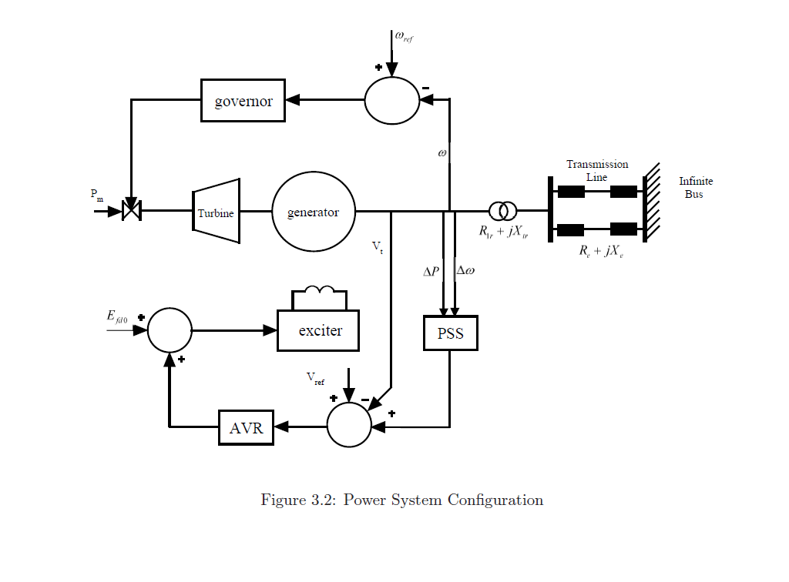
Conventional Power System Stabilizer

Slide 15
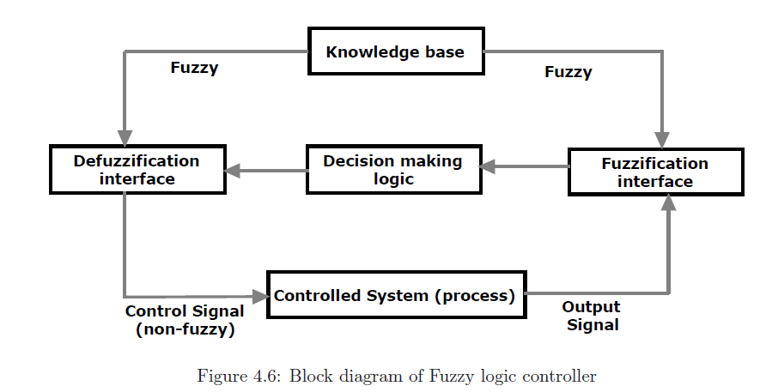
Fuzzy Logic Based PSS
FLCs are very useful when an exact mathematical model of the plant is not available; however, experienced human operators are available for providing qualitative rules to control the system.
Fuzzy logic, which is the logic on which fuzzy logic control is based, is much closer in spirit to human thinking and natural language than the traditional logic systems.

Slide 16
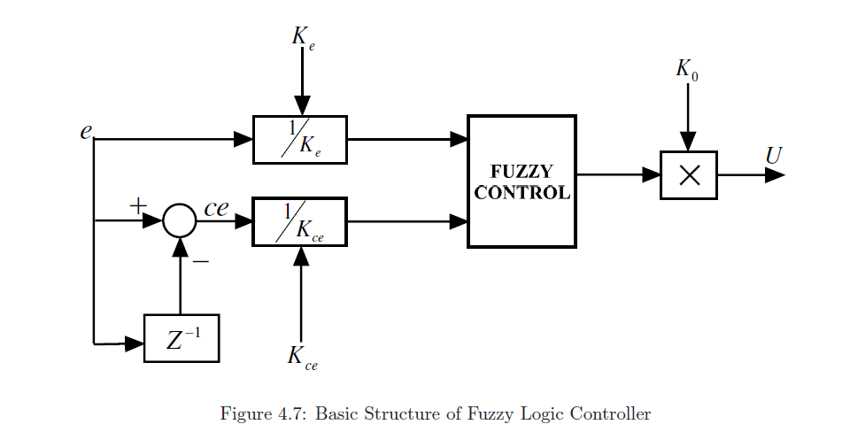
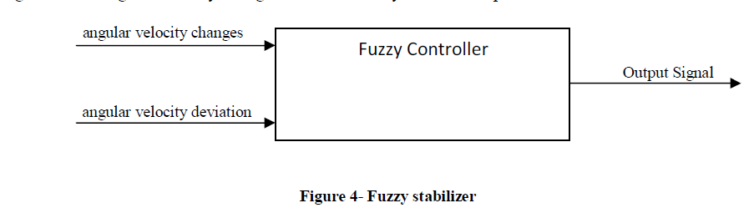
Fuzzy Logic Based PSS
The fuzzy controller used in power system stabilizer is normally a two- input and a single-output component. It is usually a MISO system. The two inputs are change in angular speed and rate of change of angular speed whereas output of fuzzy logic controller is a voltage signal.

Slide 17
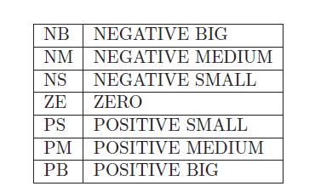
Fuzzy Logic Based PSS
The design starts with assigning the mapped variables inputs/output of the fuzzy logic controller (FLC). The first input variable to the FLC is the generator speed deviation and the second is acceleration. The output variable to the FLC is the voltage.
Choosing linguistic variables. These variables transform the numerical values of the input of the fuzzy controller to fuzzy quantities.
The membership function maps the crisp values into fuzzy variables.
The triangular membership functions are used to define the degree of membership.

Slide 18
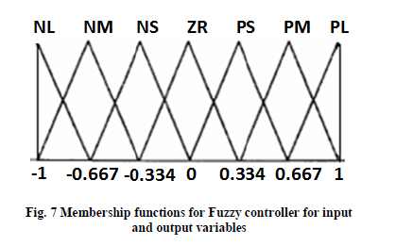
Fuzzy Logic Based PSS
Membership functions for Fuzzy controller for input and output variable

Slide 19
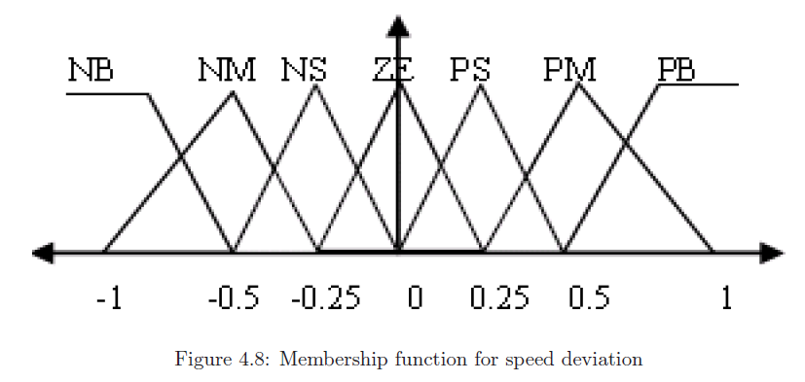
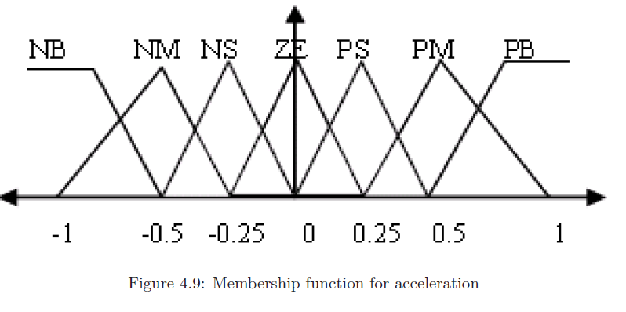
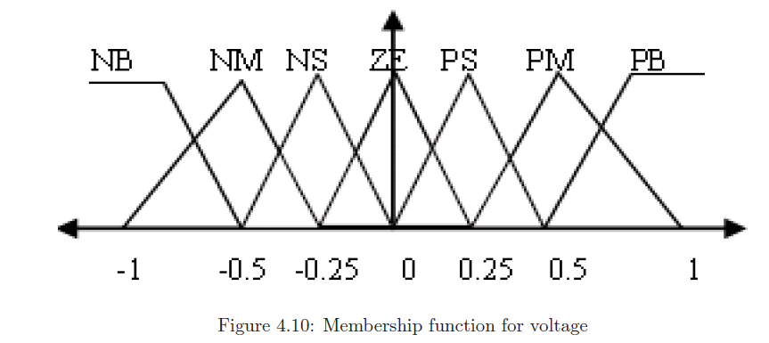
Fuzzy Logic Based PSS

Slide 20
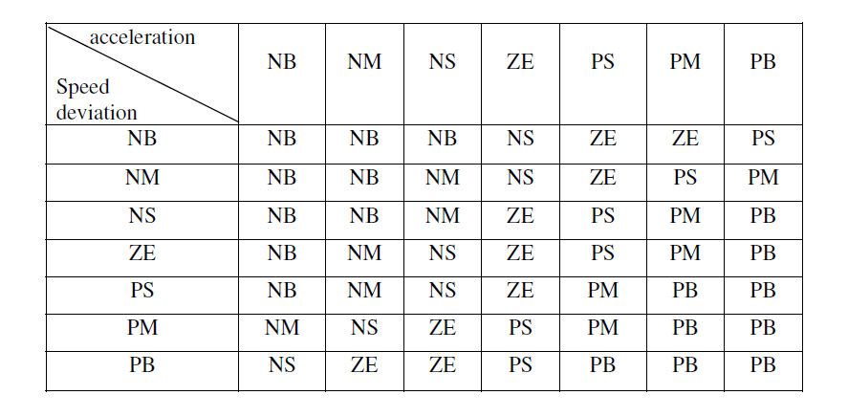
Fuzzy Logic Based PSS
Table : Rule Base

Slide 21
Fuzzy Logic Based PSS
It depicts that the system reaches it steady state value much earlier with Fuzzy PSS compared to conventional PSS .
Therefore, it can inferred that the fuzzy controller does not require any complex mathematical support and the response is much improved than with conventional PSS.
Fuzzy rules and membership functions shape should be adjusted to obtain the best control performance in FLC. Conventionally the adjustment is done by the experience of experts or trial and error methods. Therefore it is difficult to determine the suitable membership functions without the knowledge of the system.
Hence, in order to overcome this problem Evolutionary Computation(EC) is used.

Slide 22
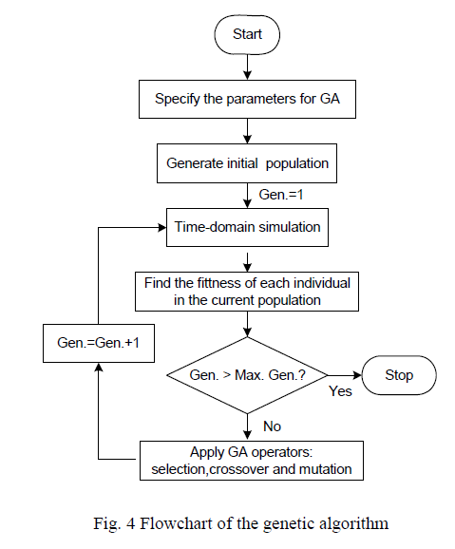
Evolutionary computation Using Genetic Algorithm
Genetic algorithm (GA) is a search heuristic that mimics the process of natural selection. This heuristic (also sometimes called a meta-heuristic) is routinely used to generate useful solutions to optimization and search problems.
Is an iterative process, with the population in each iteration called a generation. In each generation, the fitness of every individual in the population is evaluated; the fitness is usually the value of the objective function in the optimization problem being solved.

Slide 23
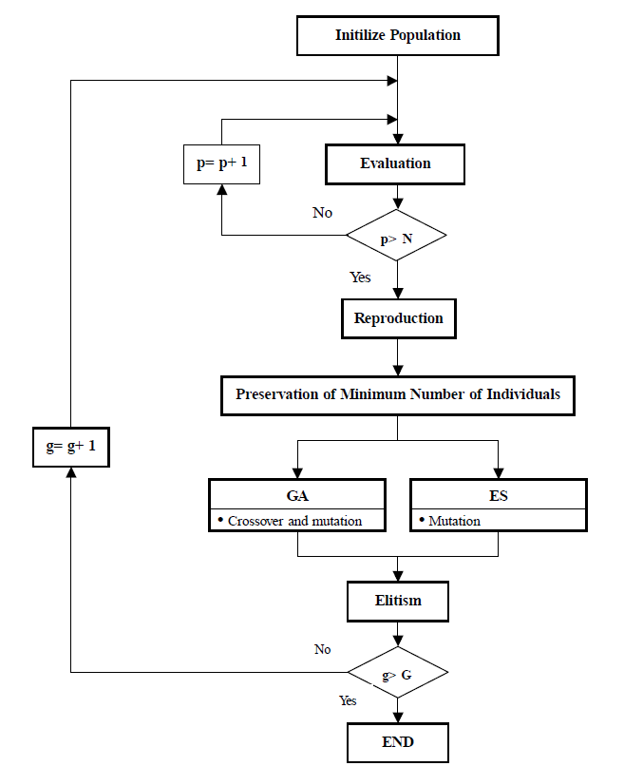
Evolutionary computation Using Genetic Algorithm
This generational process is repeated until a termination condition has been reached. Common terminating conditions are:
A solution is found that satisfies minimum criteria.
Fixed number of generations reached.
Allocated budget (computation time/money) reached.
The highest ranking solution's fitness is reaching or has reached a plateau such that successive iterations no longer produce better results.
Manual inspection.
Combinations of the above.

Slide 24

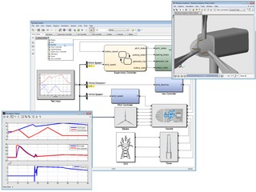
Simulation Tools
Mat Lab
Simulink
MATLAB (matrix laboratory) is a numerical computing environment and fourth-generation programming language.
MATLAB allows matrix manipulations, plotting of functions and data, implementation of algorithms, creation of user interfaces, and interfacing with programs written in other languages, including C, C++, Java, and Fortran.
Simulink is a data flow graphical programming language tool for modeling, simulating and analyzing multi-domain dynamic systems.
Its primary interface is a graphical block diagramming tool and a customizable set of block libraries. It offers tight integration with the rest of the MATLAB environment and can either drive MATLAB or be scripted from it.

Slide 25
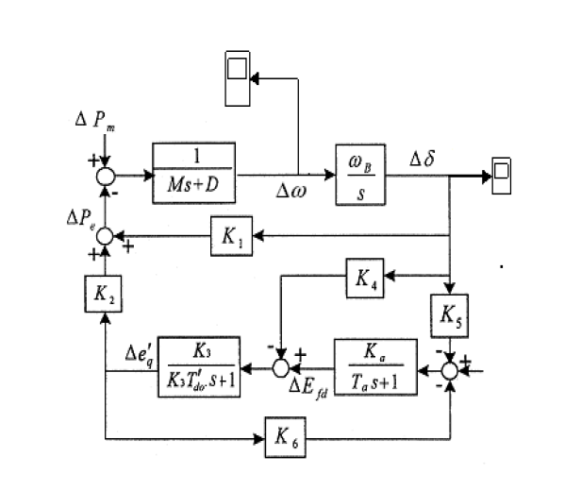
Heffron-Phillips Simulink model without controller

Slide 26
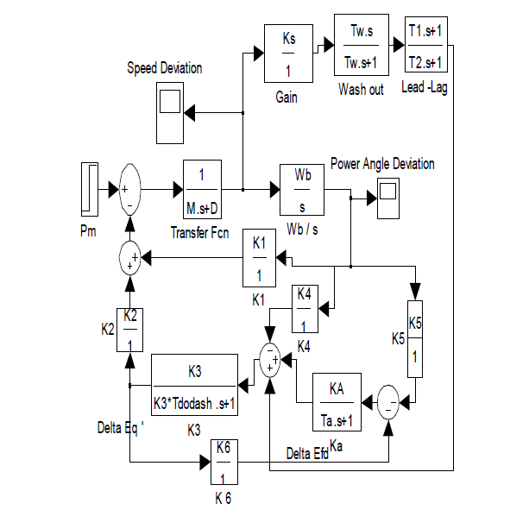
Simulink model of conventional PSS

Slide 27
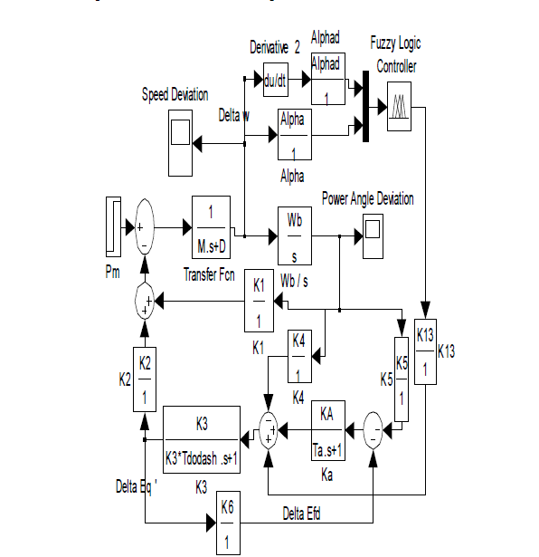
Simulink model of Fuzzy rule based PSS

Slide 28
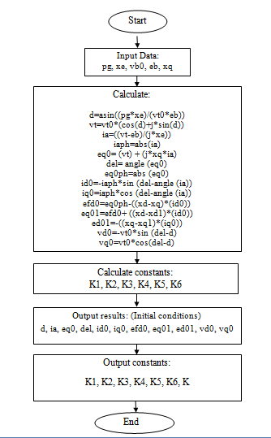
Flow chart for SMIB Heffron-Phillips model

Slide 29
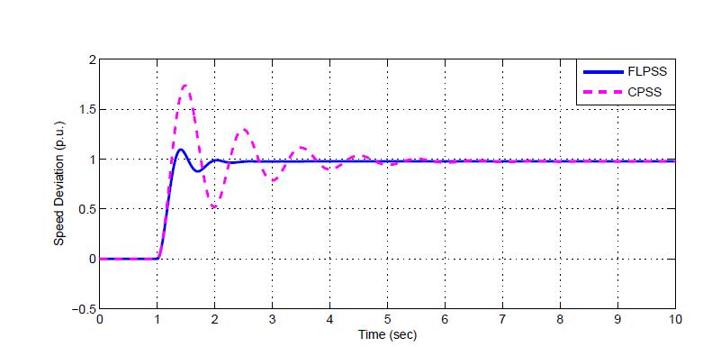
Power angle deviation of SMIB
Power Angle Deviation ( p.u.)

Slide 30
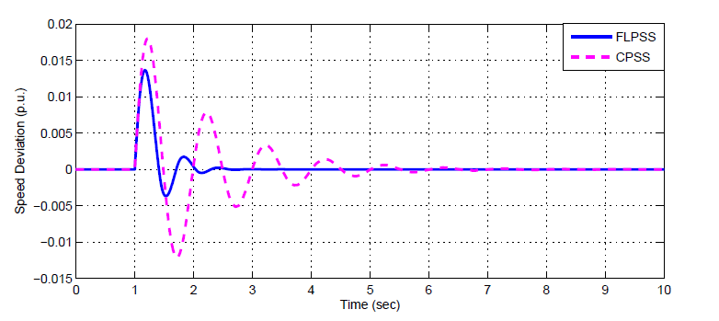
Speed deviation of SMIB

Slide 31
Comparison between Conventional and Fuzzy PSS
Conventional PSS
Settling time is relatively more.
Simple in design.
Implementation cost is comparitively less.
For complex systems design is difficult.
It is a mathematical model.
Fuzzy PSS
Settling time is less.
Design is little complex but robust.
Implementation cost is more.
For complex systems design is easy.
It is a heuristic model.
.

Slide 32
Scope for future work
PSS can be added to state space variable model and stability of system can be analysed.
Instead of using conventional PSS, ANN(Artificial Neural Network) based or an adaptive fuzzy based PSS with GA(Genetic Algorithm) optimization can be considered for analysis.
Many Optimization techniques can be employed for tuning PSS.

Slide 33
Results
SMIB system was subjected to small disturbance in terms of rise in Pm to evaluate the effectiveness of PSS. The SMIB system was analyzed with conventional PSS and Fuzzy PSS.
It is observed that settling time for power angle deviation and speed deviation is improved when Fuzzy PSS is employed rather than conventional PSS.

Slide 34
Conclusion
Small is never big if you think small, and small is big if you never think small. Similarly, small signal instability is one such which can’t be suppressed but can be confined.

Slide 35
References
Power system dynamics – stability and control by K.R.Padiyar
Power system stability by Shailendra Kumar
Digital Simulation of Reduced Rule Fuzzy Logic Power System Stabilizer for Analysis of Power System Stability Enhancement by Vijay Kumar Tayal and J. S. Lather
L.A. Zadeh, 'Fuzzy Sets', Information and Control 8, pp.338-353, 1965.

Slide 36
ACKNOWLEDGEMENTS
Mr.Ajoy Chatterjee ( Principal and Head )
Captain Philip John ( Vice Principal )
Mr.Varinder Katyal ( Course Incharge )
Ms.Meena Ravishankar ( Soft Skill Trainer )

Slide 37
ANY QUESTIONS?
HOPE THIS PRESENTATION IS QUITE EDUCATIONAL
THANK YOU FOR YOUR PATIENT LISTENING

