Slide 1

TRANSTECH’15
NUCLEAR POWERED MERCHANT SHIPS
PREPARED BY
R.BALASUNDARAM
SVCE,CHENNAI

Slide 2
MAIN COMPONENTS of nuclear powered ship for propulsion
Reactor core
Steam generator
Pressurizer
Primary coolant pump
Secondary coolant pump

Slide 3
MAIN COMPONENTS of nuclear powered ship for propulsion
Main turbine
Turbo generator
Main condenser and pump
Clutch and reduction gear
Battery and electric motor for propulsion

Slide 4
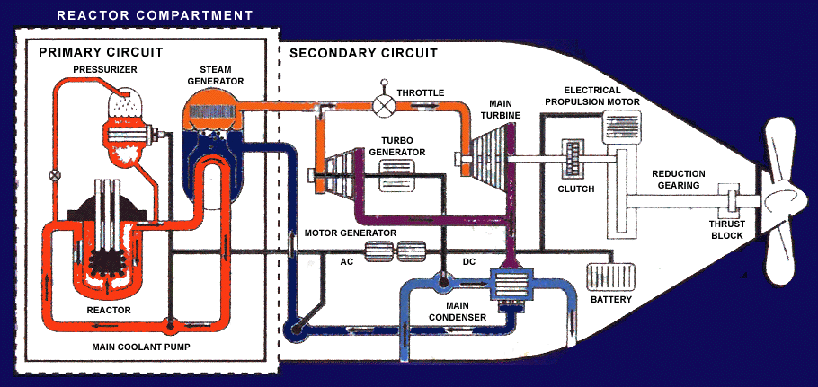

Slide 5
TYPES OF NUCLEAR FUEL
₉₂U²³⁵
₉₂U²³³
₉₄Pu²³⁹
Kamini [Kalpakkam minireactor] is the only operating reactor in the world which uses ₉₂U²³³ as fuel. In this reactor, the fuel is an alloy of uranium and aluminium and is in the form of plates.

Slide 6
THORIUM AS NUCLEAR FUEL in ship
Easily available, abundant, cheap and irradiated material.
Availability of thorium is three times of availability of uranium.
India has 846000 (13.31% of earth) tonnes of thorium.
It couldn’t start a fission process at its own accord.
Thorium absorbs a neutron and transmute ₉₂U²³³

Slide 7
Types of nuclear reactor
BWR
PWR
PHWR
FBR

Slide 8
Components of nuclear reactor
MODERATOR
Ex: Ordinary water, Heavy water and Graphite
NEUTRON SOURCE
Ex: Beryllium with Plutonium or Polonium
CONTROL ROD
Ex: Boron or Cadmium

Slide 9
Components of nuclear reactor
NEUTRON REFLECTOR
In PHWR, the moderator itself acts as the reflector.
In FBR, the reactor core is surrounded by depleted uranium (uranium which contains less than 0.7% of ₉₂U²³⁵ or thorium (₉₀Th²³²) which acts as neutron reflector.
SHIELDING
Ex: Concrete wall thickness of 2 to 2.5m

Slide 10
Nuclear fission and binding energy
NUCLEAR FISSION REACTION
The fission reactions with ₉₂U²³⁵ are represented as
₉₂U²³⁵ + 0n¹ →₅₆Ba¹⁴¹ + ₃₆Kr⁹² + 3 ₀n¹ + Q
₉₂U²³⁵ + 0n¹ → ₅₄ xe¹⁴⁰ + 38Sr⁹⁴ + 2 ₀n¹ + Q
BINDING ENERGY
Binding energy = [Zm_{P} + Nm_{n} – m] c² = Δm c²

Slide 11
ENERGY RELEASED IN A FISSION
Let us calculate the amount of energy released during the fission of ₉₂U²³⁵ with a neutron.
The fission reaction is ₉₂U²³⁵ + ₀n¹ → ₅₆Ba¹⁴¹ + ₃₆Kr⁹² + 3₀n¹ + Q
Mass of ₉₂U²³⁵ = 235.045733 amu
Mass of ₀n¹ = 1.008665 amu
Total mass of the reactant = 236.054398 amu
Mass of ₅₆Ba¹⁴¹ = 140.9177 amu
Mass of ₃₆Kr⁹² = 91.8854 amu
Mass of 3 neutrons = 3.025995 amu
(3 × 1.008665)
Total mass of the products = 235.829095 amu
∴ Mass defect = 236.054398 – 235.829095 = 0.225303 amu
As, 1 amu = 931 MeV, energy released in a fission =
0.225303 × 931=200 MeV

Slide 12
Challenges in nuclear propulsion
Reactor core remains inaccessible
Rapidly-changing demands for power
Ship’s pitching and rolling
Insurance

Slide 13
Defueling and disposal of a ship’s reactor
The defueling process removes the nuclear fuel. About 99.9 of radioactive products could be removed.
Two types disposal method for the defueled reactor.
(1) placed in protective storage for an extended period.
(2) prepared for permanent disposal or recycling.

Slide 14
Examples of successful submarines and ships
First nuclear powered submarine -USS Nautilus.
Russia and USA had over one hundred each in service, with UK and France less than twenty each and China six.
INS ARIHANT- 6000DWT - 85 MW
INS ARIDAMAN- Under construction
INS CHAKRA- 7900DWT- taken for lease from Russia for 10 years.
proposals

Slide 15
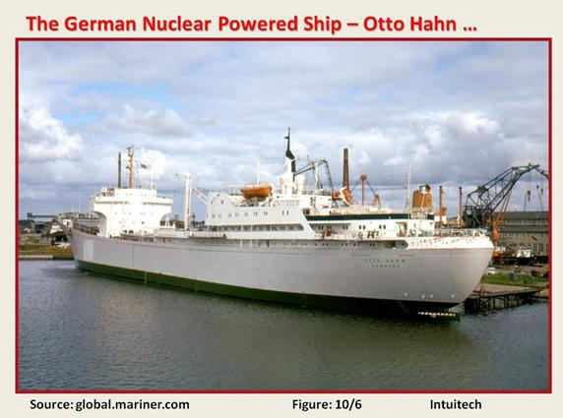
Examples of Nuclear powered merchant ships
The German-built Otto Hahn, a cargo ship and research facility, sailed some 650,000 nautical miles (1,200,000 km) on 126 voyages over 10 years without any technical problems.

Slide 16
Examples of Nuclear powered merchant ships
In 1988 the NS Sevmorput was commissioned in Russia, mainly to serve northern Siberian ports. It is a 61,900 tonne 260 m long LASH-carrier (taking lighters to ports with shallow water) and container ship with ice-breaking bow capable of breaking 1.5 metres of ice.
The reactor was to be decommissioned about 2014, but Rosatom has approved for overhauling and it will be returned to service in 2016

Slide 17
LEU fuel consumed by otto hahn for 250000 NM in kg=22
Amount of LEU consumed for 1 NM in kg =22/250000=8.8×10⁻⁵ kg
Cost of one kg of LEU as metal rod per kg = 8854 USD
Cost of 8.8×10⁻⁵ kg of LEU= 8854 × 8.8×10⁻⁵ =0.77191 USD
SFOC of MAN 32/40 is 185g/kwh.
Rated power is 7680kw.
Amount of fuel consumed for
one hour at rated speed in tonnes=(7680×185)/1000000=1.42 tonnes/hr
Rated speed= 21 NM/hr
So, 1.42 tonnes of HF oil can propel the ship to 21 NM
Amount of fuel required for 1 NM=1.42/21=0.067 tonne
Therefore, cost of 0.067 tonne of HF oil=0.067×600=40.2 USD

Slide 18
Vessel name | Otto hahn | Juan carlos I
Top speed | 17 knot | 21 knot
Displacement | 25790 | 26000
Propulsion | Nuclear power plant | Diesel engine MAN 32/40
Type of Fuel | LEU | HF oil
Fuel consumption per NM | 8.8×10⁻⁵ kg | 0.067 tonne
Cost of fuel required per NM | 0.779152 USD | 40.56 USD

Slide 19
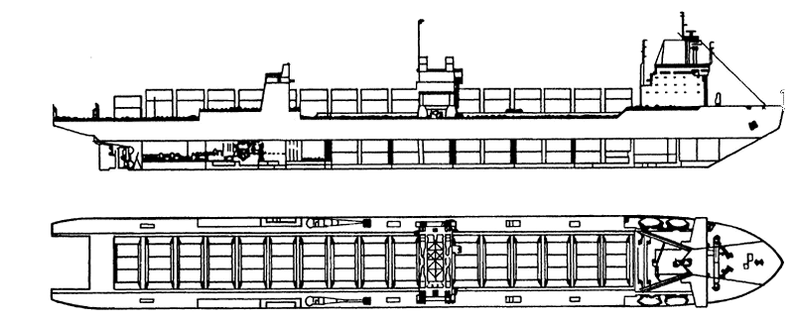
Sevmorput constructional image

Slide 20
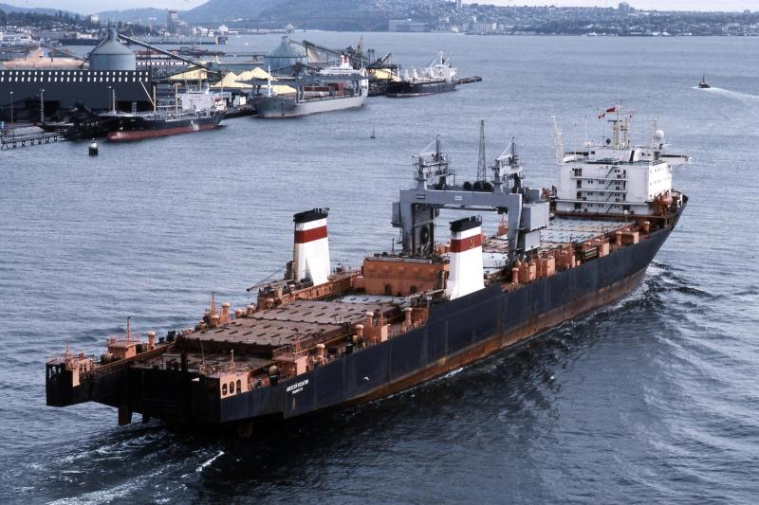
Sevmorput image

Slide 21
Protection against radiation
(1) Radioactive materials are kept in thick−walled lead container.
(2) Lead aprons and lead gloves are used while working in hazardous area.
(3) All radioactive samples are handled by a remote control process.
(4) A small micro−film badge is always worn by the person and it is checked periodically for the safety limit of radiation.

Slide 22
Biological effects of radiation
(i) Short term recoverable effects
(ii) Long term irrecoverable effects and
(iii) Genetic effect

Slide 23
References
www.world-nuclear.org
www.fos.org
www.wikipedia.com
www.energyquest.ca.gov
Tamilnadu Textbook Corporation

Slide 24


Slide 25


