Slide 1
An Uncertain International Order and
Disruptions in Shipping Trade
Is there a connection?
Tolani Maritime Institute
17 March 2023

Slide 2
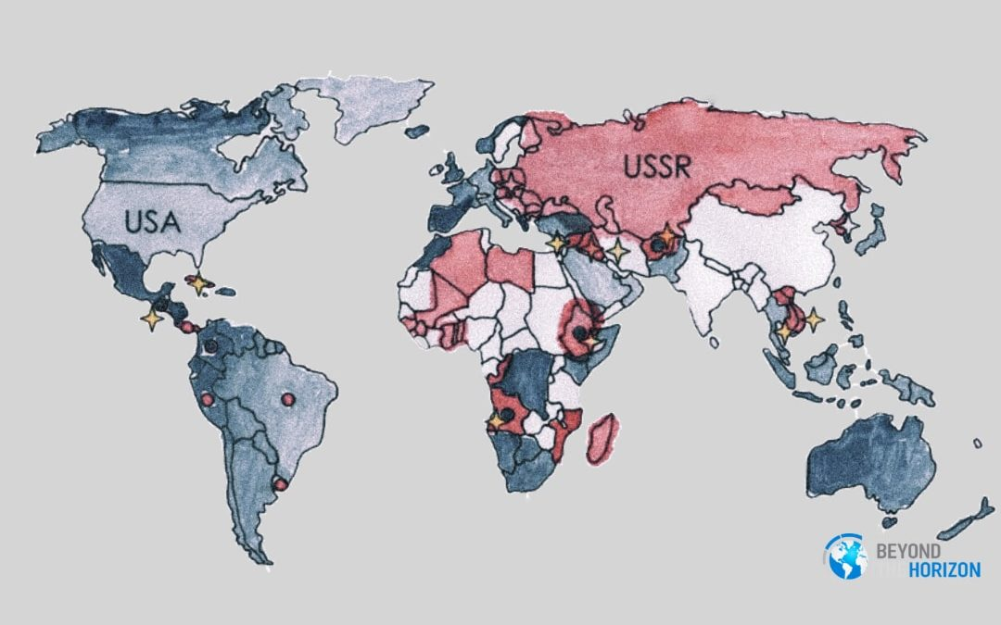
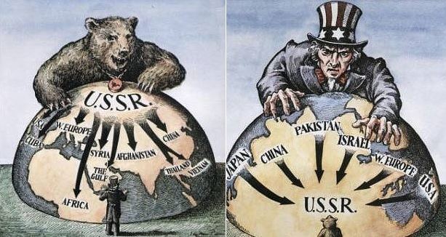
Cold War 1.0
Mackinder's heartland
Spykman’s Rimland
Two decoupled Worlds of US and USSR
Halford Mackinder's heartland and Nicholas Spykman’s Rimland
Only Joined loosely at the seams
Hardly any economic interactions
And a largely inconsequential world of NAM
A Certain World (1950-1990)

Slide 3
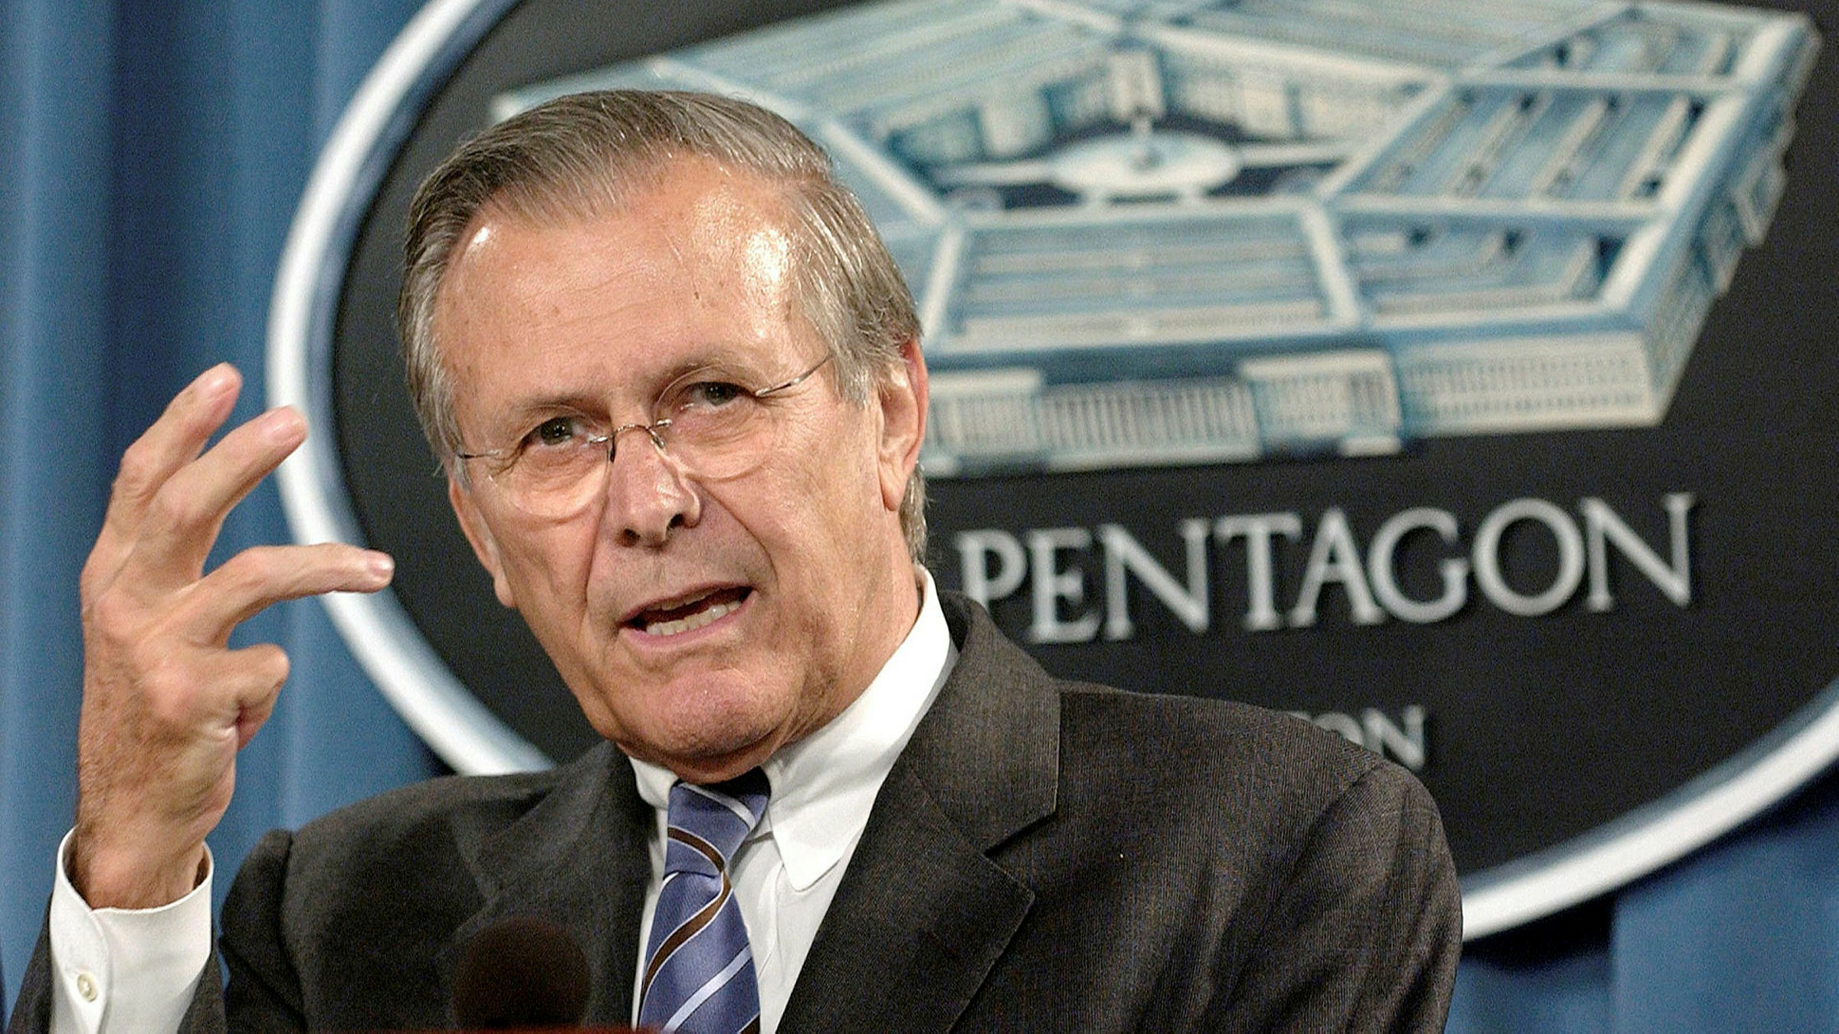
Uncertain World Order
Uncertainty began when Mackinder and Spykman’s world started to interact
China is challenging the US-led LIO of 1945. Can the US resist Chinese hegemony and revanchism?
West doesn’t want Ukraine to lose. As a nuclear power and P5, Russia can’t lose the war. What is the future of Europe?
World is going through an economic slowdown. Is de-dollarisation a possibility?
De-globalisation has begun in areas like technology. Will decoupling occur?
Former US Secretary of Defense, Donald Rumsfeld (2001-06)
Silverline - Despite uncertainties, at least the Unknown (?) are known. It is, therefore, possible to prepare for geopolitical and economic trends ahead

Slide 4
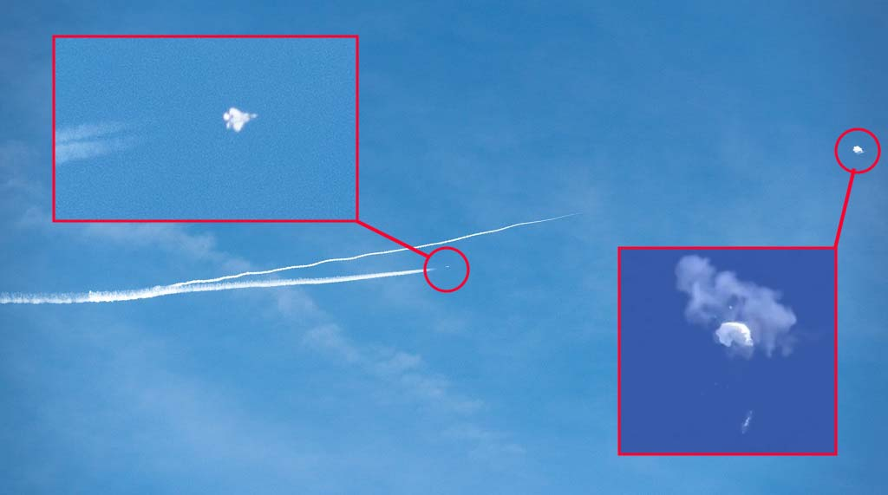
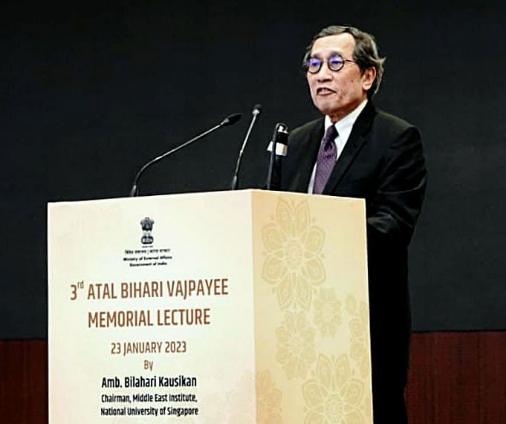
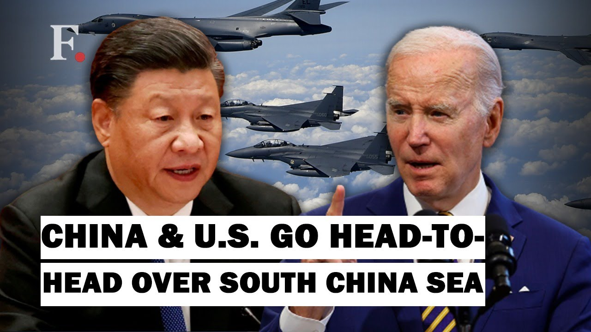
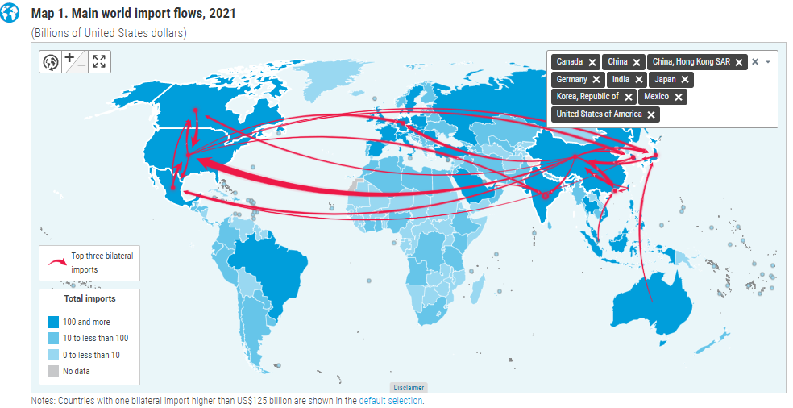
So, what will an uncertain world look like?
World’s largest bilateral flow of merchandise trade runs between China and the US
Goods imported by the US from China in 2021 – US$542 bn
Goods imported by China from the US in 2021 – US$181 bn
China’s trade with Japan, Taiwan, and S Korea - US$1.06 trillion
04 February
Amb. Belahari Kausikam
Retired Diplomat of Singapore
PR to United Nations 1995 to 1998
Coop-Conflict and Coexist
Uncertain World is a World of No Cold War 2.0
Source: UNCTAD Handbook of Statistics 2022

Slide 5
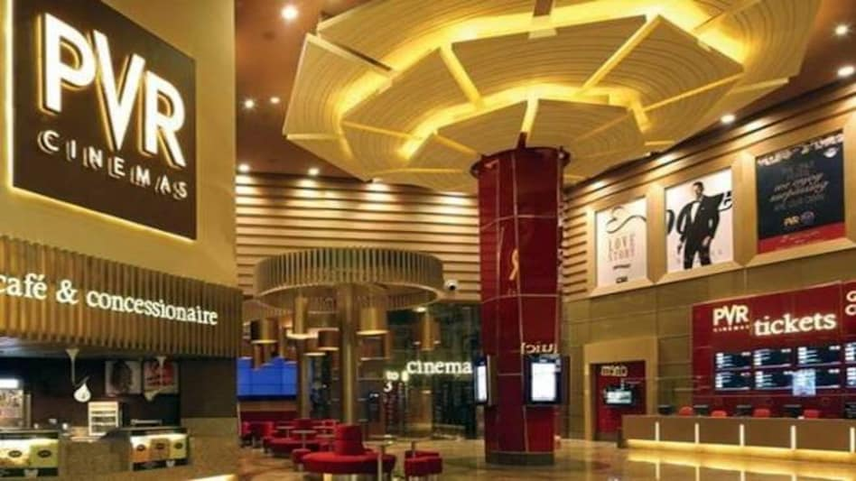
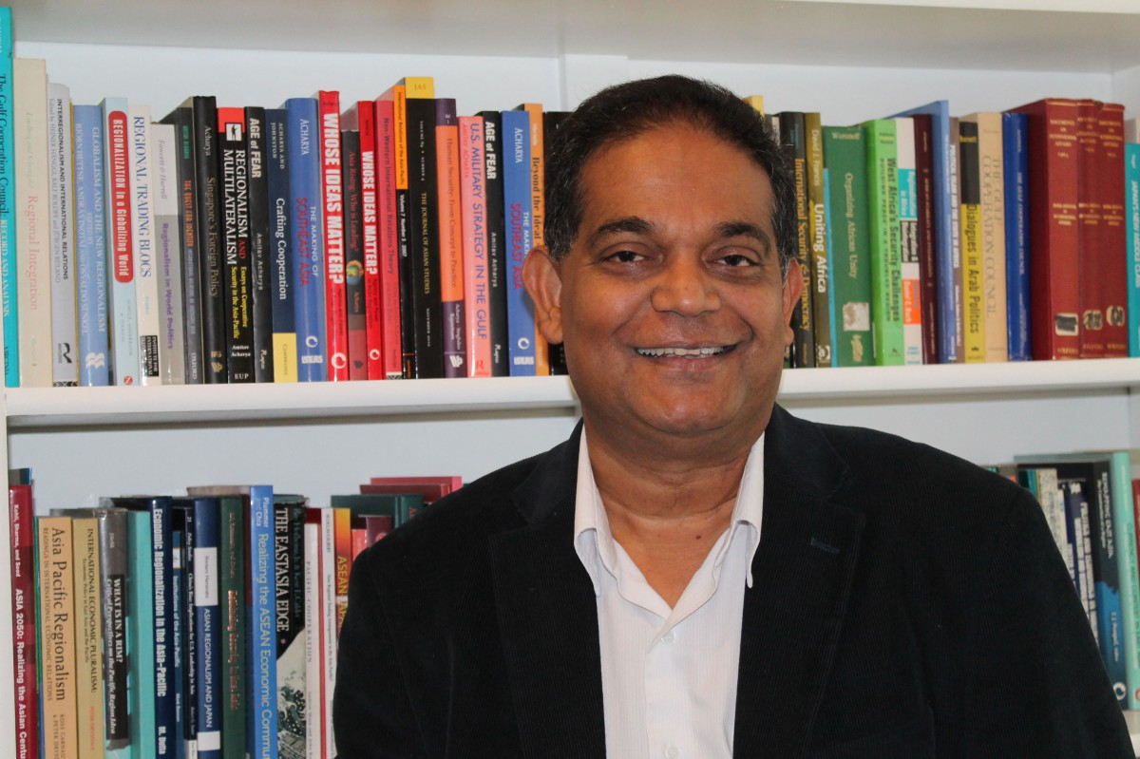
Uncertain World Order – Unknown is Known
Prof Amitabh Acharya
Distinguished Prof of IR at American University, Washington, D.C.
Holds the UNESCO Chair in Transnational Challenges and Governance
Chair of the ASEAN Studies Initiative
A Multiplex World Order

Slide 6
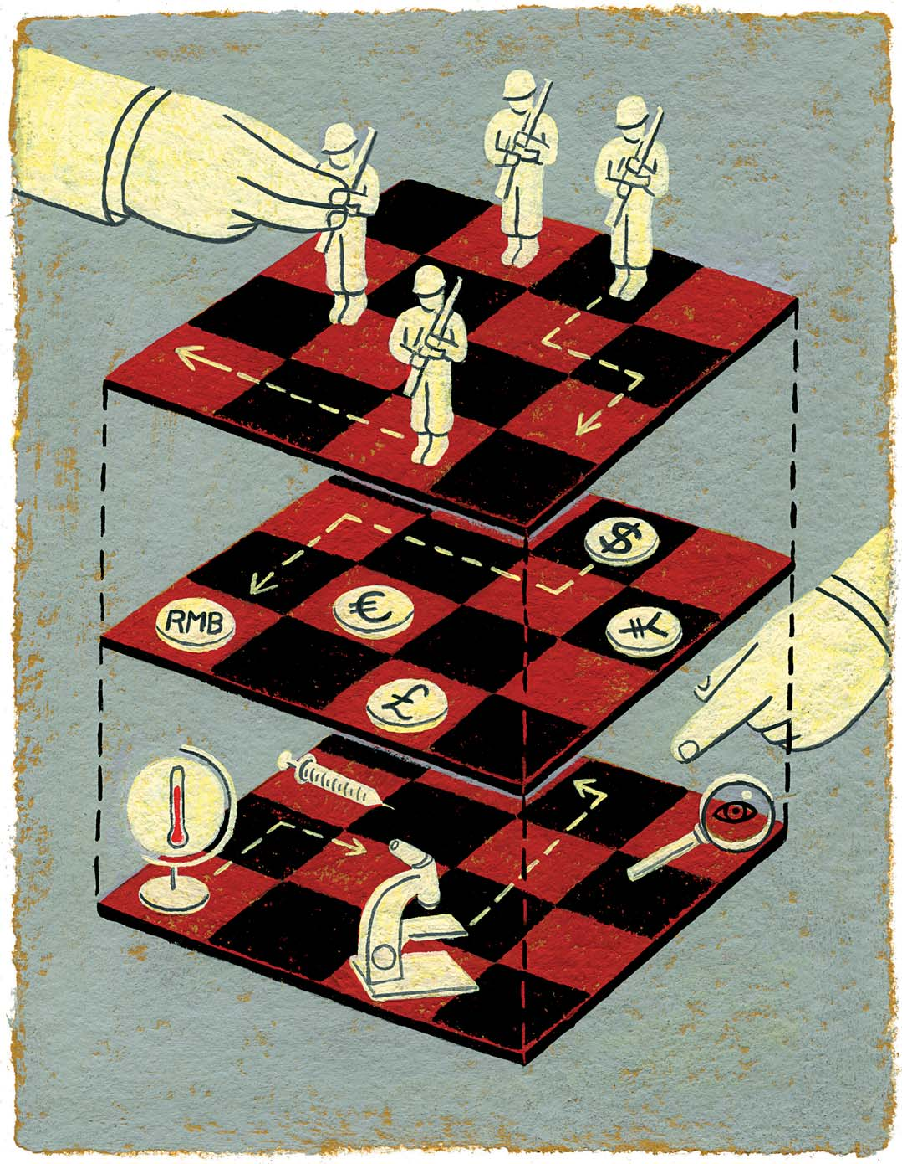
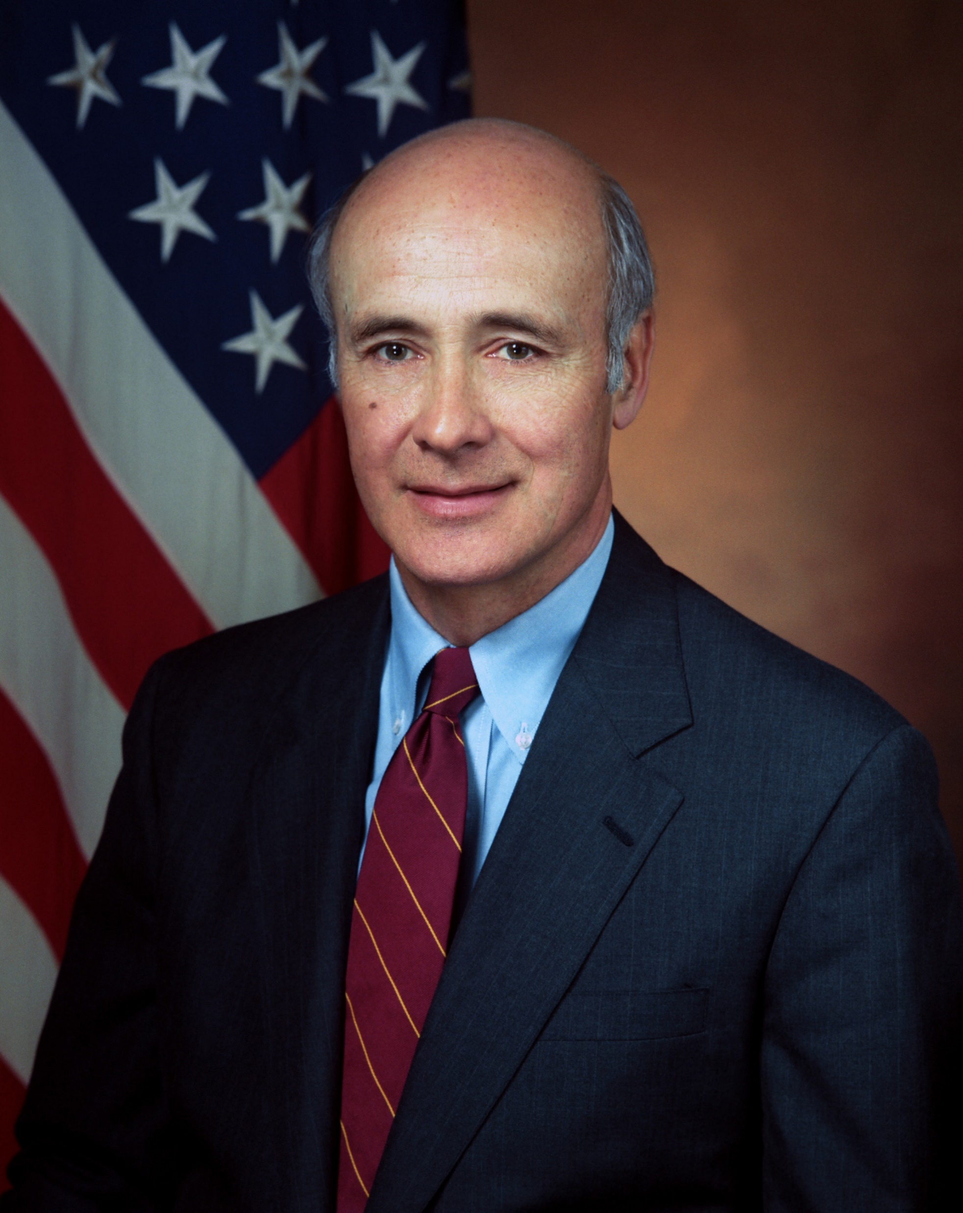
Uncertain World Order – Unknown is Known
Prof Joseph Nye
Dean of the John F. Kennedy School of Government at Harvard University
Coined the term Soft Power
3D Chess Board

Slide 7
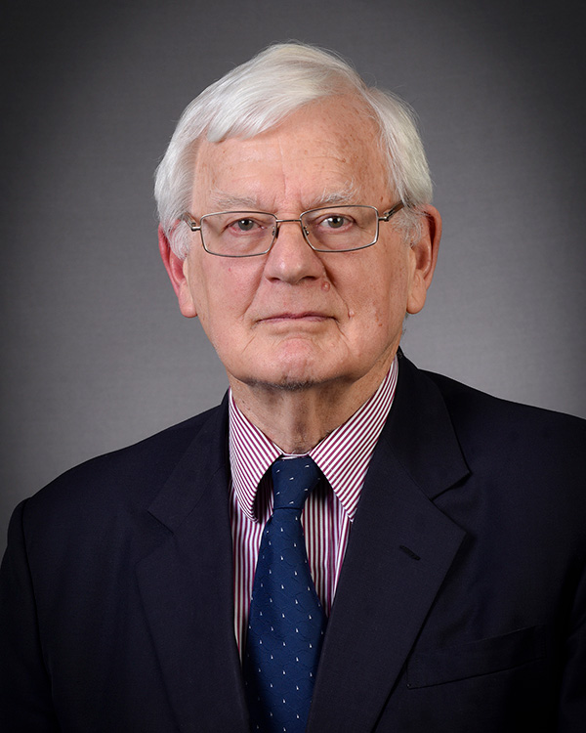
Prepare for 3 Simultaneous Trends
Competitive Westphalian - Balance of Power to possibly manage the rising powers like China/ Russia/ Brazil. Conflicts like Ukraine and SCS – Hegemony
Cooperative Post-Westphalian - Free trade, Multilateral cooperation to deal with common problems climate change, food, energy, water, pandemics, terrorism, piracy. Global response to Pandemic – Leadership
Anti-State - No Order No Rule - Rise of Global Crime/ Bankruptcy - terror, extremism, drugs, TOC. Syria, Libya, Yemen, Somalia, and next door Pakistan – Failed States
Emeritus Professor in King’s College London
Maritime Studies in the Defence Studies Department
Director of the Corbette Centre of Maritime Policy Studies
Prof Geoffrey Till

Slide 8
Backdrop – My Presentation seeks to Explore
The connection between uncertain World Order and maritime trade with
  Uncertainty of Local War - Ukraine
  Uncertainty of Global Pandemic - Covid-19
  Taiwan???
Why is India’s economy booming amid these Uncertainties: What are the Drivers of India’s inevitable rise?
How should India rise?

Slide 9
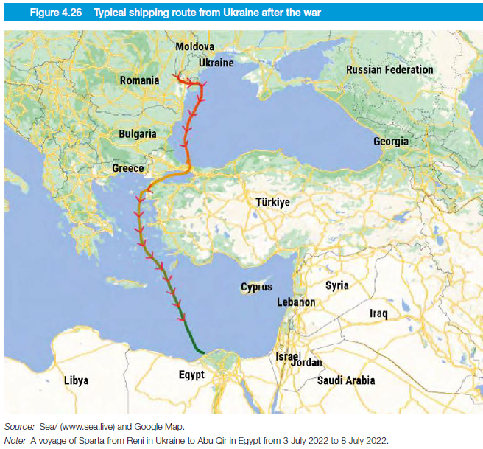
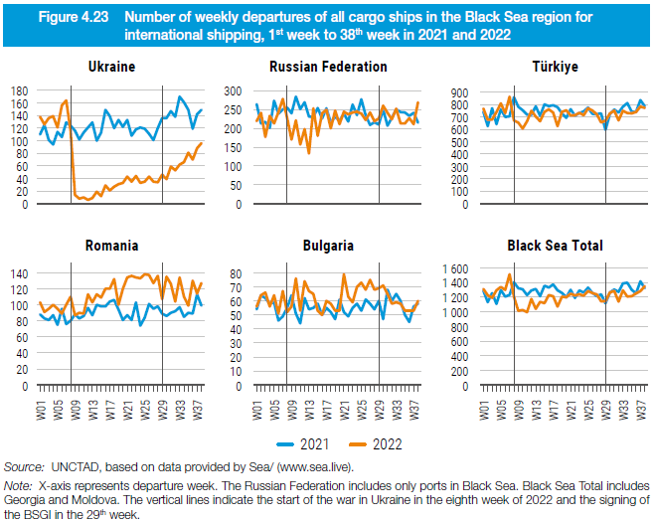
Impact of Local War – Initially on Shipping
Weekly Departure from Black Sea Ports
24 February 2022 – The onset of war
Ukraine – Weekly Shipping departure dropped from 160 to 10
Russia - Departures declined from 280 to 150
Turkiye - Port calls dropped from 700–800 to 600
Romania - Traffic increased from 80 to 100 because some cargoes are transported from Ukraine to Romania by road, rail or barge and then shipped
Safer trade routes - Departing Danube river ports of Ukraine, Reni and Izmail to Sulina in Romania, into the Black Sea
Reni
Izmail
Sulina
Constana

Slide 10
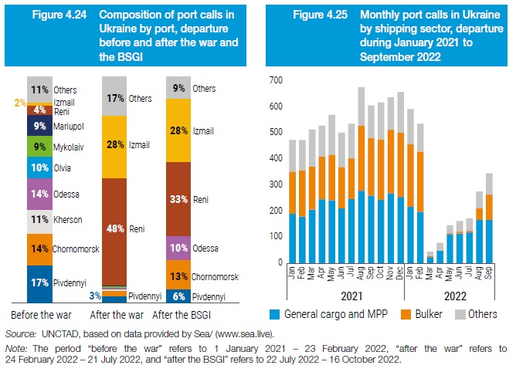
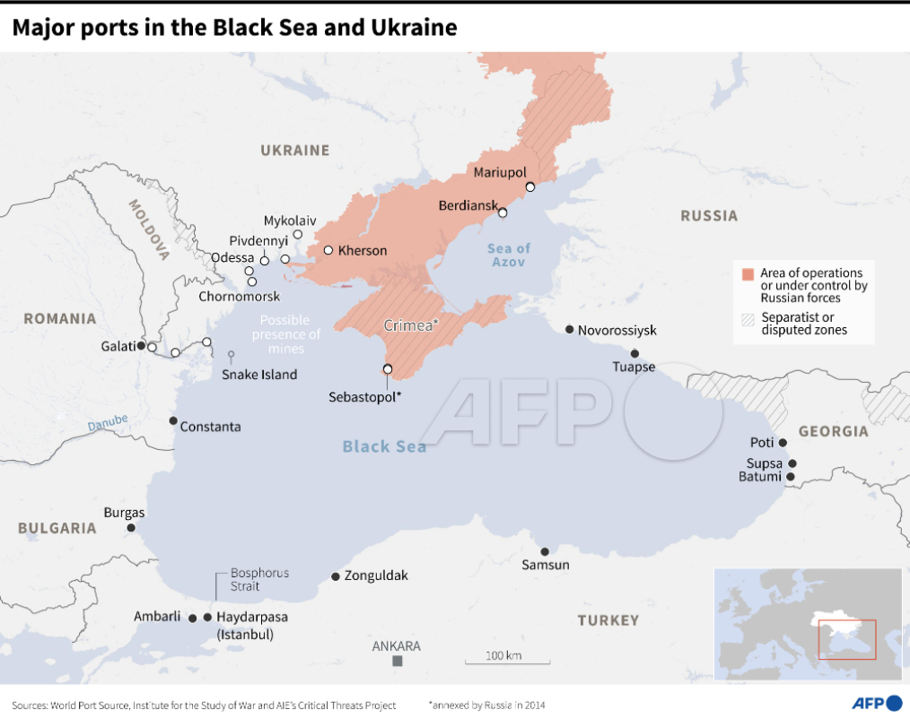
Impact of Local War – Initially on Shipping
Reni
Izmail
Sulina
Trade from Major Ukrainian Ports of the Black Sea came to a crashing halt
*BSGI – Black Sea Grain Initiative – 22 July 2022

Slide 11
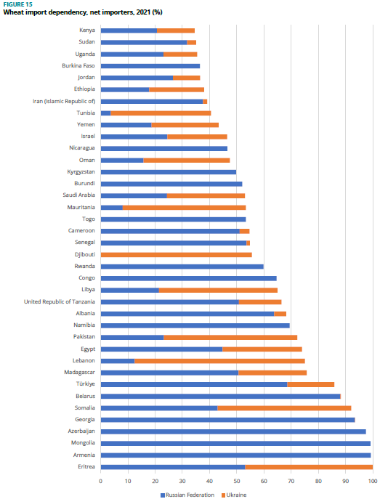
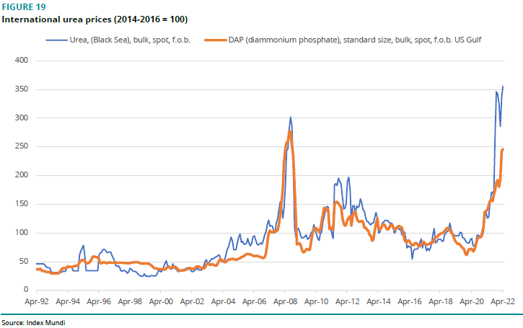
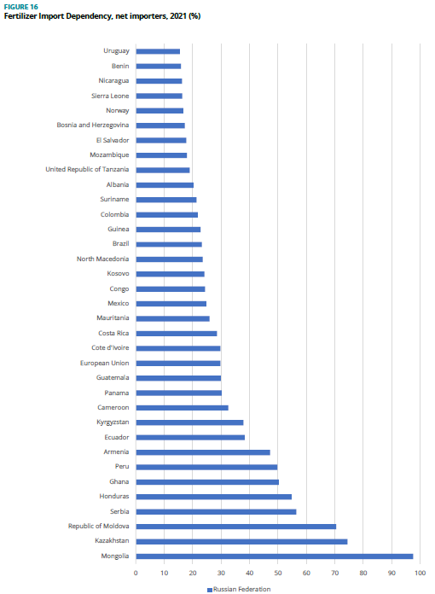
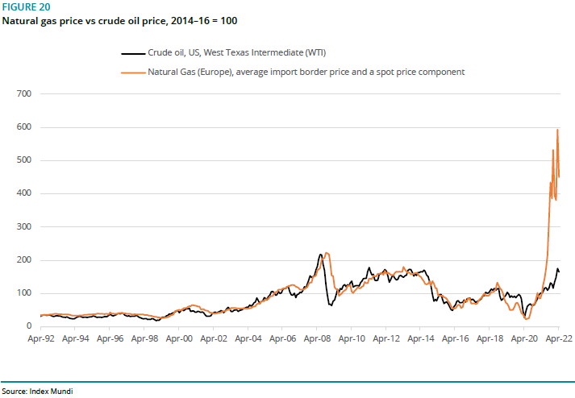
Follow-on Domino Effect - Food, Fuel and Fertiliser
Wheat imports from Russia and Ukraine are unavailable
affecting all, poor the most
Fertiliser Prices
Fertiliser imports from Russia unaffordable for mainly poor farmers
Gas and Crude Prices
Especially Least Developed County (LDC) Especially Low-Income Food-Deficit Country (LIFDC)

Slide 12
Follow-on Domino Effect - Food, Fuel and Fertiliser
Wheat imports from Russia and Ukraine are unavailable
affecting all, poor the most
Fertiliser Prices
Fertiliser imports from Russia unaffordable for mainly poor farmers
Crisis of Unaffordability Crisis of Unavailability
Gas and Crude Prices
Especially Least Developed County (LDC) Especially Low-Income Food-Deficit Country (LIFDC)

Slide 13
Follow-on Domino Effect - Food, Fuel and Fertiliser
Wheat imports from Russia and Ukraine are unavailable
affecting all, poor the most
Fertiliser Prices
Fertiliser imports from Russia unaffordable for mainly poor farmers
Today's era isn’t of war
– PM Narendra Modi reminded President Putin at SCO Meeting on 16 September 2022
Crisis of Unaffordability Crisis of Unavailability
Gas and Crude Prices
Especially Least Developed County (LDC) Especially Low-Income Food-Deficit Country (LIFDC)

Slide 14
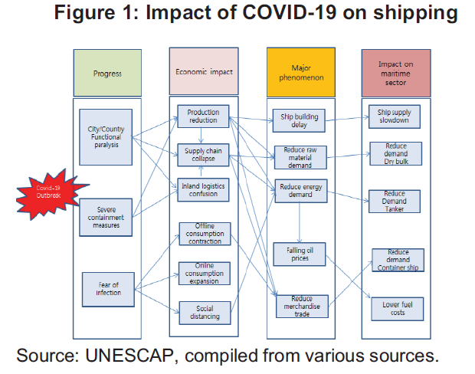
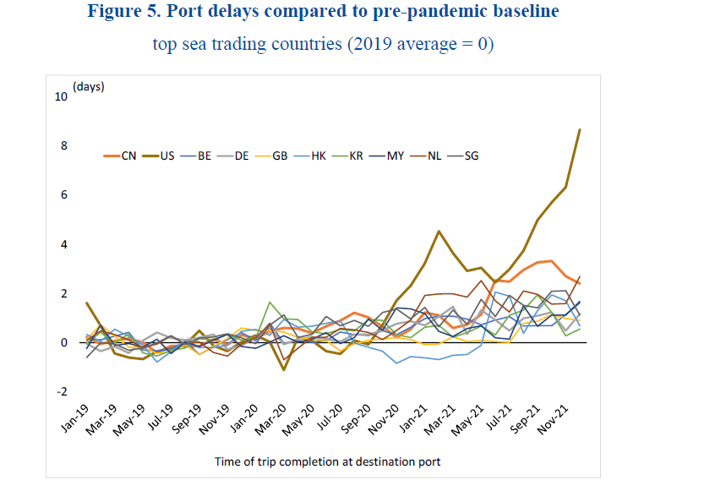
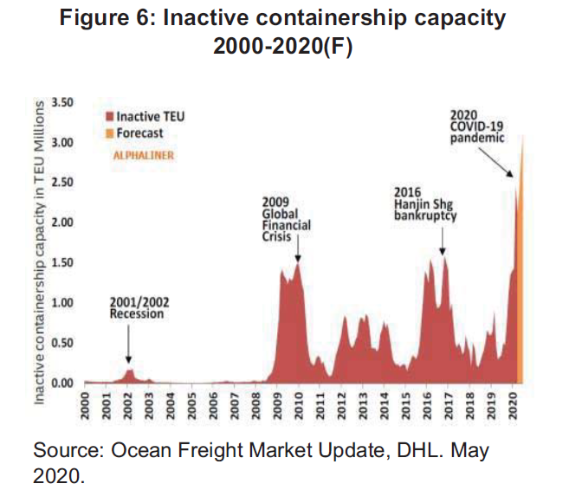
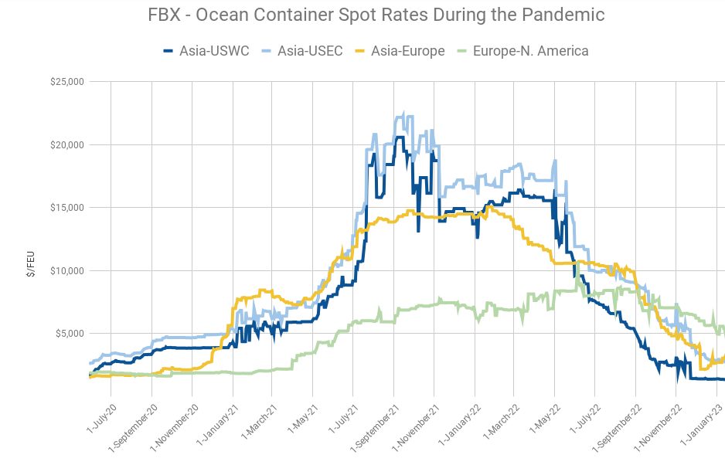
Impact of COVID-19 on Global Shipping
Economic
Maritime Sector
Low Production
Supply Chain Collapse
Online Mkt
Social Distancing
Shipbuilding
Slowdown
Reduced Demand
Bulk Carrier
Containers
Tankers
Increased Delays
Total World TEU 23.23 mn
2013
European Debt Crisis
Container Spot Prices

Slide 15
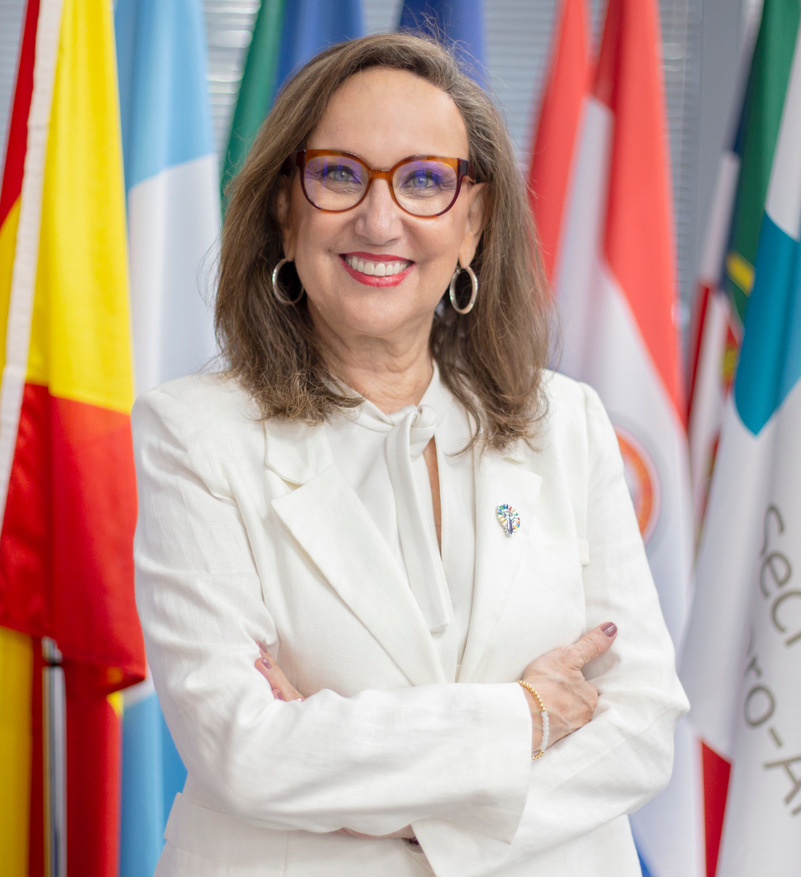
Rebecca Grynspan
Gen Secy UNCTAD
Uncertainties like local war or global pandemic cause trade disruptions. And everyone is impacted. But more importantly, it re-emphasises that the World is Unequal, and the poor majority bear the brunt. Some of these are associated with the Maritime Space – Gen Secy UNCTAD

Slide 16
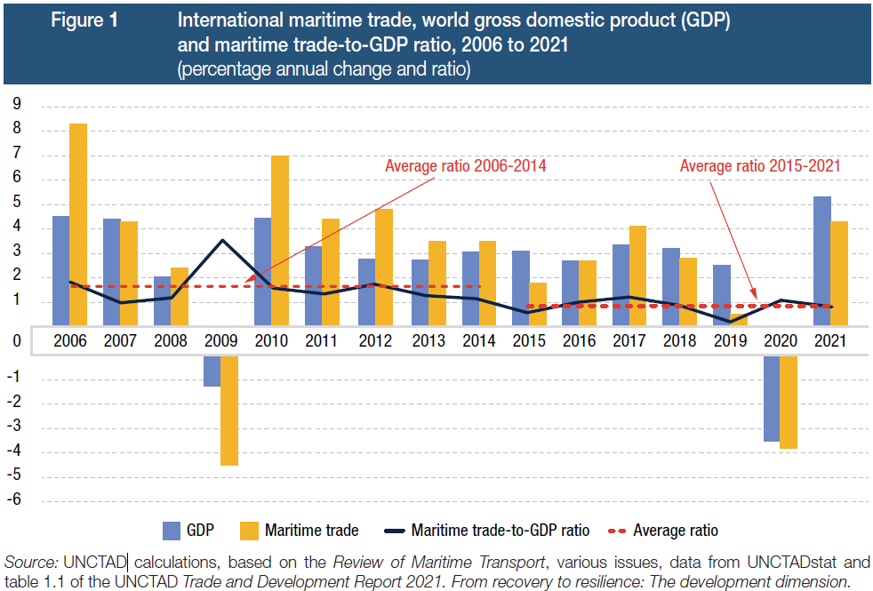
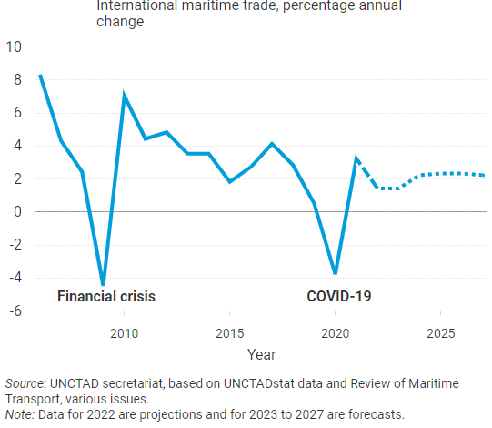
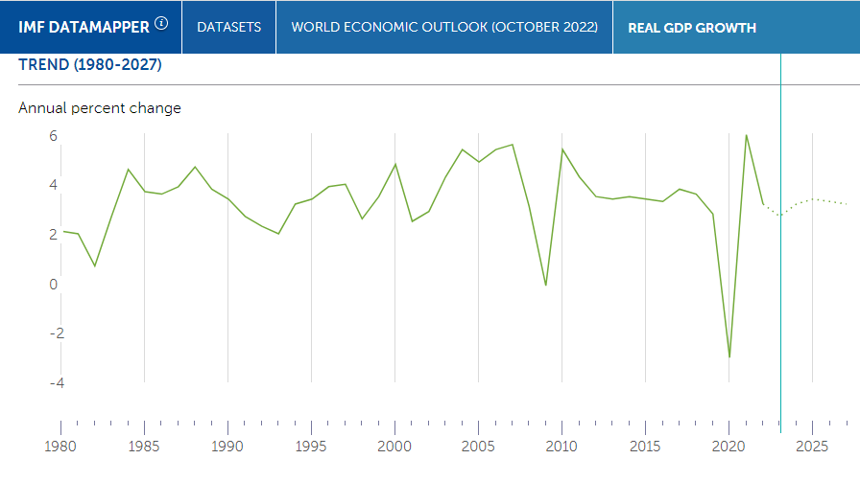
Macroeconomic Trend vs Maritime Shipping
Forecast of Int Mar Trade Growth
A slowdown of the Western and Chinese economy
Forecast of Global GDP Growth
Not connected with of disruptions
of war or pandemic

Slide 17
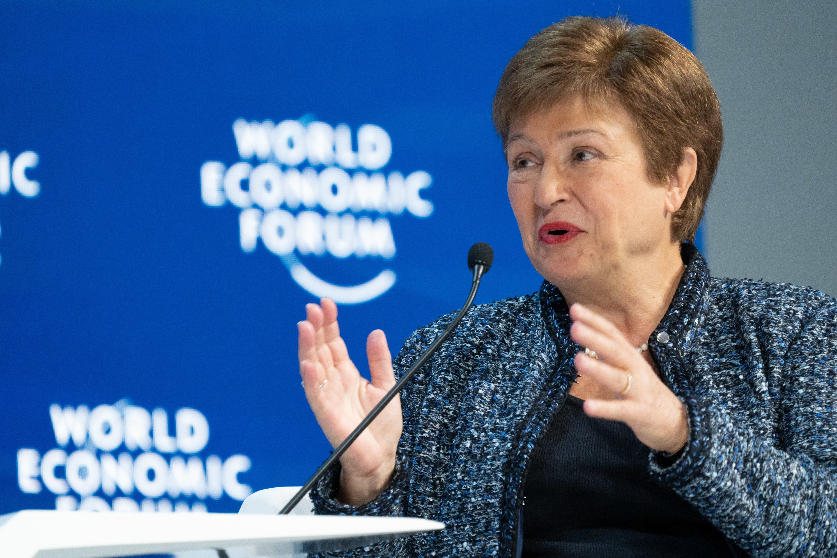
Can India Reverse the Macro Trend?
India is the Silver Line
India deserves to be called a bright spot on this otherwise dark horizon
India to contribute 15% of global growth in 2023
Carried out structural reforms like digitization and infrastructure
India is a strong voice for strong institutions encouraging fairness
India has leapfrogged in renewable and solar energy
Kristalina Georgieva
Managing Director, International Monetary Fund (IMF)

Slide 18
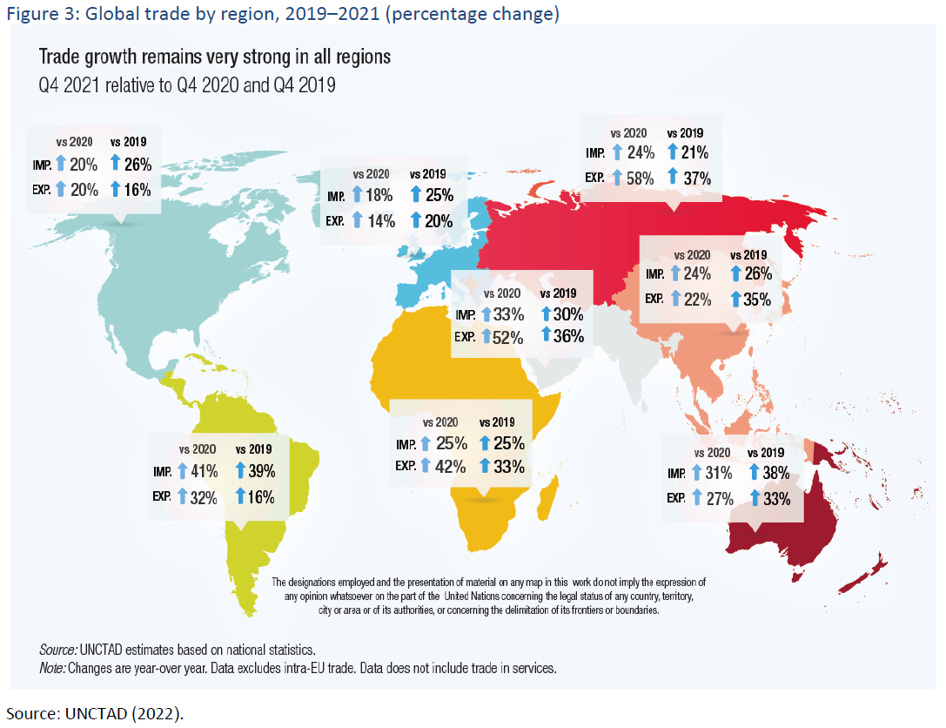
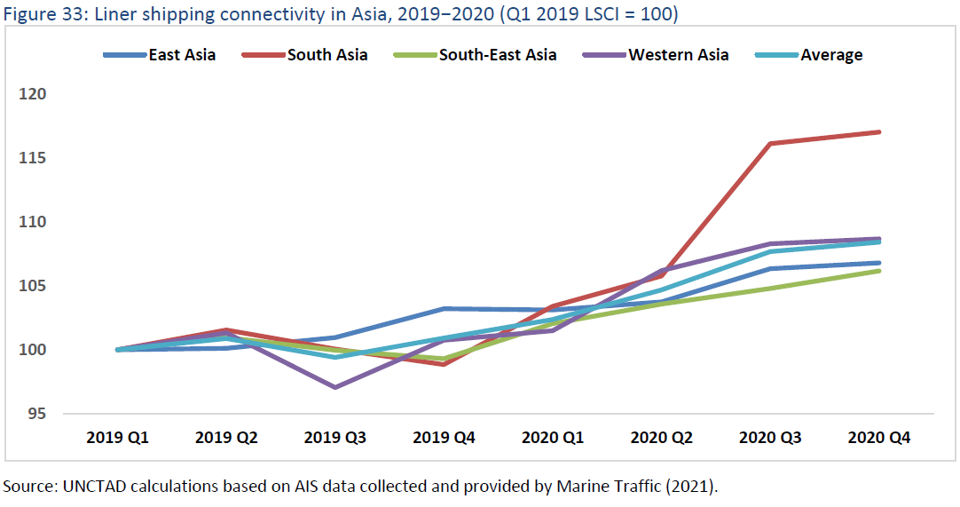
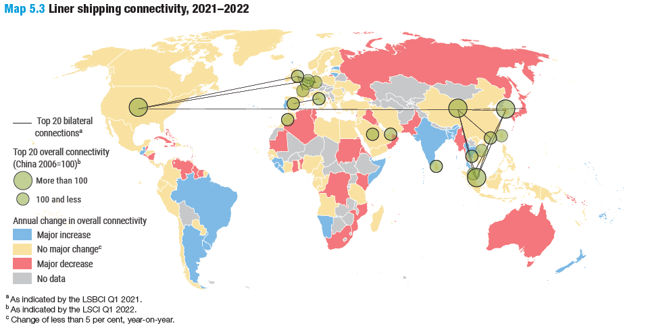
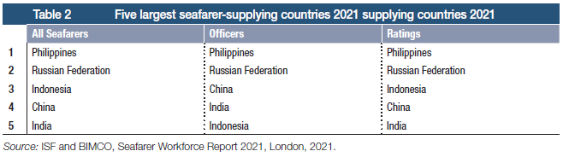
Optimism: Signs of India’s Rise
By Region - India & West Asia have shown the best in Global trade% in 2021
India & South Asia have had the best for liner shipping connectivity
India contributes the 5th
largest number of Seafarers
India is one of the few to show major increase in liner traffic

Slide 19
India’s Rise: Amrit Kal has Begun
Hypothesis – India’s rise can reverse the global trend of maritime growth. Dictate the political economy of maritime transport. India can transform from a rule taker to a rule maker of the international order during the Amrit Kal between 2022 and 2047. Emerge as Vishwa Guru
What are the Drivers of this Amritkal?

Slide 20
India’s Rise: Amrit Kal has Begun
Hypothesis – India’s rise can reverse the global trend of maritime growth. Dictate the political economy of maritime transport. India can transform from a rule taker to a rule maker of the international order during the Amrit Kal between 2022 and 2047. Emerge as Vishwa Guru
What are the Drivers of this Amritkal?
  Diplomacy
  Development – Port-led prosperity with Sagarmala
  Commerce - Nimble shipping strategy

Slide 21
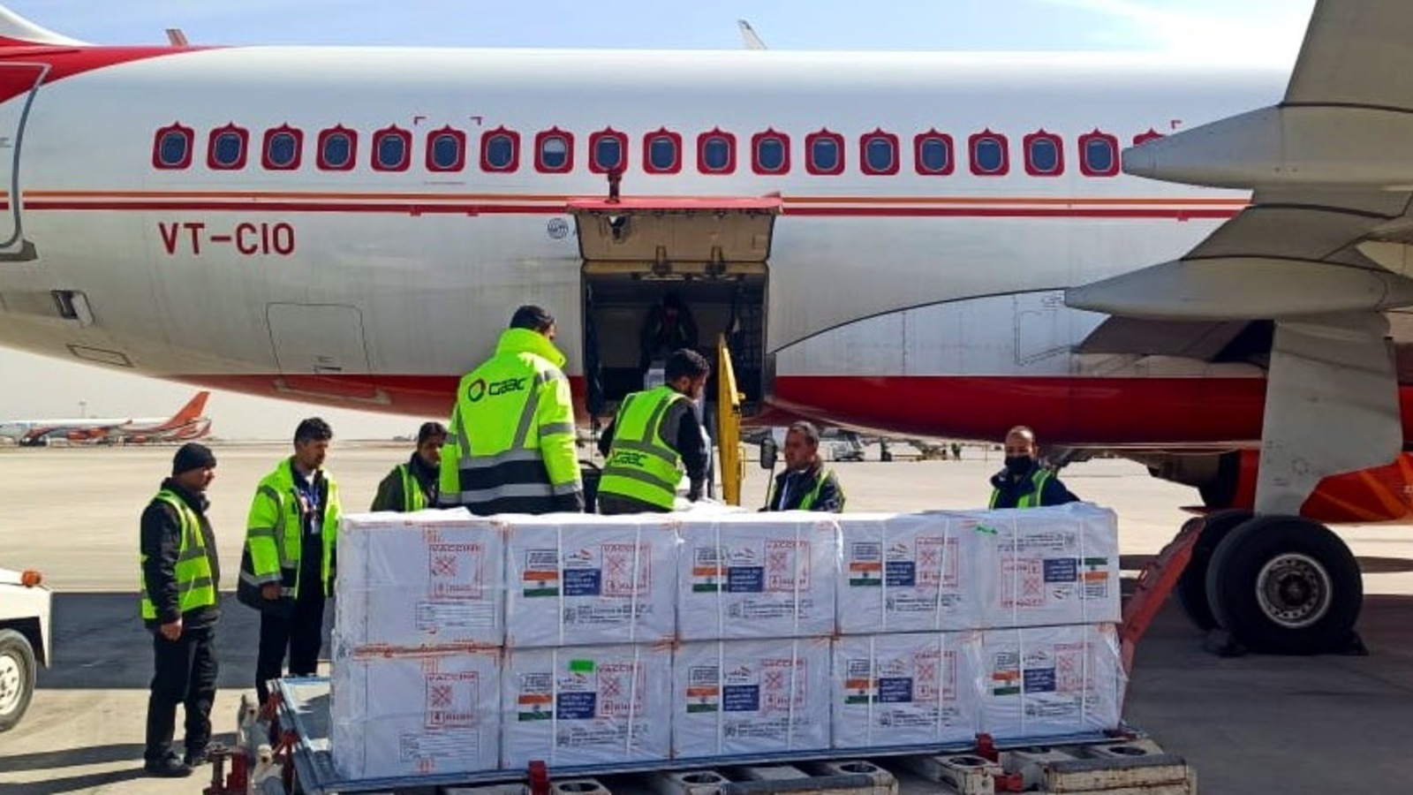
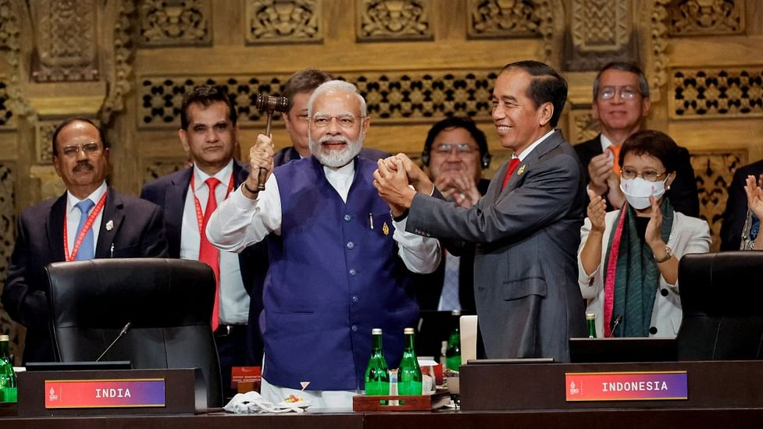
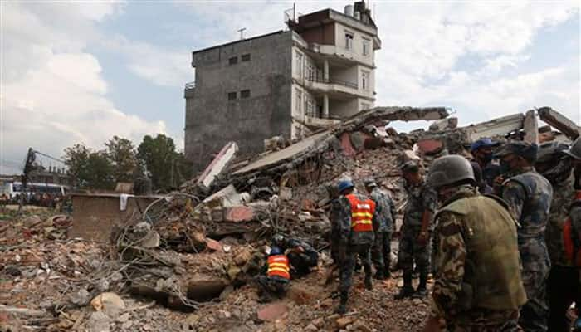
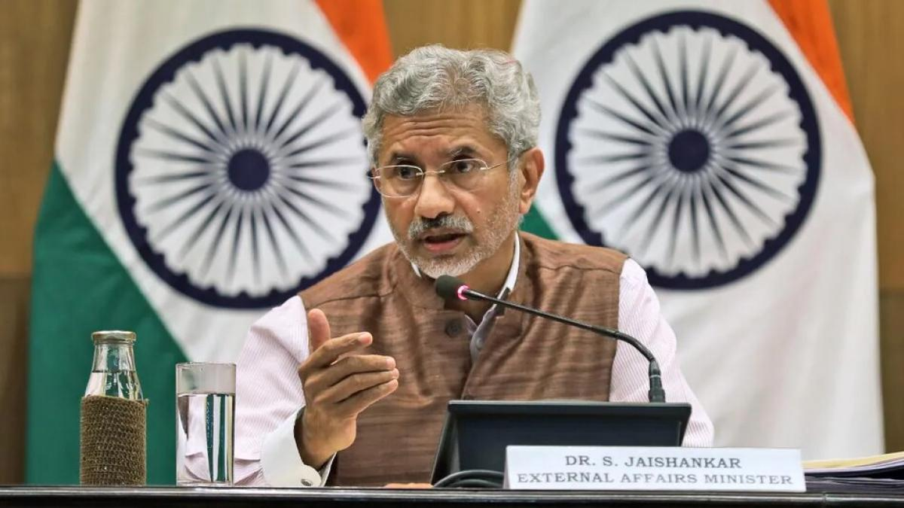
1st Driver for Amritkal: Indian Diplomacy
Goodwill
Operation Maitri – 162 million Vaccines to 96 countries
Leader - Shaping the World Order at G 20
Operation Dost to Turkey and Syria – 5950 T
Oil Imports from Russia - May 2022 to February 2023
Indian import of Crude – 68k to 1.3mb/d
Price of Brent Crude from OPEC – 82 to 110 USD
Price brought from Russia - < 60 USD
Savings – 3.6 Bn USD (Rs. 3 Lakh Cr)
Protecting India’s National Interest

Slide 22
1st Driver for Amritkal: Indian Diplomacy
Goodwill
Operation Maitri – 162 million Vaccines to 96 countries
Indian Diaspora, all Traders, and all Seafarers are Indian Ambassadors.
We spread Indian greatness and goodwill through the culture of humility, empathy, and Vasudeva Kutumbakam
Leader - Shaping the World Order at G 20
Operation Dost to Turkey and Syria – 5950 T
Oil Imports from Russia - May 2022 to February 2023
Indian import of Crude – 68k to 1.3mb/d
Price of Brent Crude from OPEC – 82 to 110 USD
Price brought from Russia - < 60 USD
Savings – 3.6 Bn USD (Rs. 3 Lakh Cr)
Protecting India’s National Interest

Slide 23

A Port-Led Prosperity
2nd Driver: Development
“The country's coastal economy is being strengthened through the Sagarmala programme, wherein along with modernization of old ports, new ones are being built. We believe that our Ports are gateways to development.”
- Prime Minister Narendra Modi

Slide 24
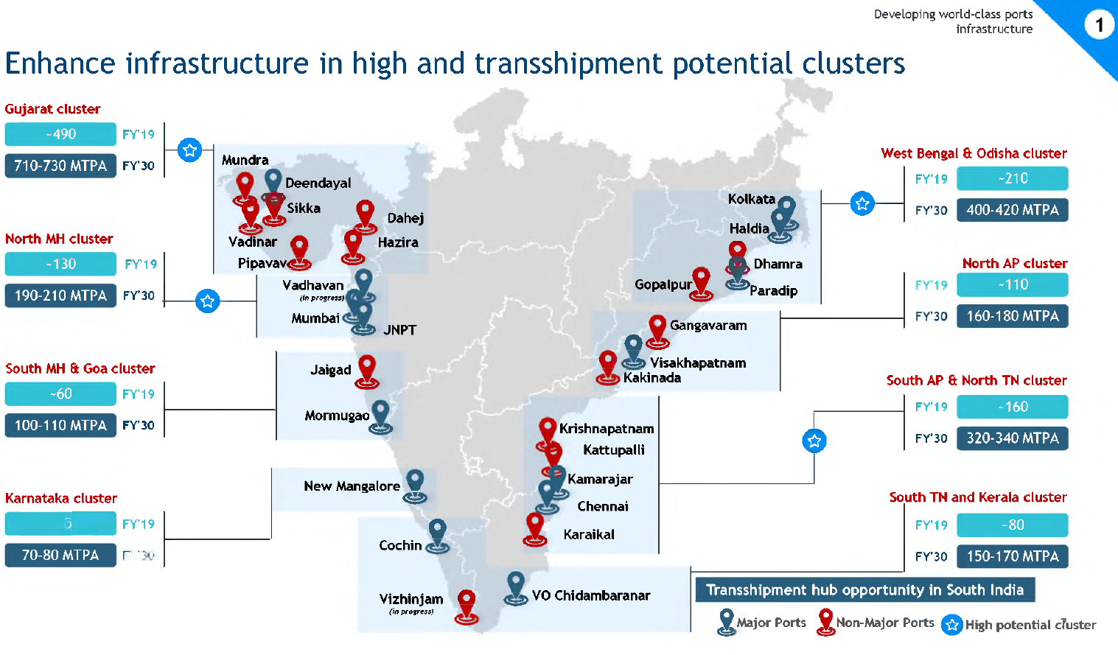
2nd Driver for Amritkal: Sagarmala
Salient 1 - Developing World-Class Port Infra
By 2030
Rs 5,54 L Cr earmarked
3 major ports handling >300 MTPA cargo
Indian ports will handle 75% of transhipment cargo
9 Ports with have draft > 18 mts
Public Private Partnership
There are 123 PPP projects at an estimated investment of Rs. 2.63 lakh Cr.
29 PPP projects with an investment of Rs. 44,961 Cr. have been completed
31 PPP projects worth Rs. 50,942 Cr. are currently under implementation
Eight Clusters

Slide 25
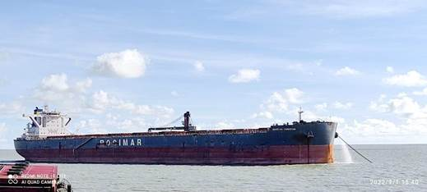
2nd Driver for Amritkal: Sagarmala
Salient 1 - Developing World-Class Port Infra
Depth of Port increased - 1st September 2022
M V Mineral Yangfan Cape size vessel
LOA of 299.92 mtrs and a beam 50 mtrs
Discharged 70,300 MT of Coking Coal by Floating Cranes for M/s Steel Authority of India Limited
At Sagar Anchorage. This is the largest dry bulker carrier at Sagar
Recent Developments
Source: Rajya Sabha Report 319 –March 2022 Implementation of Sagarmala
Transshipment Hub – 19 Jul 2022
Proposal received for Vizag from stakeholders
Central Govt proposes to develop Galathea Bay at Great Nicobar Islands, and Cochin Port
Kerala State Govt proposes at Vizhinjam

Slide 26
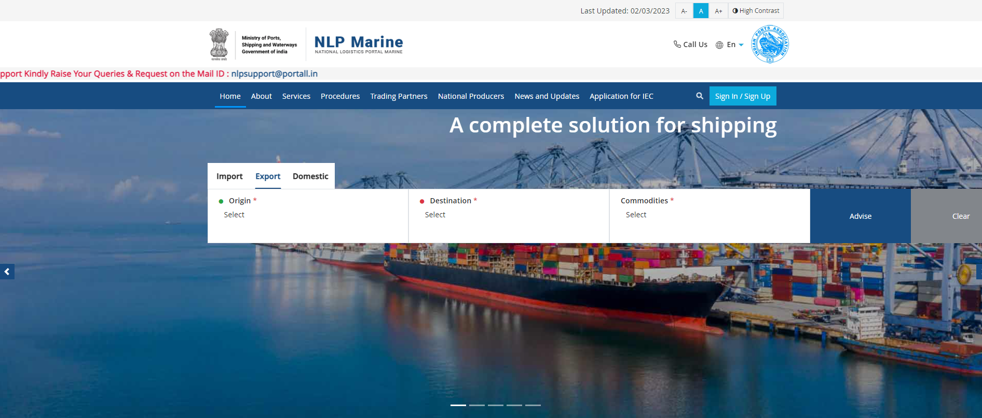
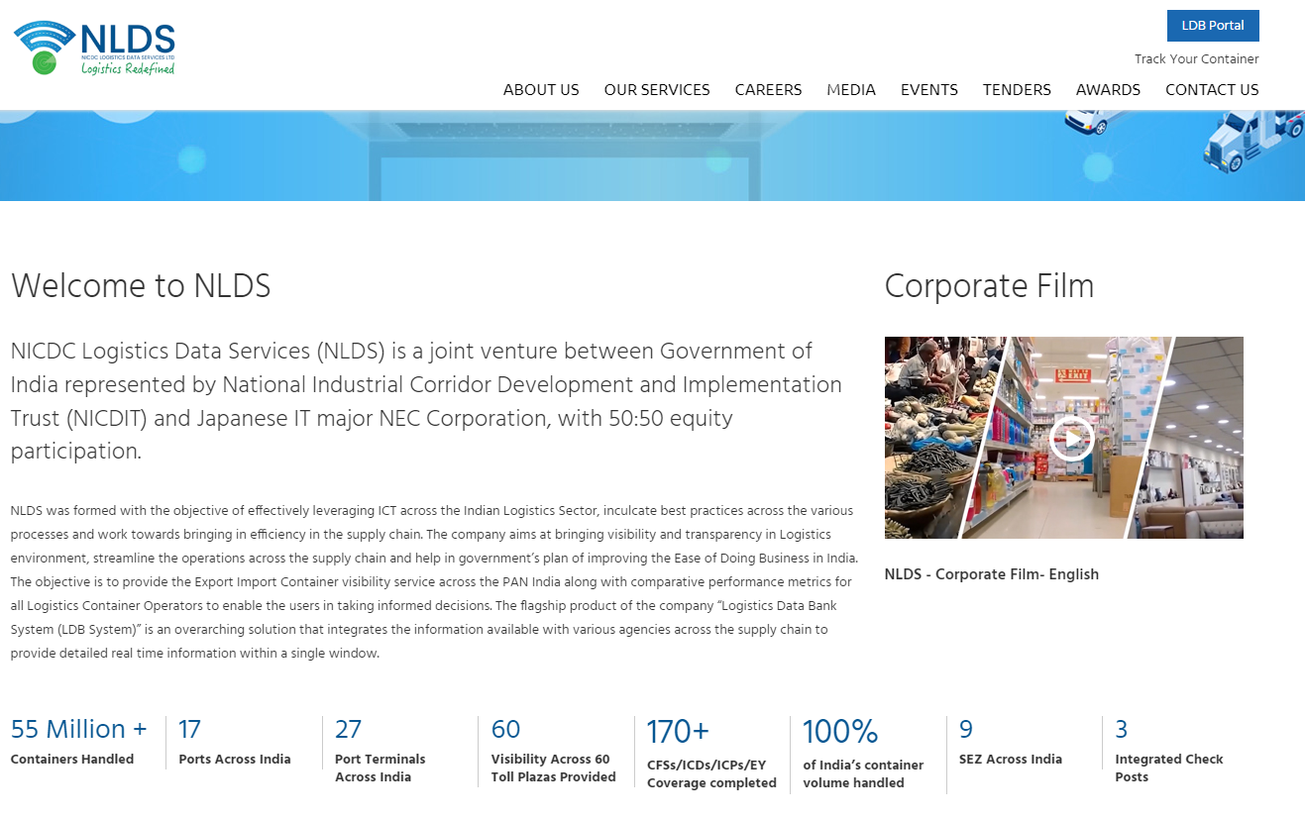
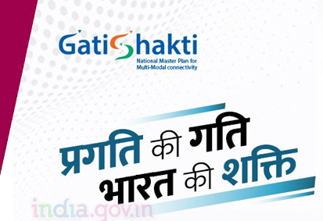
2nd Driver for Amritkal: Sagarmala
Salient 2 - Smart Ports to Improve Ease of Doing Business (EoDB)
Port Community System (PCS) 1x
https://indianpcs.gov.in/
Logistics Data Bank Service
https://nldsl.in/about.aspx?mpgid=2&pgidtrail=3
Enterprise Business Systems
https://www.deendayalport.gov.in/en/
Transformational Change
Digital Platform connecting 16 Ministries and State Governments - Bharatmala, Sagarmala, Inland Waterways, Dry/Land ports, UDAN
National Logistic Portal (NLP)
https://nlpmarine.gov.in/landings/landing-page
Direct Port Delivery (DPD)
Direct Port Entry (DPE)
From 143rd rank in 2014 to 63rd in 2022

Slide 27
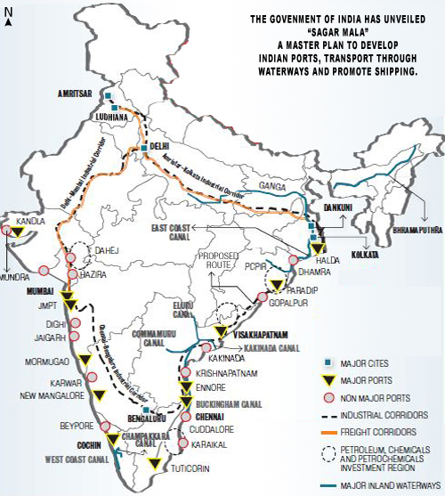
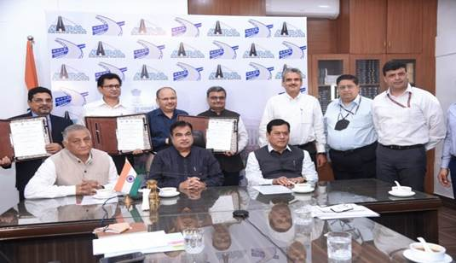
2nd Driver for Amritkal: Sagarmala
Salient 3 - Reducing Logistics Costs – Multi-modal Shift
National ecosystem being created
NW2
NW1
NW73
NW97
NW5
Multi-Modal Logistics Parks (MMLP) under Bharatmala Pariyojna
35 MMLP for Centralize freight consolidation and reduce logistics cost from 14% to 10% of GDP
Agreement - National Highways Logistics Management Limited (NHLML), IWAI and Rail Vikas Nigam Limited (RVNL) on 23 August 2022
‘Hub & Spoke’ model, connecting warehouses, cold storage, mechanised material handling, and value-added services such as customs clearance
RIL awarded the first MMLP in Chennai. Spread over 184 acres
NW100
NW4
NW68
NW3
NW8

Slide 28
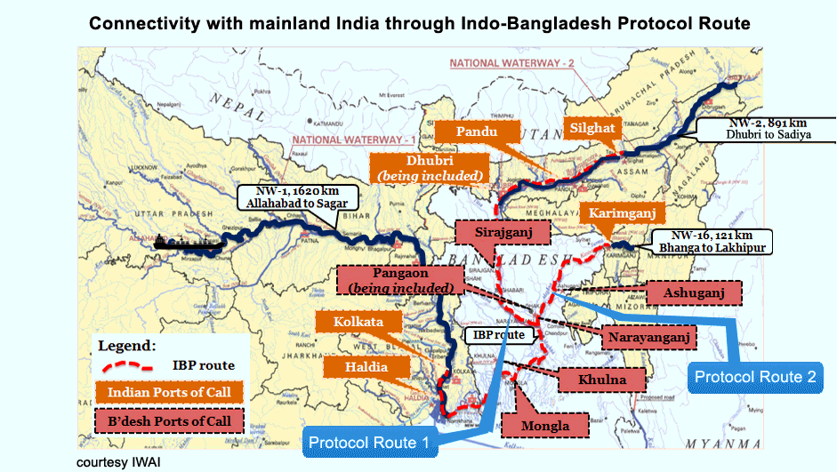
2nd Driver for Amritkal: Sagarmala
Salient 3 - Reducing Logistics Costs – Multi-modal Shift

Slide 29
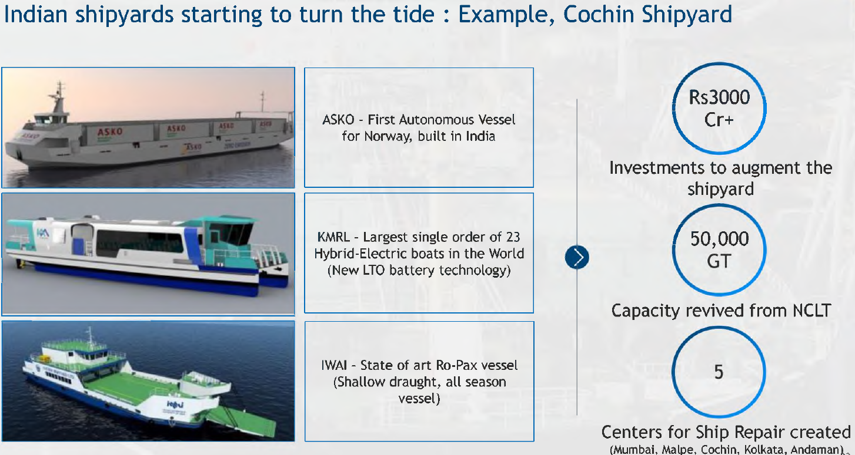
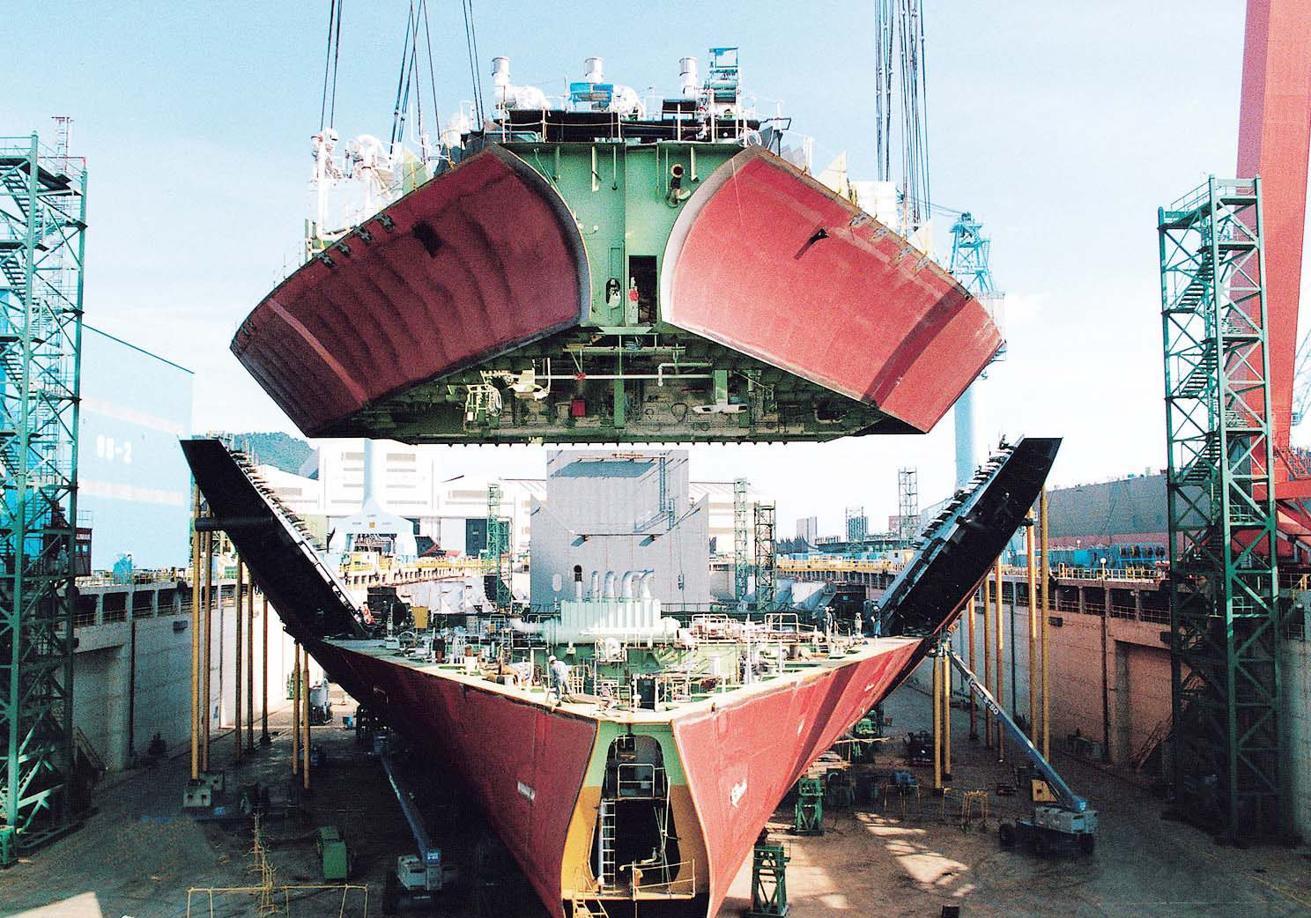
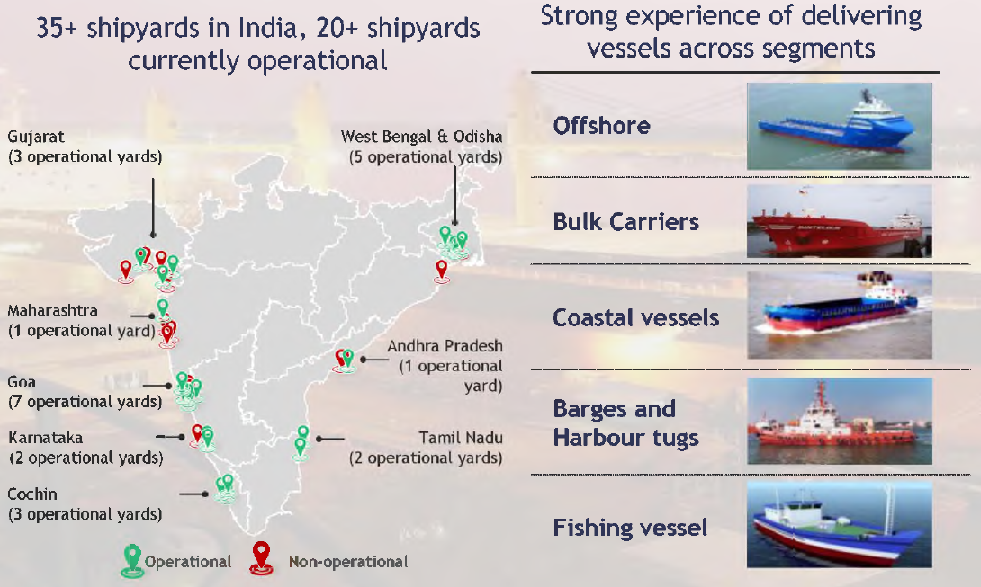
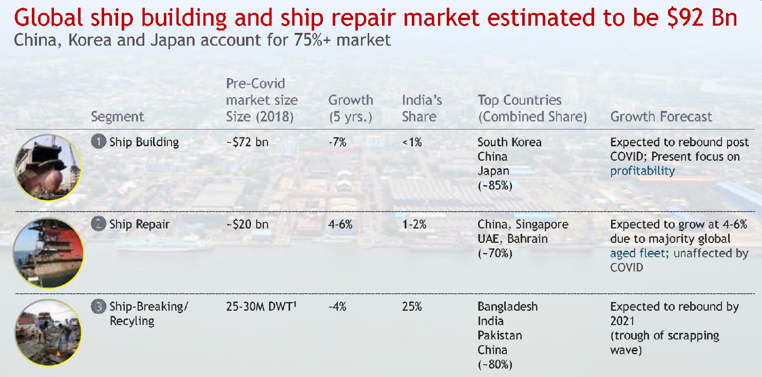
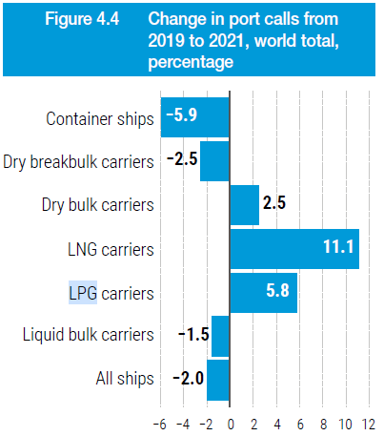
2nd Driver: Sagarmala
Salient 4 – Atmanirbhar in Shipbuilding & Repair
Source: Maritime India Vision 2030

Slide 30




2nd Driver for Amritkal: Sagarmala
Salient 5 – World Class Maritime Research, Education and Training
CoC – Certificate of Competence
RPSL – Recruitment and Placement Services License
IMU Chennai
Tolani Maritime Institute
Source: Maritime India Vision 2030

Slide 31
3rd Driver for Amritkal: Adapt to New Shipping Trends
Adapt to
Energy transition and decarbonization
New Supply chains that will be shaped by best-cost and national security (and not lowest-cost)
New consumption patterns of e-commerce
Digitisation/ Innovation
Shipping and Port Consolidation

Slide 32







1. Energy Transition and Decarbonization
3rd Driver for Amritkal: Adapt to New Shipping Trends
40 Yrs
3°C
9 Yrs
18 Yrs
30 Yrs
%
Carbon Budget
getting exhausted
Countries altering their energy choices – Ports and Seafarers have to adapt

Slide 33

India’s National Declaration at COP 26 Glasgow 2022
An Ambitious Declaration - At Conference of the Parties (COP26) to the United Nations Framework Convention on Climate Change (UNFCCC) India articulated the five nectar elements (Panchamrit) of India’s climate action:
Reach 500 GW Non-fossil energy capacity by 2030
50 per cent of its energy requirements from renewable energy by 2030
Reduction of total projected carbon emissions by one billion tons from now to 2030
Lifestyle For Environment (LIFE)
Reduction of the carbon intensity of the economy by 45 per cent by 2030, over 2005 levels
Achieving the target of net zero emissions by 2070
India is not alone

Slide 34



3rd Driver for Amritkal: Adapt to New Shipping Trends
Relative CO2 Emissions of Carriers
Age
Size
Speed
Carbon Taxes will encourage more green shipping

Slide 35


2. Supply Chains are being shaped by Best-Cost
(Not lowest-cost) and National Security
3rd Driver for Amritkal: Adapt to New Shipping Trends
Coal
Oil
Iron Ore
Shift from Near Shoring to Friend Shoring is changing the liner routes
Gas

Slide 36



3rd Driver for Amritkal: Adapt to New Shipping Trends
3. New consumption patterns as e-commerce takes hold
Will bring more Container Ships to and from India and China

Slide 37





3rd Driver for Amritkal: Adapt to New Shipping Trends
Horizontal Consolidation
4. Container Shipping and Port Consolidation
The monopoly of a few carriers will affect all, especially small countries like Palau, Caicos, and Futuna
In 1996 top 20 container carriers used to be 48%. In 2022 their share has gone up to 91%
Ave size of the world’s largest container ships have from 9,380 to 23,992 TEU between 2006 and 2022

Slide 38





3rd Driver : Nimble Shipping Strategy
Vertical Integration
4. Container Shipping and Port Consolidation
Control Logistics
Shipping companies buying
warehouses and freight-forwarding. MSC runs MedLog,
Moller-Maersk has acquired B2C
CSP Abu Dhabi Terminal
Control Terminal Operation
The four largest carriers are now among the top ten terminal operators. Of global throughput COSCO handles 13%, and Maersk – APM 11%

Slide 39
3rd Driver : Nimble Shipping Strategy
Vertical Integration
4. Container Shipping and Port Consolidation
Control Logistics
Shipping companies buying
warehouses and freight-forwarding. MSC runs MedLog,
Moller-Maersk has acquired B2C
Oligopsony - When Carriers become Clients
When there are more sellers and fewer buyers
Greater Negotiation Power and Monopoly
CSP Abu Dhabi Terminal
Control Terminal Operation
The four largest carriers are now among the top ten terminal operators. Of global throughput COSCO handles 13%, and Maersk – APM 11%

Slide 40



How Should India Rise?
Thucydides's Trap
Peloponnesian War (431 BC) Athens and Sparta
Draws all in the region into war, and destruction – Avoidable by India. Maintain strategic autonomy

Slide 41



How Should India Rise?
Charles Kindleberger
Kindleberger Trap – A Term Coined by Joseph Nye
Charles Kindleberger (1910-2003) taught at MIT
Was an intellectual architect of the Marshall Plan
Argued - “The disastrous decade of the 1930s was caused when the US replaced Britain as the largest global power but failed to take on Britain’s role in providing global public goods”
Joseph Nye

Slide 42

How Should India Rise?
Charles Kindleberger
Kindleberger Trap – Term Coined by Joseph Nye
Charles Kindleberger (1910-2003) taught at MIT
Was an intellectual architect of the Marshall Plan
Argued - “The disastrous decade of the 1930s was caused when the US replaced Britain as the largest global power but failed to take on Britain’s role in providing global public goods”
China’s BRI has drawn US into a Kindleberger Trap – Providing Public Goods and Leadership to the world – Unaffordable for India
Joseph Nye

Slide 43


India Rising ….
  Hypothesis - Uncertain International Order
  Protect national interest with astute Diplomacy
  Prosper with Port-led development like Sagarmala
  Seafarers and Ports to Adapt with changing shipping trends

