Slide 1
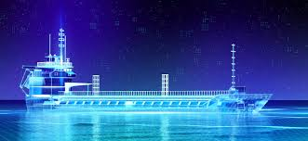
Digitalisation in Shipping
By
Capt. Shailesh Bhambhani
(SMARTSHIP HUB)
For
TRANSTECH’ 23

Slide 2

Concept
Digitization and Digitalization
They sound the same, but do they mean the same thing
“NO”
not even close

Slide 3
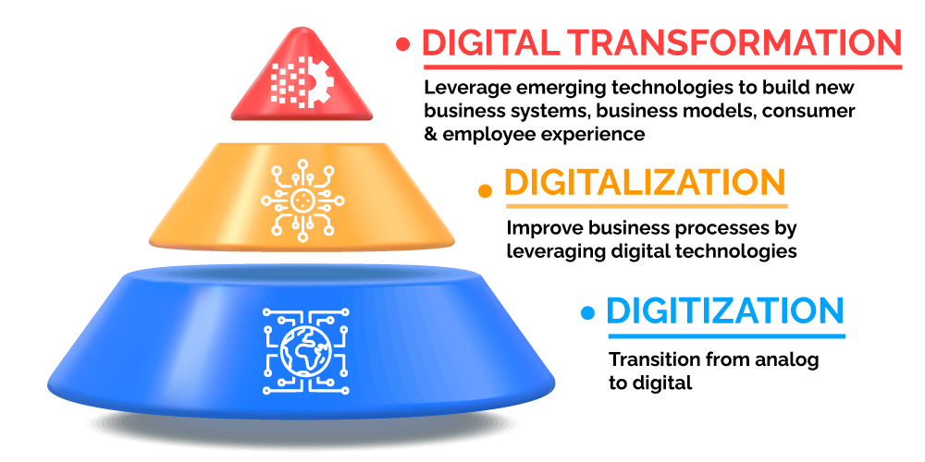
Digitization vs Digitalization vs Digital Transformation
Digitization: Is the process of converting information from a physical format into a digital one. It is the simple process of re-representing non-digital data in a digital format
Examples:
Scanning bills, documents, and files
Digitalization: Is the process of leveraging digitization to improve business processes
Digital Transformation: Is another word that appears alongside digitization and digitalization. Basically, digital transformation is the impact caused by the process of digitalization

Slide 4
Process
 | Digitalisation | Digitalization | Digital transformation
Focus | Data Conversion | Information processing | Knowledge leveraging
Goal | Change analog to digital format | Automate existing business operations and processes | Change company’s culture, the way it works and thinks
Activity | Convert paper documents, photos, microfilms, LPs, films, and VHS tapes to digital format | Creation of completely digital work processes | Creation of a new digital company or transformation to a digital one
Tools | Computers and conversion/encoding equipment | IT systems and computer applications | Matrix of new (currently disruptive) digital technologies – AI, Robotics, ML
Challenge | Volume Material | Price Financial | Resistance to change Human Resource
Example | Scanning paper-based registration forms | Completely electronic registration process | Everything electronic, from registration to content delivery

Slide 5
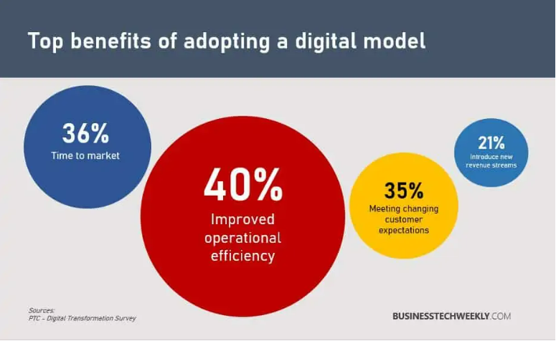
Benefits

Slide 6


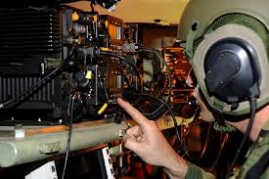

The Start – Analog to Digitisation
Typewriters
to
Computers
Complicated Radio Equipment
to
Satellite Mobile phones

Slide 7
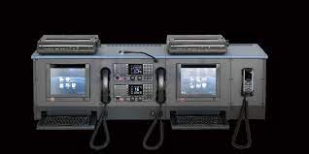
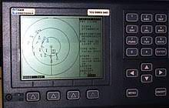
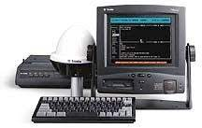
The Start - Communication
Late 1990s: GMDSS and Inmarsat-C
Real breakthrough came with mandatory automatic identification system (AIS) in 2002

Slide 8
Stages of digitalization
As per UNCTAD report # 75
The effects of digitalization on maritime transport can be divided into the following three stages:
Optimization – maximizing efficiency and reliability in existing processes to reduce the costs of trading
Extension – moving beyond efficiency to produce opportunities for new services and businesses
Transformation – reinventing logistics, trade and business models, based on data-driven revenue streams and shifts in trade flows.

Slide 9
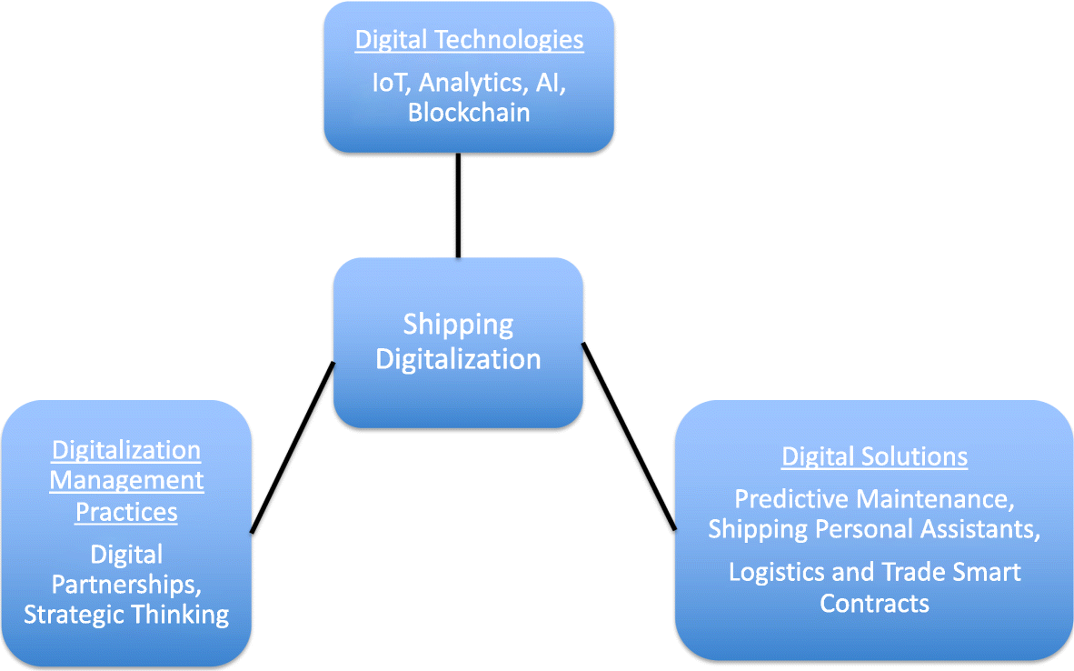
Shipping Digitalization

Slide 10
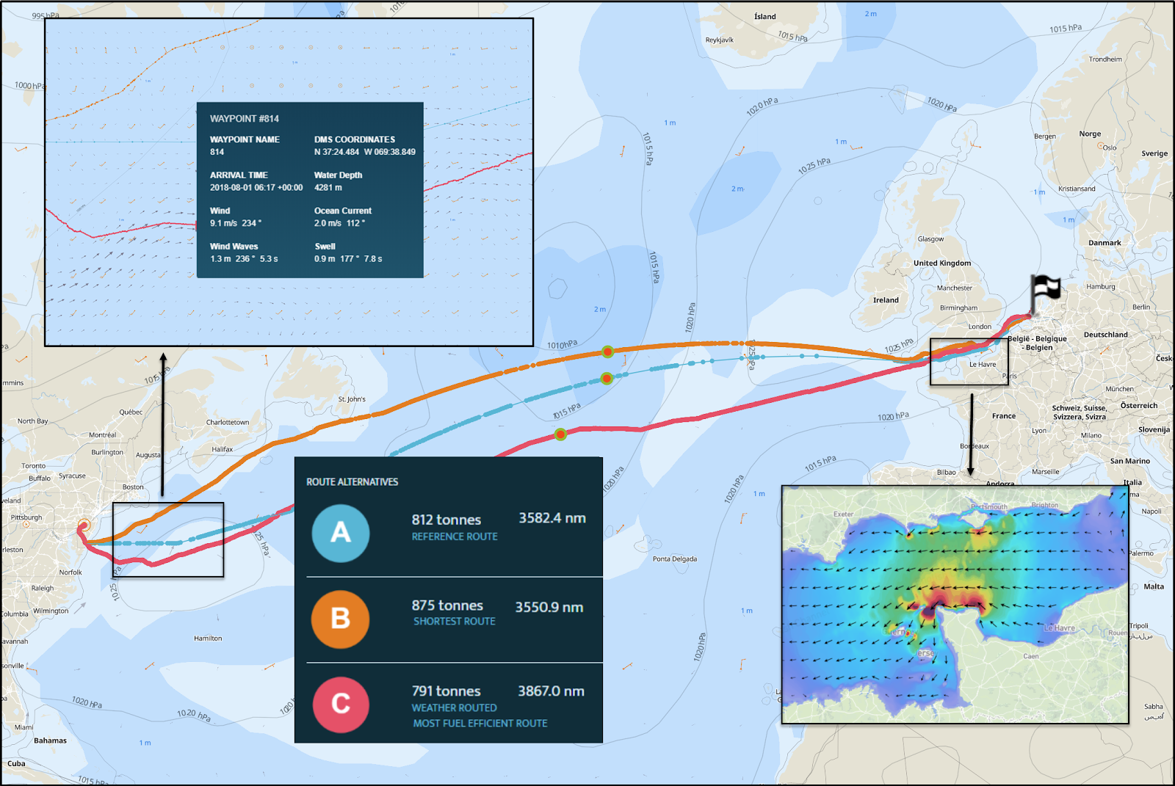
The Present – Voyage
Voyage optimisation services

Slide 11
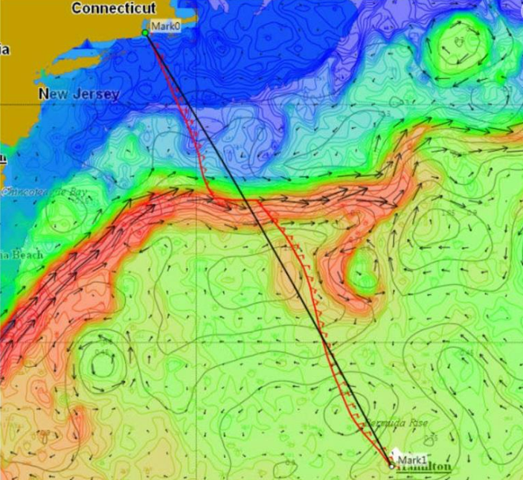
The Present - Weather
Weather routeing services

Slide 12
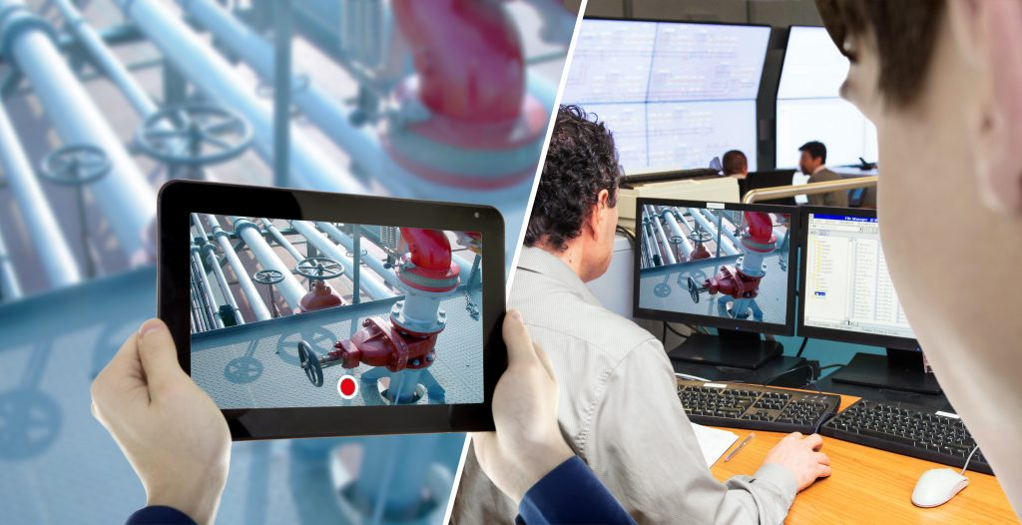
The Present - Surveys
Remote vessel Survey

Slide 13

The Present - Inspections
Underwater Remotely Operated Vehicles

Slide 14
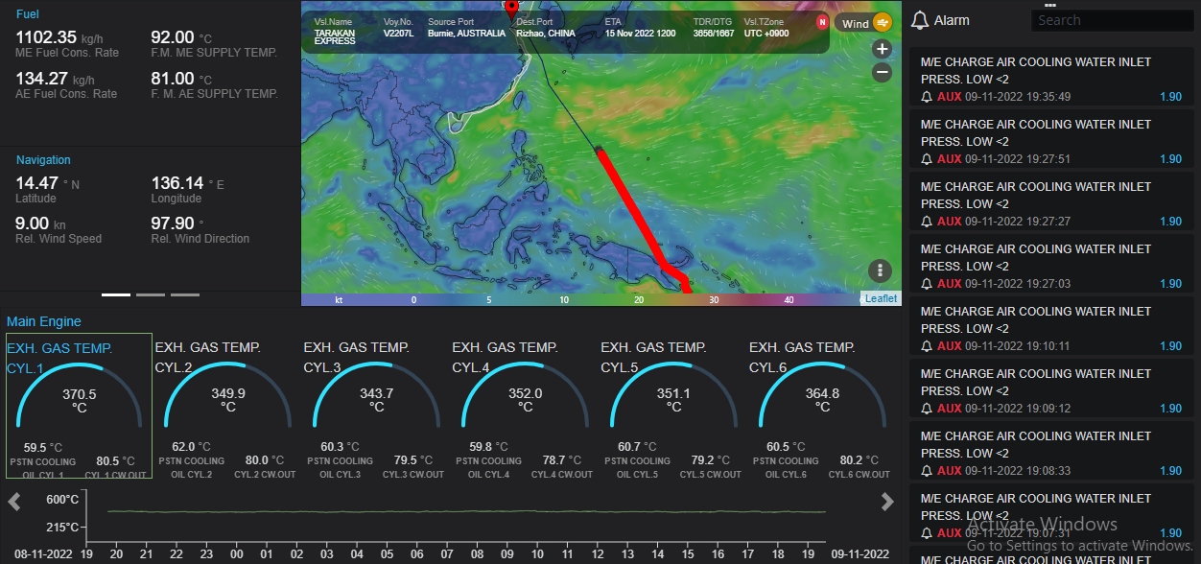

The Present - Monitoring
Digital Twin – Remote Machinery monitoring

Slide 15
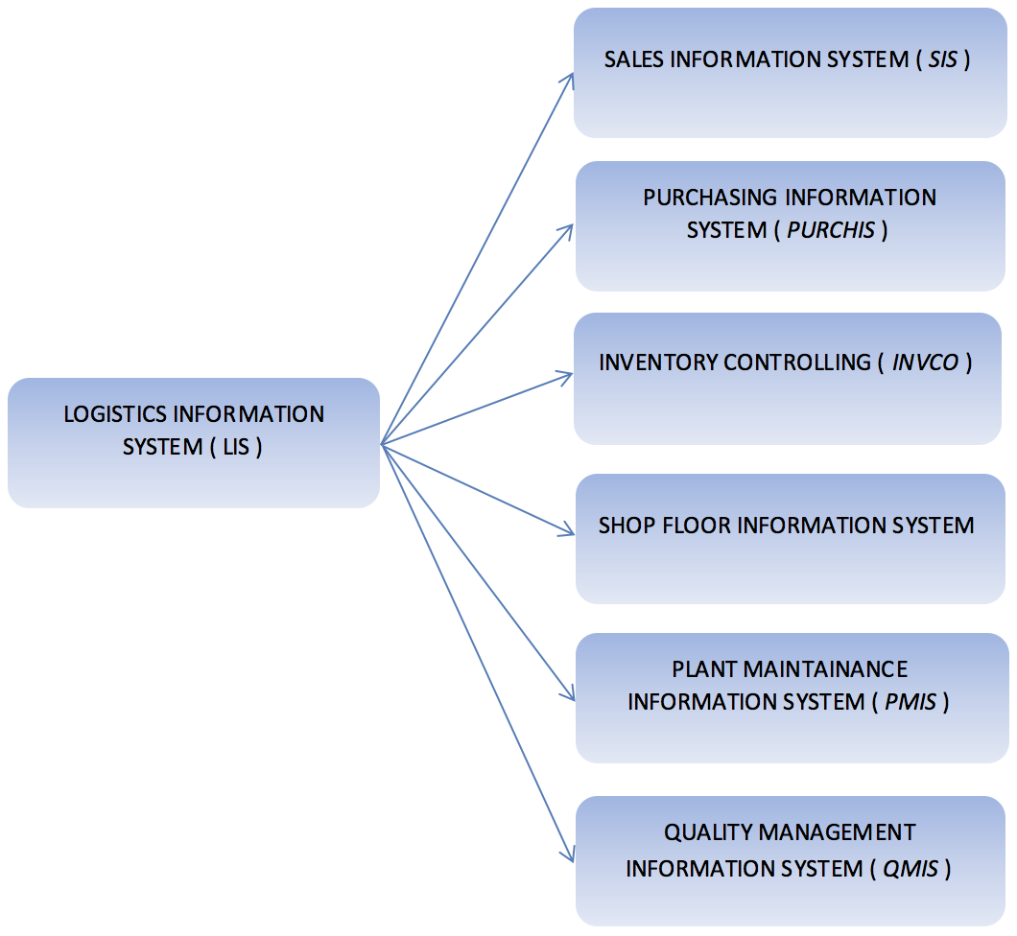
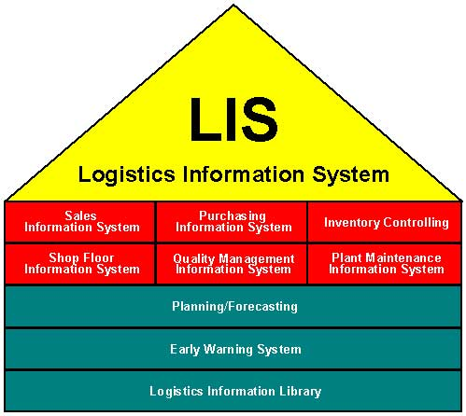
The Present- Logistics
Logistics Information System

Slide 16
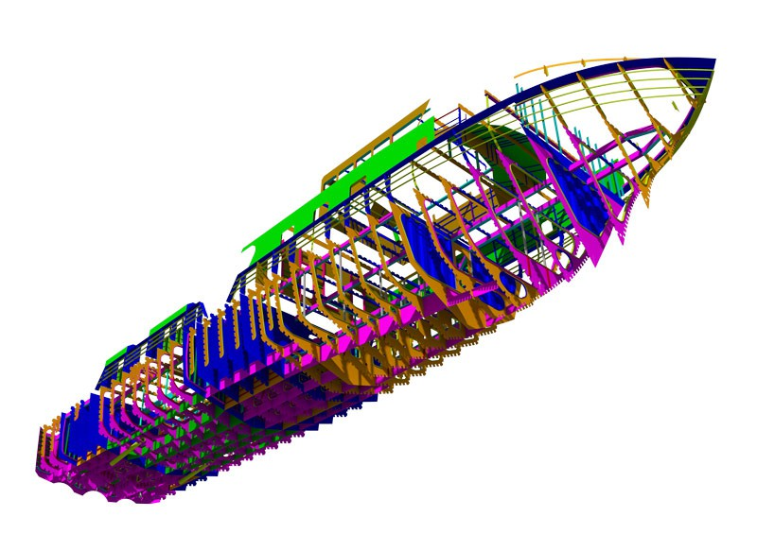
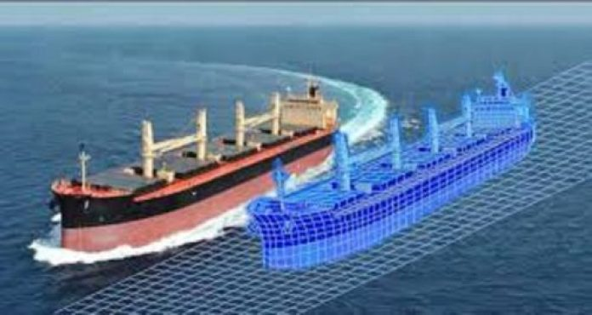
The Present – Naval Architecture
Advancement in Vessel designing

Slide 17
Fourth Industrial Revolution
The so-called “Fourth Industrial revolution”, also termed as “Industry 4.0”, composed of nine important technological pillars
Cyber-physical systems (CPS)
Internet of Things (IoT)
Big Data Analytics (BDA)
3D printing
Advanced Robotics
Advanced Simulation
Virtual and Augmented Reality
Cloud Computing (CC)
Cyber Security
THE shipping industry is increasingly comfortable with digital solutions such as performance monitoring, artificial intelligence, remote surveying, and automation.
However, many shipowners are watching and waiting

Slide 18
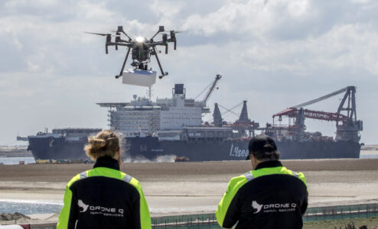
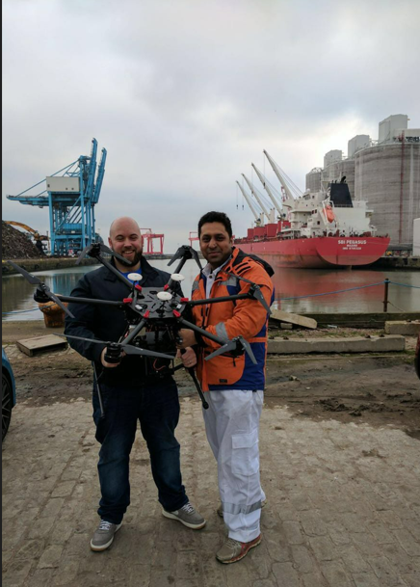
The Future - Drones
Drone for delivery and inspections

Slide 19
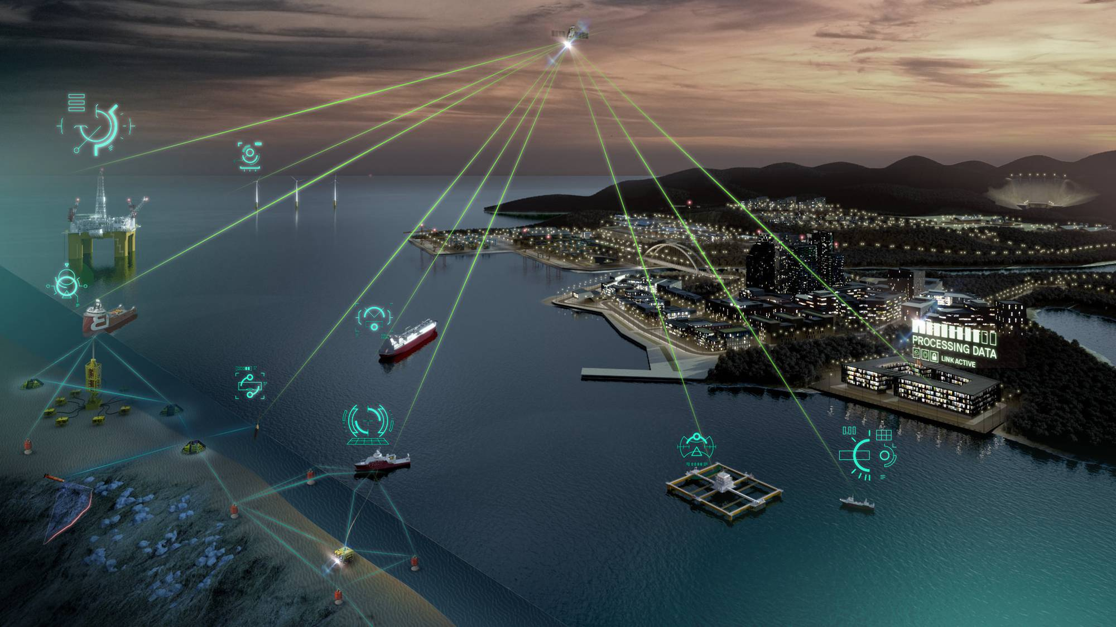
The Future – Connected
Connected GLOBAL Economy

Slide 20
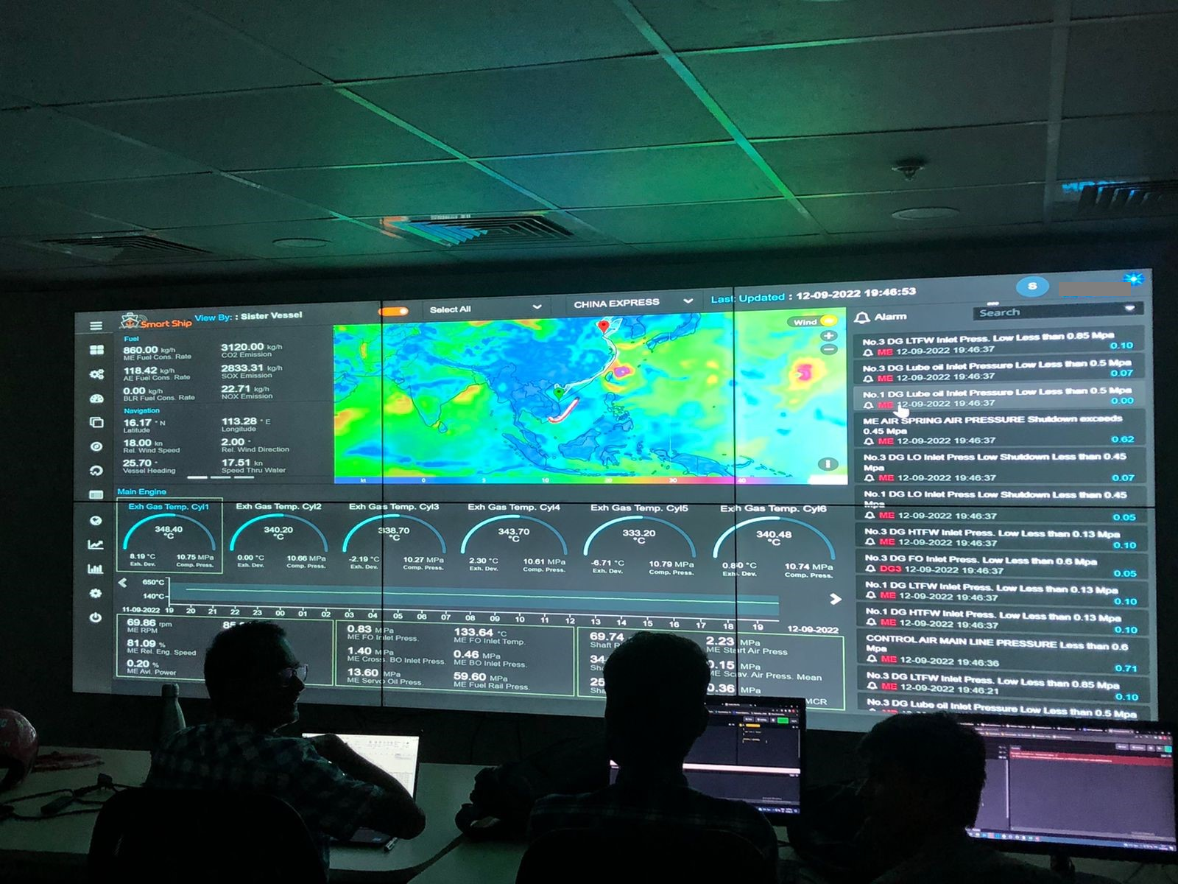

The Future – KPO’s
Remote Vessel Monitoring – KPO’s

Slide 21
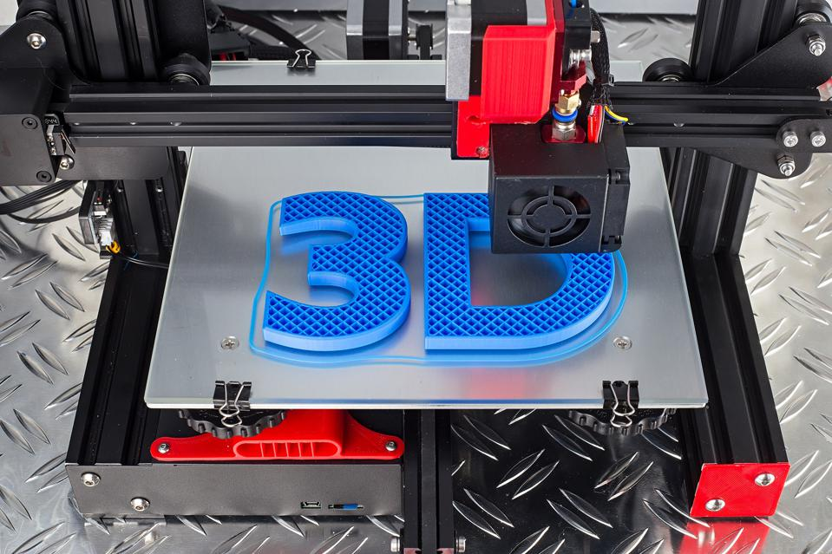
The Future - Spares
3 D Printing

Slide 22
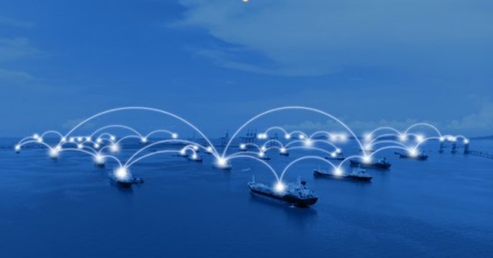
The Future - Communication
Connected Ships

Slide 23
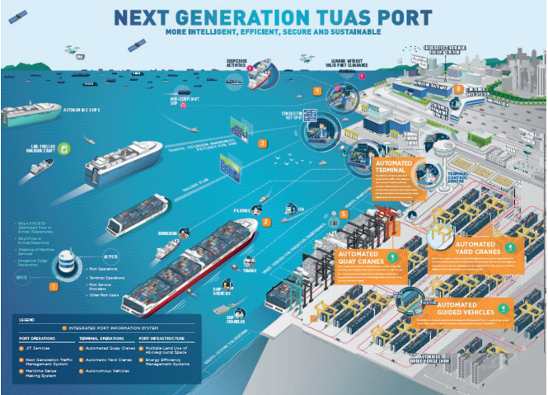
The Future - Ports
TAUS PORT – 2030 Vision

Slide 24
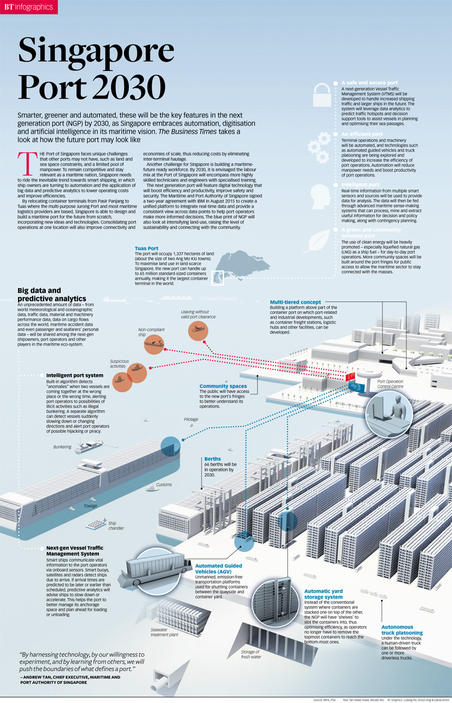
The Future - Ports
Singapore Port - 2030

Slide 25
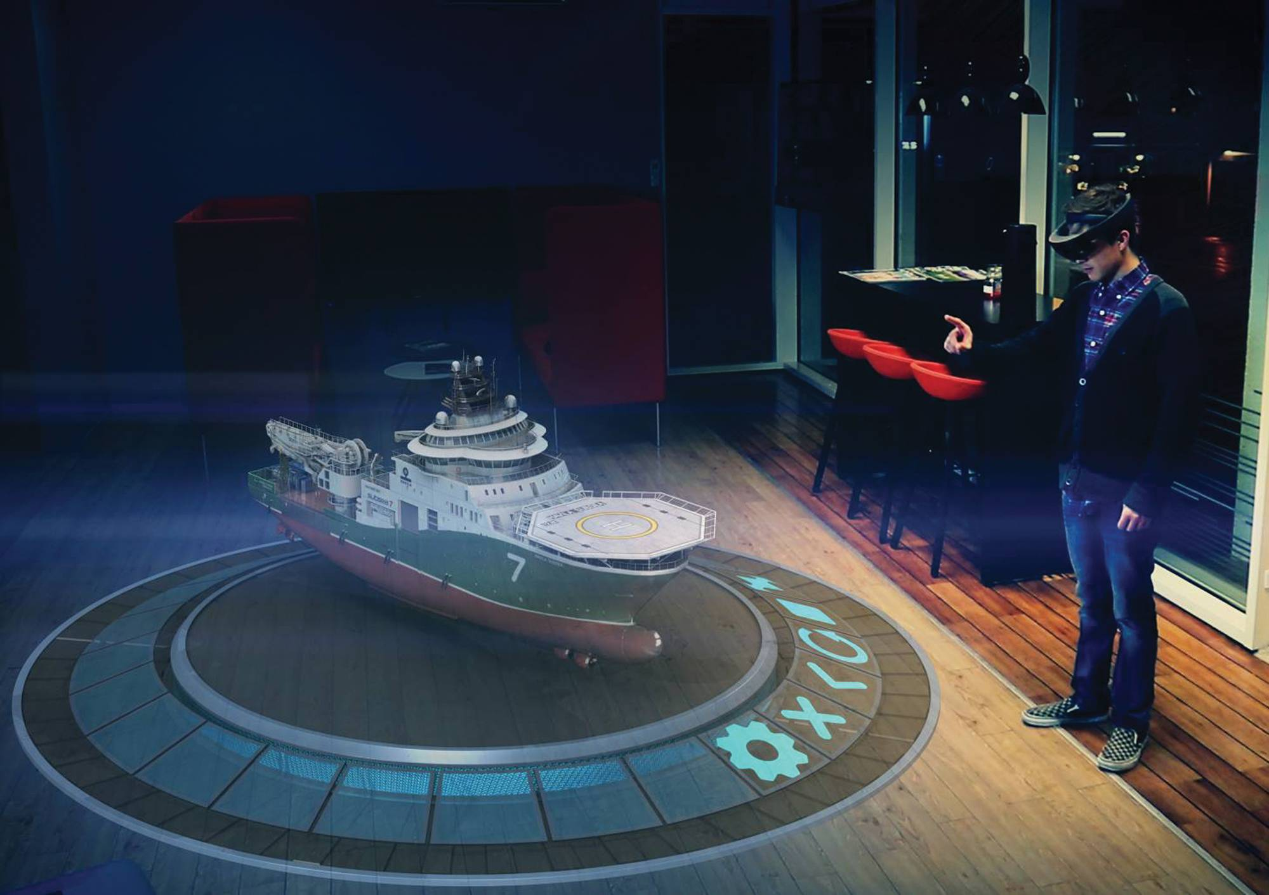
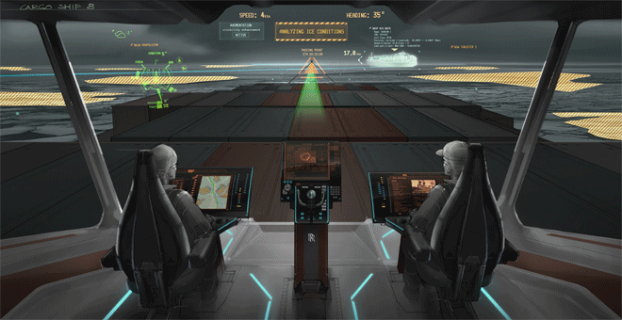
The Future - Training
Augmented Reality & Virtual Reality
Notes:
VR creates an immersive virtual environment, while AR augments a real-world scene. VR is 75 percent virtual, while AR is only 25 percent virtual. VR requires a headset device, while AR does not. VR users move in a completely fictional world, while AR users are in contact with the real world

Slide 26
The Future – Big Data
Role in the industry | Big data applications
Ship operator | Drafting energy-efficient solutions to cut on fuel consumption, monitor emissions, reducing operation costs
Fleet Planning | Smart allocation of the fleet and other planning that actively involve proven statistical data
Shipbuilder | Ensure maximum optimization for your newbuilds with the help of big data
Technical Management | Maximize safety and security by analyzing previous mishaps Ensure proper vessel inspection.

Slide 27
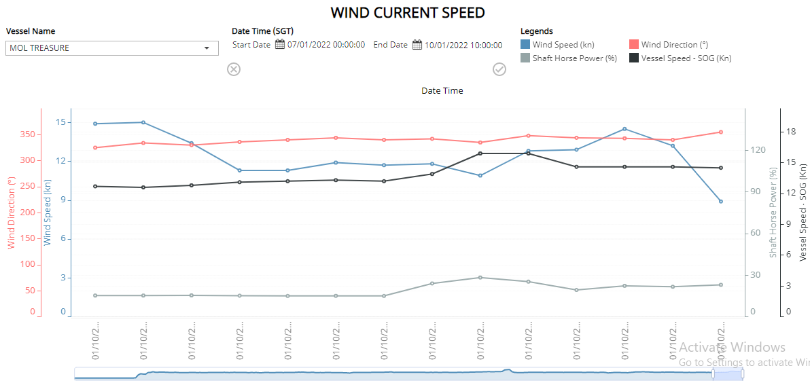
The Future - Analytics
Big Data Analytics
Notes:
VR creates an immersive virtual environment, while AR augments a real-world scene. VR is 75 percent virtual, while AR is only 25 percent virtual. VR requires a headset device, while AR does not. VR users move in a completely fictional world, while AR users are in contact with the real world

Slide 28
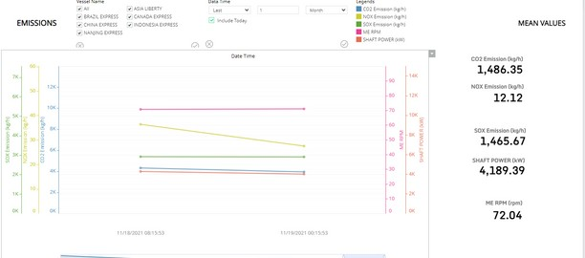
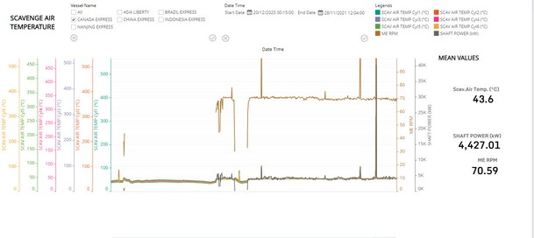
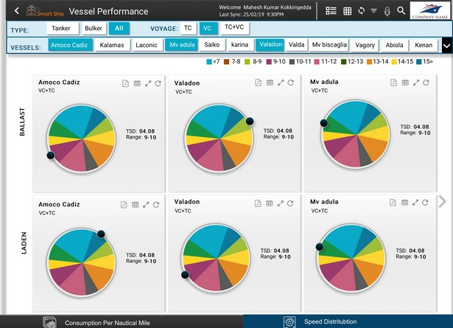
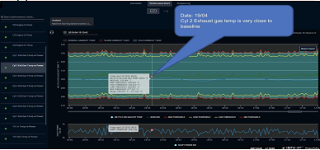
The Future – High Frequency data
AI driven Analytics
Notes:
AI has many uses in the maritime industry, such as:
For surveillance of port and coastal areas.
To protect fishing areas and adhere to fish quotas.
To monitor pollution in the environment.
To follow cargo movements and predict vessel ETAs.

Slide 29
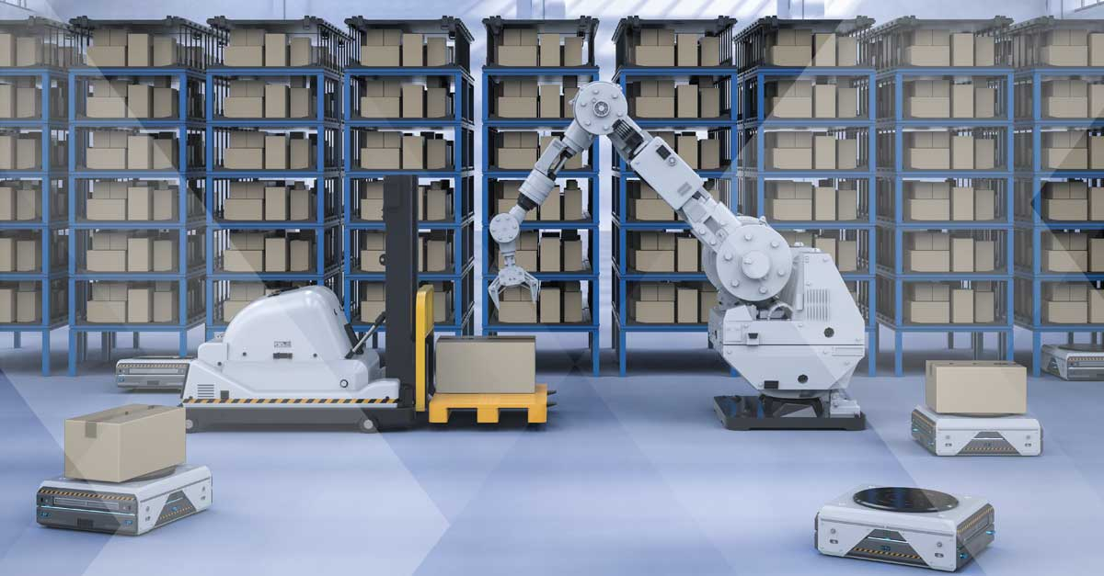
The Future - Warehousing
Advanced Robotics
Notes:
VR creates an immersive virtual environment, while AR augments a real-world scene. VR is 75 percent virtual, while AR is only 25 percent virtual. VR requires a headset device, while AR does not. VR users move in a completely fictional world, while AR users are in contact with the real world

Slide 30
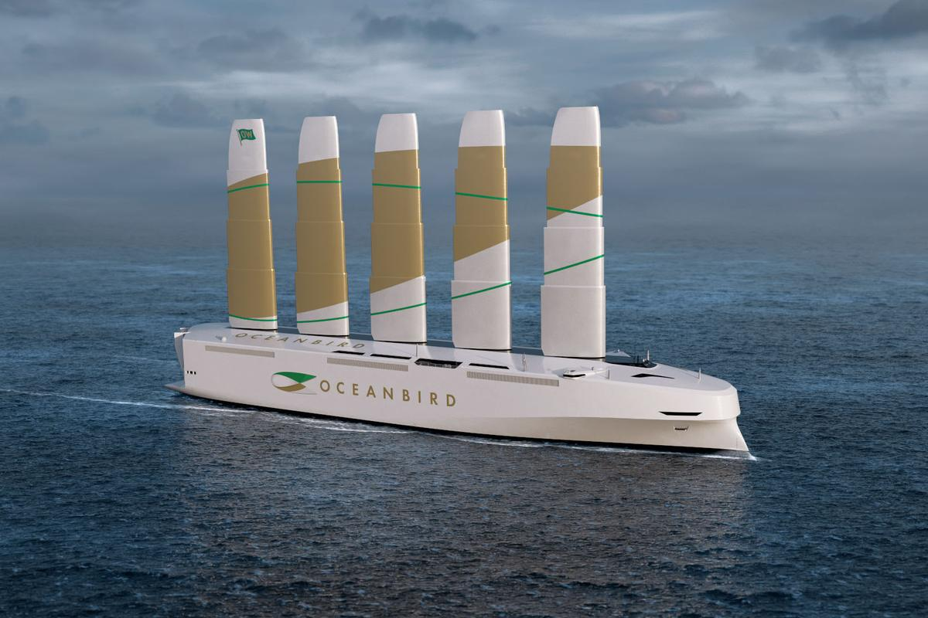
The Future – Clean fuel
Ocean bird – Sail ship
Notes:
The latest concept is the Oceanbird, a giant Pure Car and Truck Carrier capable of transporting up to 7,000 cars at an average speed of 10 knots on a North Atlantic crossing. That's not quite as quick as a conventional ship; you're looking at around 12 days instead of the typical 8, but the Oceanbird's four colossal 80-meter (260-ft) high extendable wing sails promise to reduce emissions by as much as 90 percent.

Slide 31
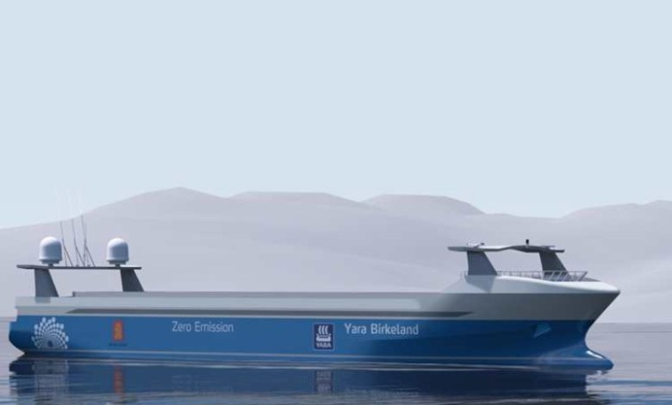
Finally
Autonomous Ship
Notes:
Yara Birkeland is the world’s first fully electric and autonomous container vessel with zero emissions. With this container vessel, Yara will reduce diesel-powered truck haulage by 40,000 journeys a year.
The zero-emission vessel will transport mineral fertilizer from Yara's production plant in Porsgrunn, Norway to the regional export port in Brevik.
his applies to the sensors and integration required for remote and autonomous operations, as well as electrical propulsion, battery and control systems.
put into commercial operation in Porsgrunn in the spring of 2022. During the first to years of operation, the vessel will go through a gradual transition towards full autonomous sailing

Slide 32
Benefits
Company Level
Better control of documents and data
Better control and supervision
Real time analysis
Work from home or remote operations
Enhances decision making capabilities
Better control over cyber security risk
Reduce Human Error
Automated information sharing
Shared tonnage capacity
Reducing in total UNIT cost economy
Better profit margins
Improved customer satisfaction
World Level
Optimized fuel efficiency
Reduction in greenhouse gases emissions
Saving the ecosystem
New cleaner fuel technology
New design
Industry Level
Faster turn around times
Better documentation and clearance processes
Real time monitoring of fleets
Increase in traceability and accountability of cargo
Faster or more efficient transit times
Predictive & Intuitive ETAs to reduce port congestions
Automated speed reduction / speeding advisories to make shipping more efficient
Opex reduction
Accident prevention
Predictive maintenance

Slide 33
Expectation & Challenges
In the current era of the Internet and new technologies, the competitive environment has evolved, as well as the customers’ behaviors and expectations.
They require transport services which are:
Reliable
Flexible
Transparent
Cost-efficient
But the maritime industry faces multiple challenges:
Reducing its environmental impact
Ensure efficient and sustainable operations
Increasing both short and long-term competitiveness
Comply with stricter regulatory requirements
Biggest Challenge facing the industry is CLARITY
Lack of Clarity on the Organizational leadership level and Industry level

Slide 34
Barriers
Company Level
Qualified professionals
Clarity from the top – Vision and Strategy
Aligning business strategy with digital strategy
Employee motivation
Awareness creation on the benefits of digital transformation
Resistance to Change
Culture changes
World Level
Unclear regulations & guidelines
Lack of industry standards
Inadequate monitoring
Investment requirements
No collaboration
Sharing of best management practices
Skill share
Pooling resources
Industry Level
Cost of implementation
Cost of internet & connectivity
Different levels of technology advancement even among various or related parties
Installation time
Constant Sale and purchase of assets
Business secrecy
A survey carried out late in 2020 by Informa Engage on behalf of Inmarsat highlighted that 58% of respondents expected digitalisation to deliver savings below 10% — significantly less than what is sometimes promised

Slide 35
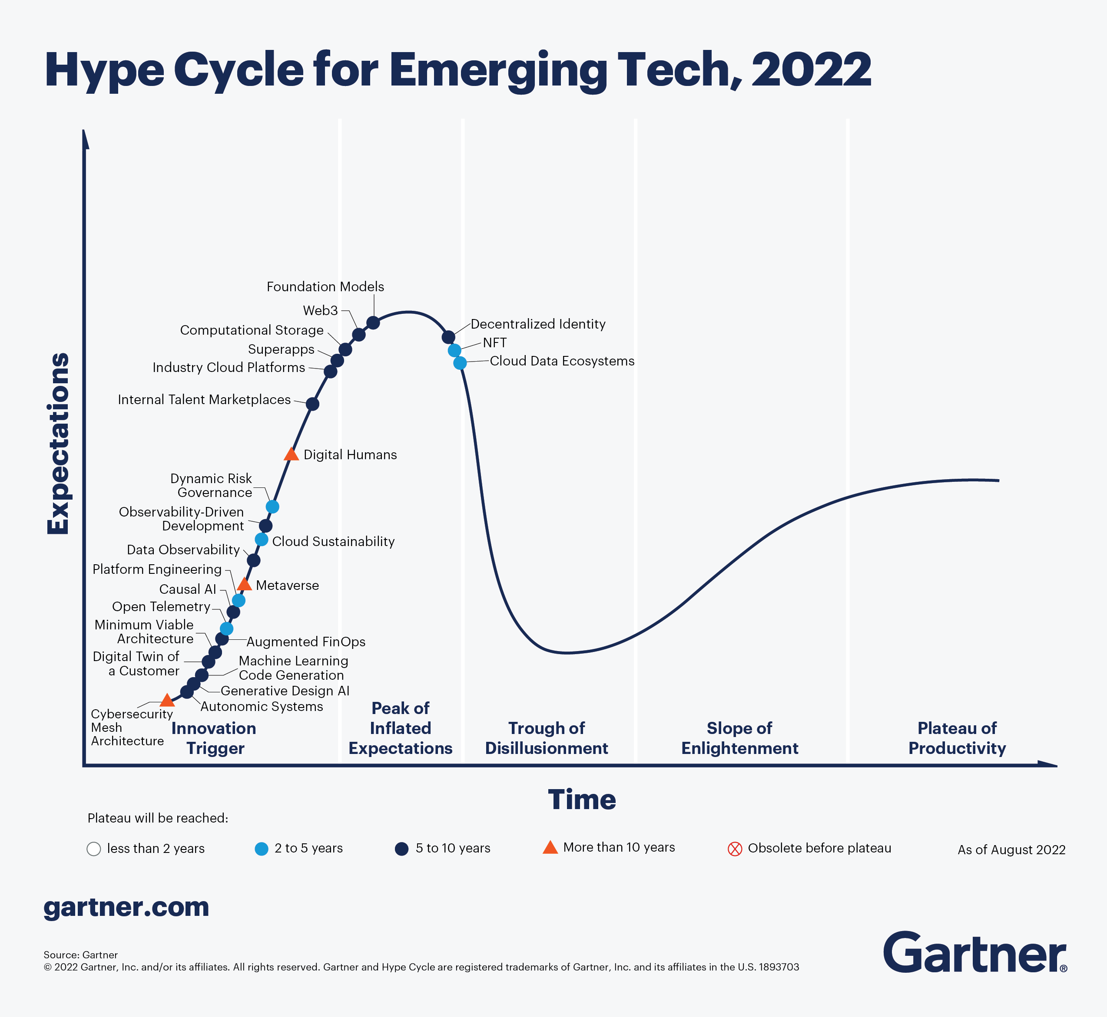
Gartner – Hype Cycle

Slide 36

Gartner – Logistics Industry

Slide 37
Questions
Happy to Answer

Slide 38
Thank you
Contact info
Mobile / Whatsapp: +91 9820019069
Email: B.shailesh@smartshiphub.com / Bhambhani.shailesh@gmail.com
Linkedin: linkedin.com/in/capt-shailesh-bhambhani-6680a9b

