Slide 1
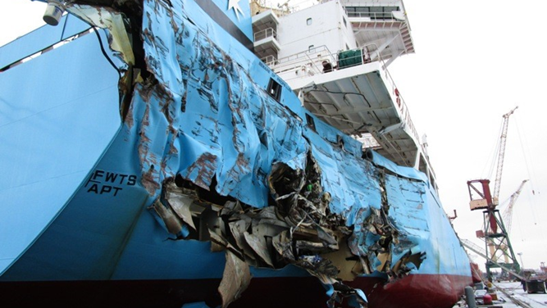
Manas Vaid
Maersk
Notes:
Thank Tolani – Kanangoo Sir for the Opportunity and trust over the years
Purpose is Not to scare – but to highlight risk exists in everything we do.. and therefore we can only be well prepared to mitigate it to the best possible extent.

Slide 2

Technological advancements – Marine Insurance & Claims
Introduction
Trade – is all around us!?
Risk Landscape – Integrated Supply Chain Logistics
Risk Management – Responsibilities & Complexity
Possible Solutions leveraging Technology!
Notes:
Thank Tolani – Kanangoo Sir for the Opportunity and trust over the years
Summarise the flow – briefly reflecting on the trade picture, changing risk landscape
Reflect on the a story of learning at the University before diving in the topic

Slide 3
700+
12 million
container vessels are deployed on routes to and from
containers carrying all kinds of goods from anywhere to everywhere
20%
121
100,000+
of all containers moved in the world
countries on all continents where we call 343 ports
customers all over the world, large and small
Every
6 minutes
90,000+
one port call somewhere in the world
port calls every year by our container vessels
Notes:
Trade

Slide 4

Risk Landscape – Integrated Logistics
Active risk management in real time basis (dynamic)
Origin
Transport/Transit
Destination
  Landside Activities : Manufacturing, Packaging, Labelling, Stuffing, loading, Stowing, Declaring, Complying Custom and clearing formalities (export)..
  Certain Risks:
  manufacturing defect (inherent),
  low/wrong quality of the packaging,
  wrong/inadequate stowage,
  mis-declarations,
  wrong labelling/consolidation
  use of equipment with pre-existing damage, trucking,
  pressure to optimise on the cost,
  unclear terms under sale contract V transportation legs being performed
  inadequate insurance, Et al
  Activities : Ocean/Air/Rail/Road transits
  Objectives: Remain competitive, reliable and profitable
  Certain Risks:
  Fire
  Grounding/Stranding
  Collision/Contacts
  Machinery breakdown
  Heavy Weather
  Accidents
  Capesizing /Sinking
  Falling objects
  Loading/discharging
  Fines
  Et al
  Landside Activities : Manufacturing, Packaging, Labelling, Stuffing, loading, Stowing, Declaring, Complying Custom and clearing formalities (import)..
  Certain Risks:
  Some of them already existing at Origin and/or picked up during Transit
  Trucking
  Storage
  Delays
  Et al
Notes:
Risk landscape is very dynamic in today’s world and so whilst we like to achieve our primary objectives as liner to remain competitive, reliable and profitable – the need to communicate and manage expectation around handling the uncertain risks/event therefore remains crucial.
Customer and stakeholders prefer to get real time updates,

Slide 5
Risk Management: Responsibilities & Complexities!
Underwriting: Insurance Contracts, Re-insurance, Captive, Premiums, risk modelling, risk advisories, quotations
Declarations: Valuations, War risk, material changes, etc. to ensure no warranties are breached.
Policy Documentation: timely issuance of documentations.
Communications: Brokers, Insurers, Finance, internal stakeholders
Claims Management: Incident handling, Assessing liabilities and ascertaining losses, settlements & recovery.
Claims Documentation: Survey reports, adjustment report, claim statements and supporting voucher
Notes:
Typical responsibilities within Risk Management function – transactional, less admin, less error

Slide 6
Possible Solutions leveraging Technology!
POSSIBLE SOLUTIONS:
Leverage technology - INSURWAVE (SaaS) platform (blockchain)
Connects insurance buyers, brokers and sellers to transform the way specialty insurance and reinsurance is transacted
https://youtu.be/sENBQSB1kaE
KEY BENFITS:
Reduction of Risk Management Costs: optimise transactional and administrative burden
Insight & Decision Making: ability to monitor and alter key risk events on real time basis
Captive Optimisation: effective insurance contract administration and reduced reconciliation
https://youtu.be/fw1SWgs1SS0

Slide 7
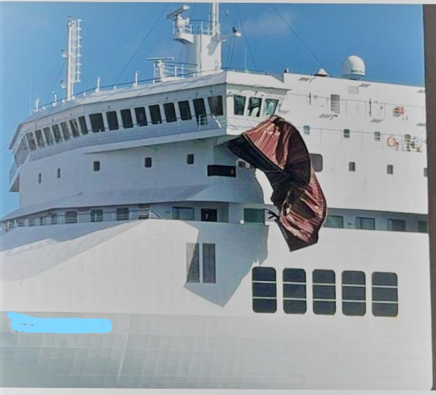
THANK YOU and BE PREPARED!

