Slide 1
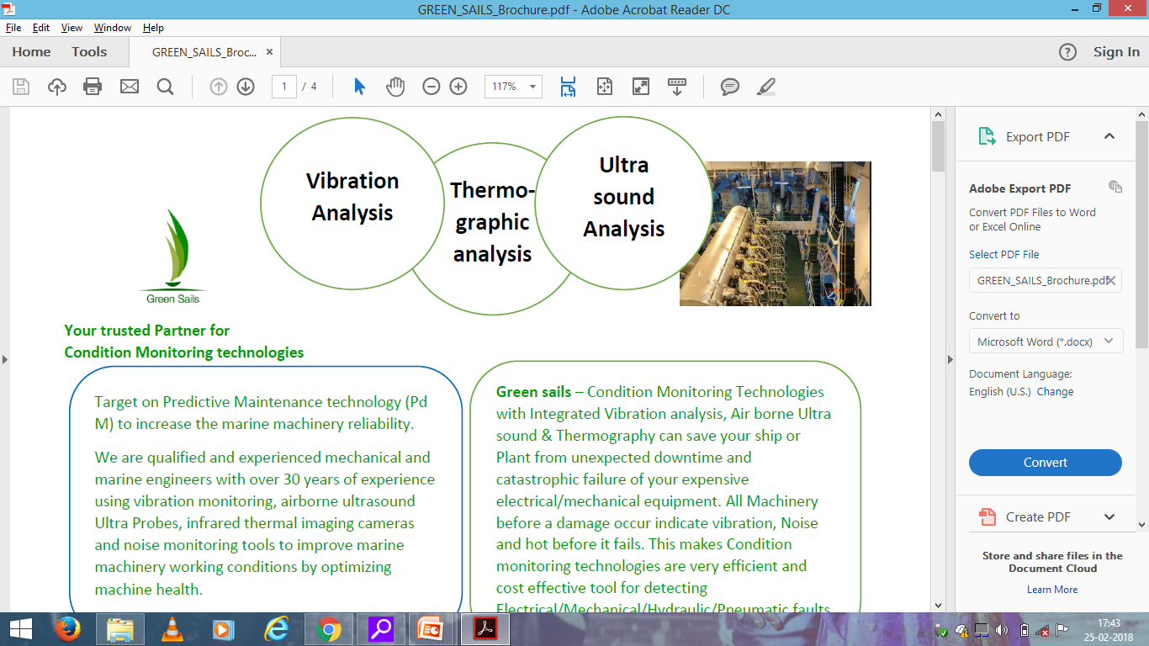
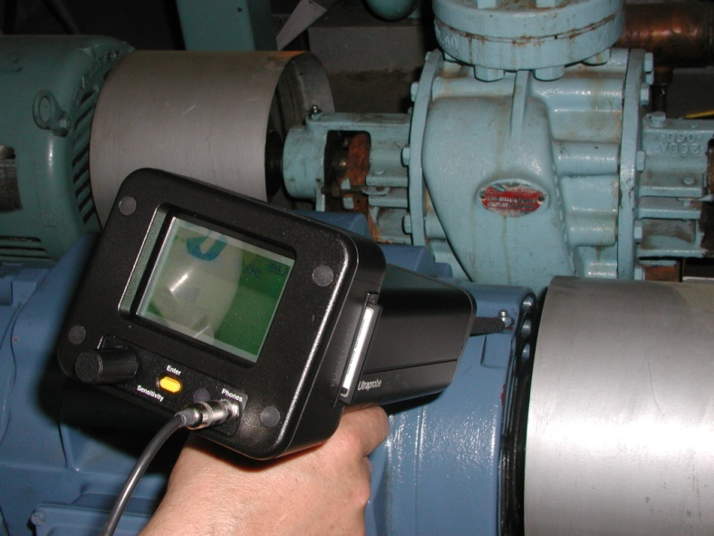
Energy Conservation /
Equipment Reliability using
ULTRASOUND TECHNOLOGY
Balendra Kumar
Green Sails

Slide 2
Today’s Topics
Green Sails- Who we are and What we do
Ultrasound Technology- What it is and what it does
Applications- Where is it used
Plant Examples- Why companies use it and how much they have saved
Ultrasound at YOU- How to get started

Slide 3
Where doe ULTRASOUND fit into an overall RELIABILITY PROGRAM?
CBM Technologies are an integral part of a Reliability Program
The following slides demonstrate where Ultrasound falls on the PF Curve as compared with other CBM technologies and programs

Slide 4
Peak Performance
Reactive
Heat
Feel
Equipment Performance
Noise
Smell
Smoke
FF
←-----------------Life span of Equipment------------------------→

Slide 5
Proactive
Predictive
Peak Performance
Vibration Analysis
Mechanical Ultrasound
Oil Analysis
Lubrication Excellence
Wear particle testing
Precision Maintenance
Alignment, Balance, etc.
Thermography
Reactive
ESA
Select Suppliers
NDT
Supplier Specifications
Metrics
Equipment Ranking
Heat
RCM
TPM
Feel
Equipment Performance
RCA/FMEA
Noise
RCD
Training Programs
Smell
Written Procedures
Job Planning/Scheduling
Smoke
CMMS System
FF
←-----------------Life span of Equipment------------------------→
5
Notes:
Again, perhaps one slide and then we can bring in text.

Slide 6
What’s In Your PDM Toolbox?
One Technology CAN NOT do Everything!!!!!!
Successful integration of technologies like Ultrasound, Vibration and Thermography is the key to getting the most out of your resources.

Slide 7
ULTRASOUND TECHNOLOGY AND ITS APPLICATIONS

Slide 8
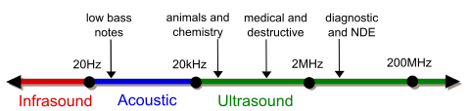
What is Ultrasound???
SOUND, ACCORDING TO FREQUENCY, IS DIVIDED INTO THREE GROUPS:-
<20 HZ = INFRASOUND
20 HZ AND 20 KHZ= AUDIBLE SOUND
> 20 KHZ = ULTRASOUND

Slide 9
LOW FREQUENCY SOUND WAVES RANGE
IN SIZE FROM 3/4” TO 56’
(assuming the average hearing is 16.5 kHz)
HIGH FREQUENCY (ULTRASOUND) SOUND
WAVES RANGE IN SIZE FROM 1/8” (0.34 CM)
TO 5/8” (1.7 CM)
(assuming ultrasound range from 20 kHz-100kHz)

Slide 10
GENERIC DIVISIONS of ULTRASOUND

Slide 11
ADVANTAGES OF AIRBORNE/ STRUCTURE BORNE ULTRASOUND
DIRECTIONAL
LOCATABLE
NUMEROUS APPLICATIONS
COMPATIABLE IN ALL ENVIRONMENTS
EARLY WARNING FAILURE INDICATION
SUPPORTS OTHER TECHNOLOGIES

Slide 12
SOURCE OF ULTRASOUND???
TURBULENCE
FRICTION

Slide 13
APPLICATIONS OF ULTRASOUND BASED ON SOURCE:-
TURBULENCE:
→LEAK DETECTION
DETECTION OF ELECTRICAL DISCHARGES
VALVES AND STEAM TRAP INSPECTION
FRICTION:
→BEARINGS MONITORING
→CONDITION BASED LUBRICATION

Slide 14

TYPICAL APPLICATIONS
PRESSURE / VACUUM LEAKS
COMPRESSED AIR, STEAM LEAKS, HYDRO CARBON LEAKS, SPECIALITY GASES LEAKS
STEAM TRAPS
VACUUM LEAKS

Slide 15
LEAK DETECTION
COMPRESSED GAS LEAKS
COMPRESSED AIR LEAKS
STEAM LEAK
VACUUM LEAKS
SPECIALITY GASES
COSTLY/ INFLAMMABLE/ POISOUNOUS GASES

Slide 16
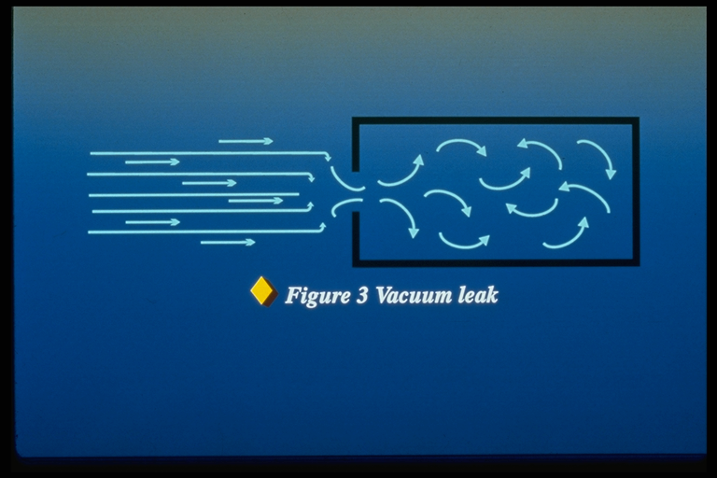
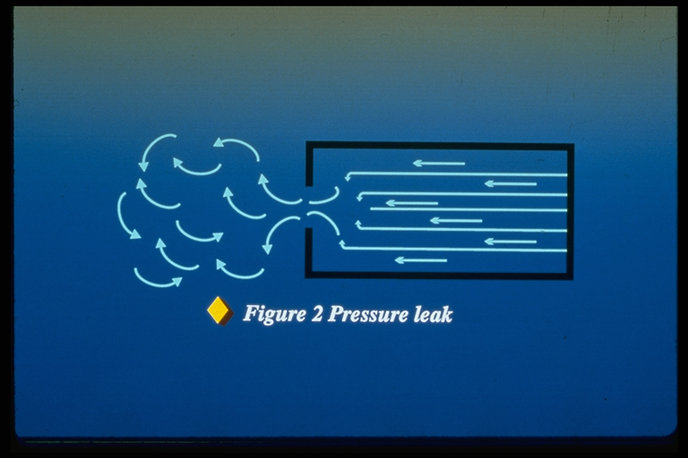
LEAK DETECTION

Slide 17
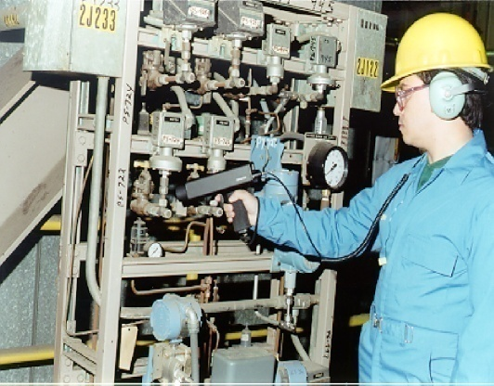
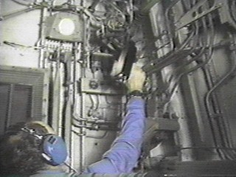
LEAK DETECTION
REASONS FOR ULTRASOUND:
1. ECONOMICS
2. ENVIRONMENTAL
3. SAFETY
Industry | CFM Loss | KWH/day | Savings / Year
Auto | 2134 | 9938 | $457,920
Pharma | 238 | 1146 | $42,896
Glass | 1123 | 5285 | $182,640

Slide 18
LEAK DETECTION
Compressed air costs money! Avoid energy loss by fixing your leaks
  Industry average 31% of energy use can be avoided by just fixing leaks!
  Reduce running hours / wear and tear on existing equipment
  In many cases a lower spec or shut down of a compressor can be the result
Specialty gasses
  Cost avoidance, expensive to buy or produce
  Environmental impact of certain gasses
Production efficiency
  Achieve better efficiency of the process
  Run pressures or vacuum pressures at desired levels
Inflammable gasses
  Even small leaks are hazardous
Toxic gasses
  Can cause ill health or even Fatality in vicinity and surroundings

Slide 19
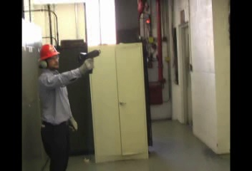
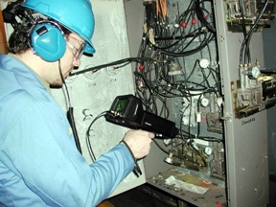
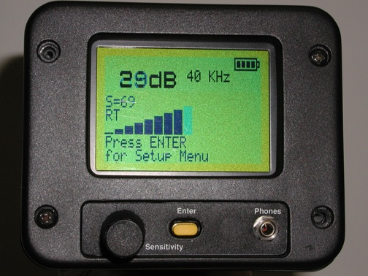
ULTRASONIC LEAK
DETECTOR
Locate the leak
Measure the Leak
Calculate costs
Calculate Greenhouse Gas emission reduction
19
Notes:
This is the BEST method to find leaks! (DEMO GROSS to FINE) Use a volunteer to find nozzle leak.
How do you know where to start your inspection? When entering a room with a known leak it is hard to determine where to start. In order to locate a leak in a potentially ultrasonically noisy environment the inspector must perform a Gross to Fine scanning method. Remember to scan around fittings. It is possible to pinpoint exactly where the leak is coming from if you scan completely around the area of interest.
1. Start at Maximum and Scan at suspected leak area.
2. Reduce Sensitivity and Move Closer to Area
3. Attach Rubber Focus Probe (if necessary)
4. Continue to Move Closer to Loudest Sound Source and Scan While Reducing Sensitivity
5. Isolate the Sound by Moving Up Close and Scan in All Directions to Pinpoint Loudest Signal.

Slide 20
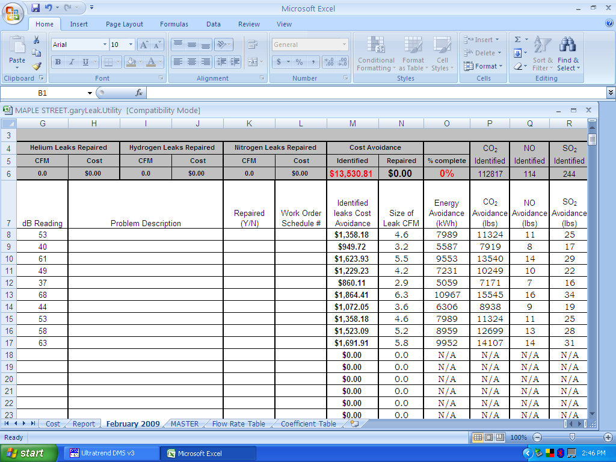
REPORTING SOFTWARE

Slide 21
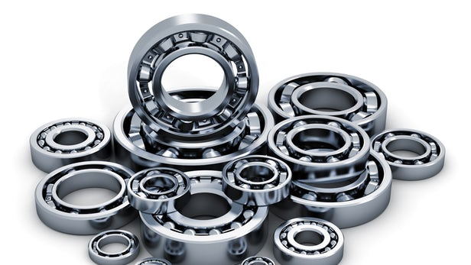
TYPICAL APPLICATIONS
MECHANICAL INSPECTION
BEARINGS -
LACK OF LUBRICATION/FAILURE
BEGNING OF FATIGUE FAILURE
BRINELLING OF BRG SURFACES
SLOW SPEED / VFD
PREVENT OVER GREASING

Slide 22
MECHANICAL INSPECTION with ULTRASOUND
Effective as a sorting tool
Historical trending
Slow speed bearings
Condition Based Lubrication

Slide 23

ULTRAPROBE
Digital Ultrasonic Inspection System
Test
Record
Trend
Analyze
&
Report

Slide 24
LEVELS OF SEVERITY
dB Levels over Baseline
8 dB LUBRICATION
12 dB MINOR DAMAGE-Microscopic faults
16 dB DAMAGE-Visual faults
35+ dB CATASTROPHIC FAILURE IMMINENT

Slide 25
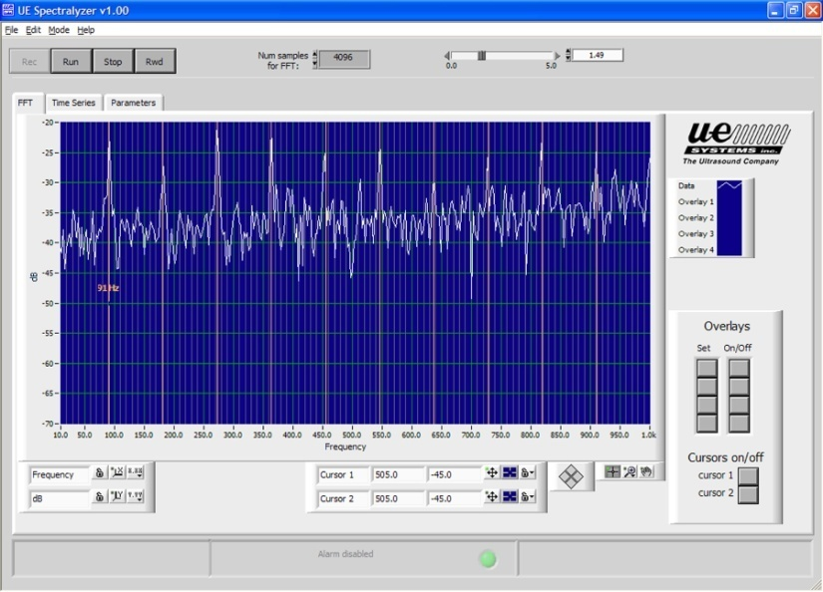
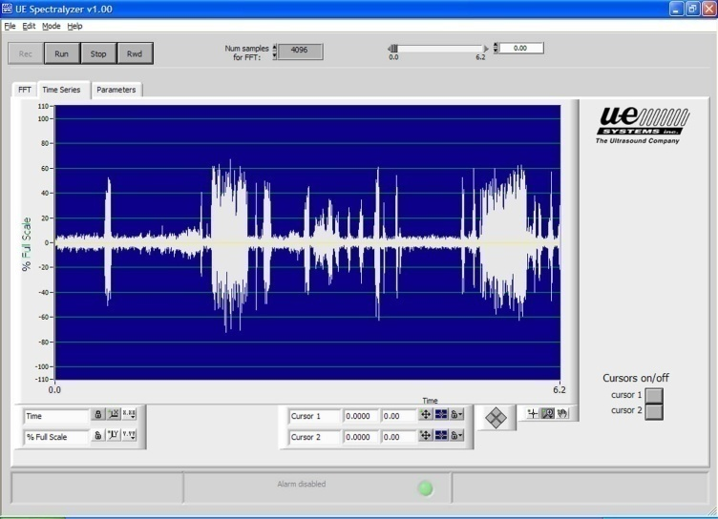
ULTRAPROBE
Digital Ultrasonic Inspection System
UE Spectralyzer spectral analysis software is included with the system. View recorded sounds in Spectral View or in Time Series
Spectral View
Time Series View

Slide 26
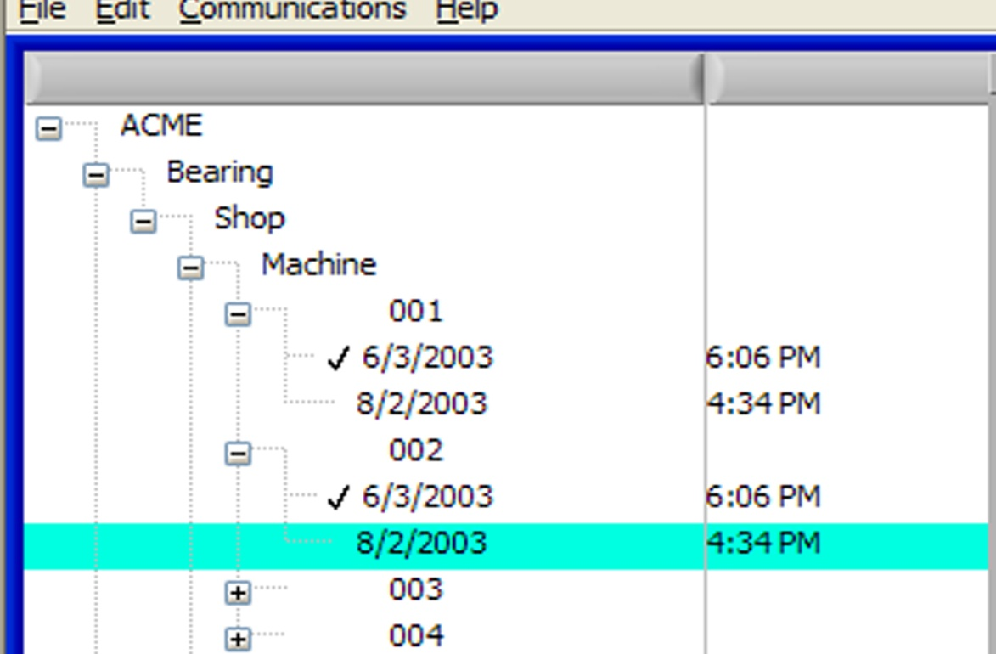
ULTRAPROBE
Digital Ultrasonic Inspection System
Within the Hierarchy all pertinent data can be viewed and analyzed. The Hierarchy is as follows:
Plant
Application
Group
Location
Numbered Location
Number of Records
for a Location

Slide 27
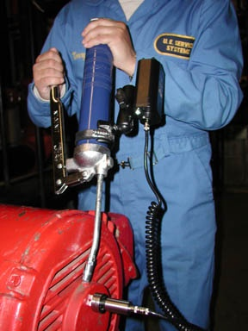
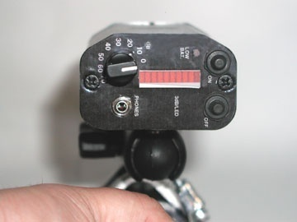
CONDITION BASED LUBRICATION with Ultrasonic GREASE CADDY

Slide 28
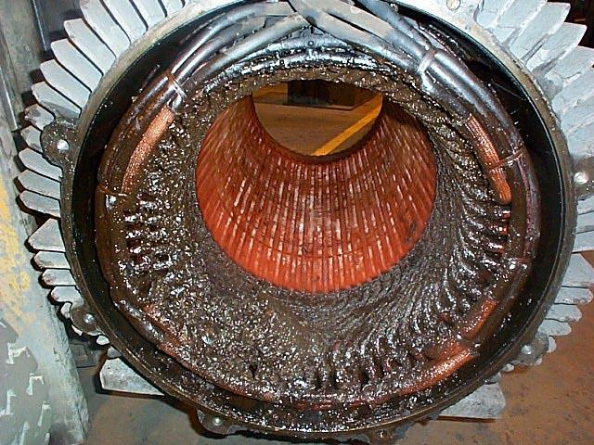
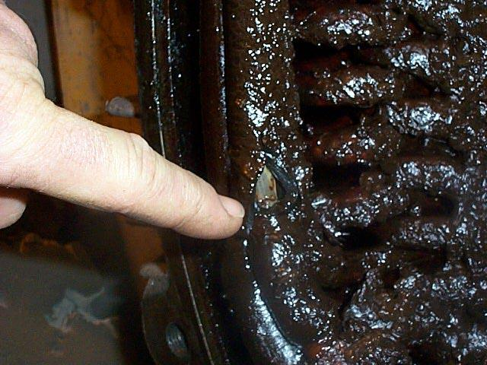
Over Lubrication
Examples Of:
Over Lubrication Bare Wire

Slide 29

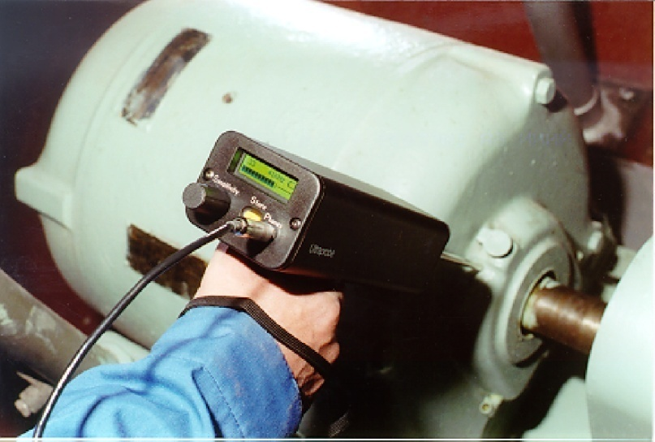
BEARING TESTING
GOOD
SUSPECT
LUBRICATE

Slide 30
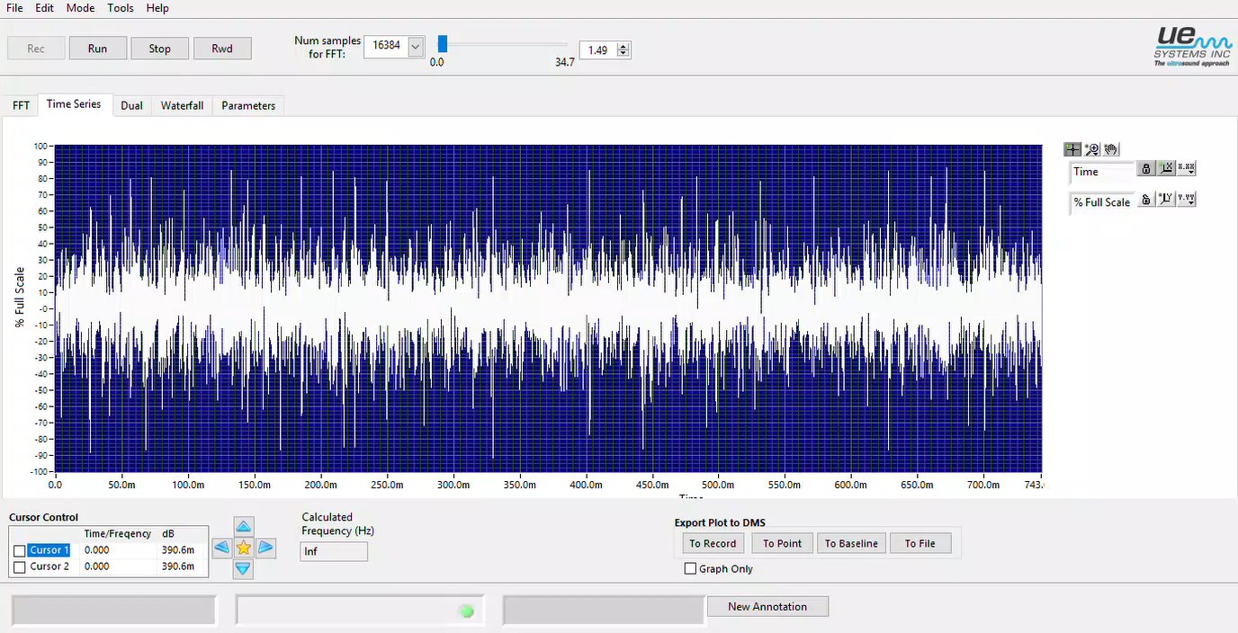
BEARING BEING LUBRICATED:-

Slide 31
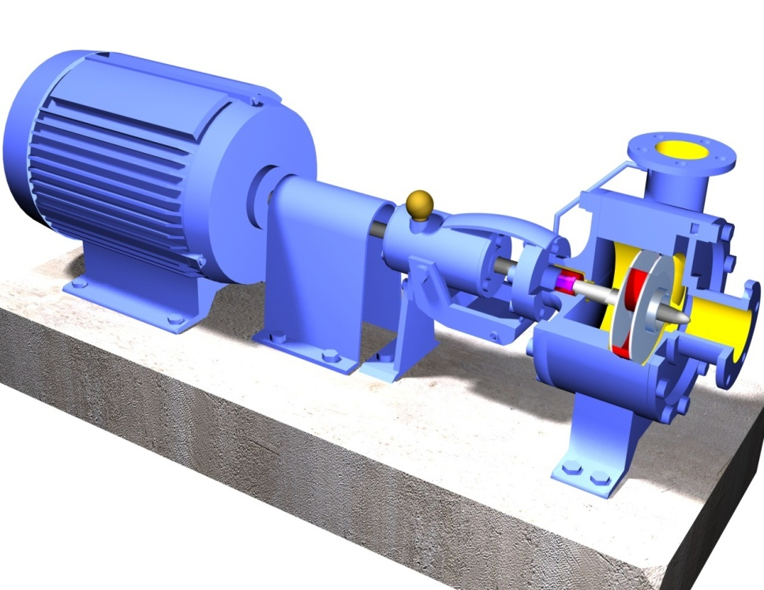
TYPICAL APPLICATIONS
MECHANICAL INSPECTION
PUMPS & MOTORS
GEARS/GEAR BOXES
FANS
COMPRESSORS
CONVEYERS etc

Slide 32
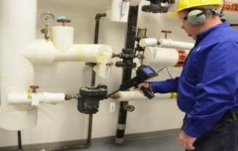
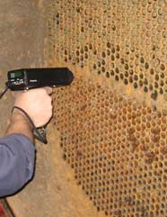
TYPICAL APPLICATIONS
VALVE INSPECTION
VALVE INSPECTION
LEAK DETECTION IN
HEAT EXCHANGERS
BOILERS
CONDENSERS
TANKS
PIPES

Slide 33
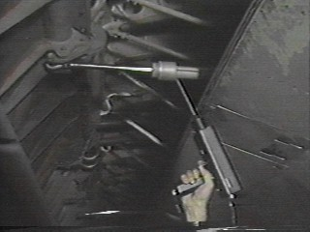
VALVES AND STEAM TRAPS
VALVES EFFECT FLOW - LEAKAGE CAN
EFFECT THE EFFICIENCY OF THE SYSTEM
DETERMINE IF FLOW IS UPSTREAM OR DOWNSTREAM
ALL TYPES OF VALVES TESTED - EVEN WHILE OPERATIONAL
DETERMINE IF A TRAP IS OPERATING PROPERLY

Slide 34

Testing On/Off Valves
A
B
C
D
A=35 dB
B=33 dB
C=32 dB
D=28 dB
Notes:
Valves typically operate two ways. They are either modulating or are an on/off design. Examples of on/off valves would be gate, globe, butterfly, and ball. These valves are used in flow or no flow applications. Modulating valves, such as globe or V-ball are used for controlling flow at all times. The testing procedure for both valves is similar, but testing personnel must identify the type of operation of the valve before testing.
Use four test points on almost all varieties of valves. If you have a tremendous amount of background adjust your sensitivity.
ON/OFF VALVES
On/off valves are usually checked for position, open or closed, or for leakage in the closed position. Valves are tested with the ultrasonic unit utilizing the contact module. The first step in testing a valve for leakage is to visually confirm if the valve is closed or in the off position. The valve is then tested for leakage. This is accomplished by first contacting 2 points upstream of the valve, test point A and B, and adjusting the sensitivity to read about 50 percent of scale. This is called establishing a baseline, The downstream side is then contacted at two test points C & D. The sound intensity of the baseline is compared to test point C. Test point D is measured to insure there is no other ultrasonic sound from downstream of the valve. If reading D is higher than C, this means that ultrasonic sound is being transmitted from a point downstream. This ultrasonic sound must be either tuned out or shut off to get a proper test of the subject valve. If reading D is lower than C, the valve test is valid.

Slide 35

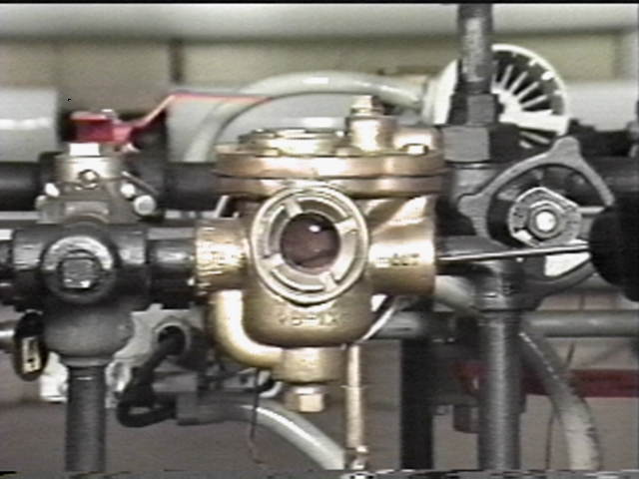
INVERTED BUCKET TRAP
Normal
Failed Open
Bad Linkage
  Early Warning indication
  of Potential Leakage

Slide 36
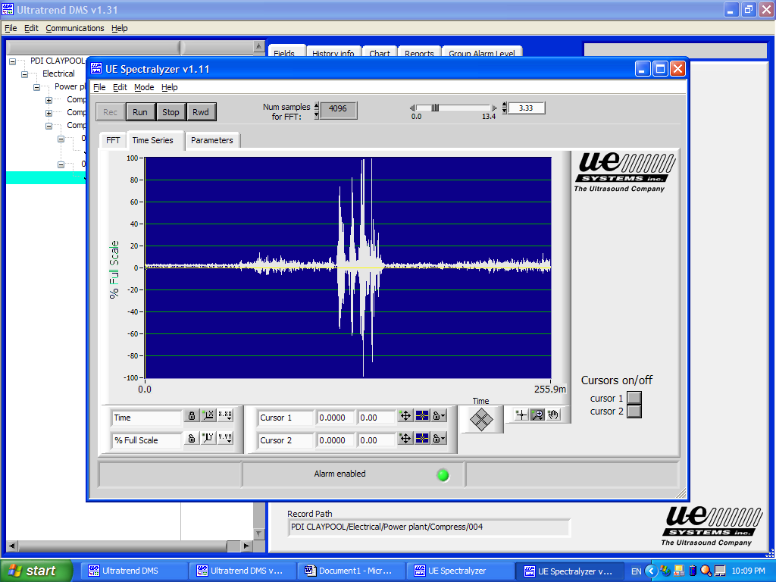
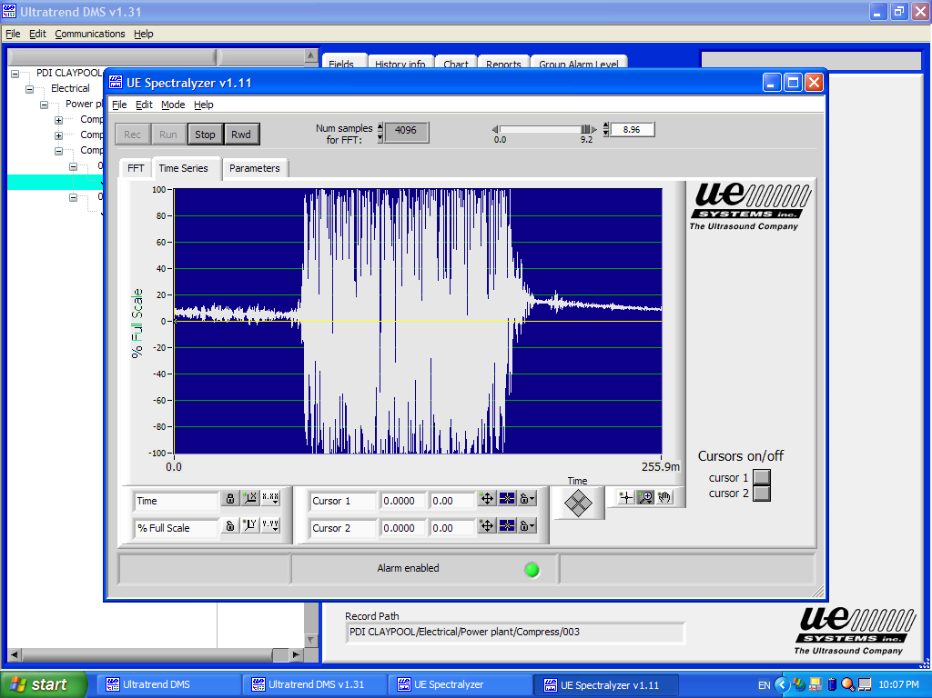
Good Valve – Bad Valve

Slide 37
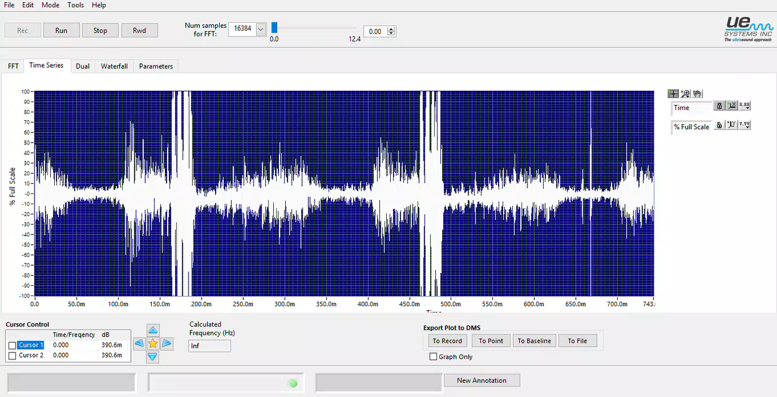
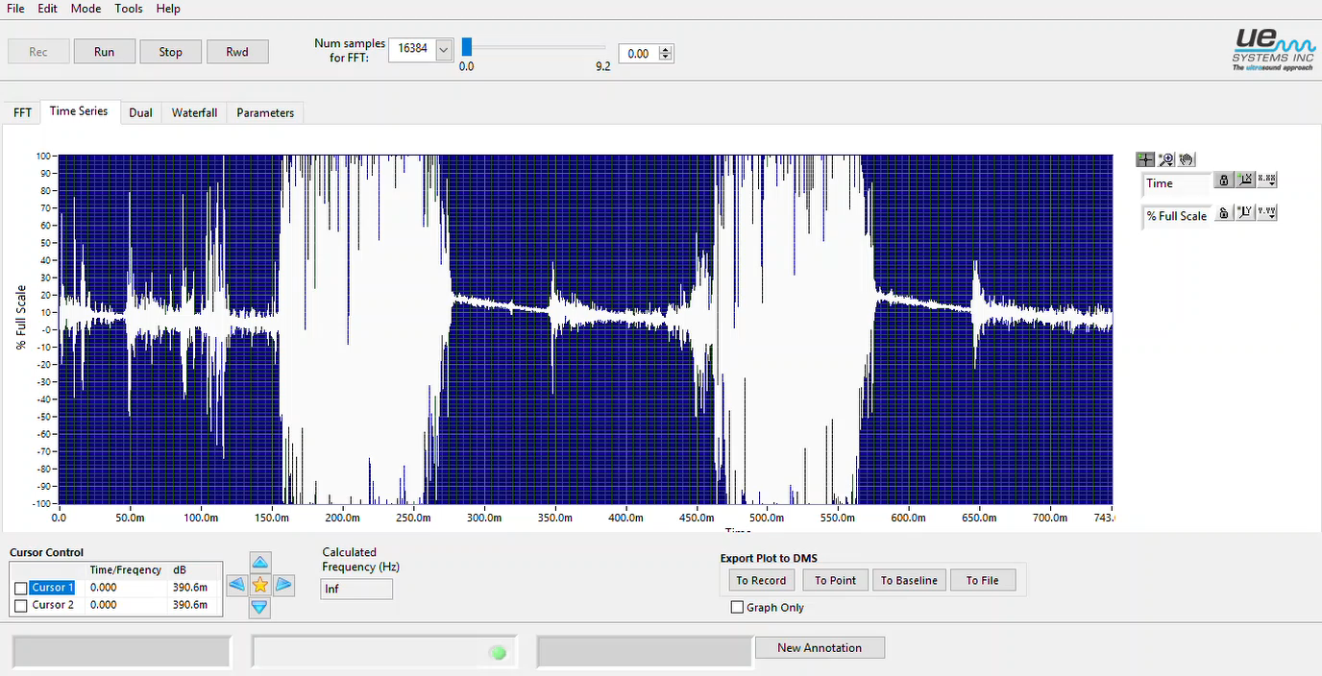
Good Valve – Bad Valve

Slide 38
OTHER APPLICATIONS OF ULTRASOUND TECHNOLOGY
ELECTRICAL ASSETS CONDITION MONITORING
PARTIAL DISCHARGE
CORONA
TRACKING
ARCING

Slide 39
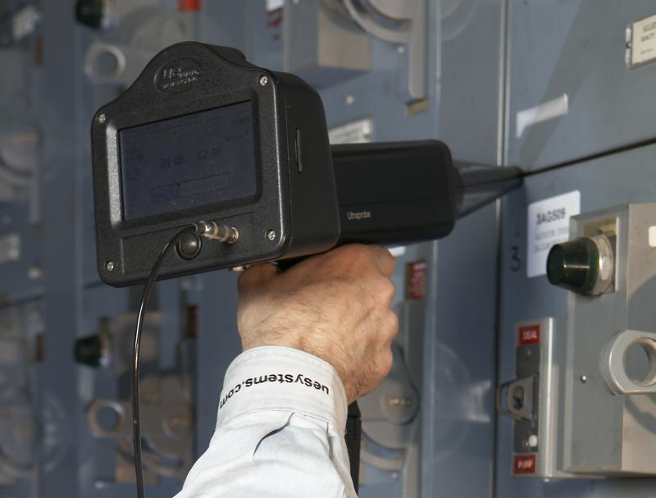
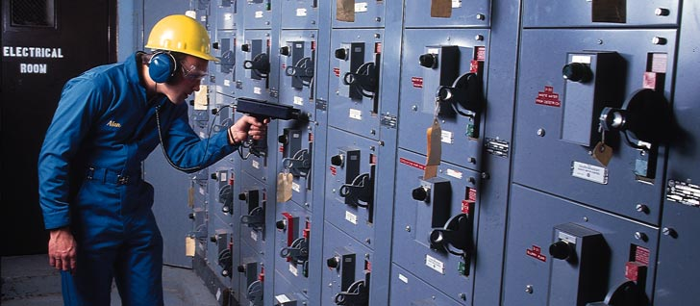
TYPICAL APPLICATIONS
ELECTICAL INSPECTION
Can be effectively used in -
  Switch boards
  Relays
  Transformers
  Motor Terminal boxes
  Switch yards

Slide 40
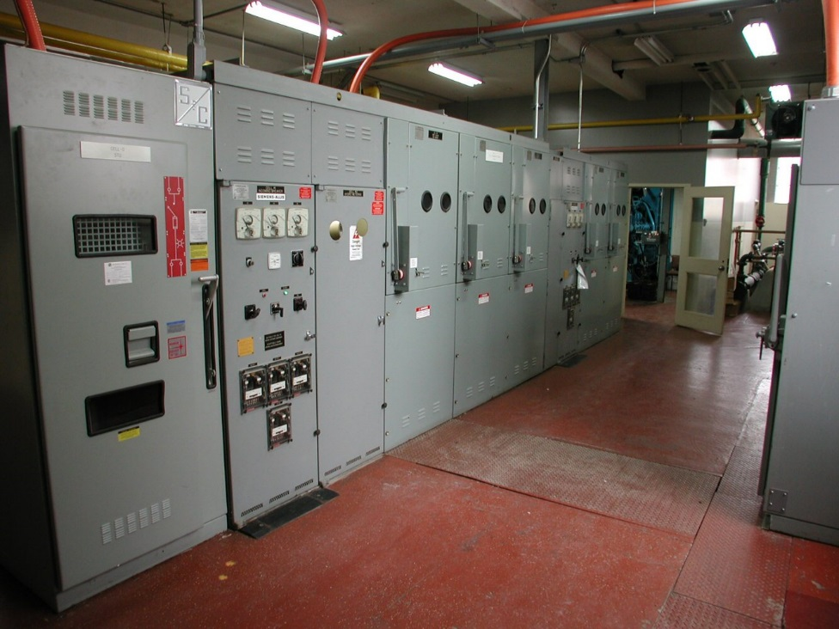
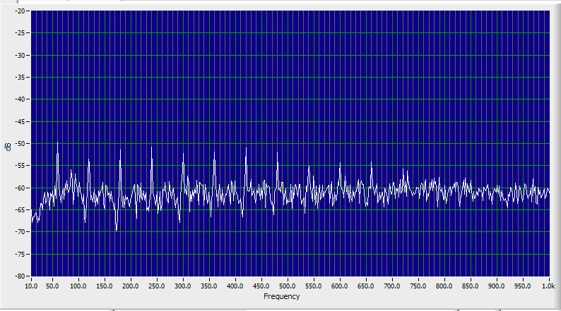
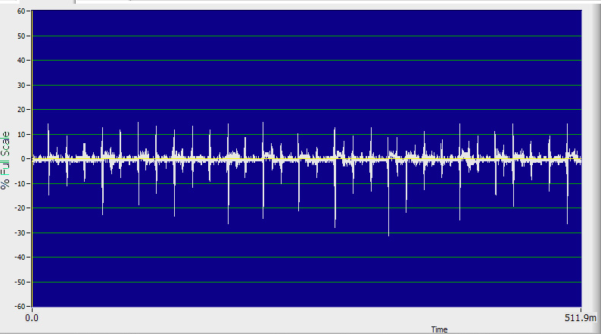
Corona Sound Signature
Corona: Steady Constant Frying Sound
Baseline: No Sound

Slide 41

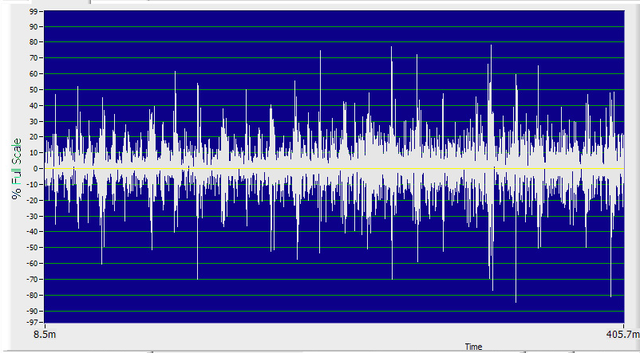
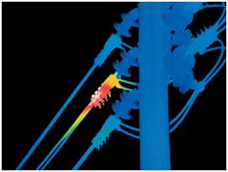
Tracking
Tracking builds in intensity, then discharges. A small temperature difference is not always an indication of a problem using Thermography.

Slide 42
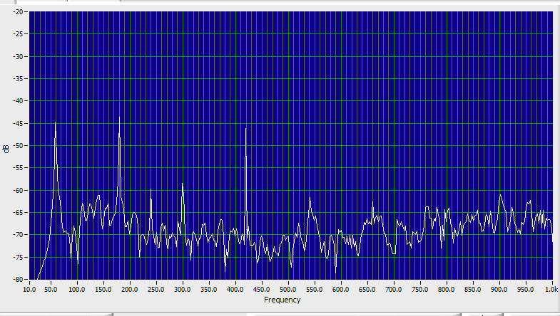

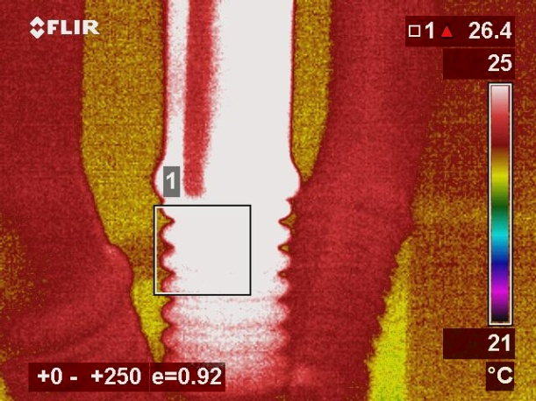
Arcing
Arcing is quick and abrupt. It starts and stops randomly.

Slide 43
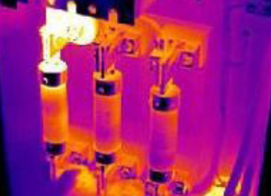
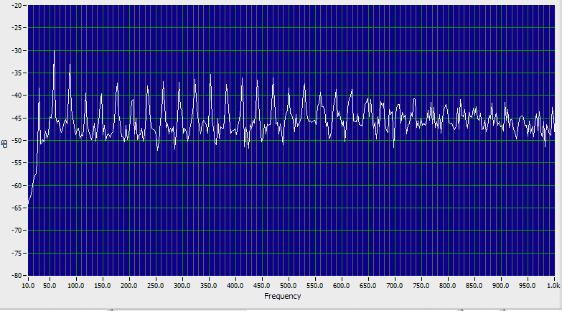
Mechanically Vibrating Components
Often Can sound like corona, but not the 30 Hz Harmonics which are a tell tale sign of a Vibrating Component.

Slide 44
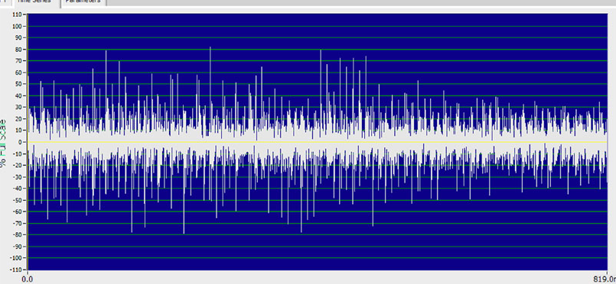
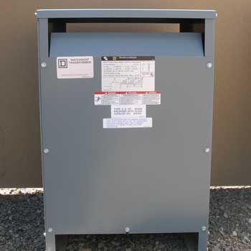
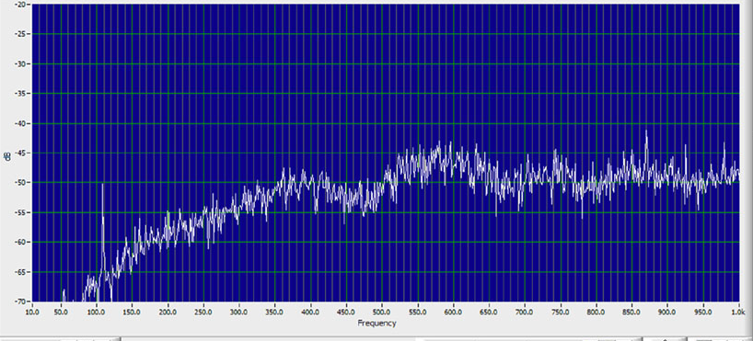
Transformers
Typical Transformer sound

Slide 45
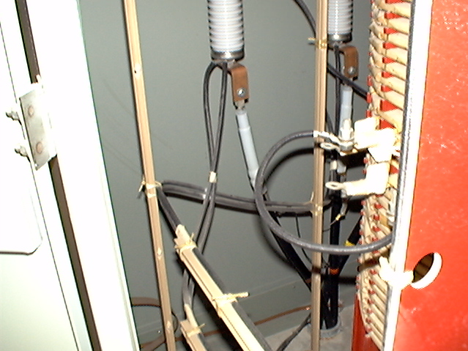
Problem Example

Slide 46
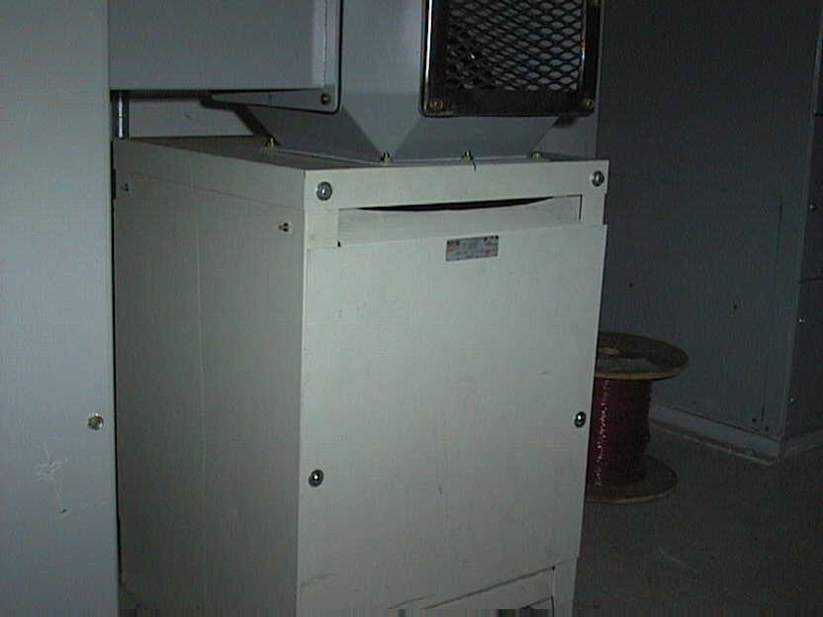
High voltage transformer components are well enclosed.
That makes for poor or sometimes impossible Infrared inspection.

Slide 47
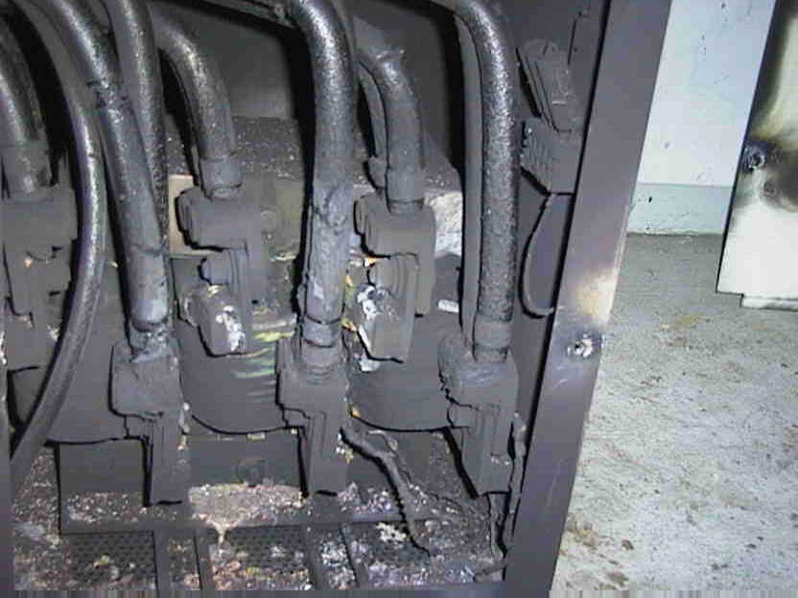
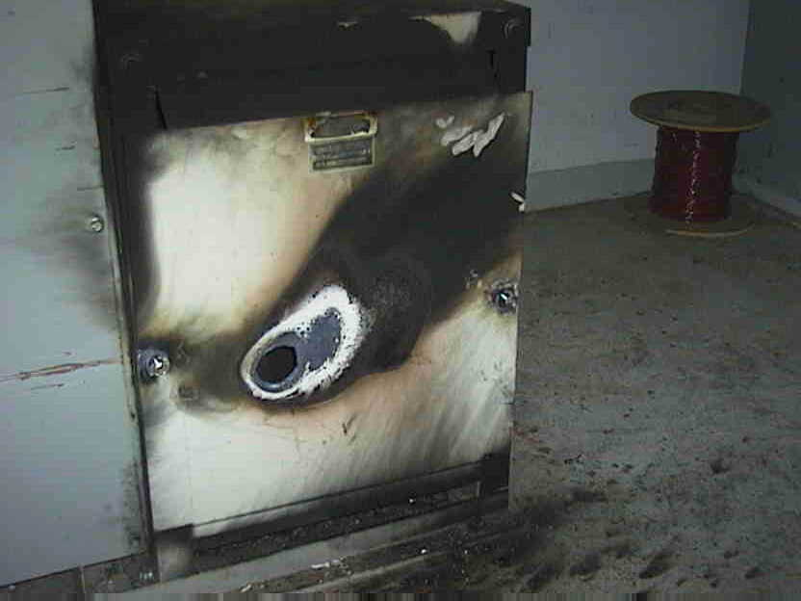
The result…
Can be catastrophic failure.
$
Burned Transformer

Slide 48
SO, WHAT HAVE WE
LEARNED TODAY?
ULTRASOUND IS A VERSATILE TECHNOLOGY
  Energy Audit Tool
  Operation / Process Tool
  Predictive Maintenance Tool - Mechanical
  Predictive Maintenance Tool – Electrical
  Trouble shooting- Root cause finding tool-Hydraulic Components/ Hydraulic schematics
  Trouble shooting- Root Cause finding Tool- Pneumatic Circuits/ components/ Steam and Gas systems

Slide 49
CONCLUSIONS
ULTRASOUND:
  VERSATILE
  SIMPLE TO USE
  AIDS ALL TYPES OF Energy and PDM PROGRAMS
  SUPPORTS OTHER CONDITION MONITORING TECHNOLOGIES
HIGHLY COST EFFECTIVE

Slide 50
GREEN SAILS- INDIA
Condition Monitoring Services
Training Schedule
On-Site Trainings
CONTACT US
TSR Chary Balendra Kumar
contact@greensails.sg balendra@greensails.sg
+65 97558166 +91 - 9869160282
http://www.greensails.sg

