Slide 1
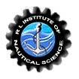

R.L.INSTITUTE OF NAUTICAL SCIENCES
MADURAI

Slide 2

IMPACTS OF TECHNOLOGIES ON HUMAN LIFE
PRESENTED BY
PAWAN KUMAR PANDE B.S. ME IV
JAVVAJI PRADEEP KUMAR B.S. ME IV
P HARSHAVARDHAN REDDY B.S. ME IV

Slide 3
HUMAN SAFETY
CONTENTS
  INTRODUCTION
  IMPACTS OF ADVANCED TECHNOLOGY ON TRANSPORTATION
  IMPACTS OF ADVANCED TECHNOLOGY ON HUMAN HEALTH
  IMPACTS OF ADVANCED TECHNOLOGY IN COMMUNICATION
  IMPACTS OF ADVANCED TECHNOLOGY IN SAFETY

Slide 4
INTRODUCTION
Technology is a key element of life. "Technology can be most broadly defined as the entities, both material and immaterial, created by the application of mental and physical effort in order to achieve some value". Technology has transformed our lives, and is still doing so at an ever increasing pace, reaching every aspect of living.

Slide 5
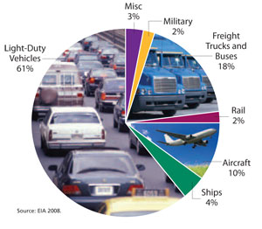
IMPACTS OF TRANSPORTATION

Slide 6
INTELLIGENT TRANSPORT SYSTEMS (ITS)
Add information and communications technology to transport infrastructures and vehicles
Optimize transportation times and fuel consumption thus providing greener and safer transportation
It also includes the use of information and communication technologies (ICT) for rail, water and air transport, including navigation systems.

Slide 7
FUTURE ITS
To design true multi modal ITS (Integrates several data streams from air, land and sea)
The trend in transportation management is to use data to predict future traffic conditions

Slide 8
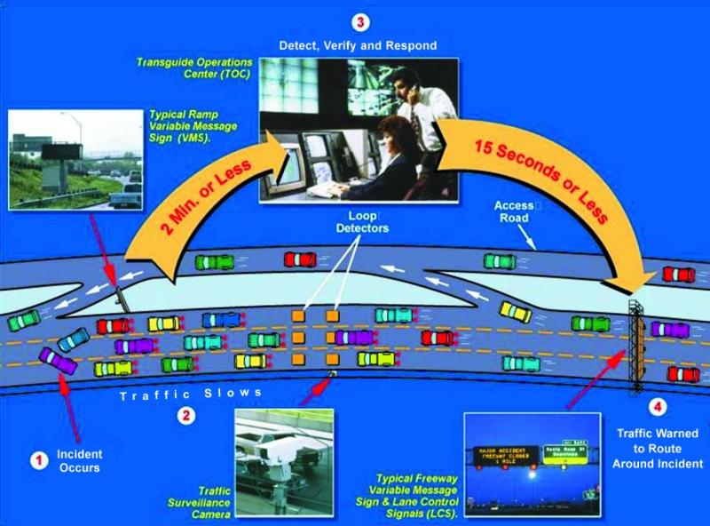

Slide 9
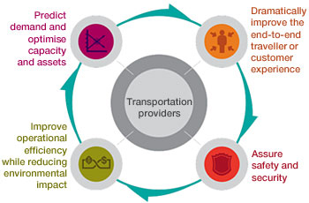

Slide 10
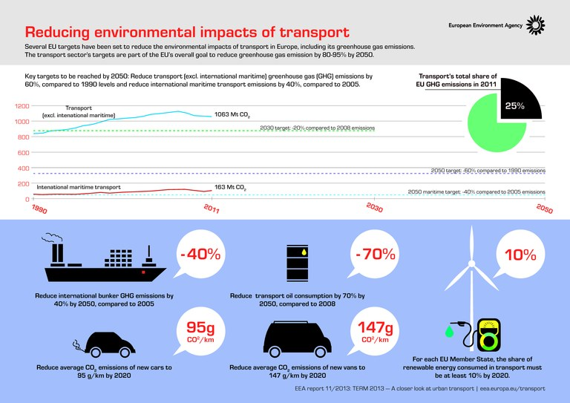

Slide 11
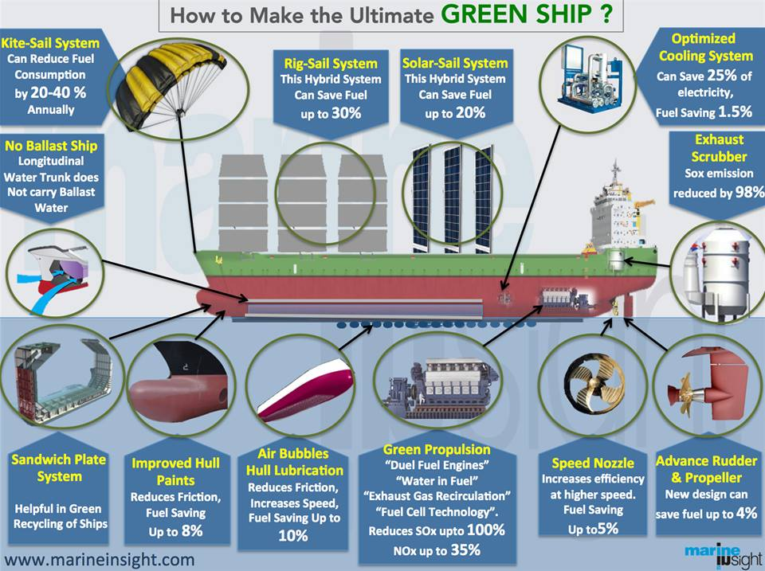

Slide 12
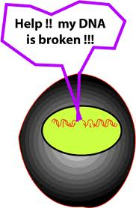

IMPACT OF TECHNOLOGY ON HUMAN HEALTH

Slide 13
DNA
DNA is the main genetic material in living organism, which contains all of the genetic information needed for the growth, development and reproduction of organism.
CAUSES FOR DNA DAMAGE
Physical factors
High temperature
Ultraviolet rays
Other ionizing radiation

Slide 14
Chemical factors
Base molecular Isomerization,
Alkylating agent
Mustard gas
Alkyl sulfate-ester

Slide 15
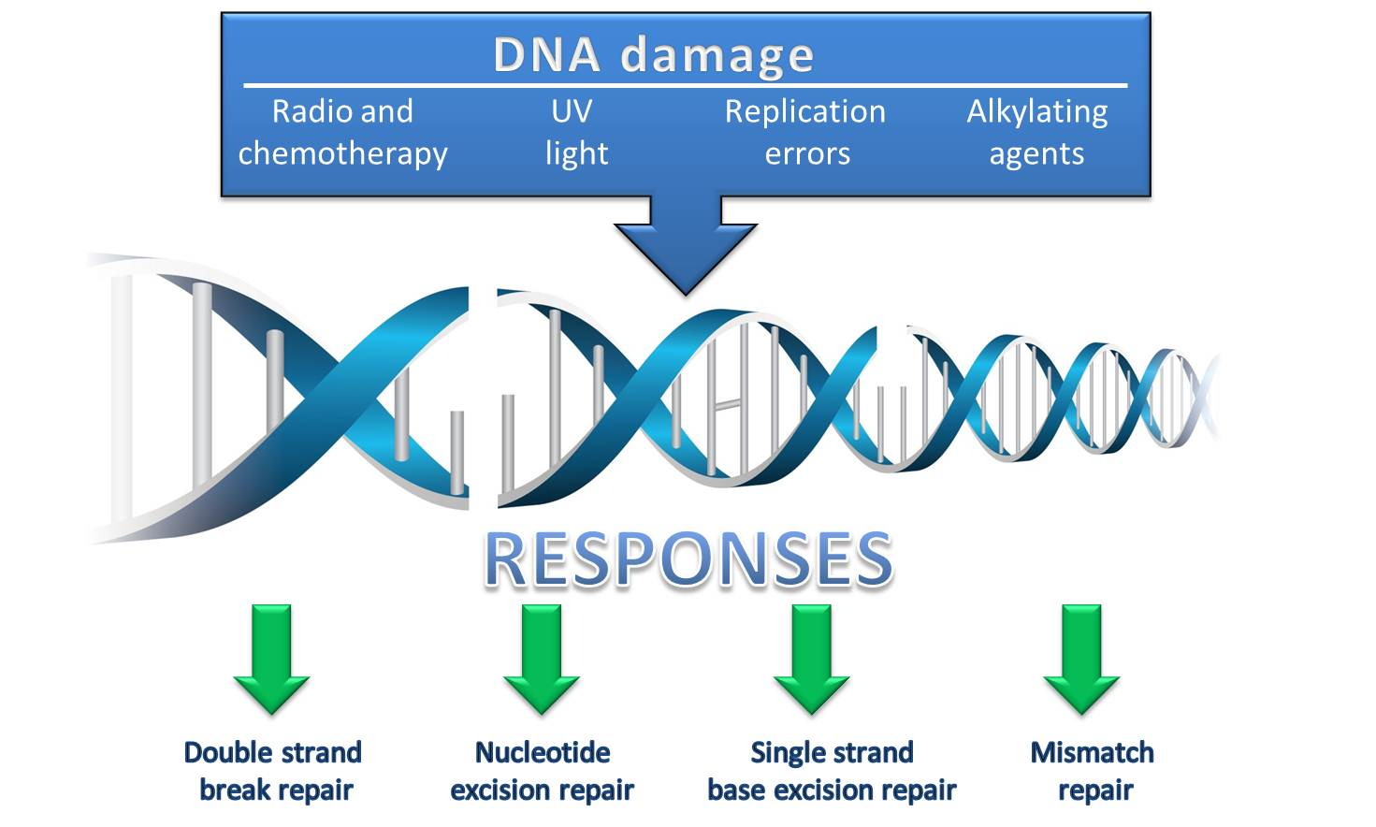

Slide 16
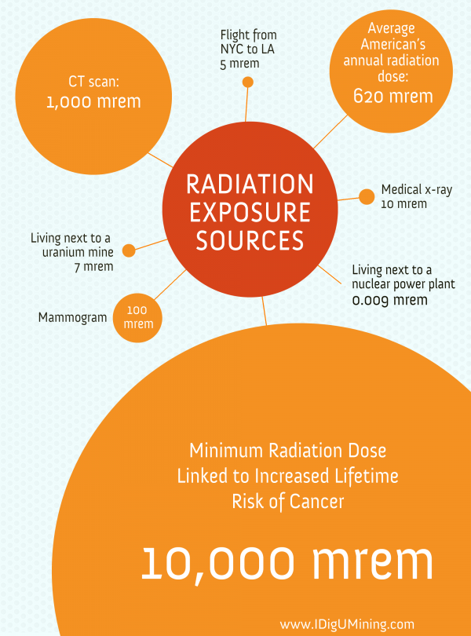

Slide 17
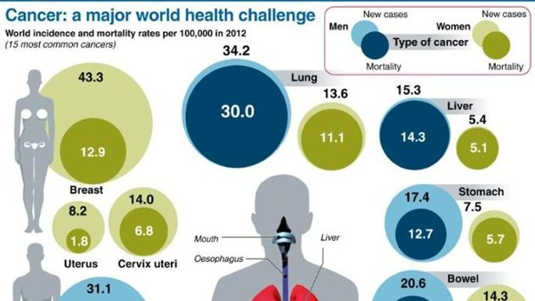

Slide 18
MAJOR TREATMENTS FOR CANCER
Radiation therapy
Chemotherapy
Targeted therapies
SECOND CANCERS OCCURING DUE TO CANCER TREATMENTS
Risk of leukemia
Risk of solid tumors
Prostate cancer

Slide 19
NATURAL PREVENTION / TREATMENTS FOR CANCER
Proper nutrition and clean water
Detoxification
Immune building
Oxygen therapy
Natural chemotherapies
Lifestyle changes: adequate sleep, sunlight & exercise
A positive attitude
Spiritual cleansing

Slide 20
TECHNOLOGIES IN COMMUNICATION
The best and worst part about communication is that it evolves , develops and expands
Technology in communication today is the order of the day
Technology has improved the lives of people
POSITIVE IMPACTS
Communication is online via live chat through Voice over the Internet Protocol (VOIP) & instant messaging (IM).
Bunch of knowledge- i.e. World Wide Web(WWW)

Slide 21
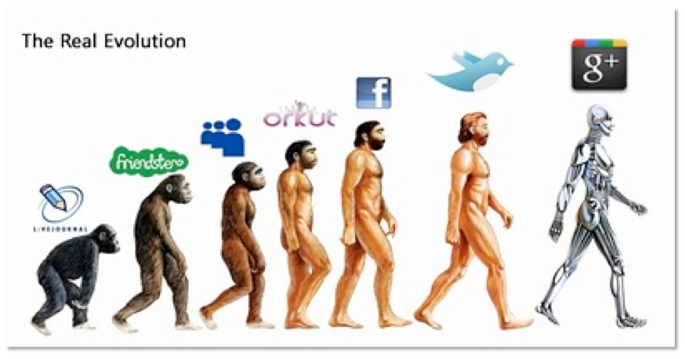

Slide 22
Reduced cost of communication due to day to day improvement of technology
People to interact with different people from all walks of life
Companies employed with new technology have seen
better performances eg. Online advertisement
Organize and maintain the company’s activities eg. Meeting held through Skype
Classroom through video conferencing.
Online recruitment/exam and e-payment facilities without wasting time, energy, paper etc

Slide 23
Satellite communications for fixed services, using microwave radio relay technology. Applications: GPS communications to ships, vehicles, planes etc, TV and radio broadcasting
Social networking : Facebook, Twitter ,MySpace, YouTube etc
NEGATIVE
Brought some unethical behavior in the society both in the individuals and even in business related areas eg. Hacking, money extortion, money frauds etc.
Production and advertisement of fake materials
Can impact personal life - relationship

Slide 24
Sometimes person lacks essential interpersonal skills
Teenagers are more close to online friends, gap between parents and kids has increased
Communicate to unsuspecting beings pretending someone else

Slide 25
TECHNOLOGIES IN SAFETY
More technology leads to requirement of more safety
Safety must be ensured for personnel as well as machines
Safeties in day to day life by using technology
Vehicle safety
Brakes
Air bags
Electronic stability Control
Lane departure Warning
Collision warning with automatic braking

Slide 26
Electrical Safety
Grounding: low-resistance path that connects to the earth.
Guarding : enclosing electric equipment
Circuit Protection Devices: stop the flow of current automatically when ground fault, overload , or short circuit occurs
General
Locate earthquake prone areas
Natural Disaster warning and evacuation system

Slide 27
