Slide 1
Oil-Eating Microbes
Samundra Institute of Maritime Studies
A fight against oil spill
By:
Cdt. Richardson P.A.
Cdt. Soumyajyoti Chaudhuri
Cdt. Tanmoy Nandy

Slide 2
Oil-Eating Microbes
OVERVIEW
Transportation – Advantages and Disadvantages.
Shipping as the most advantageous mode of transportation.
Oil spill as a most challenging environmental effect of shipping.
Oil-eating bacteria as the solution to the problem.

Slide 3
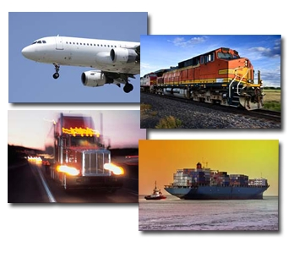
Oil-Eating Microbes
Transportation
Movement of people and goods from one location to another.
Air, rail, road, water, cable, pipeline, and space.
Should not deplete the natural resources and badly affect the environment.

Slide 4
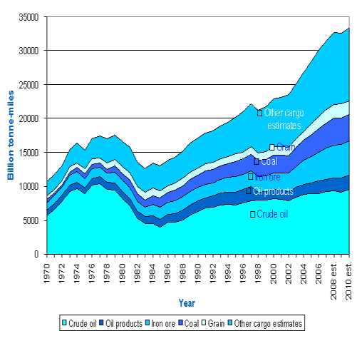
Oil-Eating Microbes
ADVANTAGES OF SHIPPING AS A MEDIUM OF TRANSPORT
90% of world trade is carried by the international shipping.
Transporting every kind of cargo.
8 thousand billion tonne-miles in 1968 to over 32 thousand billion tonne-miles in 2008.
Cheaply transported from countries to countries easily through sea route.

Slide 5
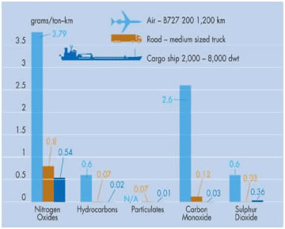
Oil-Eating Microbes
Figure showing comparative exhaust gas emissions

Slide 6
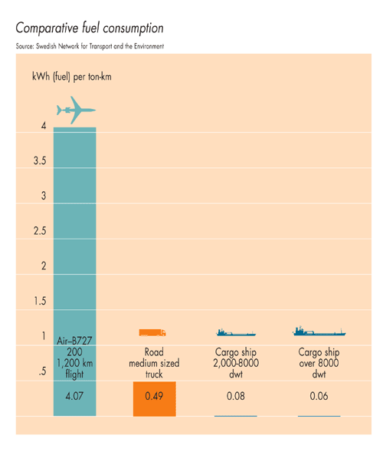
Oil-Eating Microbes

Slide 7
Oil-Eating Microbes
SHIPPING AND ENVIRONMENTAL IMPACTS:
NOx and SOx and carbon dioxide that contributes to air pollution.
Accidental and purposeful oil spill on the ocean’s surface.
Impact of ballast water due to change in habitat of micro organisms.
Disposal of sewage.
Disposal of garbage
Pollution due to paints from the ship’s hull
Noise pollution caused by ships.

Slide 8
Oil-Eating Microbes
OIL SPILLS
An oil spill is the release of a liquid petroleum hydrocarbon into the environment due to human activity, and is a form of pollution..
Sudden, localised release of petroleum into the environment. In the case of major spillages, the quantities greatly exceed what the local environment is able to assimilate without resulting in damages.
An accidental or intentional discharge of oil which reaches bodies of water can be controlled by chemical dispersion, combustion, mechanical containment and/or adsorption and the oil-engulfing bacteria.

Slide 9
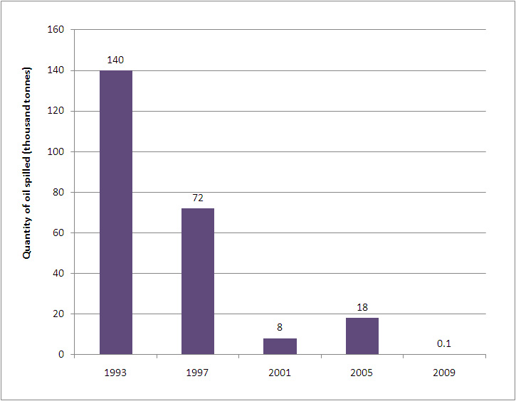
Oil-Eating Microbes
Figure showing the quantity of oil-spill due to shipping

Slide 10
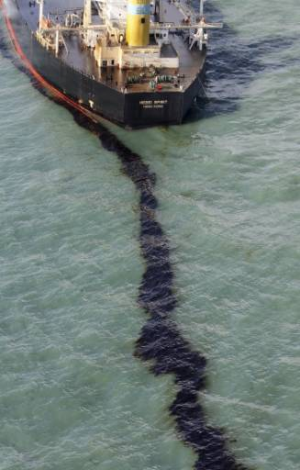
Oil-Eating Microbes
OIL SPILL caused by :
Collision
Grounding
Failure of the hull due to corrosion
Spills while bunkering
Drilling rigs and wells.
Natural oil seeps.

Slide 11
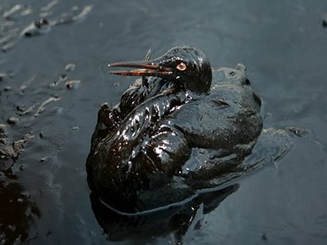
Oil-Eating Microbes
ENVIRONMENTAL IMPACTS:
Beach sand, gravel, rocks and boulders, vegetation and terrestrial habitats of both wildlife and humans
Also kill to a large extent the fish and other food species
Affects the humans in case they consume these infected food stuffs.
Long term ecological effects
Wildlife near the ocean are poisoned by the oil and this includes the reptiles mammals and amphibians in water bodies adjacent to the ocean
Oil traces will remain for a long time.

Slide 12
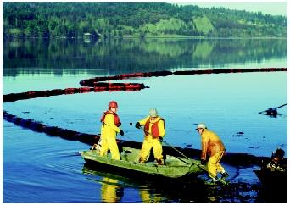
Oil-Eating Microbes
Present methods of clean up
Containment and burning
Skimming
Filtering
Dispersing
Absorbent pads
Bioremediation

Slide 13
Oil-Eating Microbes
TECHNICAL DETAILS ABOUT THE OEM
Advantages of using this method:
n-alkane degradation (which includes metabolism, biosurfactant production and biofilm production).
Eg. CnH(2n+2) + O2 --> nCO2 + nH2O (in presence of oxygen and bacteria).
Nitrogen, phosphorous, sulphur, and other elements in a nutrient-poor marine environment allows for more efficient alkane degradation.
High salt contents and high UV radiation since it thrives mostly in the upper layers in the ocean where UV light is encountered.
Addition of too much fertilizers can create blooms of algae that use up all the oxygen in the surrounding water, creating ``dead zones.''

Slide 14
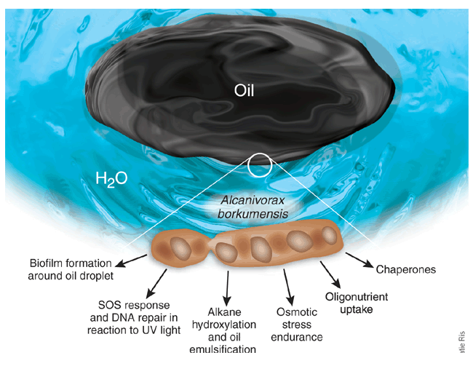
Oil-Eating Microbes
Fig: showing mechanisms for oil degradation and survival encoded by the A.borkumensis.

Slide 15
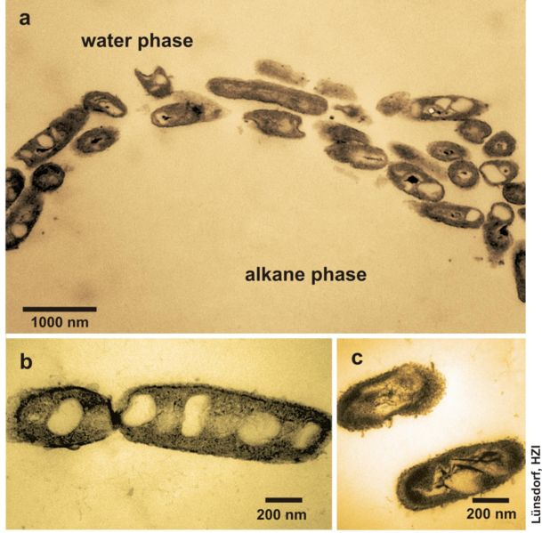
Oil-Eating Microbes
Oil is made up of dozens of different hydrocarbon molecules.
The microbes take in oxygen and hydrocarbons—the carbon-hydrogen molecules in the plume and degrade them out as CO₂ and biological waste.
Another concern has been that the oil-eating microbes could deplete oxygen within the plume. But after taking several oil samples, it is seen the oxygen level is well above the critical range.
Fig: showing the microscopic view of Alkanivorax borkumensis in its alkane phase.

Slide 16
Oil-Eating Microbes
OIL SPILL BEHAVIOUR
Spreads over the water.
Oil rises to the surface of the water
Forms a kind of blanket layer over the water
This layer may get broken up due to the rough weather conditions
Volatile compounds in this spill start to evaporate
20 to 40% reduction in the total mass
Oil remaining highly viscous and very dense
Very small percent of the oil dissolves in water
Part of it sinks with suspended particulate matter.(most difficult to clean)
Remaining oil now becomes sticky tar balls

Slide 17
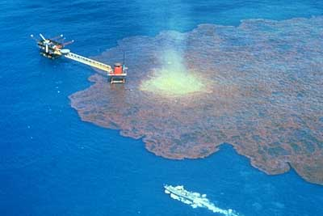
Oil-Eating Microbes
Figure showing spreading of oil on water body forming a thick layer.

Slide 18
Oil-Eating Microbes
METHOD OF USAGE:
Microbes are already available in the ocean in low abundances.
When there is an oil spill the microbes start to exponentially multiply.
The oil serves as nutrients which the microbes use for liberating necessary energy to sustain.
The first step would be to apply dispersants.
Dispersants stimulate bacterial multiplication and it reduces the oil water interfacial tension so that the oils are effectively dispersed as fine droplets.
It is of minimal toxicity and will not add to the environmental damage caused by the oil spills. These would be forms of carboxylic acids.
These make it easier for the microbes to chew on the oil.
The OEM can work in temperatures between 15º to 30º Celsius and pH of 5.5 to 10 for the microbes to work effectively.

Slide 19
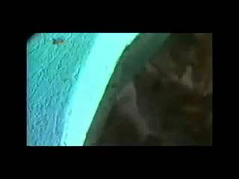
Oil-Eating Microbes

Slide 20
Oil-Eating Microbes
Effective oil-spill clean ups
Oil-Eating Microbes Successfully Cleaned Up Mumbai Oil Spill.
OEM cleaned up China oil spill.
Disappearing oil from the BP spill in the Gulf of Mexico due to OEM.

Slide 21
Oil-Eating Microbes
AFTERMATH OF ENGULFING BACTERIA
Also leaves behind bacterial plume.
Large amount of dispersants that have been dumped into the ocean(OEM chews up the dispersants too)
Give out carbon dioxide after they degrade the oil and this is just adding up to the green house effect

Slide 22
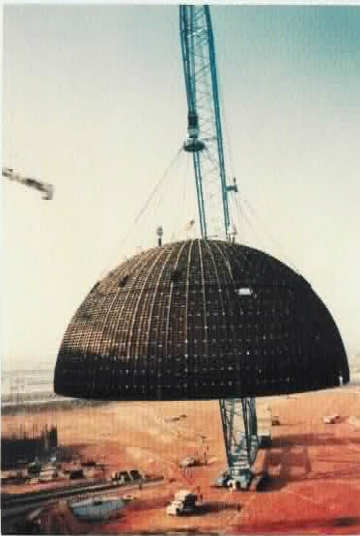
Oil-Eating Microbes
Future scope
Figure showing gigantic oil containment dome.

Slide 23
Oil-Eating Microbes
Conclusion
Oil-eating bacteria could be the key to cleaning oil spills in the sea, without further damage to the environment
Enhancing the proper environment for the bacteria to grow and degrade the oil (hydrocarbon)
More research is still being done to develop a better genetically modified bacteria.
It lives solely on oil and dies after consuming all oil in its surrounding.

Slide 24
THANK YOU

