Slide 1

CARGO INSURANCE & SURVEYING
Gnanananda Mayam Devam Nirmala Spatika Kruthim Aadharam Sarva Vidyanam Hayagrivam Upasmahe!
Meaning: I meditate the lord of Hayagreeva who is the personification of knowledge and Happiness, who is very pure, and who is the basis of all learning

Slide 2
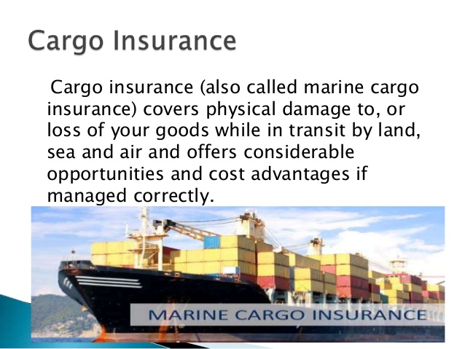
CARGO INSURANCE

Slide 3
TYPES OF CARGO INSURANCE
Open Cover
Specific (Voyage) Policy.

Slide 4
OPEN COVER
This is the most usual type of cargo insurance, where a policy is drawn up to cover a number of consignments. The policy can be either for a specific value that requires renewal once the insured amount is exhausted or permanently open policy that will be drawn up for an agreed period, allowing any number of shipments during this time

Slide 5
SPECIFIC (VOYAGE) POLICY
As against the Open Cover, if a shipper or consignee do not have regular exports or imports, they may take a Specific (Voyage) Policy for a particular shipment . While an Open Cover assures automatic insurance coverage, however, Specific (Voyage) Policy since covers particular shipment, seller or buyer depending upon terms of sale(Inco Terms) have to approach Insurer at appropriate time so that insurance coverage is properly covered.

Slide 6
Marine Insurance Coverage
FORTUITOUS - sea accidents or casualties caused without willful intervention of human (an element of chance or ill luck)
INSURED PERILS
Fire, Pirates and Thieves, Stranding
Barratry - act willfully committed by master and crew against owner or charterer of ship. It is an act of gross misconduct committed by a master or crew of a vessel which damages the vessel or its cargo.
Jettison –throwing of cargo overboard due to either a deliberate act or at the wake of grave danger
Taking at sea –when vessel is captured by enemy or others
Foundering at Sea –ship has been reported lost after a stipulated time
Collision –ship collides with another ship or with other objects, causing damage
UNINSURED PERILS
Wear and Tear, Leakage, Breakage of goods, Inherent Vice, Loss by Rats and Vermin

Slide 7
Types of Losses
TYPES OF LOSSES
  TOTAL LOSS
    ACTUAL TOTAL LOSS
    CONSTRUCTIVE TOTAL LOSS
  PARTIAL LOSS
    PARTCULAR CHARGES
    SUE & LABOUR CHARGES
    EXTRA CHARGES
    SALVAGE CHARGES
  GENERAL AVERAGE LOSS

Slide 8
MARINE CLAIMS
Insurance Product as you all know is intangible in nature.
Hope I do not to elaborate on intangible nature
Product Marketing Vs Service Marketing
Say for eg. When you sell a computer, you can give a demonstration.
Unfortunately this is lacking in Service Marketing.
How difficult is Service Marketing ??
Hats off to those involved in Service Marketing, be it Freight or Insurance Products or Banking products.

Slide 9
MARINE CLAIMS MANAGEMENT
Quality of an Insurance Product can be evaluated only during claims management.
As against , Product Marketing Tangible nature to some extent can be felt only during claims handling by an Insurer.
Hence an efficient management Claims Management is over emphasized.
Claims Management is not an one man show and unless all stake holders take active role.
Let me add in following slides, Surveyor’s perspective.

Slide 10
Marine Claims – Major Areas
Chronology
Nature of packing
Nature of Damage/Loss
Cause of Damage/Loss
Claim against parties responsible for damage/loss
Exclusions
ICC Clauses ‘A’, ‘B’, and ‘C’
Documents

Slide 11
Chronology
Commencement of journey or voyage
Date arrived at place of destination
Date of Delivery
Date of notification of loss
Date survey held
Notes:
This data will enable Insurer to decide if Insurer has any liability or otherwise. In the case of Overseas Marine Transit, 60 days time limit from date of arrival of vessel/landing. In the case of local transit or domestic transaction, 7 days only avilable.

Slide 12
Nature of Packing
Packing plays vital role in Claims Handling.
Whether the packing is customary or adequate in nature to withstand transit hazards.
Lloyds Hand Book of Survey gives customary packing for various cargoes.
Inadequacy or insufficiency in packing will place an Insurer to repudiate the claim, vide General Exclusion Clause, which we will see later.
Notes:
When I commenced my independent profession there was a consignment of capacitors (made of porcelain) despatched from Mumbai to Chennai in a truck . They just kept on a wooden pallet and wrapped a polythene sheet. There were lots of breakages. I said the packing was not adequate and customary and hence claim may be inadmissible.

Slide 13
Nature of damage/loss
Here again detailed descriptive of nature of damage or loss has to be insisted
Damage is only a general term.
Specific damage has to be described, like drum dented/holed and part contents spilt/leaked out.
Similarly, machinery part dented/bent or broken etc.

Slide 14
Claim against the parties responsible for loss/damage
Insured must prefer claim against third parties responsible for loss/damage like Transporter or Port or Airport or CFS
Very many Insureds ask, when they insure with Insurance Company, why should they claim against third parties ?
This monetary claim against third parties will facilitate Insurer to go for recovery. If Insurer’s recovery right is not firmly protected, Insurer may settle a claim after deducting certain percentage.
Notes:
Non standard claim. I have never come across in any Text Book on Marine Claims on Non – Standard claim. But in practice most Insurers follow this.

Slide 15
Exclusions
Willful misconduct.
Ordinary leakage, loss in weight and volume.
Insufficiency or unsuitability of packing.
Ordinary wear and tear
Inherent vice or nature of subject matter
Delay, even if caused by an insured peril.
Weapon of war using atomic or nuclear fission/fusion radio active force or matter

Slide 16
Exclusions – Contd.
Deliberate damage to or deliberate destruction of subject matter (in B & C clauses)
Un-seaworthiness or un-fitness of vessel, conveyance, container
War risks
Strikes, Lock outs, Civil Commotions

Slide 17
Institute Cargo Clauses A, B & C
SR.NO. | RISKS | A | B | C
01 | FIRE/EXPLOSION
02 | STRANDING/SINKING
03 | BARRATRY/JETTISON
04 | COLLISION
05 | THEFT/PILFERAGE/ND |  | x | x
06 | SHORTAGE |  | x | x

Slide 18
Institute Cargo Clauses A, B & C Contd.,
SR.NO. | RISKS | A | B | C
07 | CONTAMINATION |  | x | x
08 | HEAVY WEATHER |  | x | x
09 | SPONTANEOUS COMBUSTION | x | x | x
10 | WAR/STRIKES/INSTABILITY |  | x | x
11 | TERRORISM/PIRACY | x | x | x

Slide 19
Institute Cargo Clauses A, B & C Contd.,
SR.NO. | RISKS | A | B | C
12 | G.A. SACRIFICE
13 | EARTHQUAKE/VOLCANO/LIGHTNING |  |  | x
14 | LOB/WASHING OVER BOARD |  |  | x
15 | DISCHARGE IN PORT OF REFUGE/DISTRESS

Slide 20
Institute Cargo Clauses A, B & C Contd.,
SR.NO | RISKS | A | B | C
16 | ROUGH HANDLING(BURSTING OF BAGS, BREAKAGE, LEAKAGE,SWEAT, CONDENSATION, RAIN WATER, IMPROPER STOWAGE ETC |  | x | x

Slide 21
Documents
Insurance Policy
Invoice Copy
Damage certificate from carrier
BL/LR/AWB/RR copy with endorsement
Monetary claim on carrier
Carrier’s reply or AD slip
Packing List
Claim Bill

Slide 22
CASE STUDY ON A CLAIM OF RUSTY STEEL COILS
M/s. Mercury Manufacturing Co. Ltd., Tambaram, Chennai imported 20 Nos. Cold Rolled Steel Sheet in coils weighing 110.03 MT from China.
Coils arrived per m.v.”ROSBORG”(arrived Chennai on 27th October, 2011)
Import discharge took place between 29th October, 2011 and 09th November, 2011 at South Quay No.1 (an open berth)
Said importer cleared their consignment on 20th November, 2011.

Slide 23
Case Study – contd.
M/s. Mercury Manufacturing Co. Ltd.,Tambaram, Chennai imported 20 Nos. Cold Rolled Steel Sheet in coils weighing 110.03 MT from China.
Coils arrived per m.v.”ROSBORG”(arrived Chennai on 27th October, 2011)
Import discharge took place between 29th October, 2011 and 09th November, 2011 at South Quay No.1 (an open berth)
Said importer cleared their consignment on 20th November, 2011.

Slide 24
Case Study – Contd.
On 28th November, 2011 consignee served a provisional monetary claim on Ship’s Agents for a sum of USD 97000.71 as coils were received in rusty condition by RPAD duly received by Agents on 29th November, 2011.
On 30th November, 2011, we received survey intimation from M/s. Ingosstrakh, P & I Claims Dept, Russia to survey and report upon cause, nature and extent of damage.
By the time we received survey intimation, vessel had already sailed, consignment cleared from Port and we could only collect various information from Agents.

Slide 25
Case Study – Contd.
Salient facts collected:
Invoice dated 30th August, 2011.
Shipment loaded on board on 05th October, 2011 at Shanghai.
B/L is clean without any clause.
Pre-shipment inspection by an Independent survey Agency at Shanghai stated that cargo stored at open yard covered by tarpaulin before shipment. Though they recommended certain clause in M/R. However, B/L was issued clean.
Disport Survey Report indicated cargo landed apparently sound except load port remarks.

Slide 26
Case Study – Contd.,
Normally P & I Surveyors conduct Joint Survey within Port premises along with other concerned surveyors.
But in this case, since consignment already cleared from Port premises and vessel also already sailed out, we informed consignee that we will do survey strictly without prejudice and independent in nature.
We normally carry a bottle of Silver Nitrate Solution(0.01 N – AgNo3) to ascertain saline reaction on rusty surface. In this case spot Silver Nitrate Test showed negative saline reaction. But besides spot test, we also drew wet packing materials and rusty particles scrapped from coil for independent chemical analysis. Chemical Analysis also confirmed negative saline reaction.

Slide 27
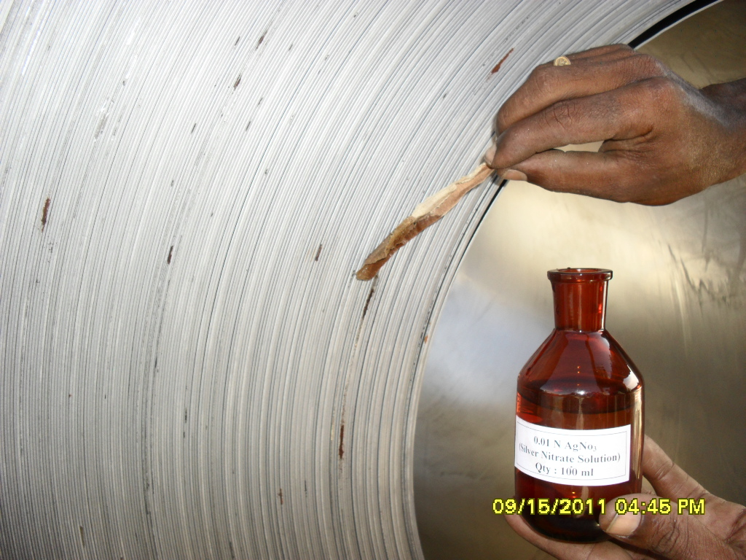
Case Study – contd.,

Slide 28
Case Study – contd.
Out of 20 Coils, 3 Coils were sound, 7 Coils partly rusty and 10 coils severely rusty.
Further from the degree of rust, it was not throughout entire circular winding, but confined to section of windings.
Prior to our attendance, on 24th November, 2011, Surveyors from Lloyds Agents carried out survey and indicated loss seemed to be pre-shipment in nature.
Accordingly, they repudiated claim.

Slide 29
Case Study – contd.,
Conclusion:
Both spot Silver Nitrate Test and Lab analysis confirm negative saline reaction.
Invoice dated 30th Aug., 2011 and shipped on board 05th Oct.2011. Indicative shipment was awaiting pre-shipment storage.
Pre-shipment survey indicated cargo lying in open warehouse covered by tarpaulin.
Coils packed with G.I sheeting and hence any water seepage into coils not visible.
Discharge took place between 29th Oct.2011 and 09th November, 2011 and delivery from Port held on 20th November,2011.

Slide 30
Case Study – contd.,
Coils discharged at South Quay No.1 , which is an open berth.
During the period of discharge, it was monsoonal with intermittent rains.
From the degree of rust, it was not through out entire circular winding, but confined to section, indicating that the coils may be subjected to stagnated rain water during storage.
In view of foregoing, we opined loss/damage might not be due to operation of maritime peril.

Slide 31
Conclusion
When I presented this Case Study in our Institute Seminar, an Insurance Company Manager challenged that once a Ship owner issued a clean Bill of Lading, it is their duty to bear the loss.
In some cases, for commercial compulsions, shippers issue LOI to Master and obtain clean B/L.
Though this is done in practice and according to Professor Tetley, the letter of indemnity given by the shipper to the carrier in exchange for the clean bill of lading has been held to be unlawful, and therefore been treated as unenforceable by some courts.
For any profession, continuous improvement is required and Surveyors have no exception. I feel achieving perfection is more akin to walking towards horizon. Every day is a new beginning and new experience.
I hope my presentation is informative.

