Slide 1
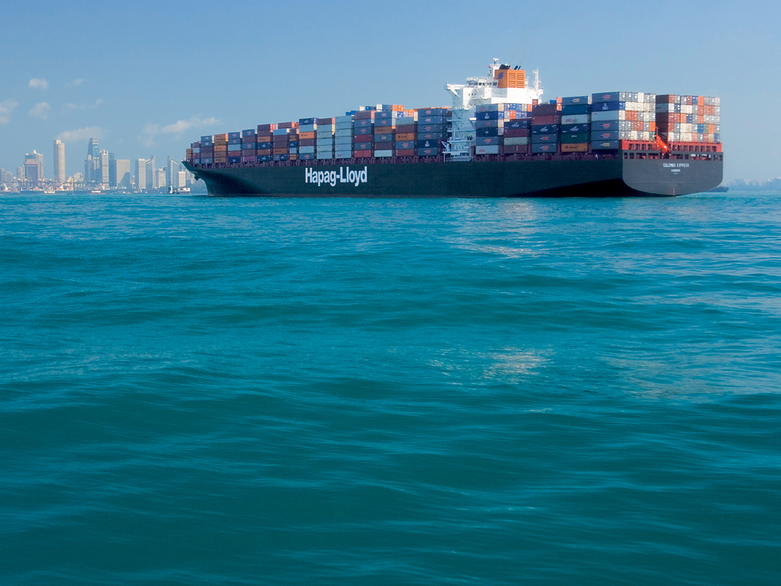

.
AIR BUBBLE LUBRICATION
“SHIP’S MAGIC CARPET”
BY,
Cdt. Paritosh Manjrekar
Cdt. Shreyas Desai
Cdt. Yogesh Jamwal

Slide 2
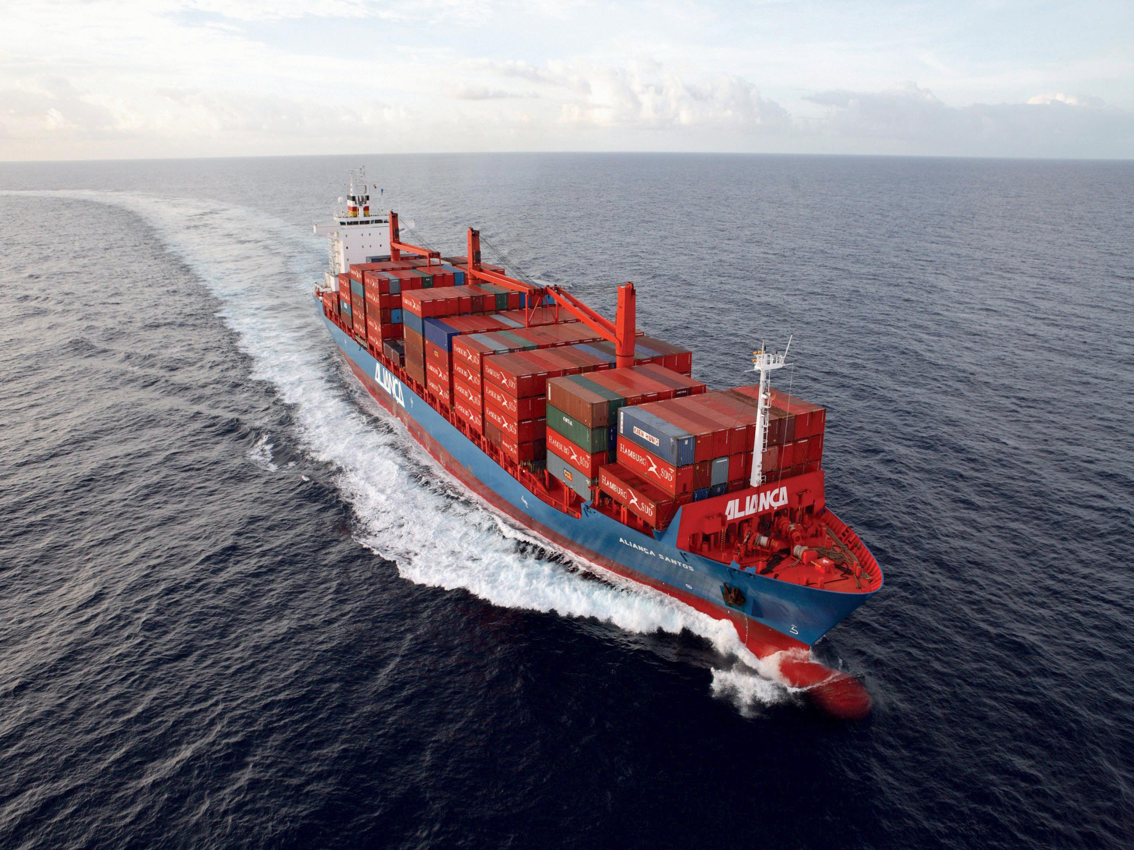
OVERVIEW
* INTRODUCTION
* NECESSITY
* SOLUTION
* WORKING
* CASE STUDIES
* INSTALLATIONS
* CONCERNS AND SOLUTIONS
* CONCLUSION
* REFERENCES
2

Slide 3
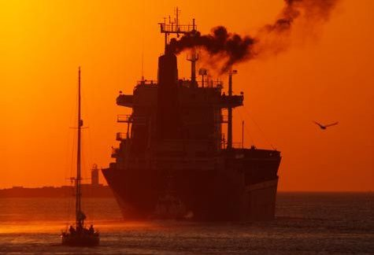
INTRODUCTION
CONCERNS ON AIR POLLUTION
Notes:
Emission by ships are continuously growing, while land based emissions are gradually coming down.
•If proper measures not taken by 2020 shipping will be the biggest single emitter of air pollution.
• So, it can help in meeting the future MARPOL Annex 6 regulation

Slide 4

Significance of Air Pollution
Emission by ships
Land based emissions
Threat in the future.
Largest emitter.
Difficulty in being under the limit imposed by regulatory bodies (MARPOL Annex 6)

Slide 5

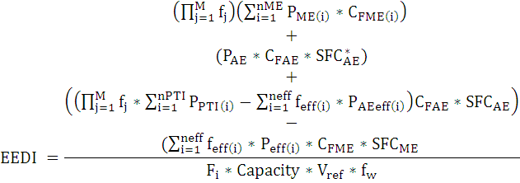
EEDI’S FORMULAE
Emission From
Main Engine
Emission From Auxillary Engine
CO2 from Shaft Motor
Energy Saving Devices
Innovative Technologies
*fc
PME: main engine power (kW)
PAE: auxiliary engine power (kW)
SFC: Specific fuel consumption (g/kW)
Cf: Fuel to CO2 factor (g Co2/g Fuel) (nearly 3)
Capacity: for cargo ships DWT, for passenger ships GT
Vref: reference speed (nm/hour)
f i: correction factor for capacity
f w: correction factor for performance in real weather
f j: correction factor for efficiency

Slide 6
PHASES OF IMPLEMENTATION
Reference Line = Phase 0 (2013 & 2014)
EEDI
No reduction
Attained EEDI < Required EEDI
Phase 1
2015 - 2019
10%
20%
Phase 2
2020 - 2024
30%
Phase 3
on and after 2025
DWT

Slide 7

FUEL PRICE
•
Notes:
For example the fuel consumption of a large ship at normal speed is around 200 tones per day.
•Assuming the cost of heavy fuel oil around $400/mt i.e. for 200 tones cost is $80000 per day.
• Approximately for 1year cost of fuel oil would be $2920000•
•Mitsubishi Air lubrication system(MALS) on ‘Yamatai’ & ‘Yamato’ of NYK lines has proven to reduce oil consumption upto 6-10%.
•i.e. saving of $175200

Slide 8

LET’S DO SOME MATH!
For example,
The average fuel consumption =36 tones/day
Assuming FUEL PRICE = $700/metric tonne
FUEL PRICE of 36 tones = $25000/day
FUEL PRICE for 1 year = $9 million approx.
Notes:
The major area of sulphur existence in ships is the fuel. Sulphur oxide is formed by oxidation of sulphur in the fuel. SOx as a product of combusting fuel oil can be reduced by decreasing the sulphur content in the fuel supplied to the vessel

Slide 9

WHAT NOW?

Slide 10

Solution ?
SOLUTION
Air bubble lubrication system has proven to reduce oil consumption up to 10%
i.e. saving upto
$ 1 MILLION
Per annum
Modular carrier ship ‟YAMATAI”

Slide 11
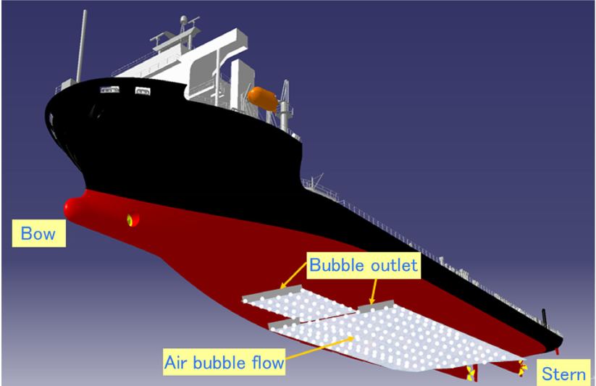
WHAT IS AIR BUBBLE LUBRICATION SYSTEM?
Notes:
It’s a system which reduces hull friction by blowing out constant layer of small air bubbles along the bottom of ships hull Imaginatively linked to a ‘magic carpet’ the ship rides on.

Slide 12

Let’s get to the working.

Slide 13

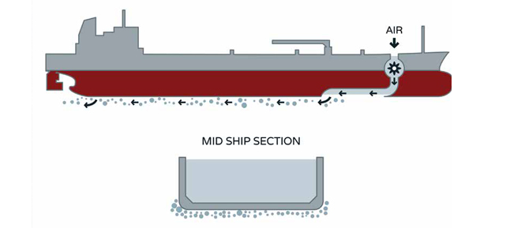
HOW DOES AIR BUBBLE LUBRICATION SYSTEM WORK?
• Air ejecting device supplies air to the bottom at the midship
• These air bubbles flow as a film from the midship to the stern.

Slide 14
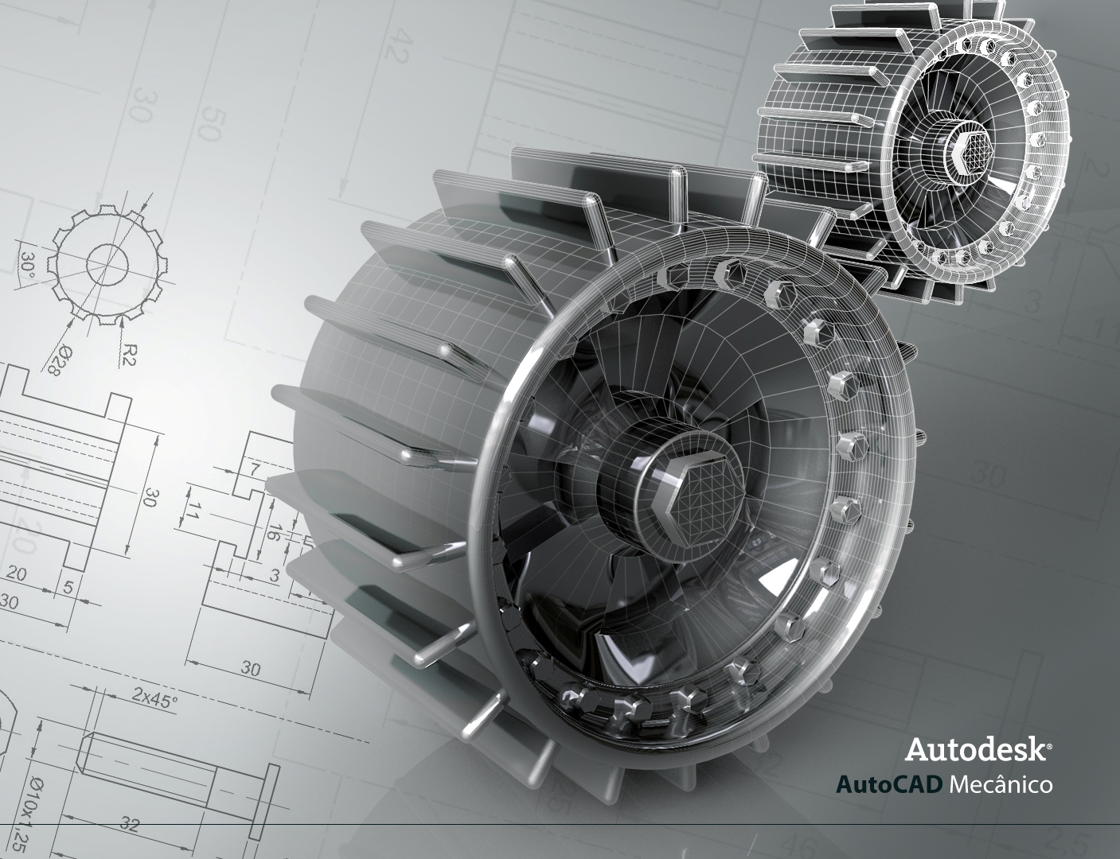
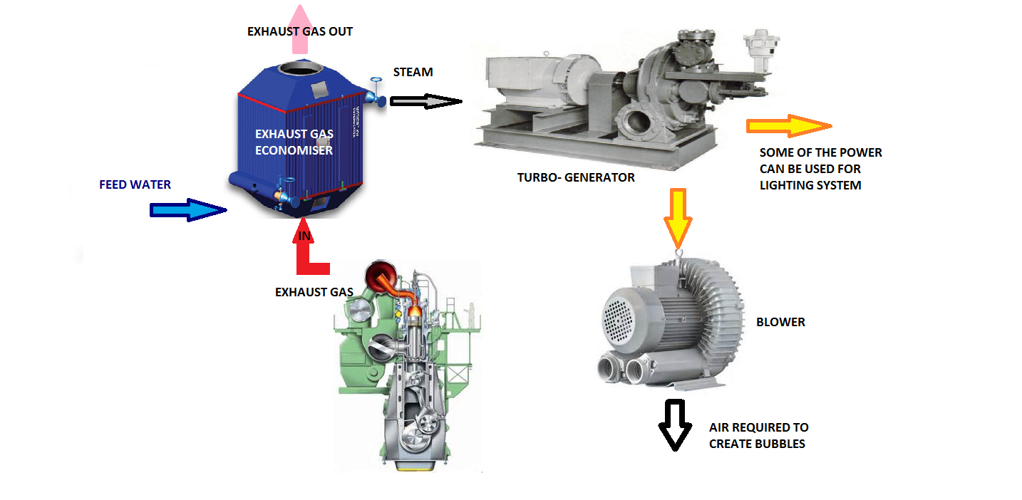
POWER TAKE-OFF

Slide 15

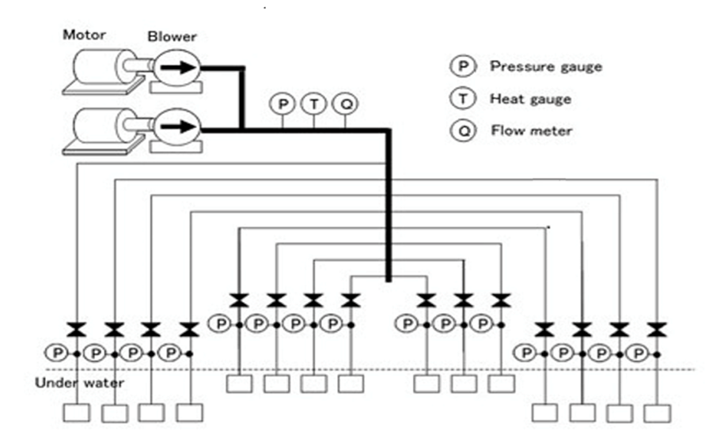
System Layout

Slide 16


Slide 17

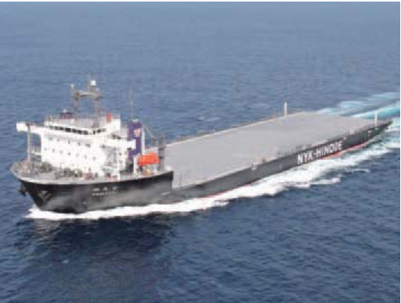
CASE STUDY
April 2010
* YAMATAI, a module carrier belonging to the NYK-Hinode Line, Ltd.
* Energy-saving effect of more than 10% at sea trials prior to delivery achieved.
Oct 14 2011
* MHI developed 95,000 dwt bulk carrier enable reduction in CO2 emission by about 25% compared with conventional average bulk carriers.
YAMATAI
Notes:
The Mitsubishi Air Lubrication System (MALS) was the first air lubrication system in the world to be applied to a newly built ship, and resulted in a substantial reduction in the ship’s resistance.
The Nagasaki Shipyard & Machinery Works of Mitsubishi Heavy Industries, Ltd., (MHI) completed YAMATAI, a module carrier belonging to the NYK-Hinode Line, Ltd., in April 2010.
An air lubrication system was installed on a ship for the first time on this occasion. The ship achieved an energy-saving effect of more than 10% at sea trials prior to delivery.

Slide 18

Design Conditions and Blower Specifications
Item | Unit | Module carrier | Bulk carrier | Container ship | Passenger ship
Length, L | m | 153 | 230 | 350 | 240
Speed, V_{s} | Kt | 13.0 | 14.0 | 24.0 | 17.0
Flow rate, Q_{s} | m³/min | 80-120 | 150-250 | 200-550 | 100-200
Pressure, P | kPa | 65 | 155 | 170 | 100
Blower Motor Rated Power, P_{m} | kW | 130-200 | 500-840 | 680-1900 | 230-460

Slide 19

STUDY FOR APPLYING MALS
Points to be considered while designing that allow MALS to be installed by shipyards other than MHI
Also recommended standard specifications & design for the same
1. Air outlets
2. Chamber
3. Location and shape of openings
Notes:
In regard to expanding the target ship types of MALS, points to consider for design that allows MALS to be installed by shipyards other than MHI are organized.
Also recommended standard specifications and design standard are defined in order to quickly respond customer needs.

Slide 20

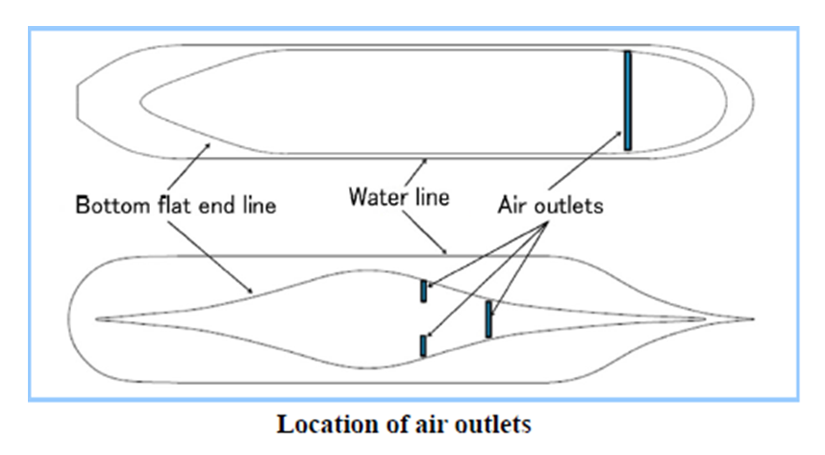
1. Air outlets

Slide 21
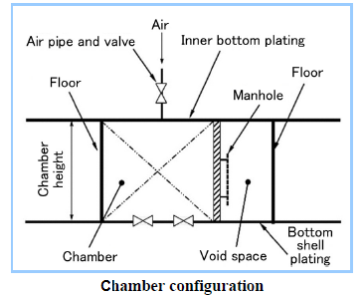
2. Chamber

Slide 22
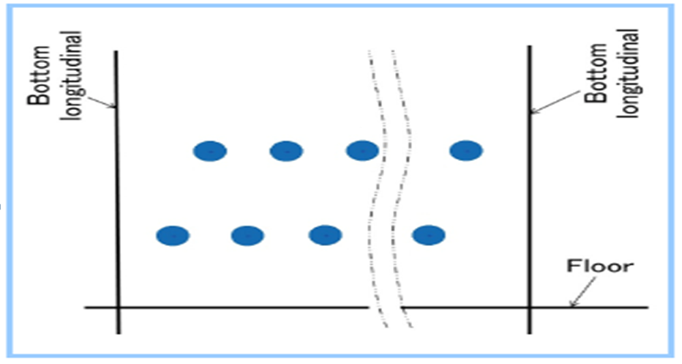
3. Location and shape of openings
Arrangement and shape of openings (bottom plan)

Slide 23

CONCERNS & SOLUTIONS…
AIR LUBRICATION SYSTEM
1. COMPATIBILITY
2. TRAPING OF AIR BUBBLES BENEATH THE HULL
3. STABILITY OF SHIP
4. SIZE OF AIR BUBBLE

Slide 24
CONCLUSION
20% reduction in drag
With a High Efficiency Hull - 25% reduction in CO2 emission
10% reduction in fuel consumption
Companies such as AIDA cruise & others already decided to implement
Integration of greener technologies only way to meet the norms & standards

Slide 25
REFERENCES
Mizokami, S. et.al, Experimental Study of Air Lubrication Method and Verification of Effects on Actual hull by Means of Sea Trial, Mits ubishi Heavy Industries Technical Review Vol1 Kodama, Y. et al., Experimental Study on Microbubbles and their Applicability to Ships for Skin Friction Reduction, International Journal of Heat and Fluid Flow, Vol.21, Issue 5 (2000) p.582
Kodama, Y. et al., A Full-Scale Air Lubrication Experiment Using a Large Cement Carrier for Energy Saving (Result and Analysis) , Conference Proceedings, the Japan Society of Naval Architects and Ocean Engineers, Vol.6 (2008) p.163
Murakami, A. et al., Numerical Simulation of Flow Around a Full Scale Ship Equipped with Bubble Generators, Conference Proceedings, the Japan Society of Naval Architects and Ocean Engineers, Vol.6(2008) p.153
Takano, S. et al., Experimental Investigation of the Bubble Diameter of Injected Air on the Ship Bottom and Its Influence on Propeller, Conference Proceedings, the Japan Society of Naval Architects and Ocean Engineers, Vol.10 (2010) p.455.47 No.3(2010) pp.41-47

Slide 26
ACKNOWLEDGEMENTS
We would like to thank :
Our institute , GEIMS,
Principal, Mr. Ajoy Chatterjee
Vice principal, Capt. Philip John
Course in-charge, Mr. R.K. Joshi
Soft skills trainer, Mrs. Meena Ravi Shankar
All faculty Members

Slide 27

HOPE OUR PRESENTATION WAS QUITE EDUCATIONAL
THANK YOU FOR YOUR PATIENT LISTENING
ANY QUESTIONS?
Notes:
Hope you found our presentation informative and educational
thank you for giving us a patient ear
Questions are most welcome

