Slide 1

Seafarers’ Pre-departure awareness session
Presented by:-
Chirag Bahri
Director of Regions - ISWAN

Slide 2
ISWAN – Who we are
International charity based in the UK
International presence in India, Philippines, Nigeria
Object is to promote the welfare of seafarers worldwide
We run programmes and projects on health and wellbeing
We work with partner organisations

Slide 3

SeafarerHelp
24 hour free and confidential helpline for seafarers and their families
International – the team speak 10+ languages
In 2020/21 dealt with approx. 6,000 cases involving over 31,000 seafarers
WhatsApp:
+44 7909 470732

Slide 4
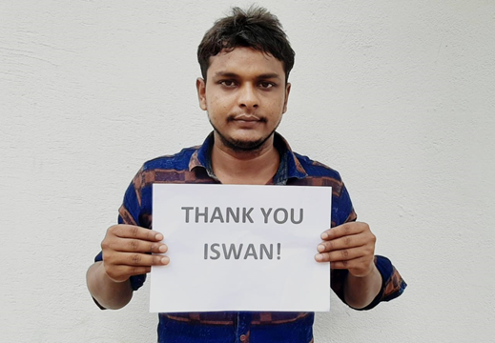
SeafarerHelp - cases
Many cases relate to financial help, repatriation and labour issues
SeafarerHelp team providing more emotional support to seafarers
Mental wellbeing cases increasing

Slide 5
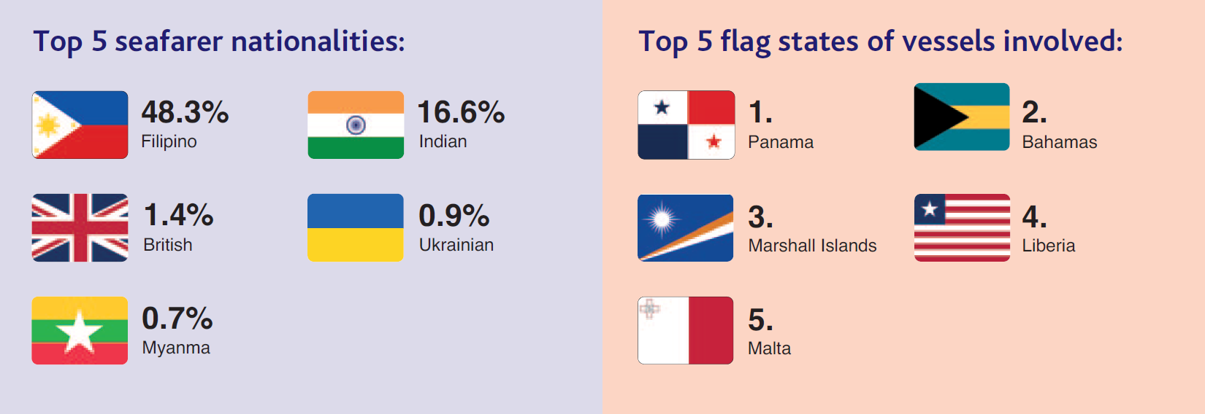
ISWAN’s Helpline Statistics
Notes:
81% of cases dealt with in-house
19% of case referred
Calls initially 3.5 times higher compared to previous years due to the pandemic, then reduced to 1.5 times the usual number for the rest of the year
Double the usual number of calls relating to suicides or cases of seafarers with suicidal thoughts

Slide 6
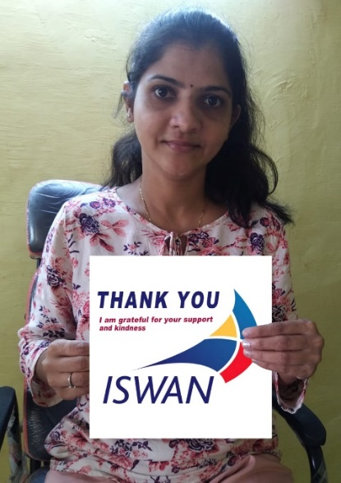
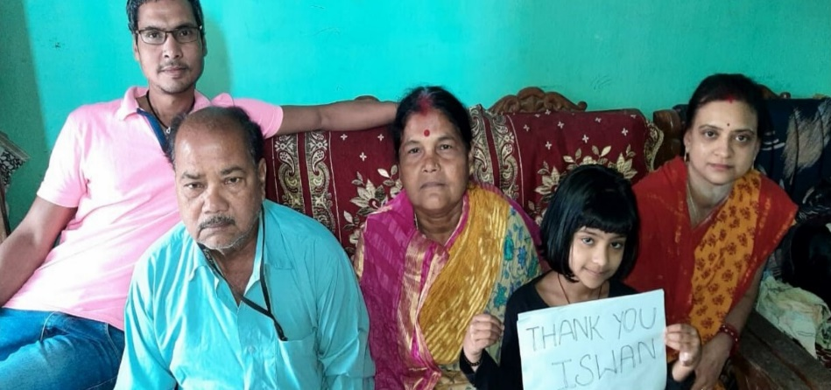
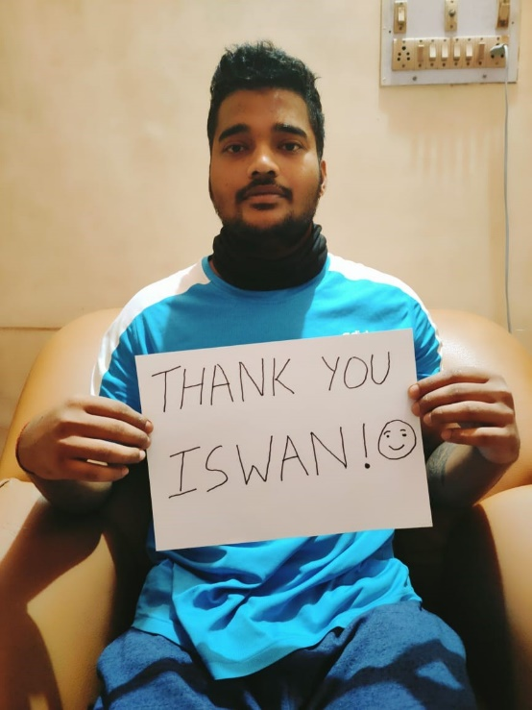
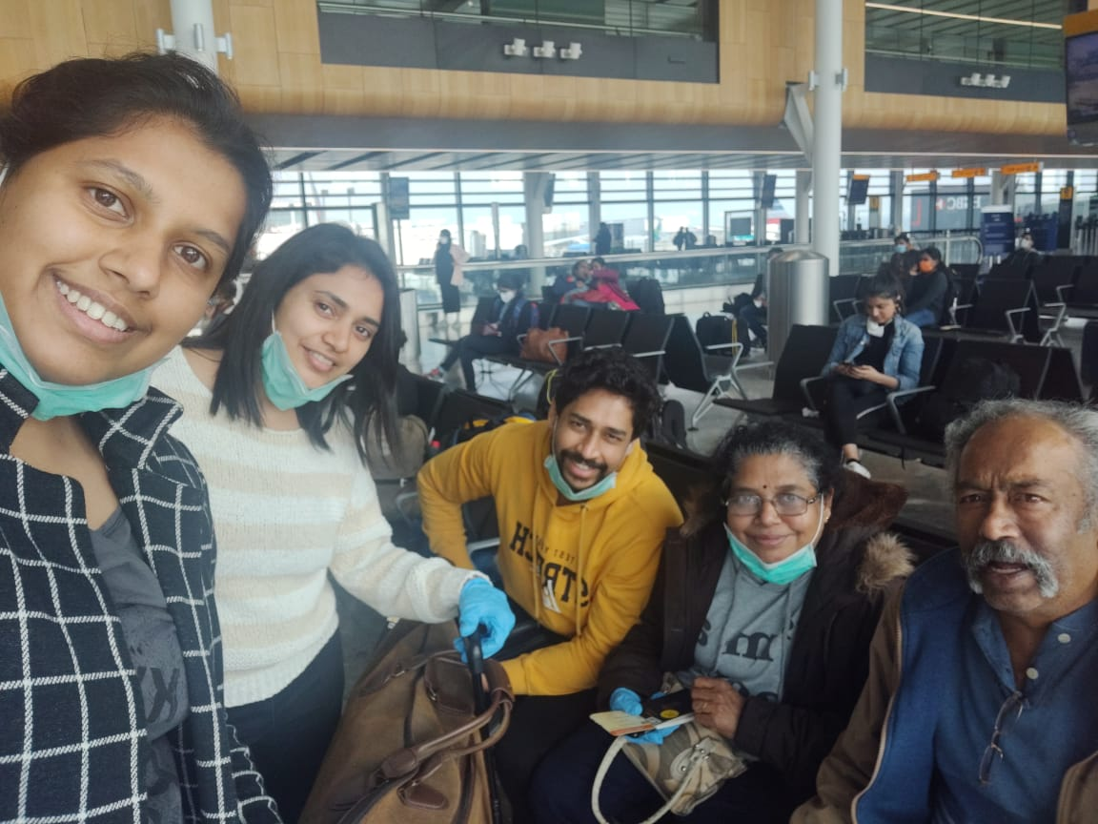
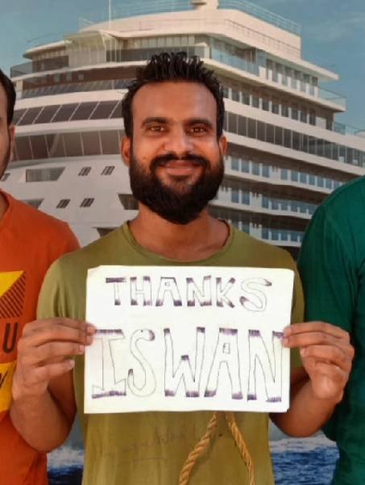
India & South Asia
Notes:
31 abandonment forms involving 333 seafarers submitted to the ILO/IMO Database on reported incidents of abandonment of seafarers
171 cases involving 242 seafarers deceived by fraudulent crewing agents
Supported seafarers who were unable to sign off or join vessels, or were stranded during lockdown and unable to get home:
Worked closely with more than 15 Indian missions to help Indian seafarers and families with infant children board the Vande Bharat flight home
Guided and assisted more than 4,200 Indian seafarers and their families with the repatriation process
Helped a total of 1,874 seafarers to return home, 1,085 of which were in the UK
Supported three Iranian hostages released by Somali pirates after nearly five years and five months in captivity and arranged grants to support their rehabilitation

Slide 7
Vaccination drive for Indian Seafarers
More than 1500 Indian seafarers assisted
Partnership with two private medical hospitals – Narayana Health & Medica Group of Hospitals

Slide 8

Campaign Against Fraudulent Crewing Agents
Notes:
This is the campaign that we have started in India to sensitise seafarers to not join shipping through non registered agencies.

Slide 9
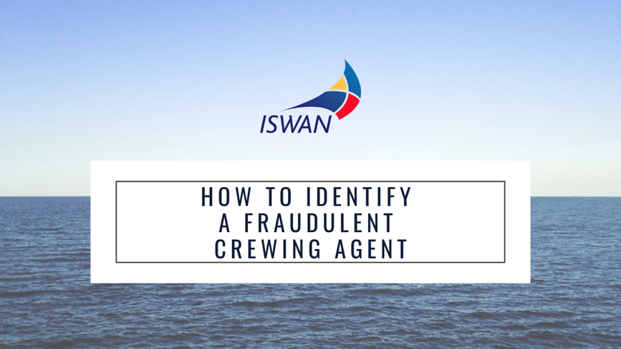
RPSL crewing agent
RPSL stands for the Recruitment and Placement Services License issued to approved Recruiters and Agents by DG Shipping. The license provides security for Indian seafarers serving on Indian and foreign vessels, along with essential guarantees of repatriation in the event of abandonment.
Each RPS is issued with an RPSL number. A list of all registered RPSL is available on the DG(S) website. You must check the RPSL list before joining a shipping company.
Notes:
A Recruitment & Placement Services License (RPSL) must be licensed by all RPS providers. They must renew their license when expired and undertake to send a monthly report to the Director-General of Shipping / Seamen’s Employment Offices, notifying the name of the seafarer, CDC No, the name of the ship and its flag that it has entered, the date of signing ON, the date of signing OFF and its arrival in India. Such data is sent on a monthly basis and the DGS maintains a database for the above information sent by the RPS providers.

Slide 10
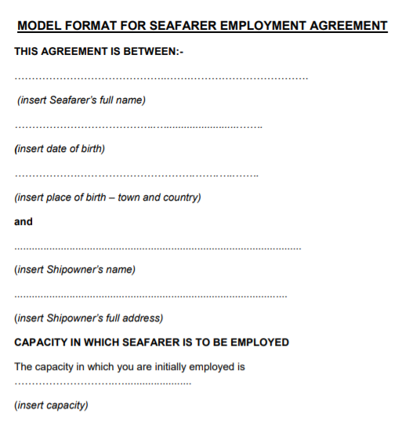
The Employment Agreement
The name of the ship or ships on board which the seaman undertakes to serve;
either the nature and, as far as practicable, the duration of the intended voyage or engagement or the maximum period of the voyage or engagement, and the places or parts of the world, if any, to which the voyage or engagement is not to extend;
the number and description of the crew of different categories in each department; hours of work and rest in a week, as may be prescribed;
the time at which each seaman is to be on board or to begin work;
the capacity in which each seaman is to serve;
the amount of wages which each seaman is to receive; [ the entitlement for leave, as may be prescribed;]
the seafarer’s position on board;
the conditions for terminating the agreement, including the notice period, if the agreement is for an indefinite period (this must not be less for the shipowner than for the seafarer); the expiry date, if the agreement is for a fixed term; and the port of destination, if the agreement is for a specific voyage;
the health and social security protection benefits provided by the shipowner;
the seafarer’s entitlement to repatriation;
Notes:
An agreement with the crew shall be in the prescribed form, and shall be dated at the time of the first signature thereof, and shall be signed by the owner or agent and the master before any seaman signs the same.

Slide 11
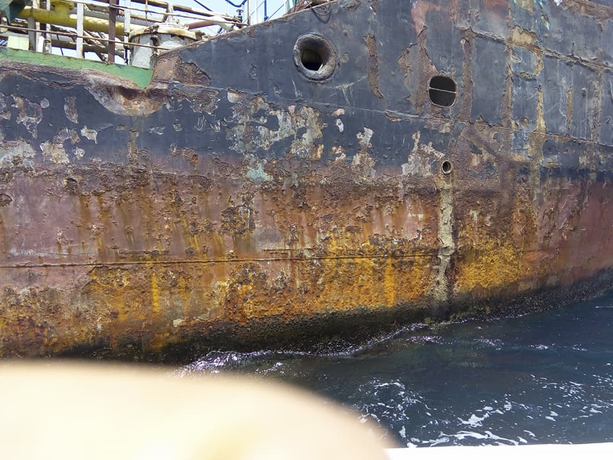
Sailing on a Sub-standard ship with no insurance or proper regulatory framework can not only effect you but it can have a major emotional and financial impact on your loved ones
Notes:
Certainly no seafarer would like to sail on a ship which is unseaworthy and risk the life.

Slide 12
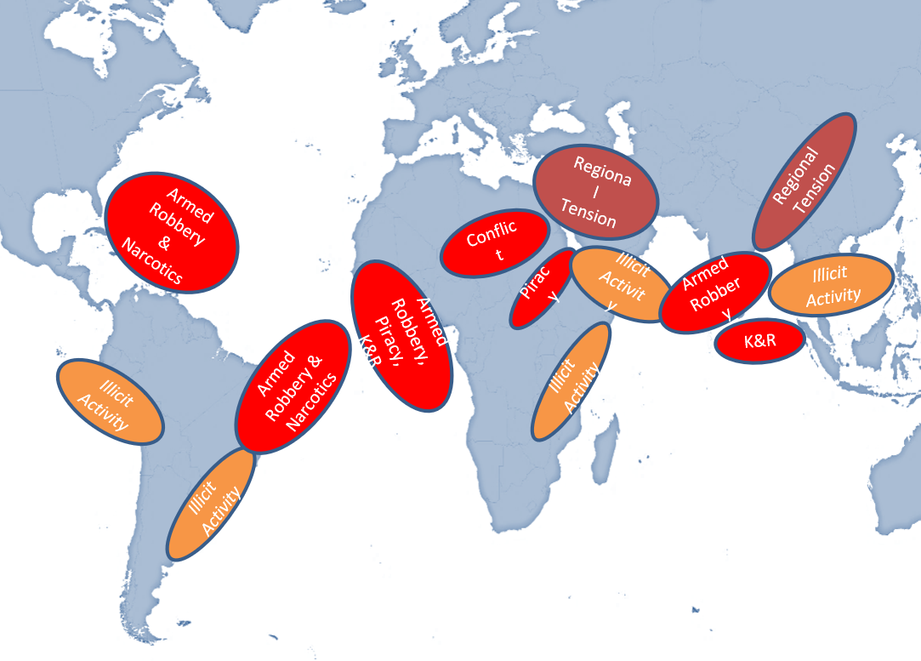
Overview of Maritime Threats
X

Slide 13



Best Management Practice
Notes:
Give a brief information to participants on latest BMP5 and its contents, share a copy of the book with them.

Slide 14
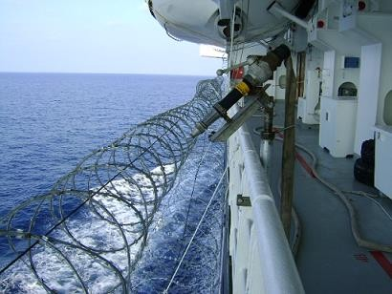
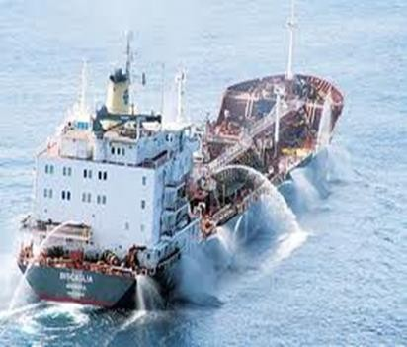
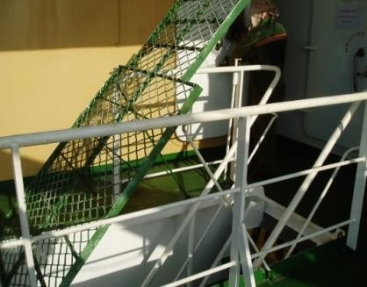
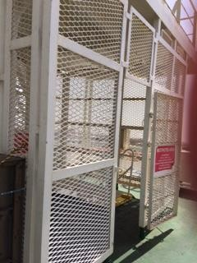
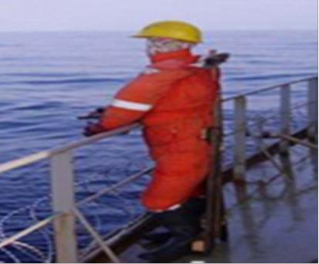
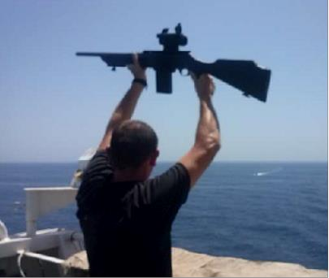
Ship Protection Measures
Examples of Razor wire, Hoses, Fences & Barriers, Dummies and Armed Security Teams
Best Practices must be visible to discourage attacks
Notes:
Keep

Slide 15
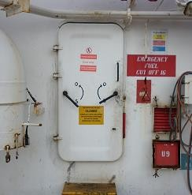
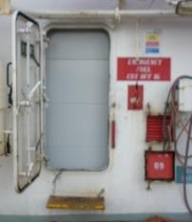
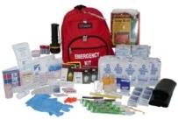
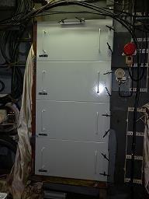
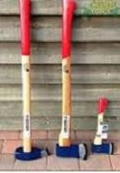
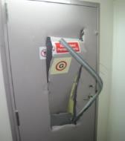
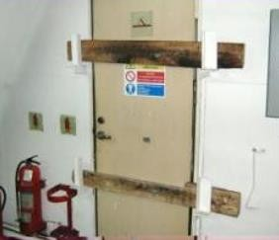
Citadels
100% of crew and AST mustered in the Citadel.
External Comms (VHF/SATCOM) from Citadel. Ensure minimum 3 days food/ water supply.
Medical kit available; including all prescribed medication.
Deny access to ships tools
Notes:
Keep

Slide 16
Crew Reactions
How the crew responded
Shock,
Extreme Fear
Panic
Angry, Depressed
Stockholm syndrome
What they should do….
Offer NO resistance
Stay united
Keep your faith, morale high
Meditation, Yoga
Be calm and not aggressive
Motivate and supports fellow crew members
Do not argue
never say ‘NO’ to pirates in case they demand for any job to be completed instead try to make them understand if possible.
Notes:
Explain them on how crew behaves normally. It is important to emphasise that the situation is abnormal but our reactions to that situation is absolutely normal.

Slide 17

Cyber Hygiene
Notes:
Show video on Cyber Hygeine
https://www.youtube.com/watch?v=xdf-x-KI7Mo
Cyber film

Slide 18

Cyber Hygiene
Use a firewall
Document your cybersecurity policies
Keep personal information professional and limited
Be careful what you download
Conduct regular staff awareness training
Regularly back up all data
Install anti-malware software
Always keep your privacy settings on
Use encryption
Choose strong passwords
Keep your antivirus program updated
Make sure your internet connection is secured
Notes:
As vessels increasingly rely on automation and remote monitoring, key components, including navigational systems, propulsion and power management, can be compromised. With potentially devastating consequences for life, the environment and businesses. Ships need to embark on a simple 'cyber-hygiene' routine to ensure that many of the more obvious vulnerabilities are dealt with.

Slide 19
Why Health information for Seafarers?
To stimulate seafarers to take responsibility for their health in the living and working environment on board.
Healthier, fitter, safer
Messages must go to the hearts and minds of individual seafarers to help them change their often hazardous lifestyle.
Messages should relate to the living conditions on board.
Notes:
Seafarers are among the most isolated demographic working groups in the world, in relation to access to medical care, both, in emergency situations and for primary health care
(FOR EXAMPLE, On a large, slow vessel, in the middle of the Pacific, a seafarer may be several days away from quality medical services)
Plenty of occupational, physical, chemical and other health hazards:
Construction, cargo, isolation, climate changes
Noise, vibration, radiation
Loading, discharging, cleaning, painting
Travelling, accidents, infections, unsafe sex, piracy etc

Slide 20
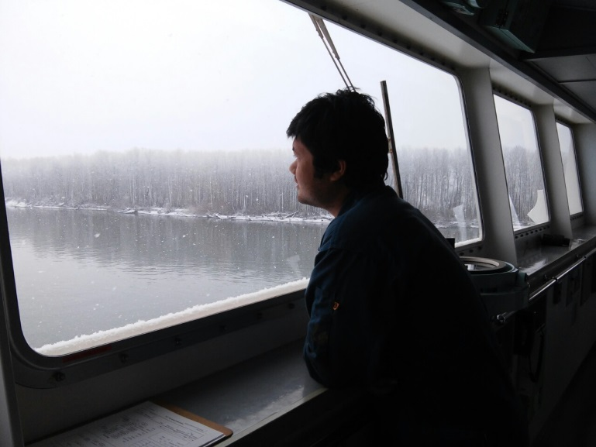
What is different for seafarers
Social isolation
Long voyages
Fatigue – watch system
Separation from family and friends
Crew numbers falling
Lack of crew cohesion
Lack of shore leave
Precarious employment

Slide 21
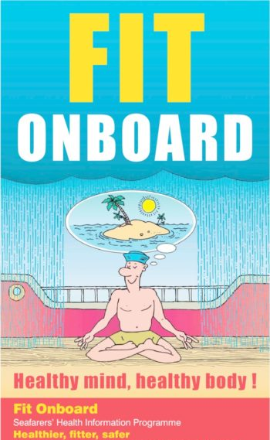
Fit on Board, Overweight, Obesity
EXERCISE!!!
Aim to exercise for 30 minutes at least thrice a week
WHY?
    Better shape & appearance
    Lose weight
    Feel invigorated
    Cuts the risk of developing CAD
    More energy
    Greater stamina

Slide 22

Coronavirus (COVID)
Every other viral infection, like COVID-19, follows the same set of rules and patterns. The methods discussed in the following slide show how we can limit the spread and control the risk of becoming affected.
Even though COVID-19 is a major threat right now, the mentioned steps will assist us in dealing with all other viruses as well.

Slide 23
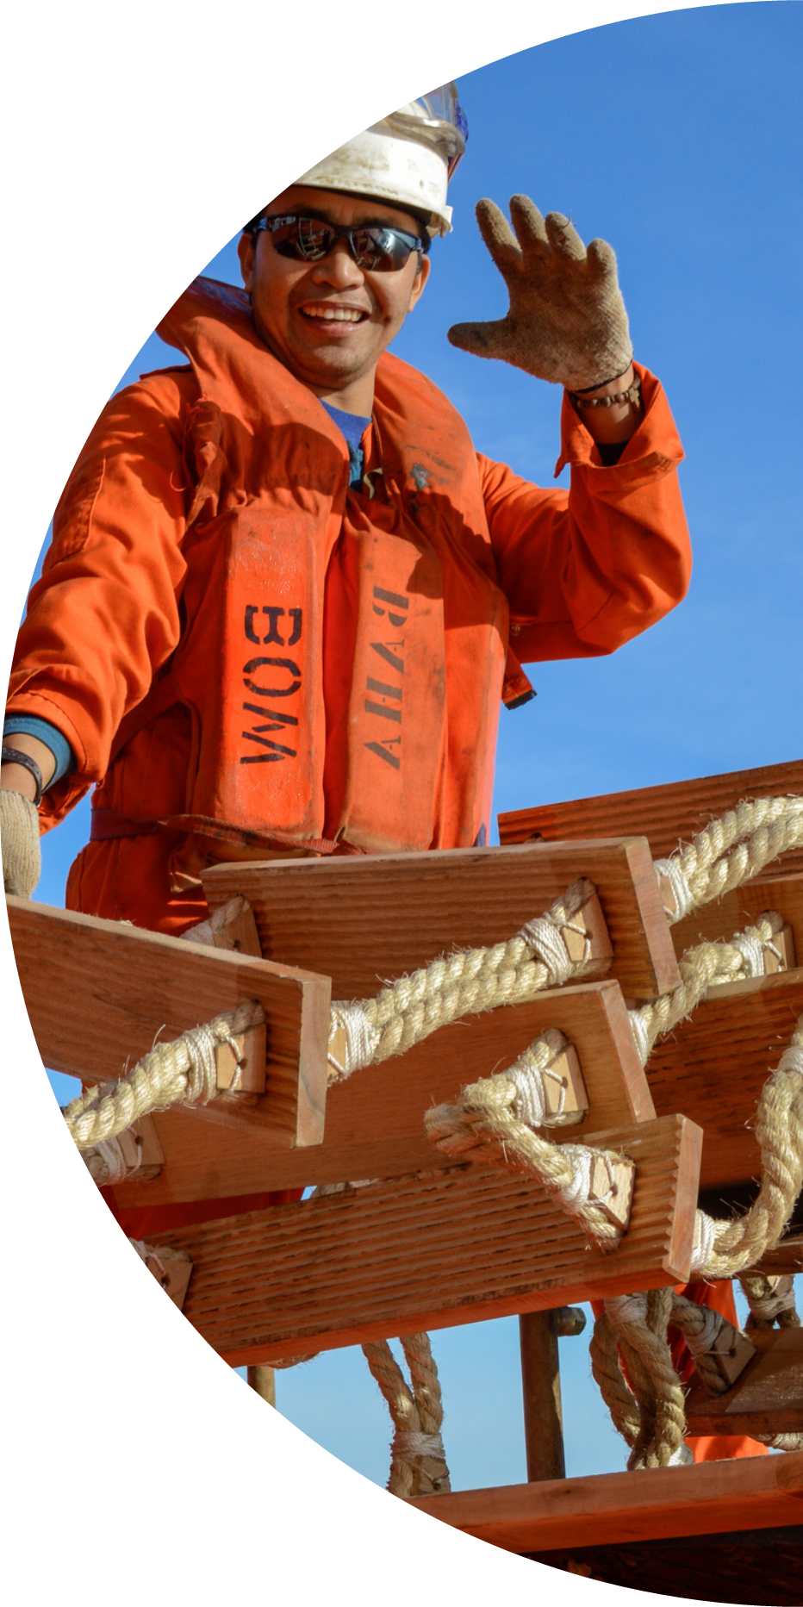
Mental Health is:
“a state of well-being in which every individual realises his or her own potential, can cope with the normal stresses of life, can work productively and fruitfully, and is able to make a contribution to her or his community.”
-World Health Organisation

Slide 24

People say they don’t talk about their mental health because:
It’s personal (or private)
I should be able to cope
They won’t understand
Men don’t talk about emotions
I would lose my job
I won’t get another contract
They will think I’m crazy
They will think I am week
They will think I’m unprofessional
Notes:
Stigma around mental health is a universal problem. People who are finding it difficult to cope for whatever reason will often cite physical health problems as a reason not to go to work rather than mental health related problems
we can’t discuss feeling low or being anxious because we think people will think we are ‘crazy’ or weak. There is NO EVIDENCE ANYWHERE that personality characteristics like being strong or week are connected to mental health problems. It is simply a factor of being human and we are all susceptible to poor mental health, but we can learn good coping strategies.
Negative attitudes towards mental health means that people are often ashamed or embarrassed and therefore don’t disclose when they are finding things difficult; this means they often don’t ask for or get offered the support or help that they might need or learn how to manage our emotions or cope during difficult times.

Slide 25
The truth is
Be Part of the Solution!
We all have mental health
We’re all human
Promote Mental Health Awareness
Increase your Understanding
Ask Questions
Watch your language
Challenge your thinking
Talk about Mental Health & Wellbeing
Ask Are you OK?
We all have mental health!
Sometimes …
when big changes happen in life (even positive ones) or we have a problem that is hard to solve (maybe we loose a loved one, or someone we love is sick, perhaps we lose our job or we have financial problems)
… we can all struggle
This is normal – it is human!
Stigma makes us frightened to talk about our worries or ask for help. Problems get worse when we try to hide them or ignore them. Stigma kills – don’t be part of the problem..

Slide 26
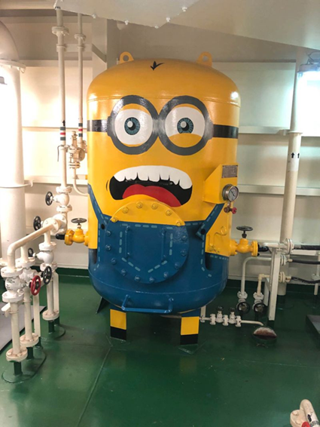
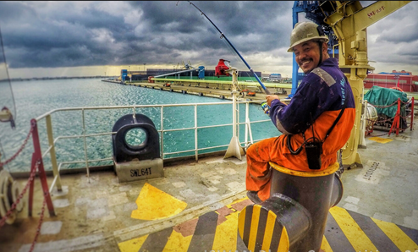
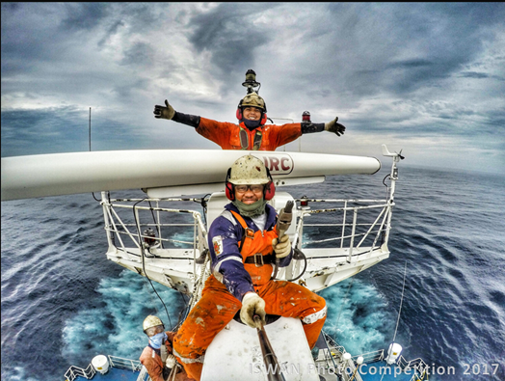
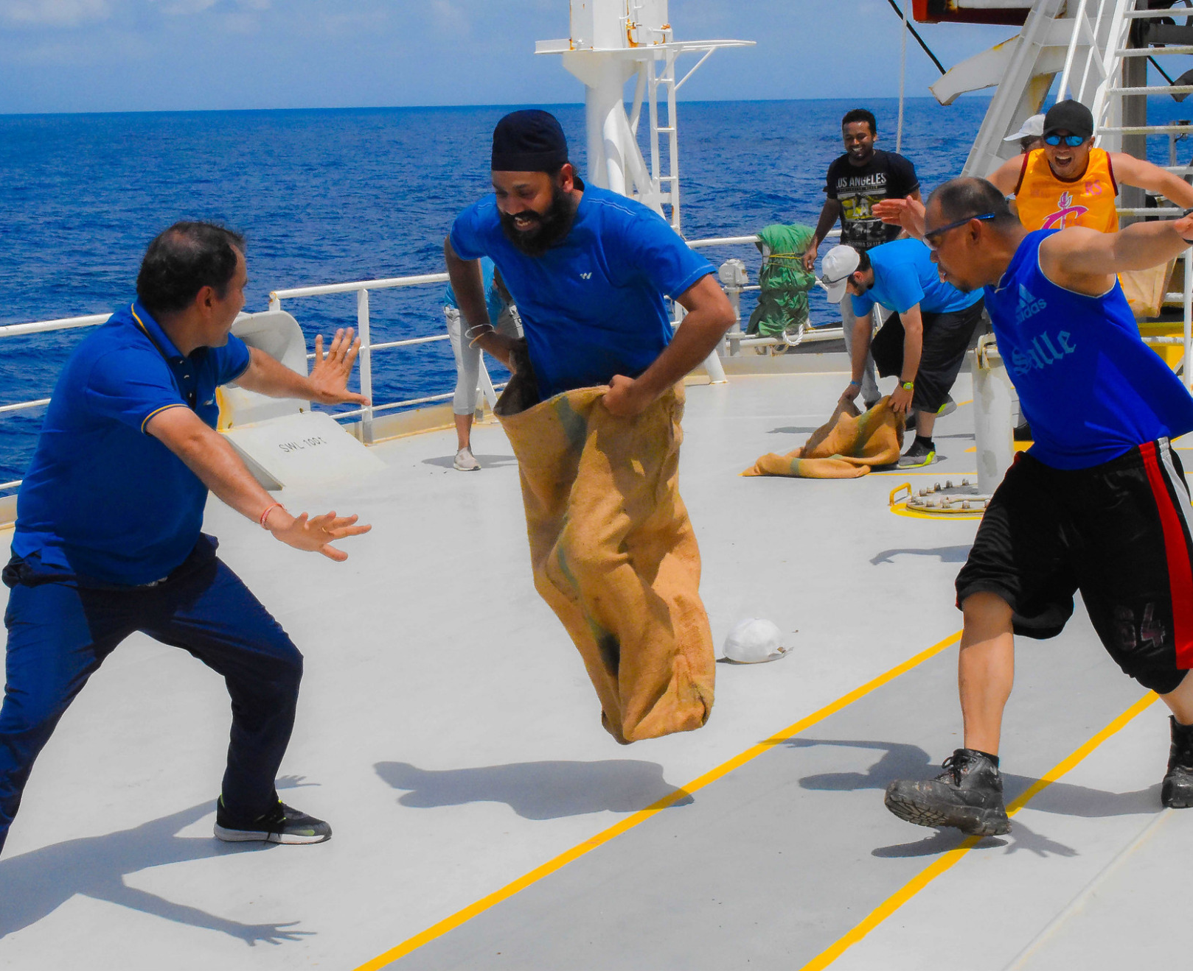
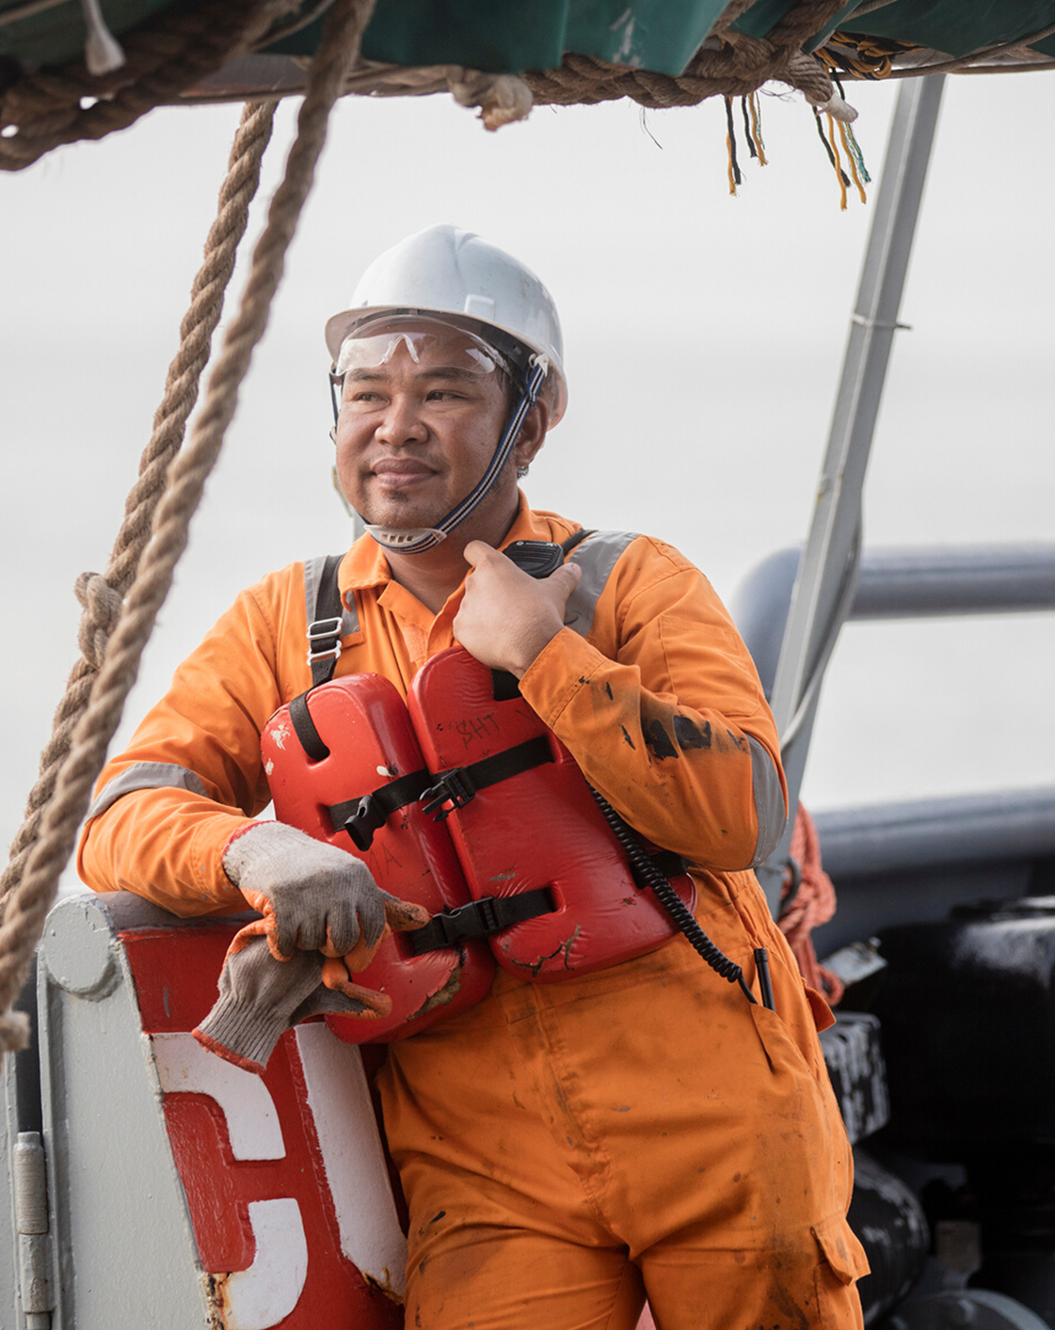
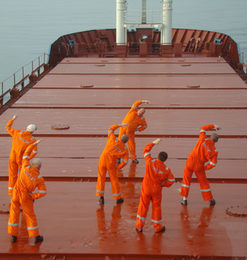
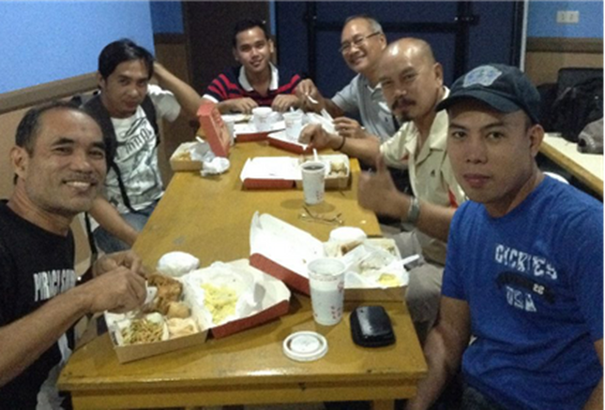
David Reynolds former Merchant Navy Officer has spent 2 years building a replica of the Mayflower from matchsticks
Iswan Photo Competition 2017
Look after your wellbeing!
The crew on the Donata Schulte transformed the engine room
IMO Day of the Seafarer Photo Competition 2018

Slide 27





















Mini Exercise
Other than films and music…
What activities could you do on board the vessel on your next voyage?
What materials/resources do you need to take with you?

Slide 28


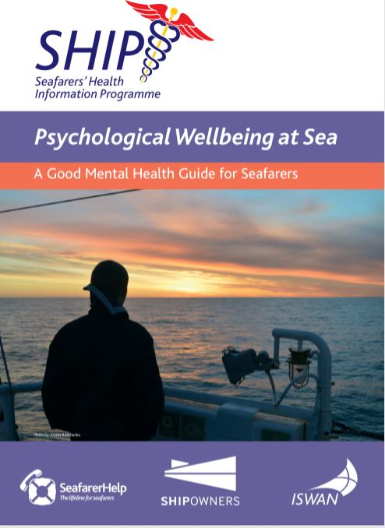
ISWAN’s
Good Mental Health Guides
Download from Seafarerhelp.org
before you board!
Notes:
ISWAN has recently produced three self help guides for seafarers with a clinical psychologist, Dr Pennie Blackburn.

Slide 29





Physical & Mental Health are closely connected
Try to ensure you get as much sleep as you need
Fatigue has been recognised as a significant problem among seafarers. Most adults need between 6 and 9 hours of sleep every night
Pay Attention to what you eat onboard
Eat plenty of fruits and vegetables and drink lots of safe drinking water
Exercise Regularly
Exercise an help your body release tension. It can help you clear your thoughts to help you get into a better frame of mind to deal with your problems. Aim to do 30 minutes of exercise a day.
Beware of how things like drink, drugs, smoking and caffeine affect you
Although they may feel like they help in short term, they wont take away the causes of stress, some will actually increase the physical effects of stress and they can create their own problems
Use your breaks well
Take time for yourself to exercise, relax, connect with others onboard. Many people stop taking their work breaks when they re stressed but this only adds to the sense of pressure and fatigue
Notes:
It isn’t always possible for seafarers to control some of these things, but as far as possible try to …..

Slide 30
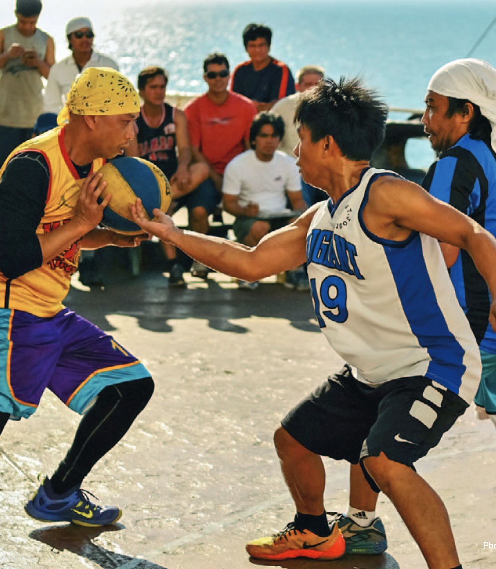
Keep connected with people at home
Build positive working relationships on board
Connections in our lives are important for our wellbeing
Friends, Family & Loved ones
Co-workers and crew-mates
Communities
Positive relationships allow us to:
Enjoy ourselves and have fun
Give and receive care & support when we need it
Social isolation and loneliness are big problems in society and at sea.
Look for opportunities to:
Interact and get to know your crew mates
Experiencing positive emotions together
Share work, activities and experiences
Be kind
Photo by: Noel Agustin Gabrido
Notes:
Encourage people to get to know crew mates, organise social events that are inclusive of all cultures and particularly to look out for and try to include individuals who may be isolated (e.g. people from different cultures or language groups and women)

Slide 31
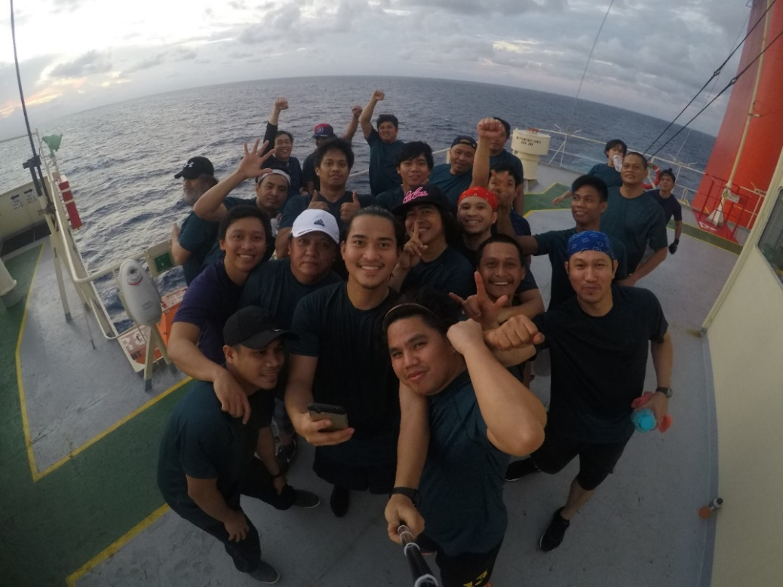
CULTURAL
COMPATIBILITY
Ability to work together irrespective of where you come from.
Seafarers are often exposed to multicultural environment where mixed crewing is practised.
Significance
It ensures great teamwork and safe operations onboard.
Photo Credits: Jaydee Datu Fajardo

Slide 32

HOW TO ENSURE CULTURAL COMPATIBILITY
Be respectful towards other cultures and their customs.
Be considerate and open to other’s perspective.
Engage in social activities to know your crew members.
Photo Credits: Theresa Chiechi @ The Balance

Slide 33
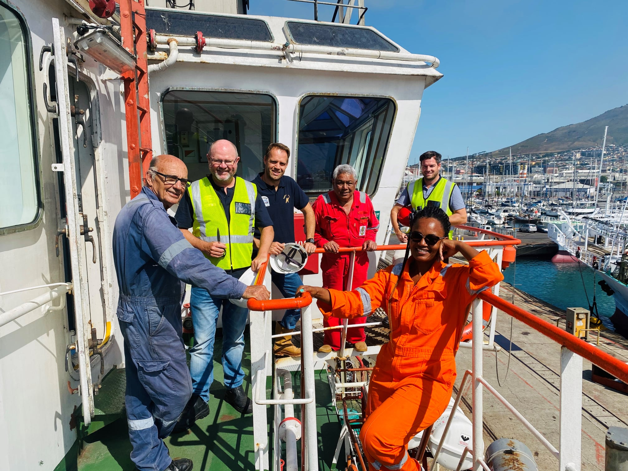
AWARENESS ON GENDER DIVERSITY
Gender Diversity
Diversity in the workplace refers to the differences between workers, such as sex/gender, race/ ethnicity, age, physical and mental ability, socio- economic class, language, religion, nationality, education, sexual orientation, family/marital status, HIV status, and so on.
Gender Diversity in the workplace is the equal treatment and acceptance of male and female employees in an organisation. Diversity adds value to an organisation due to the different viewpoints and backgrounds of diverse individuals.
Notes:
With women forming only 2% of the of the total number of seafarers sailing on the high seas. There is a need to bridge this gender gap, and this can only happen if we bring more awareness of this profession to the general public and at the same time sensitize the male seafarers towards acceptance of women on board the ship as equals. Read more from our guide: t.ly/CM94

Slide 34
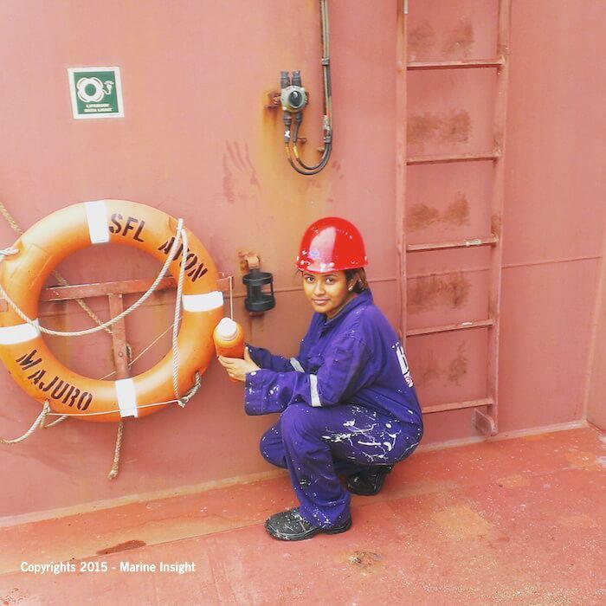
Challenges faced by Women Seafarers
Stress, Depression and Anxiety
Inappropriate work equipment
Lack of access to sanitary products / medicines
Bullying and sexual harassment
Discrimination and gender pay gap
Maternity constraints / future job prospects

Slide 35
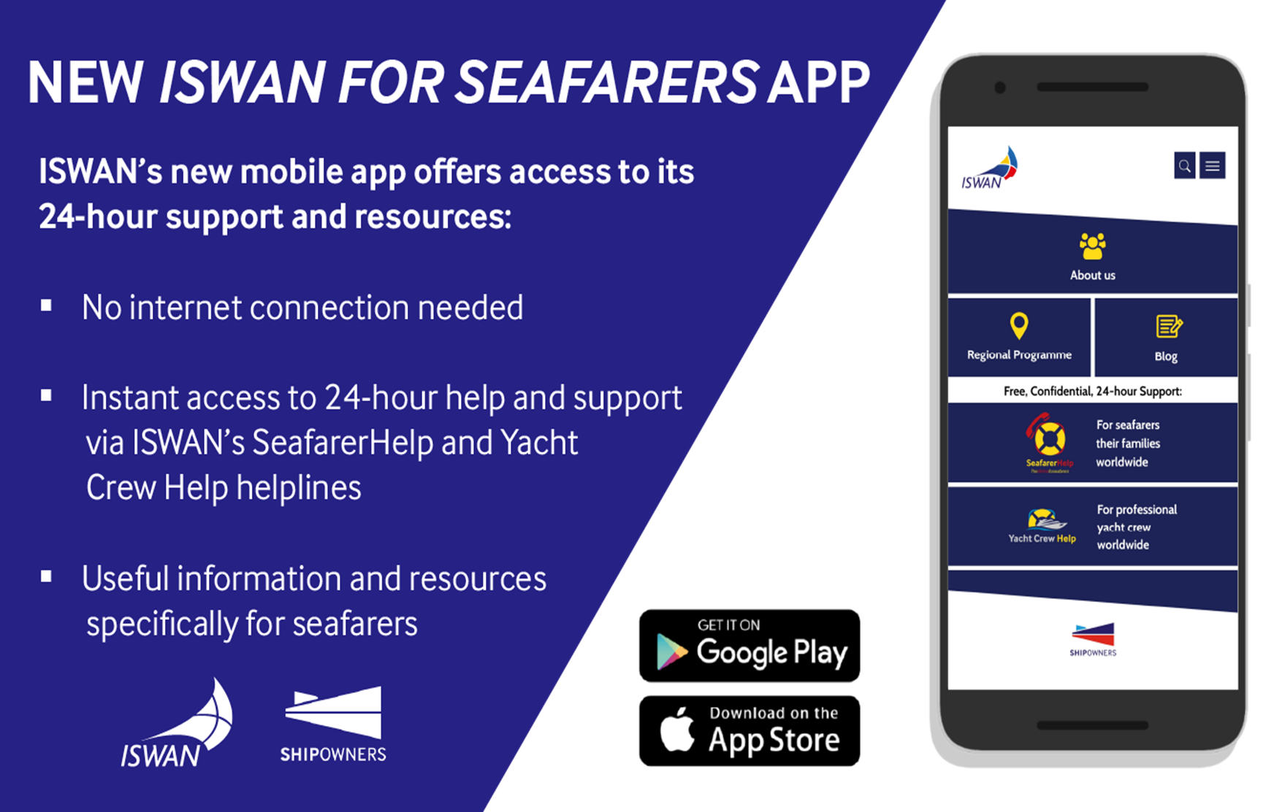
Download it before you board ship!

Slide 36
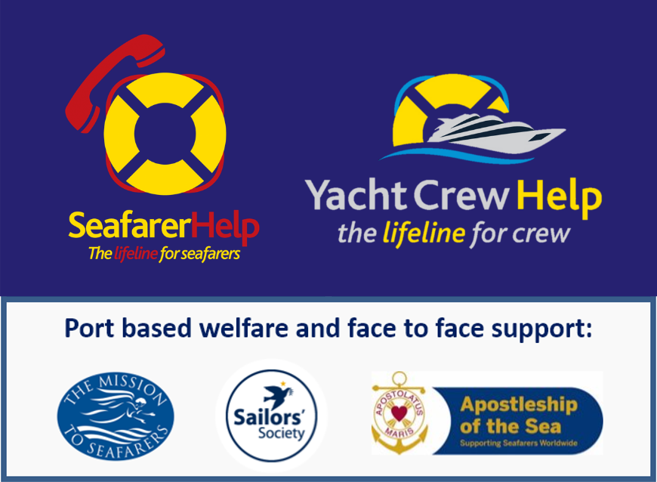

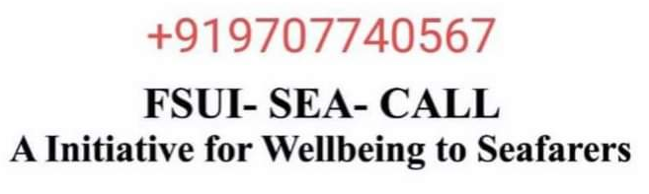
Online and Telephone Support

Slide 37


Slide 38
Thank You
Chirag Bahri
Chirag.Bahri@iswan.org.uk
www.seafarerswelfare.org
www.seafarerhelp.org

