Slide 1
Sustainable innovations for enhancing industrial growth
Advanced industrial technologies and their impact on human life
THEME
SUB THEME

Slide 2

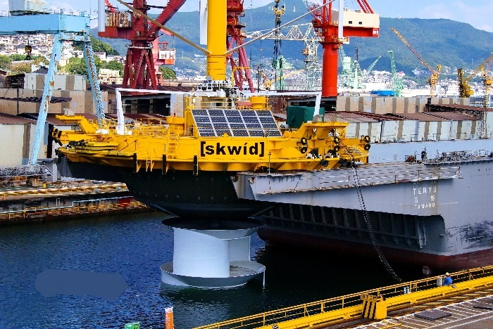
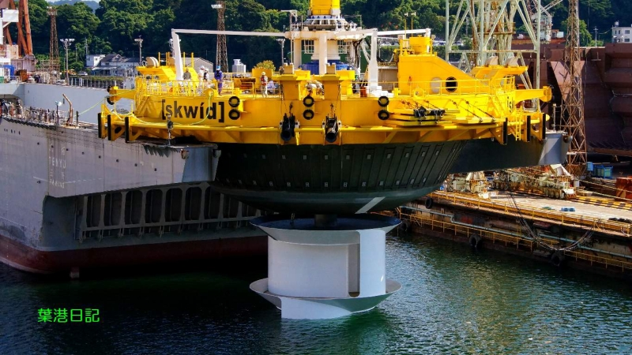
OBJECTIVE
Concept study of Savonius Keel And Wind Turbine Darrieus (SKWID) coupled with Carbon Capture Storage (CCS) to produce fuel in an on - board ships

Slide 3
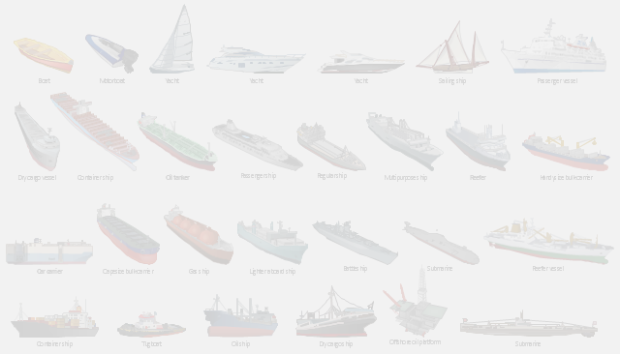
MODULES OF PRESENTATION
SKWID Technology
Its Components, Specifications, Working & Advantages
CCS technology
Production of Fuel & Working
Cost Model
Fortunes
Emphasizing on coupling CCS with SKWID technology

Slide 4
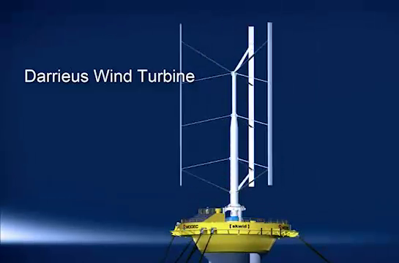
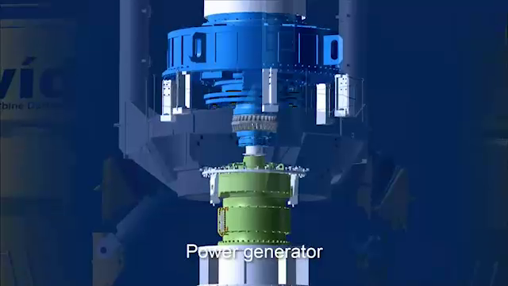
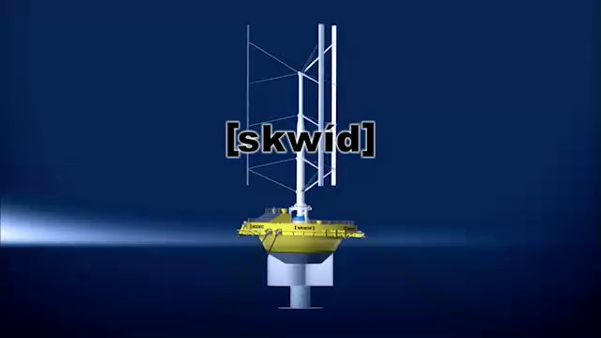
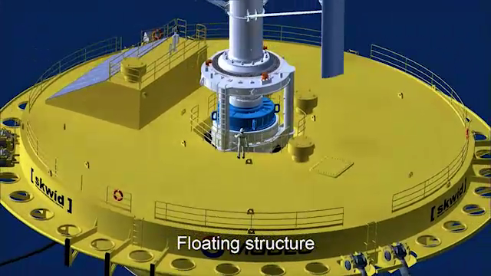
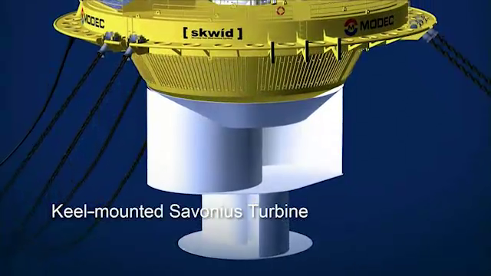
COMPONENTS OF
DARRIEUS WIND TURBINE
POWER GENERATOR
SKWID
FLOATING STRUCTURE
KEEL MOUNTED SAVONUS TURBINE

Slide 5

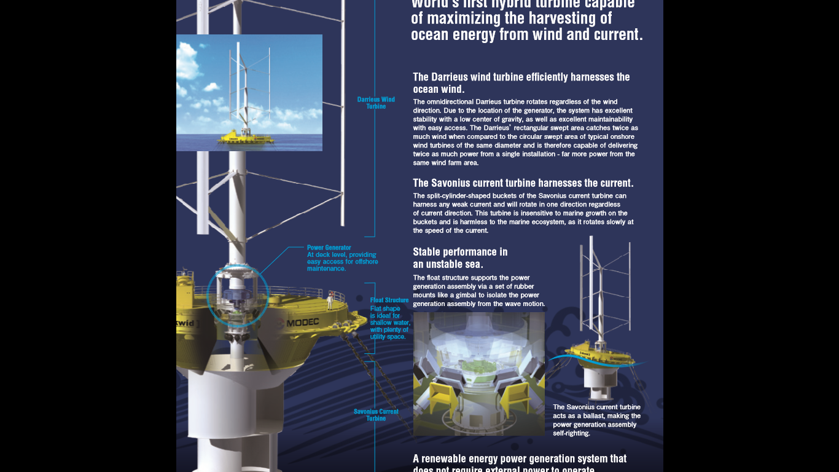
SPECIFICATIONS
MANUFACTURER :- MODEC INC. , JAPAN
TURBINE CAPACITY :- 0.5 MW
DARRIEUS TURBINE TYPE :- VAWT
TOTAL TURBINE HEIGHT :- 54.6m
DARRIEUS WINDMILL HEIGHT :- 47 m
SAVONIUS WATERWHEEL HEIGHT :- 15 m
SAVONIUS TURBINE TYPE :- SPLIT-CYLINDER SHAPE
PLATFORM DIAMETER :- 29 m
FOUNDATION :- FLOATING SEMI-SUBMERSIBLE PLATFORM
CO₂ REDUCED PER YEAR :- 716 TONNES
SO₂ REDUCED PER YEAR :- 17 TONNES
HOMES POWERED ANNUALLY :- 354 HOMES

Slide 6


Working OF SKWID
GEARBOX TRANSMITS INCREASED ROTATION TO DARRIEUS WIND TURBINE
DARRIEUS WIND TURBINE HARNESSES WIND ENERGY
SAVONIUS CURRENT TURBINE HARNESSES TIDAL ENERGY
POWER GENERATOR CONVERTS TIDAL ENERGY AND WIND ENERGY TO ELECTRICAL ENERGY
BATTERY TO STORE ELECTRICAL ENERGY

Slide 7

Skwid requires no external power for initialisation.
Rectangular swept area doubles the wind consumption.
Twice power deliver from single installation
Split-cylinder-shaped buckets.
Insensitive to marine growth.
ADVANTAGEs OF SKWID

Slide 8
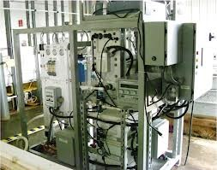
CARBON CAPTURE Storage
Removes carbon dioxide(CO₂) from seawater with a concomitant production of hydrogen (h₂), to form Hydrocarbons.
This is achieved through the use of ELECTROCHEMICAL ACIDIFICATION CELLS and FISCHER TROPSCH PROCESS.
The process is being researched by US Navy

Slide 9

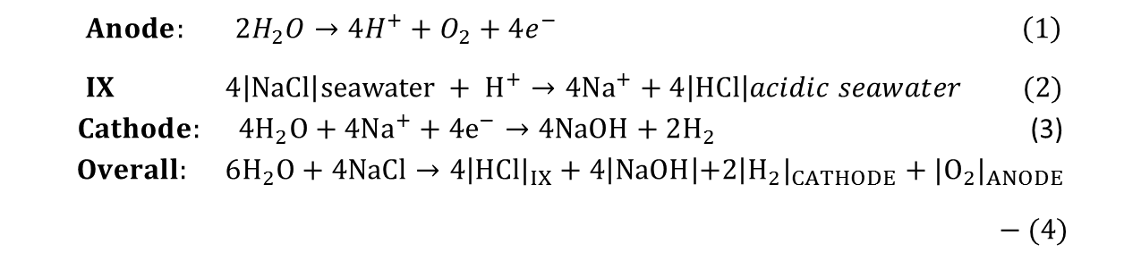
extraction of co₂ and h₂ by electrochemical acidification
SEAWATER ph <6.0
Semipermeable membrane sandwiched between electrodes.
H⁺ and OH⁻ is generated by electrolysis,
CO₂ bubbles off.
CELL REACTION :-
CO₂ BUBBLES OFF
O₂+H₂O
OH⁻
Anode
Compartment
Ion Exchange Compartment (IX)
Cathode
Compartment
C
A
T
I
O
N
E
X
C
H
A
N
G
E
M
E
D
I
A
C
A
T
I
O
N
M
E
M
B
R
A
N
E
I
N
E
R
T
E
X
C
H
A
N
G
E
M
E
D
I
A
C
A
T
I
O
N
M
E
M
B
R
A
N
E
C
A
T
I
O
N
E
X
C
H
A
N
G
E
M
E
D
I
A
H⁺
Na⁺
ANODE (+)
CATHODE (-)
H⁺
Na⁺
H⁺
Na⁺
H₂O
H₂O
$Anode: 2H_{2}O→4H^{+}+O_{2}+4e^{−} \left(1\right)$
$IX 4\left|NaCl\right|seawater + H^{+}→4Na^{+}+4\left|HCl\right|acidic seawater (2)$ $Cathode: 4H_{2}O+4Na^{+}+4e^{−}→4NaOH+2H_{2}$ (3) $Overall: 6H_{2}O+4NaCl→4\left|HCl|_{IX}+4\right|NaOH\left|+2\right|H_{2}|_{CATHODE}+|O_{2}|_{ANODE}$
$$− (4)$$
SEMI-PERMEABLE MEMBRANE
SEAWATER ph <7.8
ELECTRONS TRAVEL FROM CATHODE TO ANODE
POSITIVE IONS TRAVEL FROM ANODE TO CATHODE

Slide 10
Working OF CCS-Production of fuel
ELECTRICITY
CO₂
Reverse Water Gas Shift Reaction
HYDROCARBON STARTER MOLECULE CALLED OLEFINS
ELECTROCHEMICAL ACIDIFICATION CELL
IRON-BASED CATALYST
CO
H⁺
Reverse Water Gas Shift Reaction
POLYMERIZATION
SEAWATER
FISCHER-TROPCH PROCESS
LARGE LIQUID HYDROCARBON MOLECULES (C9-C16)

Slide 11
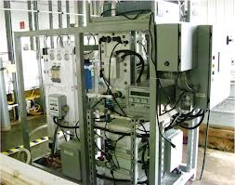
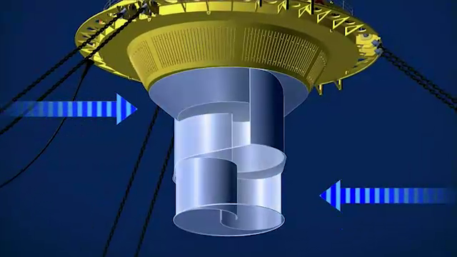
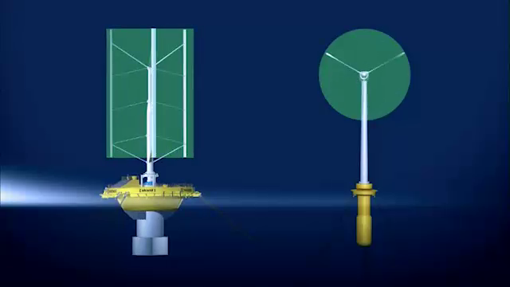
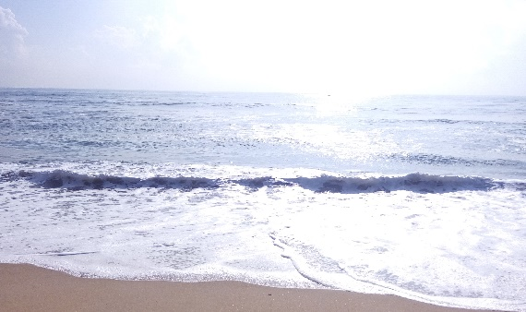
SCHEMATIC DIAGRAM OF COUPLING
CO₂
Reverse Water Gas Shift Reaction
CO
ELECTRO-CHEMICAL ACIDIFICATION
H⁺
FISCHER-TROPCH REACTION
H⁺
CCS
SAVONIUS CURRENT TURBINE
SATURATED HYDRO CARBON CHAIN / FUEL
BATTERY
DARRIEUS WIND TURBINE
SEAWATER

Slide 12
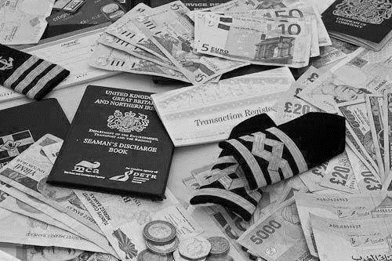
COST MODEL
200GAL/DAY
1.7*10⁴ m³/DAY
2,747.2 m³/DAY
887.8 m³/DAY
0.5MW
$1.34/LITRE
$0.17/LITRE
$1.78/LITRE
$0.27/LITRE
0.40MW FOR HYDROGEN PRODUCTION
0.10MW FOR CARBON CAPTURE
COST OF CARBON CAPTURE
FUEL PRODUCED
SEAWATER PROCESSED FOR CO2
COST OF HYDROGEN GENERATION
H₂ REQUIRED
COST OF FUEL SYNTHESIS
CARBON CAPTURE
FUEL COST
POWER CONSUMED BY CCS
POWER GENERATED BY SKWID

Slide 13
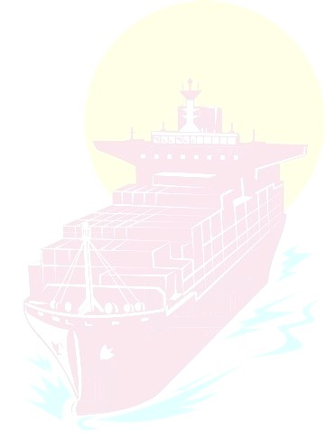
FORTUNES
CCSKWID helps in preserving eco-system.
Energy produced by SKWID is large enough to light 354 houses annually.
Independency on fossil fuels.
Risk to life reduced.
Pave way to new job opportunites in shipping industry.
Highly cost-effective.
Ships need not stop for refuelling during voyages.
It is harmless to the marine ecosystem.

Slide 14

THANK YOU!
Presented By :
Cadet ARPIT JAJOO
Cadet SK RAKIBUDDIN

