Slide 1
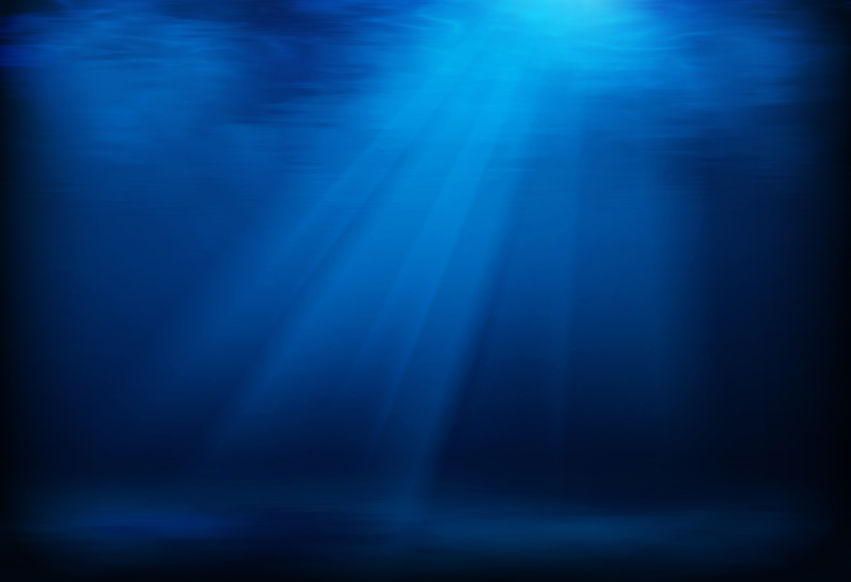
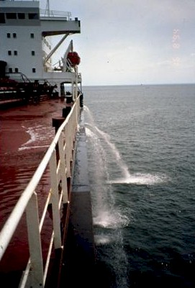
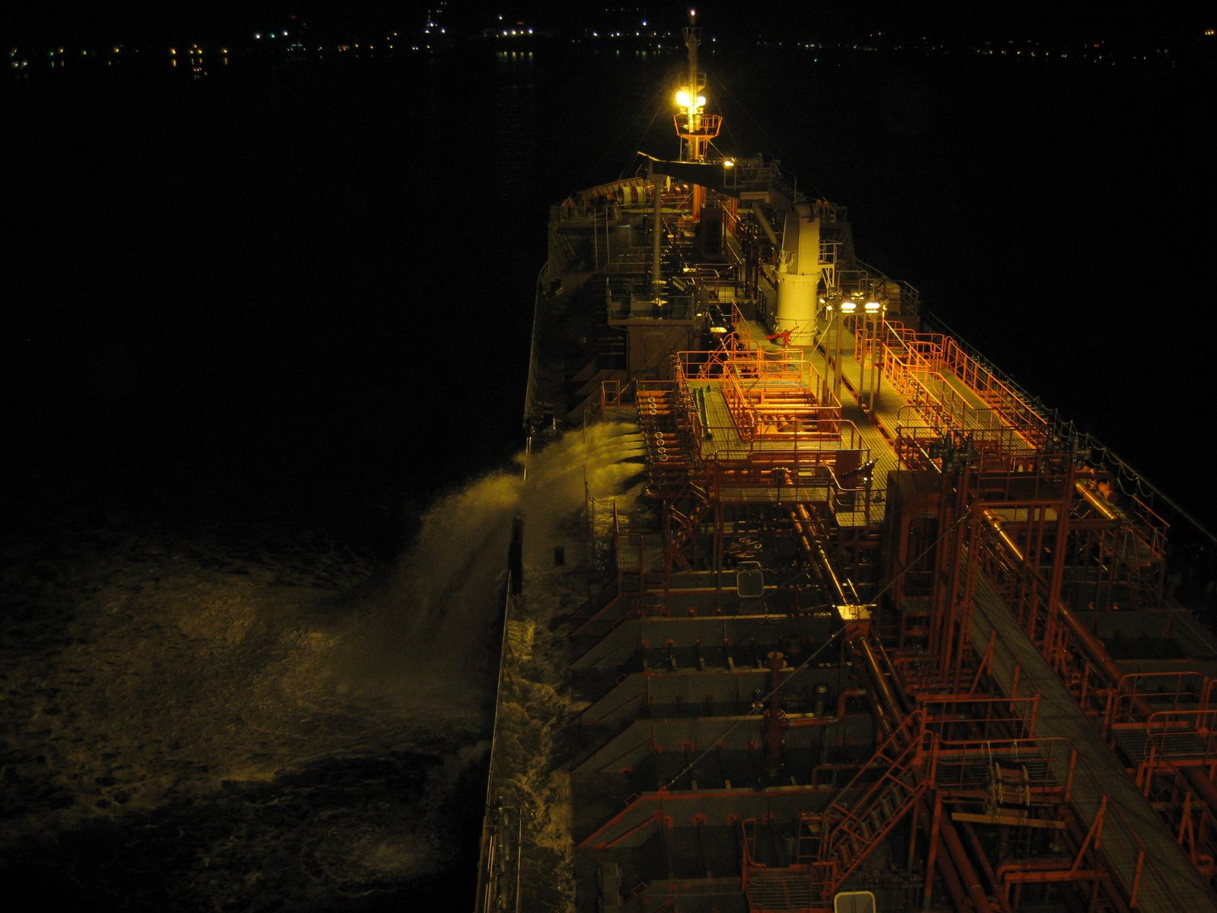
BALLAST WATER MANAGEMENT
By : Cdt Nishant Kumar
Cdt Suhas Kassa
Cdt Nishigandh R B

Slide 2
OBJECTIVE
To acquaint ourselves with the nuances of Ballast Water Management
1/27

Slide 3
PREVIEW
PART 1 : What is Ballast Water?
PART 2 : Problems associated with Ballast Water
PART 3 : Remedial Actions
2/27

Slide 4
PART I
  What is Ballast Water ???

Slide 5
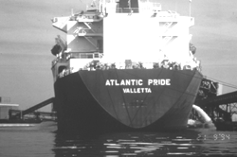
BALLAST WATER
Ballast Provides trim, stability & maneuverability for the ship.
Previously, ballast comprised of sand, rocks and sometimes cement blocks also.
Modern day ballast is mainly Seawater.
Seawater ballast includes certain sediments, rocks and living organisms.
3/27

Slide 6
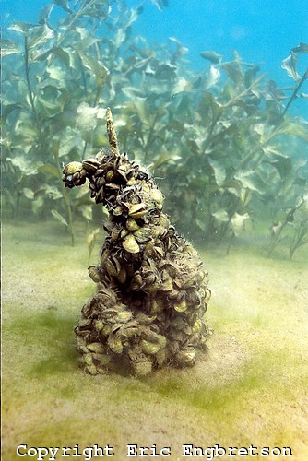
BALLAST WATER – A GROWING CONCERN
The water taken on board for ballasting a vessel may contain dormant stages of microscopic toxic aquatic organisms (& pathogens) and plants, such as dinoflagellates, which may cause harmful algal blooms after their release.
Higher rates of species transfer have primarily been attributed to
  Increase in ship speeds with shorter
  voyage times and higher survival rates;
  Increase in the amount of ballast carried
  per ship.
4/27

Slide 7
PART II
  Problems associated with Ballast Water

Slide 8
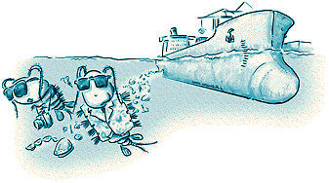
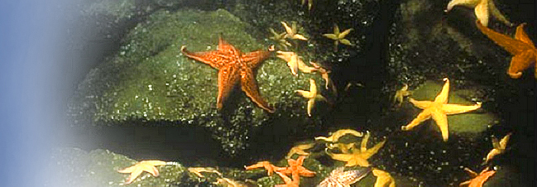
TROUBLESOME HISTORY
Wooden ships transported innumerable species
both in them (as boring organisms)
and on them(as fouling communities)
In the last quarter of the 19th century, the world's oceans had slowly begun to biologically homogenize, with the advent of commercial transport of Oysters.
Invasive species came into the frame because of its ecological impact in
  Great Lakes (USA)
  Argentina
  Australia
5/27

Slide 9

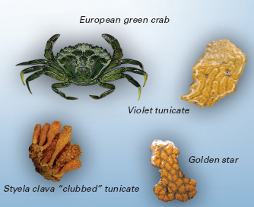
INVASIVE SPECIES
6/27

Slide 10

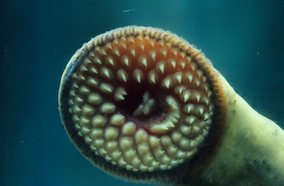
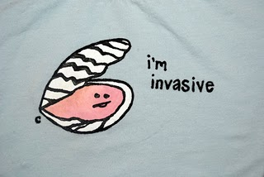
INVASIVE SPECIES
A few of the invasive species which have been categorically mentioned by the IMO are
Sea Lamprey (Petromyzon marinus)
North American Comb Jelly [Mnemiopsis leidyi]
Zebra Mussel [Dreissena polymorpha]
Asian Kelp [Undaria pinnatifida]
European Green Crab [Carcinus maenas]
7/27

Slide 11
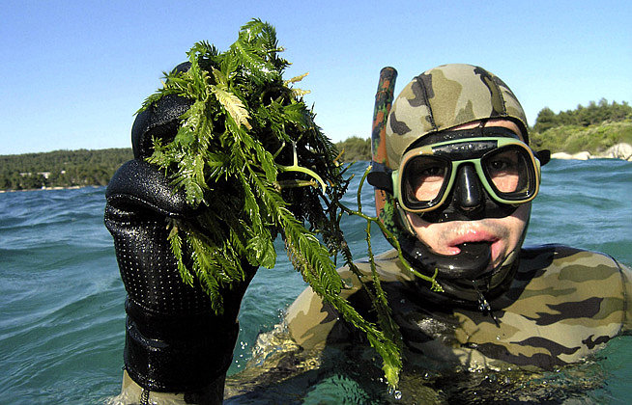
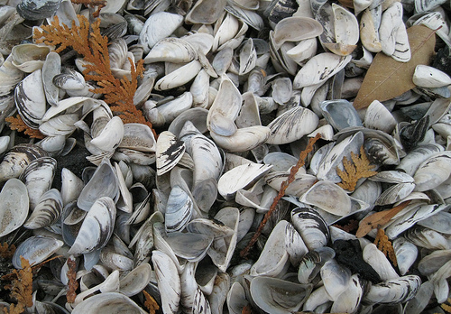
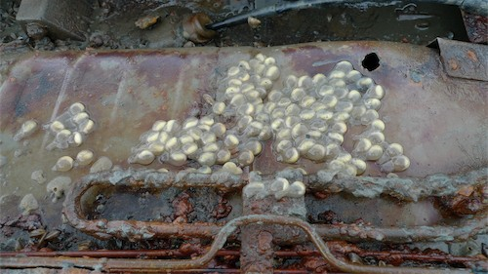
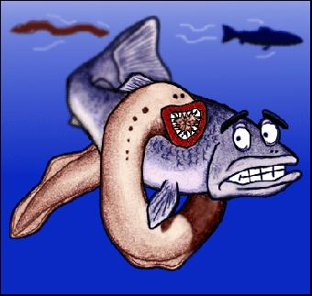
NUISANCE OF INVASIVE SPECIES
8/27

Slide 12

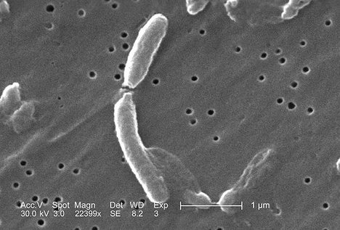
NUISANCE OF INVASIVE SPECIES
The ZEBRA MUSSEL, native to the Caspian and Black Seas arrived in Lake St. Clair via a transatlantic freighter in 1988 and within 10 years spread to all of the five neighboring Great Lakes.
In 1991 the South American CHOLERA epidemic was a result of the bacterium discovered in oysters and fish in Mobile Bay, Alabama.
Peru has recently developed into a hub
for the growth and assimilation of
Vibrio Cholerae, but back in the 1990’s,
these were primarily found in the Bangladeshi waters and upon its arrival in Peru, have claimed more than 10,000 lives so far.
9/27

Slide 13
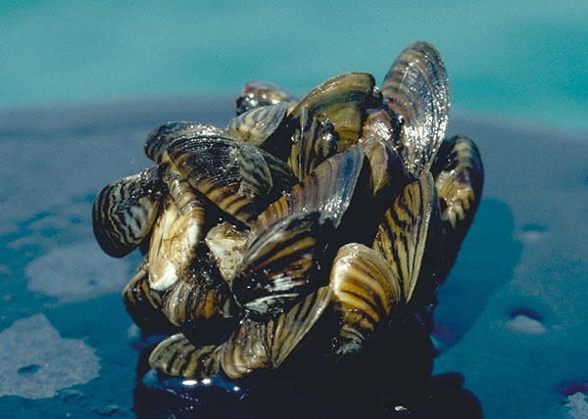
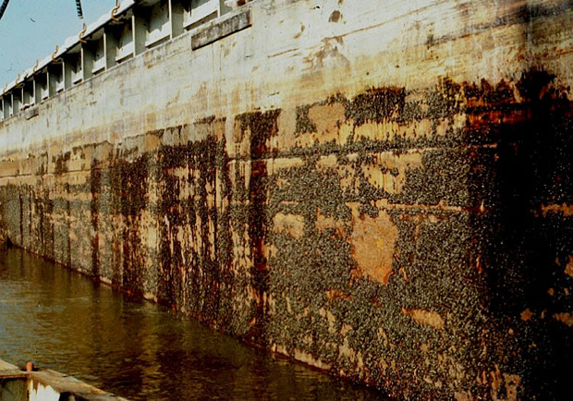
Cluster of Zebra Mussels
Zebra Mussels on a barge
10/27

Slide 14
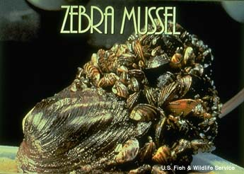
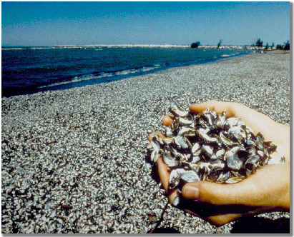
ZEBRA MUSSEL
11/27

Slide 15
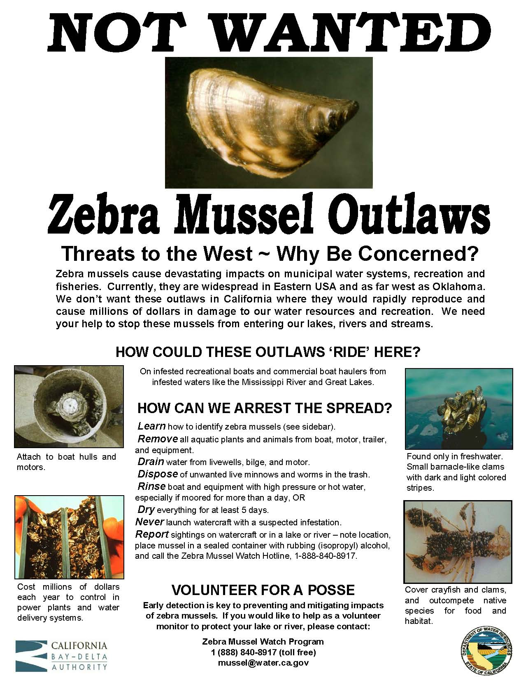
12/27

Slide 16
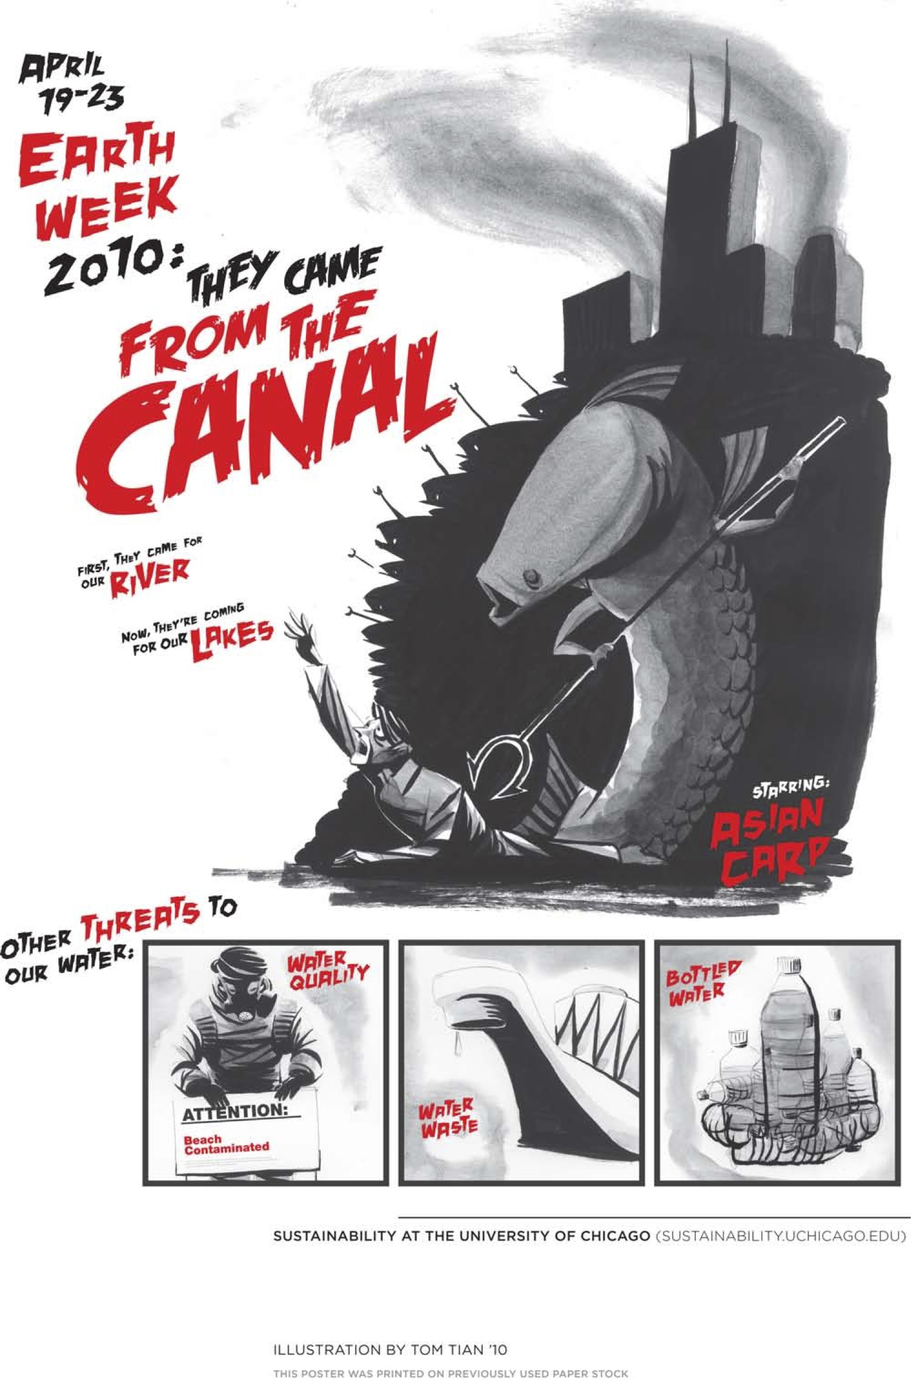
13/27

Slide 17
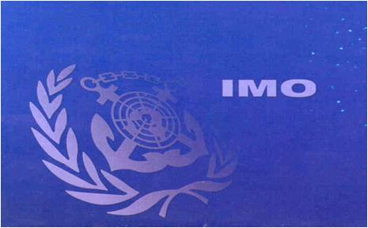
IMO INITIAL RESPONSE
First Conference on the issue of harmful aquatic organisms in ballast water was raised at IMO in 1988.
The United Nations Conference on Environment and Development (UNCED) was held in Rio de Janeiro in 1992, Agenda 21 Transfer of invasive species by ballast.
Article 196 of the United Nations’ Law of Sea Convention.
14/27

Slide 18
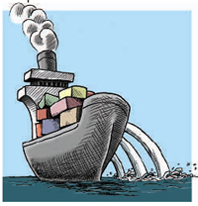
2004 CONVENTION
February 2004, Agreement necessitating a ballast water discharge standard, to be achieved by a suitable shipboard treatment plan.
Mandatory Reqmts : 1. Valid Certificate.
2. Ballast Water Management Plan
3. Ballast Water Record Book.
MEPC 53rd session :
  July 2005.
  Uniform implementation of the International Convention for the Control and Management of Ships' Ballast Water and Sediments (BWM Convention).
15/27

Slide 19
PART III
  Remedial Actions……..

Slide 20
BALLAST WATER MANAGEMENT PRACTICES
Twin standards for “purity of ballast water” are stipulated:
Exchange Standard – 1. Sequential method.
2. Flow-through method.
Dilution method.
Performance Standard – Less than 10 viable organisms per cubic meter greater than 50μm
and
Less than 10 viable organisms…..
.......10μm and limited number of
indicator microbes (bacteria).
16/27

Slide 21
BALLAST WATER TREATMENT
MECHANICAL TREATMENT
1.Screens/Filters
2. Cyclonic Separation
PHYSICAL TREATMENT
1. Ballast Water Exchange variants.
2.Sonic/Ultrasound.
3. U.V. Radiation.
CHEMICAL TREATMENT
1. Chemical/Biocides
2. De-Oxygenation
3. Ozone treatment
4. Gas Super-saturation
17/27

Slide 22
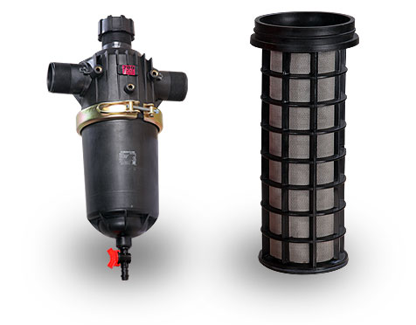
BALLAST WATER TREATMENT
FILTRATION:
  Sediments & Particles removed by disc and screen filters.
  Parallel arrangement of filter units.
  Filtration grade down to 100 / 50 / 27 µm
CHEMICAL ADDITIVES:
  Direct addition of chemical additives to the Ballast water.
CYCLONIC SEPARATION:
  Separation of solid particles due to centrifugal forces.

Slide 23
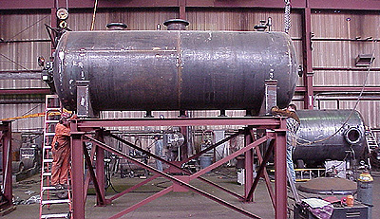
BALLAST WATER TREATMENT
ELECTROLYSIS:
– Electronic ionization by means of electrical current.
– Generation of Chlorine/Chlorine Dioxide acts as the
disinfectant.
DE-OXYGENATION:
  Removal of dissolved oxygen in Ballast Water & replacement by inactive gases.
GAS SUPER SATURATION:
  Controlled atmosphere is provided in tanks to avoid re-oxygenation.

Slide 24
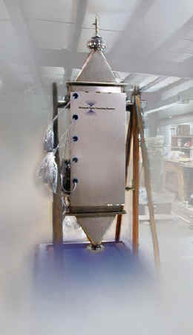
SONIC/ULTRASOUND TREATMENT
Ultrasound (27 kHz – 10 MHz) generates bubbles
Bubbles collapse – generating temp in excess of
2700°C & attain pressures up to 1800 atm.
This leads to rupture of organism cells.
Targets micro-organisms & potential to destroy
sedimentary particles.
OZONE TREATMENT
Removing oxygen out of the ambient air.
Diffusion of Ozone into seawater converts Br– to
HOBr/OBr–, which act as disinfectants.
Effectiveness of 90% and above.
18/27

Slide 25
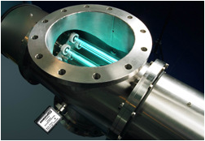
U.V. RADIATION
UV radiation (253.7 nm) targets both macro and micro-organisms.
Inactivation of organisms and pathogens by breaking the cell membrane.
Can be used on deballasting as well as ballasting.
Minimal impact on ballast flow.
Ease of maintenance.
Computer controlled UV dose.
19/27

Slide 26
PRESENT DAY BALLAST WATER TREATMENT TECHNIQUES
Hyde Marine Ballast Water treatment system.
LCP Tech. Treatment Setup.
NEI Marine - VOS™ Treatment System.
20/27

Slide 27
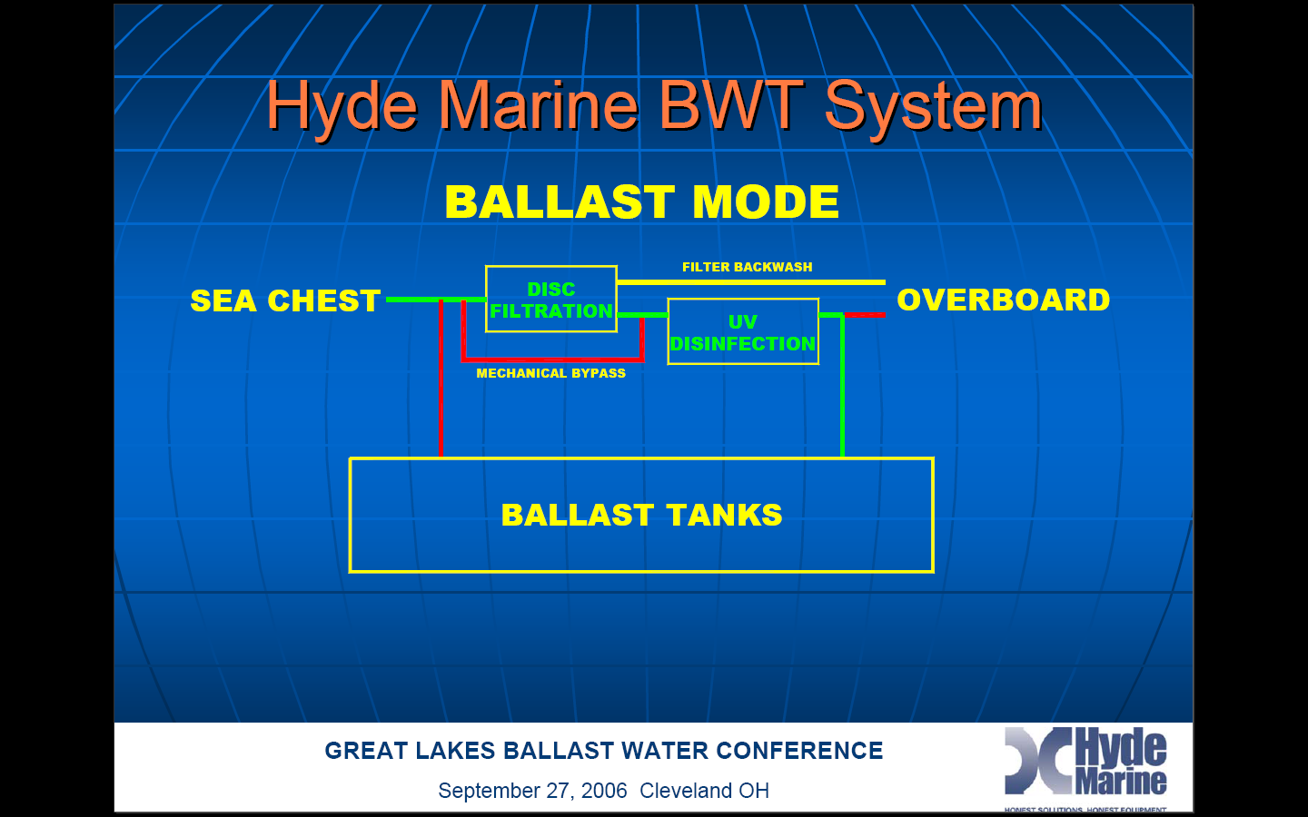
21/27

Slide 28
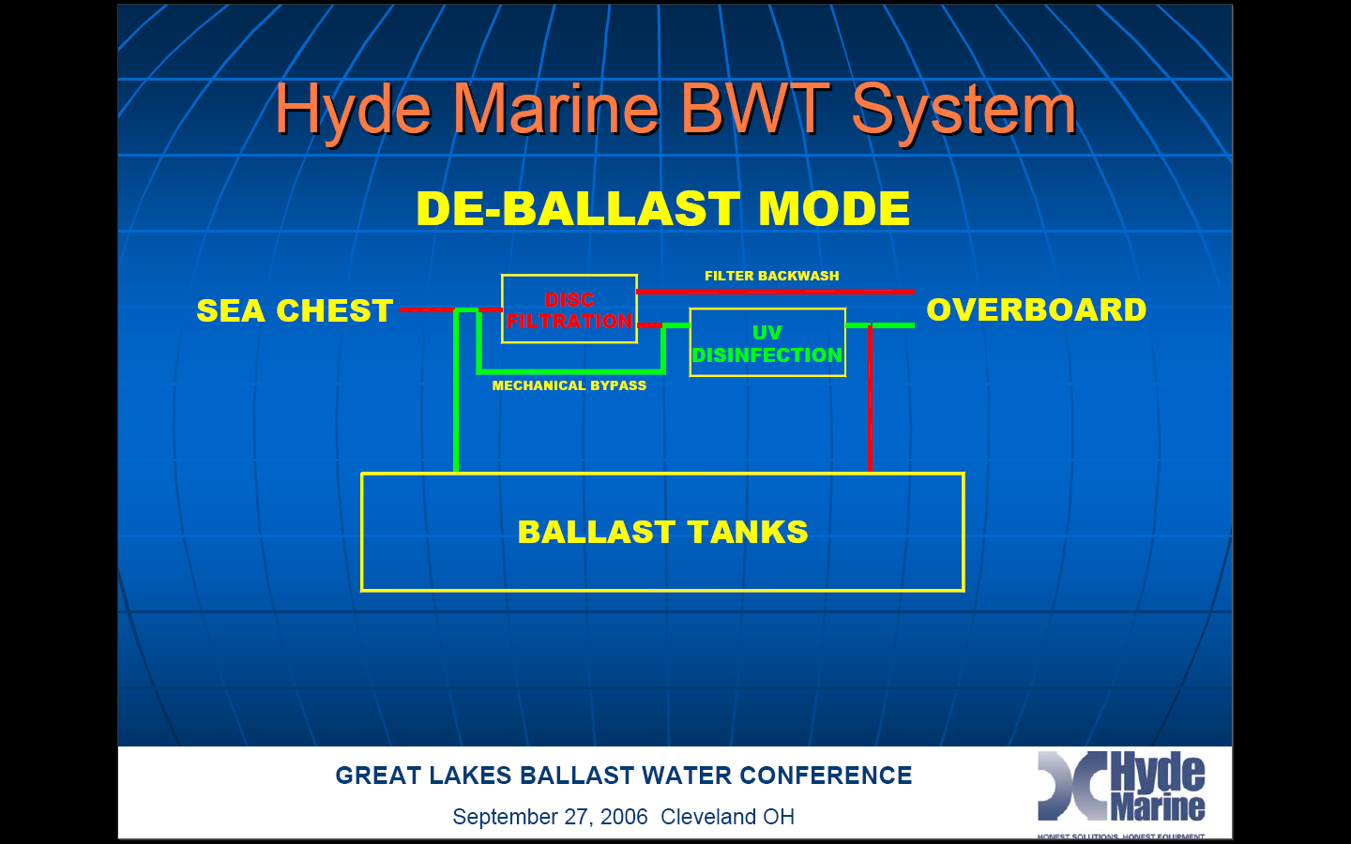
22/27

Slide 29
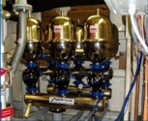
DISK FILTER (HYDE MARINE)
23/27

Slide 30
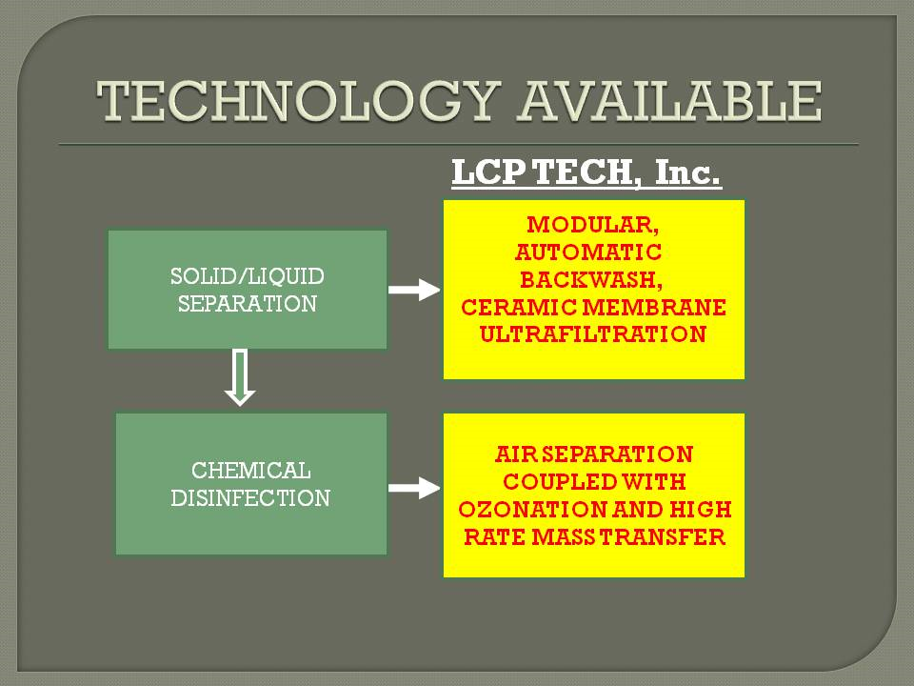
24/27

Slide 31
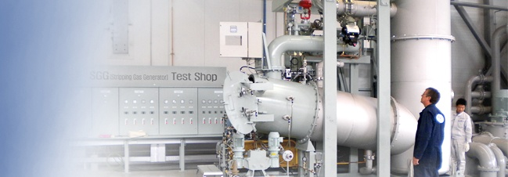
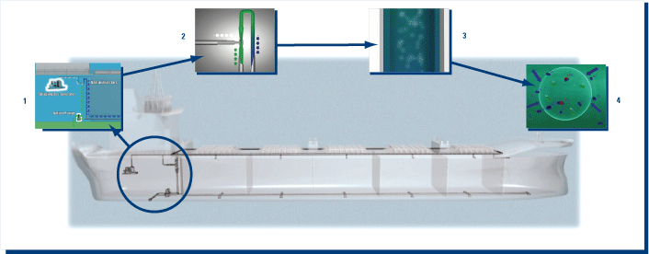
VOS™ SYSTEM
VOS™ Venturi Oxygen Stripping.
Induces a LOW OXYGEN environment in the ballast tanks which safely eliminates harmful aquatic organisms.
This low oxygen, non-toxic environment also protects ship's ballast tank coatings against degradation and corrosion of steel.
25/27

Slide 32
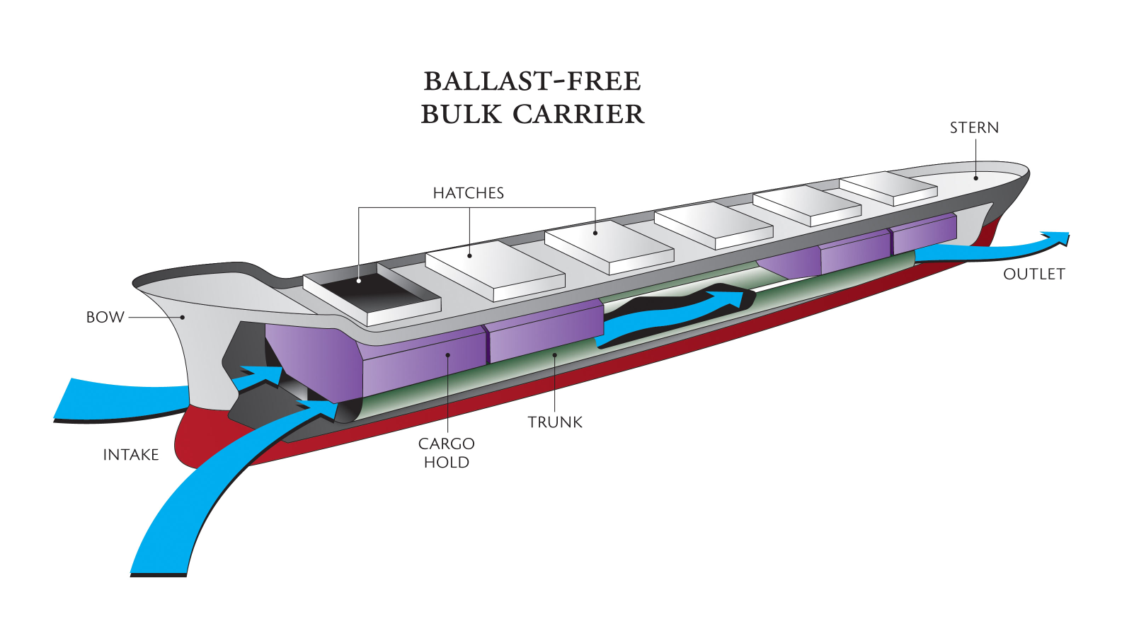
BALLAST FREE SHIPS – THE WAY AHEAD
26/27

Slide 33
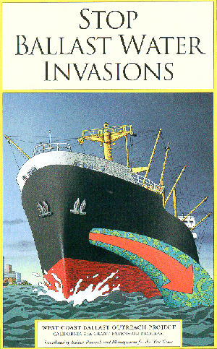
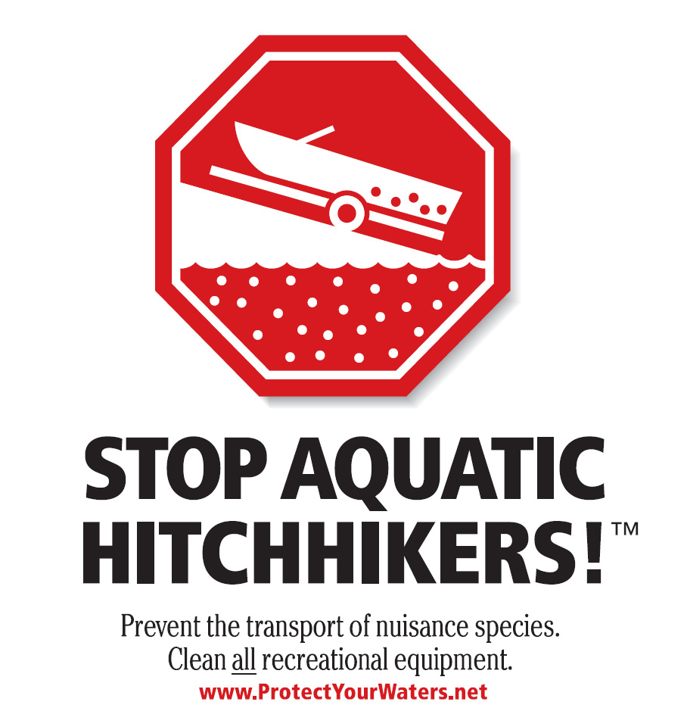
THANK YOU
27/27

