Slide 1



DEPARTMENT OF MARINE ENGINEERING
NOORUL ISLAM UNIVERSITY
TOLANI TRANSTECH ‘14
NATIONAL LEVEL PAPER PRESENTATION
SMART MATERIAL FOR SMART FUTURE
BY:-
G.VINOTH KUMAR,3RD YEAR
K.SATHEESH BABU,2ND YEAR
sailorsatheeshseafarer@gmail.com

Slide 2
INTRODUCTION
WHAT IS SMART MATERIAL?
Smart materials are designed materials that have one or more properties that can be significantly changed in a controlled fashion by external stimuli, such as stress, temperature, moisture, pH, electric or magnetic fields.

Slide 3
Smart Technologies Prospects
1. New sensing materials and devices.
2. New actuation materials and devices.
3. New control devices and techniques.
4. Self-detection, self-diagnostic, self-corrective and
self-controlled functions of smart materials/systems.

Slide 4
DEFECTS IN CONVENTIONAL MATERIALS
Corrosion
Wear and tear.
Higher maintenance
Higher thermal conductivity leads to heat loss

Slide 5

WHY WE NEED NEW MATERIALS ?
To Increase the power of engines
To get higher efficiency
To reduce the size and weight of the engine
To achieve Economically benefit

Slide 6
Low maintenance cost ?.....
Corrosion resistance?...
Less in cost ?....
Then what’s that material ?...

Slide 7

PIEZOELECTRIC MATERIALS AND
SHAPE MEMORY ALLOY MATERIALS

Slide 8
Piezoelectric materials
piezoelectric materials =( piezo and electric).
Piezo (Greek word piezein) -press tightly or squeeze.
piezein with electric -‘‘squeeze electricity.’’
Piezoelectric materials generate an electric field along their surface when subject to mechanical stress.
The piezoelectric effect first proven in 1880 by the brothers Pierre and Jacques Curie.
Based on electrical polarity piezoelectric materials change shape when an electrical field is applied by compression or expansion.

Slide 9
TYPES OF PIEZOELECTRIC MATERIALS
Naturally occurring crystals:
Berlinite (AlPO4), cane sugar, Quartz, Rochelle salt, Topaz, Tourmaline Group Minerals, and dry bone (apatite crystals)
Man-made crystals:
Gallium orthophosphate (GaPO4), Langasite (La3Ga5SiO14)
Man-made ceramics:
Barium titanate (BaTiO3), Lead titanate (PbTiO3), Lead zirconate titanate (Pb[ZrxTi1-x]O3 0<x<1) - More commonly known as PZT, Potassium niobate (KNbO3), Lithium niobate (LiNbO3), Lithium tantalate (LiTaO3), Sodium tungstate (NaxWO3), Ba2NaNb5O5, Pb2KNb5O15
Polymers:
Polyvinylidene fluoride (PVDF)

Slide 10
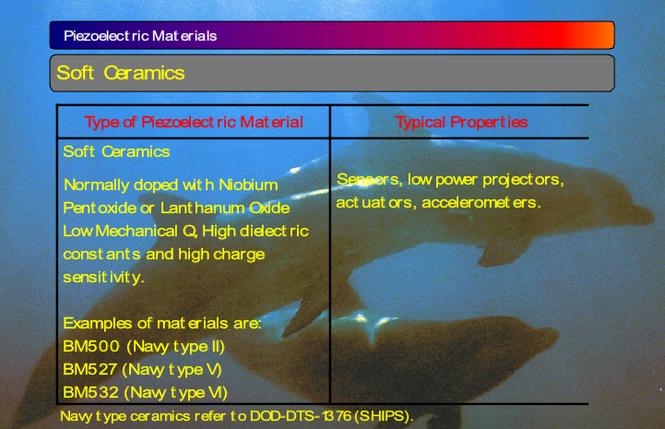
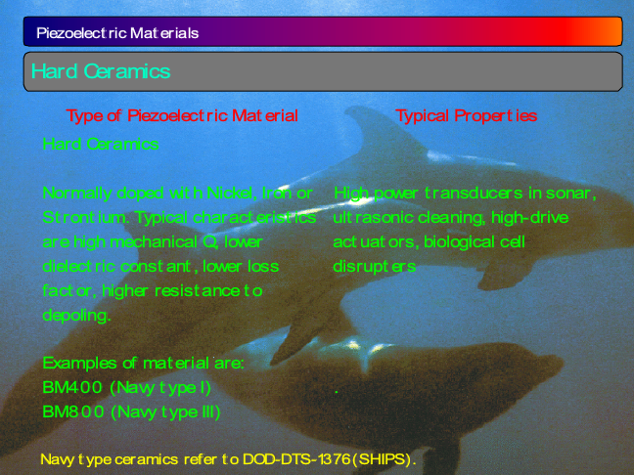

Slide 11
PIEZO ELECTRIC INJECTION SYSTEM ( FUEL)
A slice of piezo material property
An relay unit
hundreds of little piezo slices stacked
0.004 inch of movement
expansion of the piezo stack
On the completion of the Injection

Slide 12
Piezoelectric fuel injector schematic diagram

Slide 13
Advantages of piezo electric injection system
control of the injection interval
piezoelectric crystals and the drive by wire concept will completely eliminate the camshaft, push rod, rocker arm and other conventional valve operating related items.
improved combustion, Accurate injection
Piezoelectric fuel injectors provide a means to reduce fuel consumption, noise and emissions in modern IC engines.
Diesel engines: High-performance common rail diesel engines use piezoelectric fuel injectors, instead of the more common solenoid valve devices.
A piezoelectric transducer is used in fuel injection systems to measure the manifold absolute pressure (MAP sensor) and to determine engine load.
piezo-controlled injection valves in combustion engines reduce the transition times and significantly improve the smoothness and exhaust gas quality.

Slide 14
High voltage and power sources
A piezoelectric transformer is a type of AC voltage multiplier. Unlike a conventional transformer, which uses magnetic coupling between input and output, the piezoelectric transformer uses acoustic coupling.
An input voltage is applied across a short length of a bar of piezoceramic material such as PZT, creating an alternating stress in the bar by the inverse piezoelectric effect and causing the whole bar to vibrate.
The vibration frequency is chosen to be the resonant frequency of the block, typically in the 100 kilohertz to 1 megahertz range.
Step-up ratios of more than 1000:1 have been demonstrated.

Slide 15
PRESSURE APPLICATIONS
Transient pressure measurement to study explosives, internal combustion engines (knock sensors), and any other vibrations, accelerations, or impacts.
Energy Harvesting from impact on the ground
Vibrations from industrial machinery can also be harvested by piezoelectric materials to charge batteries for backup supplies or to power low-power microprocessors and wireless radios

Slide 16
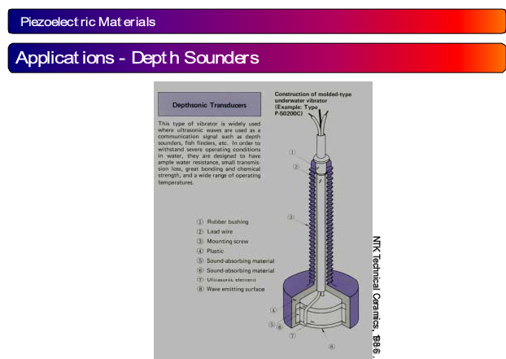
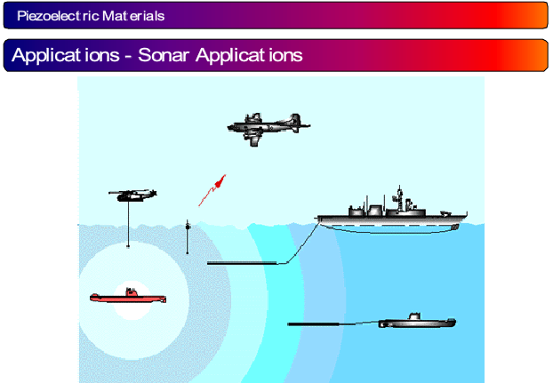
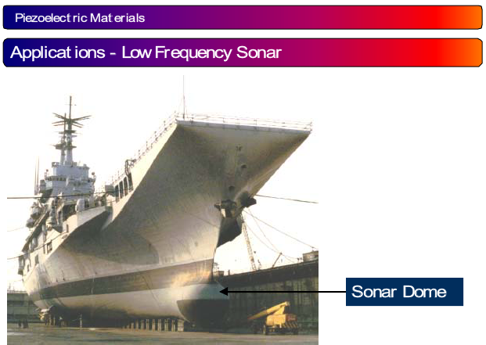
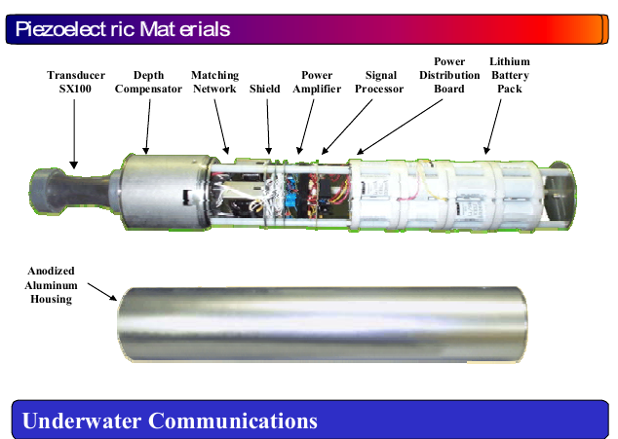

Slide 17
SHAPE MEMORY ALLOY
Shape Memory Alloys. When subjected to a thermal field, this material will undergo phase transformations which will produce shape changes. It deforms to its ‘martensitic’ condition with low temperature, and regains its original shape in its ‘austenite’ condition when heated (high temperature). (Example: Nitinol TiNi.)
Nickel-titanium alloys have been found to be the most useful of all SMAs. Other shape memory alloys include copper-aluminum-nickel, copper-zinc-aluminum, and iron- manganese-silicon alloys.
The generic name for the family of nickel-titanium alloys is Nitinol. In 1961, Nitinol, which stands for Nickel Titanium Naval Ordnance Laboratory

Slide 18

VIDEO:-

Slide 19
Stress-Strain Characteristics of Nitinol at Various Temperatures

Slide 20
Mechanical Properties of Nitinol
• Ultimate Tensile Strength: 754 - 960 MPa or 110 - 140 ksi
• Typical Elongation to Fracture: 15.5 percent
• Typical Yield Strength (hi-temp): 560 MPa, 80 ksi
• Typical Yield Strength (lo-temp): 100 MPa, 15 ksi
• Approximate Elastic Modulus (hi-tem): 75 GPa, 11 Mpsi
• Approximate Elastic Modulus (lo-temp): 28 GPa, 4 Mpsi
• Approximate Poisson's Ratio: 0.3

Slide 21
COMPARISION BETWEEN STEEL,Zro2,Al2o3,NiTi
ITEM | UNIT | STEEL | Zro2 | Al2o3
DENSITY | g/cm3 | 7.85 | 6.05 | 3.95
THERMAL EXPANSION COEFFICIENT | 10-6/k | 10.0 | 10.5 | 9.1
HARDNESS | -- | 700 | 1200 | 1800
CORRISION RESISTANCE | -- | WORSE | BETTER | BETTER
CRUSHING STRENGTH | Mpa | -- | 2100 | 1500
THERMAL CONDUCTIVITY | w/mk | 30-40 | 2 | 5
MAX TEMPERATURE | celsius | 1200 | 2510 | 1850
Ni-Ti
6.45
10
_
Excellent
1200
0.1
1350

Slide 22
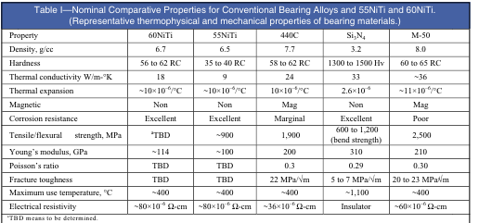

Slide 23
Manufacturing process
Vacuum Arc Remelting:- This is done by striking an electrical arc between the raw material and a water-cooled copper strike plate. Melting is done in a high vacuum, and the mold itself is water-cooled copper, so no carbon is introduced during melting.
Vacuum Induction Melting: This is done by using alternating magnetic fields to heat the raw materials in a crucible (generally carbon). This is also done in a high vacuum, but carbon is introduced during the process.

Slide 24
COUPLING
Application of SMAs in the pipe fitting business started back in the 1970s.
The coupling is a tube made from a SMA tube.
The SMA tube is formed with its inner diameter set to 4% smaller than the outer diameter of the tubes that will be joined.
The alloy is designed to have a transformation temperature far lower than room temperature(about -150oC).
Before the connection, the coupling is cooled below its transformation temperature.
Then it is forced to open to 7% or 8% greater than its starting size so that the two pipes can be inserted at either end of the coupling.
As the coupling temperature rises to room temperature, it reverts to its original diameter, binding the ends of the pipes
Such coupling have also found massive use in the plumbing of atomic submarines, warships, and ocean-floor oil transportation of oil.

Slide 25
Shape Memory Alloy Pipe Coupling

Slide 26
Advantages
Good Mechanical Properties (strong, corrosion resistant),piping
Nitinol is an actuator, sensor, and heater all in one material.
Using SMA springs include engine cooling,and engine lubrication controls, and the control of a radiator
SMAs are "ideally suited for use as fasteners, seals, connectors, and clamps" in a variety of applications
Nitinol actuators as engine mounts and suspensions can also control vibration.
It is used for couplings,
Demonstration model heat engines have been built which use nitinol wire to produce mechanical energy from hot and cold heat sources
It can be used as a temperature control system; as it changes shape, it can activate a switch or a variable resistor to control the temperature.

Slide 27
Yeah, it requires less maintenance……..!
Yes, it is corrosion resistance……!
yep, smart material increases the overhauling period………………!
Its possible………!
We can use this materials in future………!

Slide 28



CONCLUSION:
SMART STRONG FLEXIBLE
INNOVATIVE ECOFRIENDLY MONEY SAVING

Slide 29
References
http://www.memory-metalle.de/html/01_start/index_outer_frame.htm
http://www.academia.edu/1071824/Development_and_application_of_piezoelectric_materials_for_ultrasound_generation_and_detection#
1. L.C. Chang and T.A. Read, Trans. AIME, Vol 191, 1951, p 47
2. W.J. Buehler, J.V. Gilfrich, and R.C. Wiley, J. Appl. Phys., Vol 34, 1963, p 1475
3. Proceedings of Engineering Aspects of Shape Memory Alloys (Lansing, MI). 1988
4. D.E. Hodgson, Using Shape Memory Alloys, Shape Memory Applications, 1988
http://www.sma-inc.com/html/johnson_matthey_home_page.html
http://www.memory-metalle.de/shape-memory-alloy.html
http://content.aip.org/APPLAB/v84/i1/31_1.html
http://www.piezo.com/tech1terms.html
http://www.piezo.com/tech4history.html
http://www.piezoelectrics.net/piezoelectrichistory.htm
http://www.americanpiezo.com/piezo_theory/index.html
http://www.cedrat-groupe.com/
http://www.sensotec.com/accelerometer_faq.asp?category=All
http://www.apple.com/iphone/features/index.html#accelerometer
http://www.patent-invent.com/electricity/inventions/piezoelectricity.html
http://en.wikipedia.org/wiki/Piezoelectricity

Slide 30
ANY QUERIES ?
THANK YOU
“EDUCATION IS THE MANIFESTATION OF THE PERFECTION ALREADY IN MAN “
-swami vivekananda

