Slide 1
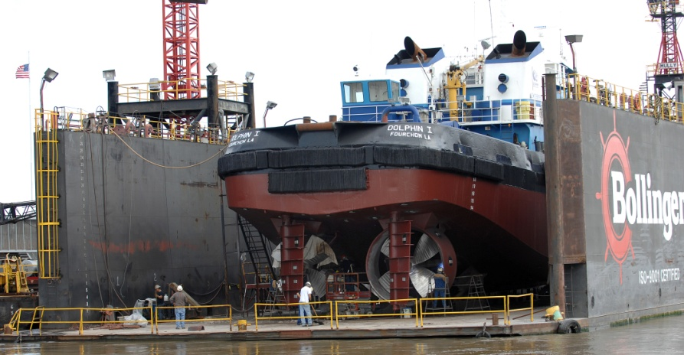
HULL AND PROPELLER
PRESENTED BY:
RAMINDER SOOD
LOKESH RAO
M.E.R.I -MUMBAI

Slide 2
INTRODUCTION
Why choose this topic?
- Earth covered with 70% of water.
- Ship major means of transport
- Each year several billion tons of bulk transported through ship.
- Hull and propeller being the most important part of the ship we are concentrating on it.

Slide 3
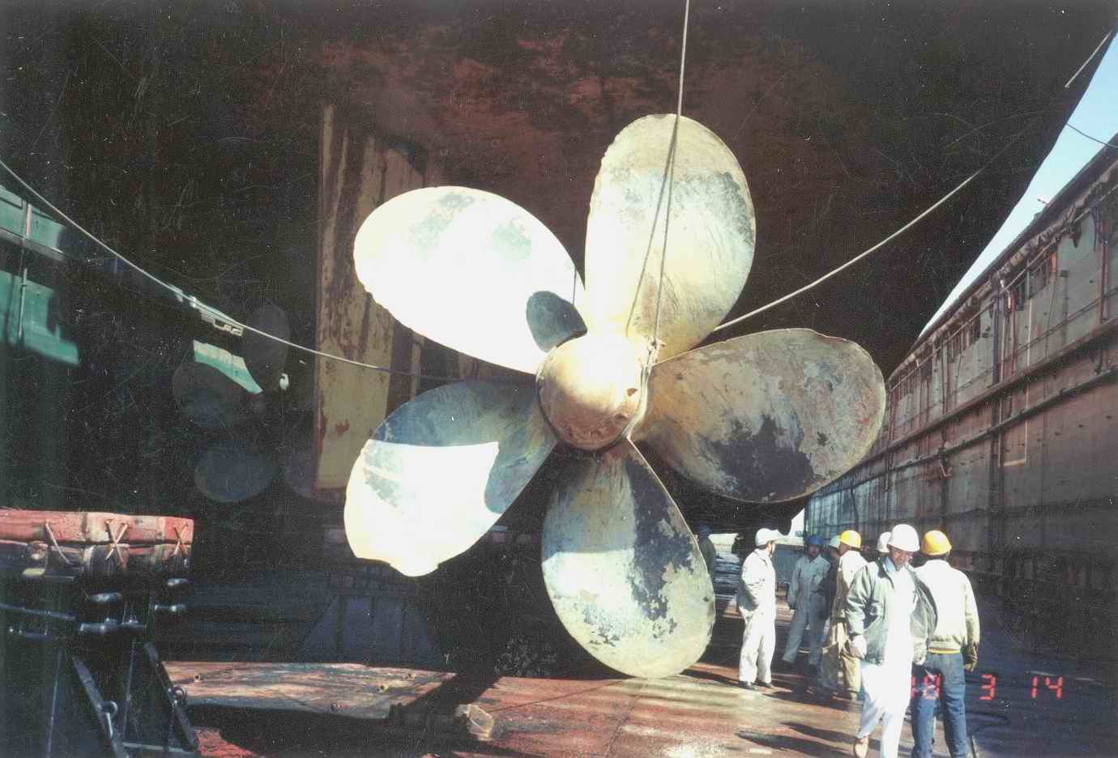
PROPELLER
A PROPELLER IS A TYPE OF FAN THAT TRANSMITS POWERBY CONVERTING ROTATIONAL MOTION INTO THRUST
A propeller is the most common propulsor on ships, imparting momentum to
a fluid which causes a
force to act on the ship

Slide 4
A pressure difference is produced between the forward and rear surfaces of the airfoil-shaped blade,and air or water is accelerated behind the blade.
A propeller that turns clockwise to produce forward thrust, when viewed from aft, is called right-handed. One that turns anticlockwise is said to be left-handed.
Another possibility is contra-rotating propeller, where two propellers rotate in opposing directions on a single shaft, or on separate shafts on nearly the same axis.

Slide 5
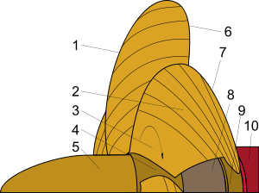
1) Trailing edge
2) Face
3) Fillet area
4) Hub or Boss
5) Hub or Boss Cap
6) Leading edge
7) Back
8) Propeller shaft
9) Stern tube bearing
10) Stern tube

Slide 6
TYPES OF MARINE PROPELLERS
CONTROLLABLE PITCH PROPELLER
SKEWBACK PROPELLER
ADJUSTABLE BOLTED PROPELLER
FIXED PITCH PROPELLER
DUCTED PROPELLER
FOLDING PROPELLER

Slide 7
CONTROLLABLE PITCH PROPELLER
It give the highest propulsive efficiency over a broad range of speeds and load conditions. By adjusting the blade pitch, the optimum efficiency can be obtained and fuel can be saved.
Load sensing hydraulics give low noise and vibration with low energy consumption
Blades and blade seals can be changed underwater
SKEWBACK PROPELLER
An advanced type of propeller used on German Type 212 submarines.
This design preserves thrust efficiency while reducing cavitation, and thus makes for a quiet, stealthy design.

Slide 8
ADJUSTABLE BOLTED PROPELLER
The Adjustable Bolted Propeller (ABP) allows the most efficient blade matching for optimum efficiency while simplifying the installation process.
Simpler, less costly installation at the shipyard
Individual blades can be replaced if damaged
Hollow hub reduces total weight
FIXED PITCH PROPELLER
It is more efficient than a CPP under a specific rotational speed and load condition.

Slide 9
DUCTED PROPELLER
A ducted propeller is fitted with a non-rotating nozzle. It is used to improve the efficiency of the propeller and are especially used on heavily loaded propellers or propellers with limited diameter.
FOLDING PROPELLER
Type of propeller where the propeller blades fold in when the propeller is not in use, and out when the propeller is in use. This type of propeller is often used on sailing yachtsto reduce drag while under sail.

Slide 10
CAVITATION OF MARINE PROPELLER
Cavitation occurs when the pressure in the fluid flowing around the propeller blades drops and causes some fluid to change into water vapor.
It occur if transmit too much power through the screw or propeller is operating at a very high speed.
It changes the homogeneity of the fluid flow.
This causes the racing of propeller shaft but the speed of the ship drops.
It causes the erosion of material particularly on the surface of the propeller blade

Slide 11
SUCTION SIDE SURFACE CAVITATION
It forms when the propeller is operating at high rotational speeds or under heavy load
When most of the blade surface is covered by cavitation, the pressure difference between the pressure side and suction side of the blade drops considerably, and thrust produced by the propeller drops. This condition is called "thrust breakdown".

Slide 12
TIP VORTEX CAVITATION
Tip vortex cavitation is caused by the extremely low pressures formed at the core of the tip vortex.
The tip vortex is caused by fluid wrapping around the tip of the propeller; from the pressure side to the suction side.

Slide 13
INSPECTION OF PROPELLER
PROPELLER MAINENANCE
Should be cleaned each time the vessel is drydocked.
May be cleaned by divers if the vessel is long out of dock.
PROPELLER VIBRATION
Frequency of vibration should be determined.
Vibration with frequency equal to RPM of shaft is called unbalanced vibrations.
Its dimensions should be checked with applicable drawing.

Slide 14
REPLACEMENT OF PROPELLER
BLADE INSPECTION
Cracks in blade
Broken blade tips
Curled or bend blade.
HUB INSPECTION
Wear around keyway.
Crack around outside of hub
Wear inside the hub

Slide 15
PROPELLER CLEANING
Remove barnacles by scraping and wire-brushing.
Polish them with fine abrasive
Coat the propeller with approved rust –preventive compound.
PROPELLER BALANCING
A ball bearing or knife-edge balancer is used as it has greater sensitivity

Slide 16
CAUTION
Propeller usually can be handled by hand but caution must be exercised to avoid damaging.
Each drawbolt must have sufficient thread in the propeller hub.
Multi-brush units shall not be used on any of the propeller surfaces.

Slide 17
HULL
Hull is the watertight body of the ship or boat
Shape entirely depends on the need of the design.
Above the hull is the superstructure or the deckhouse.
Line where the hull meets the water surface is called the waterline.
Keel is a centerline longitudinal member.
Types of ship
1.Monohull 2.Multihull

Slide 18
Not all hull have deck like dinghy.
Shape chosen to have balance between
  Cost
  Hydrodynamics
  Hydrostatic consideration

Slide 19
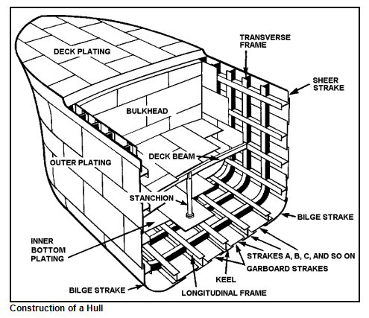

Slide 20
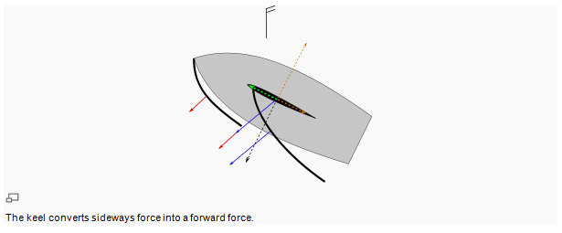

Slide 21
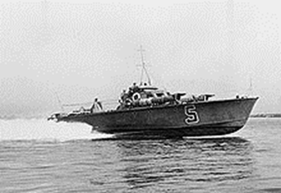
HULL TYPES
Three main classification of hull:
- displacement type
- semi displacement
- planing
Type named according to its shape

Slide 22
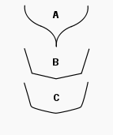
HULL FORMS
S shaped hull
Hard chinned hull
Soft chinned hull

Slide 23
DRYDOCKING
Normal dry-dock period once every 2 years or 5 years.
When ships are taken to dry ports for their repairing ,maintenance painting and other purposes it is called dry-docking.
Using ROV at different ports may increase the span between 2 dry docking.

Slide 24
STANDARD PREPARATIONS
Hull cleaning and surface preparation.
Survey of ships bottom (sighting the bottom).
Anchors- including ranging and marking, turned end to end.
Chain locker- chipping, painting, bitter end and chain locker educting system.
Sea chest to be inspected, overhauled and painted.
Anodes- location, weight and size.
Inspection and overhaul and load test of lifting equipment.
Tank, hold and closing appliances to be to be inspected and overhauled.

Slide 25
FOULING
Unwanted growth of biological organisms.
Negatively affects the hydrodynamics of hull
Increases cost of fuel and power required.

Slide 26
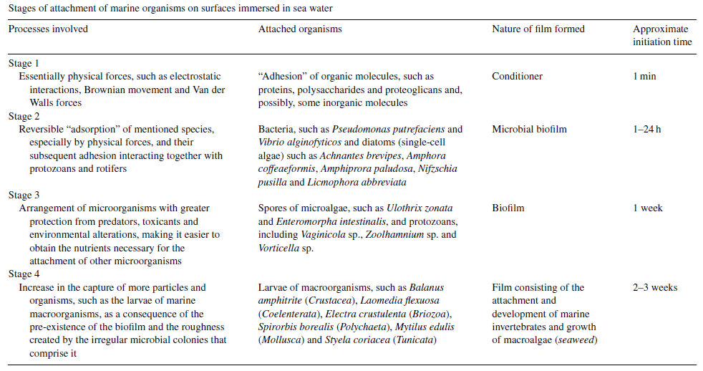

Slide 27
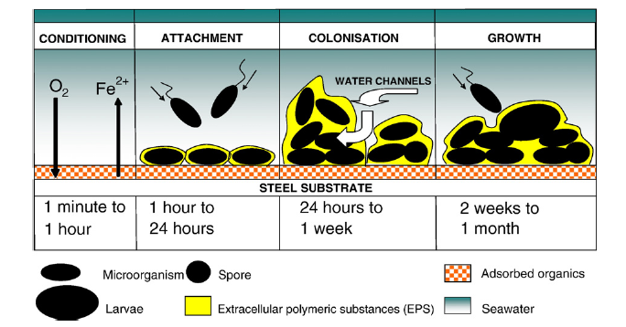

Slide 28
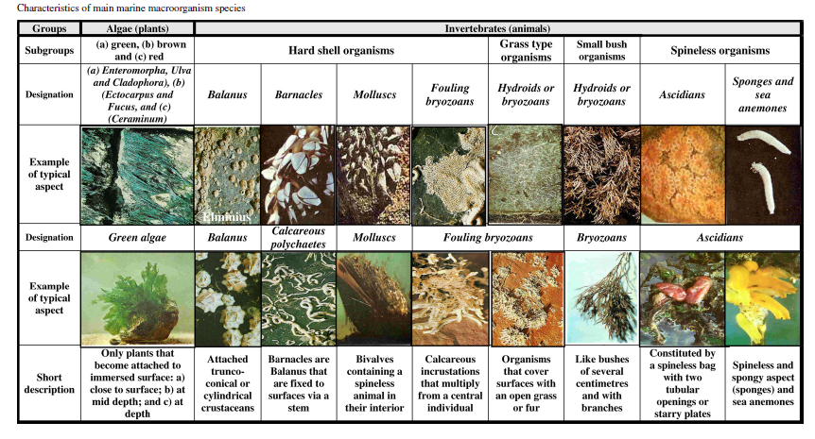

Slide 29
ANTI-FOULING
Coatings should be environmentally acceptable and maintain long life.
Commercial use of TBT was mostly preferred but it is now banned due to its adverse effects.

Slide 30
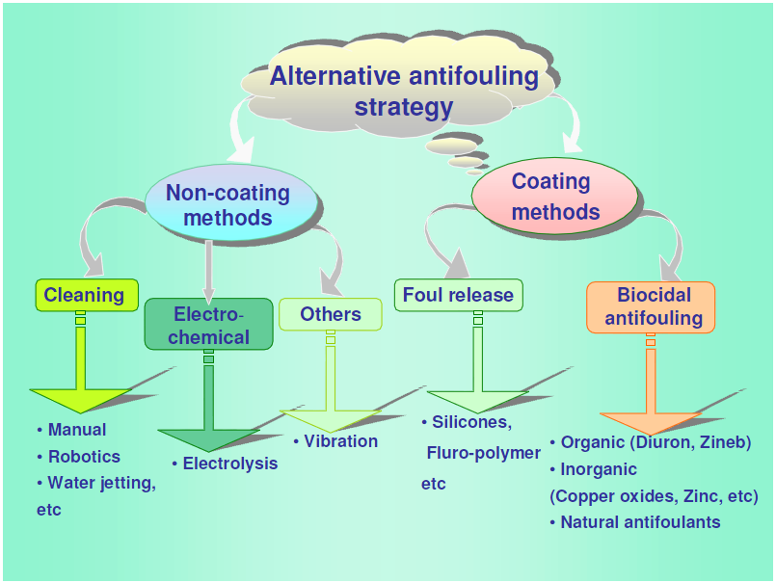

Slide 31
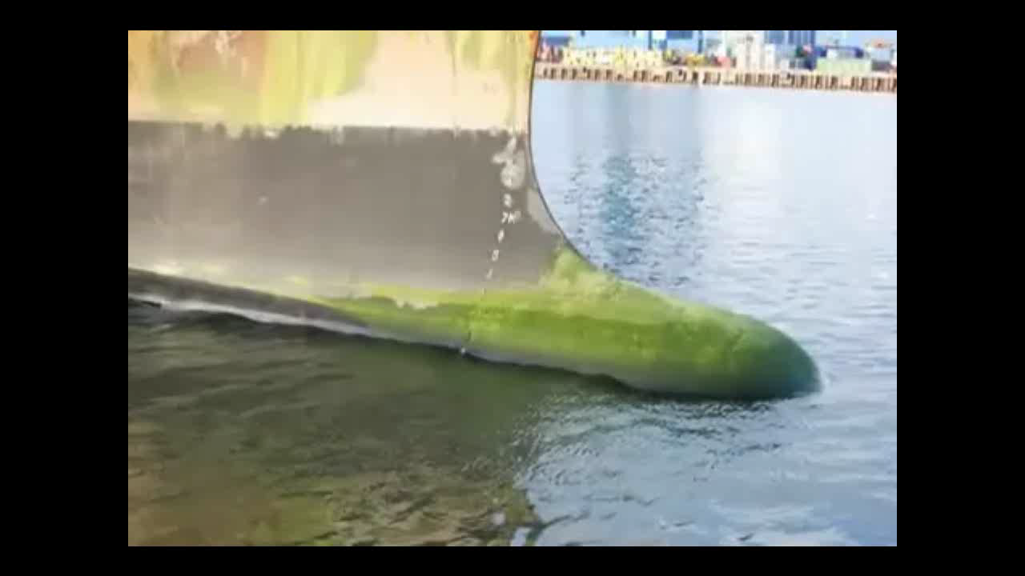
R o v

Slide 32
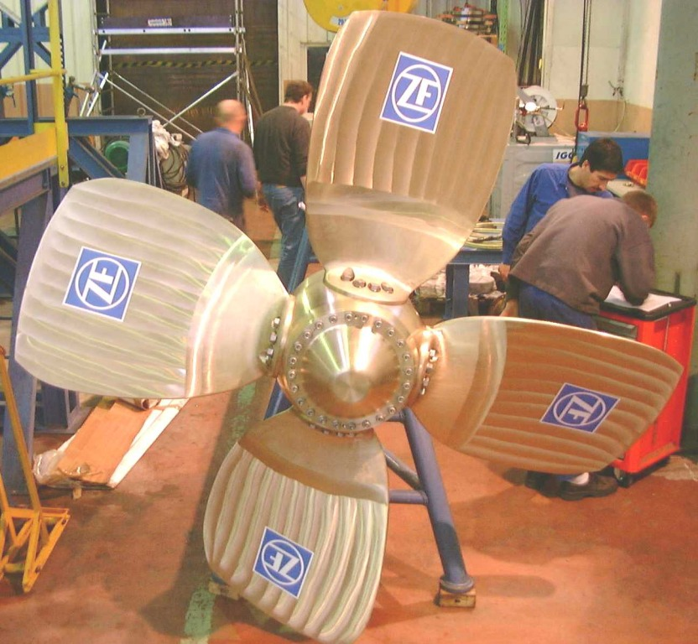

Slide 33
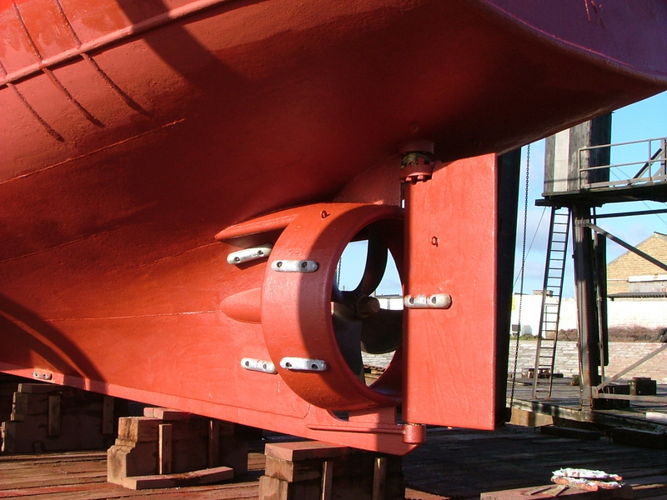

Slide 34
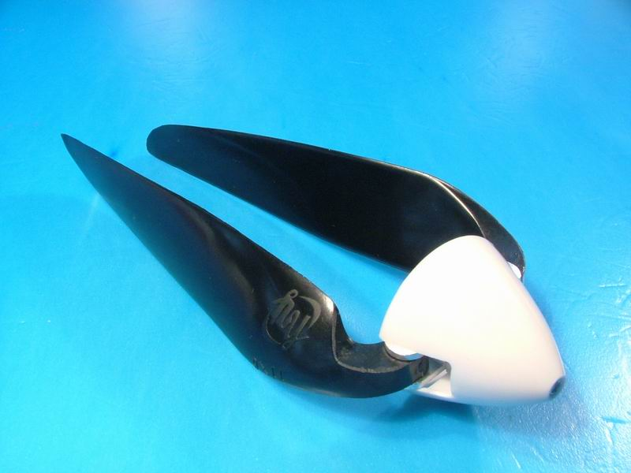

Slide 35
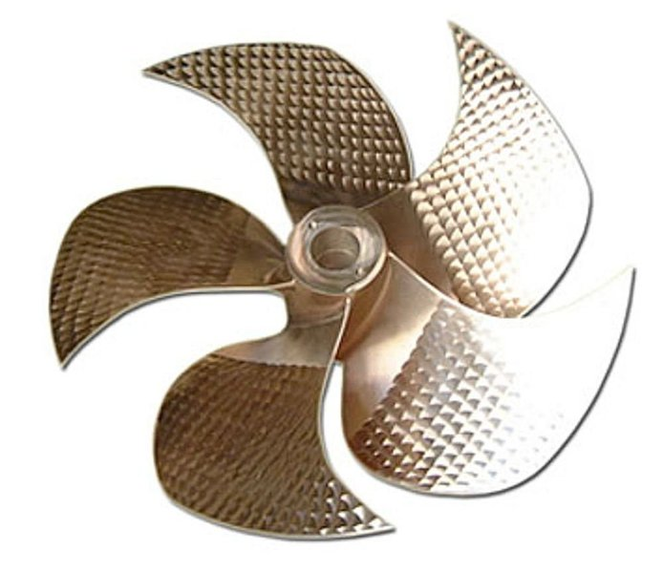

Slide 36
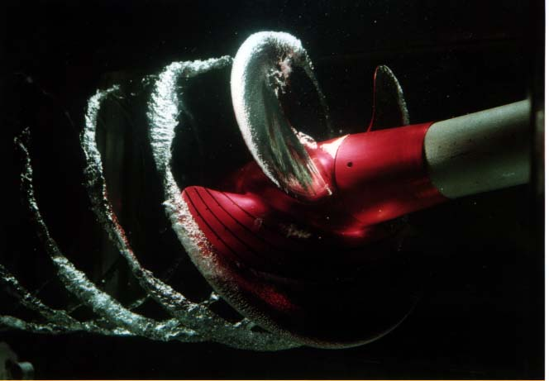

Slide 37
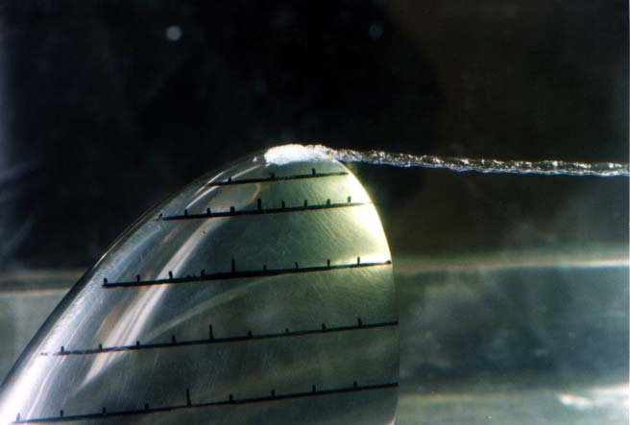

Slide 38
