Slide 1
HYBRID RENEWABLE POWER GENERATION
AND THEIR APPLICATIONS
ANKIT PARASAR
SHALABH AGARWAL
MANINDER SINGH

Slide 2
RENEWABLE ENERGY
RENEWABLE SOURCES LIKE WIND, WAVE, SOLAR, GEOTHERMAL AND BIOFUELS
LIMITED UTILIZATION OF INDIVIDUAL SOURCES INTRODUCES THE CONCEPT OF HYBRID POWER
AIM OF OUR PRESENTATION IS TO COMBINE WIND AND WAVE ENERGY.

Slide 3
HARNESSING WIND ENERGY
WINDFARMS : HUNDREDS OF WIND TURBINES CONNECTED TO ELECTRIC POWER TRANSMISSION NETWORK.
VIBRO WIND OSCILLATORS: FRAME MOUNTED WITH FOAM PADS COUPLED WITH PIEZOELECTRIC TRANSDUCER.
WINDBELTS

Slide 4
WINDBELT
RELIES ON AN AERODYNAMIC PHENOMENON KNOWN AS AEROELASTIC FLUTTER
EFFECTIVE AT PRODUCING ELECTRICITY AT LOW WIND SPEED
CONSTRUCTION:
  FRAME: HOLDS THE ENTIRE UNIT MADE OF TIMBER, Al OR PLASTIC
  RIBBON: LIGHTWEIGHT AND ACT AS AIRFOIL, HIGH TENSILE STRENGTH & TORSIONALLY STRONG. MADE OF MYLAR COATED TAFFETA OR KEVLAR. PROPERTIES: RD=1.44, UTS=3620 MPa, E=131 GPa, POISSON’S RATIO=0.36
  MAGNETS: STRONG AND LIGHTWEIGHT
  COILS: NUMBER OF TURNS DIRECTLY PROPORTIONAL TO OUTPUT EMF

Slide 5
WORKING
TENSIONED MEMBRANE UNDERGO FLUTTER OSCILLATION.
MAGNETS FOLLOW THE SAME MOTION.
MAGNETS NEAR THE STATOR COIL INDUCES CURRENT TO FLOW.
ADVANTAGES
NEW AND EXPERIMENTAL DESIGN
LOW COST
WORKS ON LOW WIND SPEED
ANALYSIS: MATERIAL, WIND SPEED, BELT TENSION FOR RESONATING FREQUENCY, ANGLE OF INCIDENCE OF WIND FOR MAXIMUM FLUTTER, MAGNET PLACEMENT, LENGTH OF BELT AND OTHER DESIGNS CAN BE TESTED.

Slide 6
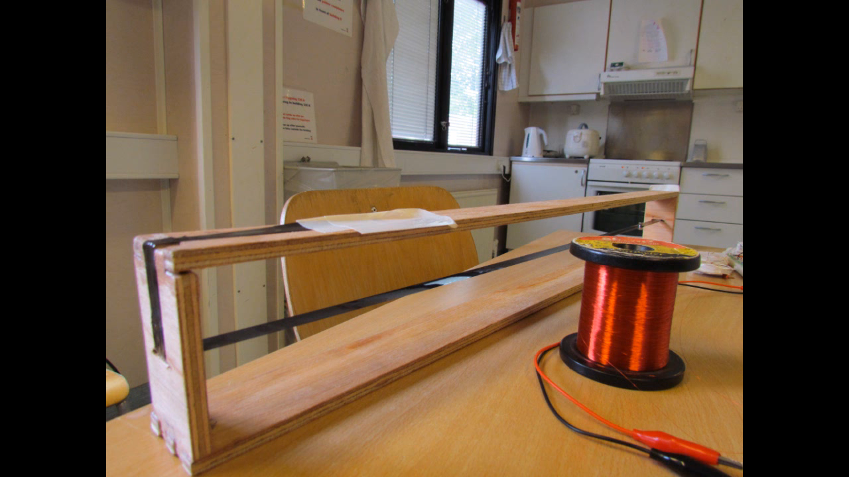
The Wind Belt

Slide 7
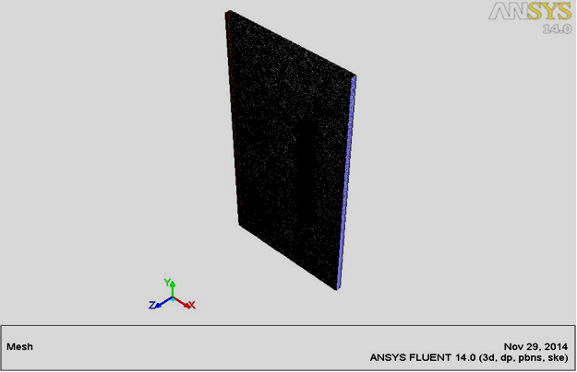
OPTIMIZATION OF ANGLE OF WIND BELT WITH RESPECT TO THE WIND DIRECTION
BELT DESIGNED IN PRO – ENGINEER.
IMPORTED IN ANSYS WORKBENCH.
WIND SPEED CONSIDERED 6m/s.
HIGH DENSITY MESHING TO CAPTURE THE EFFECT OF CHANGING ANGLES.
PRESSURE FORCE ON UPPER AND LOWER SIDES OF THE BELT MUST BE EQUAL TO MINIMIZE THE FLUTTER DAMPENING EFFECT.

Slide 8
Angle (in Degrees) | Zones | Pressure
0 | P1_lower | 0
 | P1_upper | 0
10 | P1_lower | -0.039341715
 | P1_upper | -0.044080873
20 | P1_lower | -0.098131149
 | P1_upper | -0.17388427
30 | P1_lower | -0.31364420
 | P1_upper | -0.29069931
40 | P1_lower | -0.44527532
 | P1_upper | -0.50162226
50 | P1_lower | -0.70972979
 | P1_upper | -0.64470047
60 | P1_lower | -0.99646966
 | P1_upper | -0.75648045
PRESSURE FORCES AT THE LOWER AND UPPER SIDES OF THE BELT BECOMES NEARLY EQUAL AT 30 DEGREES.
FOR MORE PRECISE RESULTS , THE PRESSURES AT THE UPPER AND LOWER SIDES BECOME ALMOST EQUAL AT 33 DEGREES.
HENCE MAXIMUM AEROELASTIC FLUTTER CAN BE OBTAINED AT AN ANGLE OF 33 DEGREES.

Slide 9
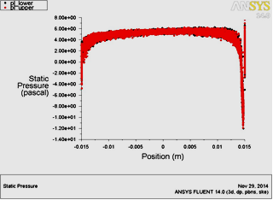
PLOTS OBTAINED AFTER THE ANALYSIS
PLOT OF STATIC PRESSURE VERSUS THE POSITION ON THE PLATE AT AN ANGLE OF ZERO DEGREES.

Slide 10
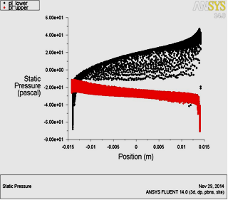
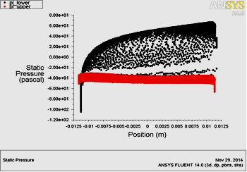
PLOTS AT 20 AND 40 DEGREES

Slide 11
RESONANCE IN WIND BELTS:
RESONANCE IS A CONDITION UNDER WHICH A BODY TENDS TO VIBRATE WITH A LARGER APMLITUDE WHEN THE APPLIED FREQUENCY BECOMES EQUAL TO ITS NATURAL FREQUENCY.
NATURAL FREQUENCY OF WIND BELT MADE UP OF KEVLAR IS FOUND TO BE 62.037 Hz USING ANSYS.
IN ORDER TO ACHIEVE RESONANCE THE APPLIED FREQUENCY MUST BE MADE EQUAL TO 62.037 Hz.

Slide 12
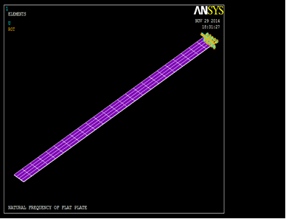
WIND BELT IN ANSYS
WIND BELT DESIGNED IN PRO-ENGINEER AND THEN IMPORTED IN ANSYS.
ONE END OF THE WIND BELT IS FIXED.
LOAD IS APPLIED ON THE OTHER END TO KEEP THE BELT IN TENSION.
LOAD IS INCREASED STEP-WISE AND THE APPLIED FREQUENCY IS OBSERVED AT EACH LOAD.

Slide 13
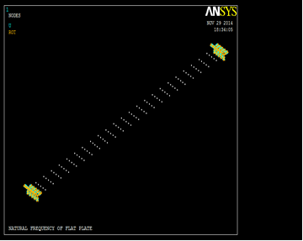
NATURAL FREQUENCY | LOAD APPLIED | APPLIED FREQUENCY
62.037 Hz | 10 N | 17.547 Hz
62.037 Hz | 20 N | 22.114 Hz
62.037 Hz | 50 N | 31.168 Hz
62.037 Hz | 100 N | 41.413 Hz
62.037 Hz | 150 N | 49.330 Hz
62.037 Hz | 200 N | 56.035 Hz
62.037 Hz | 250 N | 61.959 Hz
62.037 Hz | 251 N | 62.071 Hz

Slide 14
WAVE ENERGY
POTENTIAL OF WAVE ENERGY
  WAVE ENERGY CAN GIVE POWER TO EVERY SINGLE COUNTRY ON EARTH.
  ESTIMATED WORLDWIDE RESOURCE IS GREATER THAN 2 TW.
COMPARISON WITH OTHER SOURCES OF ENERGY.
  DENSER MEDIUM
  HIGHER PREDICTABILITY
  LESSER IMPACT ON ENVIRONMENT

Slide 15
SEA WAVES FORMATION
WAVES GENERATION BY WINDS.
FORMATION OF WRINKLES DUE TO FRICTION BETWEEN AIR AND WATER.
WIND EASILY GRIPS THE ROUGHENED SURFACE AND INTENSIFIES THE WAVES.
CREST.
TROUGH.

Slide 16
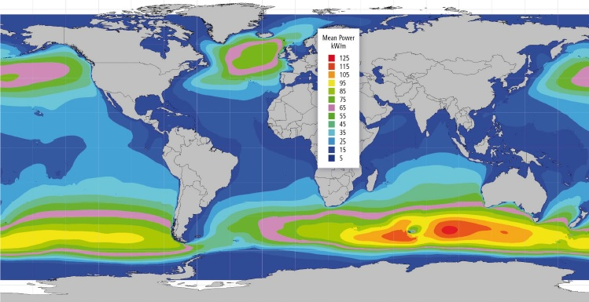
GLOBAL POWER DENSITY DISTRIBUTION

Slide 17
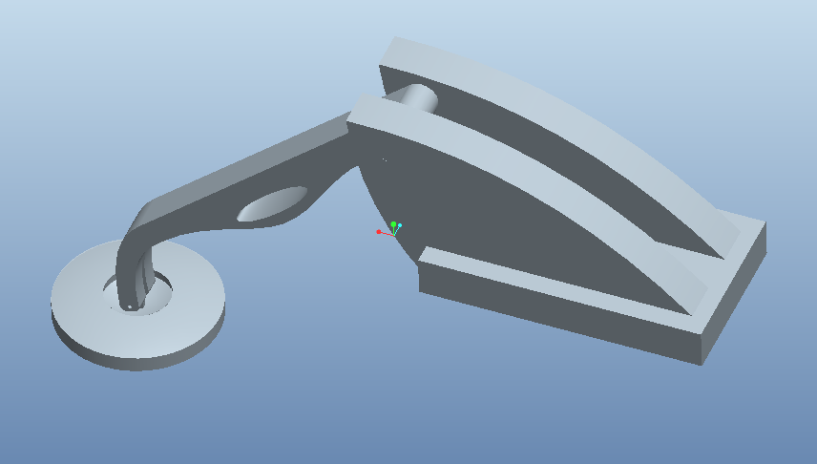
OSCILLATING BODY WAVE ENERGY CONVERTER
PROPOSED BY SUBMARINE TECHNOLOGY LABORATORY AT COPPE/FEDERAL UNIVERSITY OF RIO DE JANEIRO (BRAZIL).
FLOATING BUOY AND MECHANICAL ARM ARRANGEMENT
MECHANICAL ARM
FLOATING BUOY

Slide 18
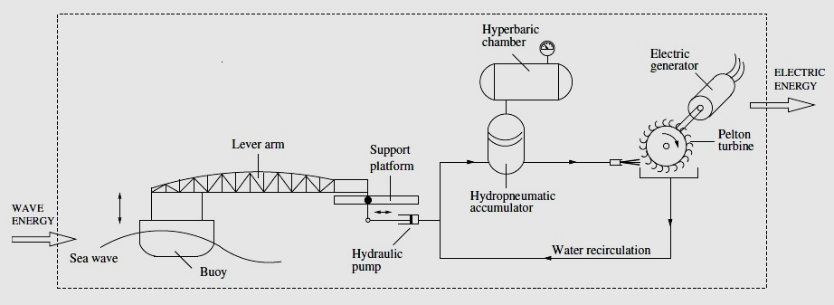
FLOATING BUOY CONNECTED TO A MECHANICAL ARM.
THE ORBITAL MOTION OF WATER CAUSES THE FLOATING BUOY TO BOB UP AND DOWN AS THE WAVE PASSES UNDER.
VERTICAL MOTION INDUCES THE HYDRAULIC PUMP TO DISPLACE WATER FROM A CLOSED CIRCUIT TO HYDROPNUEMATIC ACCUMULATOR.

Slide 19
THE HYDROPNUEMATIC ACCUMULATOR IS CONNECTED TO A LARGE HYPERBARIC CHAMBER FILLED WITH NITROGEN.
PROVIDES AN APPROX. CONSTANT HYDRAULIC PRESSURE, EVEN WITH VARIATIONS IN THE WAVES AND IN THE STORED WATER LEVEL.
WATER IS THEN RELEASED IN THE FORM OF JET WHICH MOVES A TURBINE COUPLED TO A GENERATOR.

Slide 20
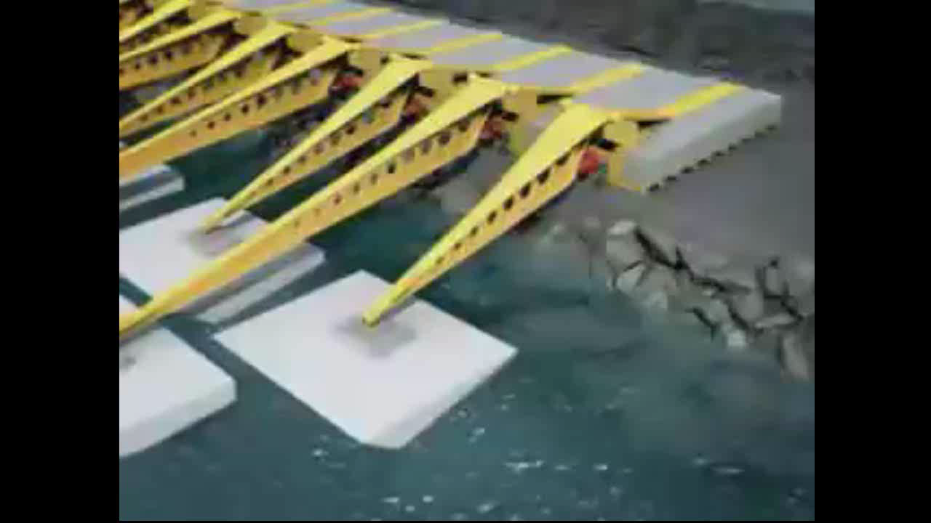

Slide 21
HYBRID OF WIND AND WAVE
PREPARING A COMMON PLATFORM TO SUPPORT BOTH THE WINDBELT AND THE FLOATING BUOY.
BEST OPTION AVAILABLE WOULD BE TO USE IT ON OFFSHORE PLATFORMS OR NEAR BREAKWATERS.
SIDES OF PLATFORM HAVE A NUMBER OF OSCILLATING BODY WECs.
CERTAIN DECKS FOR INSTALLING LARGE NUMBER OF WIND BELTS WITH ARRANGEMENTS FOR CHANGING THE DIRECTION OF FRAME AS PER THE WIND DIRECTION.

Slide 22
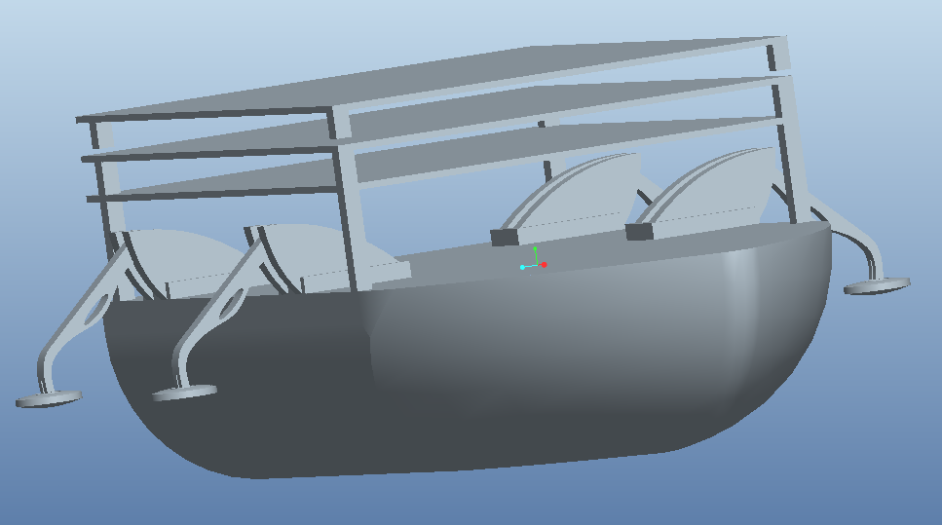

Slide 23
ANY QUESTIONS?

