Slide 1

TRANSTECH’14
SUB THEME:
HIGH VOLTAGE APPLICATION
IN
INDUSTRIES AND TRANSPORT
Kelvin d’almeida
Ram keshav

Slide 2

HIGH TEMPERATURE SUPERCONDUCTING
MACHINES
“FOR TODAY AND THE DAYS TO COME !!!”

Slide 3

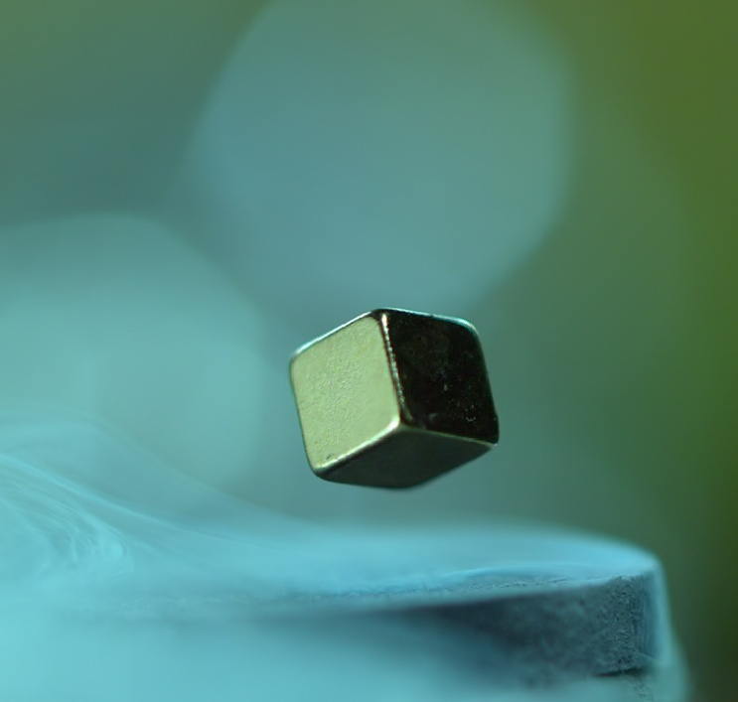
SUPERCONDUCTORS?
Materials that exhibit zero resistance when cooled below a specific transition temperature.
As Temperature decrease
Conductivity Increases
Const. Current
Resistivity Decreases

Slide 4

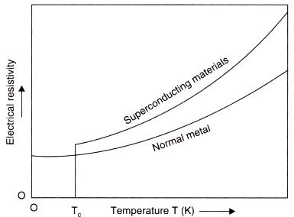
Superconductivity
Transition/critical temperature
The temperature below which superconductivity occurs
Zero Resistivity

Slide 5

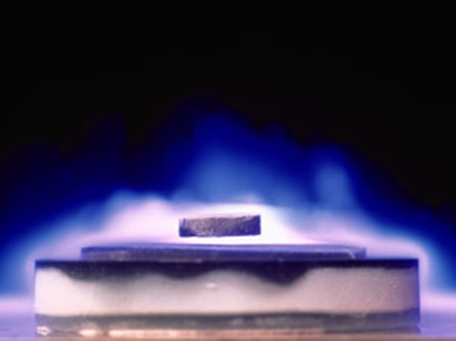
HIGH-TEMPERATURE SUPER CONDUCTORS
(hts)
Superconductivity at comparatively High Temperature
For Conventional superconductors–
        Transition temperature below 5 K(-268 °C)
        Caused practical inconvenience
HTS –
        Higher transition temperature
        As high as 138 K (-135 °C)
Yttrium barium copper oxide (YBa₂Cu₃O_{7-x})

Slide 6

APPLICATION OF HTS
IN MACHINARY

Slide 7
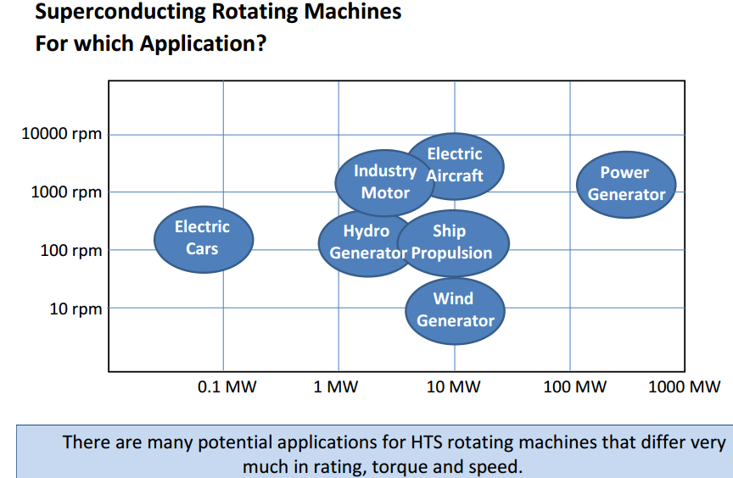

Slide 8

WHAT ARE HTS GENERATORS?
Generators that employ HTS in rotor field winding
HTS generators can either be new or retrofitted to existing generators.
Applications in industries and on-board vessels

Slide 9
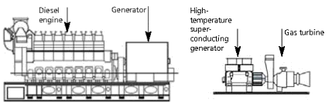

Slide 10


Benefits
Increase machine efficiency
Smaller prime mover
Energy saving
Lower life cycle cost
Reduce Heat loss
Grid stability
Reduced pollution

Slide 11
HTS MOTOR
Drawback : Requirement of keeping the HTS windings at a very low operating temperature.
Synchronous motors that employ HTS as field windings.
Significant volume and weight reduction
HTS wire has a much higher current density.

Slide 12
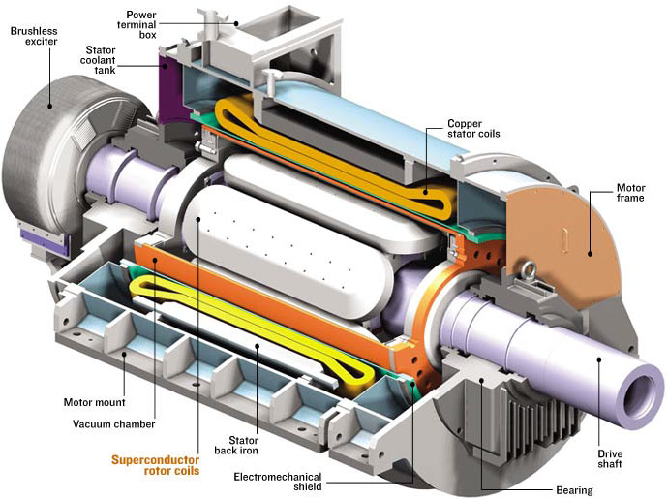

Slide 13
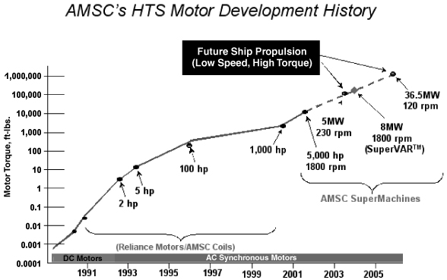

Slide 14

POWER GENERATION
AND
DISTRIBUTION ON-BOARD VESSELS

Slide 15

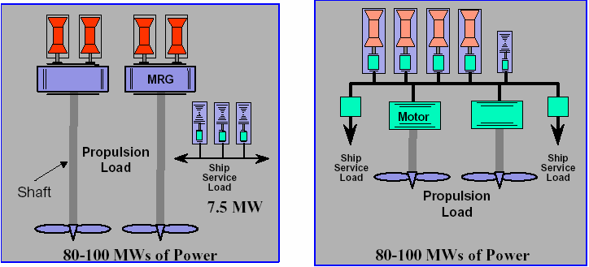
Segregated :
Integrated :

Slide 16
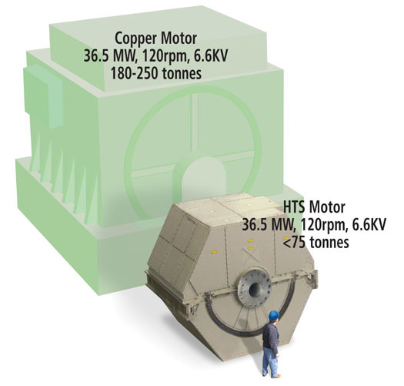
Less than half the size
One-third the weight
Lower operating cost
Equivalent prices
Higher net efficiency
Inherently quieter

Slide 17
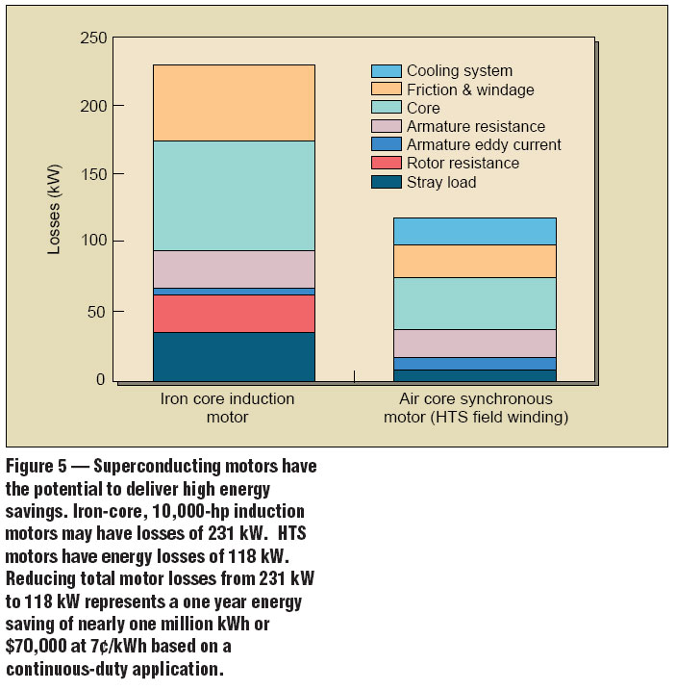

Slide 18
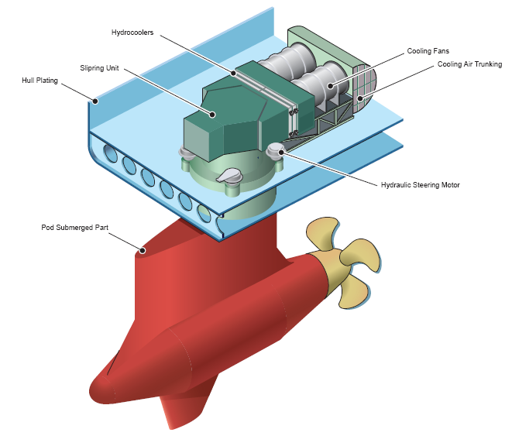
PODDED
PROPULSION

Slide 19

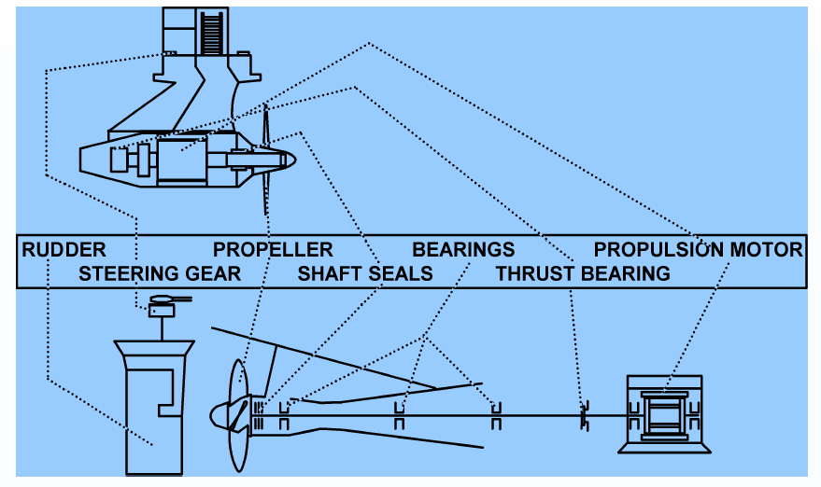

Slide 20

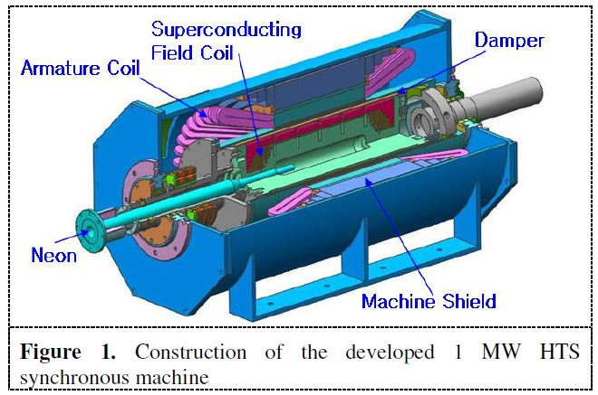
The 1MW-class HTS motor
for Podded propulsion
Cooperative research groups have developed an HTS motor for the podded propulsion system of a merchant ship since 2007
HTS motor can have higher efficiency than conventional motors and greatly decrease its weight and size
Such characteristics become advantageous further in large torque and slow rotation rate

Slide 21

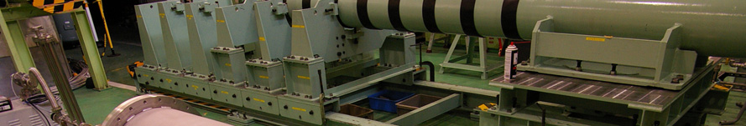
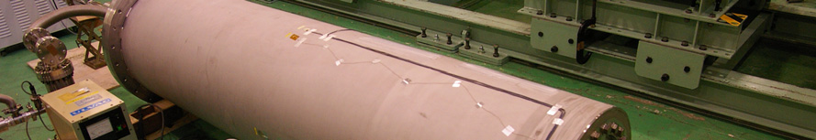
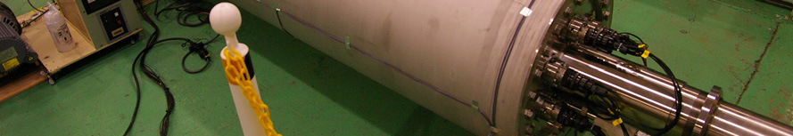
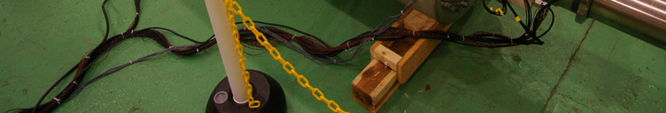
Stator :
Rotor :

Slide 22
CRYOGENIC DESIGN

Slide 23

Liquid neon is supplied from outside of the rotor through a long stainless steel pipe connected to a cold head of a cryocooler which liquefies gas neon evaporated from inside of the rotor
To improve the heat exchange between cryogenic neon gas and the rotor core, turbulence promoters are installed on the inner surface of the cryogen piping.
Bi-2223 HTS field coils are cooled by conduction heat transfer of liquid neon and copper armature coils cooled by water passing through them.

Slide 24

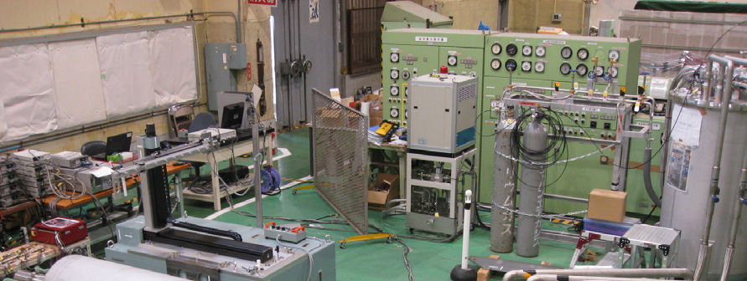
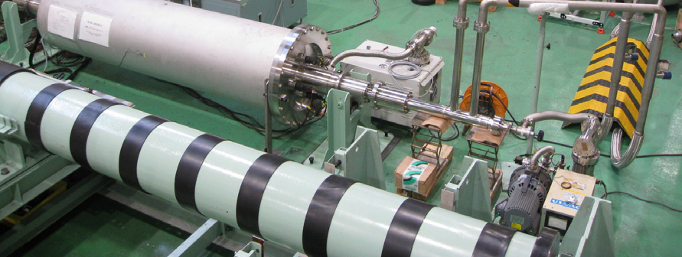

Slide 25

CONCLUSION:
Podded ship propulsion with an HTS motor becomes slenderer than that with a conventional motor.
The use of HTS generators on board is going to make the Integrated power system even more efficient.
The application of HTS as transmission medium will provide us with cleaner energy.

Slide 26


RAM
ALMEIDA
PRESENTED BY:
KELVIN
KESHAV

Slide 27

ANY QUESTIONS?

