Slide 1

Presents

Slide 2
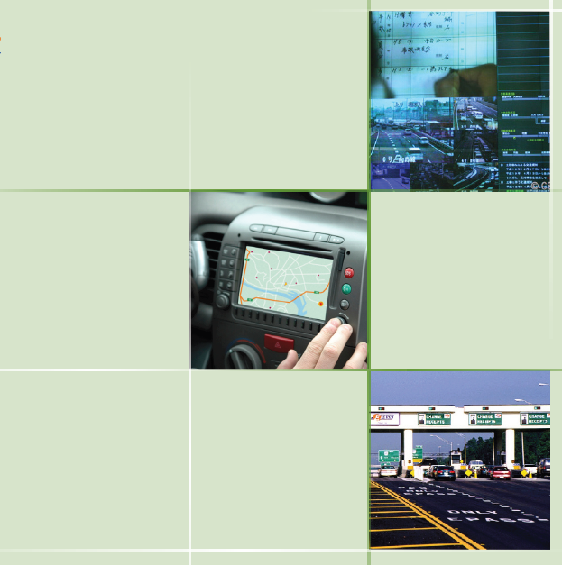
IT & Software Technology In Transportation
By
Cdt.Abdul wahab
Cdt.Karthik deepan

Slide 3
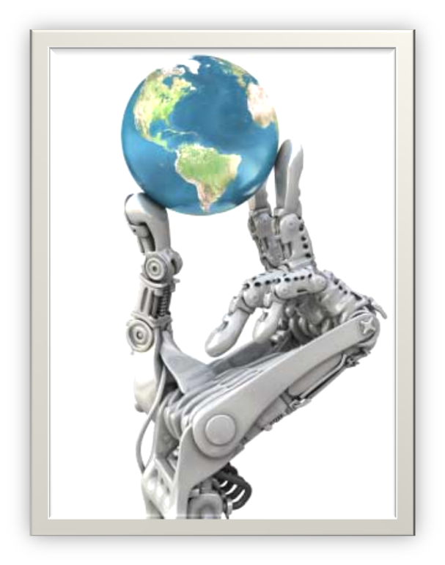
“Technology was Invented to make Man’s Life Simpler … For Hundreds Of Years Technology has brought a REMARKABLE CHANGE…
IT for sustainable mobility will pave the way for sustainable development of the national economy.

Slide 4
While many think improving a country’s transportation system solely means building new roads or repairing ageing infrastructures, the future of transportation lies not only in concrete and steel, but also increasingly in using IT.
IT enables elements within the transportation system vehicles, roads, traffic lights, message signs, etc.—to become INTELLIGENT
Intelligent Transportation System(ITS) brings significant improvement in transportation system performance, including reduced congestion, increased safety and traveler convenience.
Unfortunately, India lags the global leaders, particularly Singapore, Japan, South Korea and USA in ITS deployment. For the most part, this has been the result of two key factors: a continued lack of focus on ITS and the lack of the right organizational system to drive ITS in India.

Slide 5
Understanding Intelligent Transportation System
ITS Category | Specific ITS Applications
Advanced Traveler Information Systems (ATIS) | Real-time Traffic Information Provision
 | Route Guidance/Navigation Systems
 | Parking Information
 | Roadside Weather Information Systems
Advanced Transportation Management Systems (ATMS) | Traffic Operations Centers (TOCs)
 | Adaptive Traffic Signal Control
 | Dynamic Message Signs (or “Variable” Message Signs)
 | Ramp Metering
ITS-Enabled Transportation Pricing Systems | Electronic Toll Collection (ETC)
 | Congestion Pricing/Electronic Road Pricing (ERP)
 | Fee-Based Express (HOT) Lanes
 | Vehicle-Miles Traveled (VMT) Usage Fees
 | Variable Parking Fees
Advanced Public Transportation Systems (APTS) | Real-time Status Information for Public Transit System (e.g. Bus, Subway, Rail)
 | Automatic Vehicle Location (AVL)
 | Electronic Fare Payment (for example, Smart Cards)
Vehicle-to-Infrastructure Integration (VII) and Vehicle-to-Vehicle Integration (V2V) | Cooperative Intersection Collision Avoidance System (CICAS)
 | Intelligent Speed Adaptation (ISA)

Slide 6
Advanced
Traveler
Information
Systems
(ATIS)

Slide 7
One of the most-recognized ITS applications, Advanced Traveler Information Systems (ATIS) provide drivers with real-time travel and traffic information, such as transit routes and schedules; navigation directions; and information about delays due to congestion, accidents, weather conditions, or road repair work.
There are three key facets to the provision of real-time traffic information:
          Data collection
          Data Aggregation and translation
          Information dissemination
with each step entailing a distinct set of technology devices & platforms.

Slide 8
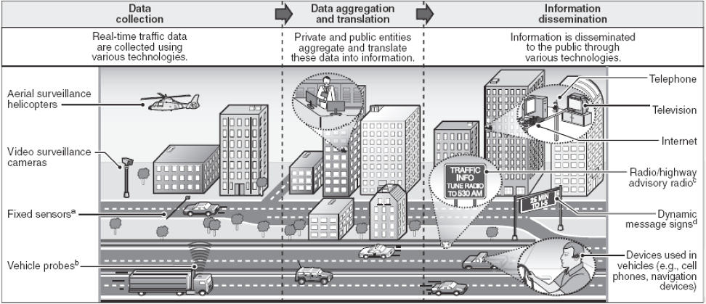
Data Collection
Data aggregation and translation
Information dissemination

Slide 9
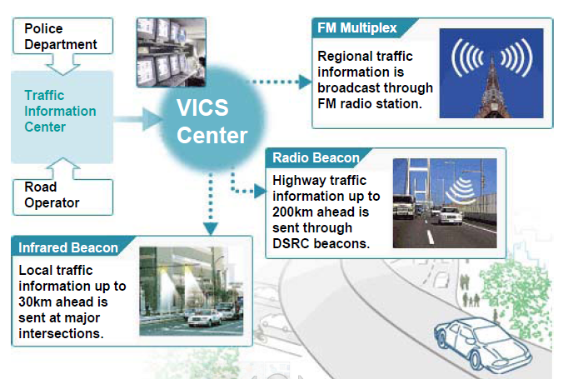
Japan’s Vehicle Information & Communication System(VICS) Centre

Slide 10
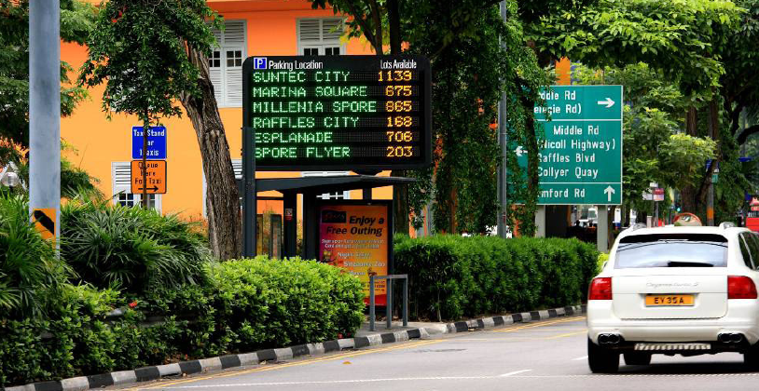
Applications
Parking Information

Slide 11
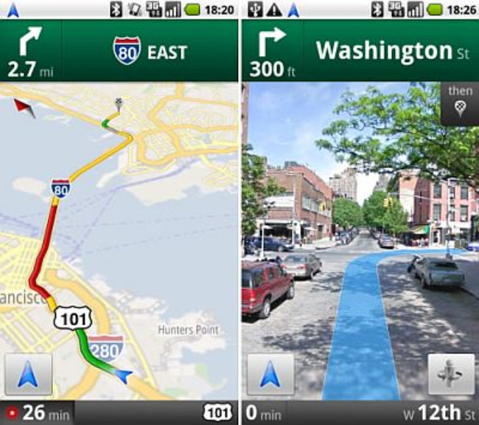
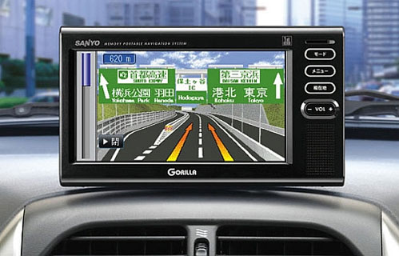
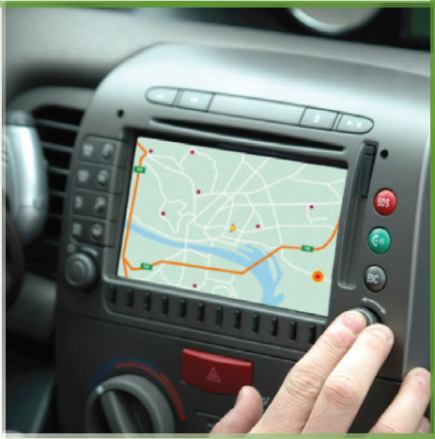
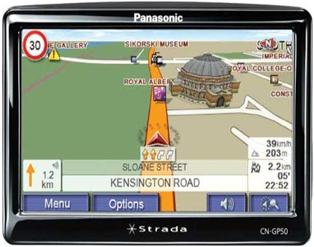
Route Guidance / Navigation Systems

Slide 12
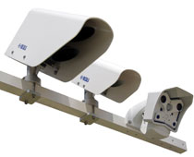
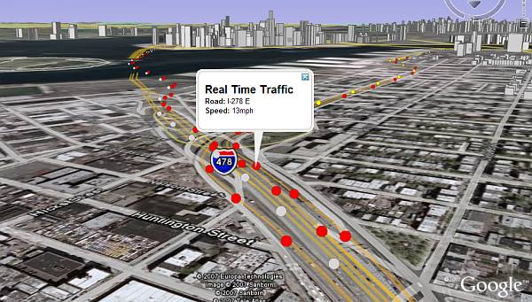
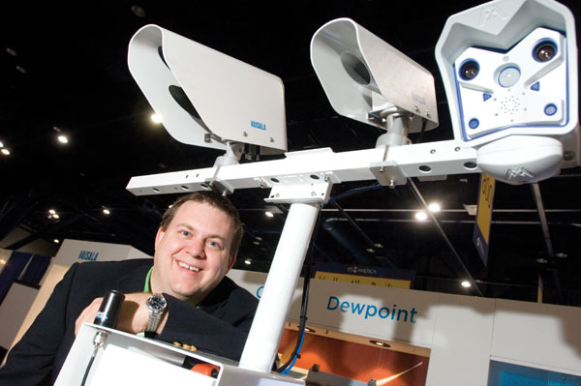
Roadside Weather Information Systems
Real-time Traffic Information Provision

Slide 13
Vehicle-to-Infrastructure Integration (VII)
&
Vehicle-to-Vehicle Integration (V2V)

Slide 14
Vehicle-to-Vehicle Integration (V2V) & Vehicle-to-Infrastructure Integration (VII)
Vehicle-to-infrastructure integration is the archetype for a comprehensively integrated intelligent transportation system. To deploy and enable a com­munications infrastructure that supports vehicle-to-infrastructure, as well as vehicle-to-vehicle, commu­nications for a variety of vehicle safety applications and transportation operations. DSRC-enabled tags or sensors, if widely deployed in vehicles, highways, and in roadside or intersection equipment, would enable the core elements of the transportation system to intelligently communicate with one another, delivering a wide range of benefits.
The Two Most Important Applications are
CICAS (Cooperative Intersection Collision Avoidance Systems)
ISA (Intelligent Speed Adoption)

Slide 15
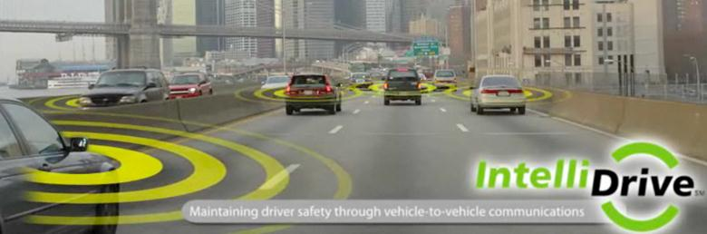
Vehicle-to-Vehicle Integration (V2V) & Vehicle-to-Infrastructure Integration (VII)
Cooperative Intersection Collision Avoidance System (CICAS)
Intelligent Speed Adaptation (ISA)

Slide 16
ITS-Enabled Transportation Pricing Systems
ITS have a central role to play in funding countries’ transportation systems. The most common applica­tion is Electronic Toll Collection (ETC), also com­monly known internationally as “road user charging,” through which drivers can pay tolls automatically via a DSRC-enabled on-board device or tag placed on the windshield (such as E-Z Pass in the United States).
ITS-enabled countries are evaluating for financing their transportation systems is a Vehicle Miles Traveled (VMT) fee system that charges motorists for each mile driven. VMT fee systems represent an alternative to the current fuel taxes and other fees that many countries and states use to finance their transportation systems.

Slide 17
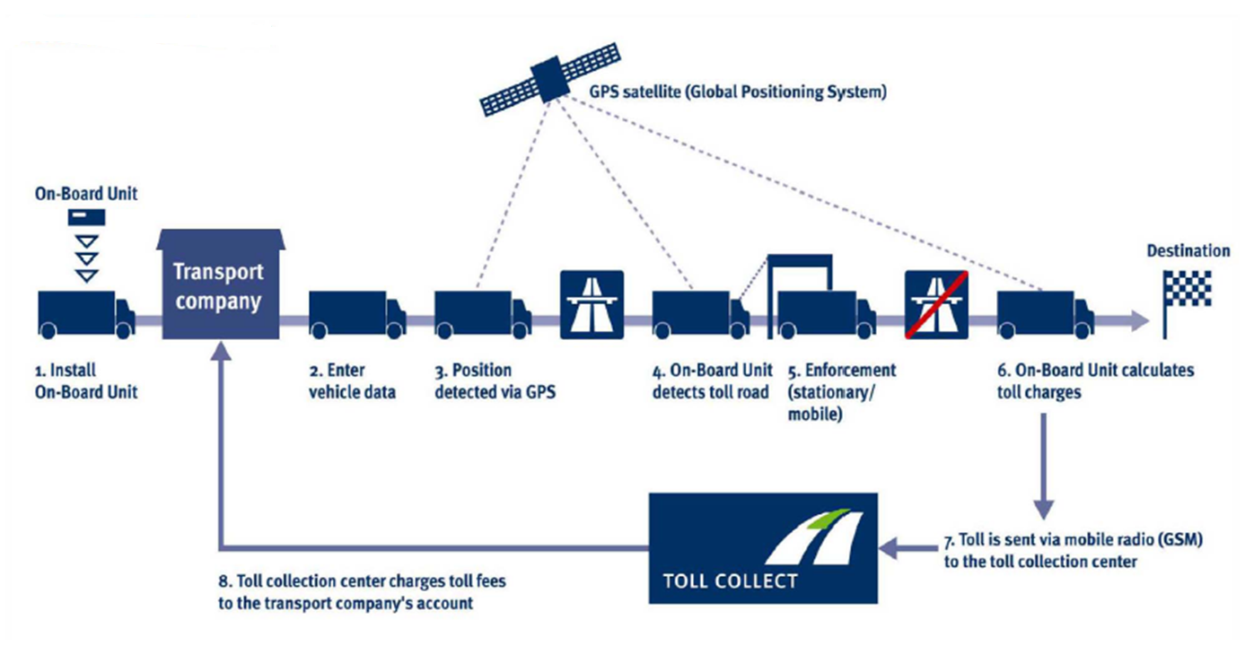
Electronic Toll Collection (ETC)

Slide 18
Advanced Transportation Management
Systems
(ATMS)

Slide 19
Weather events
Roadway hazards
Traffic flow
Accidents
Sensors ,Vehicle Probes & Cameras
Traffic Operations Centers (TOCs)
Adaptive traffic signal control
Dynamic Message Signs
Ramp Metering

Slide 20
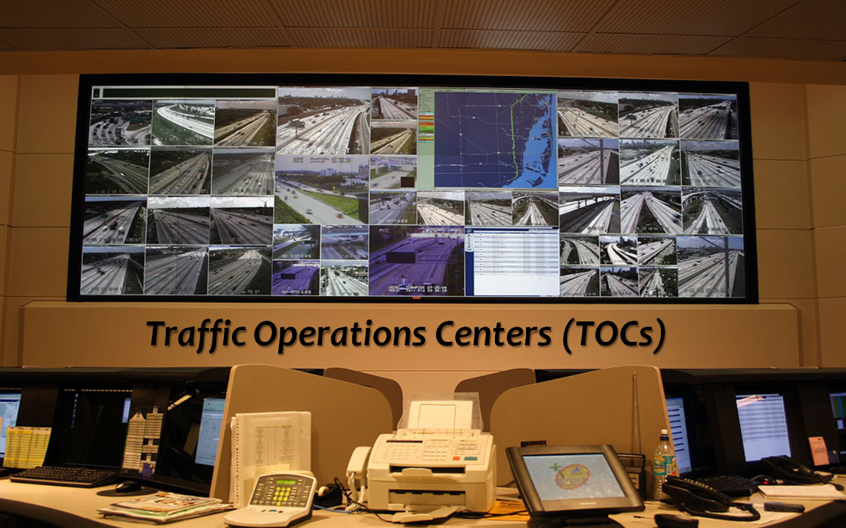

Slide 21
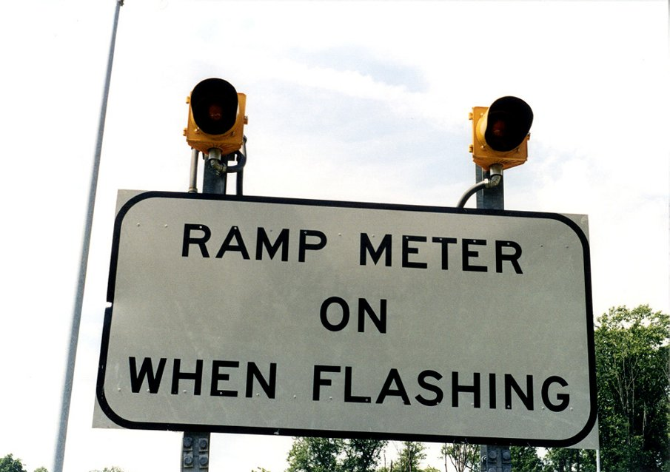
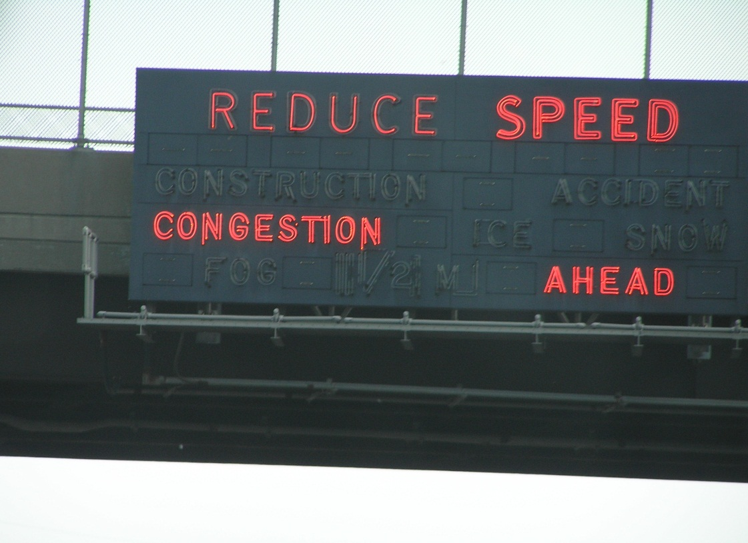
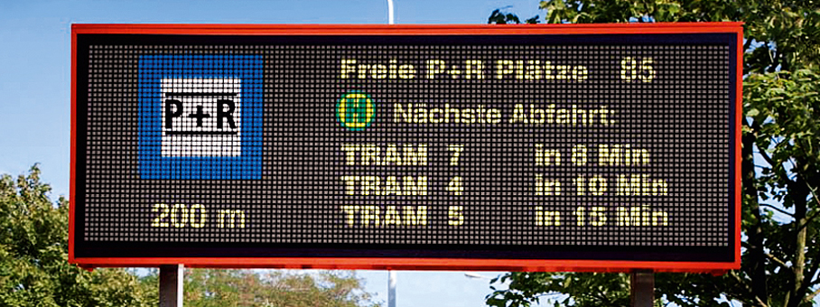
Ramp Metering
Dynamic Message Signs
Adaptive Traffic Signal Control

Slide 22
Advanced
Public
Transportation Systems
(APTS)

Slide 23
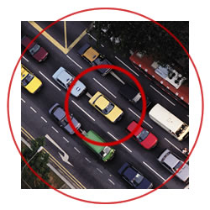
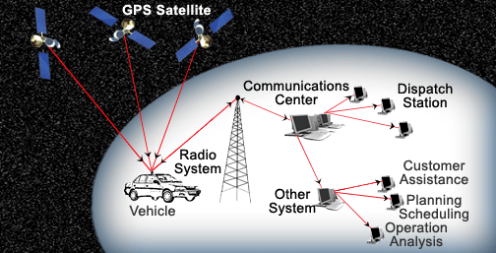
Automatic Vehicle Location (AVL)

Slide 24
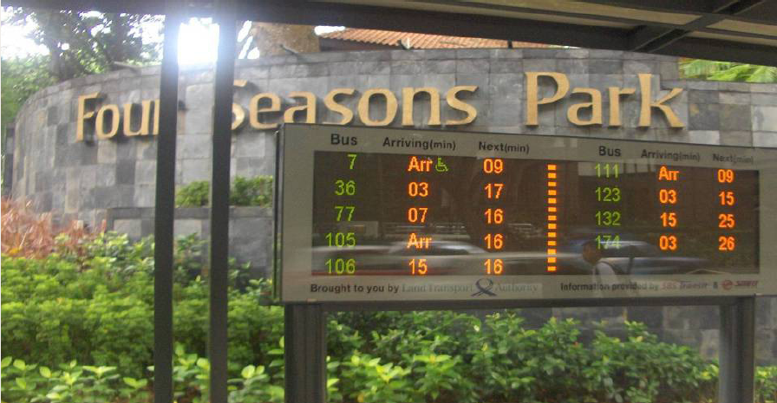
Real-time Status Information for Public Transit System (e.g. Bus, Subway, Rail)

Slide 25
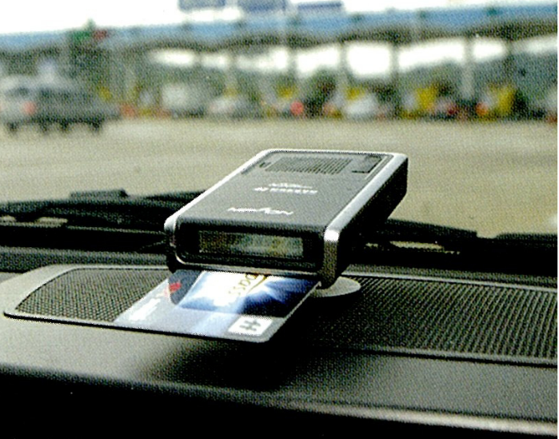
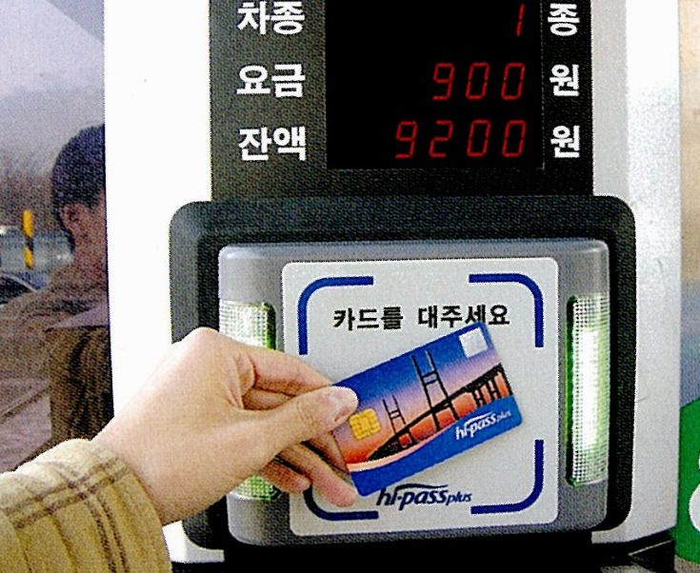
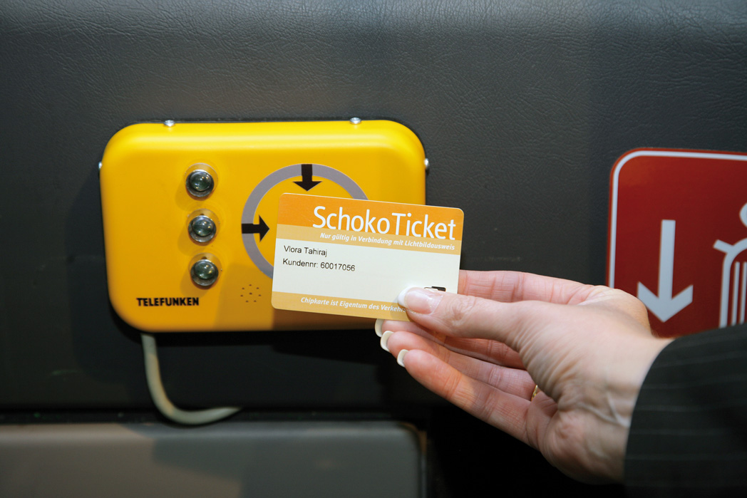
Electronic Fare Payment
(for example,
Smart Cards)

Slide 26
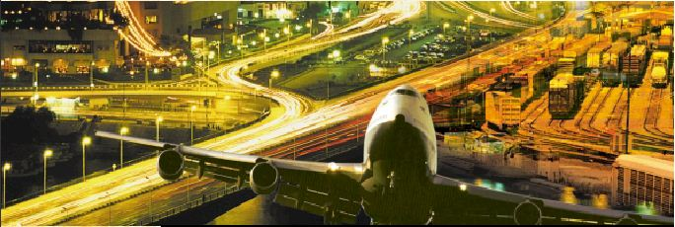
IT aiding INTERMODALITY

Slide 27
Creating e-markets in intermodal freight transport
To make intermodal transport more attractive, seamless information exchange is needed between operators and to/from their customers. Since many different parties are involved in intermodal transport chains, Electronic Data Interchange (EDI) and Telecommunications are essential to facilitate and integrate operations.
Research has demonstrated the feasibility of e-business practices in the intermodal market. Various systems, including Internet-based solutions, have been successfully piloted. These support the pre-contract stage of intermodal transport and provide clients with status information on their shipments.
Vessel traffic management and information services (VTMIS) and River information services (RIS) are ITS concepts that will support maritime and inland waterway traffic and the associated multi-modal transport logistics.

Slide 28
Benefits
Increasing driver and pedestrian safety
Delivering environmental benefits
Boosting productivity and expanding economic and employment growth
Enhancing personal mobility and convenience
Improving the operational performance of the transportation network

Slide 29
Key Underlying technologies for ITS
Global Positioning System (GPS).
Dedicated-Short Range Communications (DSRC).
Wireless Networks.
Mobile Telephony.
Radio wave or Infrared Beacons
Roadside Camera Recognition.
Probe Vehicles or Devices

Slide 30
Challenges in Implementing ITS
Given the technical feasibility and significant benefit-cost ratios,
Why have ITS systems not been deployed more broadly, especially in lagging nations?
One reason is that there are a number of challenges involved in developing and deploying intelligent transportation systems. ITS face a range of challenges, including system interdependency, scale, funding, political, institutional and other challenges. Some challenges are inherent to intelligent transportation systems across all countries; others are specific challenges faced with regard to deploying intelligent transporta­tion systems in India.
The implementation initiative for ITS is divided into two major Categories:
      First-generation, or autonomous, systems.
      Second-generation, or cooperative, systems.

Slide 31
First-generation systems focus more on the vehicle as an isolated unit capable of gathering some external inputs but operating mostly within its own sphere of information.
To move forward,
Second-generation systems
The vehicle is no longer seen as a singular element in the roadway environment; instead, all elements (including other vehicles and the infrastructure itself) work together as a system.

Slide 32
Lessons for nations that seek to be ITS leaders:
Ten policy principles
This section lays out ten policy principles for ITS that transportation policymakers the world over should follow, and identifies where the India, in the aggregate, stands vis-à-vis world leaders in exemplifying these principles.
1. Recognize intelligent transportations systems as a “force multiplier” for the transportation network.
2. ITS enable countries to shift to performance-based transportation systems by facilitating better collection of data to measure performance
3. Governments have an important role to play in convening and co-developing platforms that enable industry, academic, asso­ciation, and government entities at the federal, state, and local levels to collaborate on the development of intelligent transporta­tion systems and technology

Slide 33
4. Governments need to articulate an ITS vision for their country.
5. Governments must provide funding for both ITS R&D and deployment.
6. The most successful countries view their ITS investments as creating a platform through which the private sector can develop value-added products and services.
7. Governments have a critical role to play in spearheading the co-development of interoperable standards for intelligent transportation systems and platforms.
8. Leading countries have fostered close alignment between transportation and telecommunications regulatory agencies and technology communities in their countries, recognizing the critical importance of allocating wireless spectrum or radio frequen­cies for intelligent transportation systems.
9. Governments should fund deployment of infrastructure to collect real time-traffic information.
10. Develop a national ITS technical architecture that can serve as the template for the implementation of ITS at federal, state or provincial, and regional, community, or local levels.

Slide 34
Conclusion
ITS is likely to emerge as the major tool to solve surface transportation challenges over the next several decades, as an “INFO STRUCTURE”
In fact, the scenarios described above are not visionary or futuristic; they are real, already exist in several countries today, and are Systems available to our country that focus on developing and deploying them.
So the question for India is not “How?” but it is “How soon?”

Slide 35
THANK YOU

Slide 36
QUERIES ????

