Slide 1
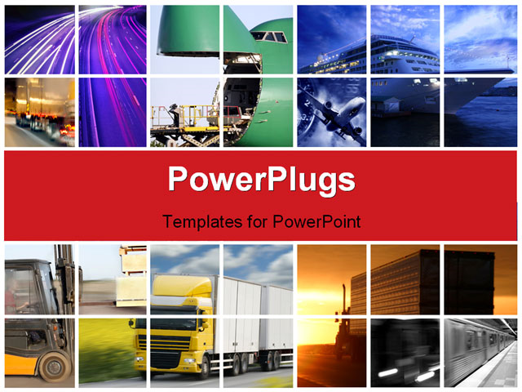
ICT Innovations for Transport Sector
Shailesh Rathod
Head Hospitality & Maritime Practice
Tech Mahindra Ltd.

Slide 2
Agenda
What is ICT?
What is Innovation?
Transport Sectors
Maritime Sectors
Blue Technologies
ICT Innovations in
  Ports
  Shipping
  Cruises
Technologies: Transform Maritime World

Slide 3
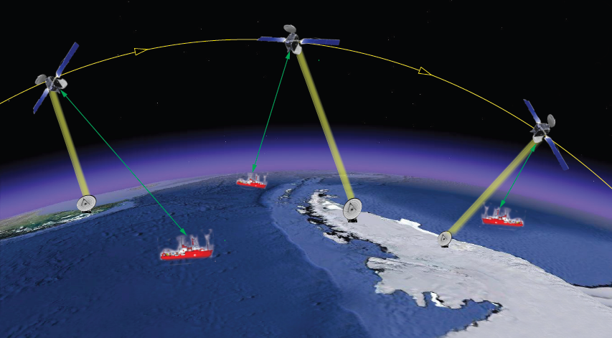
What is ICT?
Information & Communications Technology
Covers any product that will
  Store
  Retrieve
  Manipulate
  Transmit or
  receive
  information
  electronically
through a communication channel in a digital form.

Slide 4
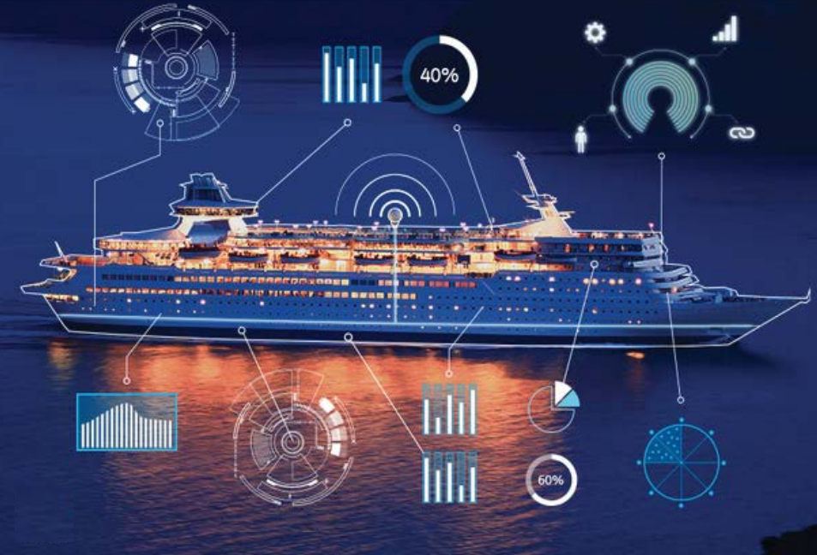
What is Innovation?
The process of translating an idea or invention into a good or service that satisfies a specific need and creates value for which customers will pay.

Slide 5
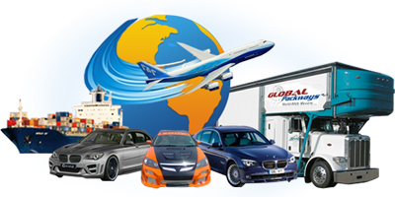
Transport Sectors
Transport or transportation is the movement of people, animals and goods from one location to another.
Modes of transport include
  Air
  Rail
  Road
  Water
  Cable
  Pipeline
  Space.

Slide 6
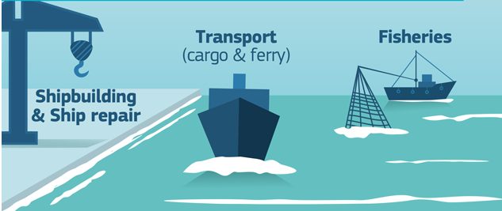
Maritime Sector
Ports
Shipping
Cruises
Ferry
Yacht
Fisheries
Ship Building
Marine Aquaculture
…….

Slide 7
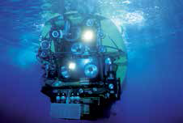
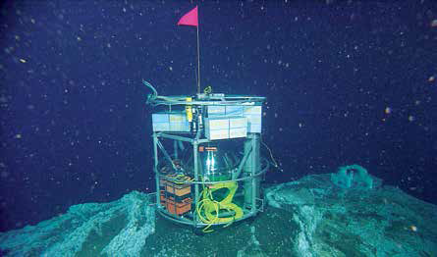
Blue Technologies
Innovation hotspot - European marine sector
Technologies that drive smarter
more efficient marine and
maritime activities whilst
maintaining and empowering
responsibility towards nature.
Autonomous platforms to explore
ocean
  Remotely Operated Vehicles
  Autonomous Underwater Vehicles
  Gliders
Renewable energy harvesting
– from wave energy to algae biofuels

Slide 8
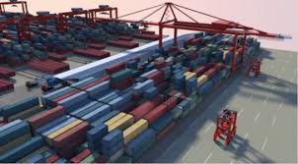
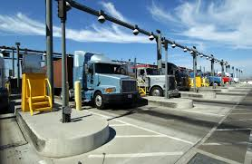
Ports : Robotics & Automation
Vessel to quay
(ship-to-shore movement)
Quay to stack
(horizontal transfer system)
Yard stacking system
In-out gate function

Slide 9
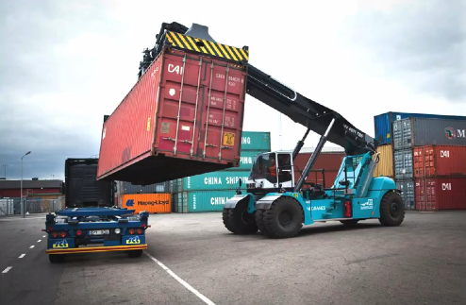
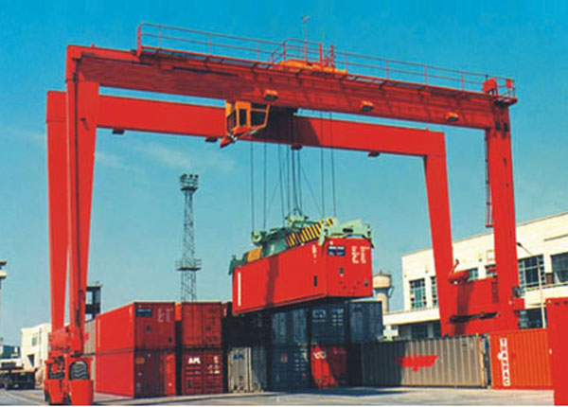
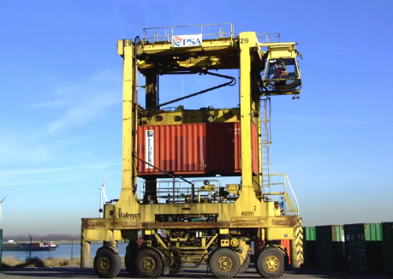
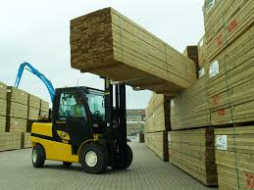
Ports : Autonomous Vehicles
  Monitor health status of vehicles
Smart traffic management
  Geofencing
  Vehicle Tracking
Driver driving behavior
Driverless vehicles
  In May 2015, Daimler's 18-wheeler
  Freightliner, called the
  "Inspiration Truck", was unveiled.

Slide 10
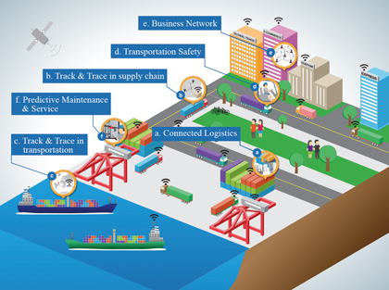
Ports: Internet of Things, Big Data
Business Network
Transportation System
Track & Trace - Supply Chain
Predictive Maintenance
& Services
Track & Trace in
Transportation
Connected Logistics

Slide 11
Shipping : Connected Vessels
Shared Traffic, Cargo, Logistics, Port, Weather and Safety information
Fleet Management - oversee routes and navigation
Monitor Engines and Fuel Consumption
Data sharing with maintenance service providers.
Insurers are kept informed
Ship to Shore Communication

Slide 12
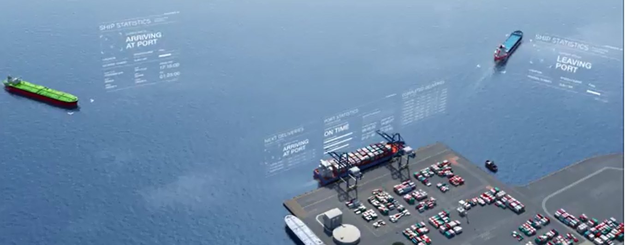
Shipping : Connected Vessels

Slide 13
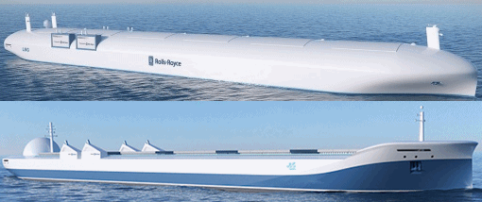
Unmanned Ships
In an age of aerial drones and driver-less cars, Rolls-Royce Holdings Plc is designing unmanned cargo ships (Bloomberg, Feb. 25, 2014)
  Drone ships would be safer, cheaper and less polluting for the $375 billion shipping industry that carries 90 percent of world trade, Rolls-Royce says.

Slide 14
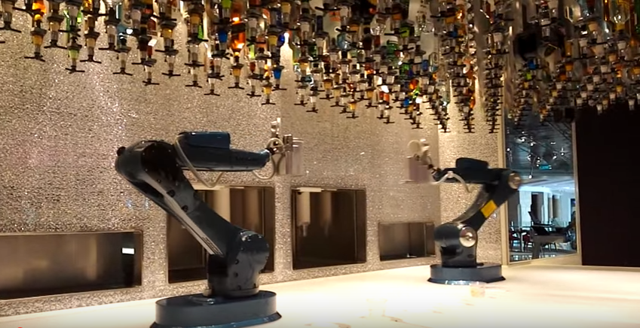
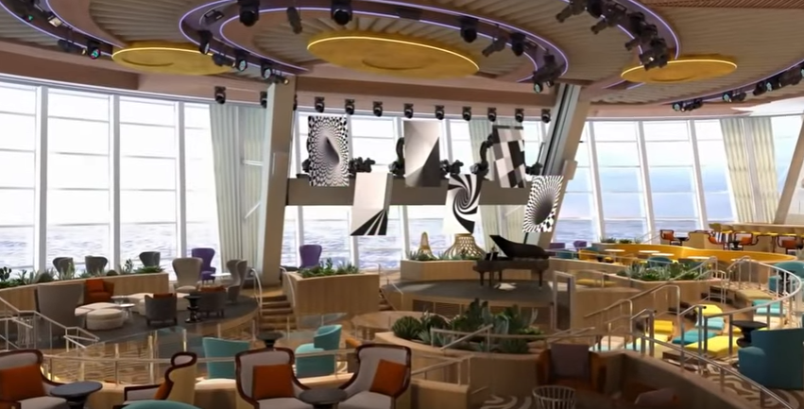
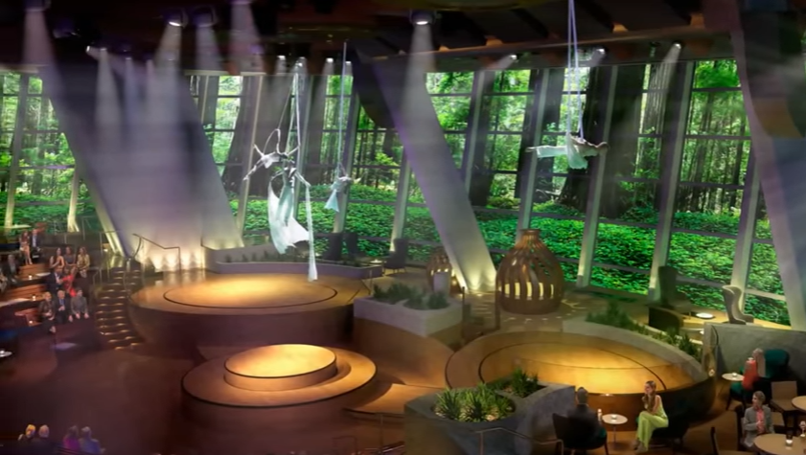
Cruise
Robot bartenders on the Royal Caribbean Anthem of the Seas
Window’s converted in video screens

Slide 15
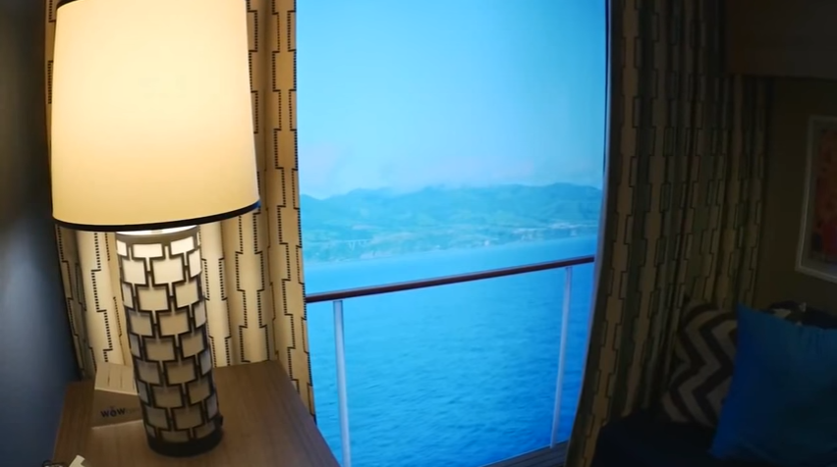
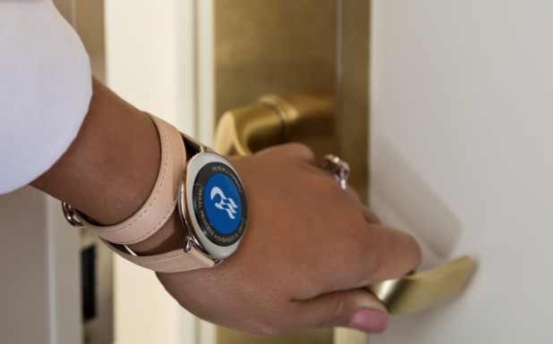
Cruise
Virtual Balcony
High-tech Wearable
wristbands.
Guests can use the
device to
- Unlock their room
- Purchase food
- Make any payments for shopping
- Track guest

Slide 16
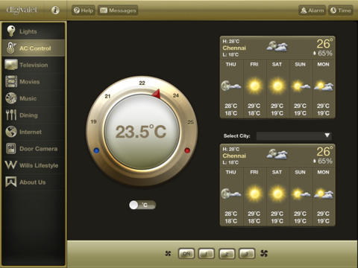
Cruise
In Room Technology Integration
Functions
Room Lights, Mood Lighting
Climate Control
Curtain Control
TV Operations
On Demand Movies, Music
Room Service
Video Door Phone
Internet
Guest Messaging
In Room Shopping
Billing Details

Slide 17
Technologies: Maritime Transformation
Energy management
Cyber and electronic
warfare
Marine biotechnology
Human–computer
interaction
Deep ocean mining
Human augmentation
Communication.
Robotics
Sensors
Smart ship
Shipbuilding
Big data analytics
Advanced materials
Autonomous systems
Propulsion and powering
Advanced manufacturing
Sustainable energy generation
Carbon capture and storage

Slide 18
Thank You
Shailesh.Rathod@TechMahindra.com

