Slide 1
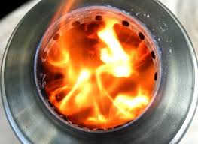

IMPROVEMENT IN DESIGN OF BIOMASS-BASED GASIFIER STOVES
Pravin Sonarkar
Eeshaan Mardikar
VNIT, Nagpur
Visvesvaraya National Institute of Technology, South Ambazari Road,
Nagpur, Maharashtra. Pin 440010 (India)
Phone: (+91-712-) 2222828
http://vnit.ac.in

Slide 2
Background
Modern LPG cylinders and gas stoves are still not available in most rural areas.
The available fuels are the biomass like wood, rice husks etc.
These fuels can be utilized by burning them in open fires or in gasifier stoves.
Though gasifier stoves are better, they too have certain limitations.

Slide 3
Objective
To examine the working of present stoves.
To study the limitations in them.
To build a new improved design of gasifier stove which will minimize these limitations.
The new design would be economical, result in a clean flame with minimum emissions of obnoxious gases and will have high fuel efficiency.

Slide 4
Content
About Biomass
Biomass Gasification
Types of Gasifiers
Limitations
Stoves under Experimentation
Results and Discussion
Future Studies
References

Slide 5
WHAT IS BIOMASS?
      Organic matter having stored energy.
      It exists in one form as plants and may be transferred through the food chain to animals' bodies and their wastes.
      Can be used as fuel for cooking food by the process of gasification in a stove.

Slide 6
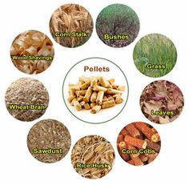
SOURCES

Slide 7
BENEFITS
Renewable
Carbon lean fuel
Less generation of atmospheric pollutants like SOx, NOx
Biomass can be sourced locally, on an indefinite basis
No danger of price rise and scarcity like that of conventional fuels
Locally sourced biomass can offer local business opportunities and support the rural economy.

Slide 8
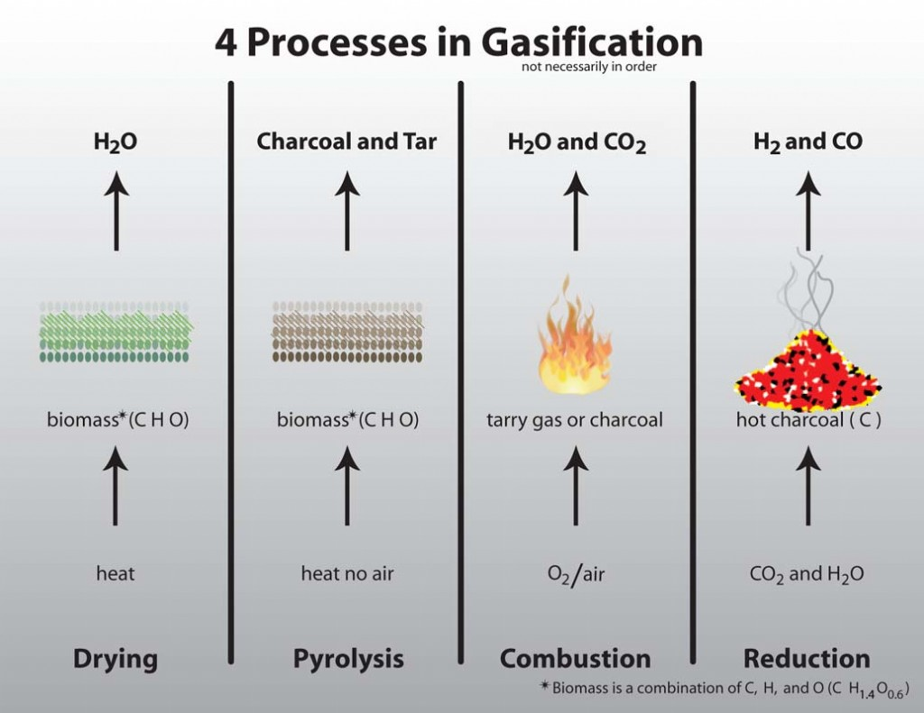
BIOMASS GASIFICATION
A process that converts organic or fossil fuel based carbonaceous materials into carbon monoxide, hydrogen and carbon dioxide
This is achieved by igniting these materials in presence of oxygen and/or steam.
The power derived from gasification and combustion of the resultant gas is source of renewable energy.

Slide 9
TYPES OF STOVES
Gasifier Stoves
Natural Draft
Updraft
Downdraft
Forced Draft
Crossdraft

Slide 10
UPDRAFT GASIFIER
DOWNDRAFT GASIFIERS
CROSSDRAFT GASIFIER

Slide 11
LIMITATIONS OF STOVES
Difficulty in manufacturing.
Expensive materials required for manufacture.
Inefficient combustion leading to generation of smoke.
Insufficient opening for air inlet leading to incomplete oxidation and lower fuel conversion, etc.

Slide 12
Stoves under Experimentation at VNIT
This stove is used for cooking purposes in some rural areas.
It is a natural updraft gasifier.
This stove is manufactured from galvanized iron.
It is light in weight, portable and resistant to high temperature flames.
1. SR Agni Stove

Slide 13
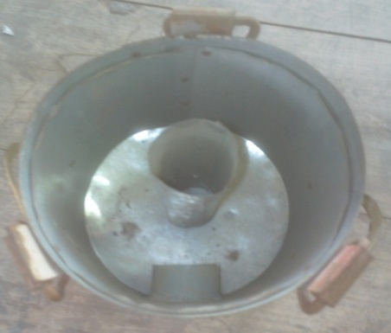
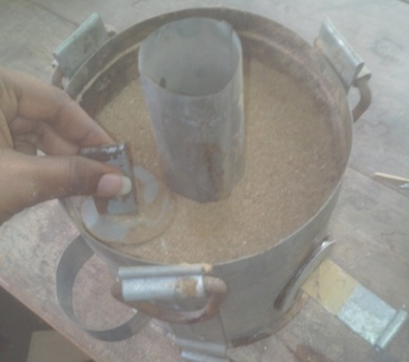
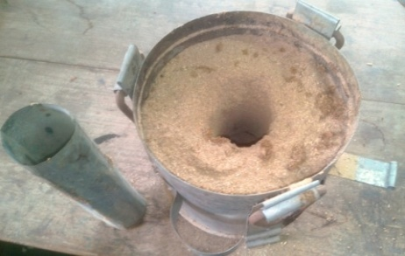
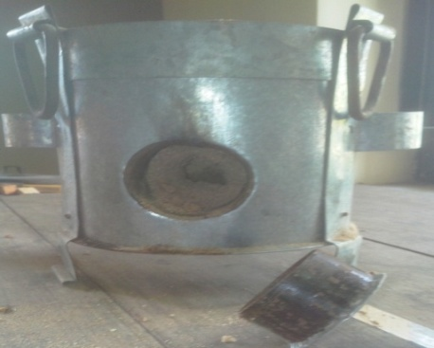
Experimental Setup for SR Agni Stove
A Cylindrical pipe is placed in middle of stove.
A small portion of biomass is added and compressed.
Cylindrical pipe is removed after the biomass feed height is 90% of stove height.
A puncture is dug through the side hole to make space to ignite the biomass.

Slide 14
2.Modified TLUD stove
This stove is constructed using two concentric cylinders.
It consists of inner cylinder and outer cylinder.
It has two air inlets: Primary and Secondary.

Slide 15
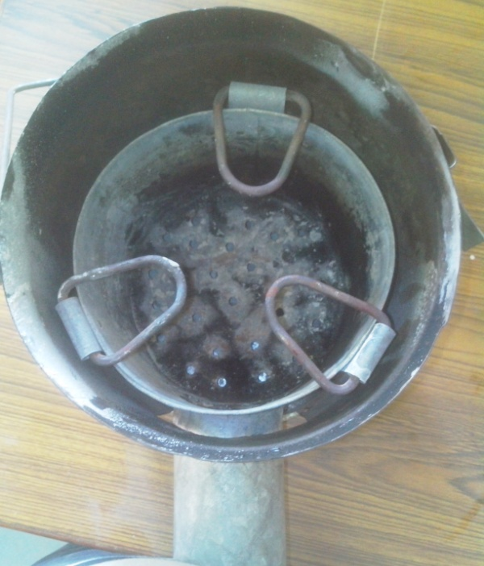
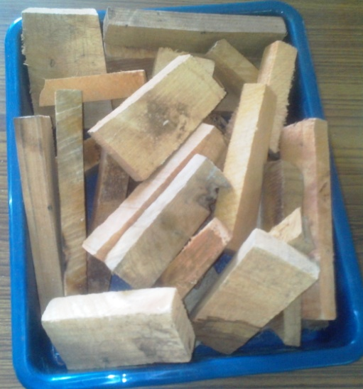
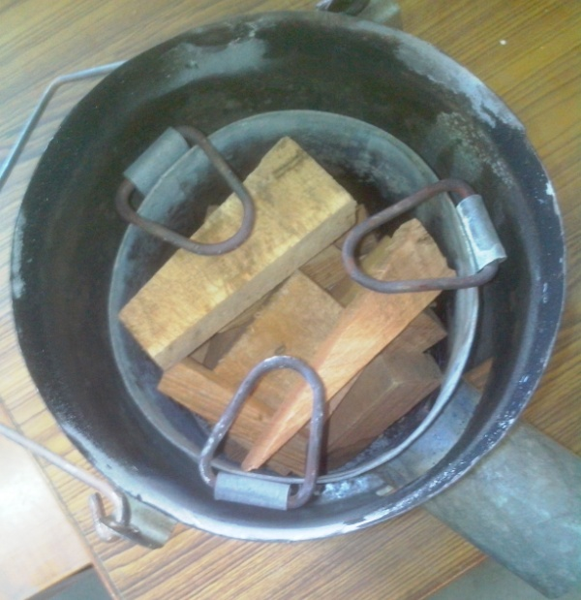
Experimental Setup for Modified TLUD Stove
A TLUD stove with secondary air opening holes.
A sufficient quantity of biomass.
The biomass fuel is directly added to fill 90% of stove height.

Slide 16
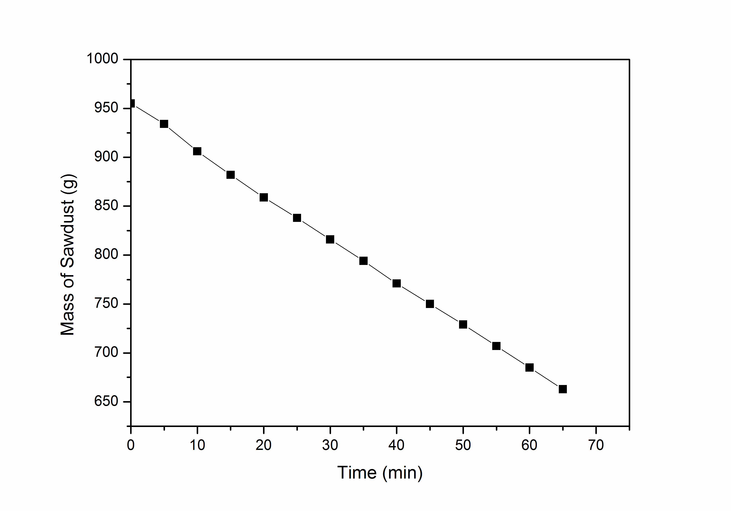
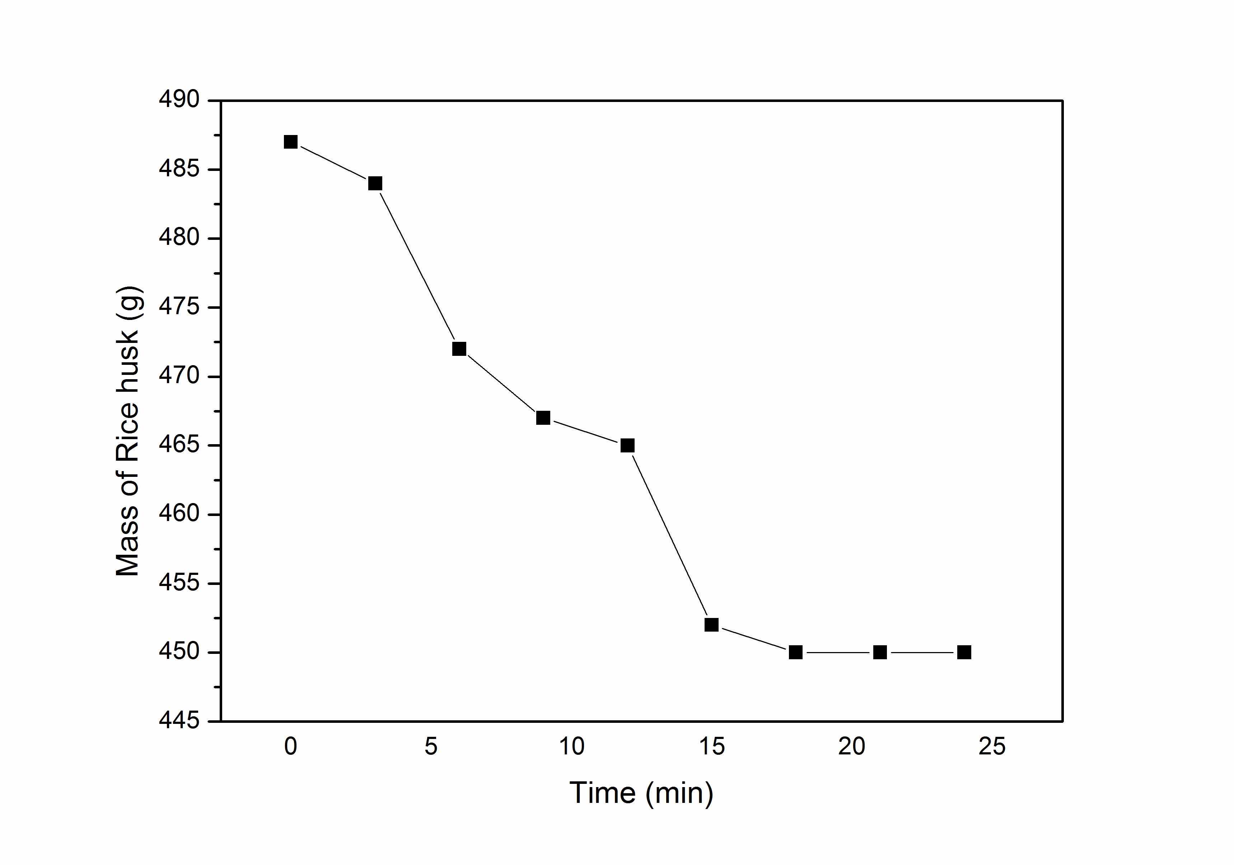
Results For SR Agni Stove
Mass of saw dust as function of time
Mass of rice husk as function of time

Slide 17
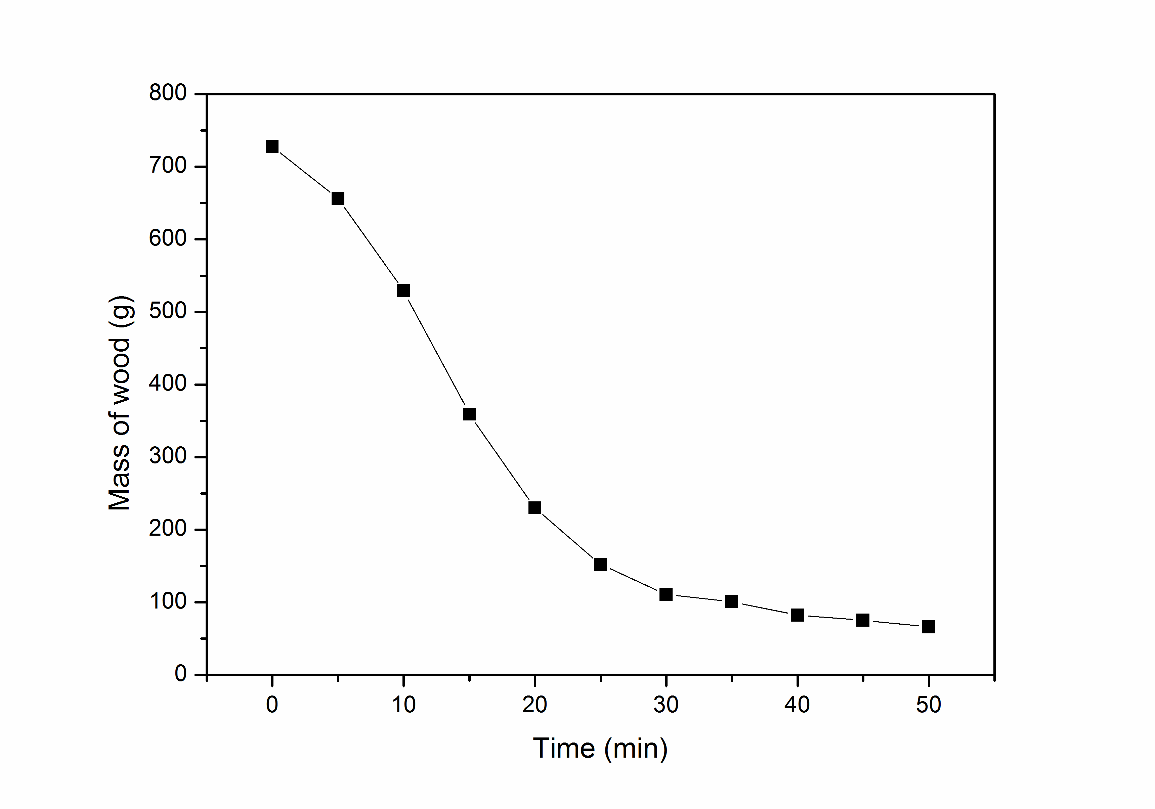
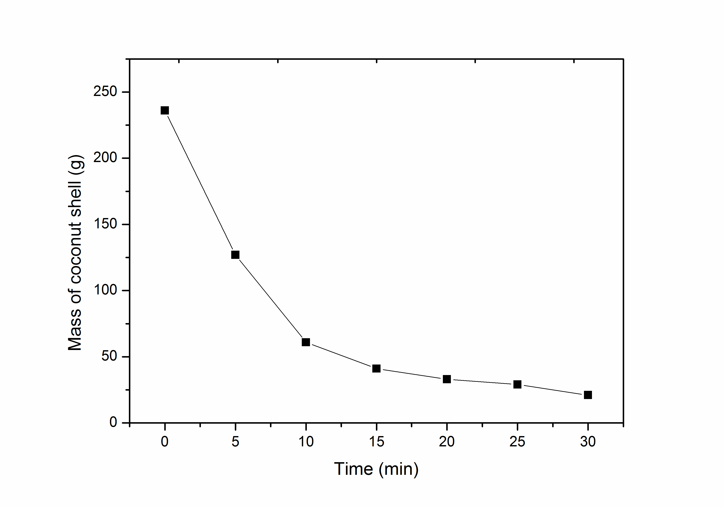
Results for Modified TLUD stove
Mass of wood as a function of time
Mass of coconut shells as a function of time

Slide 18
Discussion
Though the modified TLUD stove is costlier to build than the SR Agni stove, it is more suitable for service in the long run. This is because:
The modified SR Agni stove requires the biomass to be in the form of fine particles.
A complex procedure is involved prior to burning the feed in the SR Agni stove.
Better fuel consumption and flame output is obtained in the modified TLUD.

Slide 19
From the above conclusion TLUD is the best one among two stoves.
Hence our focus will be on conducting experiments for TLUD stove.
Following Parameters were studied for different fuel.
Thermal Efficiency.
Boiling time.
Cooking power.

Slide 20
Method for Performance Evaluation
The stove was loaded with appropriate fuel quantity.
1-2 liters of water were heated to boil and time was noted.
The setup is tested till the assembly cools down.
Then, the weight of the water and the remaining charcoal was measured
The time taken for total period of operation was noted.

Slide 21
Comparative Table
 | Modified TLUD Gasifier stove
Variable | Wood Pallets | Wood | Coconut shells
Lightning time (min) | 25 | 19 | 13
Fire starting material(g) | 6 | 6 | 6
Calorific Value (kJ/kg) | 17000 | 15400 | 14630
Initial weight of fuel (g) | 1640 | 652 | 300
Residue (g) | 151 | 38 | 48
Water evaporated up to extinguishing of fire in (g) | 1810 | 697 | 198
Total water evaporated up to end of operation(g) | 2000 | 850 | 250
Time to boil (min) | 10.5 | 7 | 13
Boiling duration(min) | 30 | 20 | 12
Duration of fire(min) (Time to boil+ Boiling duration) | 40.5 | 27 | 25
Warming duration after fire(min) | 60 | 30 | 25
Total operation time (Duration of fire+ Warming duration)(min) | 100.5 | 57 | 50
Performance | Wood Pallets | Wood | Coconut shells
Thermal efficiency % | 19.26 | 23.6 | 23.8
Boiling time(min) | 10.5 | 7 | 13
Cooking power(Watt) | 852.57 | 652.61 | 292.58

Slide 22
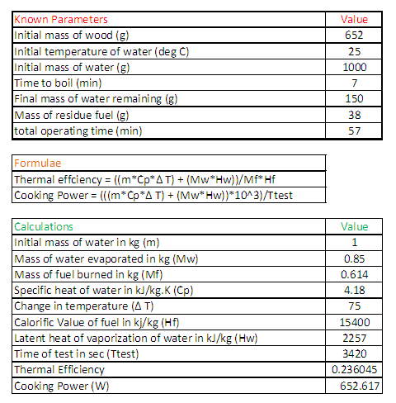
Sample Calculations

Slide 24
Remarks
Each fuel has different desirable characteristics but not all.
So, no definite conclusion can be made regarding the fuel which is most efficient.
Further tests of more parameters need to be done.

Slide 25
FUTURE SCOPE
At present, our research is mainly focused on selecting the most appropriate biomass that would maximize the efficiency of the stove.
For this, a few more sources like bagasse, corn, coconut husks etc. will also be considered.
These tests will also be followed by gas analysis to determine the gas emissions for each biomass, determination of burning rate, calculating fire power etc.
Performing all these experiments on some more available stove models.
In the final part, the emphasis will be on further increasing the efficiency of the present models by optimization of design parameters such as ways to improve air circulation, providing insulation, diameter of air inlet, height to diameter ratio etc. to obtain an improved design of the gasifier stove.

Slide 26
References
www.eai.in, ‘Biomass Gasification Technology’
S.N Varunkumar et.al. ‘Experimental and Computational Studies on Gasifier based Stoves’
Dessie Tarekegn Bantelay, Nigus Gabbiye, 2014, ‘Design, manufacturing and performance evaluation of house hold gasifier stove’
Yibo Huangfu et.al. ‘Effects of moisture content in fuel on thermal performance and emission of biomass semi-gasified cookstove
Benjamin Gituku et.al. ‘Development and Commercialization of gasifier stoves at Kirdi’

Slide 27
Thank You!

Slide 28


