Slide 1
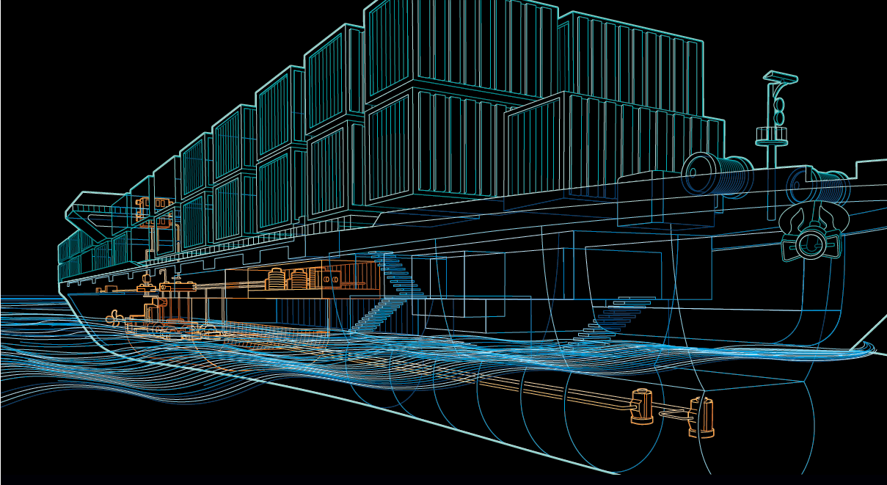
Sustainable Technology for Reduction of Fuel Consumption
Marine Engineering & Research Institute
Mumbai

Slide 2
Concerns
Efficiency
Emission
Economy
Waste Heat Recovery System(WHRS)

Slide 3
What is WHRS
A system for power generation using exhaust gas for improving efficiency without spending a single penny for fuel .
Reduces the ship's fuel consumption and CO₂ emissions by up to 12%
Energy costs consequently fall by some 10 %
Reduces not only the operating hours but also operating and maintenance costs of the existing auxiliary generators

Slide 4
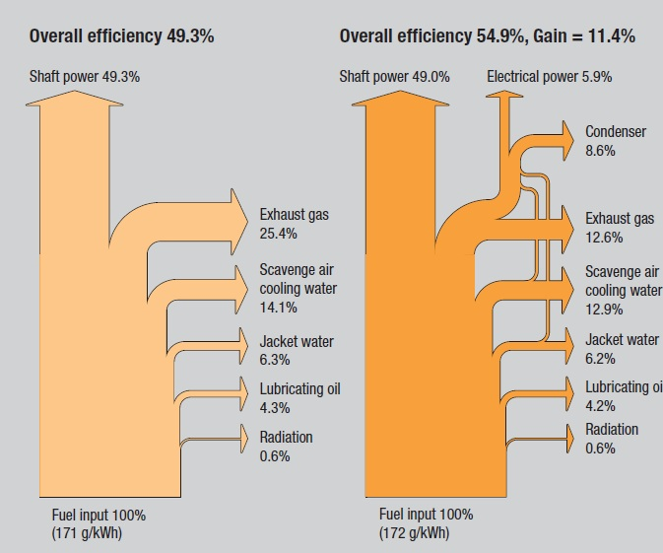
Why Waste heat recovery?

Slide 5
SHIPS WHRS CHRACTERISTICS
Adaptable
Compact
Light
Performance
Safe

Slide 6
Higher power gain
High optimization for new engine & ship designs
Effective in terms of economic considerations
Heat extractions from several sources like jacket water cooler, scavenge air
Heat extractions from auxiliary engines useful for port stay days.

Slide 7
Various types
Depending on the level of complexity acceptable to the owner and shipyard and the actual electrical power consumption on board, it is possible to choose between the following systems
PTG
Power Turbine Generator
STG
Steam Turbine Generator
ST-PTG
Steam Turbine-Power Turbine Generator

Slide 8
Power Turbine Generator

Slide 9
Simplest and cheapest of WHRS
Exhaust gas turbine installed in the exhaust gas bypass, and a generator that converts power from the power turbine to electricity onboard the ship
power turbine is driven by part of the exhaust gas flow which bypasses the turbochargers
The exhaust gas bypass valve will be closed at an engine power lower than about 50% SMCR, where the engine will run with the same high efficiency as for a normal low speed engine
PTG WHRS solution will provide a 3-5% recovery ratio(depending on main engine size)
The main connection between the PTG and the engine is only the exhaust gas by-pass line hence is the simplest

Slide 10
Steam Turbine Generator

Slide 11
The exhaust gas bypass stream is mixed with the exhaust outlet from the turbocharger(s), increasing the exhaust gas temperature before the boiler inlet
Steam turbine (often called a turbo generator), the obtainable steam production from the exhaust boiler system can be used for electric power production
The steam turbine is installed on a common bedplate with the generator in the same manner as the power turbine and the generator
STG solution can function both as a standalone and as a parallel running electric power source for the ship

Slide 12
It will be possible to recover some 5 to 8%
It is likely that the boiler installation has to be increased in size
One or two pipes should be connected to the steam turbine, depending on whether the single or dual pressure system is applied
Condenser must be installed under the bedplate of the steam turbine and, in some cases; it may be as large as the steam turbine and generator installation
It starts operating at about 30% SMCR

Slide 13
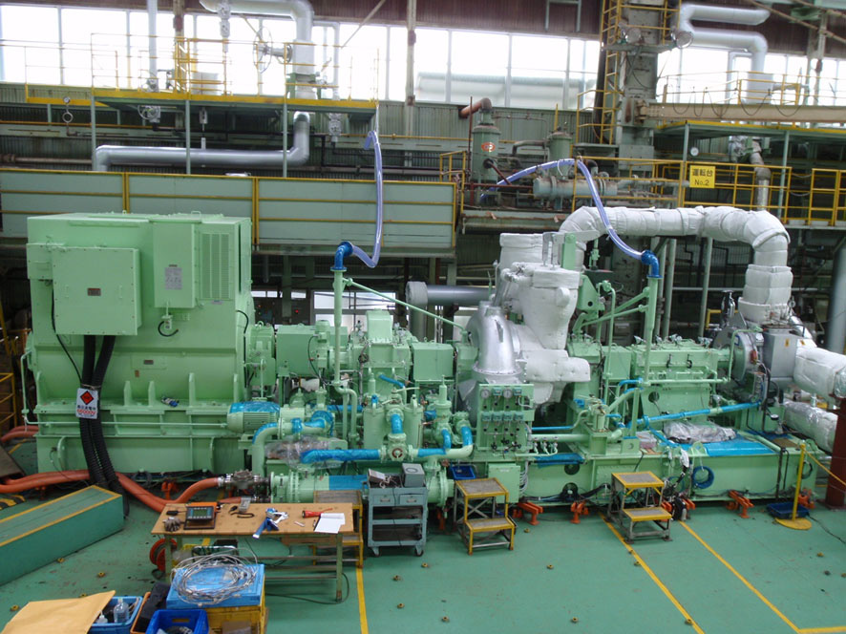
Steam Turbine-Power Turbine Generator

Slide 14
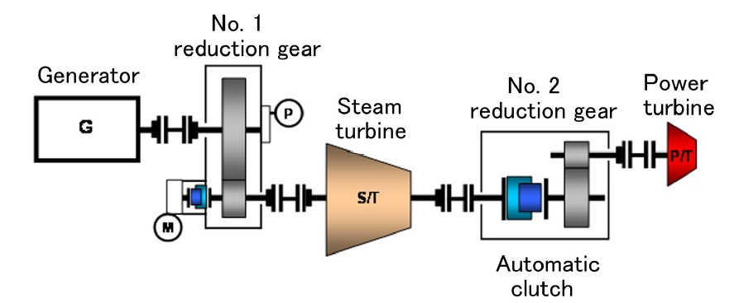
Electric power demand on the ship is very high, e.g. a container ship
The system is built onto a common bed plate and via reduction gearboxes, connected to a common generator
First the steam turbine will start at 30 – 35% SMCR main engine power followed by the power turbine which starts power production at 40 to 50% SMCR

Slide 15
Reduces the fuel costs of the ship considerably by being able to cover the total electric power needs in many conditions onboard the ship
WHRS combining both steam and power turbines some 8-11% power can be recovered
A shaft motor / generator connected to the main engine shaft could be an option, making it possible to add either electric power to the ship grid if needed, or to boost propulsion

Slide 16
WHRS system offers considerable flexibility in optimising plant operation to minimise operating costs or maximise propulsion power
Ships with a relatively stable operating profile, especially with higher propulsion loads, have the biggest potential for savings.
The more the vessel has a high-load operation, the shorter the payback time for the WHRS will be.

Slide 17
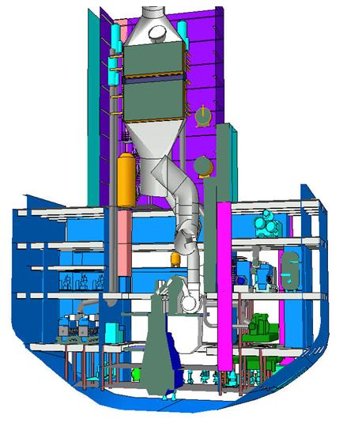
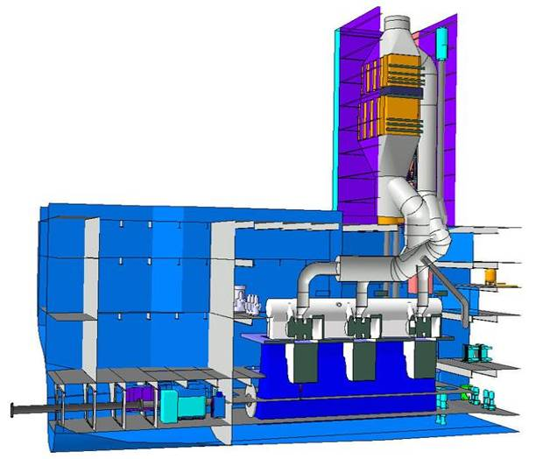
Virtual installation
Steam Turbine-Power Turbine Generator

Slide 18
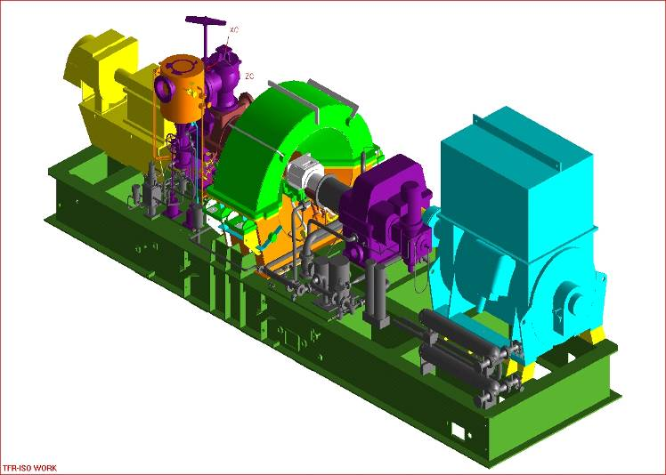
Principal arrangement of power/steam turbogenerator package

Slide 19
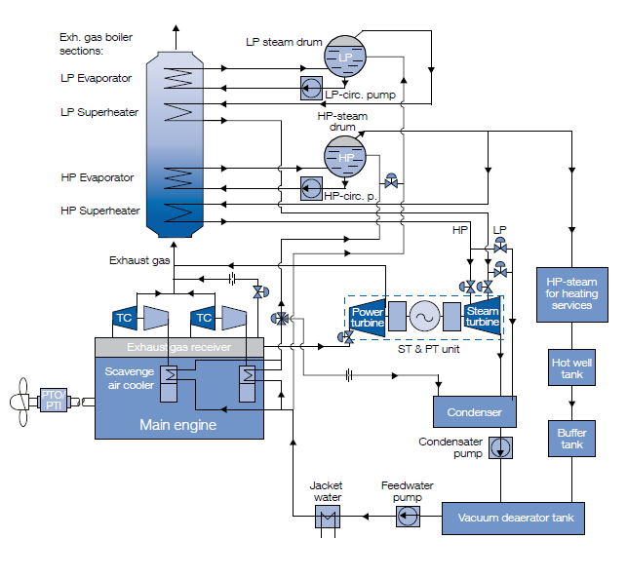
Plant Diagram

Slide 20
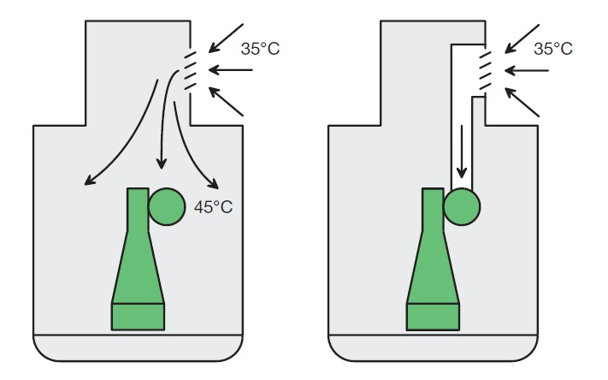
Improvement
In order to improvise exhaust gas temperature the air is drawn from outside instead of engine room owing to its higher temperature. This is called ambient suction air intake. This incurs a slightly increased fuel consumption at ISO reference conditions. But the gain in energy makes loss in efficiency look negligible.

Slide 21
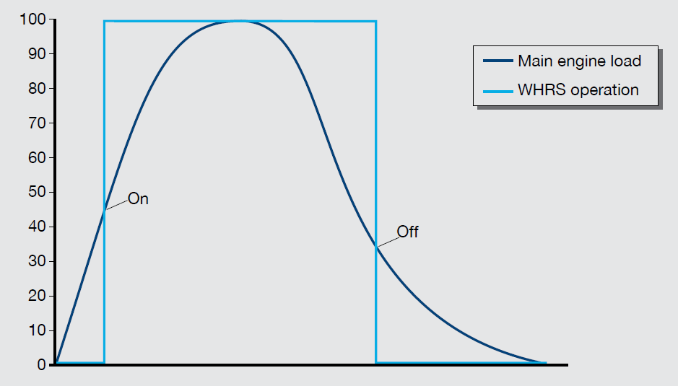
Economical Operation of WHRS

Slide 22
HIGH-EFFICIENCY WHR: CASE STUDY
Basis ship:
Main engine: Wärtsilä 12RT-flex96C
CMCR power, kW: 80,080
Annual operating hours: 6500
Average engine load, %: 85
Total electrical load, kW: 5350
Auxiliary engines, kWe: 4 x 3000
Bunker fuel price, US$/tonne: 250
Cylinder lubricating oil price, US$/tonne: 1500

Slide 23
Annual engine operating costs | Basis ship | With WHR
Fuel costs, US$: | 18,449,000 | 16,359,000
Maintenance costs, US$: | 486,000 | 333,000
Lubricating oil costs, US$: | 602,000 | 559,000
Total, US$: | 19,537,000 | 17,287,000
Annual savings, US$ at US$ 250/tonne fuel: at US$ 400/tonne fuel: |  | 2,250,000 3,482,000
Investment cost, US$ |  | 9,500,000
PAYBACK TIME LESS THAN 5 YEARS

Slide 24
Reductions
Reduction in pollution:
CO2 emission saving per year: 11,260 tons
NOx emission saving per year: 319 tons
SOx emission saving per year: 214 tons
Particulates saving per year: 29 tons
Reduction in equipment sizes:
leads to reduction in the flue gas produced results in reduction in equipment sizes
Reduction in auxiliary energy consumption: Reduction in equipment sizes gives additional benefits in the form of reduction in auxiliary energy consumption

Slide 25
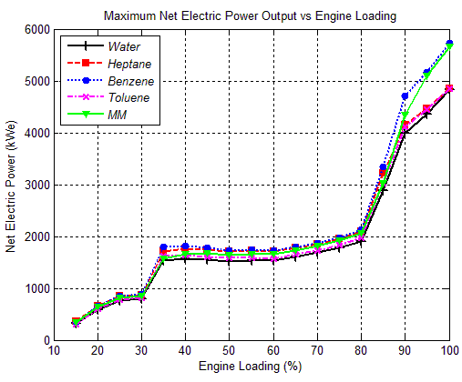
STUDY
According to study conducted by UCL upon several types of working fluid for earlier mentioned engine configuration.

Slide 26
Advantage
Operator | Shipyard | Environment
lower fuel consumption flexible utilization of generator E-Power low thermal load on ME → less maintenance for 2 stroke engine extended time between overhauls of aux.engines Shaft motor power can be weighted against lower installed ME power - Auxiliary engines can be used to propel the ship in case of emergency | improved ship design by 10% less bunker capacity (larger cargo space) lower installed diesel power less cylinders for more flexibility in engine room length (shaft motor is installed in the shaft tunnel) | lower fuel consumption lower concentration of SOx and NOx lower CO₂ emissions

Slide 27
Drawbacks
Installation cost to implement a WHRS
Retrofitting in older class ships brings congestion in space
Requires additional maintenance due to introduction of new machinery

Slide 28
Conclusion
Fuel reductions of between 4-11% are possible, depending on the selected WHRS solution, main engine power level, electric need at sea, operational profile, etc. The larger the engine power, the greater the possible fuel saving. In addition to large fuel savings, a WHRS gives large CO2, NOx, SOx and particulate reductions to the benefit of the environment.
The payback time is short for all three WHRS solutions, which alone can give the ship-owner high fuel savings throughout the lifetime of the ship
WHRS will rather substantially reduce the ship’s energy efficiency design index – same reduction level as the WHRS recovery ratio – thereby helping the ship owner meet even tighter EEDI requirements from IMO in the future.

Slide 29
QUESTIONS ?

