Slide 1

HIGH VOLATGE APPLICATION IN INDUSTRIES & TRANSPORTATION
TRANSTECH’14
Submitted By-
AKSHAY SHARMA
ANKIT KAWATRA
VIKASH KHALIYAV
R.L. Institute of Nautical Sciences, Madurai

Slide 2
High Voltage Range
IEC voltage range | AC | DC | defining risk
High voltage (supply system) | > 1000 V_{rms} | > 1500 V | electrical arcing
Low voltage (supply system) | 50–1000 V_{rms} | 120–1500 V | electrical shock
Extra-low voltage (supply system) | < 50 V_{rms} | < 120 V | low risk

Slide 3
Application in Industries
Aerospace
Consumer/Industrial
Medical
Military/Defense
Material Treatment& Mining
Offshore Drilling
Transportation
Non Destructive Tests

Slide 4
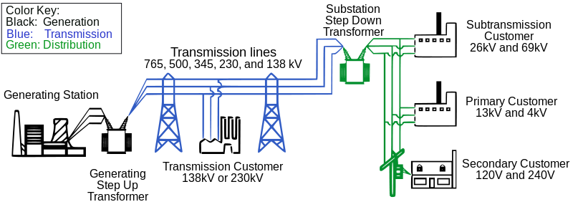
High voltage Transmission

Slide 5
X-ray Generators
X-Ray generators components-
high voltage generator,
control console,
cooling system
High voltage source (30 KV TO 150 KV)
Higher the KV , the more speed and therefore energy the electron have when they strike the anode.

Slide 6
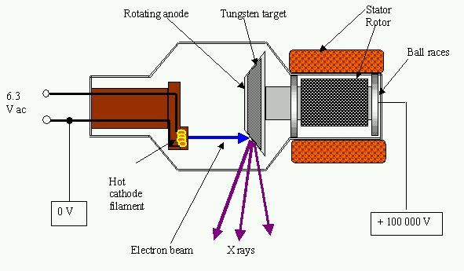
X-ray Generator

Slide 7
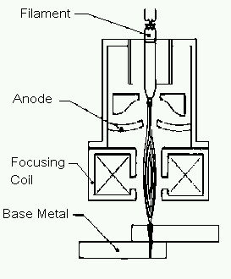
Electron Beam Welding
Focus beam of high energy is directed to weld joint.
kinetic energy of electron is transformed into heat upon impact.
High Voltage (80KV) is applied
between cathode and anode.

Slide 8
Dielectric Testing
Hipot test - dielectric withstand test .
Used to verify electrical insulation
In Hipot high voltage applied between product current carrying conductor and its metallic shielding .
Resulting current that flow through insulation is leakage current moniter by Hipot Tester.

Slide 9
Air Ionisers
Ioniser consists of thin wire strung between separate set of grounded seal ionizing plate.
Thin wire carrying high voltage of 25KV creating electron cloud.
when dust particles passes electron cloud become charge and pulled out of air.

Slide 10
Food Preservation
Pulse electric field processing
Substance placed between two electrodes then pulse electric field applied.
The electric field enlarge pores of cell membrane and kill cells.
Voltage range for 30,000 VOLTS/CM

Slide 11
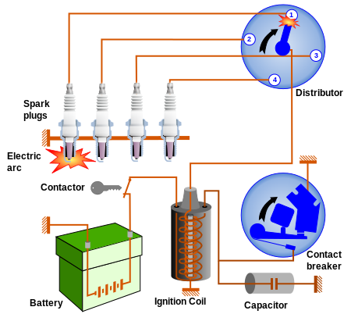
Ignition system

Slide 12
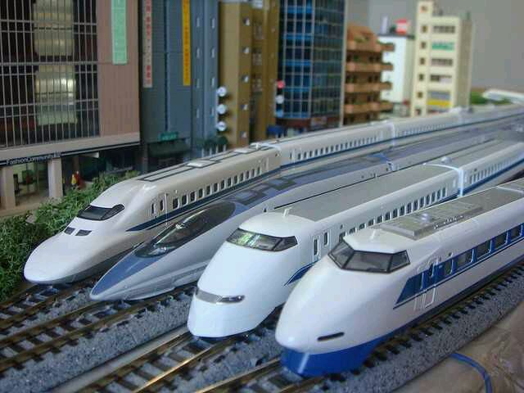

Application in Transportation
MAGLEV TRAINS

Slide 13
MAGLEV TRAINS
Maglev trains are magnetically levitated trains
The train propels forward without any friction from moving mechanical parts.
Levitation is achieved with the principal of repulsion and attraction between two magnetic poles.

Slide 14
MAGLEV TRAINS
LEVITATATION
PROPULSION

Slide 15
Suspension systems
Electrodynamic Suspension Systems (EDS)
Electromagnetic Suspension Systems (EMS)
Inductrack.

Slide 16
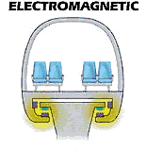
Electromagnetic Suspension
The electromagnetic suspension EMS uses attractive force system to levitate.
The attractive force between train and guideway will overcome the gravitational force and it
results in levitation.

Slide 17
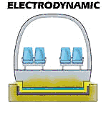
Electrodynamic Suspension
The electrodynamic suspension (EDS) train uses magnets that has same polarity .
to create repulsive force between levitation magnet and guideway magnet.
This repulsive force then will be
high enough to overcome
gravitational force.

Slide 18
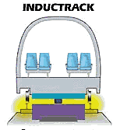
Inductrack
The inductrack uses permanent room-temperature magnets to produce the magnetic fields.
The magnets are configured
in a Halbach array such that
the intensity of the magnetic
field concentrates above the
array instead of below it.

Slide 19
Maglev Propulsion
An EMS system can provide both levitation and propulsion using an on board linear motor.
The polarity of the stators at the track will quickly change its polarity continuously to move the Maglev train.
Stators at the sides are excited sequentially

Slide 20
The process of propulsion for EDS is same as EMS except that the stators will stop for a moment after polarity change.
Referred as "pull- then neutral- then push” system.
Propulsion coils on the guideway are used to exert a force on the magnets in the train and make the train move forward.

Slide 21
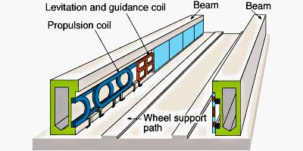
Maglev Track
The magnetized coils allows the train to levitate between 0.39 and 3.93 inches (1 to 10 cm) above the guideway.
Once the train is levitated, power is supplied to the coils
within the guideway
walls to create a
unique system of
magnetic fields that
pull and push.

Slide 22
HIGH VOLTAGE ON SHIPS
We use supply of :-
440V
3 phase
60 hz
Onboard the ship
With increase in demand and size of machineries on ship more electrical voltage is needed.

Slide 23
> 1 KV = HIGH VOLTAGE SYSTEM
< 1 KV = LOW VOLTAGE SYSTEM
BASICALLY SHIP USES 3.3 KV TO 6.6KV
PASSENGER VESSELS LIKE QE2= 10 KV

Slide 24


