Slide 1
Dr. Nandlal PRIBHDAS TOLANI
1924-2017

Slide 2
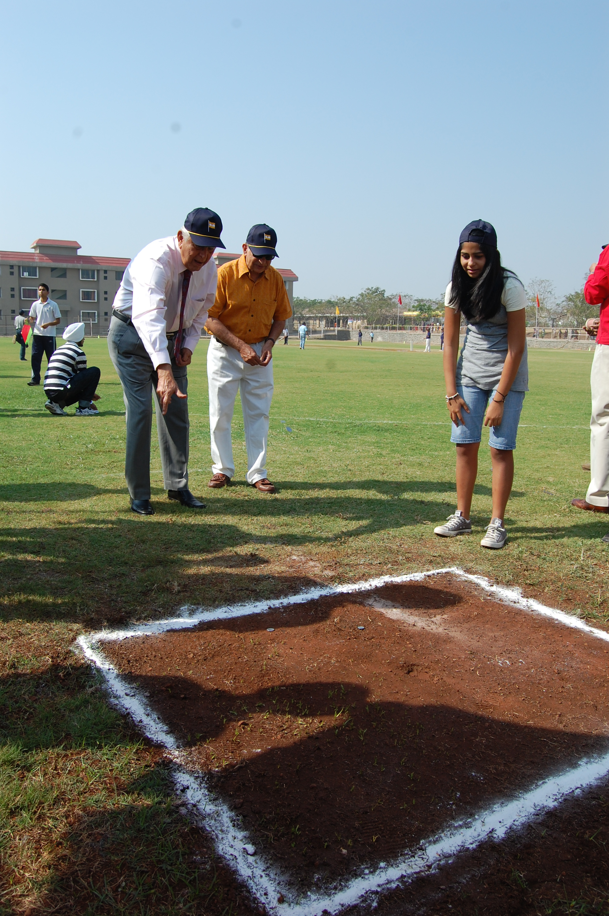

FUN Games
Ghuchi Player –
We would dig small pit in the ground on an unpaved area outside our home. The players stood around it at a distance of ten or fifteen feet, taking turns to throw coins in it. The one who got the most coins in the pit was the winner. (Courtesy Odyssey Page no. 11)

Slide 3
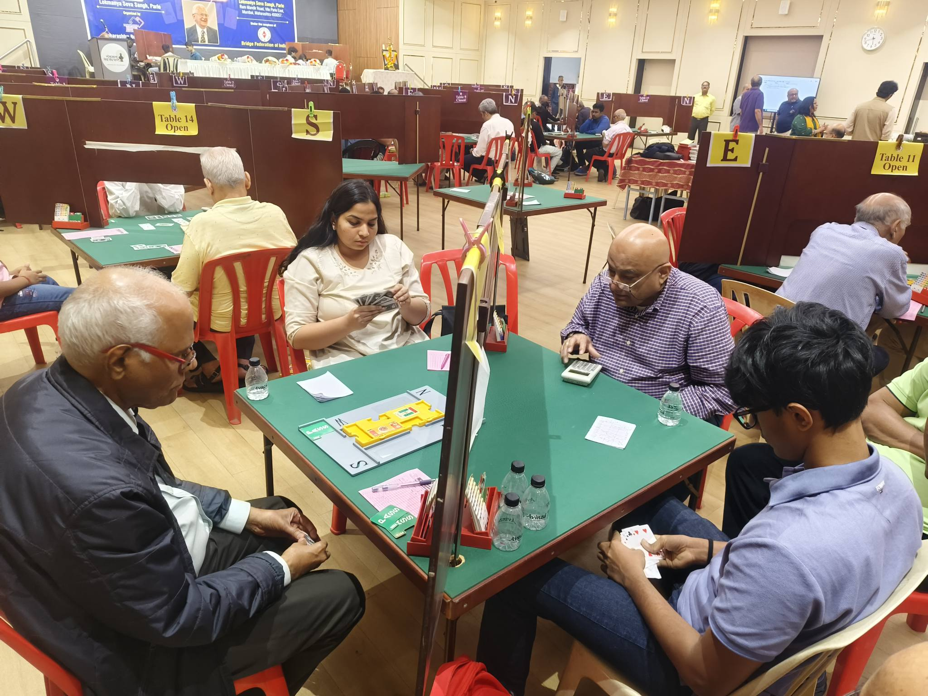
Bridge Player
Tolani National Masters Bridge Championships kicks off at Mumbai from 22-25 January 2026.
I never played for high stakes. This is because of early experiences taught me that I did not leave a taste for gambling. Dada Gopal was the captain and we won two national trophies, an achievement, Bridge to me has been a lifelong passion. (Courtesy ‘Odyssey’ Page no. 11, 36)

Slide 4
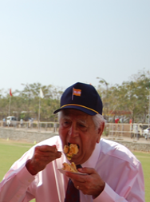
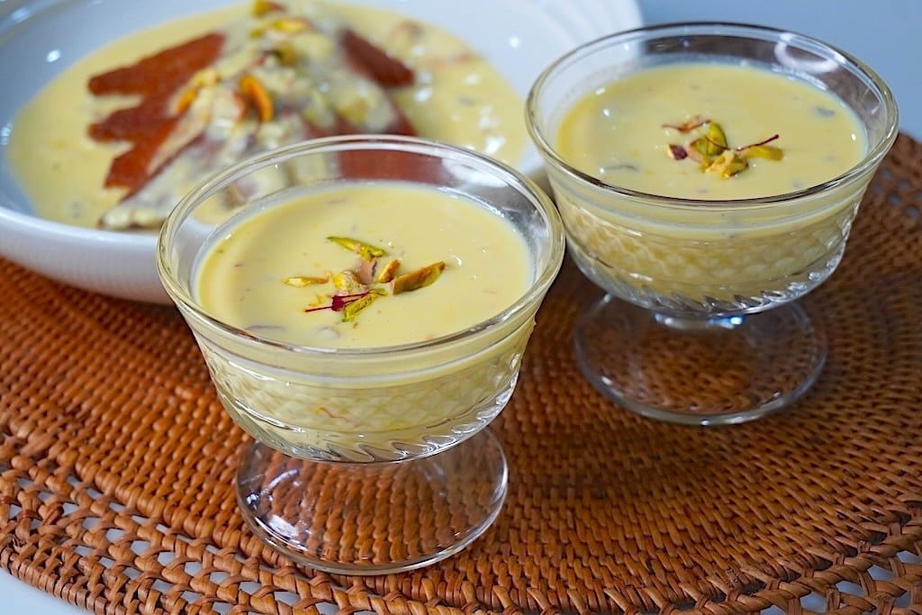
My Favorite Rabri
Rabri Eater – My Favorite sweet was Rabri, which was pure concentrated milk. When cooked slowly to thicken, it develops a texture, and this I enjoyed very much. Rabri is typically made with sugar. In latter year when I was told that sugar is bad for health, I learnt it unsweetened, with chapati, with just much pleasure. (Courtesy ‘Odyssey’ Page no. 11, 36)

Slide 5
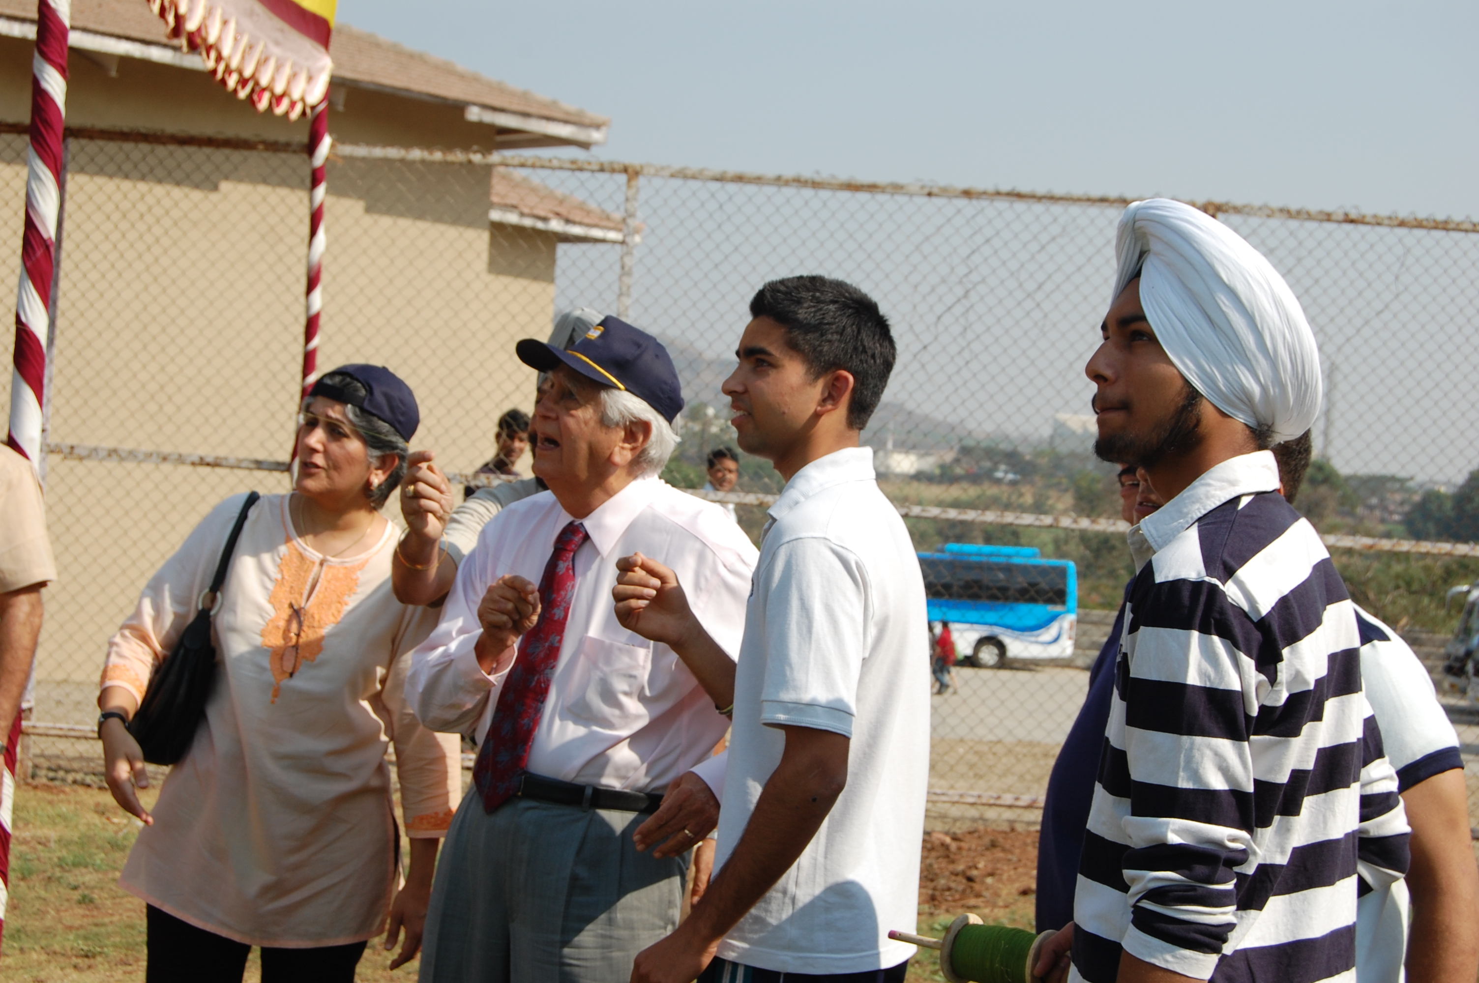
competitive kite flier
To be a competitive kite flier and cut down other kites, we would make our Manjho stronger and sharper by reinforcing it with crushed glass particles. My father always disapproved of this activity, so it has to be done secretly because of my simple pleasure as a child. (Courtesy Odyssey page no. 10)

Slide 6
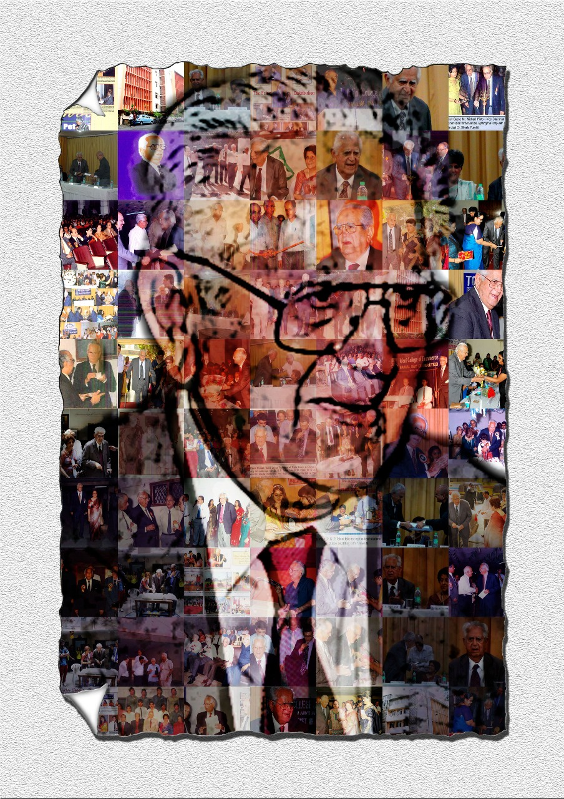
Businessman:
I wanted to do good business and have a healthy bottom line, but always within the ambit of the law. While doing so, I wanted others around me to benefit too
(Courtesy Odyssey page no. 10)

Slide 7
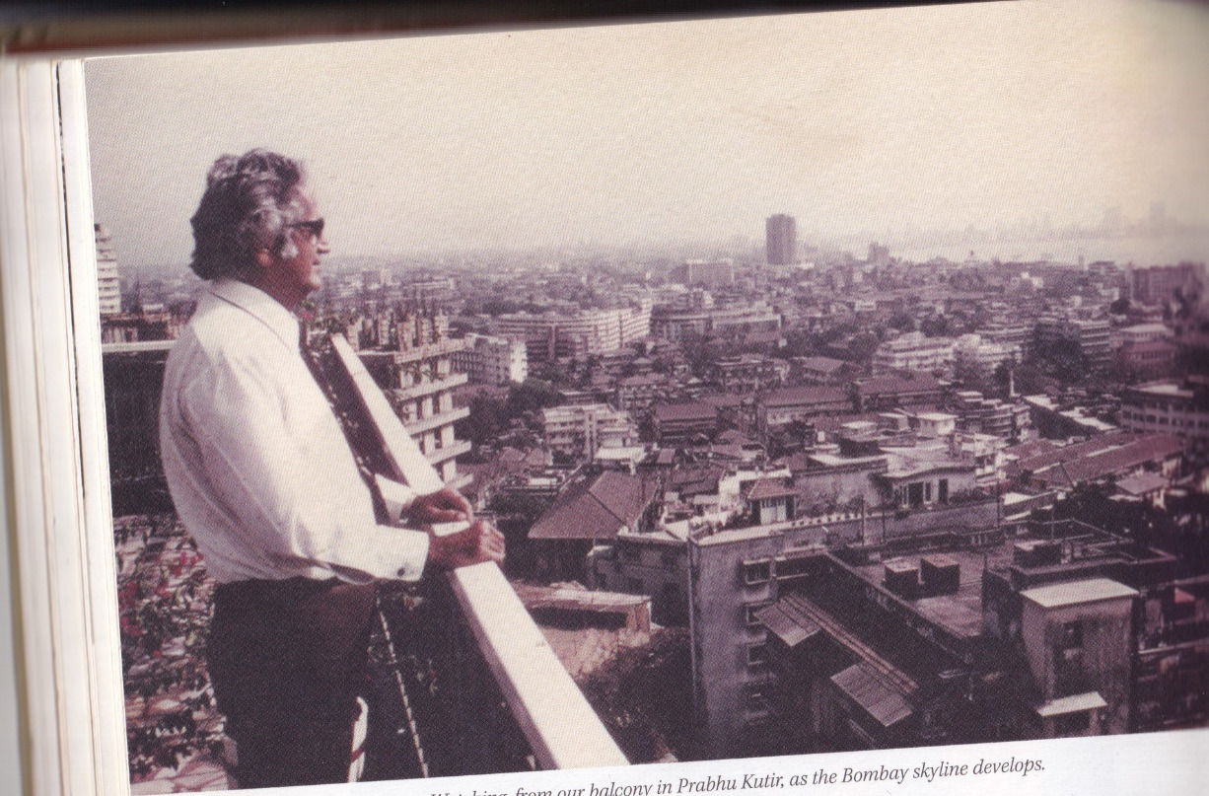
VISIONARY
THINKS AHEAD OF THE TIME

Slide 8
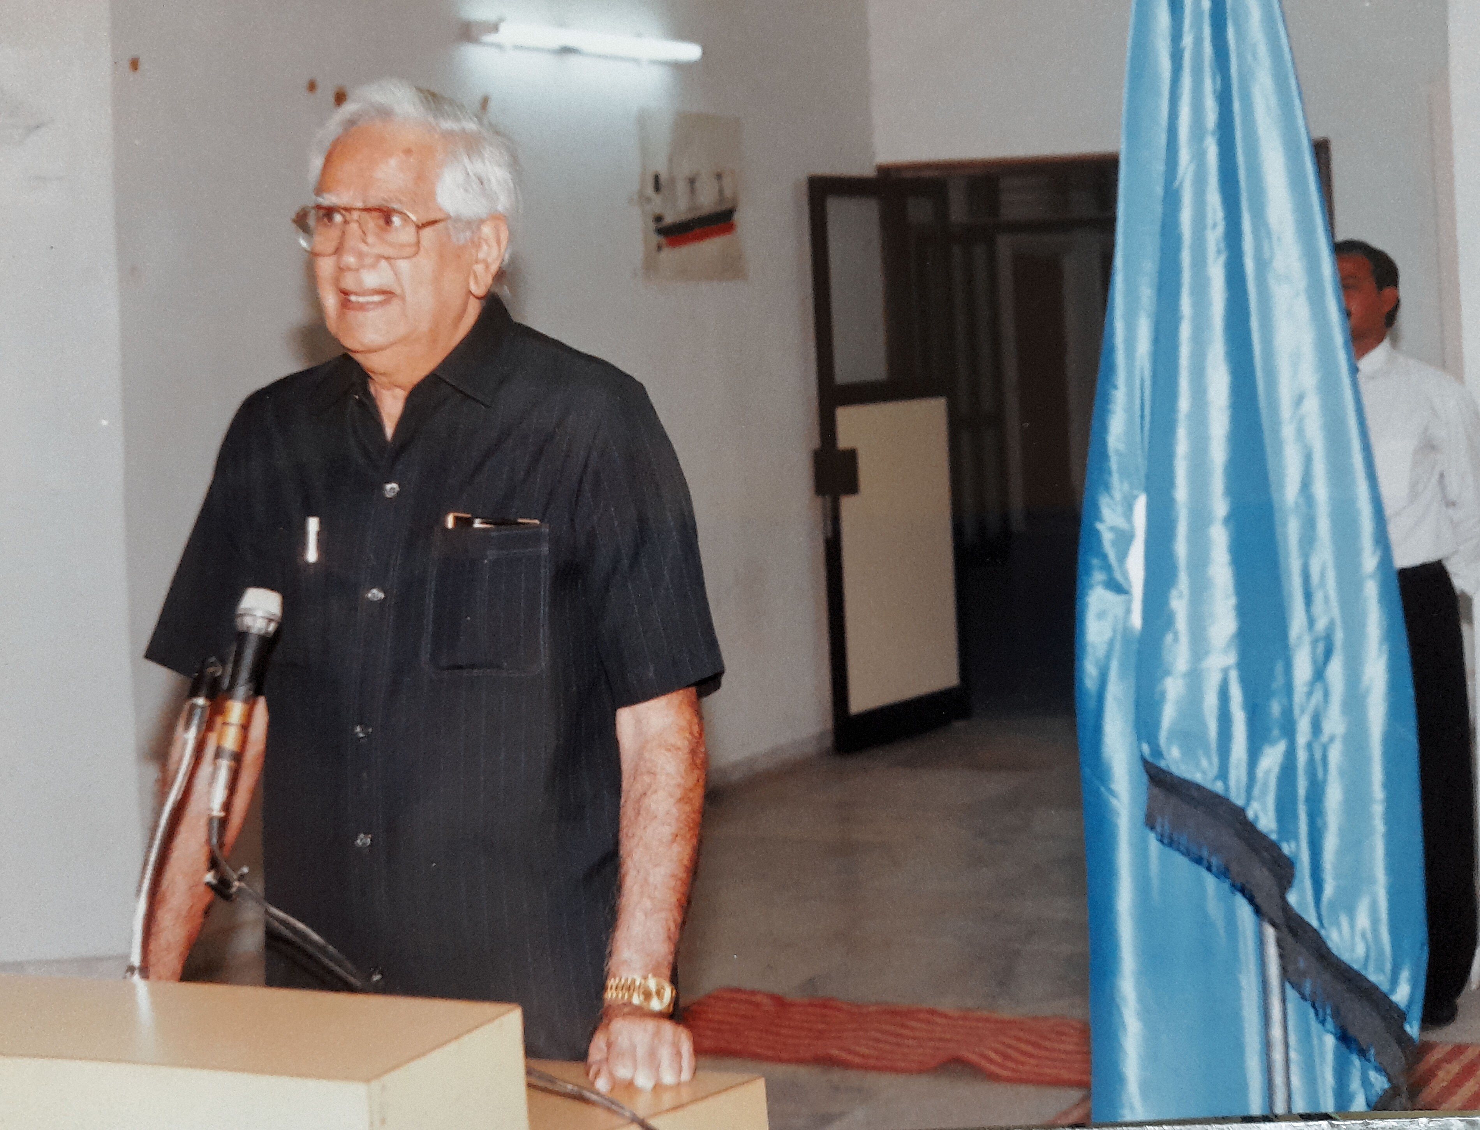
Philanthropist
A philanthropist gives of his time, talent or treasure to make positive change happen for humanity, regardless of their wealth or status.

Slide 9
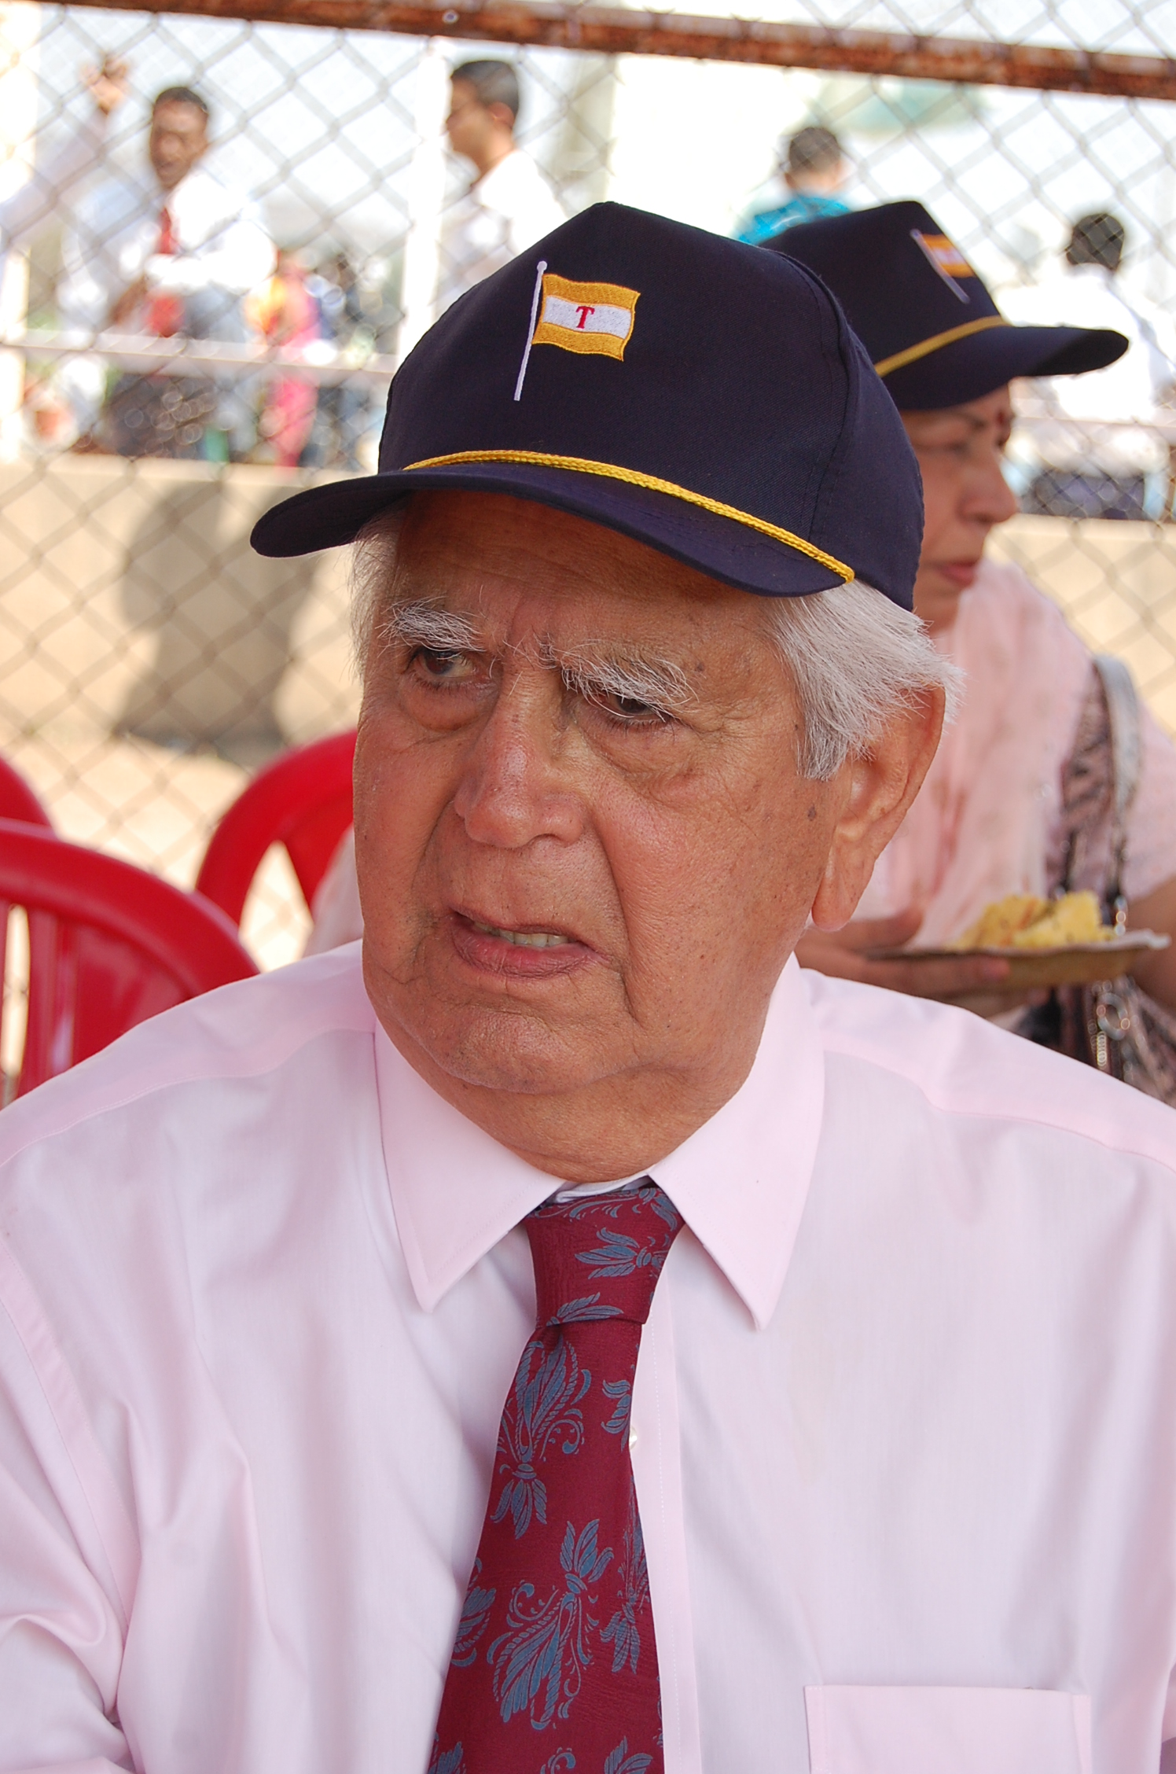
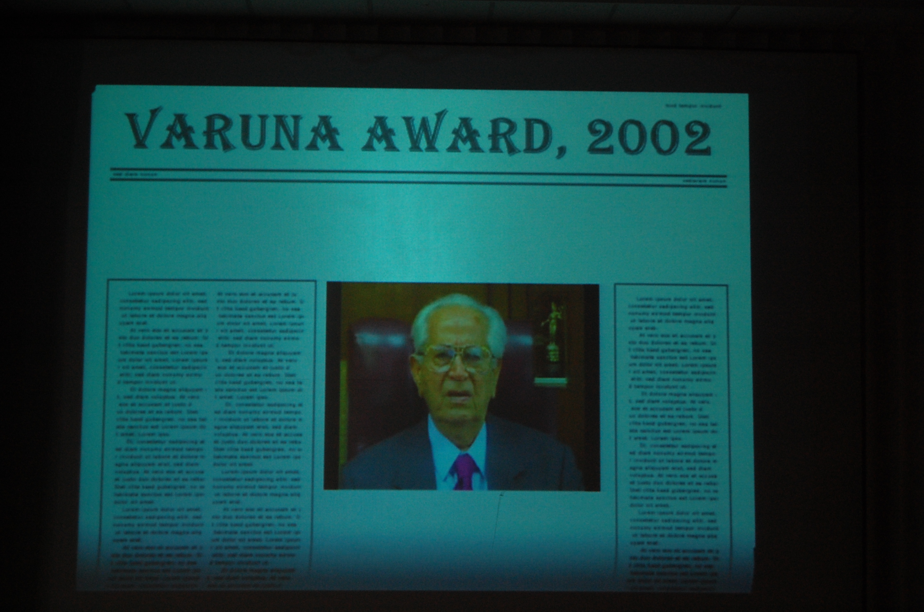
Educationist
I admired Kaka’s work aspirations and had long decided to follow in his footsteps, and established Nandlal Tolani Charitable Trust, a non-profit organisation (Courtesy Odyssey Page no. 177)

Slide 10
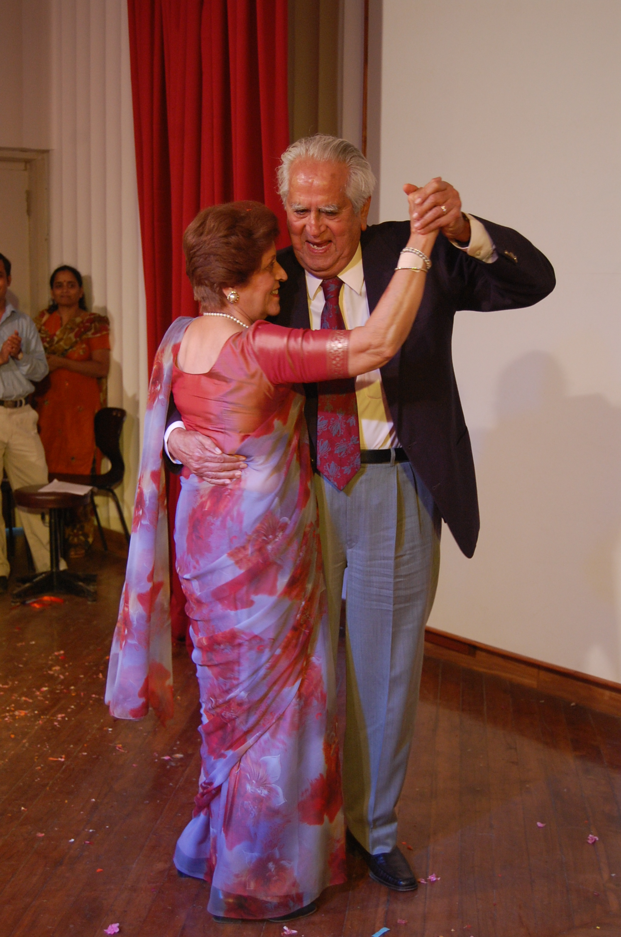
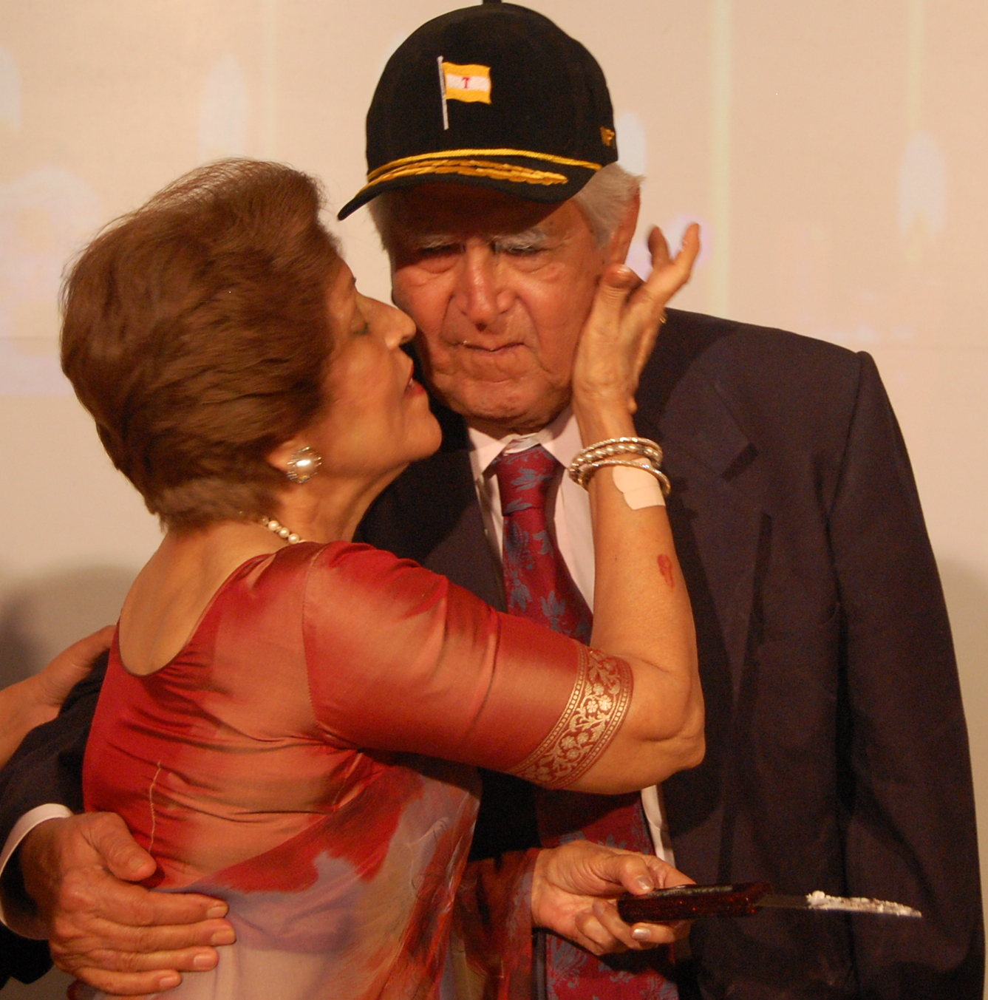
family time

Slide 11
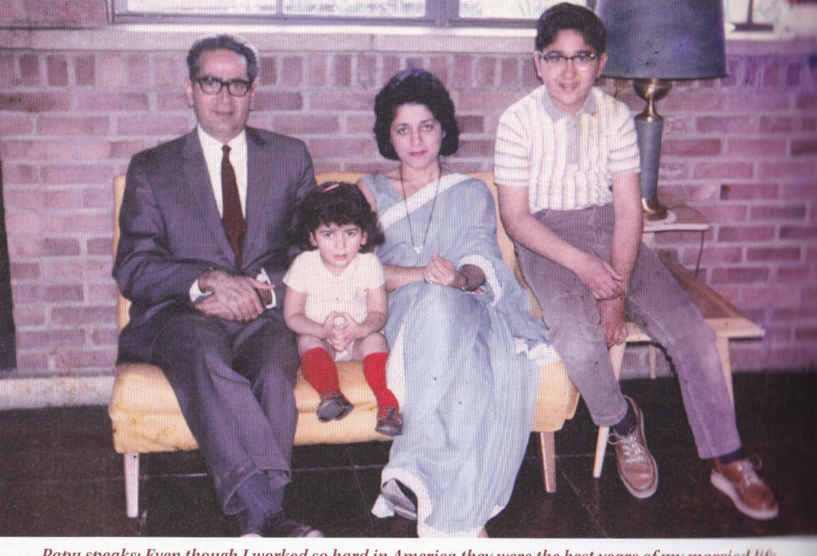
SWEET Family:
Consists father, Mother, Son and Daughter

Slide 12
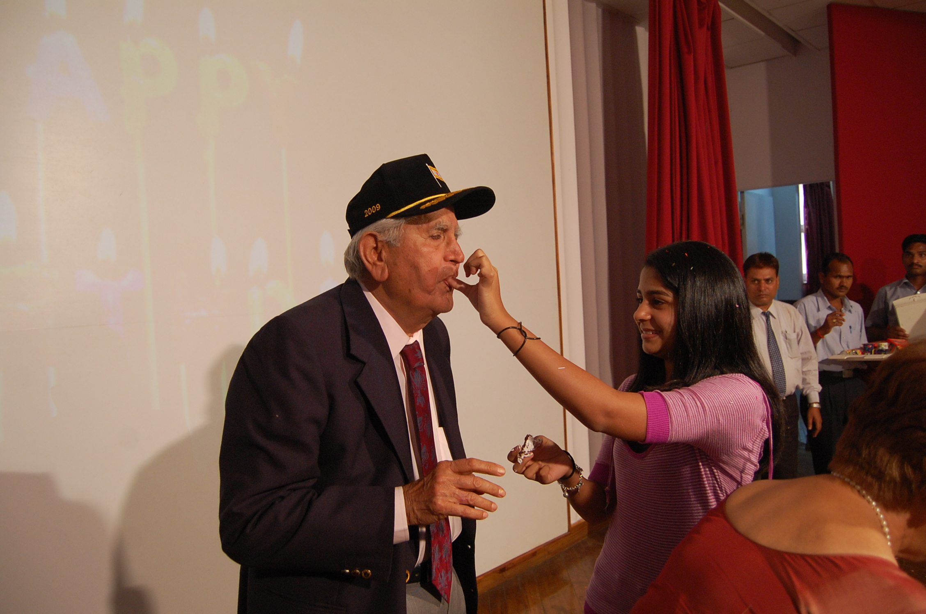
Loving and caring Grandpa

Slide 13
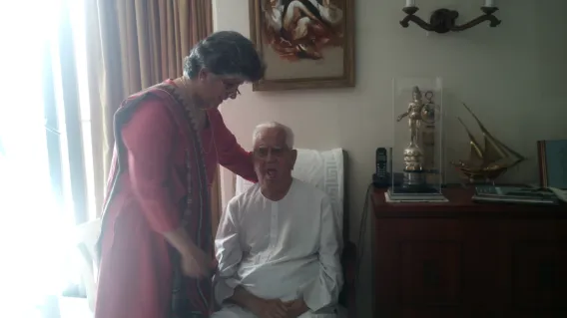
Family bonding

Slide 14
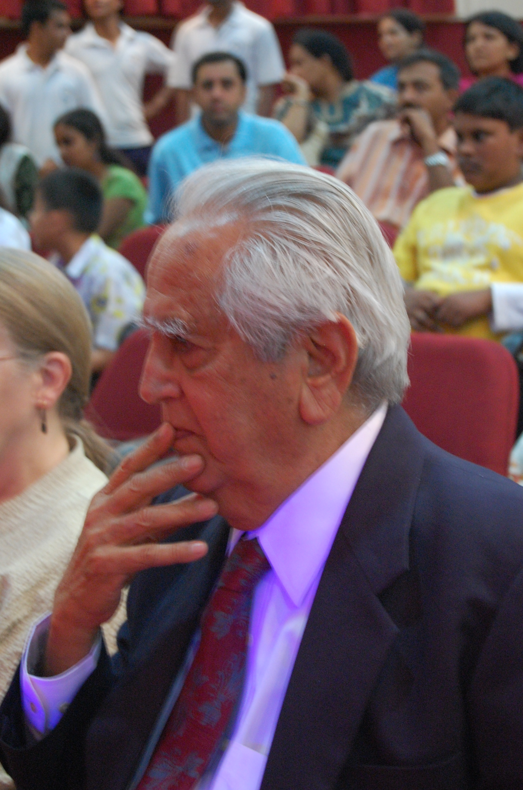
truly extraordinary person: exceptional qualities achievements abilities beyond ordinary

Slide 15
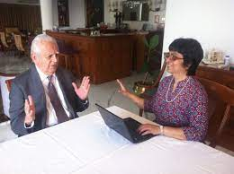
Ambitious: strong desire and determination to achieve success and goals

Slide 16
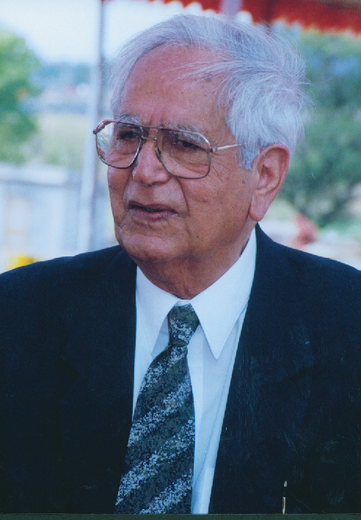
Honesty and Integrity

Slide 17
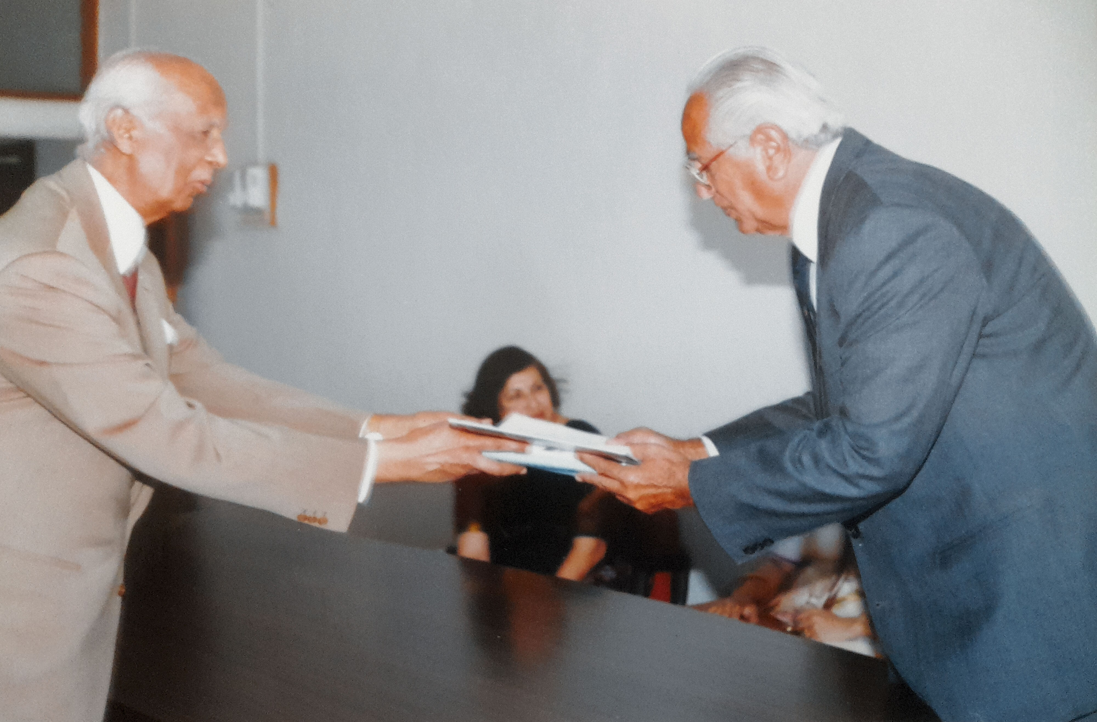
Honesty and Integrity

Slide 18
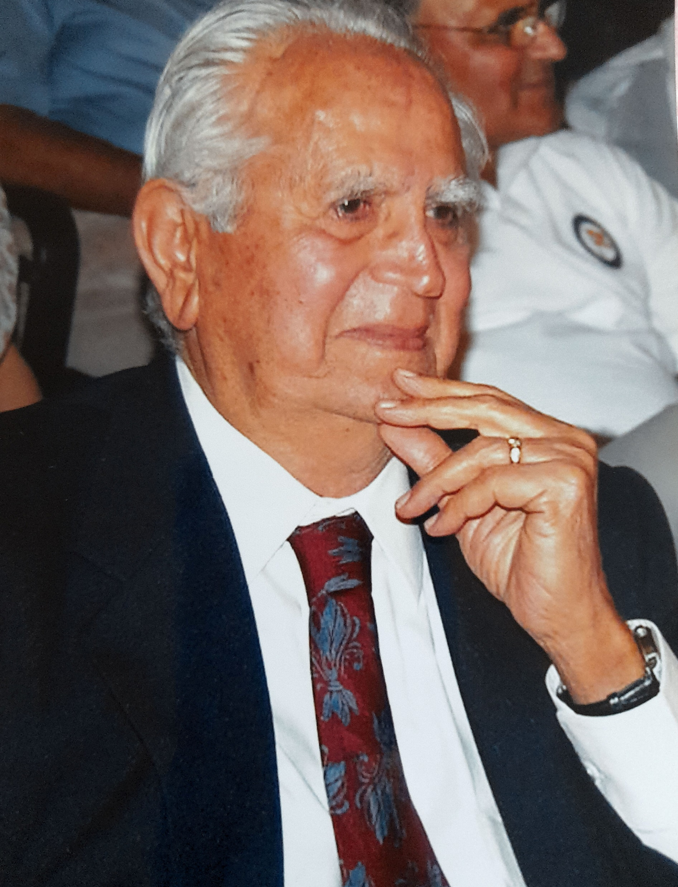
Kindness and Compassion

Slide 19
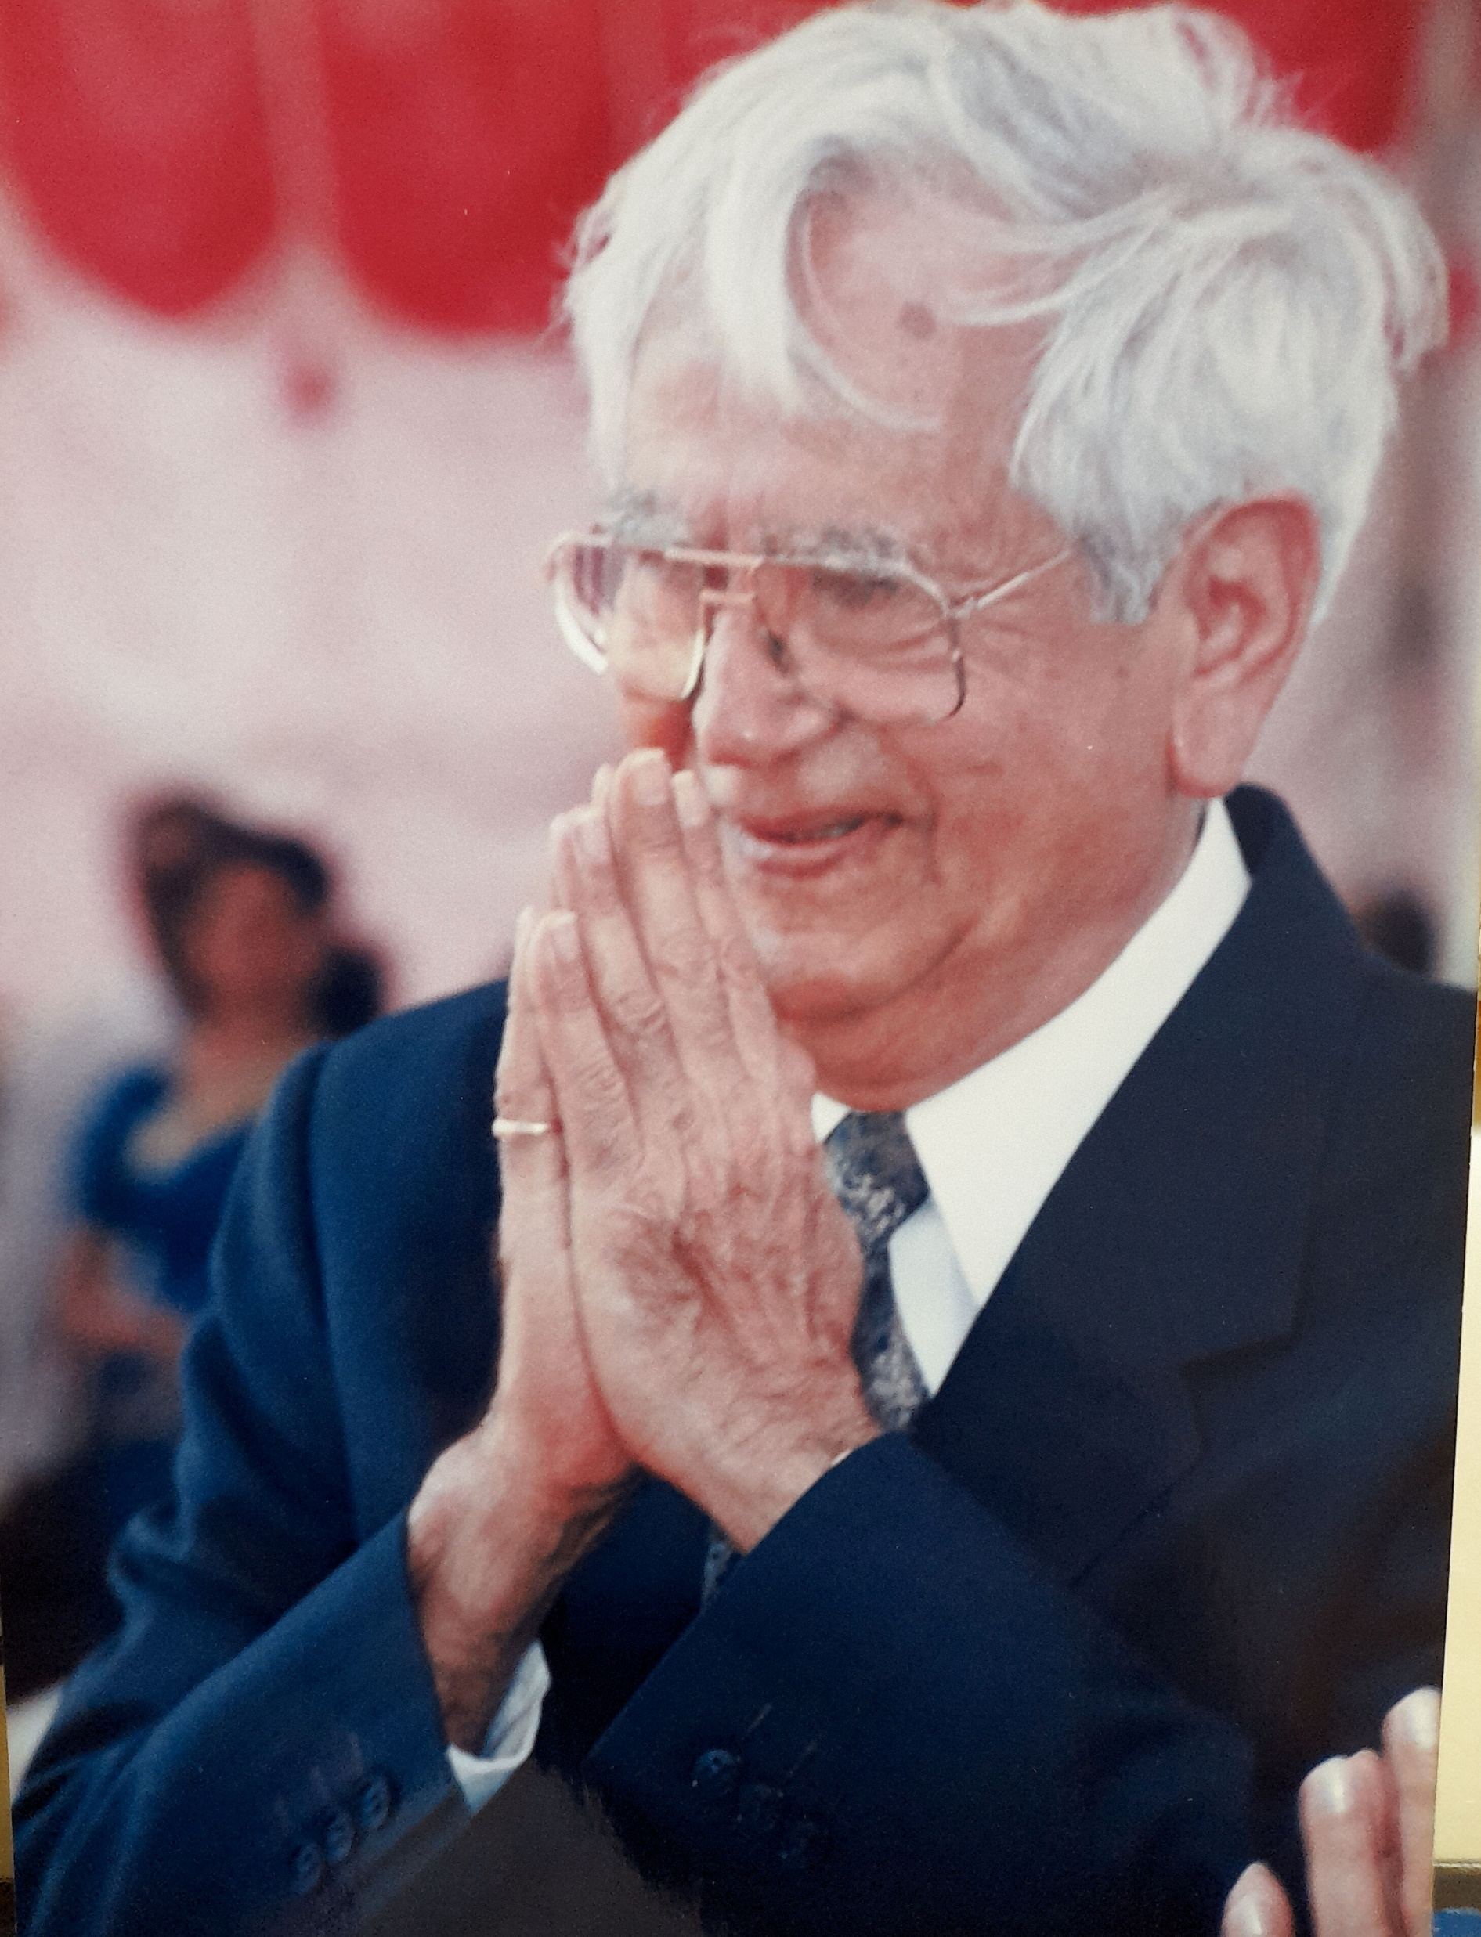
Resilience: ability to recover quickly from difficulties and remain strong to face challenge

Slide 20
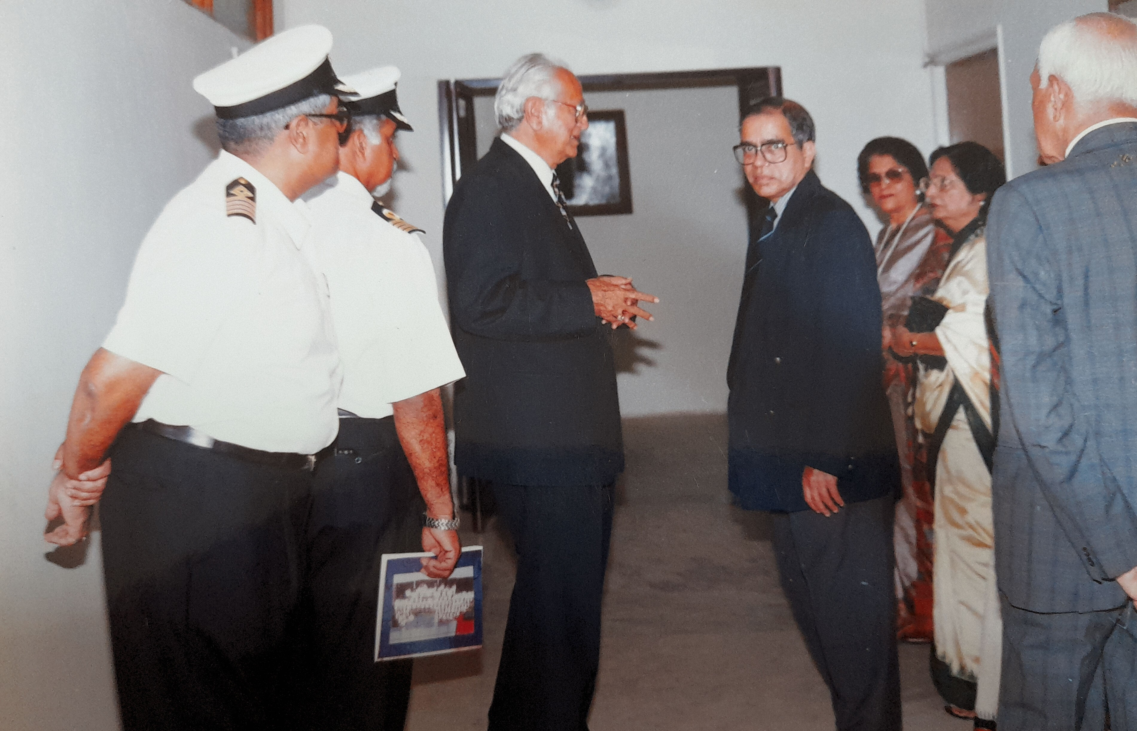
Humility

Slide 21
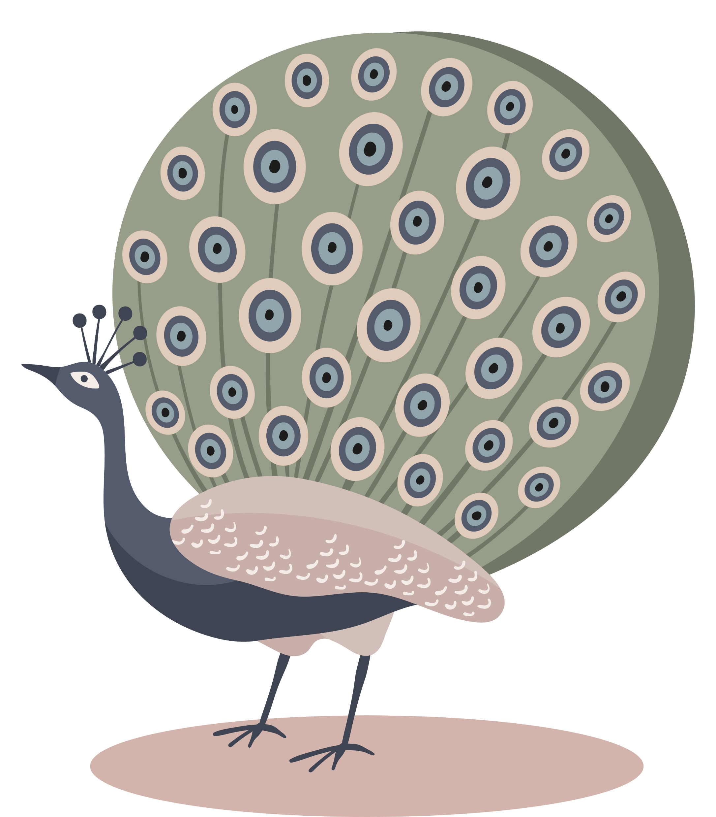
Humility

Slide 22
Accountability

Slide 23
Social

Slide 24
Professional

Slide 25
Couragious

Slide 26
Product launch
Q1
Market research
Q2
Product development
Q3
User
testing
Q4
Product launch
Currently gearing up for a ground-breaking launch
Our new offerings will captivate the market
Our marketing campaign will generate anticipation

Slide 27

Marketing strategies
Implement personalized engagement strategies
Tailor campaigns to resonate with specific demographics, fostering a sense of relevance and connection
Collaborate with influencers and thought leaders to amplify our brand message

Slide 28
Areas of focus
Our financial overview reflects a robust and resilient fiscal performance.
Key indicators show consistent revenue growth over the past quarter, attributed to strategic cost management and successful marketing.
Operating margins have improved, signaling operational efficiency, while strengthening our reserves.
This underscores our commitment to financial stability, positioning us for sustained growth.

Slide 29
Quarterly targets
Market expansion
Product innovation
Customer retention
Operational efficiency
Quarter | Revenue growth (%) | Market share increase (%) | Customer acquisition
Q1 | 12 | 2 | 500
Q2 | 15 | 3 | 600
Q3 | 18 | 4 | 700
Q4 | 20 | 5 | 800

Slide 30
Financial snapshot
Metric | Current value | Previous quarter | Change (%)
Revenue | $2,500,000 | 2,200,000 | +14%
Operating expenses | $1,200,000 | $1,400,000 | -14%
Net profit | $1,000,000 | $800,000 | +25%
Operating margin | 40% | 36% | +4%
Cash reserves | $5,000,000 | $4,500,000 | +11%

Slide 31

Innovative solutions

Slide 32
Future initiatives
Product enhancement. Introduce regular updates and features to enhance product offerings.
Technology integration. Explore emerging technologies for potential integration into our operations.
Collaborative partnerships. Foster collaborations with tech innovators and industry leaders to drive innovation.
Green supply chain
Reduced carbon footprint
Waste reduction
Water conservation

Slide 33


