Slide 1
Recent Advances in Antifouling Coatings

Slide 2
Presentation Content
Introduction
- What is fouling?
- Factors affecting fouling
- Main fouling effects
- Main objective of antifouling
- Challenges
Current antifouling technology
- Biocidal technology
- Non-Biocidal technology
Recent advances
Future challenges

Slide 3
What is Fouling?
Clean Surface
0
absorbed organics/minerals
Conditioning Film
1 Min
bacteria
Slime/Biofilm
1 Hr
microspores/algae
Macro fouling
1 Day
Plant
Animal
1 Week
Green
Red
Brown
Hard
Soft

Slide 4
Factors Affecting Fouling
Temperature
Speed/Motion
Light & Nutrients
Water, salinity and pollution
Generally speaking, greatest risk of fouling is with low activity trading extensively in tropical/coastal environments
Vessels at highest risk of fouling when in port (often tropical) while loading/unloading.

Slide 5
Marine fouling effects
Slime : 1-2% increase in drag
Weed fouling: Up to 10% increase in drag
Shell fouling: Up to 40% increase in drag
Barnacles can cut through coatings
Fouling can grow on top of other fouling

Slide 6
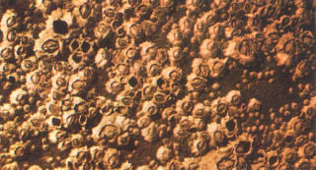
Barnacles
Barnacles

Slide 7
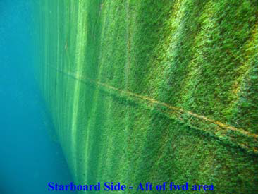
Green Weed

Slide 8
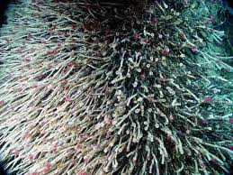
Tube Worms

Slide 9
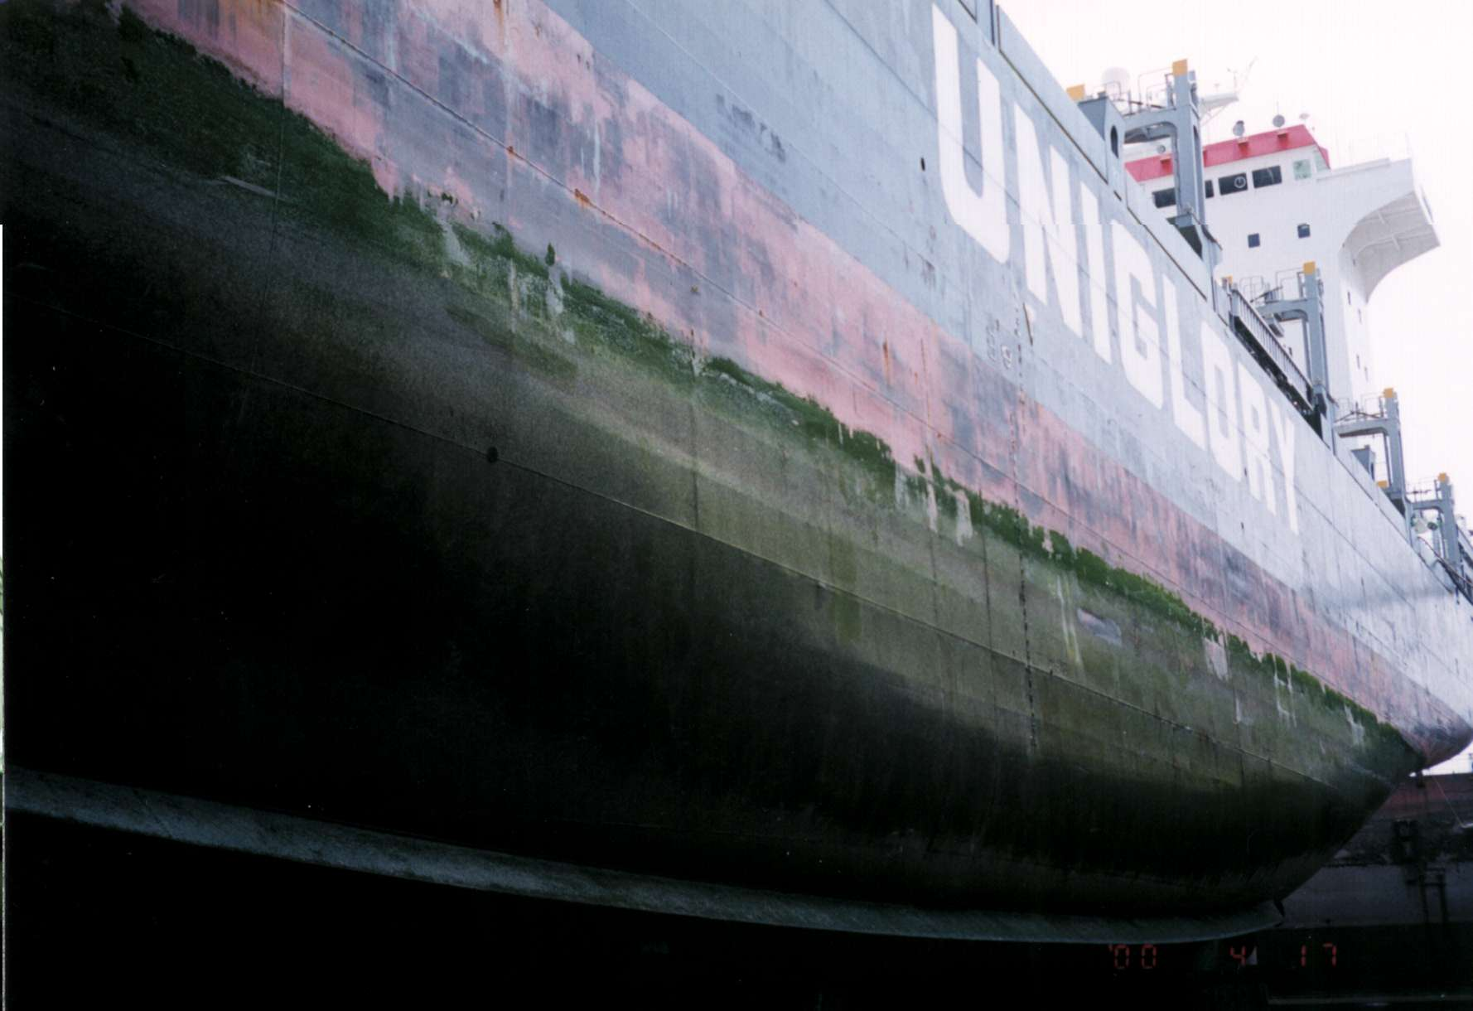
Slime

Slide 10
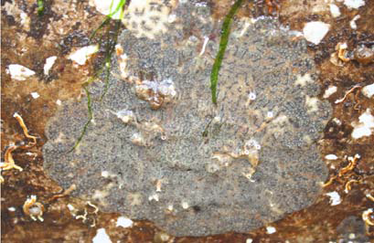
Fouling can grow on top of other fouling

Slide 11
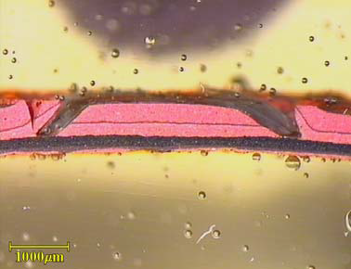
Barnacles can cut through Coatings

Slide 12
Main Objective of A/F Coatings
Preventing the attachment of fouling and hence minimising drag is the main objective of marine antifouling coatings

Slide 13
Challenges
Ever increasing and unpredictable fuel prices
- Operators are looking at cost more closely than ever
New paint technologies and associated products
- Operators are confused by the claims and counter claims
regarding to A/F
IMO
- Operators have A/F high on the agenda by law
The Environment matters more than ever
- Operators want to be environmentally compliant

Slide 14
Current Antifouling Technologies
Biocidal technology
Hydration
Hydrolysis Self Polishing Copolymer
Fusion Self Polishing Copolymer
Non-Biocidal technology
Foul Release (non-stick)

Slide 15
Biocidal Technology – Hydration
Use of Rosin, or derivatives, in the biocide releasing mechanism via “hydration”
Leached layers can become thick- increasing roughness (~75μm)
Higher volume solids content (55-60%)
Film integrity is generally poor, and re-blasting is needed after 10 years
But they are “value for money” for use in lower fouling areas or for vessels with short dry-docking intervals (up to 36 months)

Slide 16
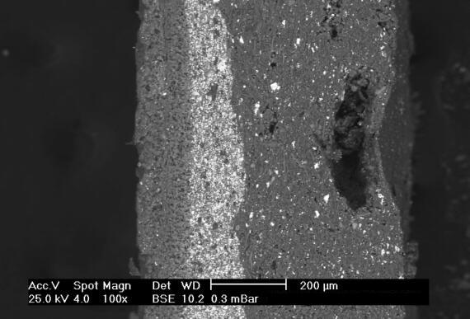
Section of Hydration
AF Film (White)
Seawater side
Hull side
Inactive Layer

Slide 17
Shortcomings in Hydration Technology
Coating is reliable upto 3 years only
The dissolution gradually slows down because of a leached layer formed by insoluble materials at the surface.
Hull roughness of surface and fuel consumption will increase with time.

Slide 18
Biocidal Technology – Hydrolysis
Controlled chemical dissolution (“hydrolysis”) of the paint film presents thin leached layers (10-15 μm)
Therefore long dry-docking intervals (up to 60 months) and better smoothing
Superior overcoatability
Fouling control in outfitting.

Slide 19
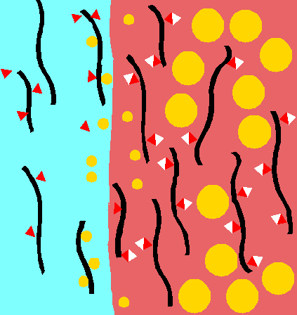
Hydrolysis Mechanism
Seawater
Paint Film
Hydrolyzed
Polymer
Hydrolyzing
Polymer
Hydrophilic
resin
Hydrophobic
resin
Dissolved
Biocide
Biocide
Reaction layer

Slide 20
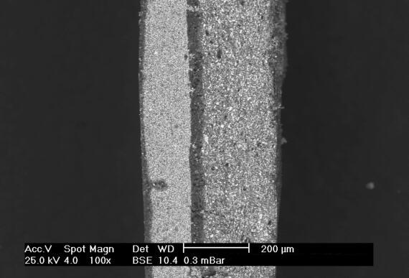
Section of Hydrolysis
AF Film (White)
Seawater side
Hull side
Reaction Layer

Slide 21
Further addition in Hydrolysis Technology
Copper free A/F

Slide 22
Features- Copper Free A/F
Anti discoloration for outfitting period/copper free tech.
Suitable for application on aluminum boats.

Slide 23
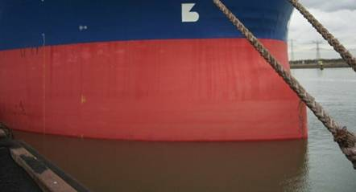
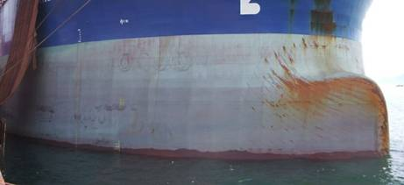
Copper free – After 12 months
Copper based AF – after 8 months

Slide 24
Shortcomings in Hydrolysis Technology
Solid content is less, hence coverage is low.
Higher cost.

Slide 25
Biocidal Technology – Fusion Self Polishing Co Polymer (SPC)
Biocide releasing technology is a mixture of “hydrolysis” and “hydration” mechanisms, combining SPC acrylic polymer with a certain amount Rosin.
Reasonable leached layer thickness (25-30 μm)

Slide 26
Fusion Self Polishing Mechanism
Biocide
Release controller
Hydrophobic resin
Hydrolysis resin

Slide 27
Reaction
Biocide
Release controller
Hydrophobic resin
Hydrolysis resin
Sea Water

Slide 28
Reaction
Biocide
Release controller
Hydrophobic resin
Hydrolysis resin
Sea Water

Slide 29
Biocidal technology - Summary
Hydrolysis
“Self-Polishing Copolymer”
Fusion
PERFORMANCE
SPC
Hydration
PRICE

Slide 30
Non-biocidal technology – Foul Release
Silicon based coating
No biocide and hence no leaching
Function by preventing or reducing the adhesion (“non-stick”) of fouling organism
Rely on the movement of the vessel to remove fouling by shear

Slide 31
Foul Release Coatings – Features & Benefits
Potential fuel savings and lower emissions
Ultra smooth surface
Durable & Long lasting
Foul Release
Low VOC
Reduce coats
Antifouling Performance
No biocides
Keeps fouling off
Lower M&R costs

Slide 32
How Do Non Stick Coatings Work?
Wa = Yl [1 +COS θ ]
YOUNG-DUPRE Equation
Yl– surface tension of liquid
Wa—adhesion property of liquid against solid surface
θ ---theta-angle of contact
COS θ = COS 180 Degree

Slide 33
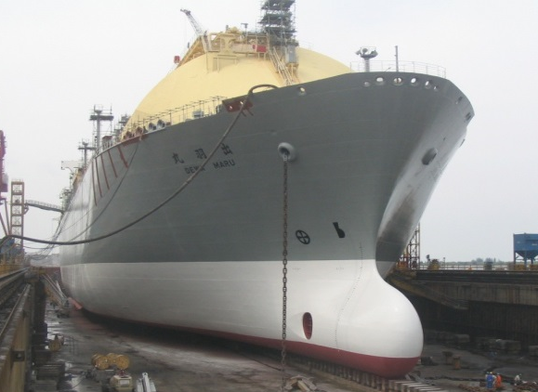
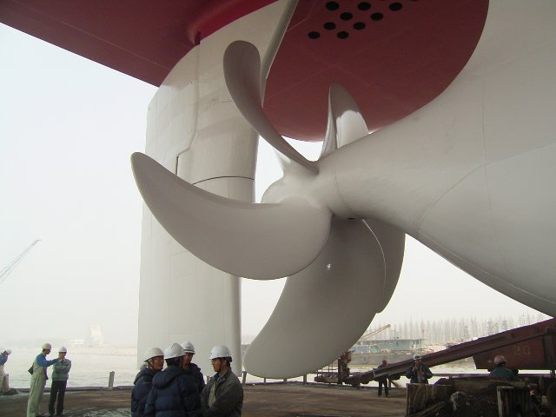
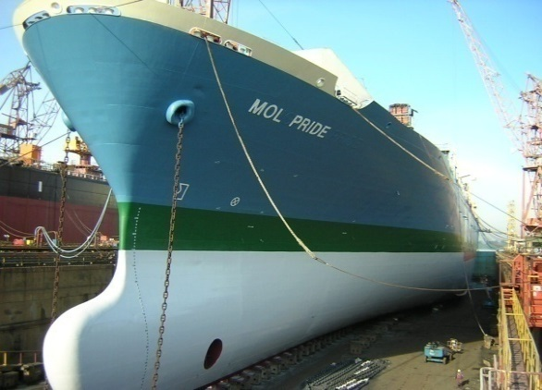
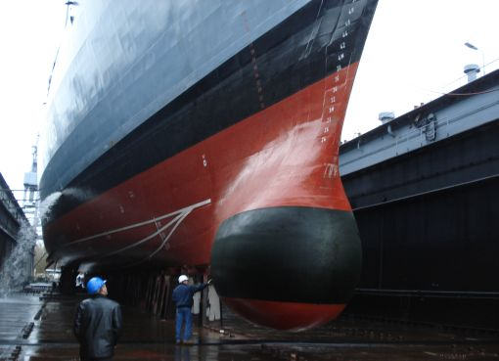
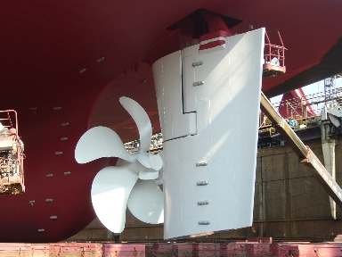
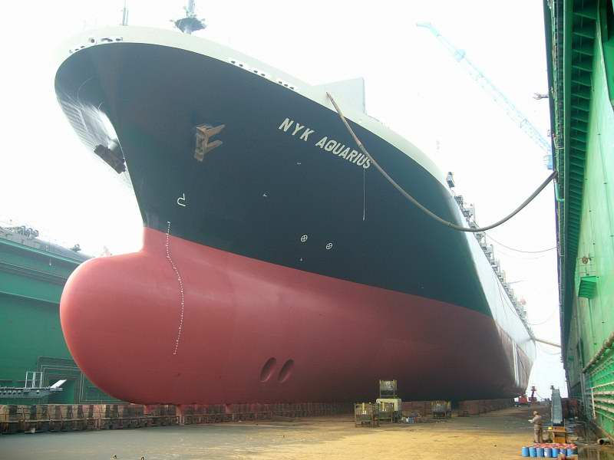
Biocide free coating in Pics
Containers, LNG’s, Tankers

Slide 34
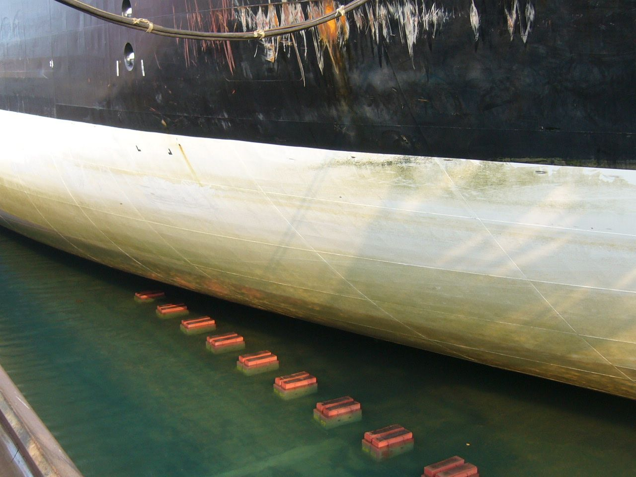
After 32 months in service

Slide 35
Recent Advances
Advanced Silyl Technology

Slide 36
Features
“Advanced” Silyl Technology
Silyl Technology
Special Release Controller
Excellent self-polishing Performance
Excellent Static Performance
Controlled low polishing rate = Reduction of DFT
Ultra Smooth Surface (Low roughness & Long wavelength)
“Micro” pigmentation & Special resin Technology
Easy Release
Excellent Anti-Fouling Performance
Low Friction, Fuel Saving

Slide 37
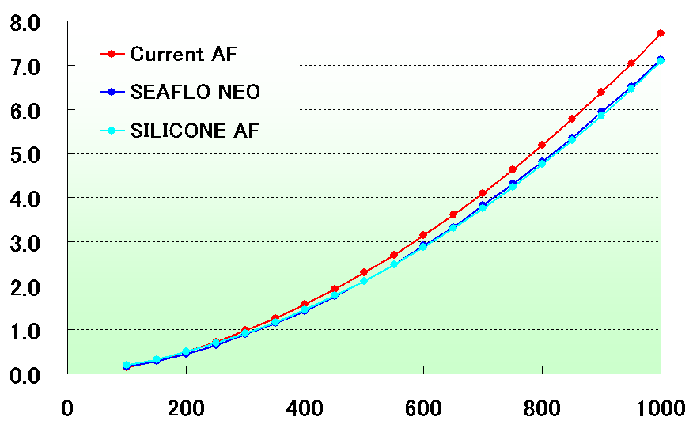
Friction Resistance Measurement
SILYL
8% Reduction of Friction Resistance
Torque (N・m)
Number of Rotation (rpm)

Slide 38
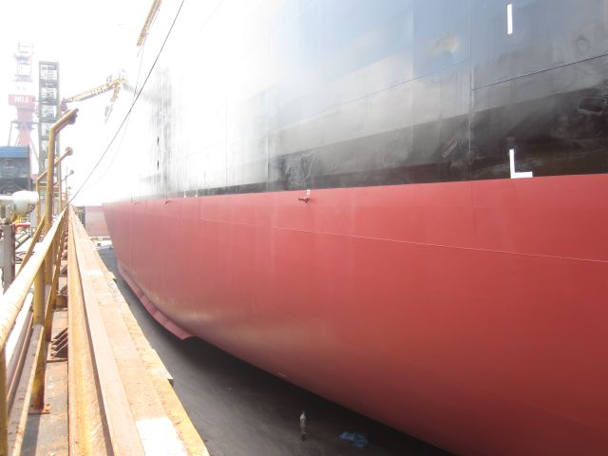

Slide 39
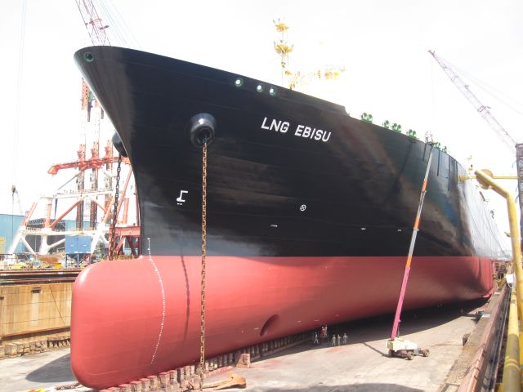

Slide 40
Future Challenges
There is a continual drive to develop improved antifouling coating technologies that will have less environmental impact
•Reduction in fuel consumption
•Release of biocides
The development cycle for new antifouling technologies is relatively long
Considerable formulation work required to meet antifouling performance, mechanical and application property requirements

Slide 41
Future Advances
Natural Product Antifoulants (NPA’S).
Surface Engineering.
Nanotechnology.
Fluoro Polymers.

Slide 42
Thank You

Slide 43
Questions?

