Slide 1
Symbiotic Dependence of Transportation and
Infrastructure Growth
Presented by:-
SAAGAR JAMBEKAR
DEV KAKRAN
VARUN NAVADIA
TOLANI MARITIME INSTITUTE
NORTHERN SEA ROUTE

Slide 2
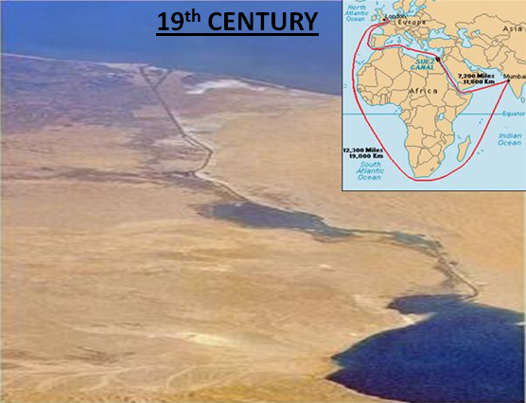
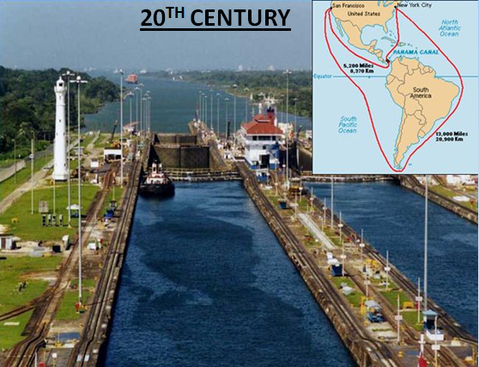
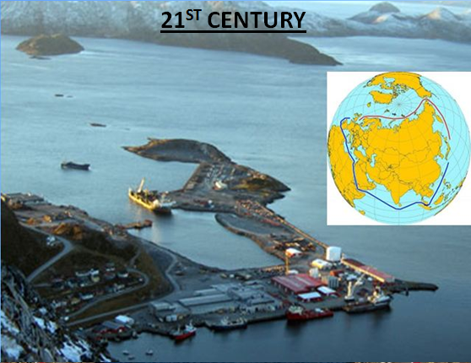

Slide 3
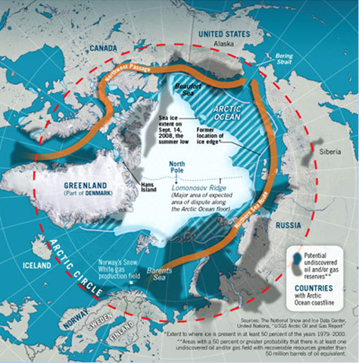
ARCTIC OVERVIEW

Slide 4
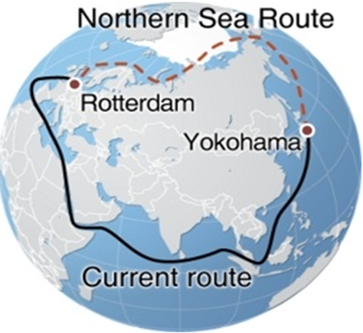
Bering Strait
Novaya Zemlya

Slide 5
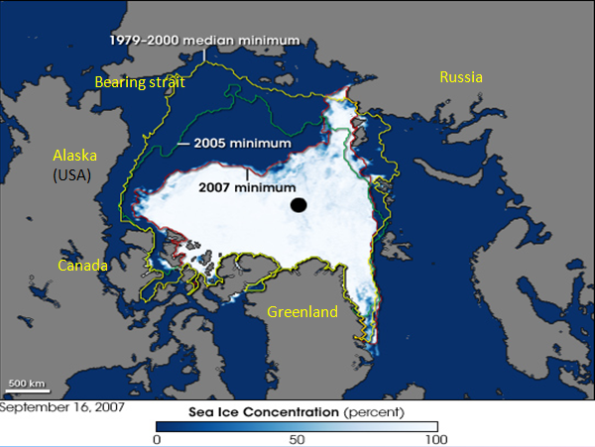
GLOBAL WARMING

Slide 6
Average per decade decline rate for the year
1979–1996 :- 2.2%
1996- 2008 :- 10.7%
Ice-free by the end of this century.

Slide 7
Significance of NSR
Great saving in time, distance and money.
Convenient export corridor for Russian natural resources.
Far less vulnerable to bottlenecks, piracy and terrorism.
Strong impact on oil and gas exploration and production.
Distance comparison:-
From Hamburg | to:
Shipping routes via: | Vancouver | Yokohama | Hong Kong | Singapore
NSR | 6635 | 6920 | 8370 | 9730
Suez Canal | 15377 | 11073 | 9360 | 8377
Cape of Good Hope | 18846 | 14542 | 13109 | 11846
Panama Canal | 8741 | 12420 | 12920 | 15208

Slide 8
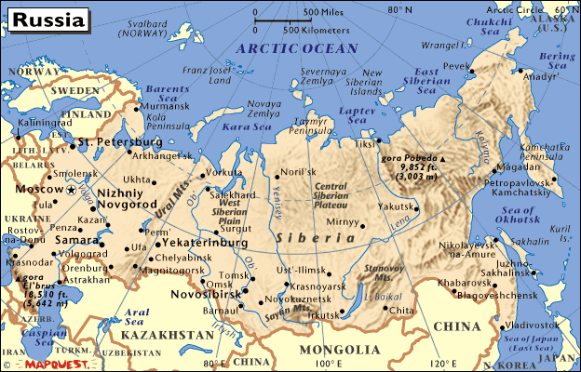
Overview of NSR Region

Slide 9
Physical constraints to NSR shipping
Draft restriction-
Sannikov Strait-12.5m
Dmitriy Laptev-6.7m
A route north of New Siberian Islands can be used to avoid this problem.
Vessel size restriction- 20,000 dwt (ice- class)
upto 50,000dwt(non ice class)

Slide 10
Ice conditions- vary greatly in different parts of NSR and season.
Summer season-4 months
i.e. June - September
Shallow sea- restrict ships with greater drafts near coastal areas and difficulty in seeking assistance during emergencies.

Slide 11
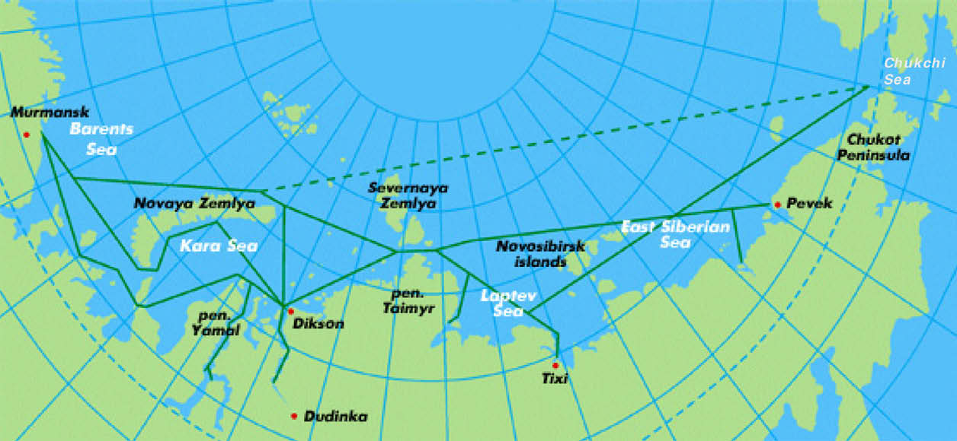
Major ports in NSR

Slide 12
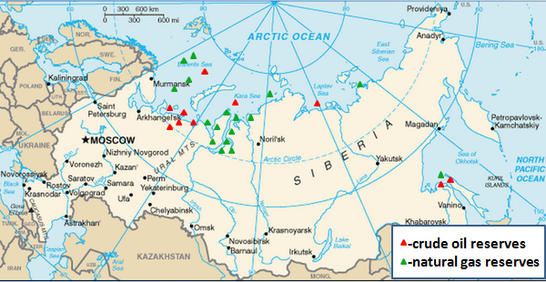
RUSSIA’S OIL AND GAS RESERVES

Slide 13
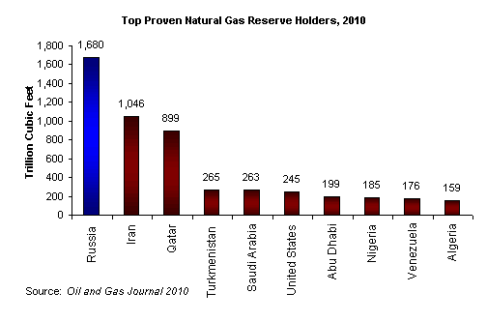
25% of the world's remaining oil and gas in ARCTIC.
Russia is ranked -first in gas reserves
-second in oil production
-third in coal reserves

Slide 14
VESSEL SAILED THROUGH THE NSR IN 2010
NAME | CAPACITY (TONNES) | TYPE | FROM: | TO:
INDIGA | 15000 | OIL | MURMASK | CHUKOTKA
VARZUGA | 15000 | OIL | MURMASK | CHUKOTKA
BALTICA | 100,000 | GAS | MURMASK | CHINA
SOVCOMFLOT | - | OIL | NENETS | JAPAN
MONCHEGORK | - | CONTAINER | MURMANSK | SHANGHAI

Slide 15
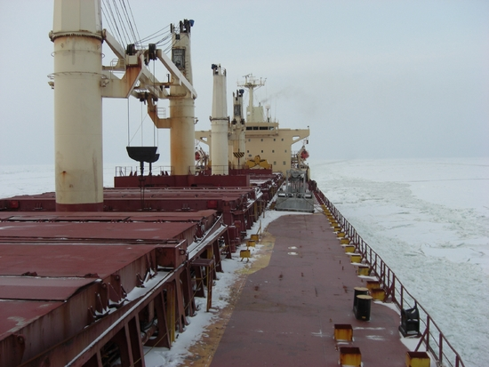
BULK CARRIER | M.V. NORDIC BARENTS | 41,000t dwt. | FROM: KIRKENES (NORWAY) | TO: CHINA
MV NORDIC BARENTS with foreign flag used the NSR to transport the iron ore from NORWAY to CHINA via NSR.

Slide 16
NSR Administration
SMT (Service of Marine Transport)
Cargo-owners NSRA Shipping companies
(Northern Sea Route Administration)
MOH
(Marine Operations Headquarters)
-pilotage
-navigational support
-organisation of convoys
-ice-breaker assistance
-designing optimum routes
The formal command chain:
NSRA MOH icebreaker ice pilot (on board the vessel)

Slide 17
It is mandatory for all vessels entering NSR to pay NSR fees.
Fees depends on :-
-the season
-part of NSR being navigated
-the vessel’s size
-vessel’s ice-class
-type of cargo carried
-nationality of its charterer
Fees does not depend on the number of days of ice-breaker escort.
The fee covers:
- icebreaking assistance
- ice-forecasting
- routing services

Slide 18
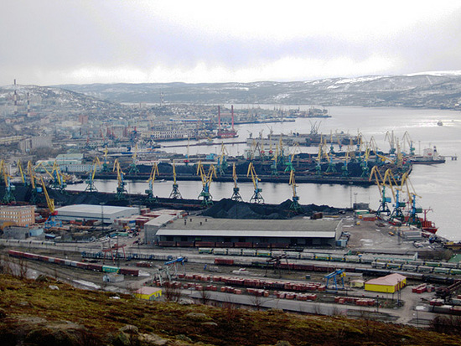
Infrastructure growth
Murmansk harbour

Slide 19
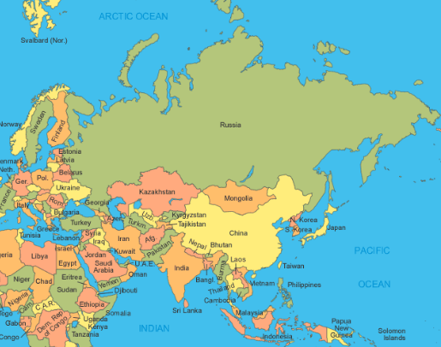
KIRKENES
MURMANSK
PEVEK
JAPAN
HONG KONG
SINGAPORE

Slide 20
What is Russia planning?
Partially privatise:
- Sovcomflot (Russia’s largest shipping company)
- Murmansk port (which handles 60% of shipping)
To develop several Arctic fields, 84% of which are likely to be offshore in the Barents Sea.

Slide 21
INDIAN ESTABLISHMENTS
ONGC VIDESH LIMITED (OVL)
July 2001- OVL acquired 20% stake in Sakhalin oil and gas offshore field (1,146 sq km).
18th Feb 2011-Novatek, Atomflot strikes deal on NSR. ONGC along with oil majors , have shown interest in harnessing this field.
2) Great Eastern- operating in North Sea.
Offshore companies like Great Eastern have opportunities to assist upcoming offshore platforms in NSR.

Slide 22
₃₎ _{2008 - Indian research base} _{(HIMADRI)}
Situated - 78°55' N, 11°56'E, Ny-Alesund, NORWAY.
Managed by -National Centre for Antarctic and Ocean Research (NCAOR).
Objectives - Research in marine science, environmental science, climate change monitoring.

Slide 23
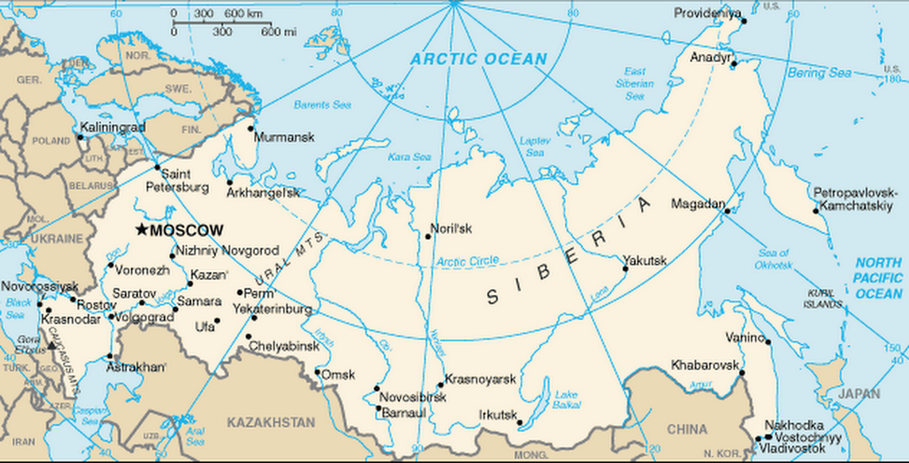
INDIAN ESTABLISHMENTS
NORTH SEA
Ny-Alesund
YAMAL PENINSULA
Sakhalin

Slide 24
CONCLUSION
Increase in traffic density will lead to greater demand for services and infrastructure development.
Increase in globalisation and economic integration causing privatisation of ports.
Bulk trade likely to shift from Suez route to NSR within 20years.
Opportunity for marine institutes to train people in NCV(Near coastal voyages) for NSR with specialised skill of ice navigation.
Economical only during summer season.
Economical in future if the rate of ice melting continues.

Slide 25
THANK YOU

Slide 26


