Slide 1
LNG Fuelled Ships and LNG Bunkering Challenges
Peilin Zhou
Professor of Marine Engineering
Dept. of Naval Architecture, Ocean and Marine Engineering
University of Strathclyde, Glasgow, UK

Slide 2
Presentation Outline
Brief introduction to the Department in Strathclyde University
Technical Presentation
Emission regulation
Advantage of LNG as marine fuel
Status of LNG engine market
LNG bunkering market and development
Conclusions

Slide 3
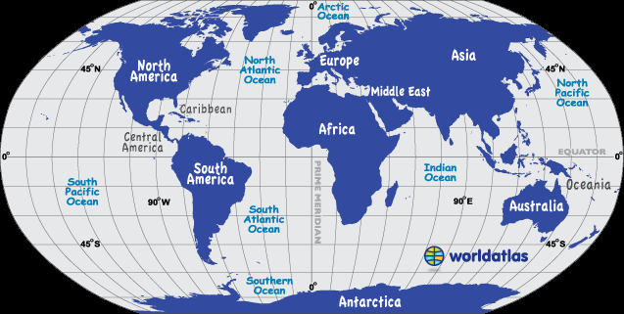
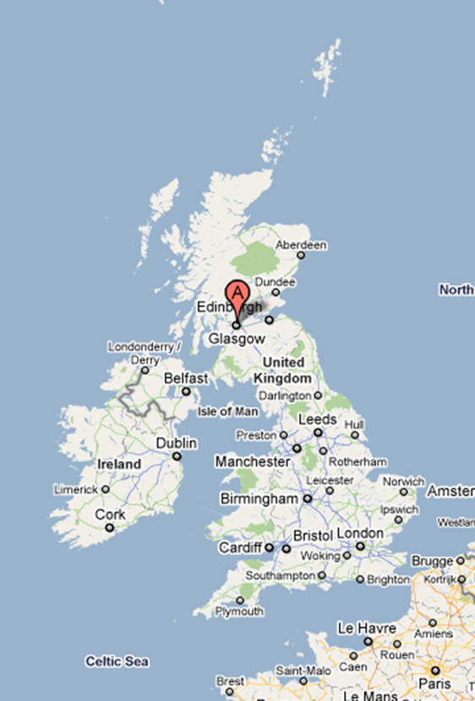
University of Strathclyde

Slide 4
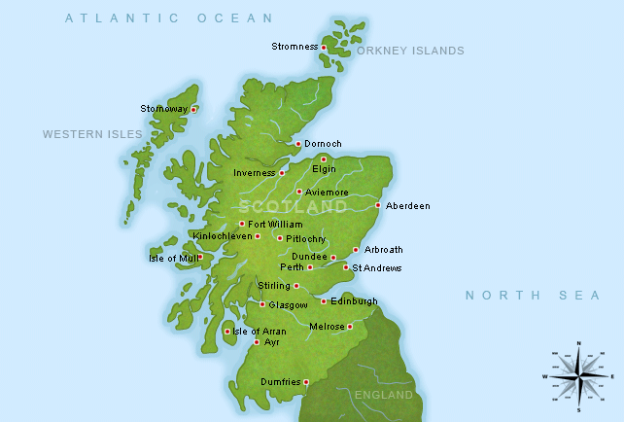


SCOTLAND and UNIVERSITY
Population, Million
Scotland: 5.30
Glasgow: 0.60
Edinburg: 0.50
London: 8.79
Glasgow is the 3rd largest city in the UK
University of Strathclyde
Founded in 1796 by Prof John Anderson
3rd Largest university in Scotland
22,000 students
Awarded Royal Charter in 1964
World top 250 University (QSWU ranking 2015)
UK Top 20 Research Intensive University
UK Top 10 research intensive Engineering Faculty
Prof J. Anderson

Slide 5


UNIVERSITY OF STRATHCLYDE
University of Strathclyde
4 Faculties
Faculty of Engineering
Faculty of Science
Faculty of Humanities and Social Sciences
Business School
8 Departments
Architecture
Biomedical engineering
Chemical and Process Engineering
Civil Engineering
Design, Manufacture and Engineering Management
Electronic and Electrical Engineering
Mechanical and Aerospace Engineering
Naval Architecture, Ocean and Marine Engineering

Slide 6


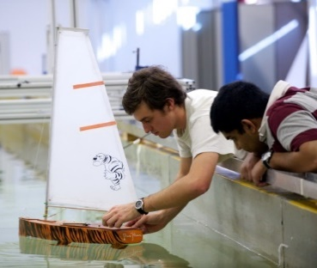

Department of
Naval Architecture, Ocean & Marine Engineering (NAOME)
136 years’ history
First world Naval Architecture Chair was established in 1883
UK and Europe largest Department in its kind
Staff number: 27
  Professor: 8
  Reader/Senior lecturer: 7
  Lecturer: 12
Student number (session 2018-19)
  Undergraduate: 350
  MSc: 73
  PhD: over 140
Students come from over 40 countries

Slide 7
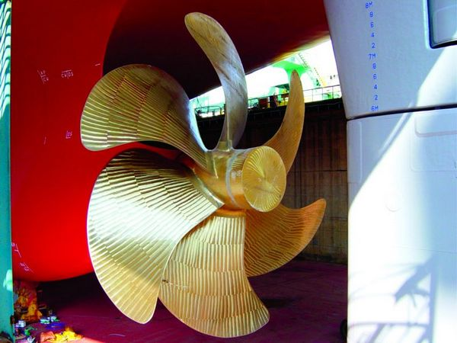

DEGREE PROGRAMMES in NAOME
BEng/MEng
  Naval Architecture and Marine Engineering
  Naval Architecture with Ocean Engineering
  Naval Architecture with High Performance Marine Vehicles
MSc
  12 months programmes
  Marine Engineering
  Marine Technology
  Offshore Floating Systems
  Ship and Offshore Structures
  Subsea and Pipeline Engineering
  Offshore Renewable Energy
  Technical Ship Management
  Advanced Naval Architecture
24 months programme
9. Ship and Offshore Technology (Joint with Hamburg University of Technology)

Slide 8
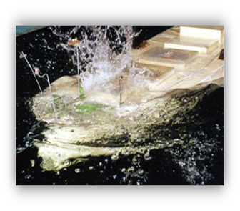
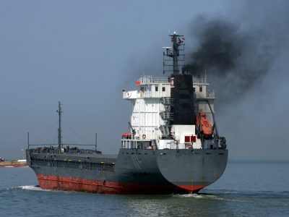
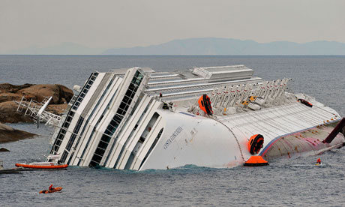
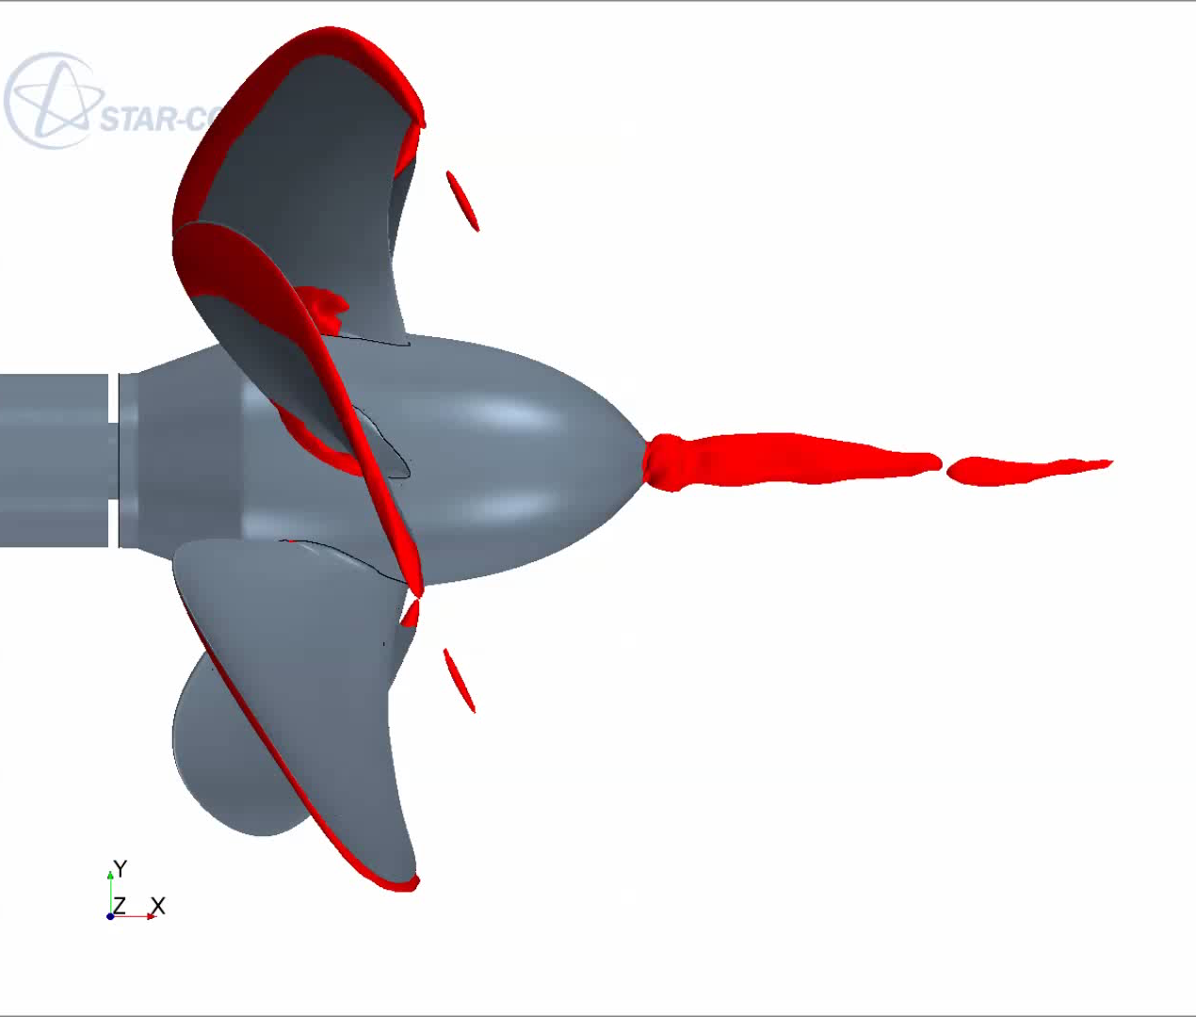
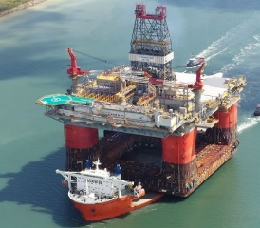
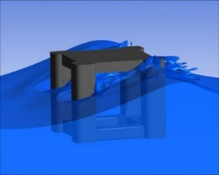
NAOME – Research co-ordination
The NAOME Research & KE Committee
and
fostered by 3 interactive & dynamic Research Groups
1. Marine design, operation & safety group
3. Fluid-Structure Interaction
group
2. Ocean engineering group

Slide 9
LNG Fuelled Ships and Bunkering Challenges

Slide 10
Emissions from Shipping
Notes:
Source: ICCT 2007

Slide 11
IMO Regulation- NOx
Tier I, 2000
Tier II, 2011
Tier III, 2016*
*The Tier III controls apply only to the specified ships while operating in Emission Control Areas (ECA) established to limit NOx emissions, outside such areas the Tier II controls apply.
Notes:
No updates
source: IMO
http://www.imo.org/en/OurWork/Environment/PollutionPrevention/AirPollution/Pages/Nitrogen-oxides-(NOx)-%E2%80%93-Regulation-13.aspx

Slide 12
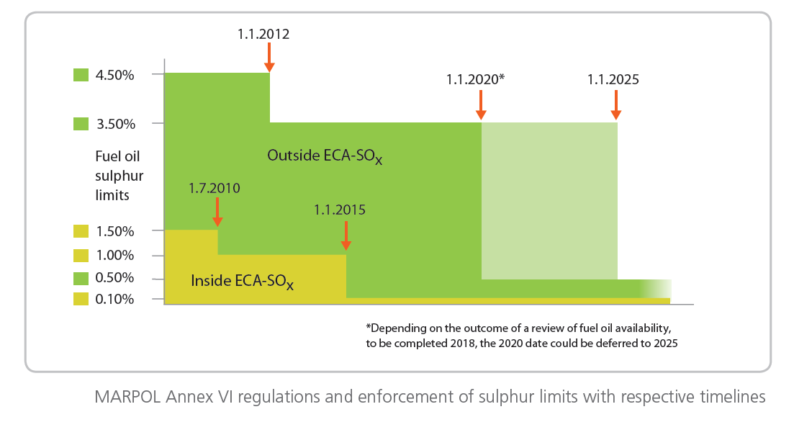
IMO Regulations - SOx
Notes:
No updates
source: IMO
http://www.imo.org/en/OurWork/Environment/PollutionPrevention/AirPollution/Pages/Sulphur-oxides-(SOx)-%E2%80%93-Regulation-14.aspx

Slide 13
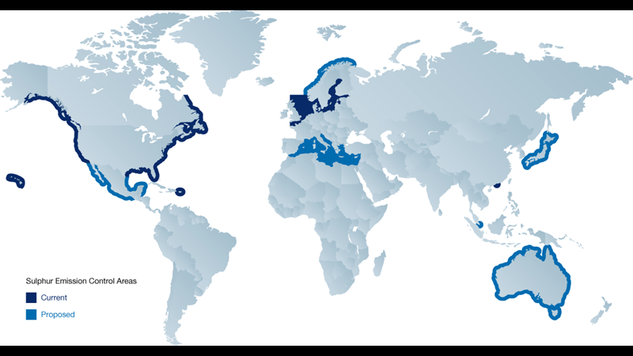
Emission Control Area(ECA)
Notes:
No updates

Slide 14
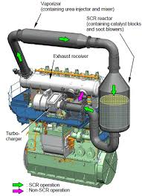
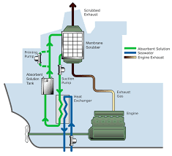
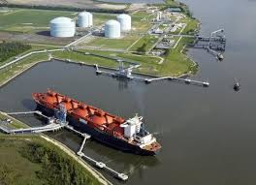
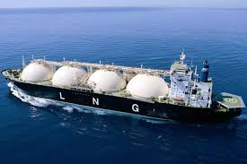
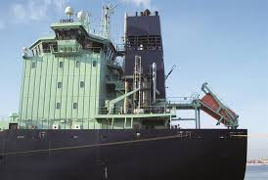
Options for Emission Control
Bunker price (Rotterdam, 28 Feb 2019)
HFO: 406 $/t, MGO: 579 $/t
HFO + Scrubber + SCR
MGO + SCR
LNG
Notes:
ICCT 2007

Slide 15
LNG
– GREEN FUEL For SHIPPING

Slide 16
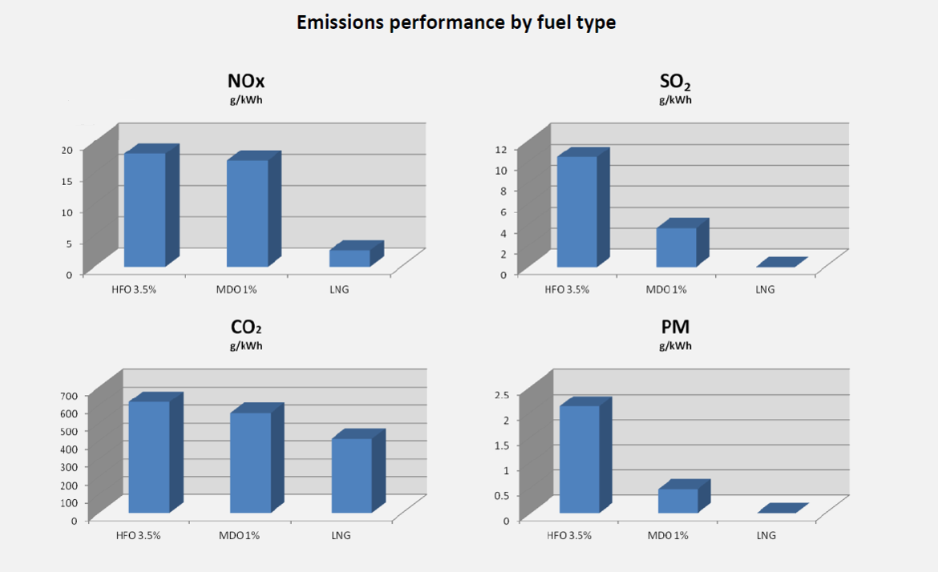
Emission Comparisons

Slide 17
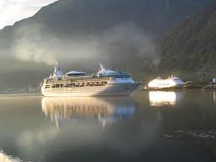
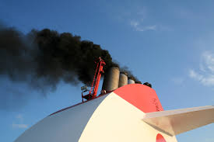
LNG – Green Fuel
Compared with HFO
Up to 80% NOx emission reduction
90-95% of SOx emission reduction
20-25% of CO2 emission reduction
Almost zero PM emission
No visible smoke
No sludge deposits
Price is 50% lower than HFO

Slide 18
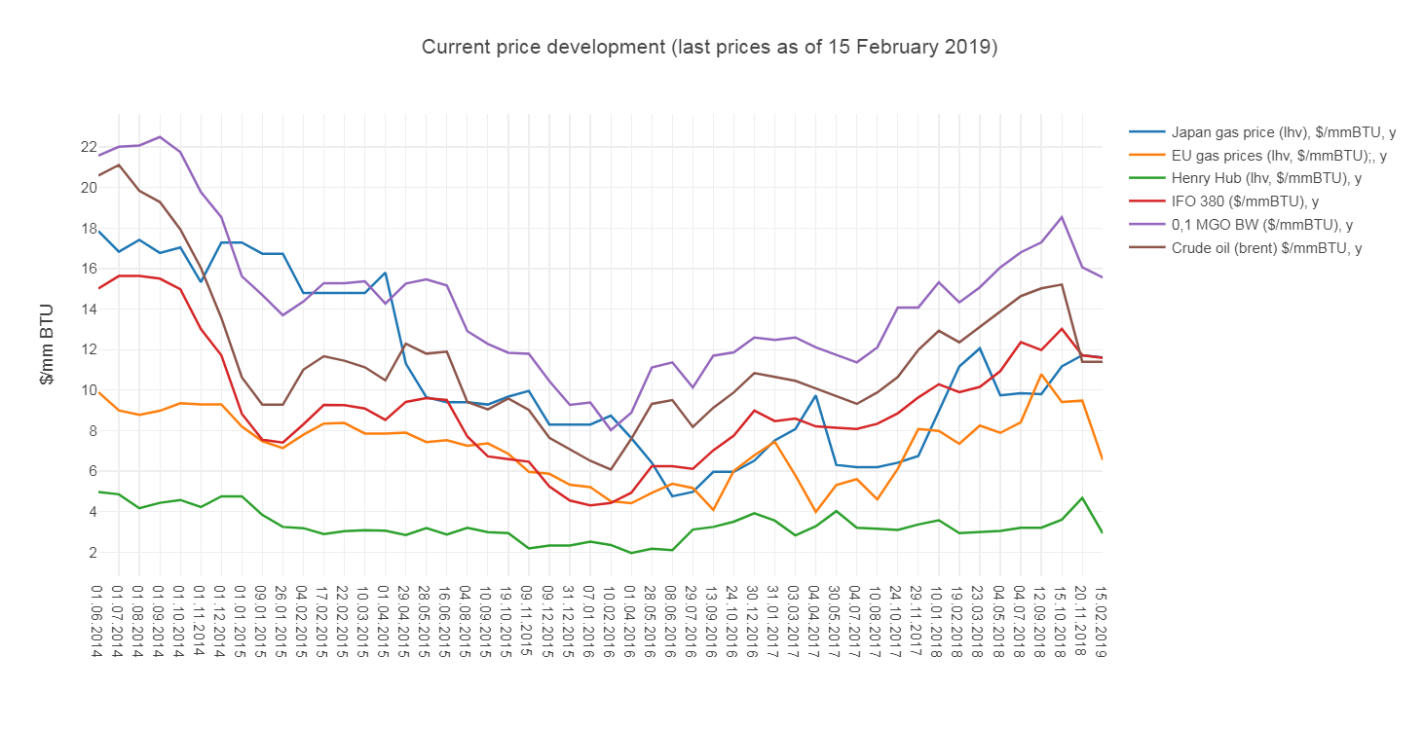
Fuel price

Slide 19

Prices

Slide 20
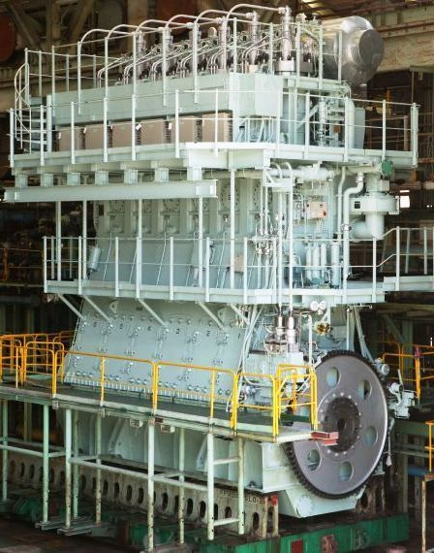
LNG Dual Fuel Engines
Dual fuel engines have been well developed for both 2-s
and 4-S engines
Take Wartsila as an Example:
DG (1987) – SG (1992) – DF (1995) - Currently,
more than 180 ships
more than 500 units
MAN B&W has similar
development
Notes:
Wärtsilä as the second big player in this market sold their irst dual-fuel two-stroke engines in 2014 (RT-lex50, X62DF). DNV, 2015

Slide 21
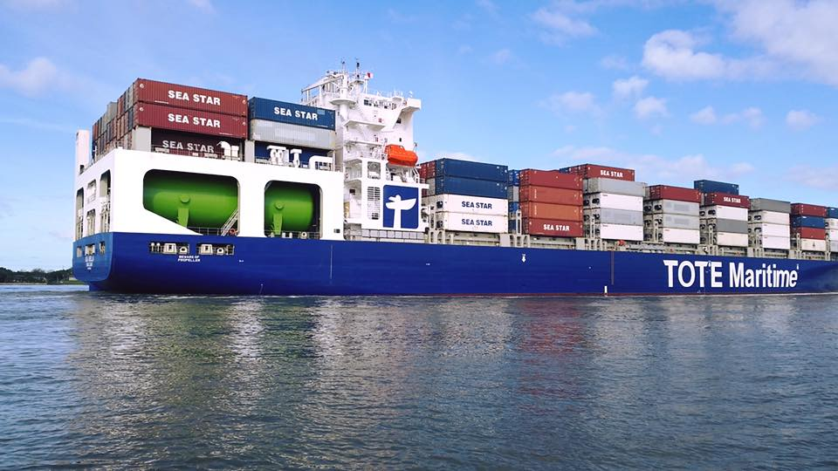
Ships’ Requirement for DF Engines
For the same power output:
LNG storage space is 178% of that HFO
-162 ºC storage temperature
BOG (boil off gas) control
  During voyage
  In port
Flammable
  -188 ºC
  Double skin pipes are required

Slide 22
LNG Fuelled Ships
Currently, 63 in operation and 76 on order worldwide.
2025: 3,200 vessels with DF power systems
2025: 139 seaports and inland ports, with EU investment, to equip with LNG bunker facilities
2017 Aug, Chinese yards won 9 world largest containerships’ order, 22,000 TEU, dual fuel engines
2017 Nov, A dual fuel ferry was launched in Ferguson shipyard, Glasgow.

Slide 23
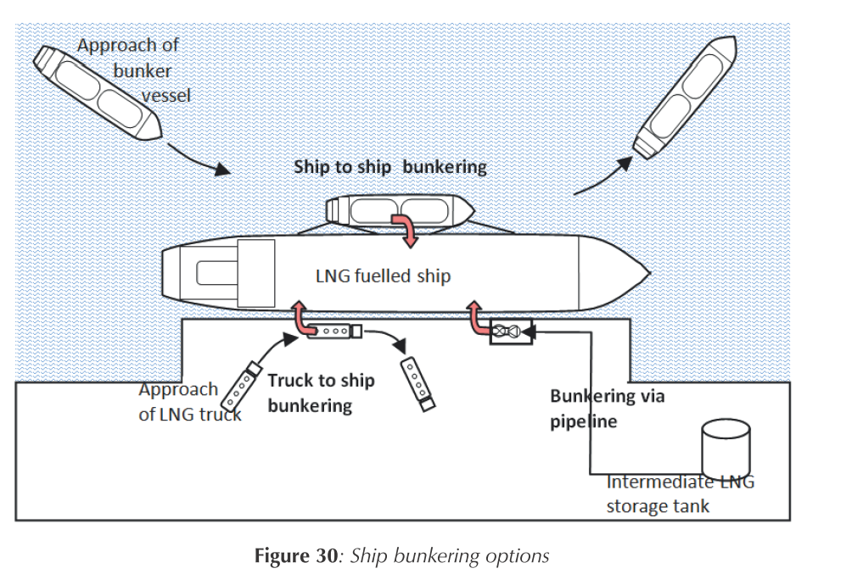
Current LNG Bunker Option
Notes:
IMO 2016

Slide 24
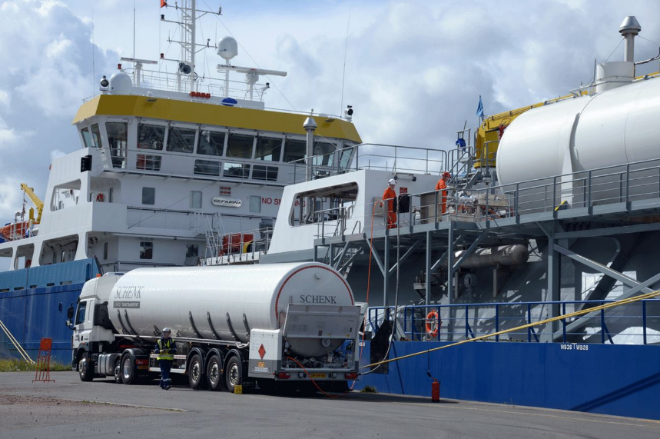
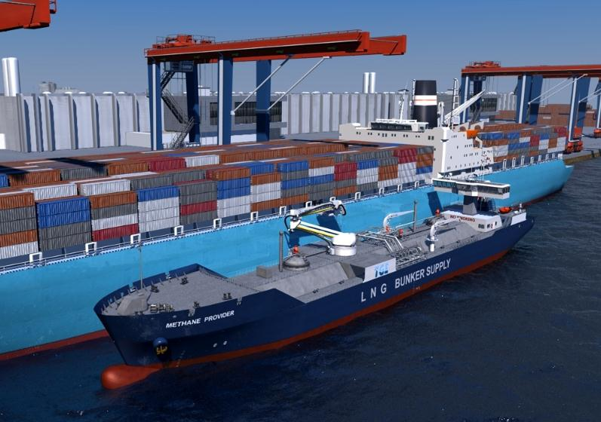
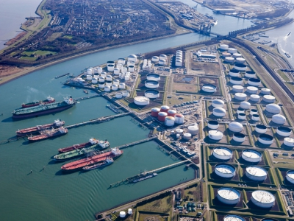
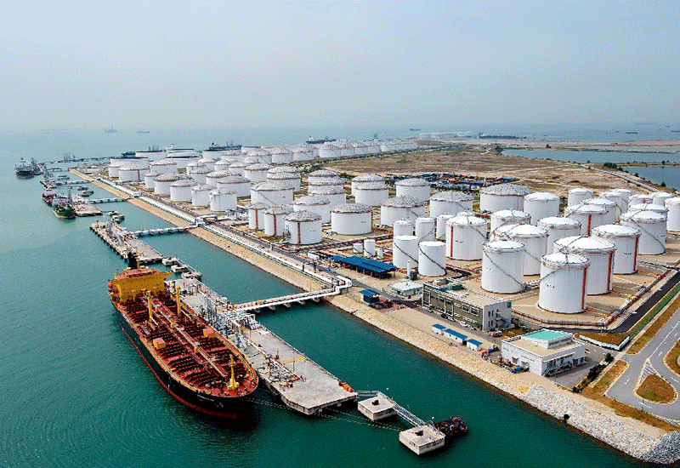
Current LNG Bunker Option

Slide 26
Bunkering station development
Notes:
Source: DNVGL, 2017
Local storage – An intermediary LNG storage, which is used for further distribution and/or storage for an industrial user. Direct LNG bunkering from the tank is not necessarily feasible/planned (see “Tank to ship bunkering”).
Truck loading facility – A terminal where LNG trucks can load LNG. Not to be confused with a location where an LNG fuelled ship can be bunkered by a LNG truck, which in principle can be “anywhere” (still subject to permits of course)
Bunker Ship loading facility – A terminal where small LNG carriers (that can be used for the purpose of bunkering LNG fuelled ships) have access and can load LNG. Not to be confused with a location where an LNG fuelled ship can be bunkered by an LNG bunker ship, which in principle can be “anywhere” (still subject to permits of course)
Tank to ship bunkering – A location where an LNG fuelled ship can bunker directly from a LNG tank on shore

Slide 27
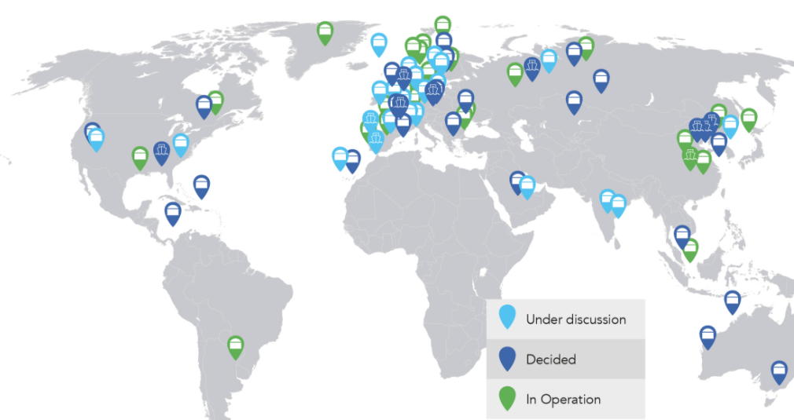
Bunkering station
60 LNG supply locations for ships worldwide today and many more decided and planned*
*There may be several bunkering facilities/modes for one location. The count includes local storages, bunker ship loading facilities and truck loading facilities. Locations where LNG fuelled ships can be bunkered by truck or by ship is not counted.
Notes:
www.dnvgl.com/lngi (register required)

Slide 28
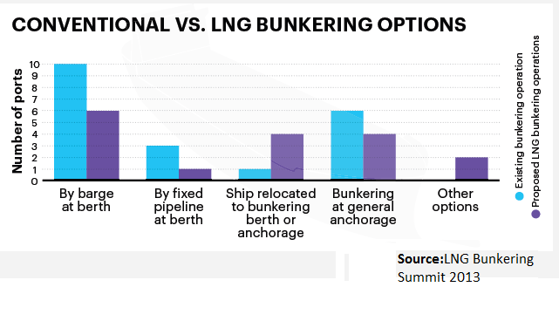
LNG Bunker Option, 2013
20 Bunkering operations by 2013

Slide 29
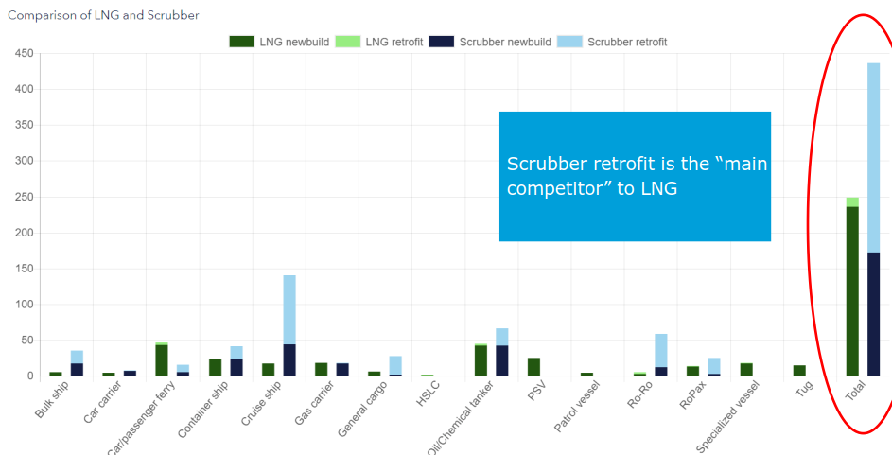
Water scrubber installation world wide (DNV, 2018 (page 12))
  2018: 384
  2019: 429
  2020: 435

Slide 30
SCR installation
The maritime sector has had more than two decades of experience with SCR, and the report found that overall, approximately 1250 SCR systems have been installed on marine vessels in the past decade. Those vessels with the longest track records have accumulated up to 80,000 hours of operation over the past two decades.
http://www.airclim.org/acidnews/scr-can-cut-ship-nox-emissions

Slide 31
Conclusions
LNG bunkering/ infrastructure
  About 10% of new ship buildings in next 8 years will be gas or dual fuelled engines
Standardisation of tanks and fuel systems
Rules and regulations have been in place
LNG bunkering/infrastructure needs local government support

Slide 32
Thank You

