Slide 1


THE GREAT EASTERN INSTITUTE OF MARITIME STUDIES
(LONAVALA)
PLC SCADA Based Distribution Monitoring & Control
Presented By-
Shaunak Das(30)
Mithlesh Kumar Sharma(18)
Ankit Chaturvedi(04)

Slide 2
Contents
Introduction
Project Details
Hardware Requirements
Project Design
Software Requirement
Project Cost
Project Features
Conclusion
References

Slide 3
Introduction
Supervisory Control and Data Acquisition (SCADA) systems consisting of SCADA hosts, Remote Terminal Units (RTUs) and field devices monitor and control the process.
Main concept of our project is “Monitoring and Control using PC". We are going to read the electrical data by the use of PLC and SCADA. Then the entire data will be displayed on SCADA.

Slide 4
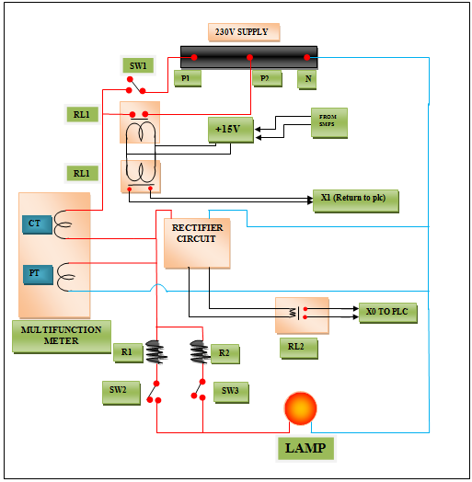
Line Diagram

Slide 5
HARDWARE REQUIREMENTS
Programmable Logic Controller (PLC)
Multifunction Meter
Miniature Circuit Breaker (MCB)
Line Filter
Switched Mode Power Supply (SMPS)
Transformer
Rectifier Circuit
Fuse
Relay

Slide 6
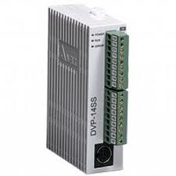
Programmable Logic Controller (PLC)
Here we have used a low cost PLC of Delta Electronics, PLC Model No. DVP-14SS.
The slim and compact SS series supports digital input/output and is built in with multiple analog I/O channels.
Specifications:
MPU points: 10 (4DI/2DO, 2AI/2AO)
Program capacity: 8K Steps.
Communication port: Built-in RS-232 and RS-485, compatible with MODBUS , RTU communication protocol.

Slide 7
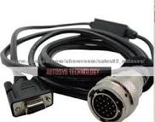
PLC Communication Cable
Automation direct offers high quality, low-capacitance data cables designed with impedances specific for RS-232/RS-485 communication applications in industrial environment.

Slide 8
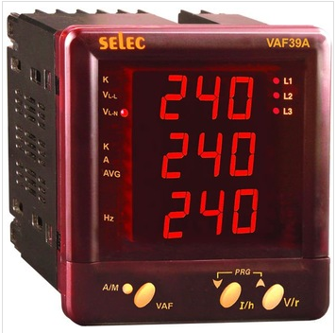
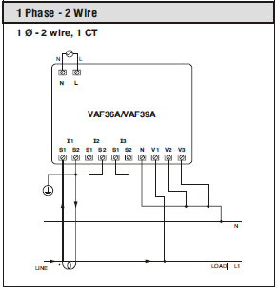
Multifunction Meter
Connection Diagram

Slide 9
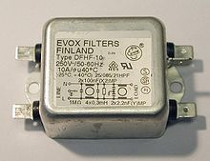
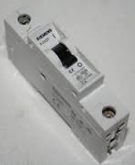
line filter
Line Filter & MCB
A line filter is the kind of electronic filter that is placed between an electronic equipment and a line external to it, to attenuate conducted radio frequencies.
It removes the spikes from the input side and gives the output of pure sine.
The purpose of the miniature circuit breaker is for protection to the PLC and other circuitry.
miniature circuit breaker

Slide 10
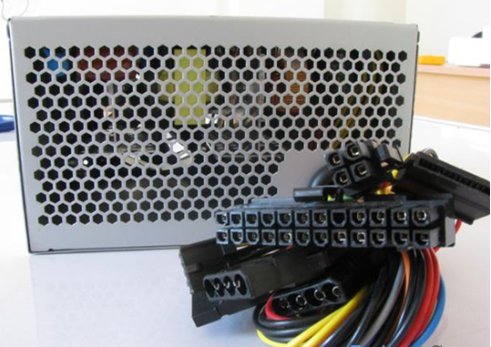
Switched Mode Power Supply

Slide 11
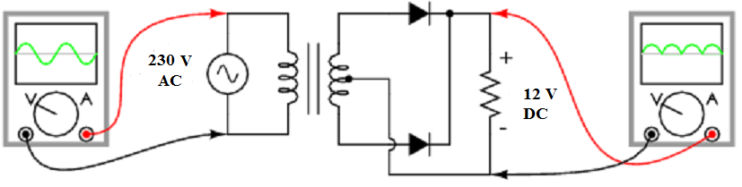
Rectifier Circuit

Slide 12
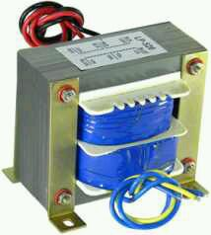
Center Tapped Step-down Transformer
We have used the centre tapped transformer which has 12-0-12 V output and the output is fed to the rectifier circuit.
For example a 24 V transformer will measure 24 V AC across the outer two taps and 12 V AC from each outer tap to the centre-tap.

Slide 13
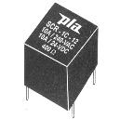

Relay
Single Pole Relay
Double Pole Relay

Slide 14
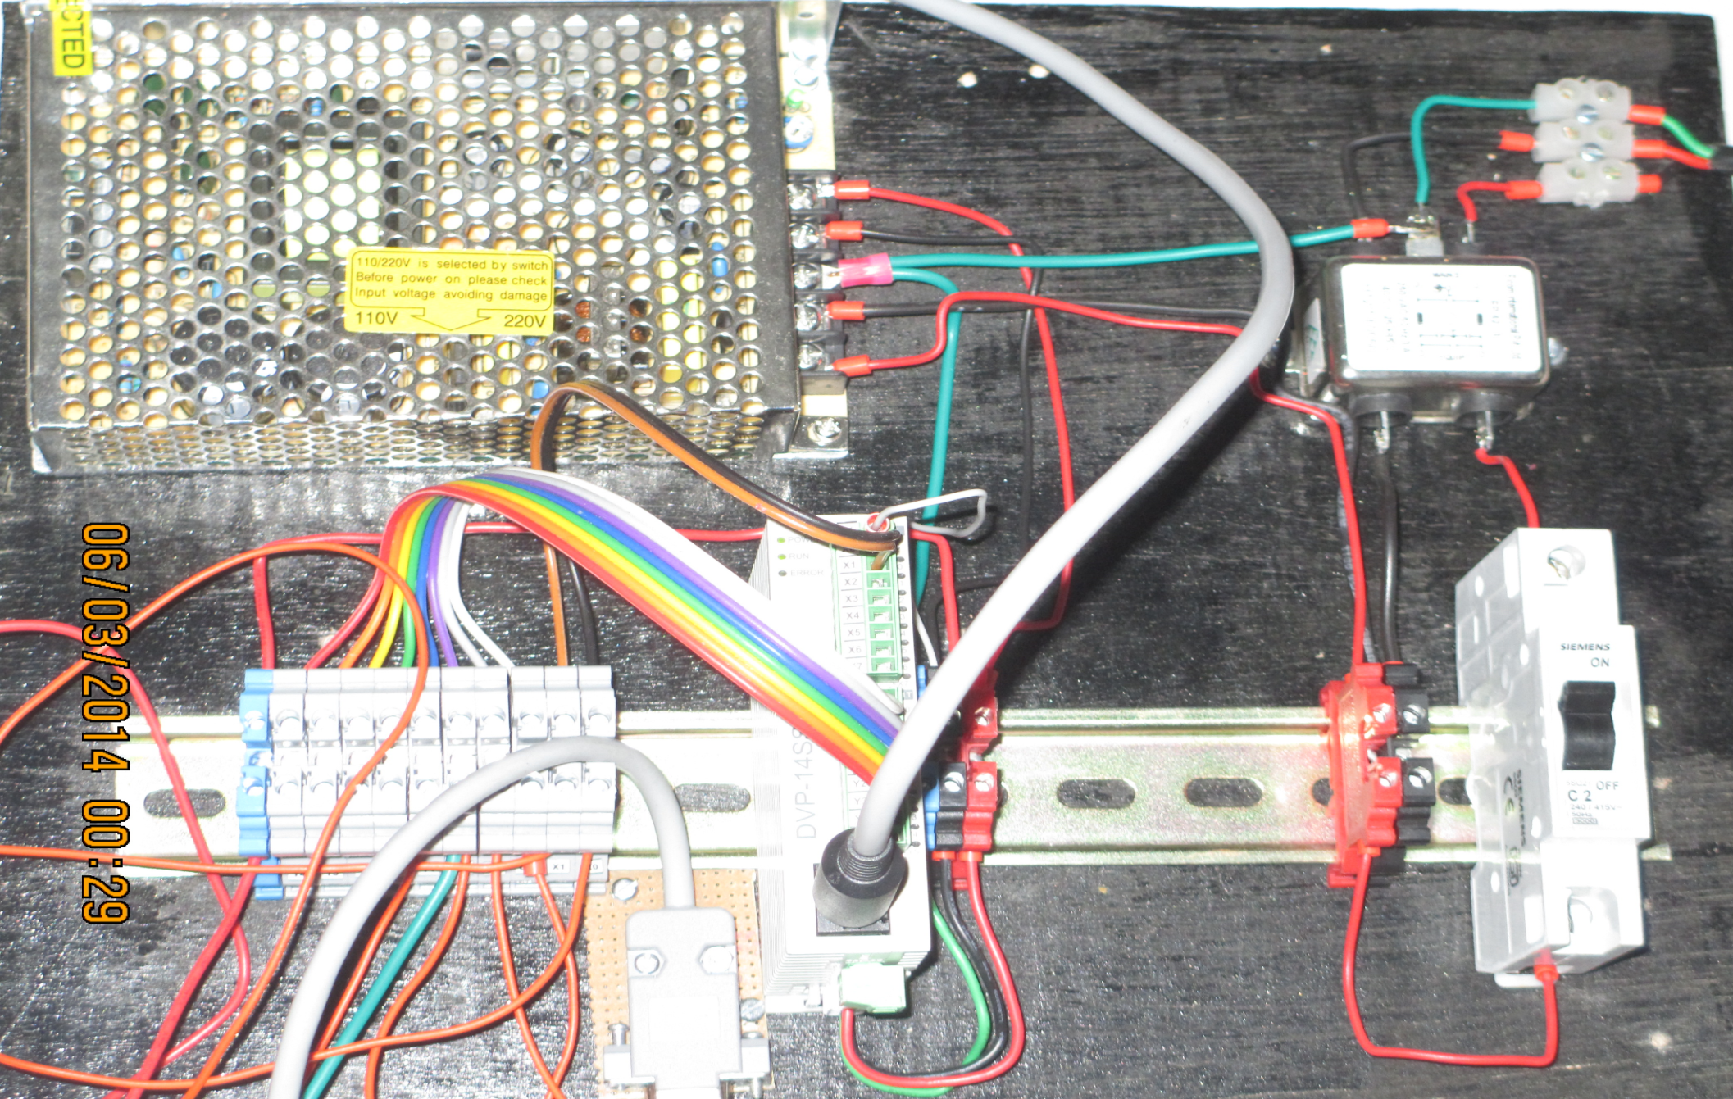

PLC Supply Panel

Slide 15
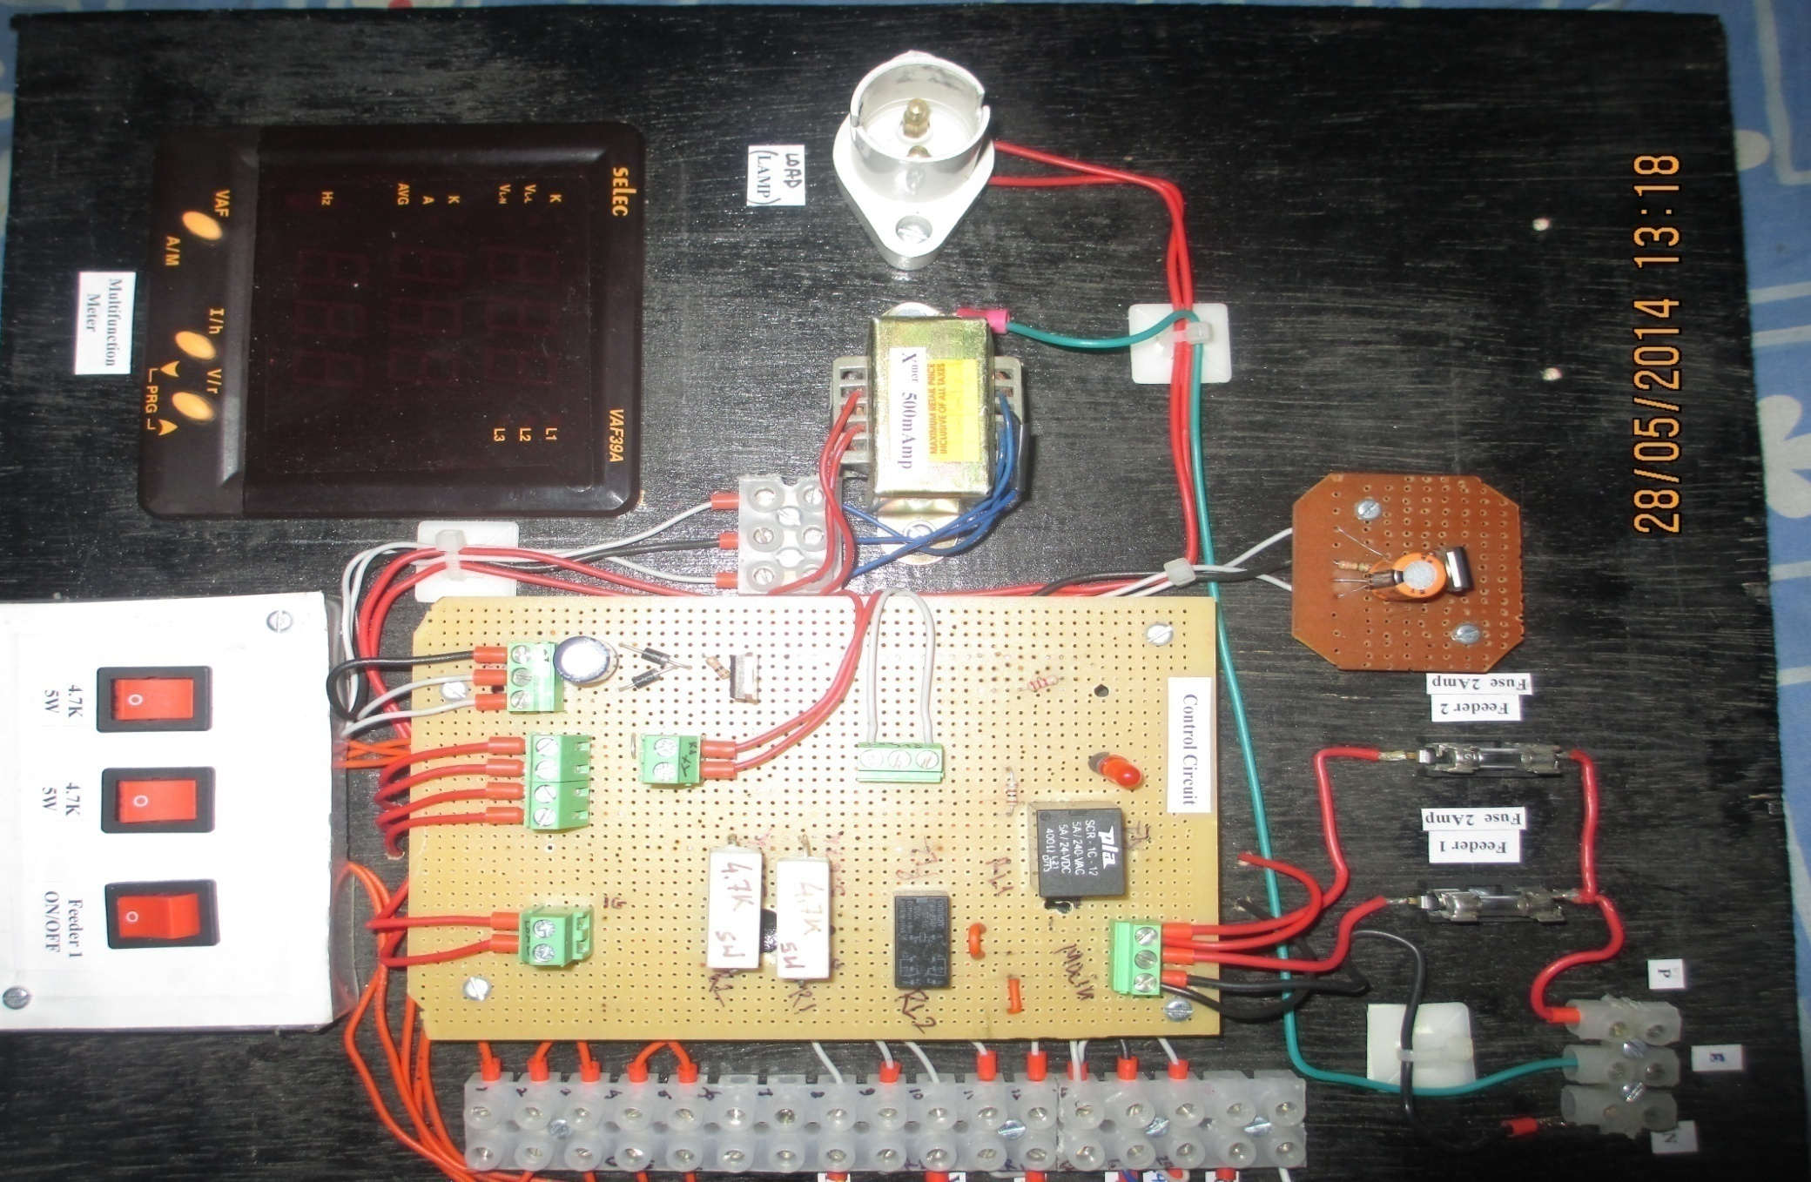
Control Panel

Slide 16
Software Requirements
PLC Software -WPL
SCADA Software -WINLOG LITE
Communication Protocol- KEP OPC

Slide 17
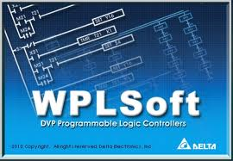
PLC Software- WPL

Slide 18
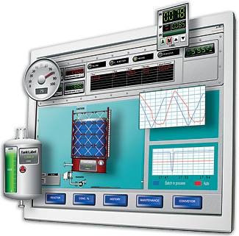
WINLOG SCADA
Winlog visualization software is a powerful SCADA/HMI for industrial automation, process control and supervisory monitoring.
Easy to use and easy to implement
Easy configuration and simplified maintenance
Modbus and OPC Connectivity
Equipped with 3D GUI
High security and availability
Virtually unlimited scalability

Slide 19
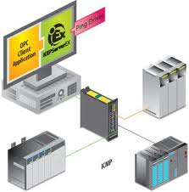
Communication Protocol- KEP OPC

Slide 20
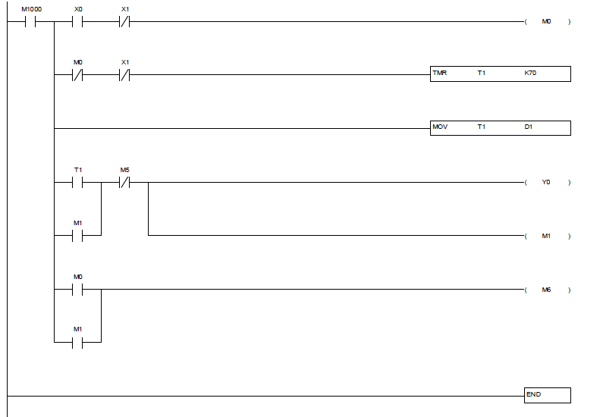
Ladder Diagram

Slide 21
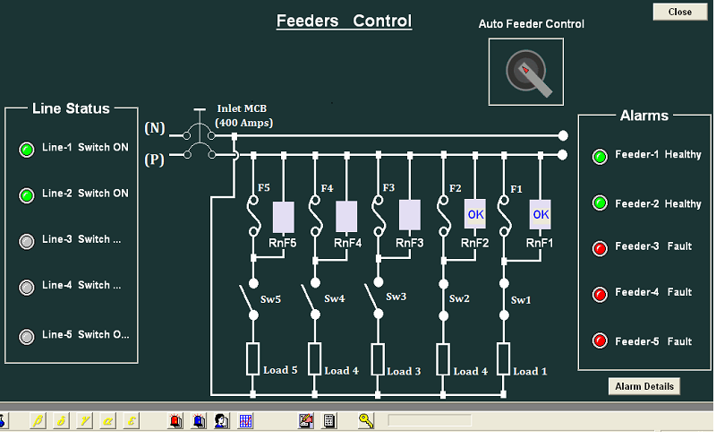
SCADA FOR CONTROLLING

Slide 22
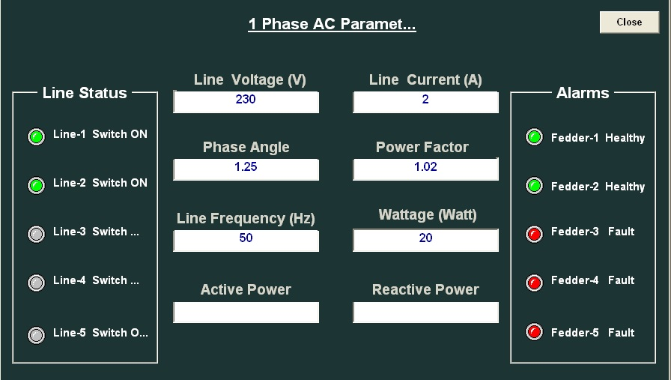
SCADA FOR MONITORING

Slide 23
Advantages
Improves the electric grid's reliability.
Balances the electric grid.
Energy efficiency.
Manages electricity costs.
Load management.
Encourage load shifting at times when the electric
power prices are high

Slide 24
Future Scope
By using this system electricity thefts can be detected and
located easily.
By using this system it is easy to avoid critical condition at
the location or area which has higher priority.
If a fault occur at any point this can be located on screen
by using SCADA.
Electricity distribution becomes easy.

Slide 25
Applications
The Power Grid Corporation.
The industries which have different types of heavy
load application.
Power generation station.
Various Industries or any of big organizations.

Slide 26
Conclusion
We are using this project for monitoring the Electrical parameter (voltage, current, power factor) in our machine lab and PLC lab.
This project proves that the control scheme for power monitoring to improve system operation, system reliability, etc.
Convenient Monitoring & Control sitting at a remote location.

Slide 27
ACKNOWLEDGEMENT
Mr. Ajoy Chatterjee ( Principal and Head )
Captain Philip John ( Vice Principal )
Mr.Varinder Katyal ( Course Incharge )
Ms.Meena Ravishankar ( Soft Skill Trainer )

Slide 28
HOPE OUR PRESENTATION WAS QUITE INTERESTING
THANK YOU FOR YOUR PATIENT LISTENING
DO YOU HAVE ANY QUESTIONS?

