Slide 1

TRANSTECH 2014
Socioeconomic Impact of Futuristic Technologies
Impact of Advanced Technologies on Human Life
Block Construction of Ship
Sujoy Dey Sarkar (201037TP309)
Rishabh V Pandey (201137TP269)

Slide 2
Introduction
Around 90% of world goods are carried through sea, making shipping a major form of transport sector, also an essential communication link connecting coastal cities, countries and continents.
Business is made by entrepreneurs by shuttling products and commodities from where they're most efficiently produced to where they're most profitably consumed.

Slide 3
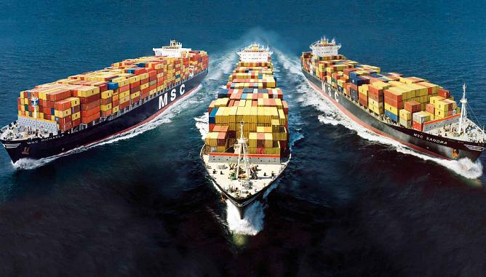
Introduction Contd..
Thus ship building industry is one of the major industry in the world, and advancement in this industry will greatly impact the socio economic scenario of the world.
Block construction of ships method is one of such advancements that has affected this area a lot.

Slide 4
The process of building a ship
Design and Implementation
Building of Subassembly
Building of a Block
Hull Erection
Pre Outfitting at Block Stage

Slide 5
Design and Implementation
Production Drawings
Basic Design
Forward Design

Slide 6
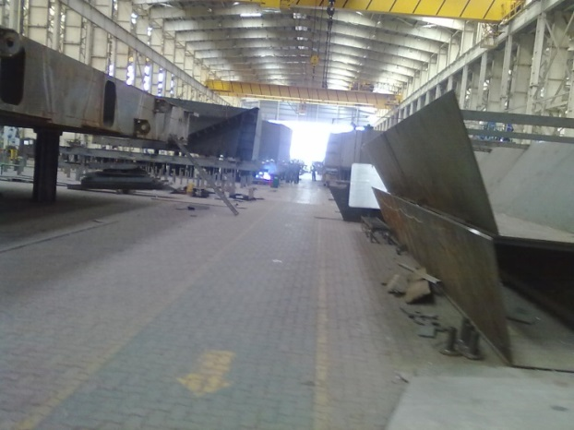
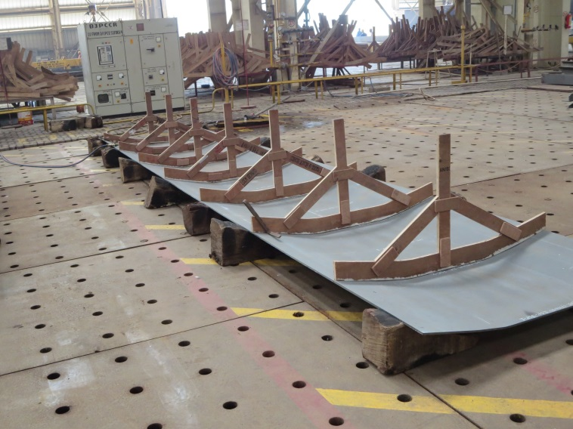
Building of Subassembly
The procedure of building a block involves creation of subassemblies, which is done by cutting and bending of steel plates; which are bought from steel factories.

Slide 7
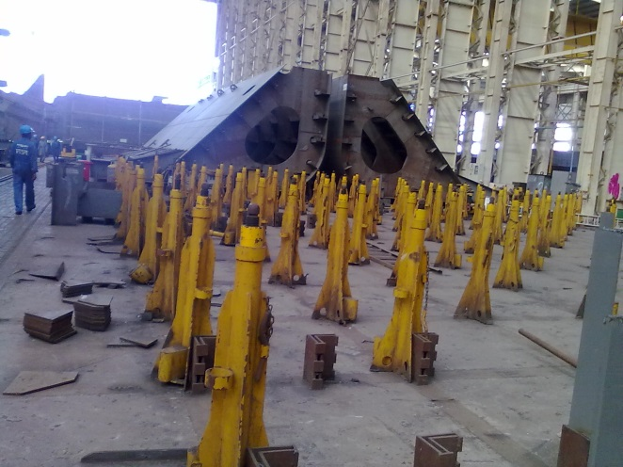
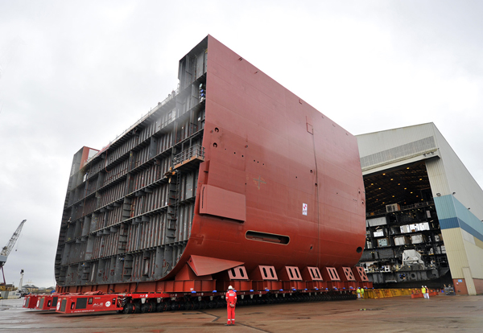
Building of a Block
The process of building a block involves creation of a base, placing the curved plates on this base and weld them together.
Further constructions on this help us to achieve a small blocks, later on these small blocks are joined together to form mega-block.

Slide 8
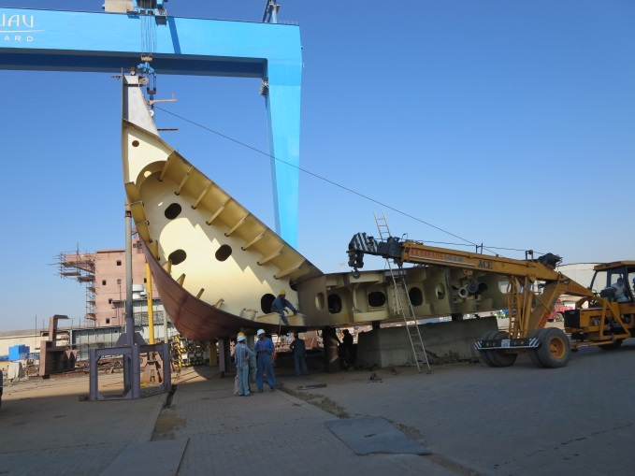
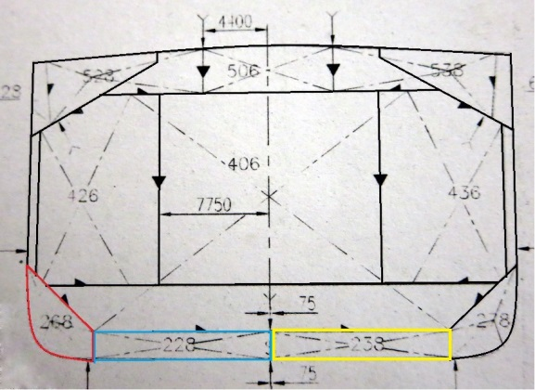
Hull Erection
Once the block units are constructed they joined together to create pre-erection, mega-block, and finally the ship itself.

Slide 9
Pre Outfitting at Block Stage
The auxiliary parts like pipefitting, manhole covers, ladders etc. are already pre-installed in the blocks to save time, however this procedure requires the production drawings to be very accurate.

Slide 10
Socio-economic Impacts

Slide 11
Increase in employment
Most of the economic impact of this industry is in the services sector
The industry directly and indirectly was associated with $36.0 billion in GDP in 2011.

Slide 12
Development of Infrastructure
Infrastructure of any country is directly dependent on its economy.
It improves as business owners make personal purchases out of the income that is generated by shipbuilding process, which ripple through the economy.

Slide 13
Demand for raw materials to create and rebuild such structures

Slide 14
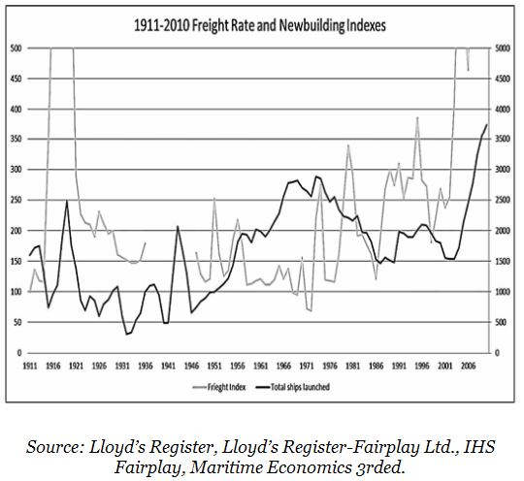
Recession and Boom, the cyclic nature of shipping
Shipbuilding activities rise when global trade and economy rise.
Shipbuilding activities go through a downfall when global trade and economy falls.

Slide 15
Changing conventions, rules and regulations

Slide 16
Advancement of developing nations in shipbuilding
The major reason behind this is cheap labour and advancement in technology at competitive prices.
China has emerged as a serious player in ship building sectors such as in bulk, gas and container.
alliances with more established yards who offer technologies and processes that have improved productivity, efficiency and product and services offerings.

Slide 17
Socio-economic Impact
Others:
Meeting energy demand of the world.
New Trade routes.
Venezuela changing political ties increases the tonne miles.
Expansion of refineries in India and China.
Consolidation and Outsourcing.
Increase in usage of LNG fuelled ships instead HFO fuelled ships in future.
The Tier III 80% reduction requirement Emission Control Areas (ECA).
The Ballast Water Management Convention (BWMC).

Slide 18
Conclusion
Shipbuilding is an industry with tremendous multiplier effects and linkages to numerous industries and economic activities; it thus presents an arguably reliable barometer to the performance of the economy as a whole.

Slide 19
THANK YOU

